Slide 1
Uris Library 2015
Kornelia Tancheva
SLAC, April 2011

Slide 2
Olin and Uris
One Collection
Two Buildings
Vision for Uris: A Library that celebrates Cornell’s history, caters to the cultural and academic research, teaching, and learning needs of the Cornell community, and stands as a symbol of Cornell University’s traditions and reach into the future.

Slide 3
Uris
Historic relevance and unique architecture
In need of modernization
Systematic and planned opportunities for serious academic pursuits
Flexible and multi-purpose spaces
Cultural Programming
Academic research, teaching, and learning

Slide 4
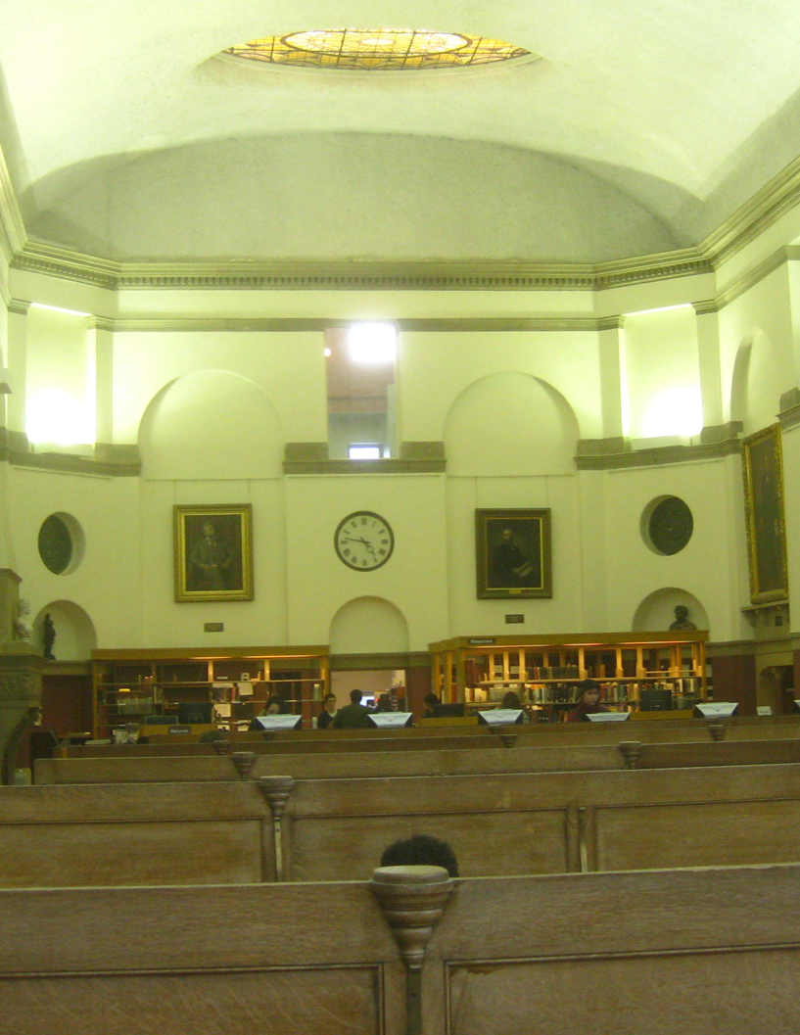
Dean Room

Slide 5
Questions
Why fewer people use the Dean Room compared to Olin?
How can we get more people to use it?

Slide 6
Answers
Lack of coherence
Indefensible personal space
Furniture
Lighting
Quiet
Enhance difference, or
Enhance similarity to other places

Slide 7
Dean Room
Grand reading room
Refinish tables, replace chairs
Re-orient the reading tables
Soft seating space in the alcoves
Move computers to Fiske
Remove shelving
Improve lighting and acoustics.
Move Circulation desk
Open up Harris Room

Slide 8
Ideas for Other Spaces
Willis Room: presentation space
Lobby: digital sign, soft seating
Kirby: quiet reading room (as Kinkledey)
Fiske: multimedia collaborative space
Cocktail Lounge and group study rooms: remodel
A. D. White: freshen up

Slide 9
Suggestions
What spaces would you like to see in Uris?

