Slide 1
Physical Sciences
Library Support
Clark Library Transition
Fall 2009

Slide 2
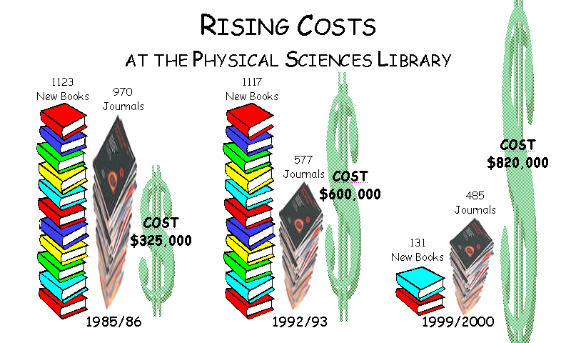

Slide 3
Collections Status Sp ‘09
Journals
  current: almost all available online
  backfiles: almost half available online
Books
  print severely limited by price cap
  few ebook packages (patron-driven selection ?)
Reference
  electronic versions emerging (addl. cost)

Slide 4
Notes:
Change to total only

Slide 5
25% of users of PSL books are from outside PS depts

Slide 6
Edna McConnell Clark Library
24/7 electronic collections
Enhanced website
Subject experts on-site
What library collections & services do you envision for January 2010 that will enable you to be effective in your research and studies?

Slide 7
PSL Transition Team
Faculty, graduate students, undergraduate students from local depts
Library staff from related CU libraries
Input & discussions April-June
Final Recommendations to UL July 1
Notes:
1- Background & Journals
2- Circulating Books & Reserves
3- Study Space Scenarios & Reference Books
4- Website & Future Services

Slide 8
Print Collection Distribution
Annex: bound journals, low use books
Mann Library: books
  organic & biochemistry
Math Library: books
  mathematics; astronomy; general, atomic & particle physics; theoretical physical chemistry
Engineering Library: books
  analytical, inorganic, organometallic & experimental physical chemistry; experimental physics
Notes:
Book Relocation Options
Circulation since 2000 on central campus
Related collections: Engr, Mann, Math
Non circulating since 2000 to Annex

Slide 9
Journal Access
E-journals list for updated online availability
Increased online back issues
  Clark Endowment Fund “dedicated to the use of the Edna McConnell Clark Library”
  Gramse gift
Annex article scan

Slide 10
$300,000 bequest "to be utilized by the Library of the Department of Chemistry, in memory of Erna L. Gramse, MA 1933”
Head, Central Information Service,
FMC Corporation

Slide 11
Book Access
Catalog
Library-to-Library Delivery
Interlibrary Loan & Borrow Direct
PSL Website E-books & New Books
Guides, Orientation & Instruction
Some indexing in some databases

Slide 12
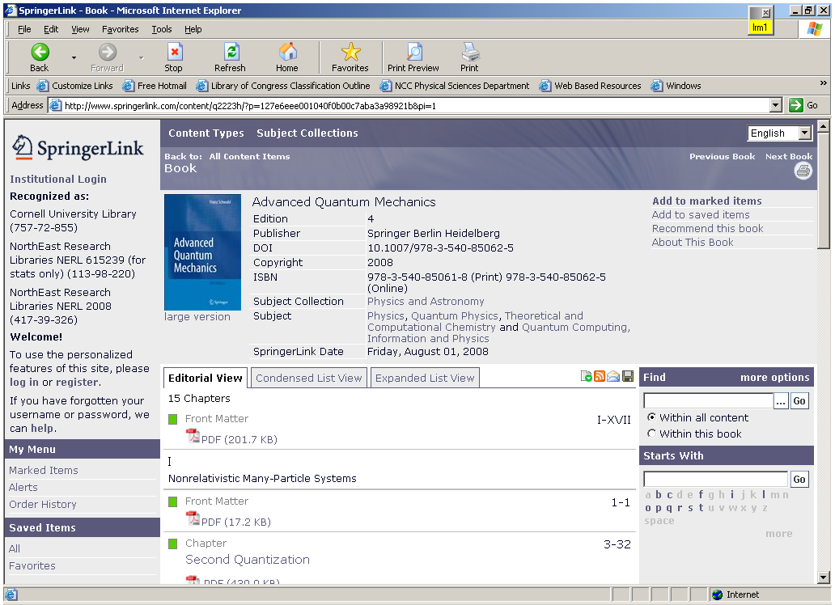
Notes:
E-books –addressing the book purchasing issue
All sciences, back to 2005, thousands of books in physics, astronomy and chemistry that we have never had due to purchasing restrictions
2,773 Physics & Astronomy
1,766 Chemistry & Materials Science
3,859 Mathematics
3,173 Engineering

Slide 13
Reserves & Reference
Current 200 reserve items to Math
Classic texts on permanent reserve at Math
Online reference resources where available & affordable
  Clark & Gramse endowments
Print sets to Engineering, Mann, Math libraries reference and stacks
Notes:
I called Tony Del Plato this morning and he let me know that they do have Chemistry books on reserve at Uris. The titles he ran by me were the same as the titles we have here at PSL so I think we could suggest that the Chemistry reserves be transferred to Uris. I also called Melody and she said that Engineering had one AEP course this Spring which she thought was the norm. I don't know if you would want to recommend AEP courses go on reserve at Engineering or not but I thought I would check anyway. -DBM 052609

Slide 14
Looking Forward…
Online resources
Library website – online service options
Subject specialists on-site
Study spaces
Large library system
Notes:
Do you have wishes for our site?
What services can we reasonably provide on the Web?
How do we market this? What do we call it?
How will people find this site?

Slide 15
Space Needs
Quiet study space
Public Computers (standup)
Access to reserve materials
Furniture (chairs, couches, tables)
Group/collaborative space
Some supervision to keep space quiet
Wireless Internet
Librarian offices
→ Math Library making some enhancements
Notes:
Agenda – June 8
1. Tour Baker student computer lab & lounge (15 min.)
2. Announcements (10 min.)
3. Public computing (10 min.)
4. Study space (30 min.)
5. Petition (10 min.)

Slide 16
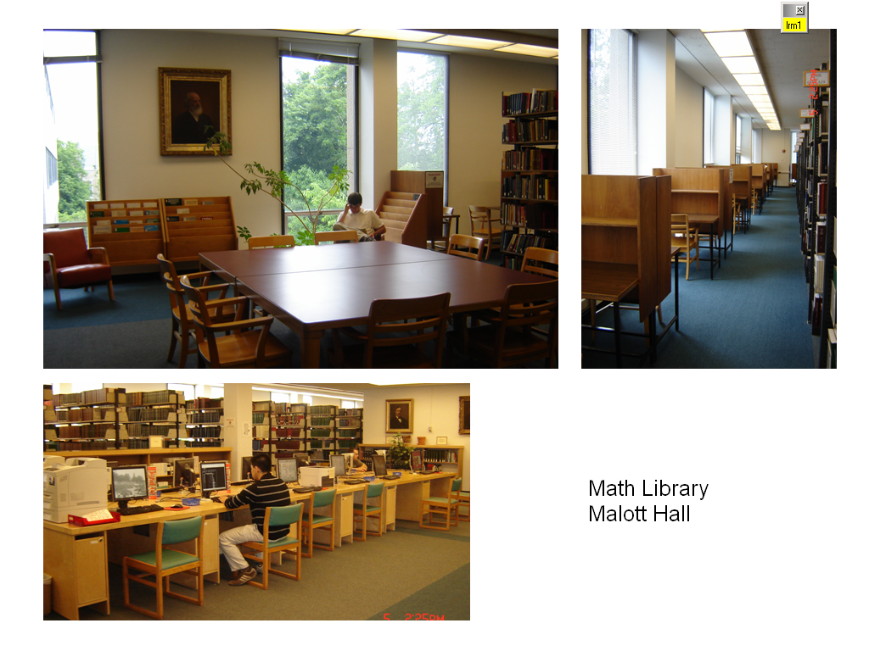

Slide 17
Proposal for Clark Hall space
Need ~125 seats (current seating)
Librarian offices, office hours
Submitted to Vice Provost for Research
Addl. proposals from local depts
  collaborative group learning
Quiet study space high priority

Slide 18
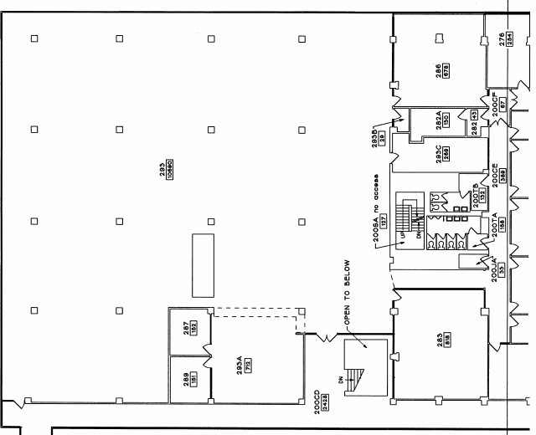

Slide 19
Edna McConnell Clark
Physical Sciences Library
Web Site
The year is 2010- what do you want to see on your Web site?
Notes:
At the last meeting we focused on physical space issues, today we’re looking at how our library will change its online presence and specifically how the library website can help connect faculty and students with library services, electronic resources, and new collection locations
Start with open ended discussion on this question.

Slide 20
Web Services Priorities
New book alerts/online displays
Link to/browse by call number
Browse by subject for journals, databases, books, etc.
Classic books (text) by title and author
Guides at orientations
Info on locating physical sciences hardcopy resources
Notes:
Here are some of the ideas we’ve been looking into, based on prior feedback.
Browse resources by subject
Journal table of contents
Highlight New books
E-books
Guides, orientation materials, reading lists
More news items & contact info.
** PhD thesis available on line
** Market website: posters, cut-outs of librarians
* RSS feeds for new articles in any relevant subject
* Add link to personal page for journal
Team discussion
Roald’s story

Slide 21
Librarian Support
Subject specialists
  Chemistry
  Physics & Astronomy
Current activities
  Student orientation in chemistry & physics
  Class lectures, workshops, credit class
  Lab & office visits, outreach to student groups
  Reference support, office hours
  Collection development
  Promotion of services
Contact a Librarian (email, phone, chat, text)

Slide 22
Fall 2009
Department forums
Book transfers
  Transfer to Annex in progress
  Transfers to Units starting Oct 26
  Reference materials late November
  Reserves on-site until close
Last open day: December 18

