Slide 1

Mobilizing the library's web presence & services
A student-library collaboration to create the library's mobile site and iPhone application

Slide 2
Library Outside the Library
Mission: To find, configure, distribute and assess electronic tools and services that take the library to its users, wherever they may be
The LOL model is perfect as a lightweight innovation model for tough economic times

Slide 3
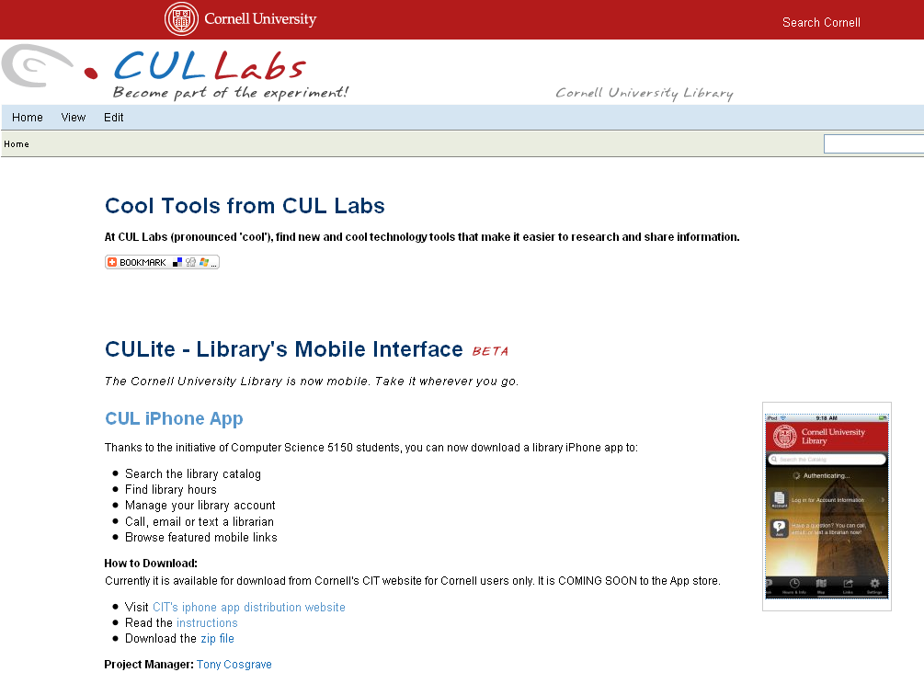

Slide 4
Why we mobilized?
LOL continuously looking for ways to bring the library to our users.
Saw students actively using their handheld devices in the library.
Talked with student representatives on the Student Library Advisory Council.
Many library staff members had handheld devices.

Slide 5
CUL’s three prong strategy
Text a Librarian in 2009
iPhone App
Mobile Website

Slide 6
iPhone Application
Create an application for the iPhone and iPod touch to make Cornell’s libraries more accessible to students
Provide easy and convenient access to library information, services, and resources
iphoneapps.cit.cornell.edu/culibrary/

Slide 7
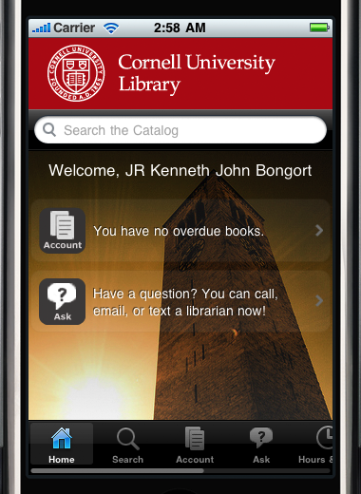
Home Screen

Slide 8
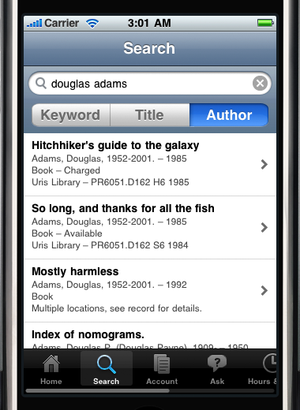
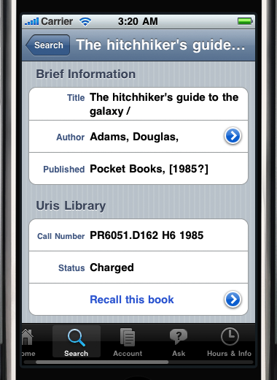
Catalog Search

Slide 9
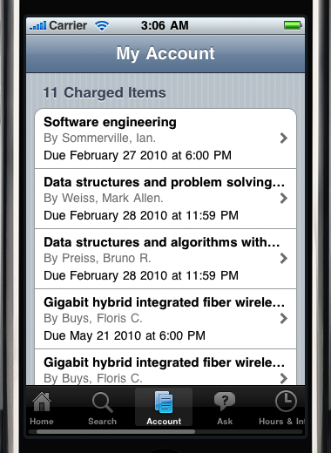
My Account

Slide 10
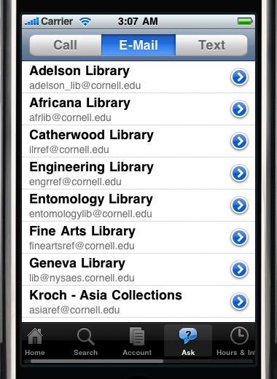
Ask a Librarian

Slide 11
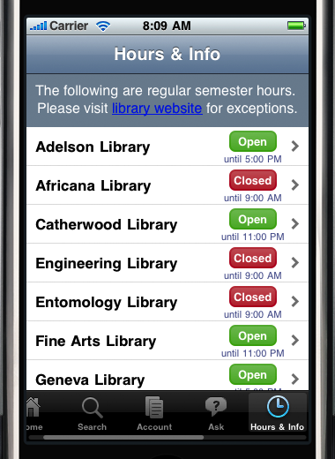
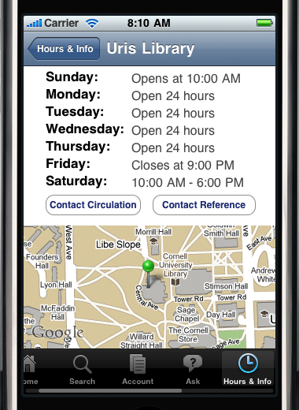
Hours & Info
Notes:
Ken – please mention how Voyager API helped make the catalog functions happen and hand over to Rick.

Slide 12
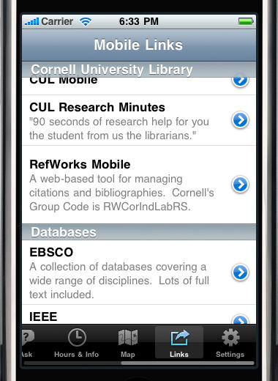
Mobile Links

Slide 13
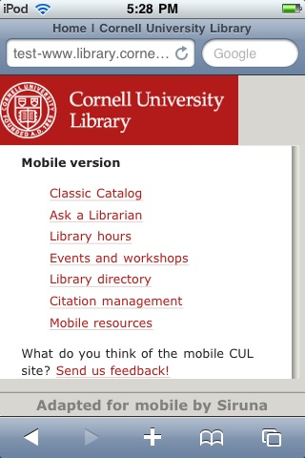
CUL Mobile – Home page
Customized home page
Other site content translated on-the-fly
Powered by Siruna: open-source, Java-based mobile translator
www.library.cornell.edu/m

Slide 14
Future Plans
Submitted to iTunes Store
WishList
(Qwidget, Libguides, course reserves, events, etc)
Another student project?
Device independence?

Slide 15
What else would like to see?

