Slide 1

ONLINE PRIVACY?
Student Library Advisory Council
September 29, 2014

Slide 2
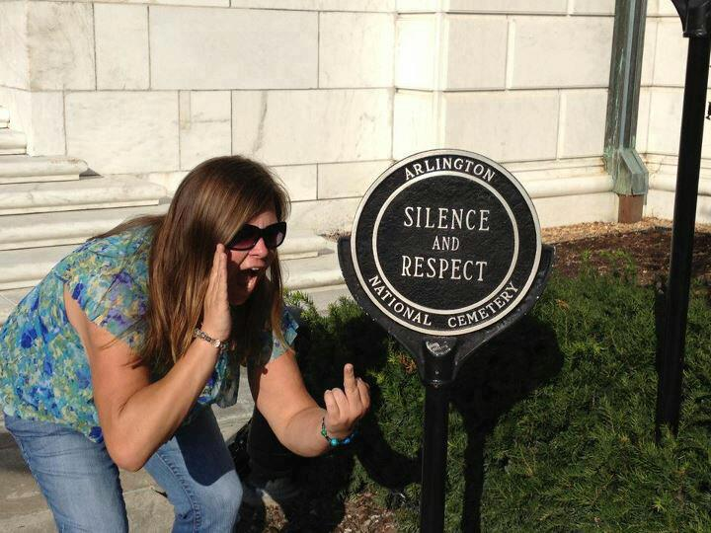

Slide 3


Slide 4
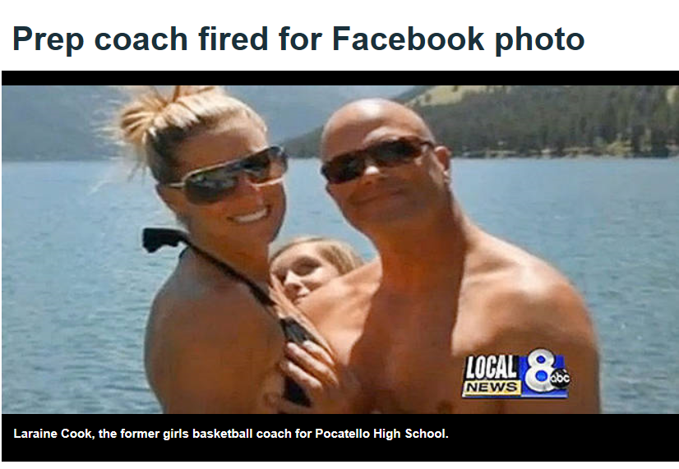

Slide 5
National Labor Relations Board
Section 7 of the National Labor Relations Act. 29 U.S.C. § 157

Slide 6
Concerted Activity
vs.
Venting

Slide 7
98% of companies used social media for recruiting in 2013, up from 94% in 2012.
Source: Mediabistro

Slide 8
Of those companies:
97% used LinkedIn
51% used Facebook
49% used Twitter
19% used Google +
4% used Pinterest
Source: Mediabistro

Slide 9
33% of companies rejected candidates because of something they found online

Slide 10
53% posted provocative or inappropriate photographs or information.
Reasons for rejecting a candidate based on what they found online
44% posted content about them drinking or using drugs.
35% bad-mouthed their previous employer, co-workers, or clients.
29% showed poor communication skills.
24% lied about qualifications.

Slide 11
Go straight to the source (webmaster, blog owner, Facebook friend).
Fixing the Problem
URL Removal Tool www.google.com/webmasters/tools/removals
Saturate the results with useful and positive information.
Use alerts to keep track of yourself online – more in a minute
Hire a professional.

Slide 12
86% of companies say candidates can gain an edge by making their profiles more employer-friendly

Slide 13
50% - Profile provides a good feel for the candidate’s personality and fit.
Reasons for hiring a candidate based on what they found online
39% - Profile supported candidate’s professional qualifications.
38% - Candidate was creative.
35% - Candidate showed solid communication skills.
19% - Other people posted positive information about the candidate.

Slide 14
Managing Social Media
Monitoring Your Google Results
Setup a Google Personal Data Alert:
  www.google.com/alerts
If This Then That https://ifttt.com/
  Link and manage social media, email, and other online and mobile accounts
Dynamic Tweets http://www.dynamictweets.com
  Preschedule up to 20 pending Tweets to ensure your account looks updated and current

