Slide 1

BEYOND
THE
MANN 2ND FLOOR RENOVATION
Camille Andrews & Sara E. Wright
NERCOMP Annual 2014

Slide 2
Our Goals
Recreate 4th floor seating – 9 individual & 3 group study rooms; nearly 160 seats (265 seats added)
Spaces where quieter collaboration & individual study exist together
Styles & colors that work with the aesthetic of the building
Modular (not necessarily mobile) furniture & seating
Highly soil, stain, and abrasion resistant materials
Remain in budget – we did not have unlimited resources
Notes:
Recreate what we lost on 4th floor – 9 ind. Study rooms, 3 grp rooms, nearly 160 seats (265 seats added)
Create spaces were collaboration and quiet study can exist together
Styles and colors that work with the aesthetic of the building
Choose furniture and seating that is modular (not necessarily mobile)
Choose materials that are highly soil, stain, and abrasion resistant
Remain in budget – we did not have unlimited resources

Slide 3
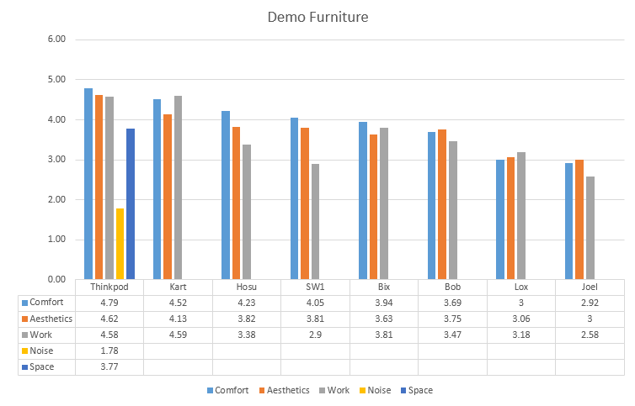
Note: Does not include flipchart or interview tallies
Notes:
Surveys (n=399 from 4/16/-5/19/2014) and flash interviews on demonstration furniture and individual study preferences as well as usability tests (n=8) and surveys (n=10) on Clickshare and Mediascape screensharing technology
Comfort: Thinkpod, Kart, Hosu, and SW1; Bix and Bob to lesser extent
Aesthetics: Thinkpod, Kart; Hosu, SW1 and Bob to lesser extent
Work: Thinkpod, Kart; Bix, Bob, Hosu to lesser extent
Online and paper: ~ 153 responses to date; largely undergraduates though about 14 responses came from staff, 10 from grads, 4 from faculty and 1 from a community member; 17 undeclared; mostly CALS and CHE though a few responses from AAP, Engineering, CAS, Law and Vet).
Flipchart surveys allowing students to make check mark by pictures of furniture that they liked best (approximately 203 responses to date).
Flash interviews on 4/28, 4/29, and 4/30/2014: (~43 respondents largely undergraduates though a few grads and 1 staff person; mostly CALS though some CHE, CAS and CIPA, Engineering, Hotel & AAP).
*Please note: a single person could provide multiple responses through multiple channels. Also Thinkpod was not available until 4/28 and paper survey was not available until 4/30.
Surveys (n=399 from 4/16/-5/19/2014) and flash interviews on demonstration furniture and individual study preferences
Usability tests (n=8) and surveys (n=10) on Clickshare and Mediascape screensharing technology
Online and paper: ~ 153 responses to date; largely undergraduates though about 14 responses came from staff, 10 from grads, 4 from faculty and 1 from a community member; 17 undeclared; mostly CALS and CHE though a few responses from AAP, Engineering, CAS, Law and Vet).
Flipchart surveys allowing students to make check mark by pictures of furniture that they liked best (approximately 203 responses to date).
Flash interviews on 4/28, 4/29, and 4/30/2014: (~43 respondents largely undergraduates though a few grads and 1 staff person; mostly CALS though some CHE, CAS and CIPA, Engineering, Hotel & AAP).
*Please note: a single person could provide multiple responses through multiple channels. Also Thinkpod was not available until 4/28 and paper survey was not available until 4/30.

Slide 4
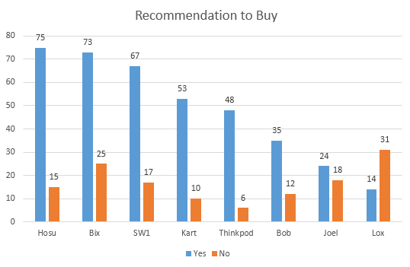

Slide 5
Assessment highlights for new space
Variable meanings of comfort
Semi-privacy vs. open space: see others vs. hidden/ sight & sound seclusion
Aesthetics: minority of respondents like more traditional & muted furniture but many prefer a variety in style, color
Requests for:
  more furniture like existing as well as other pieces/ spaces
  quiet space with plenty of outlets
  large tables/work surfaces at the right height
    Standing height desks
    Adjustable furniture
  Interview room (possible future project)
Notes:
Variable meanings of comfort for people
Depends on preferences and what they are doing (reading, lounging/socializing, laptop in lap, laptop on work surface with room to spread out); should think carefully about zones and which furniture we put in which zone
Reclining or upright-people have definite preferences; adjustability is a plus (woman who brings foam wedge with her)
Mix of fabrics; texture matters
Height and placement in relation to table important
quiet space with plenty of outlets
large tables/work surfaces at the right height
comfortable (but not too comfortable) chairs
mix between respondents who like to study in the open where they can see others and be seen (one respondent says that it helps productivity) and those who like some seclusion or privacy (mostly partial)

Slide 6
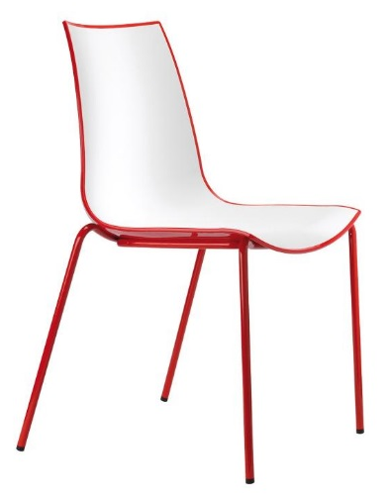
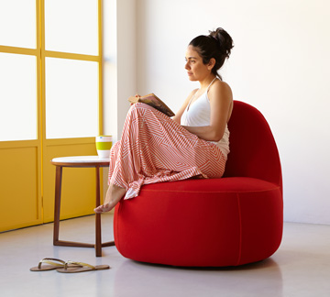
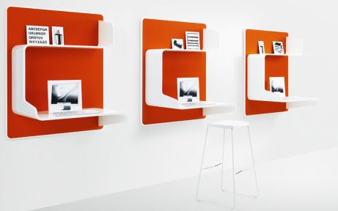
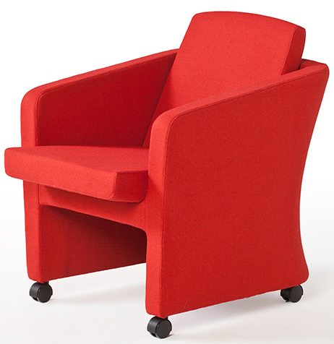
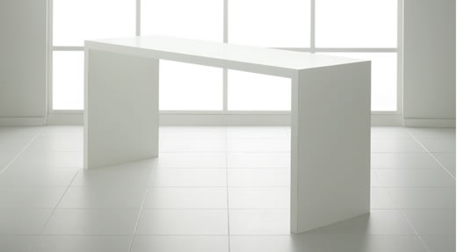

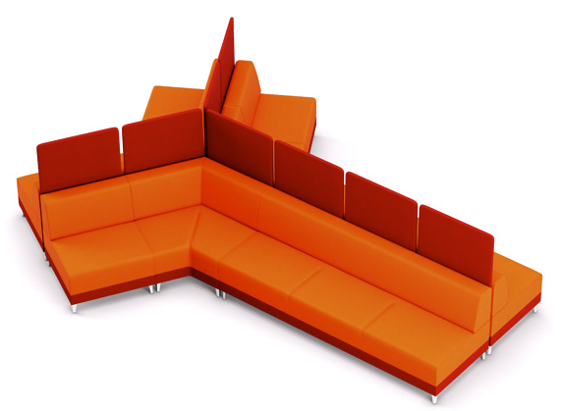
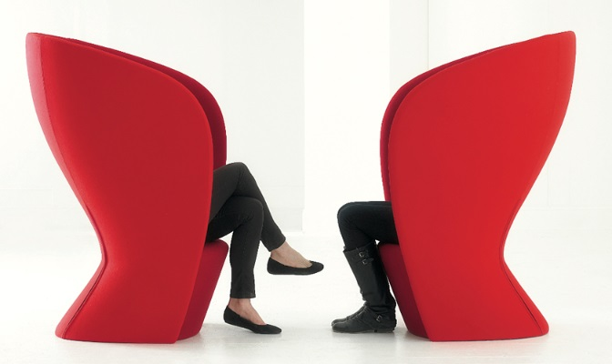
COMING SPRING 2015! NEW FURNITURE FOR MANN’S 2ND FLOOR. HERE’S WHAT STUDENTS ASKED FOR*!
*Small selection & colors and styles are different

Slide 7
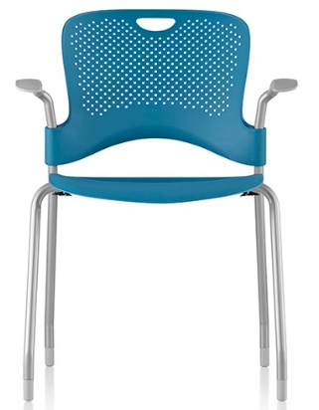
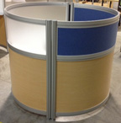

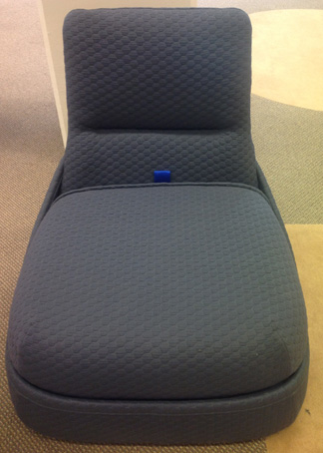
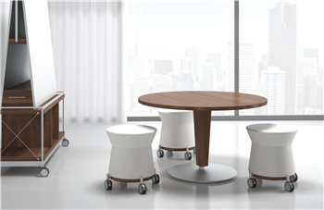
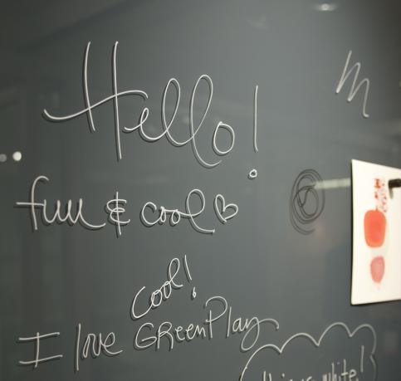
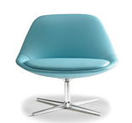
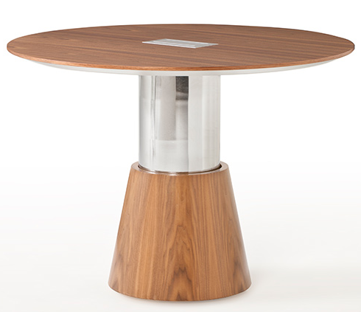
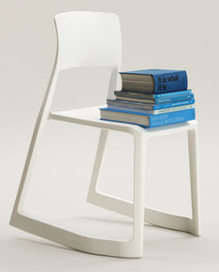
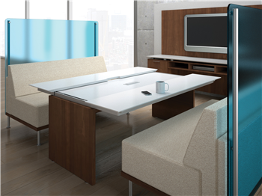
COMING SPRING 2015! NEW FURNITURE FOR MANN’S 2ND FLOOR. HERE’S WHAT STUDENTS ASKED FOR*!
*Small selection & colors and styles are different

Slide 8
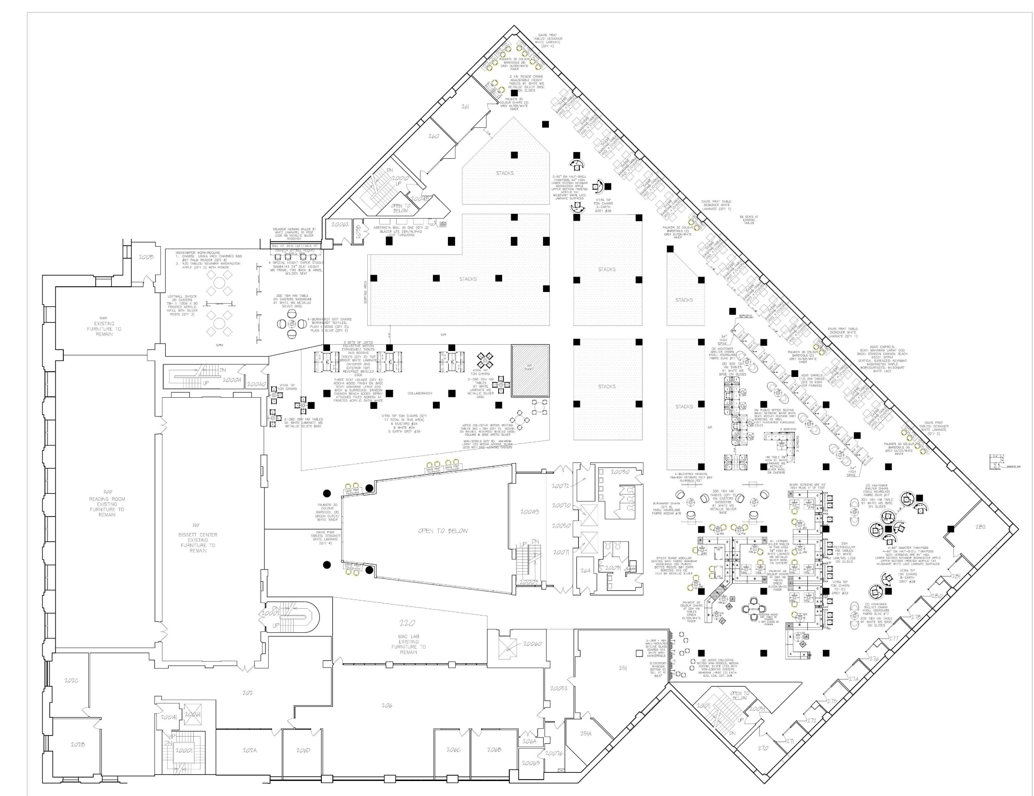
Zone 3
ZONE 2
Zone 4
ZONE 1

Slide 9
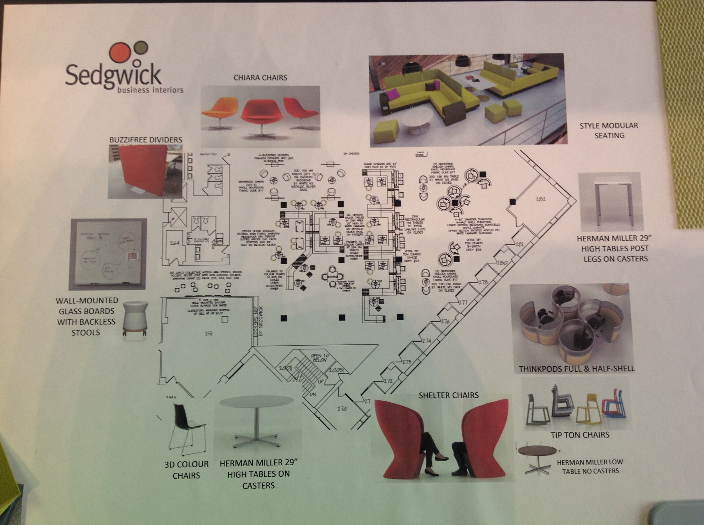
ZONE 1: QUIET COLLABORATION & INDIVIDUAL STUDY

Slide 10
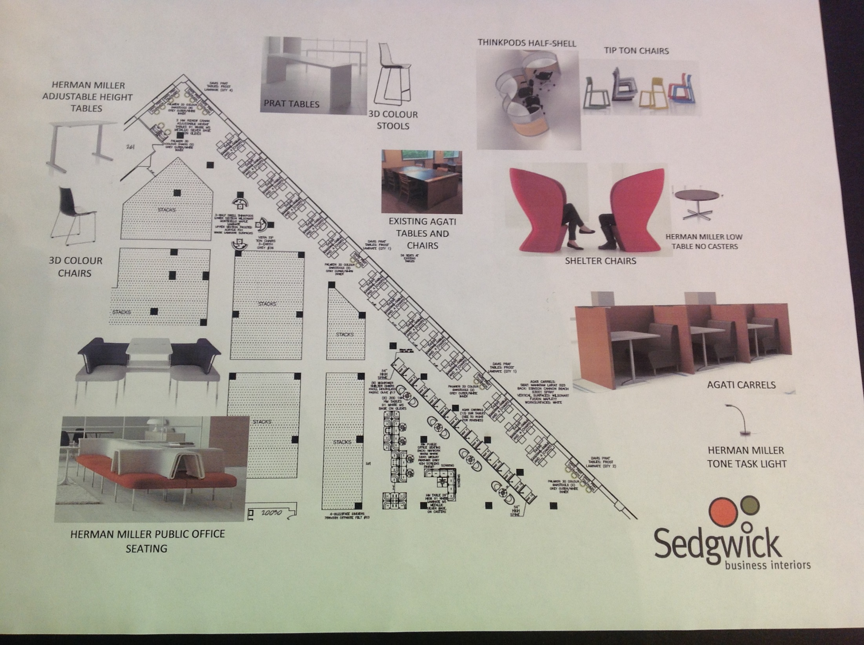
ZONE 2: QUIET INDIVIDUAL STUDY (GROUP TABLES & ALONE/SEMI-PRIVATE)

Slide 11
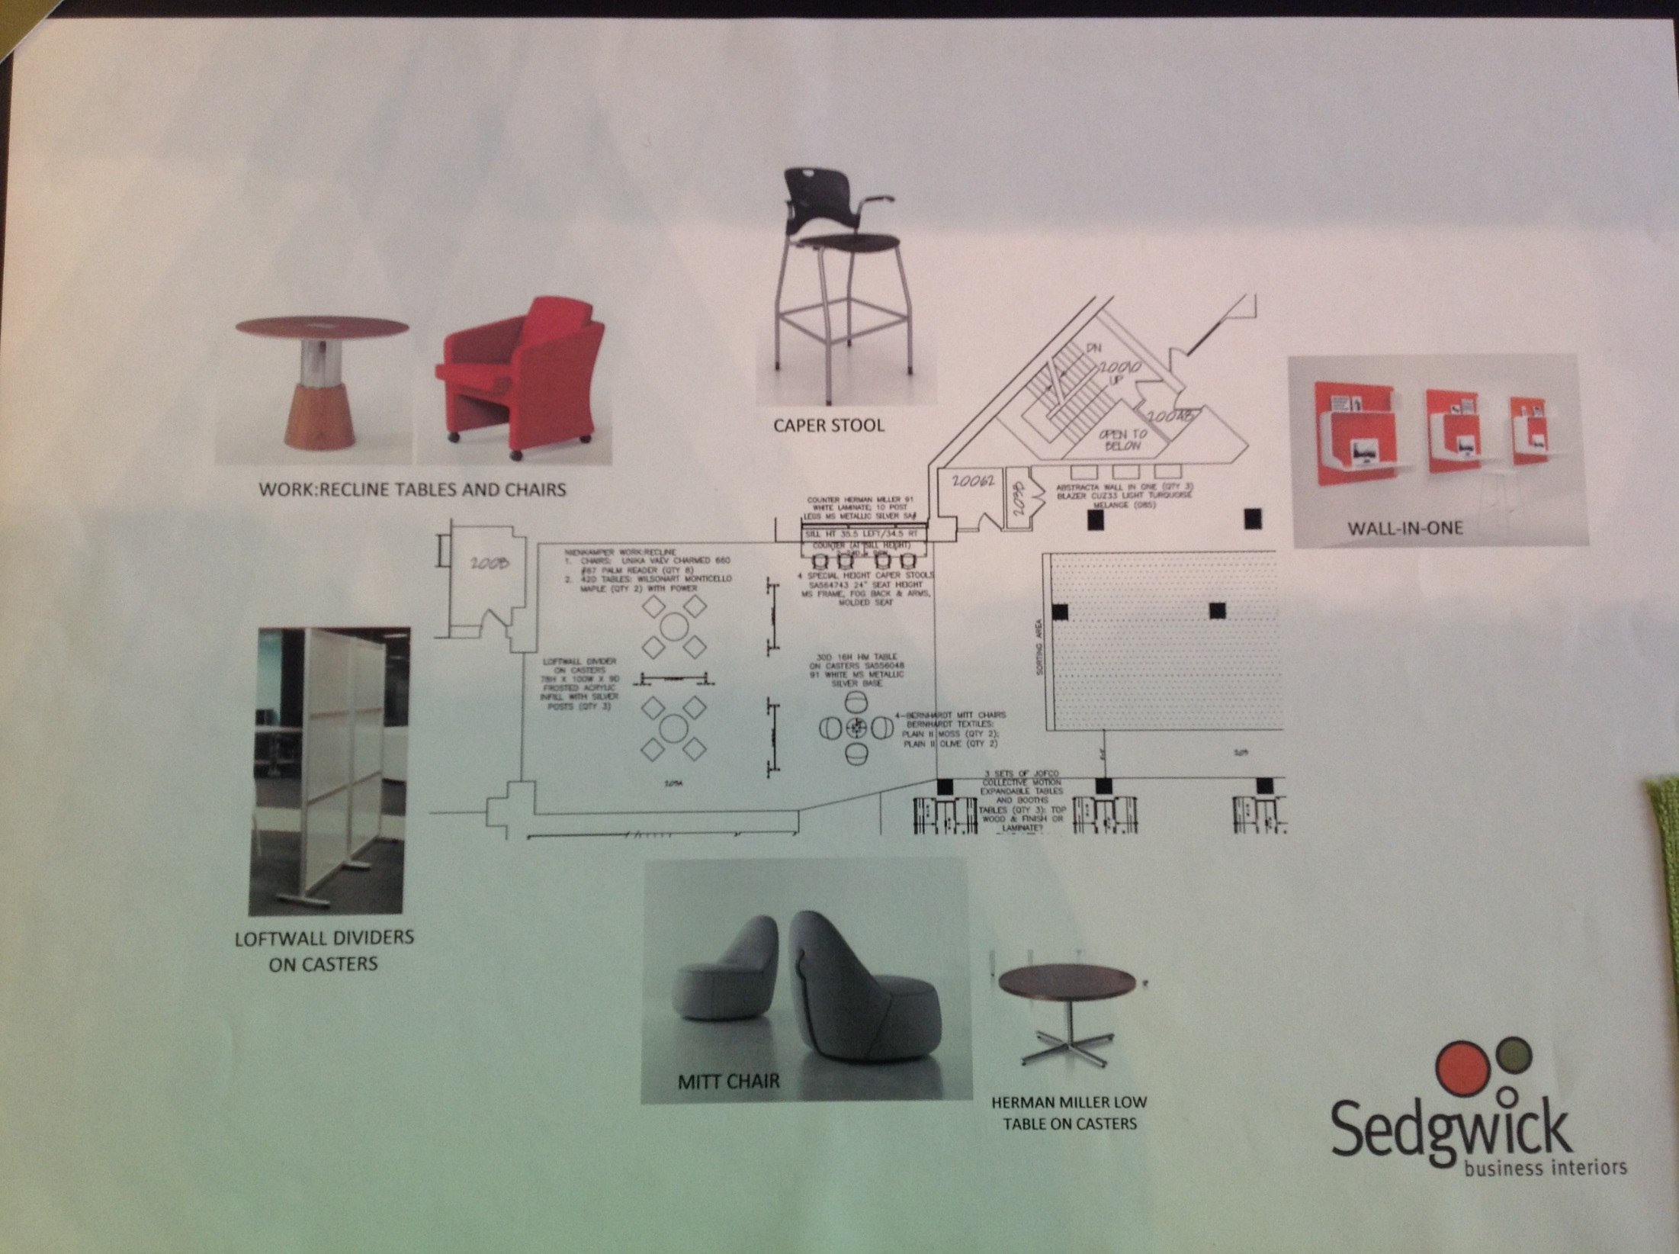
ZONE 3: COLLABORATION & INDIV. STUDY GALLERY
Notes:
Mobile furniture in gallery and

Slide 12
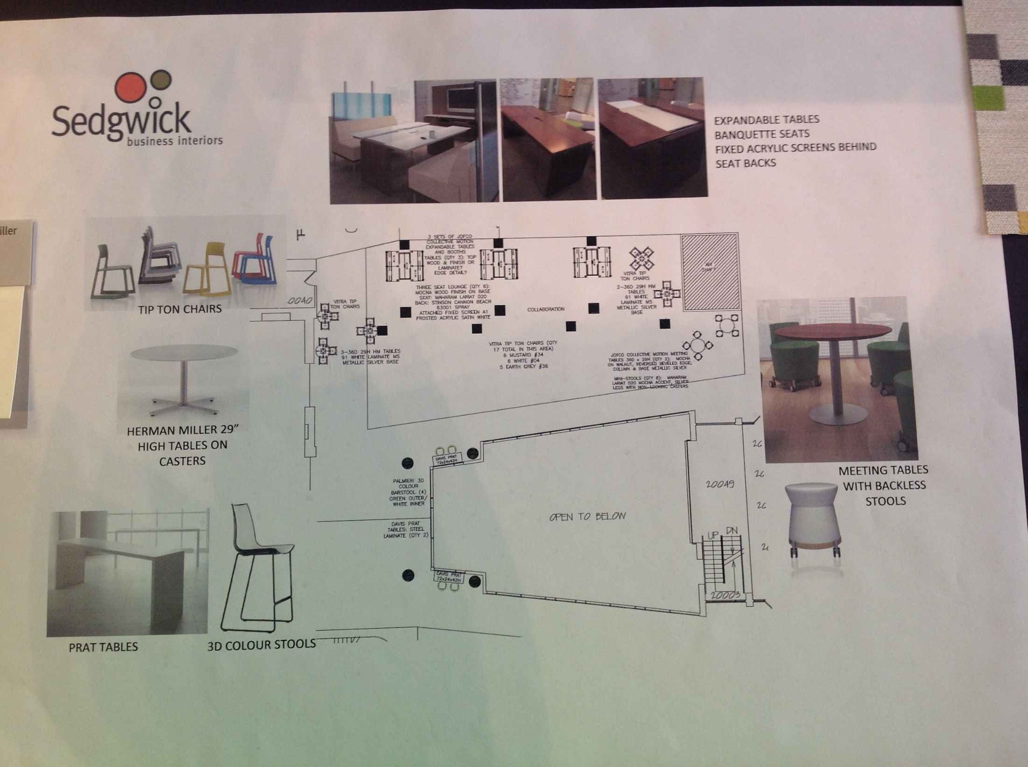
ZONE 4: LOUDER COLLABORATION & INDIVIDUAL STUDY

Slide 13
Send questions & feedback to
Sara E. Wright (sew268@cornell.edu) or Camille Andrews (ca92@cornell.edu)

