Slide 1

Linear Chemical Dose Controller Spring 2013
Andrea Castro, Kent Chan, Saugat Ghimire

Slide 2
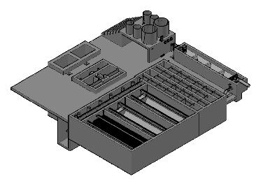
Background
Purpose: To dose coagulant prior to flocculation and to dose chlorine prior to water leaving the plant
Location within an AguaClara Plant

Slide 3
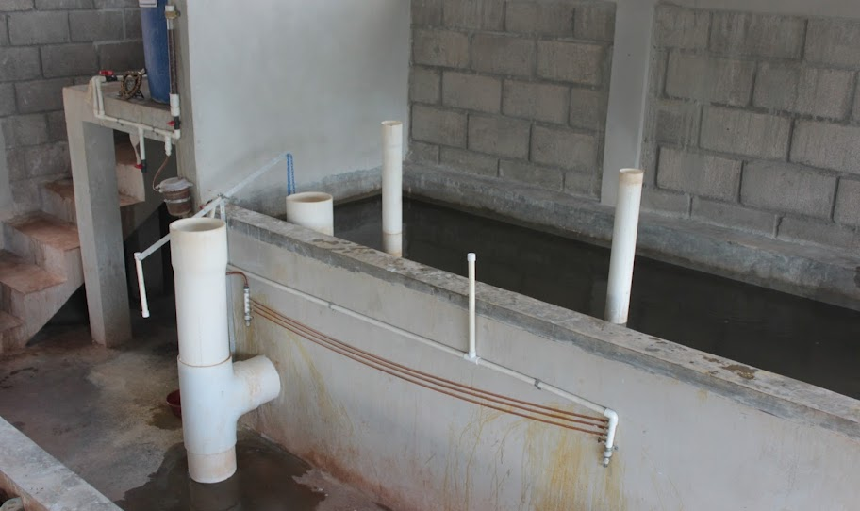
Atima, Honduras Chemical Doser
Coagulant Stock Tank
Flow calibration column
Lever
Constant Head Tank
Linear Flow Orifice Meter
Dosing Tubes
Notes:
Dosificador: 3 mangueras de 1/8" diámetro interno, 1.93m longitud, concentración madre de 187.5 g/L de PAC, dosis máxima 48 mg/L, dosis mínima 5 mg/L.

Slide 4
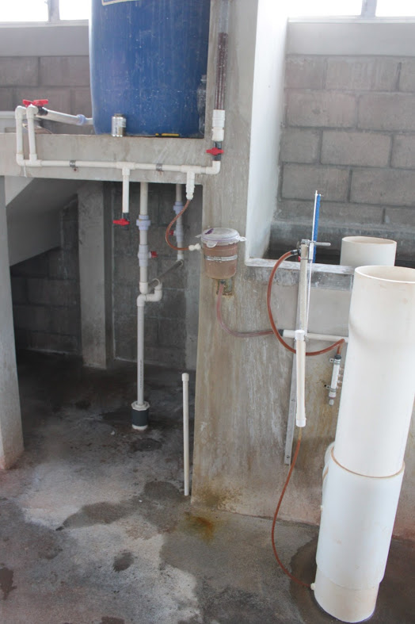
Atima, Honduras Chemical Doser

Slide 5
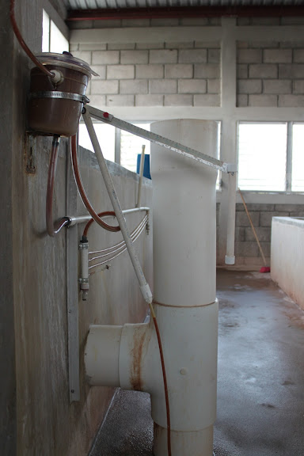
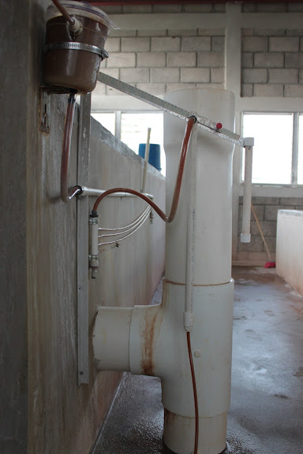
Atima, Honduras Chemical Doser
Minimum Dose
Maximum Dose

Slide 6
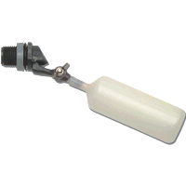
Constant head tank
Stock Tank of coagulant
Lever
Slider
H
Float valve
LFOM
Open channel supercritical flow
Drop tube
Float
Dosing tubes
Purge valves
Notes:
This is a basic schematic of what research and design teams have come up with after many years of work. The stock tank holds a stock chemical solution which is connected to a constant head tank. The constant head tank is regulated by a float valve which keeps the chemical depth constant. A large diameter tube leads from the stock tank to one or more small diameter long straight dosing tubes. A large diameter flexible leads to a drop tube with “open channel super critical flow”, where the chemical flows to be added to the plant’s influent water. The drop tube is connected to a lever via a slider. The plant operator sets the slider at the desired coagulant dose based upon characteristics of the influent water. The float attached to the lever changes position as flow rate into the plant changes, thus changing the elevation of the large diameter tube’s outlet, and maintaining a constant chemical dose.

Slide 7


Design Theory/Equations
Major losses (h_{f}) - due to viscous shear on the pipe walls
Minor losses (h_{e}) - due to expansions/compressions
LCDC system is designed so that the first term dominates relative to the second term, maintaining a linear relationship between Q and H_{Total}.

Slide 8
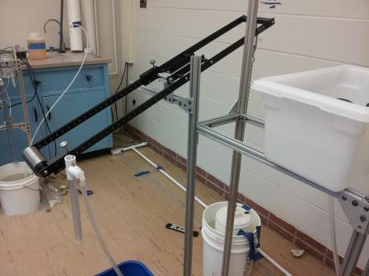

Previous Design – Fall 2012
Weight
Turnbuckle
Cross-bracing
Drop-tube
Anodization
Label
Scale
Logo

Slide 9
Spring 2013 Challenges
Build-full-scale prototype
Coating
Manifolds
Constant Head Tank
Retrofits
Data Sheets
Entrance tank float
Drop tube
Create a presentable laboratory set-up

Slide 10
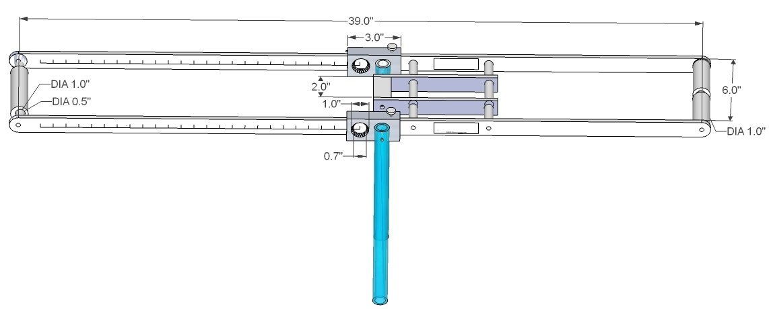
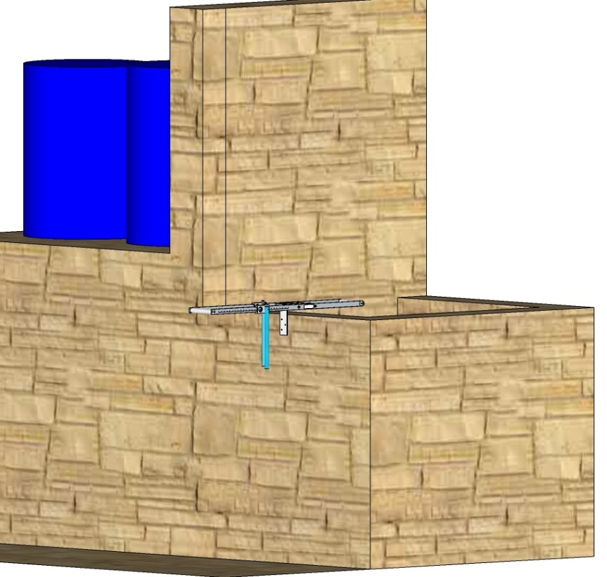
Updating the Design Drawing

Slide 11
In attempt to reduce inefficiencies:
We tried to see whether or not it was possible to remove the PVC pipe altogether, and instead connect the coagulant from the stock tank directly to the drop tube.
However, we found that this is not possible:
  The PVC pipe/Manifold system helps maintain a linear relationship for the coagulant flow, which makes the lever arm possible.
  Additionally, it makes it possible to construct a pathway for human access to the tanks/lever.

Slide 12
Atima, Honduras Chemical Doser

Slide 13
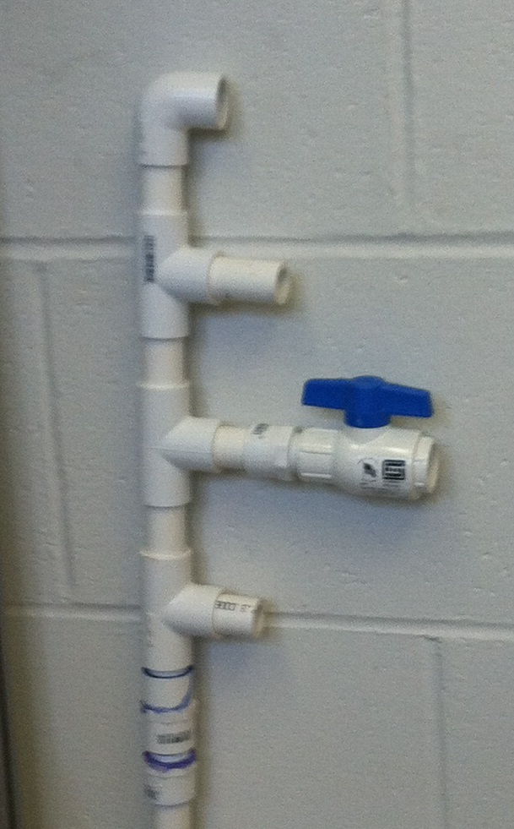
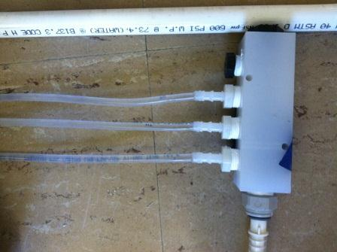
Manifold
Current Design
Fall 2012

Slide 14
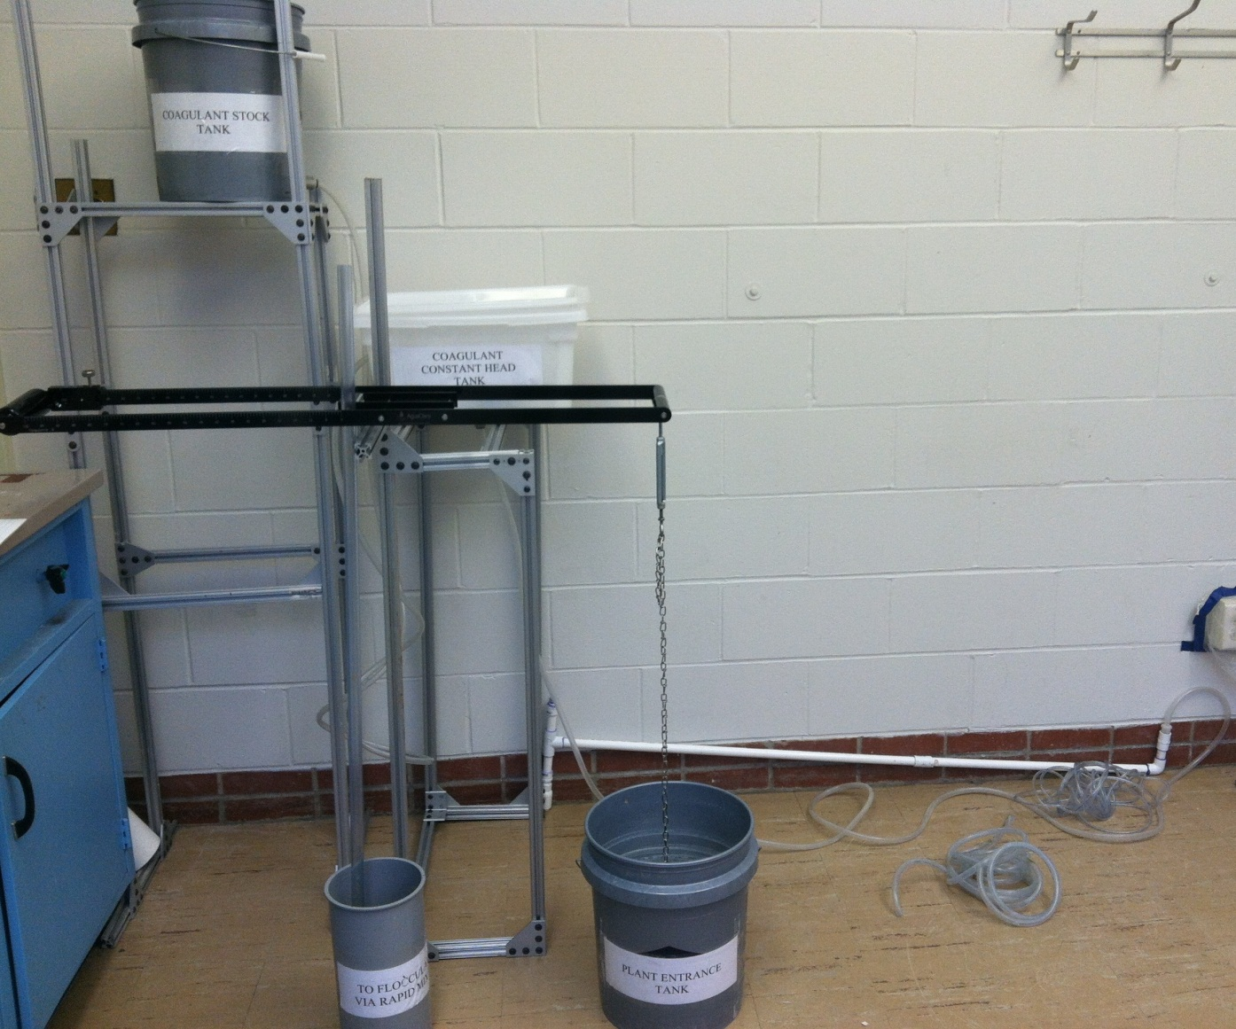
Lab Setup

Slide 15
Lever Arm
We were able to order two additional copies of the lever.
One was in English, for potential use in India, and the other is in Spanish.
We are looking to see if there is a universal symbol for coagulant and chlorine, so that specialized models of the lever arm do not need to be made.
Any suggestions regarding this?

Slide 16
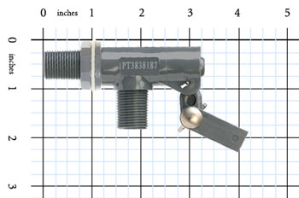
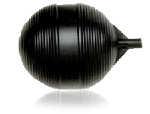
Valve
Flow>Oriifice>Ball>Tank
Ball

Slide 17
Atima, Honduras Constant Head Tank

Slide 18
Valve Sizing
Our specifications dictate that for a 32L/s water flow, there will be 8mL/s of coagulant flowing into the system.
Consequently, our Valve must be able to transfer at least 8mL/s of coagulant to the drop-tube
Based on an extrapolation of data provided on the Kerrick Valve website, the .187” orifice valve can provide 130mL/s, more than enough for our needs.
We could even do our original plan of 60L/s of water, using this valve.

Slide 19
Constant Head Tank Float
Our goal is to reduce the size of the head tank, so that it is not so heavy; We do this by reducing the size of the ball.
Statics Problem: What is the minimum rod size we can use, so that the buoyant force on the ball causes just the right amount of torque to close the valve?

Slide 20
Powder Coating VS. Anodizing
Powder coating scratches off, but is resistant to chemical attack.
We think it is the better choice, because it is unlikely anyone will intentionally scratch the lever;
For long term durability, Anodizing is better.
Anodizing is unscratchable, due to its nature of being chemically attached to the metal.
However, in our tests, under just 24hrs of bleach, the anodized metal lost a significant amount of color.

Slide 21
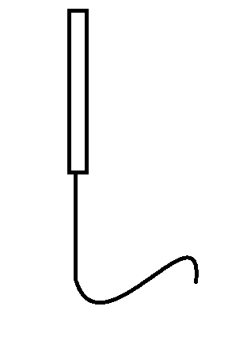
Drop-Tube Design
Currently, the drop tube has inefficient geometry.
Causes difficulties with coagulant flow
Requires a 2-piece design, which is harder to implement.
We need the drop tube to extend to the sedimentation weir.

Slide 22
Possible Solutions
Remove the connecting pipe altogether.
Simply have a flexible tube extend from the drop tube to the water flow.

Slide 23
Remaining Tasks
Develop a method of adjusting the constant head tank
Retrofits to existing Plants
Product data sheets.
Production of Doser.

Slide 24
Questions

