Slide 1

Linear Chemical Dose Controller Spring 2013
Andrea Castro, Kent Chan, Saugat Ghimire

Slide 2
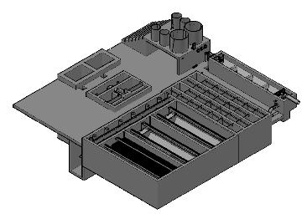

LCDC Purpose
To dose coagulant & chlorine
Location within an AguaClara Plant

Slide 3
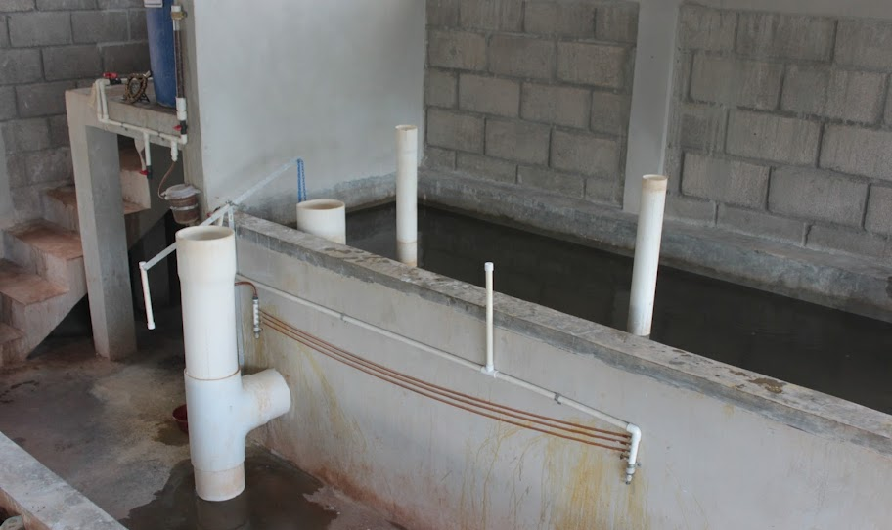
Atima, Honduras Chemical Doser
Coagulant Stock Tank
Flow calibration column
Lever
Constant Head Tank
Linear Flow Orifice Meter
Dosing Tubes

Slide 4
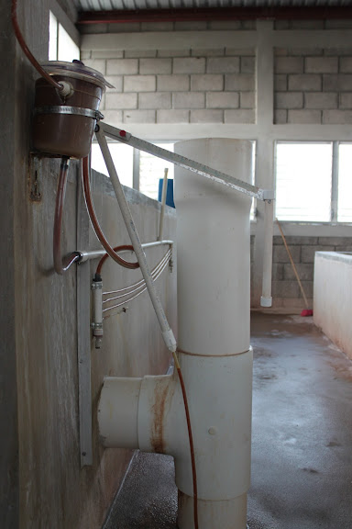
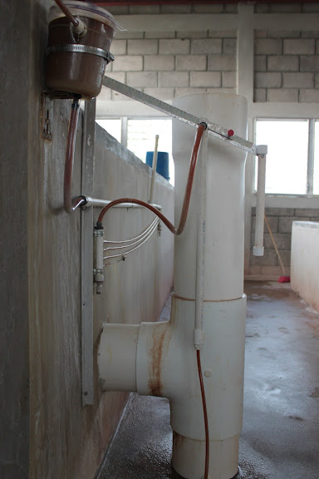
Atima, Honduras Chemical Doser
Minimum Dose
Maximum Dose

Slide 5


Design Theory
Major losses (h_{f}) - due to viscous shear on the pipe walls
Minor losses (h_{e}) - due to expansions/compressions
LCDC system is designed so that h_{f} >> h_{e}, maintaining a linear relationship between
Q and H_{Total}

Slide 6
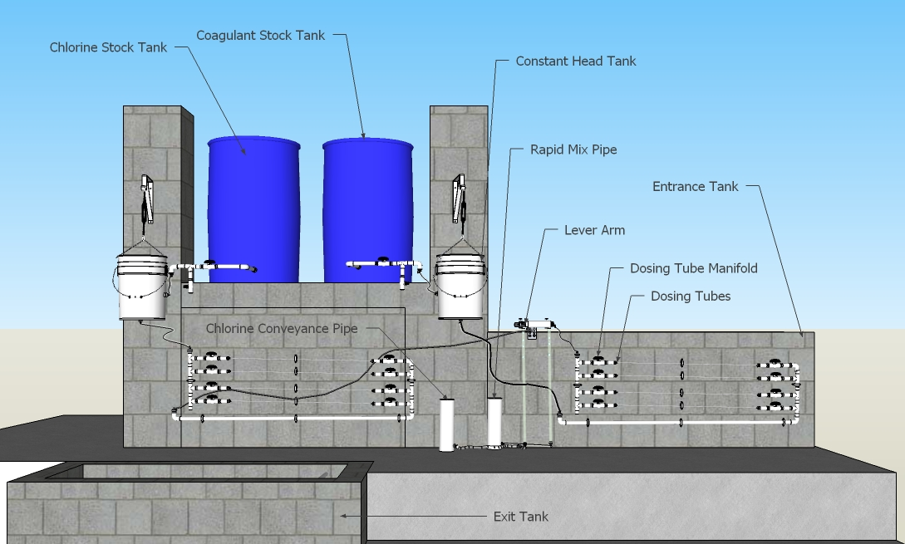
LCDC Assembly Drawing

Slide 7
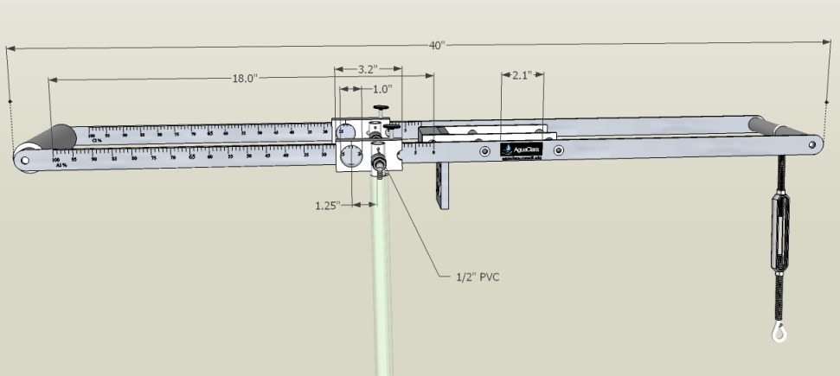
Dimensioned Lever Arm

Slide 8
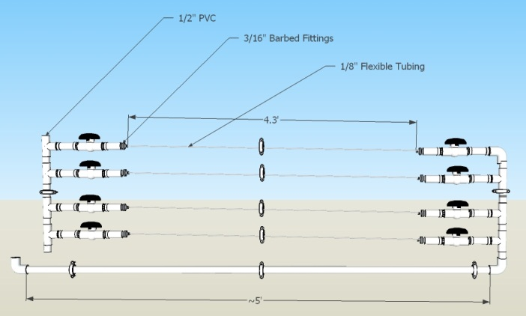
Dimensioned Dosing Tubes

Slide 9
Background Music
Notes:
http://www.youtube.com/watch?v=BNWpZ-Y_KvU

Slide 10
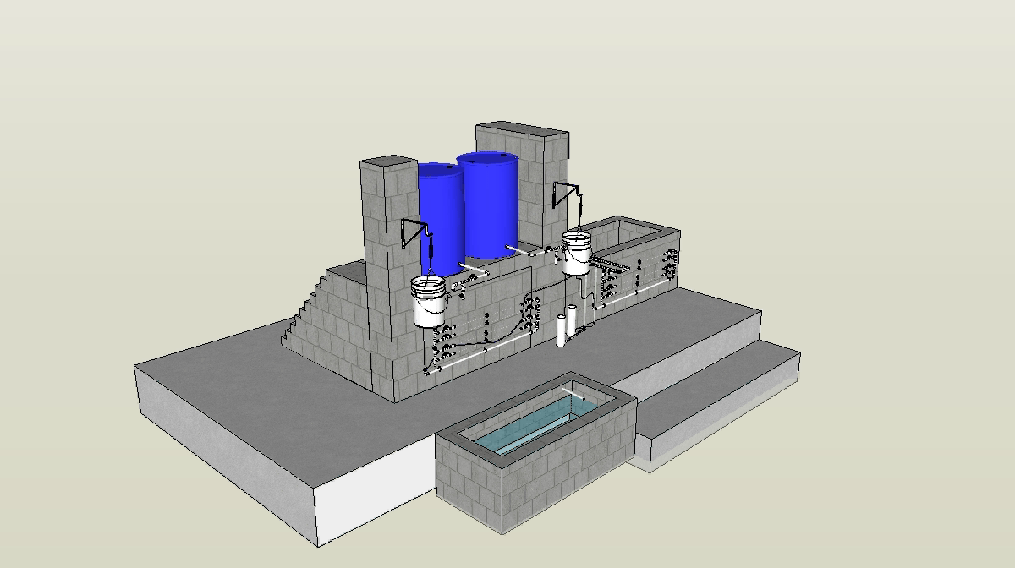
LCDC Video

Slide 11
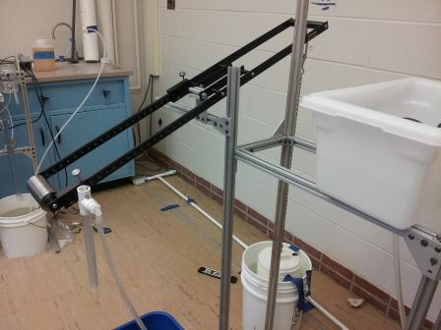
Previous Design – Fall 2012
Weight
Turnbuckle
Cross-bracing
Drop-tube
Anodization
Label
Scale
Logo

Slide 12
Spring 2013 Challenges
Build-full-scale prototype
Coating
Manifolds
Constant Head Tank
Retrofits
Specification Sheets
Entrance tank float
Drop tube
Create a presentable laboratory set-up

Slide 13
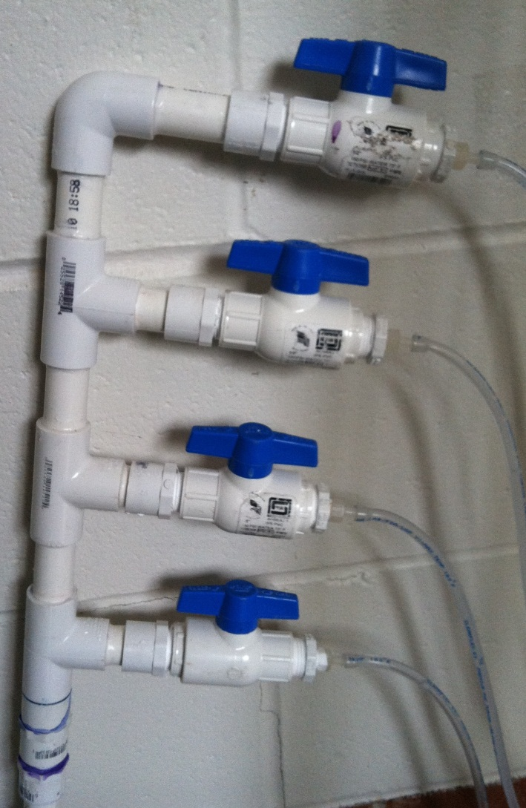
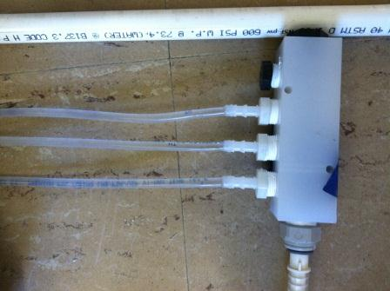
Dosing Tube Manifolds
Current Design
Fall 2012 – Not chlorine resistant

Slide 14
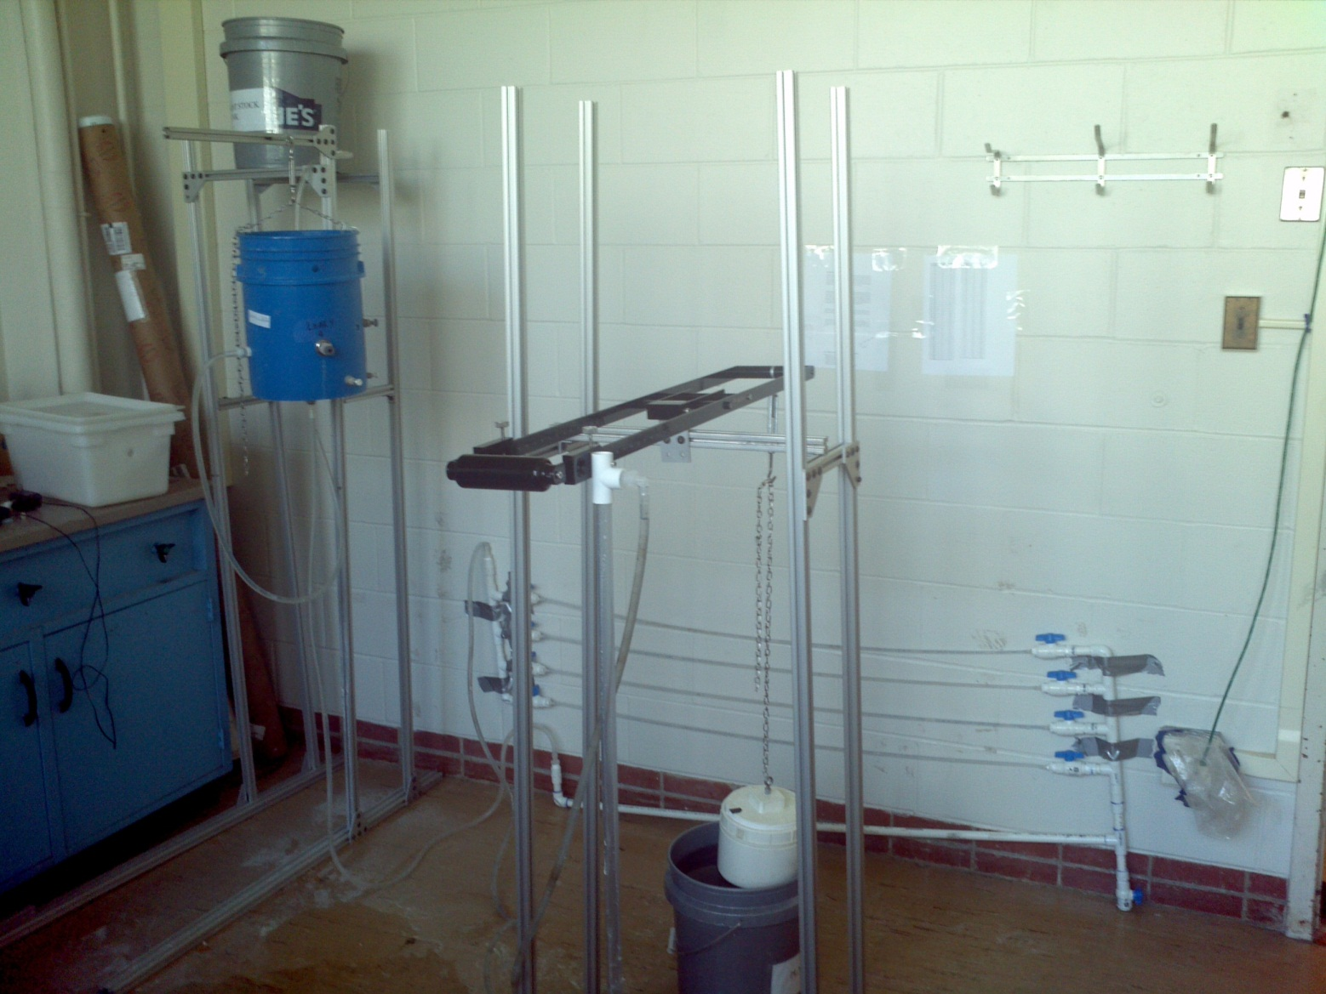
Lab Set-Up

Slide 15
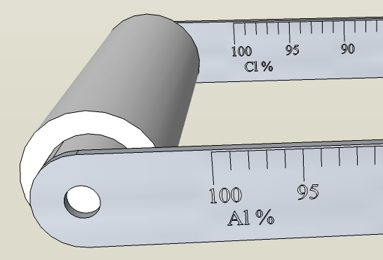
Lever Arm Labels
Had 2 units fabricated: 1 in English, 1 in Spanish
  Prompted the question – can we make a universal lever arm?
Conclusion: Use periodic table symbols
  Coagulants used (PAC, Alum) are Al based
  Disinfectant = Cl

Slide 16
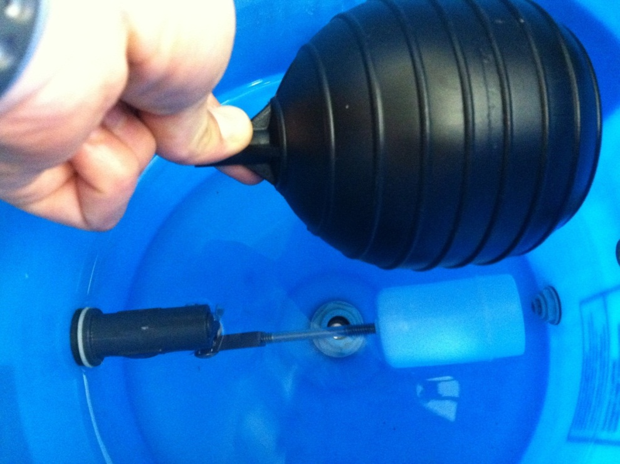
Reduced Float Size – Statics
What is the minimum rod size we can use, so that the buoyant force on the ball causes just the right amount of torque to close the valve?

Slide 17
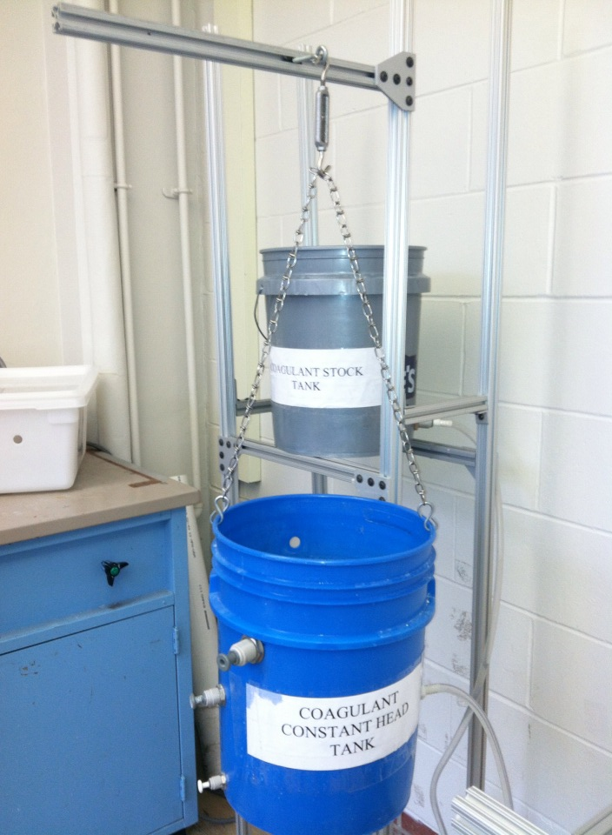
Adjustable Constant Head Tank

Slide 18
Powder Coating vs. Anodizing
Anodizing | Powder Coating
Lost a significant amount of color after 24 hours of soaking | Can be scratched off since it is a coating, not a chemical reaction
Powder coating chosen over anodizing

Slide 19
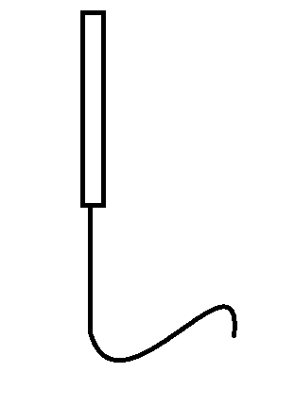
Drop-Tube Design
Drop tube extended to the length of the sedimentation weir
Enables coagulant to mix with water at the bottom of the free fall length of the drop tube

Slide 20
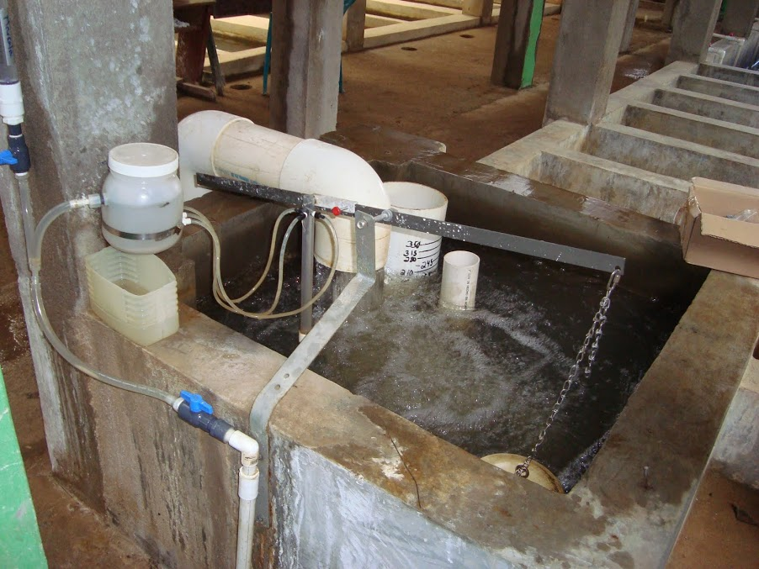
Entrance Tank Float Improvements

Slide 21
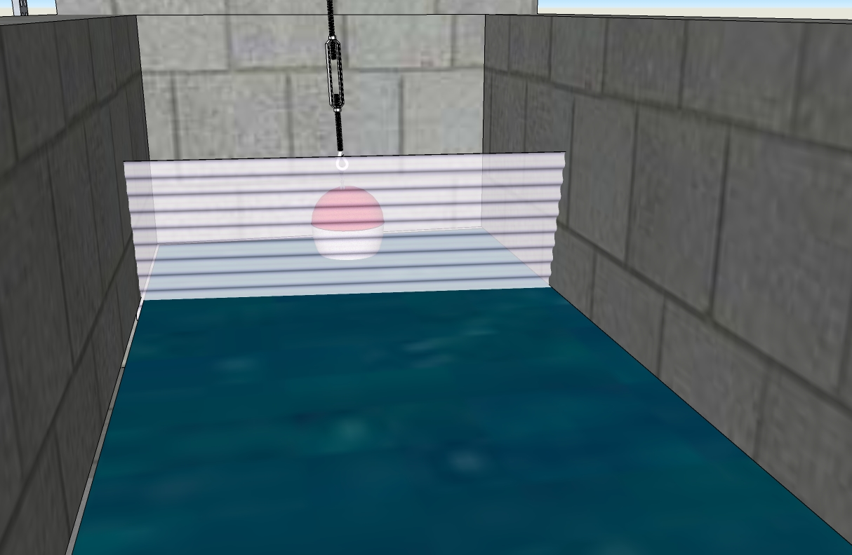
Entrance Tank Float Improvements

Slide 22
Specifications for San Nicolás, Honduras
Parameter | Value
Target plant flow rate | 32 L/s
Coagulant stock concentration | 166.7 g/L
Maximum coagulant dose | 40 mg/L
Dosing tube diameter | 0.3175 centimeters (1/8 inches)
Dosing tube length | 1.308 meters (4.292 feet)
Number of Dosing Tubes | 3 (1 spare)
Maximum coagulant flow rate | 7.7 mL/s
Test average: 7.17 mL/s and 7.67 mL/s
  Percent error = 6.9% and 0.4%, within goal of <10% error

Slide 23
Production of Doser
2 Options:
  1) Mass production in US to reduce unit cost
  2) Production in host country using specifications or a prototype
Remaining components are readily available
  Any fitting must be resistant to chlorine, such as PVC or PVDF and may need to be purchased in US

Slide 24
Remaining Tasks
Retrofits to existing plants – not a priority?

Slide 25
Future Work
Test chlorine and coagulant concurrently

Slide 26

Questions

