Slide 1

Linear Chemical Dose Controller
Ruju Mehta
Julia Mertz
Frank Owusu-Adarkwa
Spring 2012 Teach-In
3 April 2012
Notes:
We are a research team examining the linear chemical dose control system

Slide 2

Outline
Chemical dosing overview
LCDC Theory
Current LCDC Design in operation
New LCDC (Triple Doser)
Future Work
Notes:
The LCDC is the key technology for AguaClara. The LCDC makes it possible for the plant operator to directly set the chemical dose for the coagulant. However the LCDC performance has not been as good as expected due to unexpectedly high minor losses that are not proportional to the flow . (minor losses causes a departure from non-linearity due to the square dependency on flow)

Slide 3
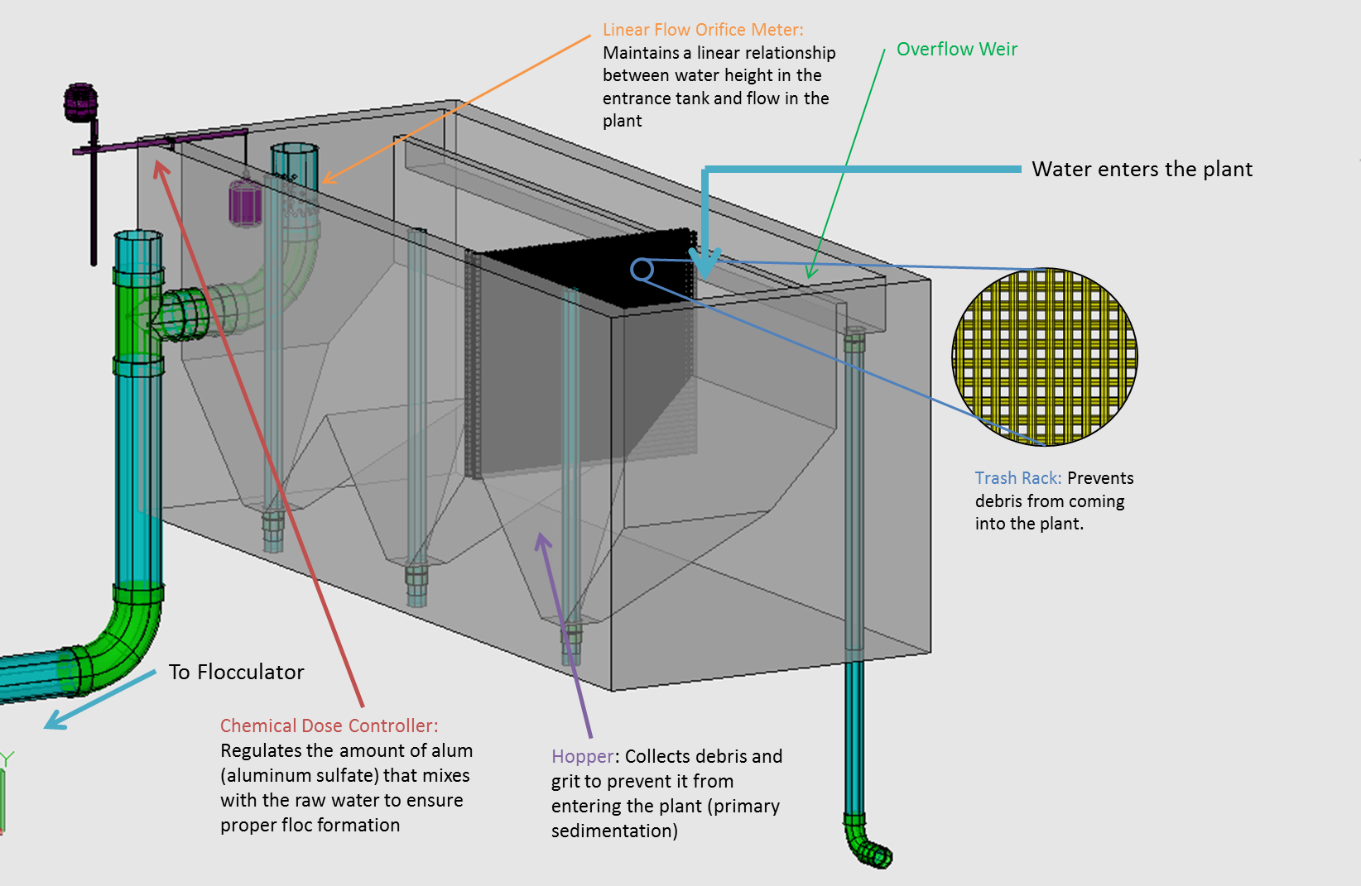
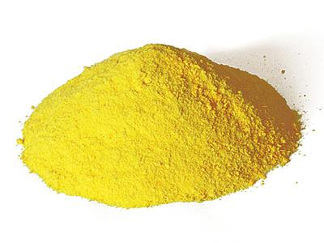
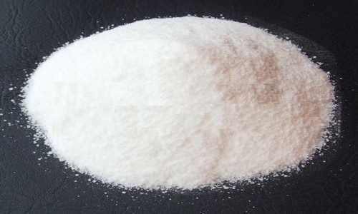
Chemical Application: Coagulation
Notes:
The first application of chemicals occurs in the entrance tank, which is labeled with the red arrow Here, a coagulant, either aluminum sulfate or polyaluminum chloride, is added at a constant dose to alter the influent water’s chemistry to make the particles in the water sticky so they will attach to each other more easily during flocculation and settle out during sedimentation.

Slide 4
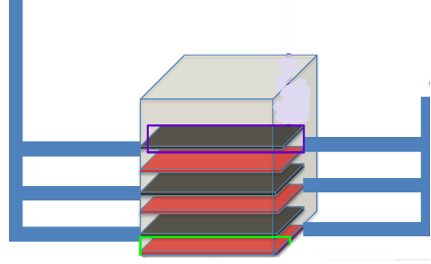
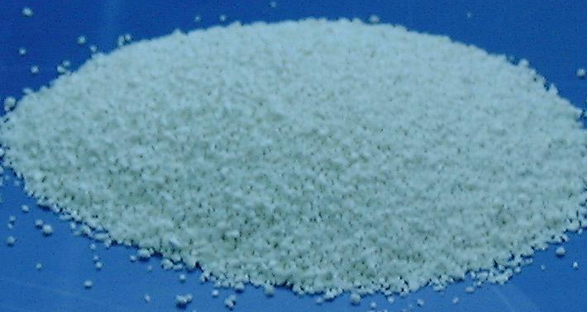
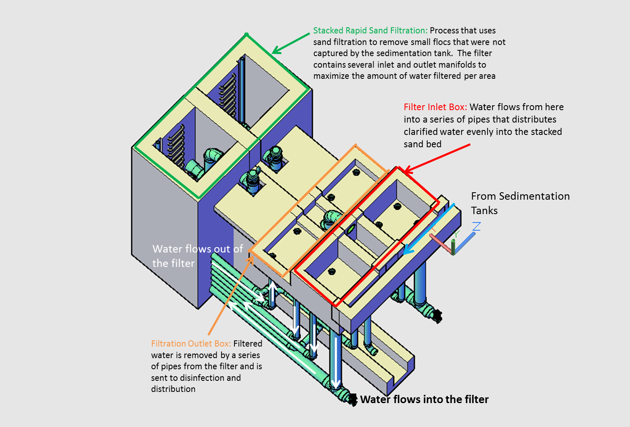
Chemical application: Disinfection
Chlorine application
Notes:
The second chemical application occurs during disinfection. At the end of the treatment process, calcium hypochlorite is added to kill any pathogens that survived through the rest of the treatment process. In existing plants, this takes place after the sedimentation tank, but in new plants with filters, it will take place after filtration.

Slide 5
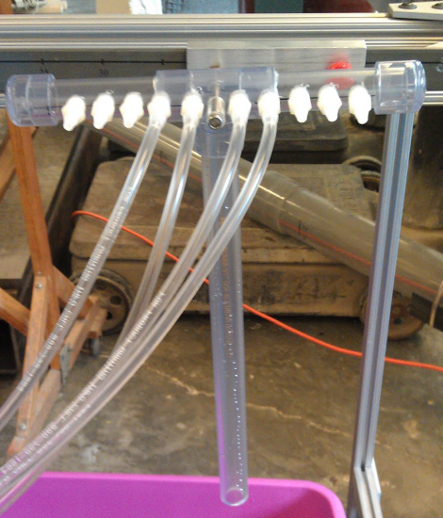
The Chemical Feeds
2 storage tanks are necessary
* 12 L/s plant
 | Coagulant, floc | Coagulant, srsf | Chlorine
Stock Concentration | 360 g/L | 120 g/L | 50 g/L
Q_chem | 2 mL/s | 2 mL/s | 0-0.48 mL/s
Dose Range | 0-60 mg/L (alum) | 0-18 mg/L (alum) | 0-2 mg/L
Length of Small Diameter Tubing | 0.864 m | 2.178 | …
Length of Large Diameter Tubing | Dependent on plant layout
# of Drop Tubes Required | 1 | 1 | 1

Slide 6
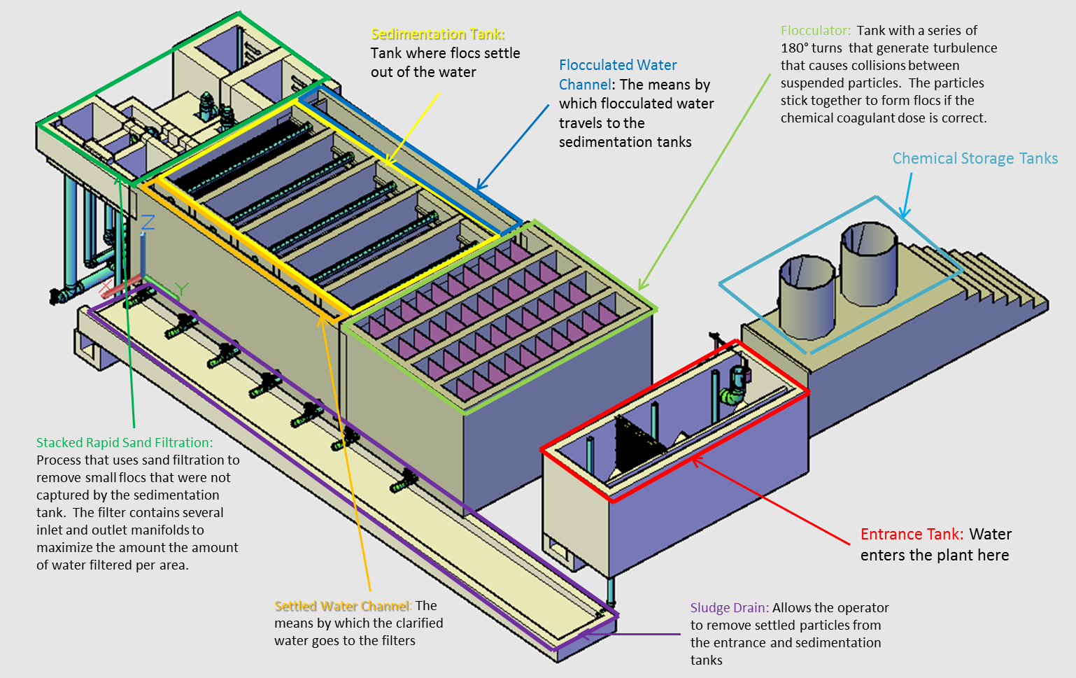
AguaClara Plant
Notes:
We need to locate the doser so that one end of the lever arms overhangs the side of the entrance tank. The float will be attached to this end. The other end of the doser needs to be accessible to the plant operator since the operator will need to set the dose of each chemical depending on the turbidity of the water coming into the plant. Aside from these two requirements, design teams over the years have tried to maximize flexibility about the doser and its components placement.

Slide 7
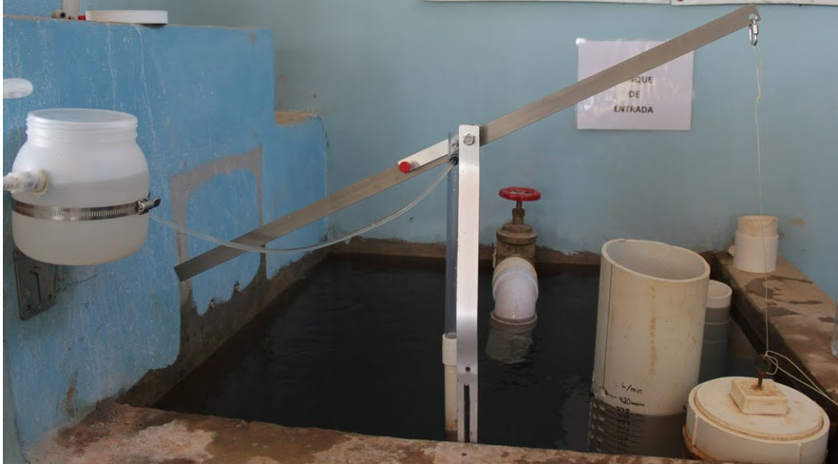
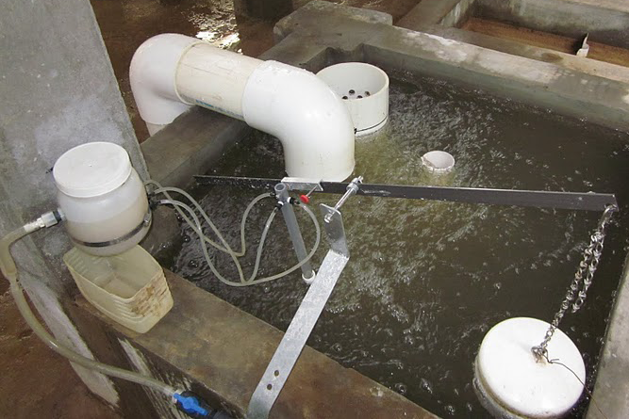
Making the LCDC work for plants with different setups/ flow rates
CHT Placement
Small diameter tubing length is a function of chemical concentration (and viscosity), plant size
Marcala
Float Dimensions
Float with large surface area and light weight is ideal
Notes:
For example, chemical comes from the storage tanks (we need 3) to constant head tanks. Small diameter tubing carries the chemical from the constant head tank to the drop tubes. However, the length of this small diameter tubing is specific to the plant’s size, the concentration of the chemical flowing through the tube and the viscosity of that chemical solution. This is to ensure the correct amount of head loss. Using additional tubing with a larger diameter to cover extra distance lets the plants individually decide where to put the CHTs. The head loss in the large diameter tubing is insignificant so this tubing can be added liberally if necessary.
A float with the largest surface area is ideal but still lightweight is ideal because this float will be able to displace a lot of water with minimal sinking. If the float submerges, this drags the end of the lever arm down, which results in incorrect dosing. The geometry of the entrance tank and the pieces that the entrance tank must hold eg the LFOM allow the float to be a maximum of 8” diameter PVC cap. Right now we have a 6” diameter cap float. Before we specify the larger float we want to make sure that the improvement is necessary and that there is a measurable improvement.

Slide 8
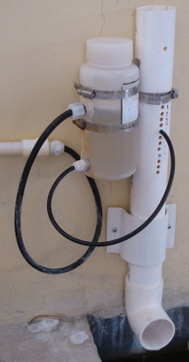
Linear Dose Controller combines 2 Linear Relationships
1) Flow Controller
•Q α h:
Flow rate of chemical dose is linear because the flow through small diameter tube is proportional to the head loss in the tube
chlorinator
Notes:
Without electricity or pumps, AguaClara has innovated to allow for chemical addition. Previous teams have developed a linear dose controller, a non-linear dose controller and a flow controller.
Dose controllers for coagulant (linear only in Agalteca)
explain dose controller vs. flow controller
Dose controller based on the flow rate of the plant.
Flow controller controls the flow in the pipe; it is based on head and it was originally used for chlorine. It cannot be used for coagulant due to the fact that coagulant dose will change if the flow of the plant changes. Huge errors will result if coagulant was dosed with the flow controller because there probably wont be enough coagulant to effectively create flocs and it will decrease performance of the plant.
- Flow controllers for disinfection with chlorine. In our design we’ve combined these two devices to make a tripe doser.

Slide 9
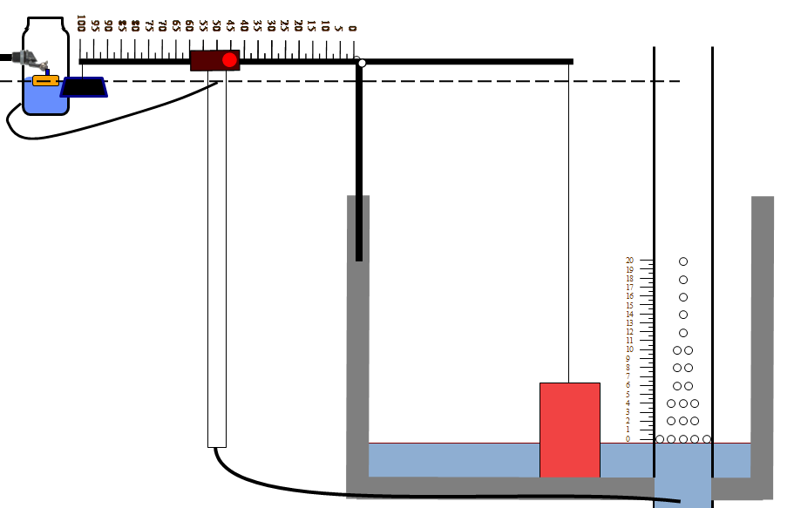
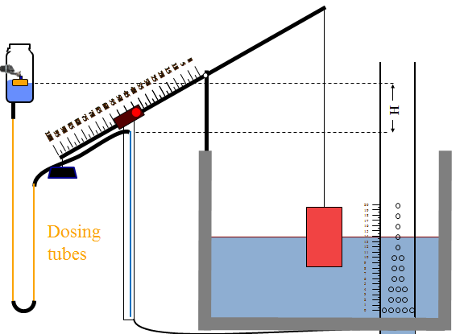
Linear Dose Controller combines 2 Linear Relationships
2) LFOM
Linear relationship between plant flow rate and height of water in entrance tank
Effect:
Dose decreases → H decreases
Flow decreases → H decreases
H = head
Notes:
Here is basic depictions of the linear dose control systems. This system is based upon a relationship between head loss and flow rate. Head loss in very general terms is energy of a flow that is lost due to friction or by expansions caused by the flow changing direction.
The linear system uses a linear flow orifice meter to maintain a linear relationship between water depth, or head, in the entrance tank and flow through the LFOM. The chemical dose controller is designed to obtain laminar chemical flow through the small diameter tube and therefore also give a linear relationship between chemical flow and head loss. Flow is controlled by major head loss, the head loss due to friction.
This is a basic schematic of what research and design teams have come up with after many years of work. The stock tank holds a stock chemical solution which is connected to a constant head tank. The constant head tank is regulated by a float valve which keeps the chemical depth constant. A small diameter tube leads from the stock tank to a drop tube, where the chemical flows to be added to the plant’s influent water. The drop tube is connected to a lever via a slider. The plant operator sets the slider at the desired coagulant dose based upon characteristics of the influent water. The float attached to the lever changes position as flow rate into the plant changes, thus changing the elevation of the small diameter tube’s outlet, and maintaining a constant chemical dose.

Slide 10
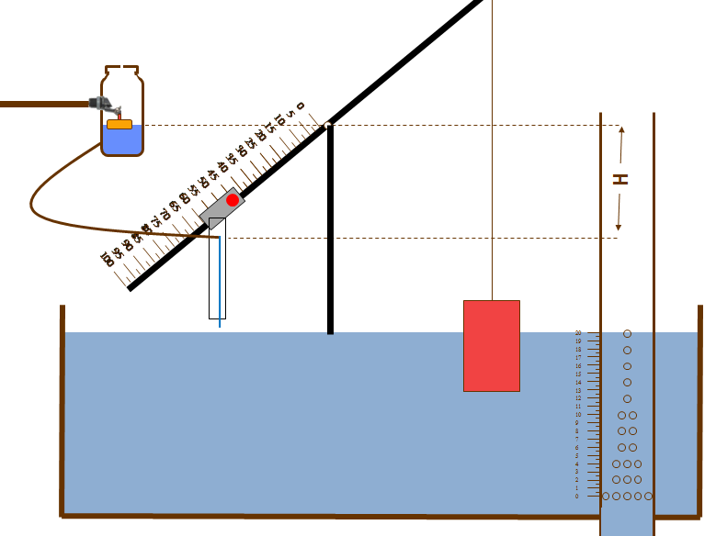
Labeled Diagram
Float Valve
Constant Head Tank
Lever Arm with Scale
Dosing Tube
Float
Slider
Drop Tube
LFOM
Notes:
Just to clarify these are the components in the system.

Slide 11
What’s new this semester?
  Build a central chemical feed unit for AguaClara Plants that doses coagulant to both the flocculator and filter, and chlorine
    3 feeds vs previous 1
  Provide detailed instructions for obtaining parts
    Comprehensive parts list which includes explanations
  Calibrate the doser LCDC taking into account torques
Notes:
-- parts list explanations enable individual plants to choose appropriate materials from available/local options

Slide 12
Dose controller design
Flow Rate (Hagen-Poiseuille)
Minimum tube
diameter
Optimal tube
length
  Assumes chemical flow is laminar with only major head losses:
  Chemical flow rate α Major Head Loss
Notes:
These are three basic equations used to design a linear chemical dose controller. The goal is to use the smallest possible tube diameter that preserves laminar flow at the maximum chemical flow rate so that you can use the shortest possible tube length.
These equations show that the tube’s diameter is selected to maintain laminar flow, with the Reynolds number in the denominator of the equation. Furthermore, the tube length and expected flow rate equations demonstrate that they are both extremely sensitive to changes in the small tube diameter, each being proportional to the diameter to the fourth power.
Difference between Turbulent and Laminar flow. And how the Minimum diameter will change due to change in velocity of the fluid flowing through the tube.
The last equation if the flor rate equation for the flow of chemical/liquid through the CDC. It is the Hagen-Pouiseuille equation, which assumes chemical flow is laminar and thus only deals with major loss in the system. It predicts that the chemical flow rate and the major head loss would maintain a linear relationship to each other

Slide 13
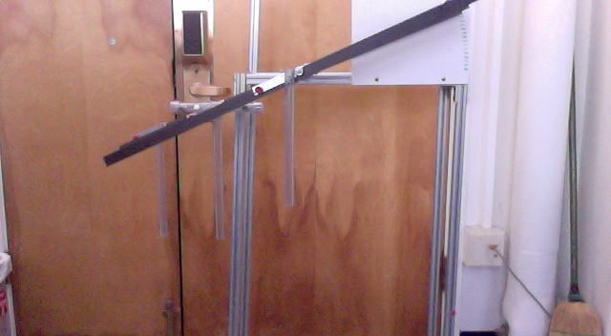
New LCDC Design (Triple Doser)
Lever Arm with Scale
Simulate Float
Slider
Drop Tubes
Notes:
Describe why the doser is at the same angle! We attached all three lever arms with a axle while keeps them at the same angle. Then this requires only one float for the whole device, which keeps it at the same angle.

Slide 14
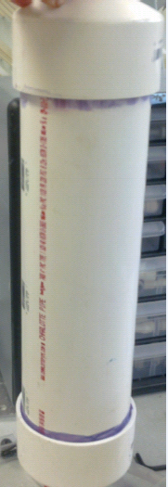
Float Design Constraints
Width of the Entrance Tank
Weight of the LCDC
Size of the LFOM
Increase diameter from
6” to 8”?
Notes:
With the LFOM in the entrance tank as well, the float needs to be the proper size to fit in the entrance tank. If the float is too large, the entrance tank will need to be altered, which will lead to higher construction costs.
The weight of the LCDC is something we need to consider while building the float because the mass of the LCDC will equal the water displaced by the float. We want to minimize the amount of water displaced by the mass.

Slide 15
Accuracy Of Triple Doser
The sliders and drop tubes will contribute torques to the lever arms
  Slider farther from pivot → greater torque
Weight of the components on the lever arm will equal the weight of the water displaced by float to minimize calibration errors.
Calibration errors should be less 10%.
Notes:
To accurately calibrate the LCDC, the difference between the weight on either side of the steel rod pivot point for the lever arms needs to be accounted for. The extra mass on the slider side of the pivot will displace water on the float side. The weight of this extra mass will equal the combined weights of the slider material from the three levers, the drop tubes (including the “T”), and an extra 3 inches of lever arm material on each lever. The sum of these weights will be equal to the weight of the water displaced by the float.

Slide 16
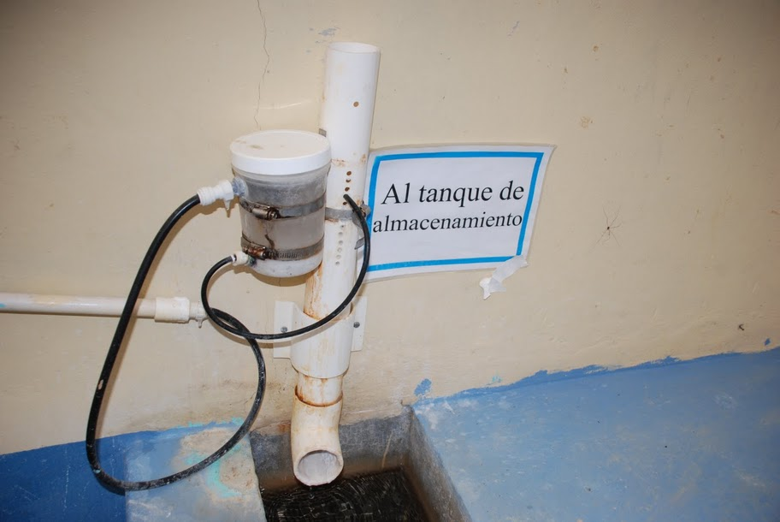
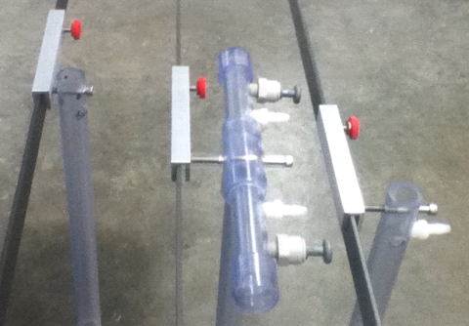
Future Work
Determine a way to control/ arrange for routine cleaning of drop tubes
Calcium carbonate buildup
Notes:
This is the current design for an AguaClara flow controller. The problem is that it appears dirty as chlorine seeps out through the holes beneath the outlet of the small diameter tube. Calcium carbonate precipitate forms when the Chlorine solution comes in contact with open air. The new LCDC design will solve this by connecting dosing tube to the drop tube. The precipitates that accumulates in the drop tube will be cleaned periodically. Two drop tubes will be provided, so that the cleaning would not affect the dosing of chlorine.

Slide 17
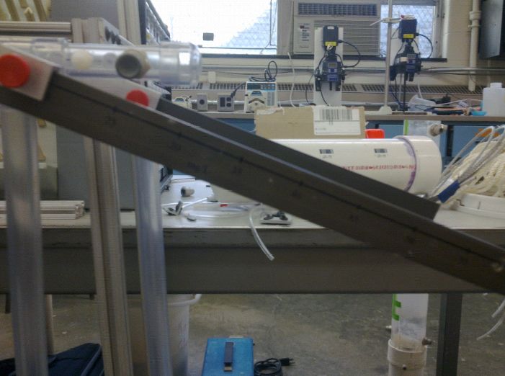
Future Work
Finalize float design
Determine suitable way to
print dosing scales on lever arms
Build and test prototype design
Create a detailed list of parts for easy assembly in Honduras
Write article for submission to Journal of Environmental Engineering that details the current LCDC design, theoretical/testing
Notes:
Include price, unit number and McMaster Carr ID#. This will be necessary to practice how part ordering would be done in an AguaClara plant in Honduras.

Slide 18

Thank you
Questions?

