Slide 1

Linear Chemical Dose Controller Fall 2012
David Buck, Andrea Castro, Rudra Koul

Slide 2
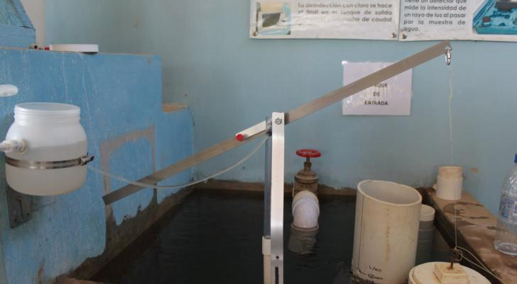

Previous Designs

Slide 3
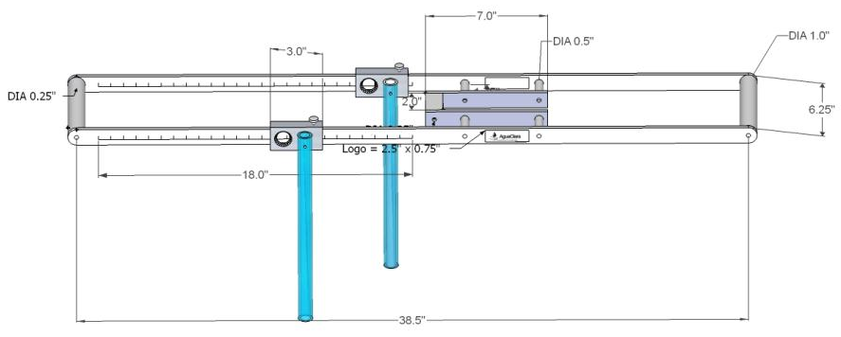
Previous Designs

Slide 4
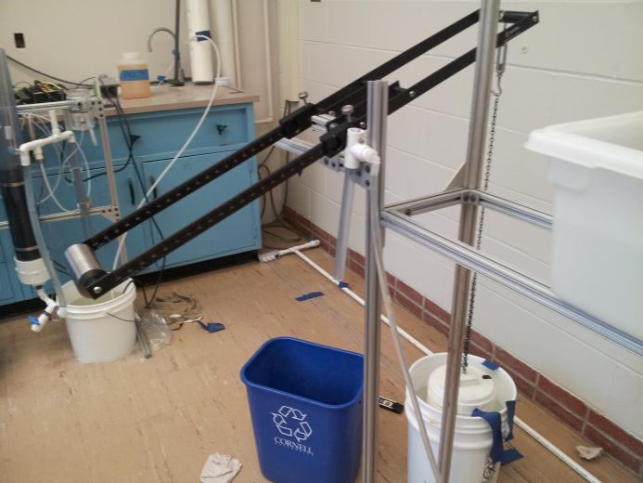
Fall 2012 Design

Slide 5
Fall 2012 Challenges
Chlorine resistance
Build-full-scale prototype
Add calibration device
Label lever arm
Document calibration method
Test prototype

Slide 6
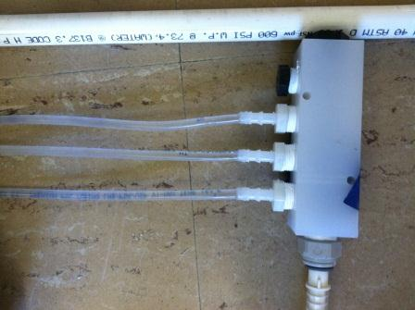
Design Modifications: Chlorine Resistance
Polypropylene and nylon: not resistant

Slide 7
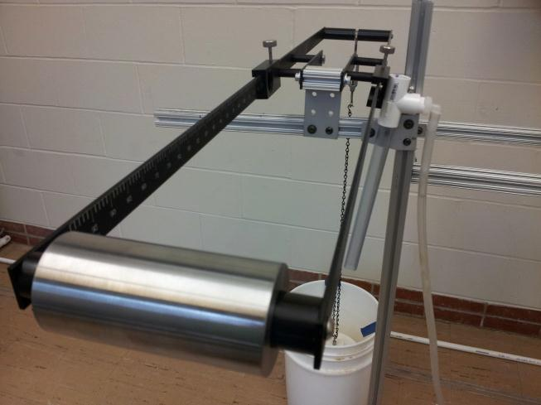
Design Modifications: Counterweight

Slide 8
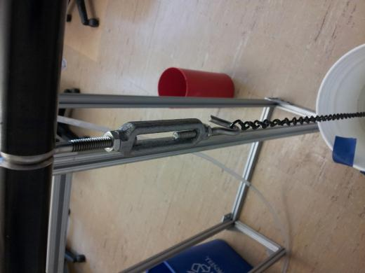
Design Modifications: Fine tune calibration with the use of a turnbuckle

Slide 9
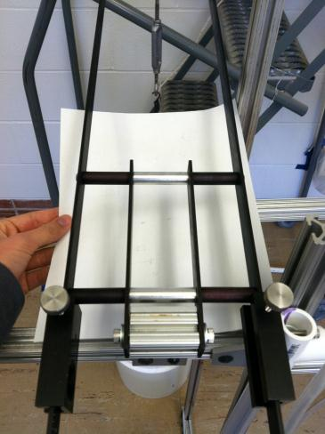
Design Modifications: Cross-bracing of the lever arm assembly to prevent bending

Slide 10
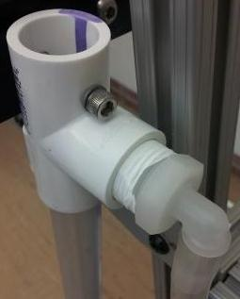
Design Modifications: Drop Tube Design
Major Constraints
  Light-weight
  Leak-free connections
  Chemical is visible
  Constant height from which the solution drops

Slide 11
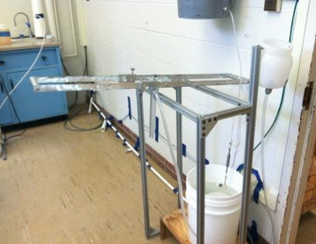
Design Modifications: Scale and Logo
Before Anodizing

Slide 12
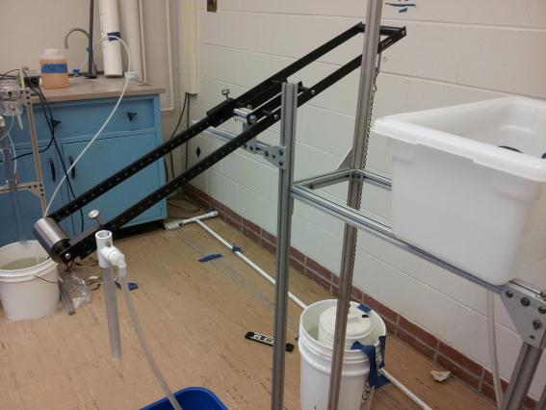
Design Modifications: Scale and Logo
After Anodizing

Slide 13
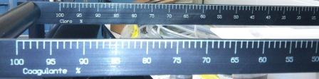
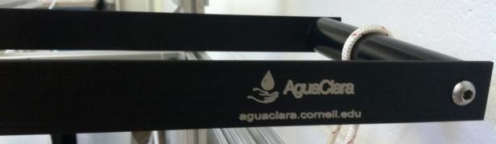
Design Modifications: Scale and Logo
Scale Engraving
AguaClara Logo

Slide 14
Methods: LCDC system laboratory setup
Design Parameters
Target plant flow rate: 44 L/s
Dosing tube length: 2.64 m (~104”)
Dosing tube inner diameter: 0.1875 cm (3/16”)
Number of dosing tubes: 3

Slide 15
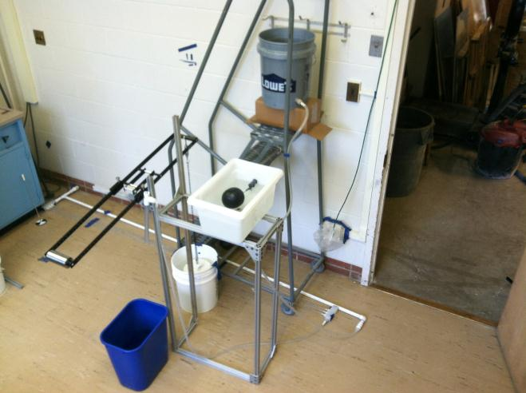
Methods: LCDC system laboratory setup

Slide 16
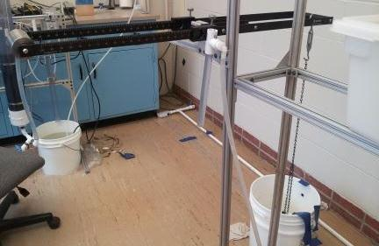
Methods: System calibration at zero flow

Slide 17

Methods: System calibration at maximum flow

Slide 18
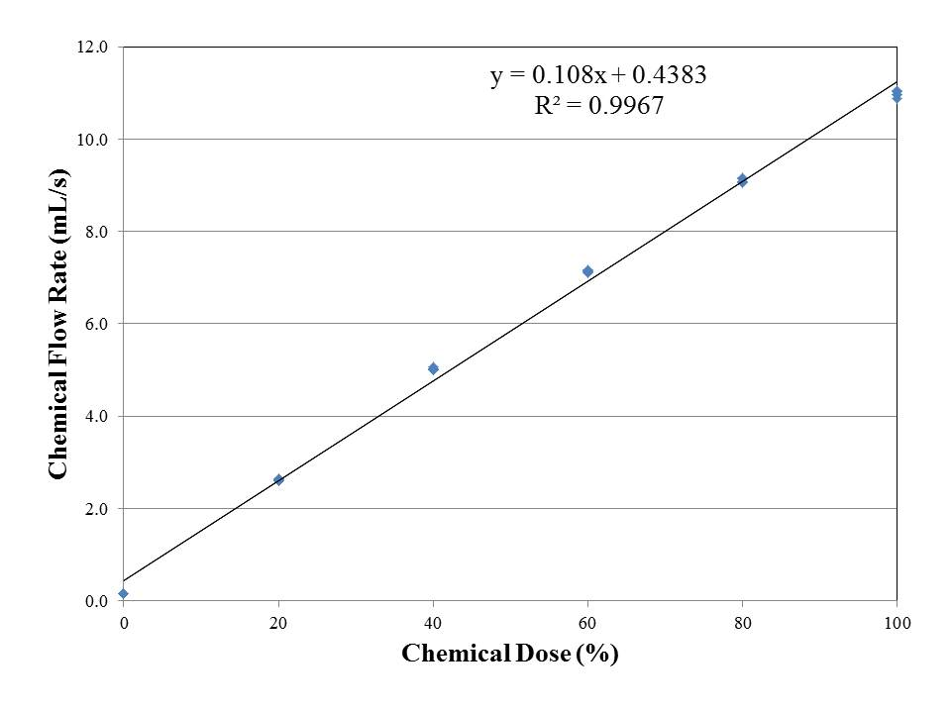
Results: Chemical flow vs. dose percent (scale)

Slide 19
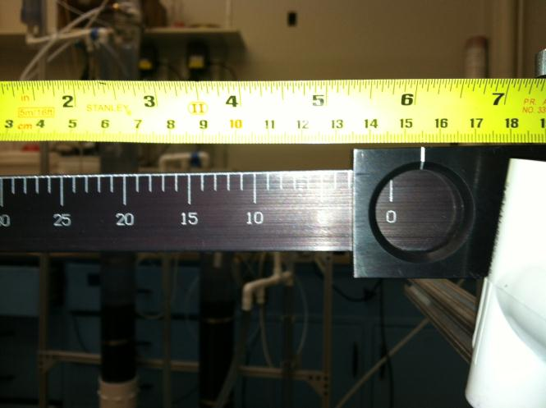
Results: Error- Scale offset on LCDC system

Slide 20
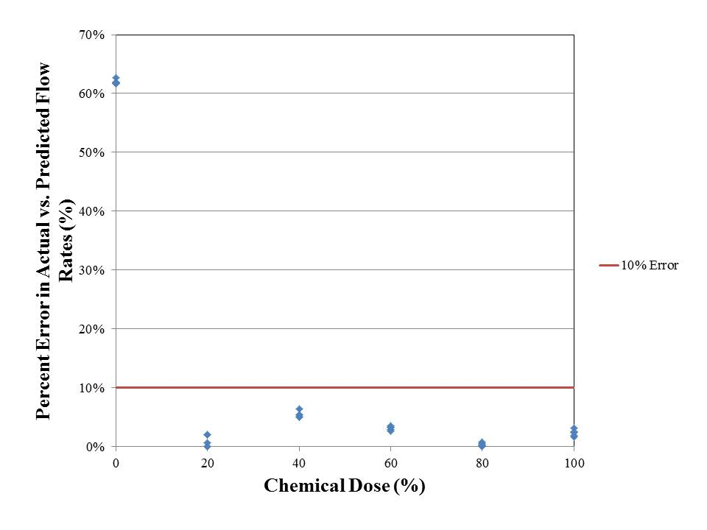
Results: Percent error- chemical flow vs. dose percent (scale)

Slide 21
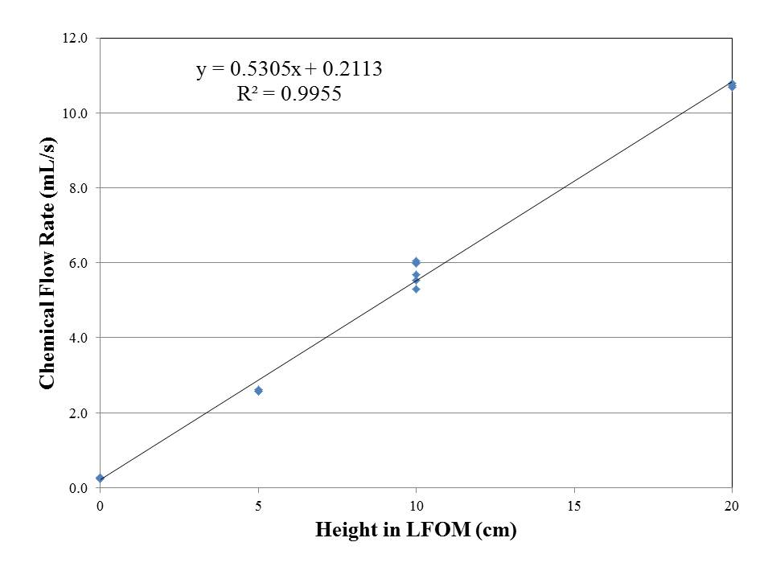
Results: Chemical flow vs. LFOM height (Q_{plant})

Slide 22
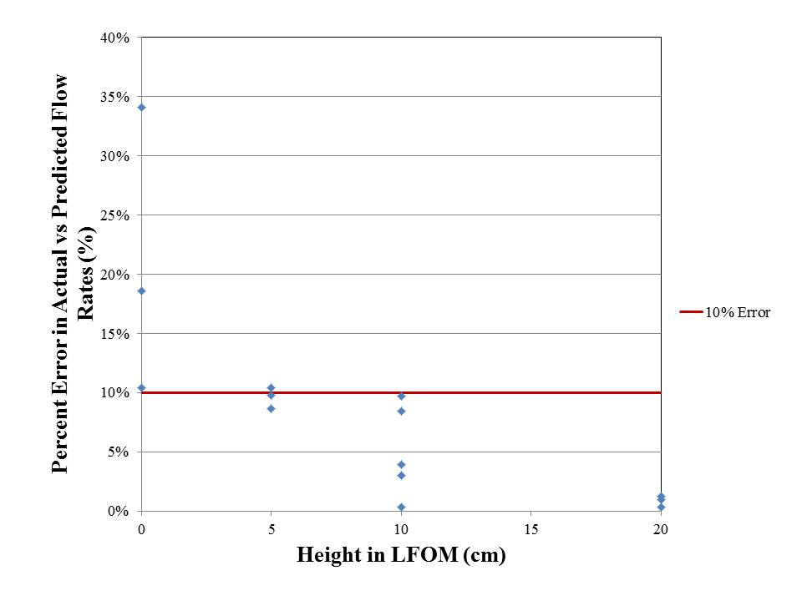
Results: Percent error- chemical flow vs. LFOM height (Q_{plant})

Slide 23
Deliverables
Fabricated prototype with design modifications
Engraved logo and scale
Verified linearity
Refined calibration method

Slide 24
Conclusions
Heavy drop tube assembly
Poor performance at low flow
Linear relationship observed between chemical flow rate and:
  Dose % (Scale)
  LFOM Height (Q_{plant})

Slide 25
Future Work
Further calibration refinement
Use only chlorine-resistant materials, i.e. PVC (not nylon or polypropylene)
Single piece for cross bracing on the lever arm
Update design tool - AutoCAD
Lighten drop tube design

Slide 26
Questions

