Slide 1

Linear Chemical Dose Controller
Jordanna Kendrot
Frank Owusu-Adarkwa
Fall 2011 Final Presentation
10 December 2011
Notes:
Hi my name is Jordanna. This is Frank. We are a research team examining the linear chemical dose control system and linear flow orifice meter.

Slide 2

Outline
Chemical dosing overview
LCDC Theory
Current : LCDC experimentation & results
Future Work
Notes:
The LCDC is the key technology for AguaClara. The LCDC makes it possible for the plant operator to directly set the chemical dose for the coagulant. However the LCDC performance has not been as good as expected due to unexpectedly high minor losses that are not proportional to the flow . (minor losses causes a departure from non-linearity due to the square dependency on flow)

Slide 3
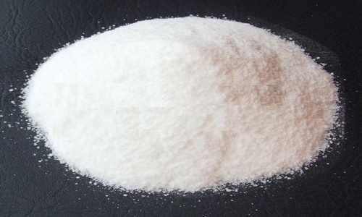
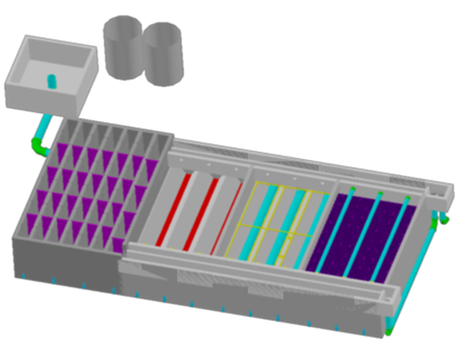
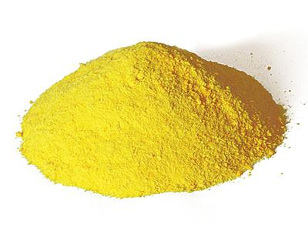
Chemical Application: Coagulation
Notes:
The first application of chemicals occurs in the entrance tank, which is boxed in red here. Here, a coagulant, either aluminum sulfate or polyaluminum chloride, is added at a constant dose to alter the influent water’s chemistry to make the particles in the water sticky so they will attach to each other more easily during flocculation and settle out during sedimentation.

Slide 4
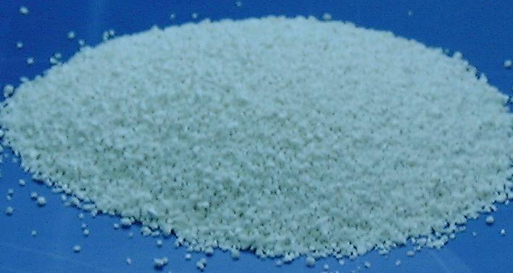
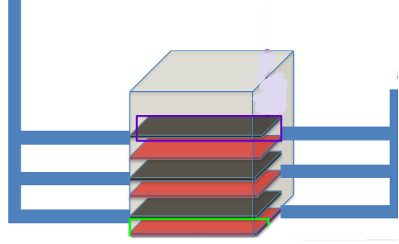
Chemical application: Disinfection
Chlorine application
Notes:
The second chemical application occurs during disinfection. At the end of the treatment process, calcium hypochlorite is added to kill any pathogens that survived through the rest of the treatment process. In existing plants, this takes place after the sedimentation tank, but in new plants with filters, it will take place after filtration.

Slide 5
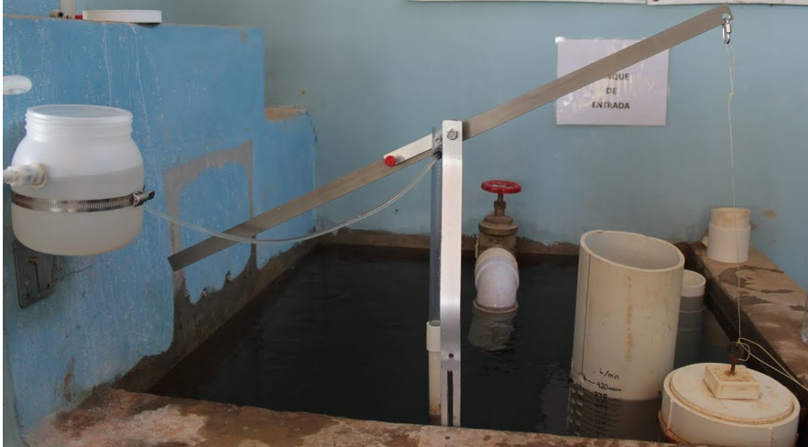
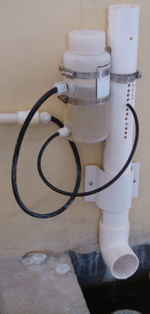
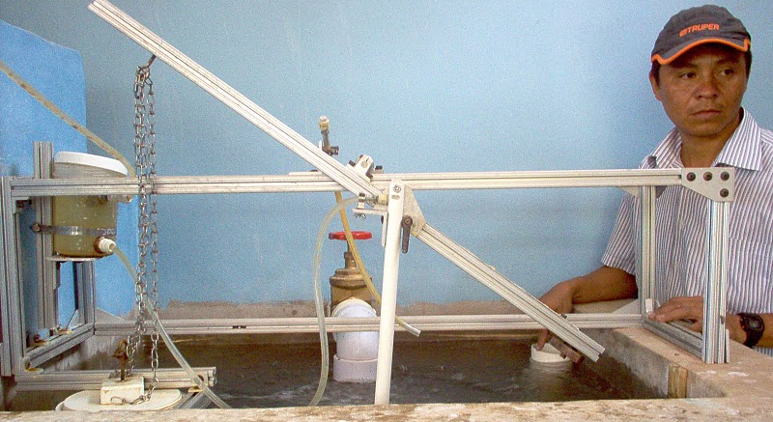
Current AguaClara Chemical Dosing Designs
AguaClara
Flow Controller
Linear Dose Controller
Non-linear Dose Controller
Notes:
Without electricity or pumps, AguaClara has innovated to allow for chemical addition. Previous teams have developed a linear dose controller, a non-linear dose controller and a flow controller.
Dose controllers for coagulant (linear only in Agalteca)
explain dose controller vs. flow controller
- Flow controllers for disinfection with chlorine

Slide 6
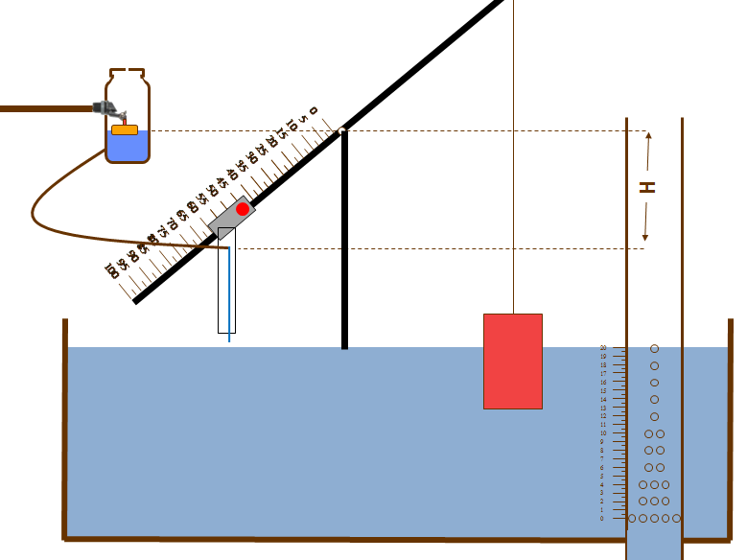
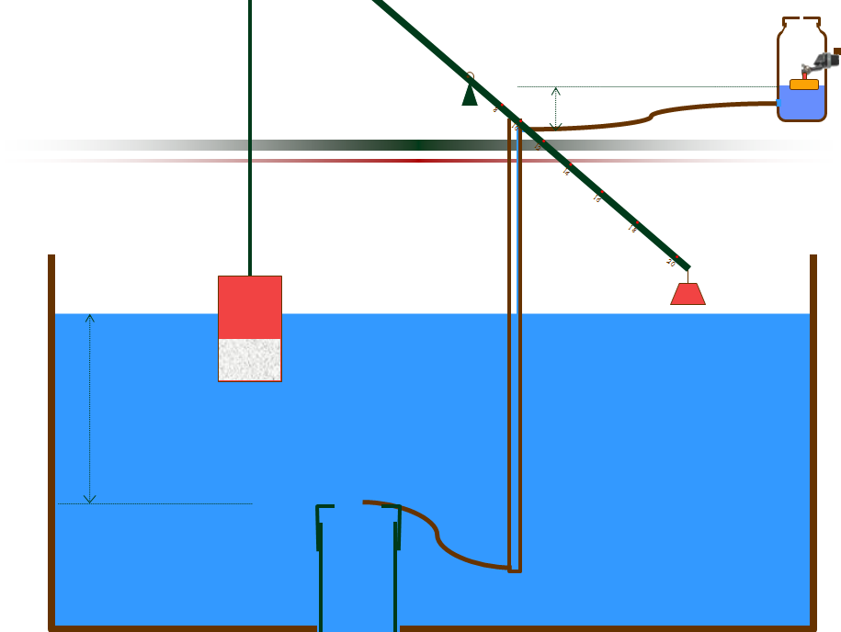
Linear vs. Non-linear system
                Linear
                •Linear chemical dose controller
                •Linear flow orifice meter
                •Q α h
                Non-linear
                •Non-linear chemical dose controller
                •Orifice
                •
Notes:
Here are basic depictions of the linear and non-linear dose control systems. Both systems are based upon a relationship between head loss and flow rate. Head loss in very general terms is energy of a flow that is lost due to friction or by expansions caused by the flow changing direction.
The linear system uses a linear flow orifice meter to maintain a linear relationship between water depth, or head, in the entrance tank and flow through the LFOM. The chemical dose controller is designed to obtain laminar chemical flow through the small diameter tube and therefore also give a linear relationship between chemical flow and head loss. Flow is controlled by major head loss, the head loss due to friction.
In contrast, the non-linear system uses an orifice to control flow. Therefore it’s controlled by minor head losses, the losses that occur when flows change direction and expand. The flow rate through the orifice is proportional to the square root of the water depth in the entrance tank. Therefore, the chemical dose controller is designed to also be non-linear, orifice-controlled flow. Non-linearity allows for turbulent flow through the chemical dose controller and therefore can accommodate higher flow rates than the linear doser.
This is a basic schematic of what research and design teams have come up with after many years of work. The stock tank holds a stock chemical solution which is connected to a constant head tank. The constant head tank is regulated by a float valve which keeps the chemical depth constant. A small diameter tube leads from the stock tank to a drop tube, where the chemical flows to be added to the plant’s influent water. The drop tube is connected to a lever via a slider. The plant operator sets the slider at the desired coagulant dose based upon characteristics of the influent water. The float attached to the lever changes position as flow rate into the plant changes, thus changing the elevation of the small diameter tube’s outlet, and maintaining a constant chemical dose.
Now Frank is going to talk for a bit about how our team tests this setup in the lab.

Slide 7
Dose controller design
Minimum tube
diameter
Optimal tube
length
Flow rate
  Hagen-Poiseuille
  Assumes chemical flow is laminar with only major head losses:
  Chemical flow rate Major Head Loss
Notes:
These are three basic equations used to design a linear chemical dose controller. The goal is to use the smallest possible tube diameter that preserves laminar flow at the maximum chemical flow rate so that you can use the shortest possible tube length.
These equations show that the tube’s diameter is selected to maintain laminar flow, with the Reynolds number in the denominator of the equation. Furthermore, the tube length and expected flow rate equations demonstrate that they are both extremely sensitive to changes in the small tube diameter, each being proportional to the diameter to the fourth power.
The last equation if the flor rate equation for the flow of chemical/liquid through the CDC. It is the Hagen-Pouiseuille equation, which assumes chemical flow is laminar and thus only deals with major loss in the system. It predicts that the chemical flow rate and the major head loss would maintain a linear relationship to each other

Slide 8
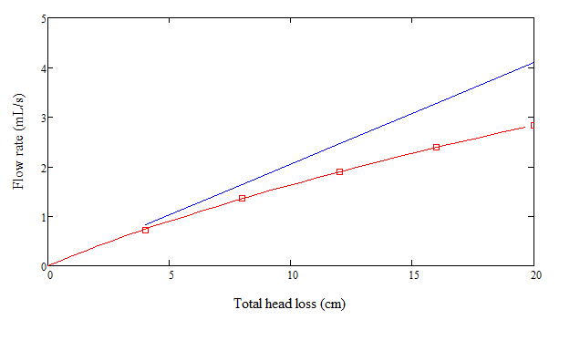
Minor Loss ≠ Minor = Important!
Total head loss is both major AND minor loss
Minor loss is from expansions and curvature
  Blue Line = Hagen-Poiseuille
Red Line = What really happens!
If the minor
coefficient, k_{e}, is
totally minimized
the flow will be linear
and the LCDC system
will work perfectly!
Notes:
Past LCDC and LFC designs assumed that the length of the small diameter tube was sufficient enough to ensure that the major head losses dominated the Equation. These designs also believed that the linear relationship between the chemical flow rate and the major head loss would be maintained, as shown in the Hagen-Poiseuille Equation However, during the Spring 2011 semester, the LCDC team observed quadratic tendencies in the relationship between head loss and chemical flow (see Spring 2011 Final Report “Initial Laboratory Results” section for an analysis of the experiments that gave these results”. Minor head losses result from flow expansions through the system and are proportional to the square of the chemical flow rate. When the Spring 2011 LCDC team observed these results, they designed a method to model the magnitude of the minor head losses and sought to eliminate their sources.

Slide 9
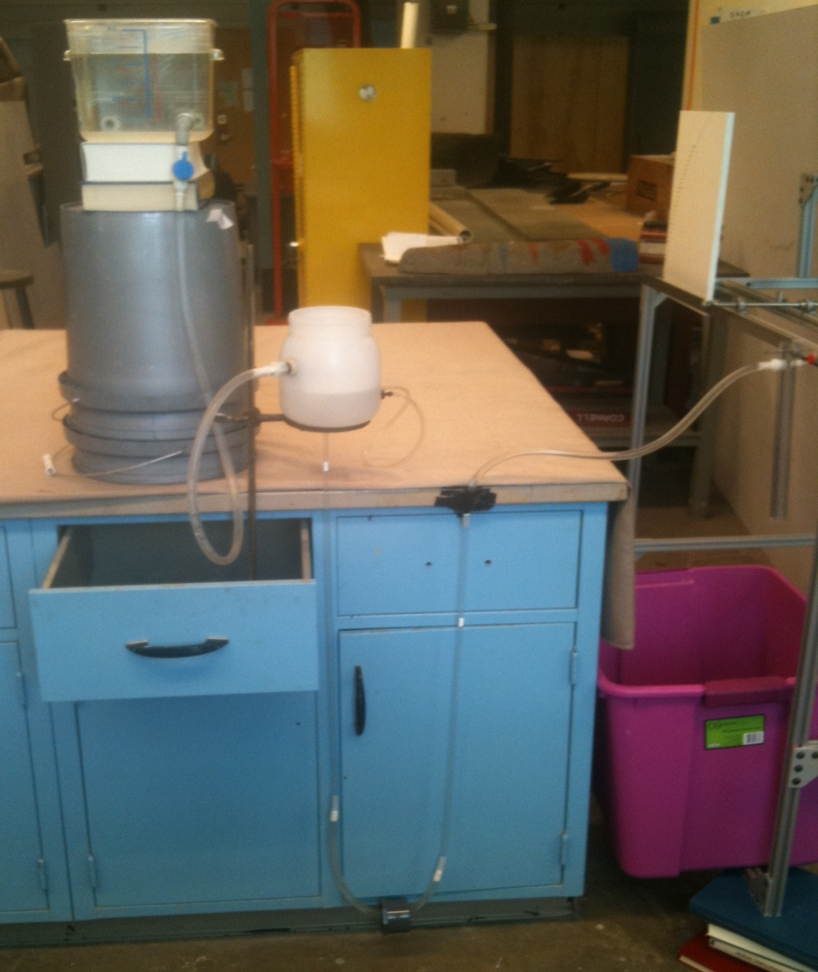
Goals of Fall 2011 LCDC Team
  Reduce horizontal distance needed by design
  Reduce the minor loss coefficient (K)
  Test combinations of different ID tubes
Notes:
goal of the Fall 2011 team is to both reduce the k-value and the horizontal distance needed by the apparatus

Slide 10
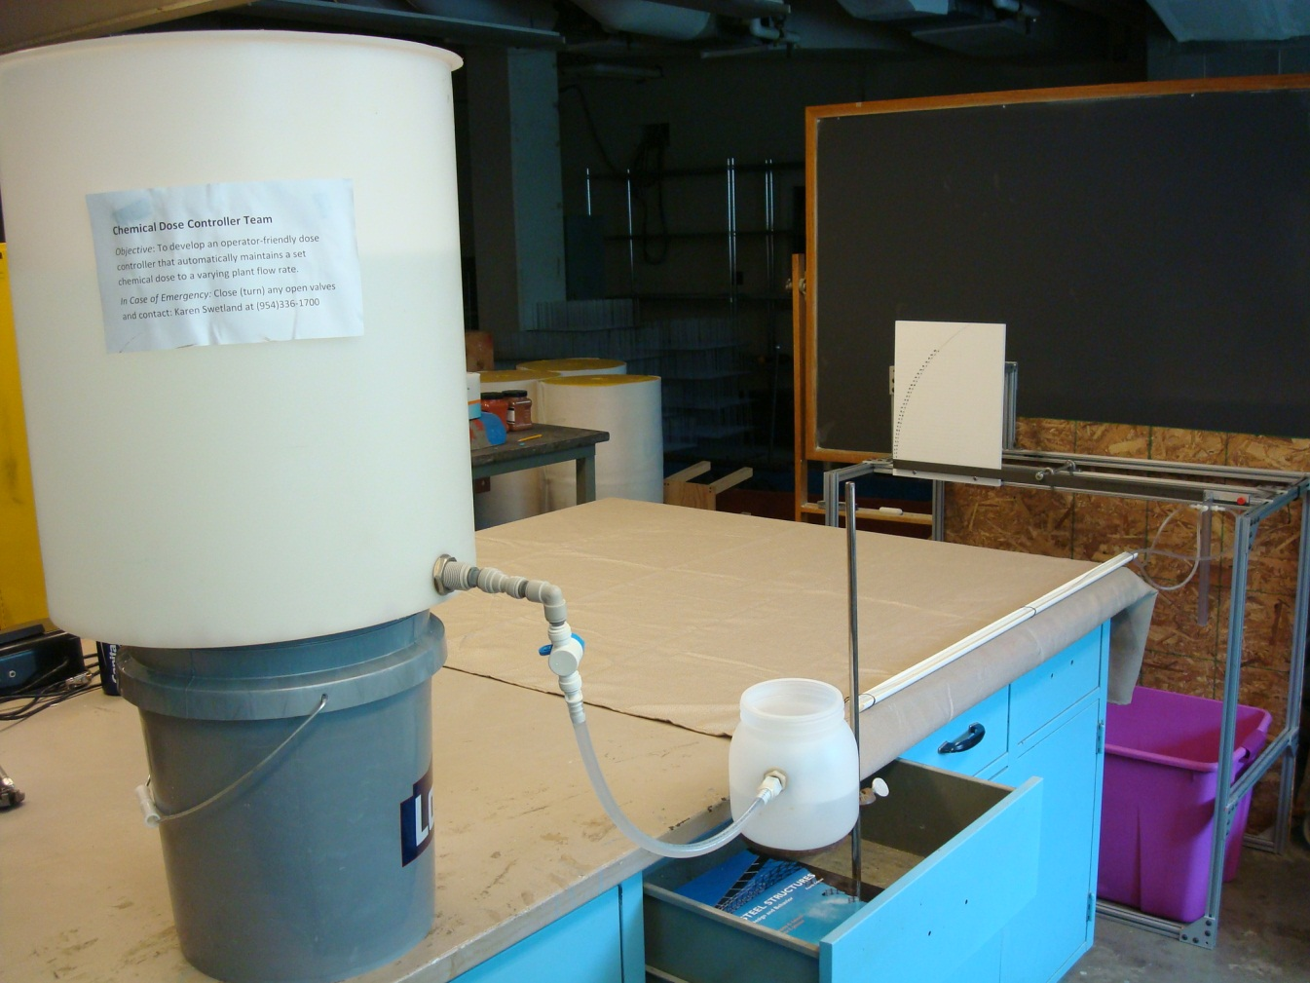
Previous Experiments
Spring/Summer 2011 Experimental Setup
Lowest k-value (currently!!!)
  Larger barbed fittings than ID
  Held straight in a PVC trough
  Highly impractical for use in plants due to space needed
Notes:
This design, though reducing a large percentage of minor loss, is not highly practical for use in the field because of the need for a perfectly straight tube that takes up a large amount of horizontal area

Slide 11
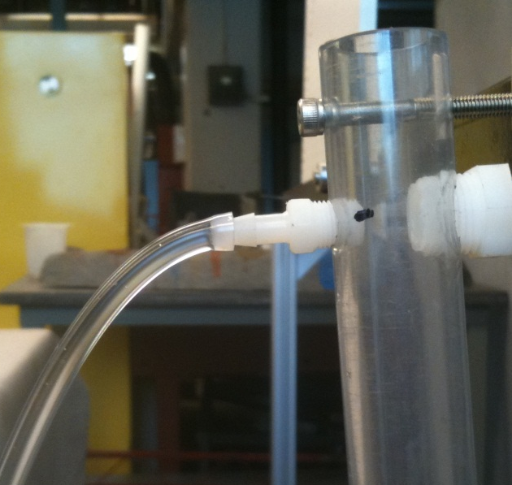
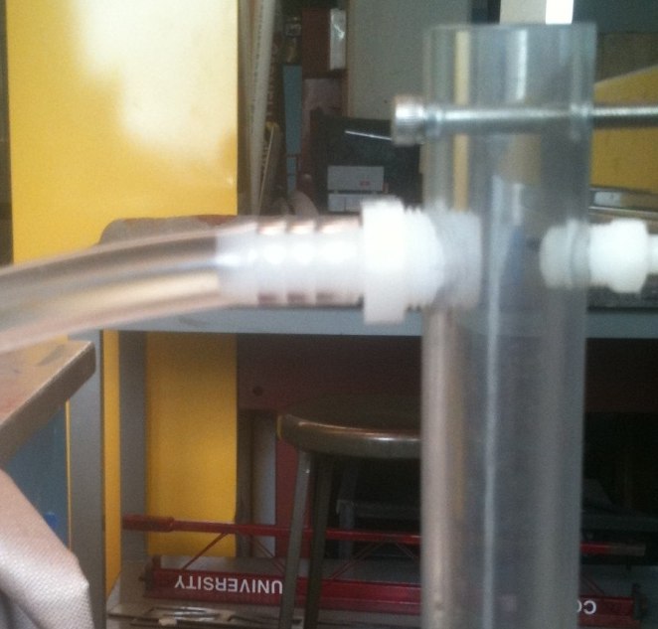
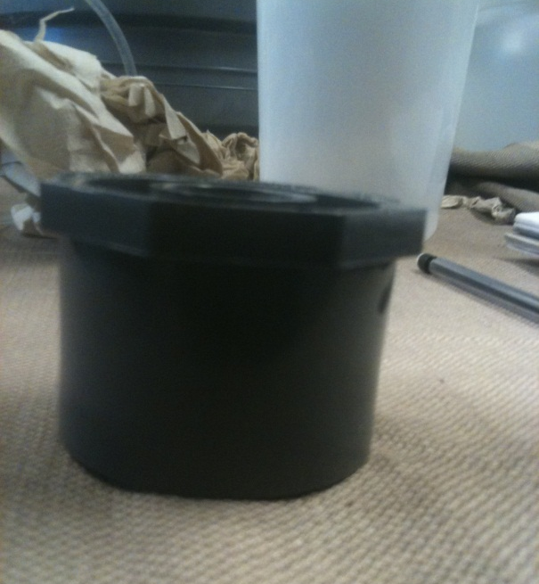
Fall 2011 Apparatus Variables
Reduce Minor Losses
  Limit small ID tube curvature, increase straight section length (weight)
  Larger ID tubing (1/2”)
  Larger barbed fittings
Notes:
These are the variables and setups that will be tested.
Instead of simply moving the CHT closer to the drop tube, allowing the tube to hang free, there will be various different experimental setups to see which will give the lowest value for the minor loss coefficient, K . There will be three separate setups that will be tested along with addition or exclusion of a minor weight, less than 100 grams as shown in Figure and using a new barbed fitting for ID tube that will be connected to the smaller ID tube (Figure ([fig:fittings]). If it is shown that the addition of the weight, and a particular setup, give a better k-value than the purely horizontal setup, this will be experimented with further by either increasing the weight or moving it along the tubing.

Slide 12
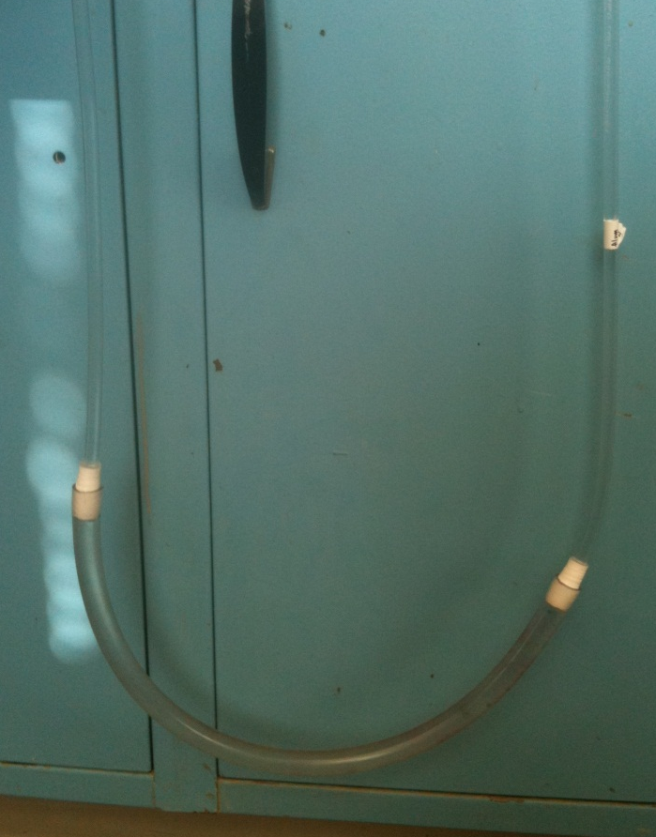
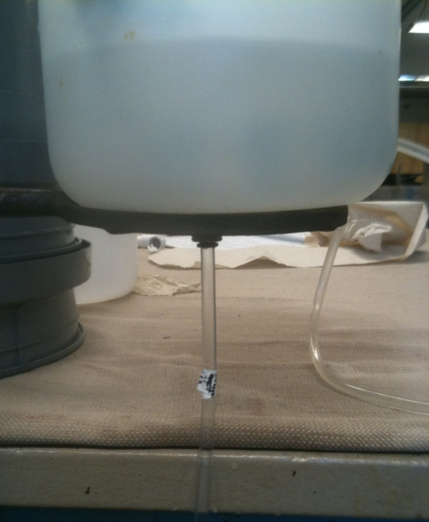
Fall 2011 Apparatus Variables
Reduce Distance
  Vertical Components
  CHT connection to dosing tube, change from side to base
  Combination of tubes, 1/8” ID to 1/2” ID for curve
Notes:
These are the variables and setups that will be tested.
Instead of simply moving the CHT closer to the drop tube, allowing the tube to hang free, there will be various different experimental setups to see which will give the lowest value for the minor loss coefficient, K . There will be three separate setups that will be tested along with addition or exclusion of a minor weight, less than 100 grams as shown in Figure and using a new barbed fitting for ID tube that will be connected to the smaller ID tube (Figure ([fig:fittings]). If it is shown that the addition of the weight, and a particular setup, give a better k-value than the purely horizontal setup, this will be experimented with further by either increasing the weight or moving it along the tubing.

Slide 13

Major Components of Experimental Apparatus
Chemical Stock Tank
Lever used to control total head loss of system
Constant Head
Tank (controlled by float valve)
Drop Dose
Tube
Small diameter tubing (split tube setup example with weight)
Large diameter tube connected to dose tube (minimal minor and major loss)
Notes:
goal of the Fall 2011 team is to both reduce the k-value and the horizontal distance needed by the apparatus

Slide 14
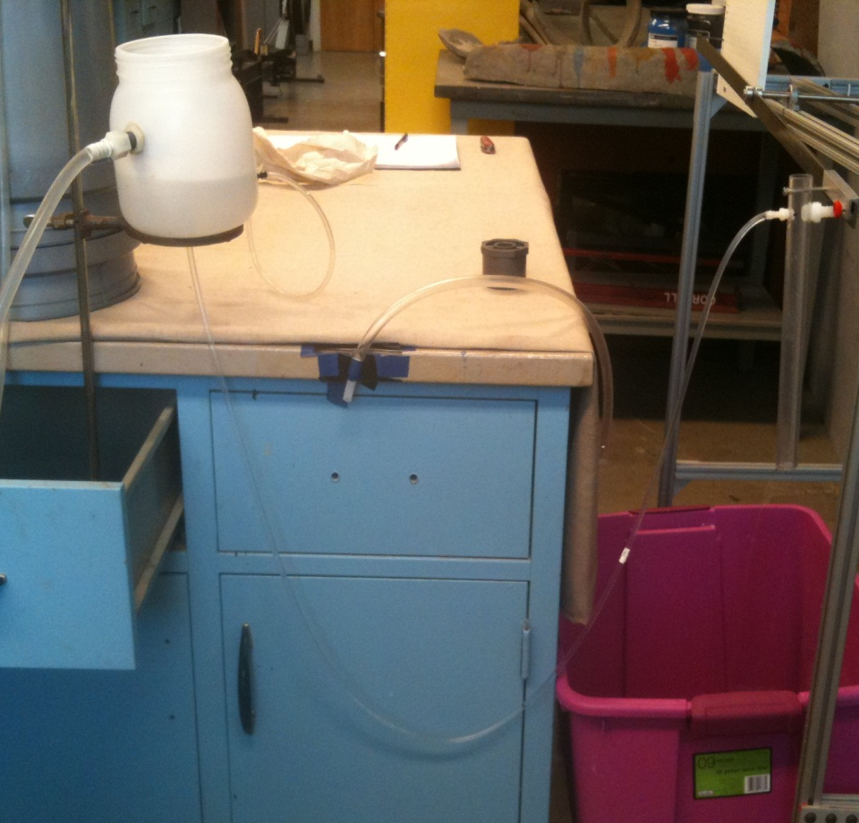
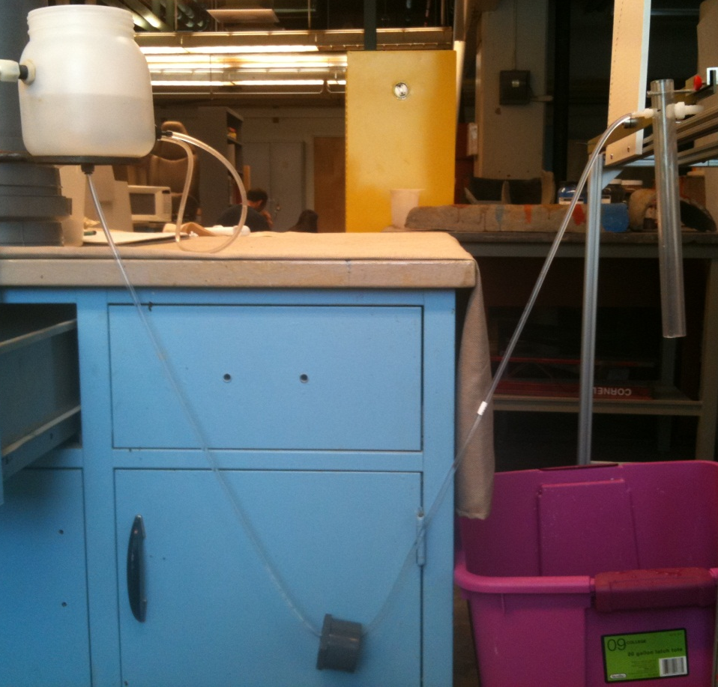
Single Tube With and Without Weight
Straight to Drop Tube
Notice the addition of a fairly small weight (<100gm)
drastically increases the amount of straight sections in the tubing
Notes:
Experiments using single tube, connected to base of CHT without weight

Slide 15
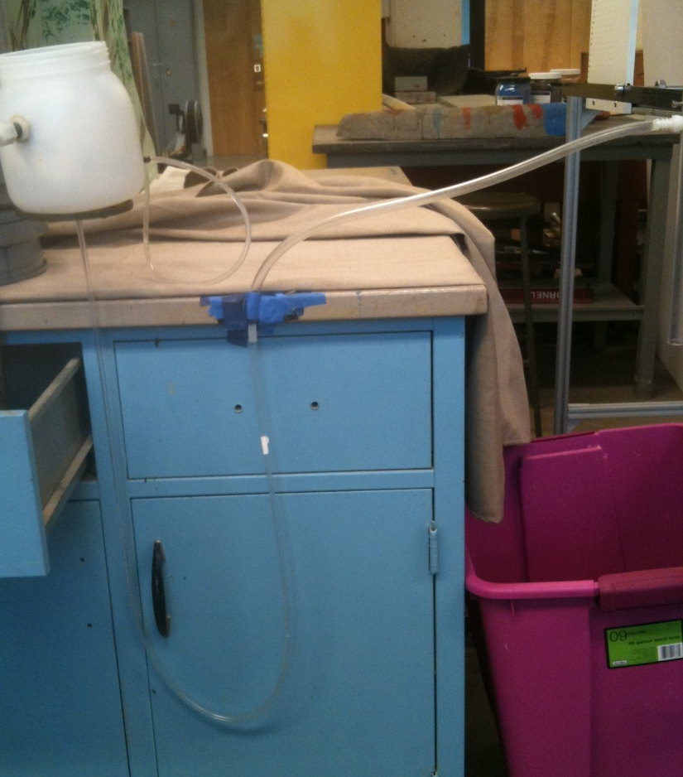
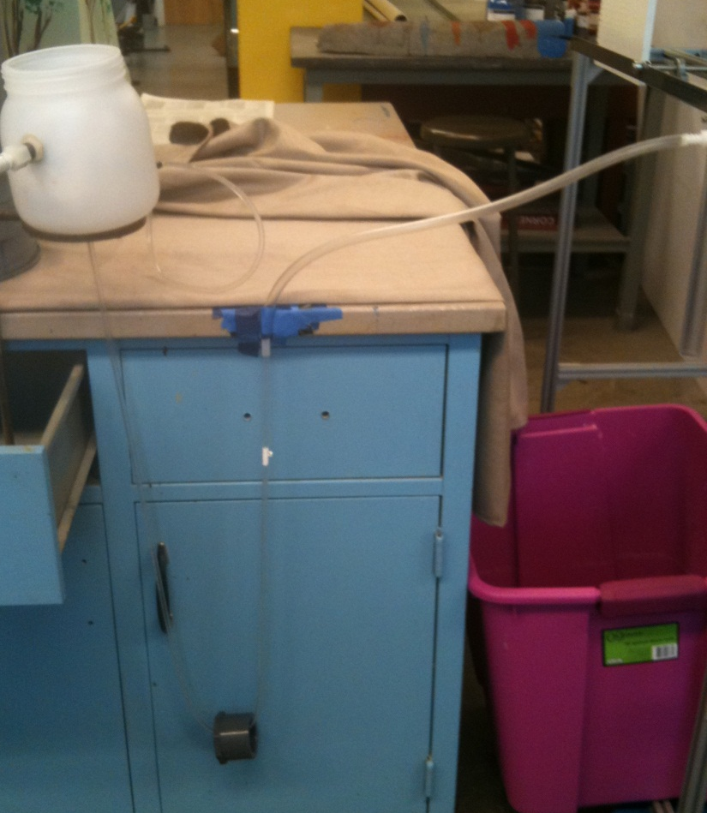
Single Tube With and Without Weight
To Larger ½” ID Dose Tube
Connect to larger ID tube with a small section of rigid tubing as a transition in sizing. These tubes will not contribute significant minor losses, due to large diameter.
Notes:
Experiments using single tube, connected to base of CHT without weight

Slide 16

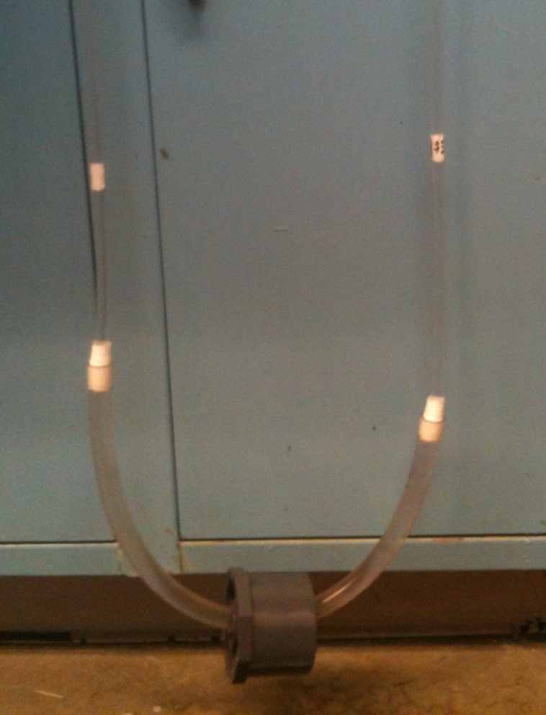
Split Tube With and Without Weight
To Larger ½” ID Dose Tube
Free hang split initially has fairly straight small diameter tube sections, but the weight does improve the setup. A larger weight may straighten tube configuration further.
Notes:
Experiments using single tube, connected to base of CHT without weight

Slide 17
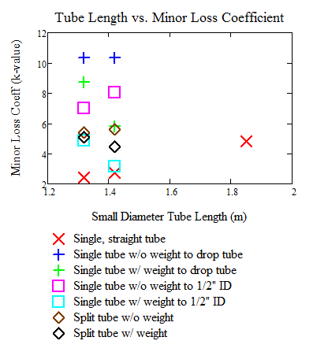
Previous CDC Experimental Results
A refresher from last time:
The large tube as a connection to the drop tube greatly reduced the minor loss (~35%)
The small weight increased this reduction up to 60% in some setups
This brings even the highest of these k-values to 4.8, already performing at a level equal to or better than most plants in Honduras
The straight tube is still the “best”, even without connection to the large ½” tube
Notes:
The straight tube is considered the “best” setup available, giving a close to linear chemical flow and also having the smallest k-value present

Slide 18
What we learned from last time!
From the old k-value data, it has been determined that:
Use the weight; the k-value will always be lower
More data is required to see any data trends, so six lengths will be used in approx. 10cm increments
The split tube setup, despite having consistent low k-values, is difficult to use in lab and thus would be even more difficult in the field
Begin use of ¼” ID tubing as “large tube connection” because, theoretically, minor losses should be reduced by factor of 16 from change in diameter
Remember this equation?
Notes:
Previous LCDC teams had assumed kinematic viscosity equal to water (1 mm² /s). However in the summer it was determined that kinematic viscosity increases with coagulant concentration. The results found by the Summer 2011 team indicate that for coagulant concentrations above 100 gm/L, the kinematic viscosity cannot be assumed to be approximately equal to that of water. Kinematic viscosity must be taken into account when predicting chemical flows rates through the LCDC system.

Slide 19
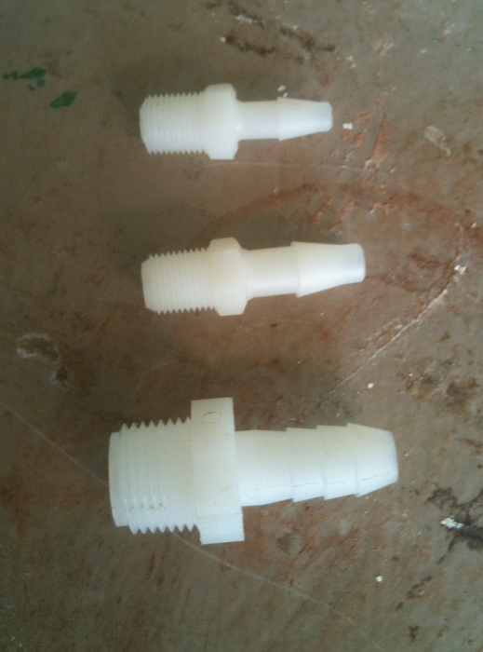
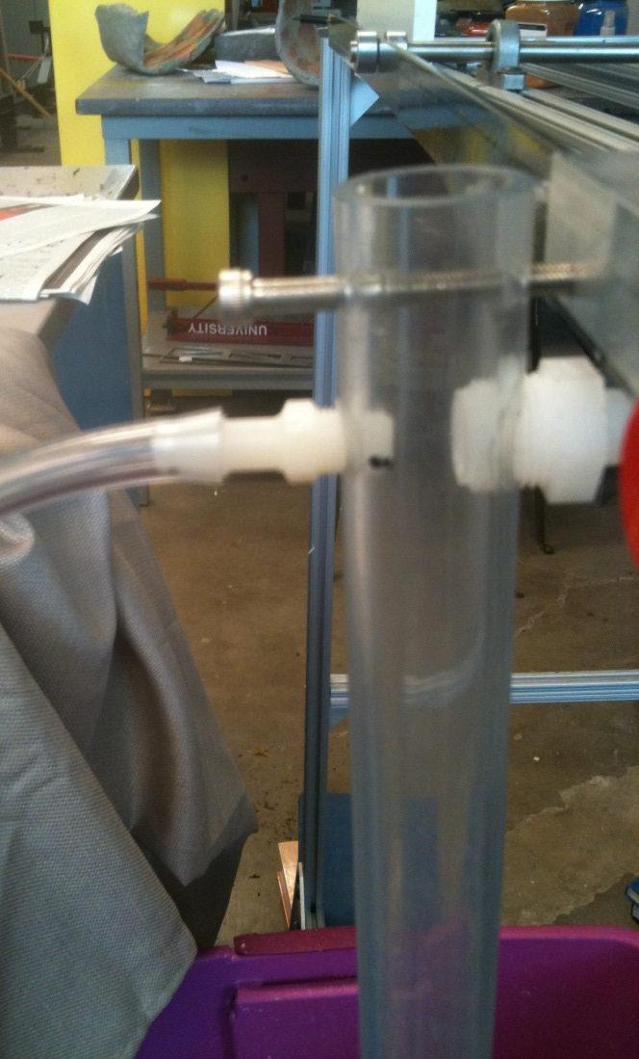
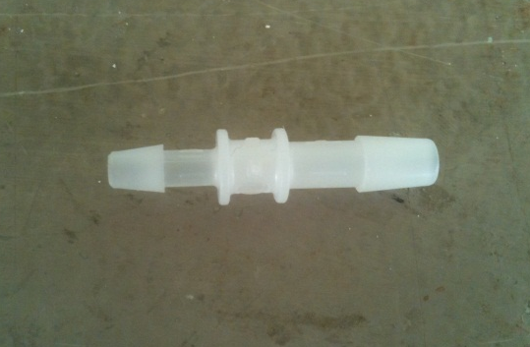
New Barbed Fittings to be Tested
Make Minor Losses Even Smaller!
  Use ¼” ID tubing as the connector (Factor of 16)
  New barbed fitting for drop tube that can be retrofitted due to threading
  Reducing barbed fitting;
  3/16” ID to 1/4” ID
3/16”
1/4”
1/2”
3/16” to 1/4”
Notes:
Previous LCDC teams had assumed kinematic viscosity equal to water (1 mm² /s). However in the summer it was determined that kinematic viscosity increases with coagulant concentration. The results found by the Summer 2011 team indicate that for coagulant concentrations above 100 gm/L, the kinematic viscosity cannot be assumed to be approximately equal to that of water. Kinematic viscosity must be taken into account when predicting chemical flows rates through the LCDC system.

Slide 20
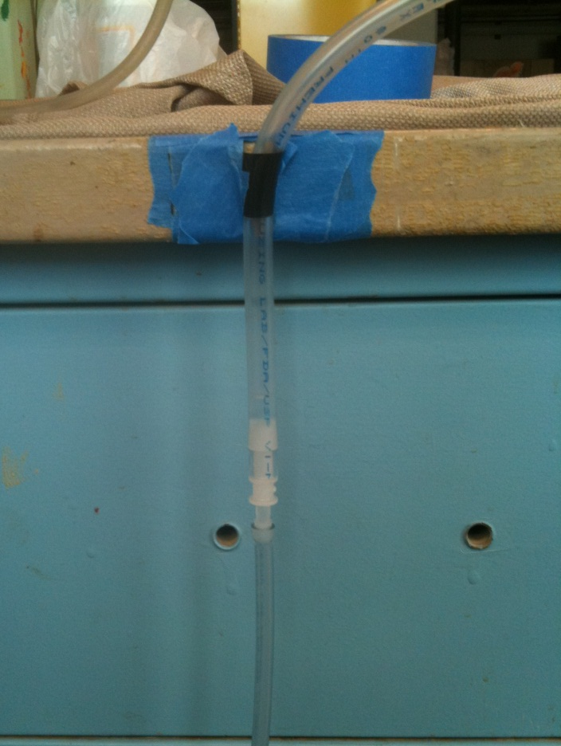
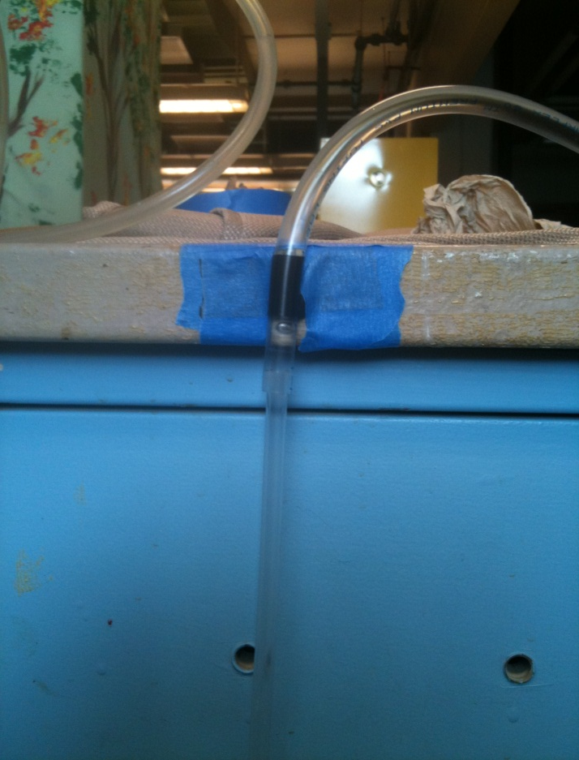
¼” ID Tubing With and Without Reducing Barbed Fitting
Both setups have the weight variable added to them, since it always makes a positive change in the k-value. This reducing fitting was chosen because there are no readily available reducing barbed fittings
for a tubing change of 3/16” ID to 1/2” ID.
Notes:
Previous LCDC teams had assumed kinematic viscosity equal to water (1 mm² /s). However in the summer it was determined that kinematic viscosity increases with coagulant concentration. The results found by the Summer 2011 team indicate that for coagulant concentrations above 100 gm/L, the kinematic viscosity cannot be assumed to be approximately equal to that of water. Kinematic viscosity must be taken into account when predicting chemical flows rates through the LCDC system.

Slide 21
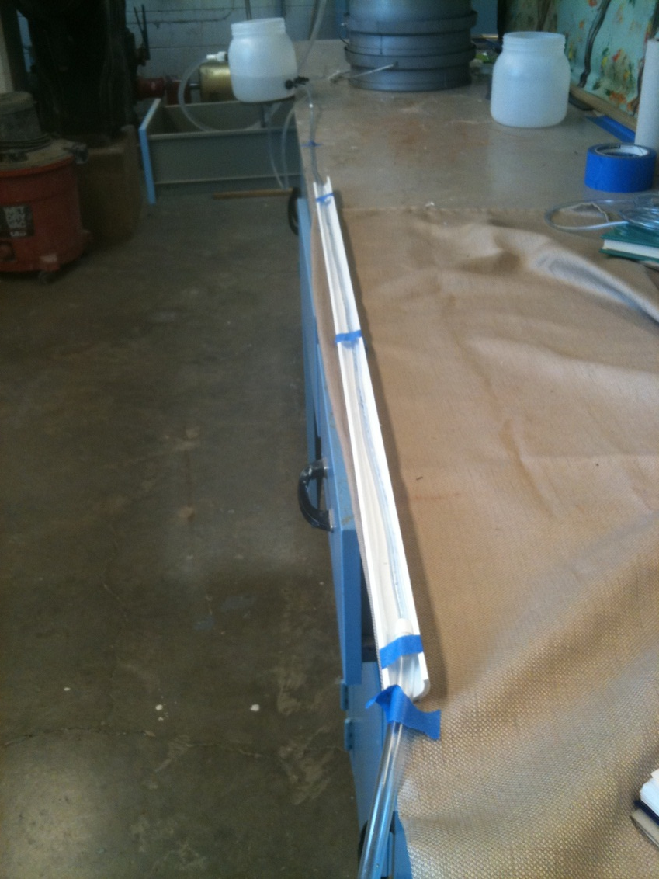
Straight Tubing With ½” Tube Connection
Attaching the ½” ID tubing to the straight tubing, is it plausible?
  PVC was not long enough to contain entire tube length
  Curvature was present in tubing
  Could never be used in Honduras; at the shortest length it is almost 2m long
Notes:
Previous LCDC teams had assumed kinematic viscosity equal to water (1 mm² /s). However in the summer it was determined that kinematic viscosity increases with coagulant concentration. The results found by the Summer 2011 team indicate that for coagulant concentrations above 100 gm/L, the kinematic viscosity cannot be assumed to be approximately equal to that of water. Kinematic viscosity must be taken into account when predicting chemical flows rates through the LCDC system.

Slide 22
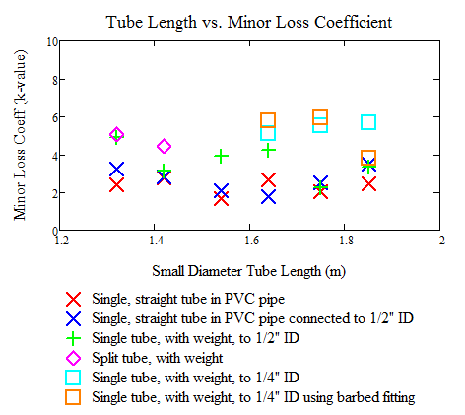
CDC Experimental Results
Addition of larger ID tube to straight tube in PVC did not have a marked decrease in k-value, seemed to increase because of difficulty keeping tube length straight (2.5m+ length)
Use of new reducing barbed fitting!
Minor errors were found in the ¼” ID tests due to calibration errors, thus were re-run with a more significant decrease in k-value (next slide)
Notes:
The straight tube is considered the “best” setup available, giving a close to linear chemical flow and also having the smallest k-value present

Slide 23
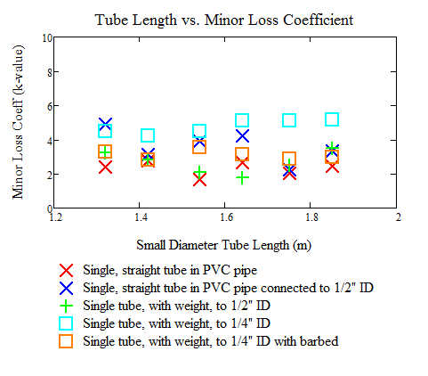
CDC Experimental Results
More new k-data!
When re-run, the ¼” experimental results showed results consistent with the theory
Reducing barbed fitting had k-value all under 4, with an average k-vale of 3.107
The barbed fitting reduces k-value by approximately 35%
Notes:
Previous LCDC teams had assumed kinematic viscosity equal to water (1 mm² /s). However in the summer it was determined that kinematic viscosity increases with coagulant concentration. The results found by the Summer 2011 team indicate that for coagulant concentrations above 100 gm/L, the kinematic viscosity cannot be assumed to be approximately equal to that of water. Kinematic viscosity must be taken into account when predicting chemical flows rates through the LCDC system.

Slide 24
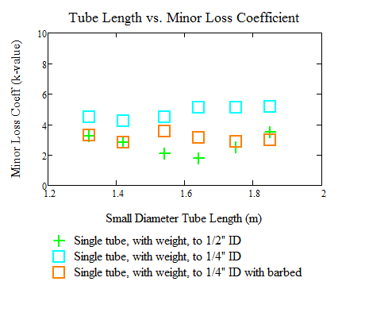
Important Variable Data
Simplified view of previous graph
Single tube with weight is still the “best” of the setups, but with no barbed fitting safety is an issue
Snugness of fit is not a viable reason to use to the 1/8” ID to 1/2”, and thus a barbed fitting is needed
There is no reducer currently on the market that has a barbed fitting with both a 1/2” ID barbed fitting and 3/16” ID barbed fitting
3/16” ID to 1/4” is available, and has good results, so it will be used
Notes:
Previous LCDC teams had assumed kinematic viscosity equal to water (1 mm² /s). However in the summer it was determined that kinematic viscosity increases with coagulant concentration. The results found by the Summer 2011 team indicate that for coagulant concentrations above 100 gm/L, the kinematic viscosity cannot be assumed to be approximately equal to that of water. Kinematic viscosity must be taken into account when predicting chemical flows rates through the LCDC system.

Slide 25

Final Design: Use this!
  Reduce horizontal distance by using a base connection to the CHT
  Reduce the minor loss coefficient (k) by reducing curvature with weight
  Using a barbed fitting is always better then shoving one tube into another!
Bring new barbed fittings (drop tube and reducing fittings) to Honduras in January 2012 trip, and retrofit to LCDC’s currently in use

Slide 26
Future Team Work (Spring 2012)
Continue testing horizontal setup, replace push-to-connect with tested 3/16” barbed fittings
Research a 100gm weight that can be easily obtained in Honduras that can also be clipped on tube while it’s in use
Coagulant testing was not done this semester, so the coagulant data used in MathCad could be incorrect. Also a wider range of concentrations should be tested
Deposit build up in the float valve orifice is a problem. This could possibly be controlled by float valve submersion. This setup should be tested in lab to see if flow is affected
See if k-value is consistent if multiple tubes are being used
Notes:
They will be tested with longer segments/sections of tubing to see if the k-value varies widely with each tube length increase. Again, this will show a trend in k-value increase or decrease
The dosers that are used for chlorine all look terrible in Honduras because of small chlorine leaks. We need to improve plumbing connections that will completely eliminate leaks and be easy to clean and maintain.
Include price, unit number and McMaster Carr ID#. This will be necessary to practice how part ordering would be done in an AguaClara plant in Honduras.

Slide 27

Thank you
Questions?
Notes:
-minor loss modeling through the CDC system
Adding a reducer to allow us to connect more than 3 small diameter tubes
Building one of the chlorine flow controllers we mentioned earlier
Developing an easy way to calibrate the CDC in the field

