Slide 1
Chemical Dose Controller
Annie Cashon
Jeanette Liu
Saugat Ghimire

Slide 2
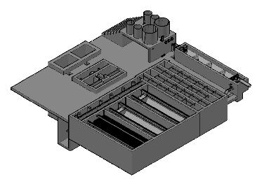
Background
Purpose: To dose coagulant prior to flocculation and to dose chlorine prior to water leaving the plant
Location within an AguaClara Plant

Slide 3
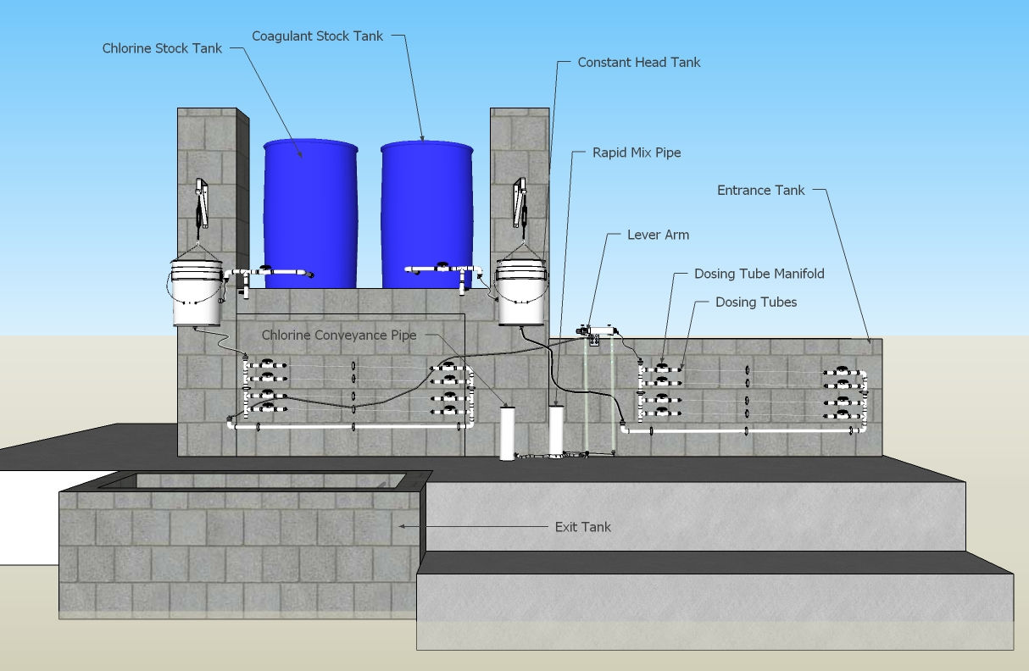
Plant Setup

Slide 4
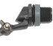
Constant head tank
Stock Tank of coagulant
Lever
Slider
H
Float valve
LFOM
Open channel supercritical flow
Drop tube
Float
Dosing tubes
Purge valves
Notes:
This is a basic schematic of what research and design teams have come up with after many years of work. The stock tank holds a stock chemical solution which is connected to a constant head tank. The constant head tank is regulated by a float valve which keeps the chemical depth constant. A large diameter tube leads from the stock tank to one or more small diameter long straight dosing tubes. A large diameter flexible leads to a drop tube with “open channel super critical flow”, where the chemical flows to be added to the plant’s influent water. The drop tube is connected to a lever via a slider. The plant operator sets the slider at the desired coagulant dose based upon characteristics of the influent water. The float attached to the lever changes position as flow rate into the plant changes, thus changing the elevation of the large diameter tube’s outlet, and maintaining a constant chemical dose.

Slide 5
Types of Lever-arm
Half-sized
  Single
  Double
Full-sized
  Single
  Double

Slide 6
What We’ve Done

Slide 7
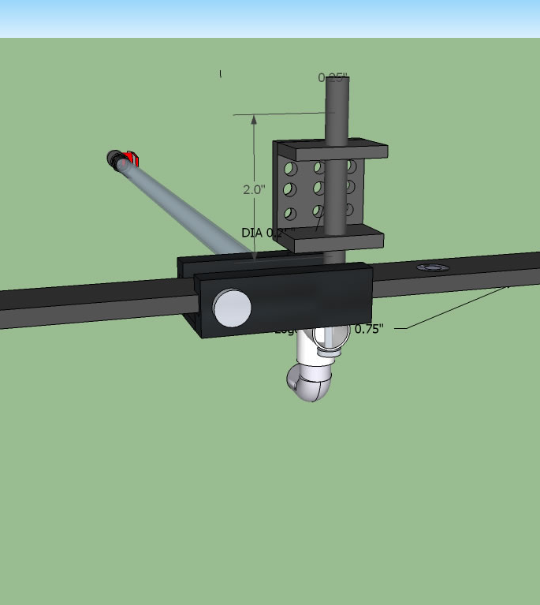
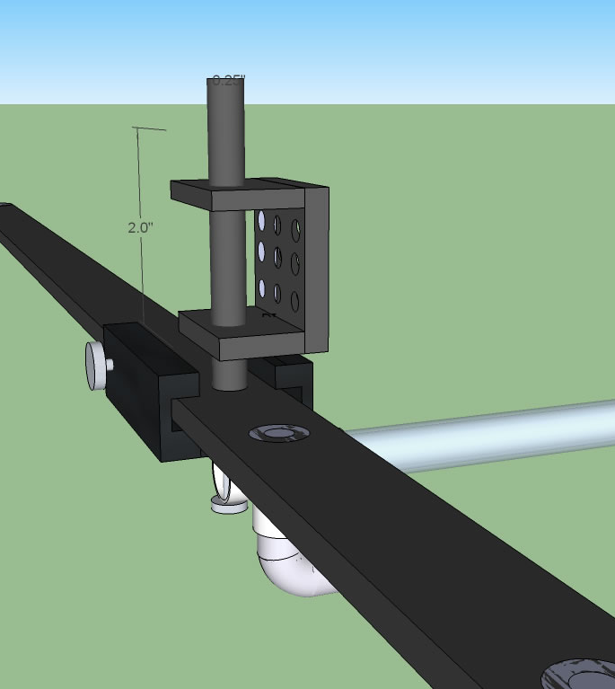
Single Lever Arm

Slide 8
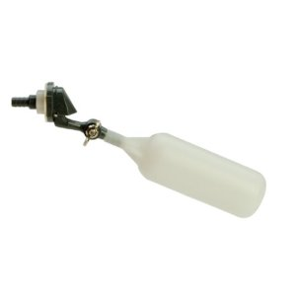
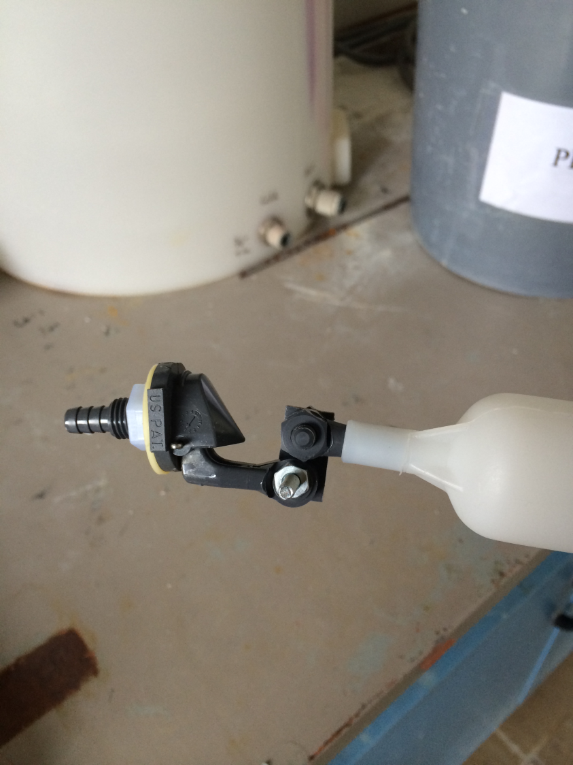
Float Valve

Slide 9
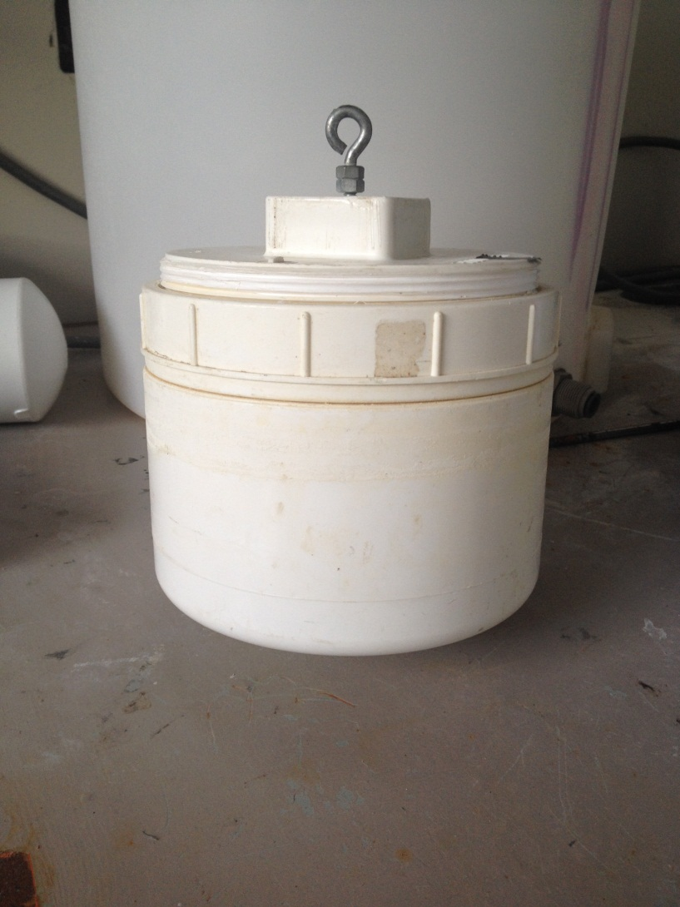
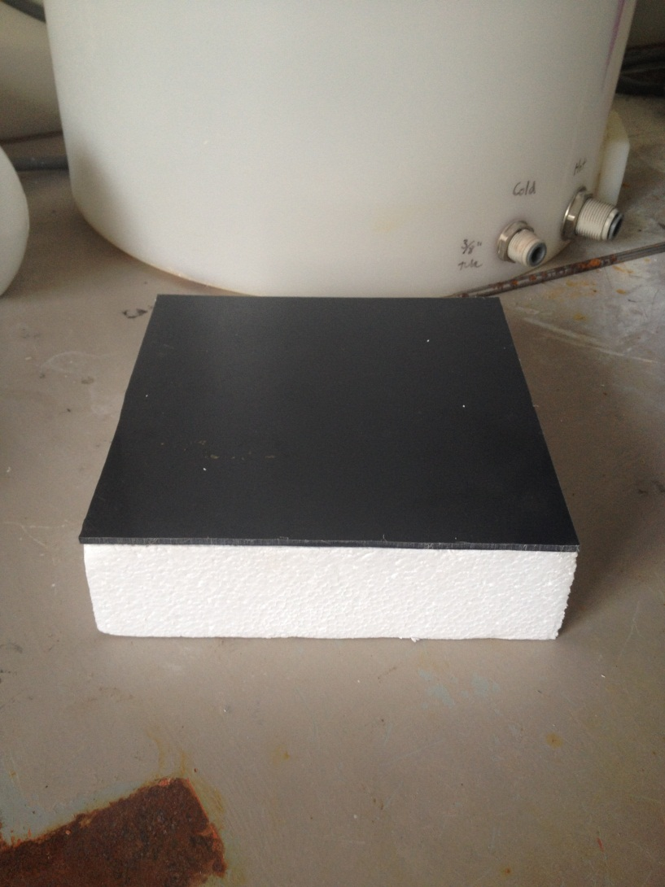
Float

Slide 10
What We’re Going to Do
Develop a method to remove air from the dosing tubes easily.
Demonstrate that the calibration procedure is easy.
Determine the flow range for the mini float valve and then design for higher flow rates using a larger float valve.
Locate tubing connectors that are chlorine resistant from constant head tank to rapid mix.

Slide 11
Questions For You!
How can we replace the metal pin in the float valve?
What materials could we use for the float that would be more durable than foam?

Slide 12
Questions?

