Slide 1

Chemical Dose Controller
[The Fall 2016 Chemical Dose Controller sub-team has been working on a modular constant head tank design. The presentation will review the last two semester’s designs and compare them to this semester’s design, focusing on modularity and construction. More information on this subject can be found on the Chemical Dose Controller Team AguaClara wiki page.
Fabrication | Symposium Presentation Fall 2016
Notes:
The Linear Chemical Dose Controller (CDC) system was designed to maintain a constant chemical dose to the treatment train as the plant flow rate changes. Past CDC teams worked on improving the design of the Constant Head Tank (CHT), and making the CDC system modular. This semester the CDC team will be redesigning the CHTs so that all four tanks are connected to each other, and so that the calibration columns are attached to the CHT module. Additionally, the team will be recreating and modifying the modular CDC system designed in past semesters.
Link to read only-report: https://www.overleaf.com/read/vzxkhyvyfchn

Slide 2
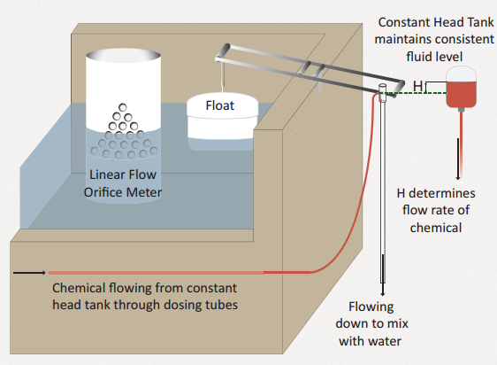
The CDC system regulates the flow of chemicals into the treatment train
Chemical Dose Controller | Fabrication | Final Presentation Spring 2016
Notes:
The Chemical Dose Controller (CDC) system in AguaClara water treatment plants automatically controls the chemical dosage entering the treatment train. An integral part of the CDC system is the Constant Head Tank (CHT), which contains chemical solutions of either coagulant or chlorine which dose the raw water entering the plant. CHTs are designed such that the flow of chemicals leaving the CHT is controlled only by the elevation difference between the free surface in the CHT and the dosing tube exit that is open to the atmosphere.
This elevation difference can change in two ways: (1) The operator slides the end of the dosing tube along the lever arm to set the dose. (2) The plant flow rate changes, causing a corresponding change in the entrance tank water level that in turn lifts the float and changes the inclination of the lever arm. This system automatically controls the chemical flow rate based on the influent plant flow rate (Castro et al., 2013).
Figure Caption: A schematic of the Chemical Dose Control (CDC) system. The chemical flow rate into the treatment train is automatically controlled based on the elevation difference between the free surface in the CHT and the dosing tube level which is linearly correlated with water level in the Entrance Tank by a Linear Flow Orifice Meter

Slide 3
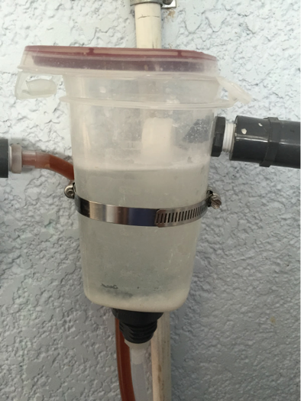
Current Implementation is not chlorine resistant
Chemical Dose Controller | Fabrication | Symposium Presentation Fall 2016
Notes:
The current implementation of the CHT in Honduras is a re-purposed Tupperware container. The tubing at the inlet of the container, shown at the right side, connects the chemical feed stock and the custom float valve. To the left is the outlet tube, which transports chemicals from the CHT to the lever arm.
At the bottom of the CHT is the drain tube, which serves maintenance purposes. When sediment, namely calcium carbonate, builds up and settles at the base of the CHT, the CHT is taken off line and flushed with vinegar to clear off the calcium deposits. At this point, the inlet and outlet tubes are closed off and the drain tube is open to clean out the tank.
Although the CHT in the figure above uses locally available materials, the Tupperware is not chlorine resistant and must be replaced periodically. Additionally, there is sediment build up on the sides of the tank that will not be completely solved by the drain.

Slide 4
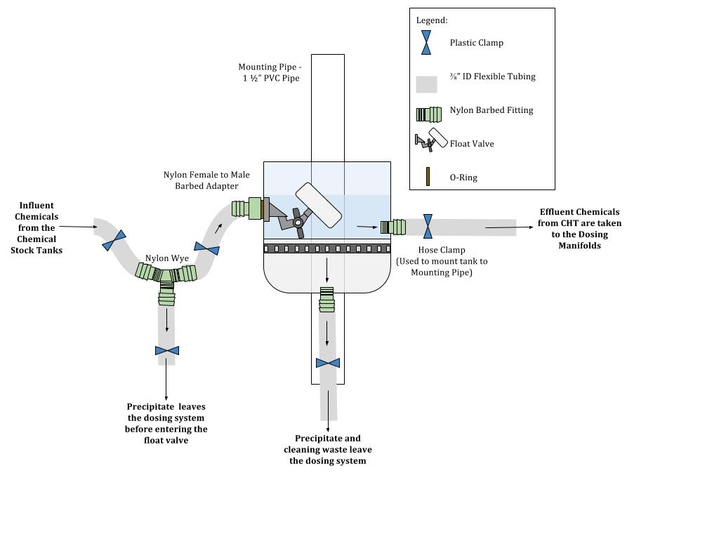
Next design for Las Vegas is not modular and requires modified floats
Chemical Dose Controller | Fabrication | Symposium Presentation Fall 2016
Notes:
In Spring 2016, the design of the constant head tank was created from large diameter PVC pipe. This design, shown in the figure above, solves the issue of periodic tank replacement since the PVC is fairly resistant to chlorine oxidizing effects. The design still implements the custom made float valves, which are shorter in length than the manufacturer made ones. The bottom of the PVC pipe tank is a fitted pipe cap that is drilled through to make room for the drain valve. The rounded nature of this CHT design's bottom resolves some of the issue of sediment build up and aids in simple maintenance.
the fabrication of this CHT is very easy compared to the necessary welding to fabricate the Fall 16 design of the CHT. However, the non modular nature of this design is a demerit that is addressed by Fall 16.
Additionally, the use of tubing clamps is not ideal as the clamps permanently deform the tubing. In Fall 2016, the CDC team addresses this by using barbed valves instead which are a little more expensive but do not damage the tubing in anyway.

Slide 5
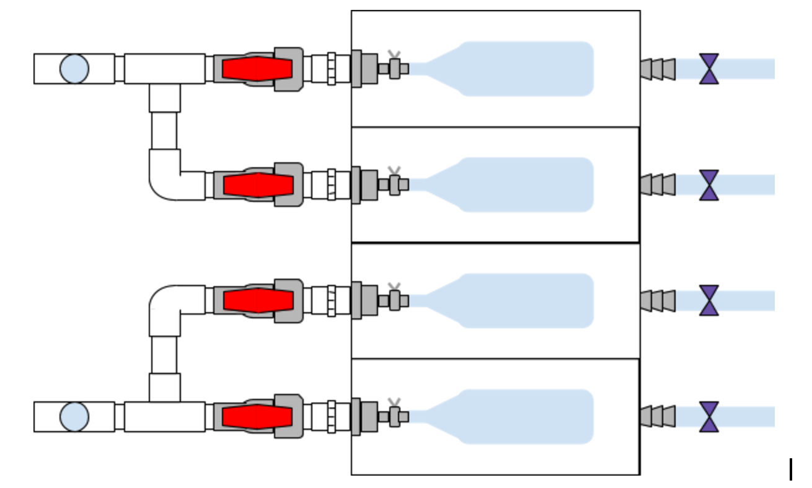
New design takes into account 5 parameters
Resistance to Chlorine
Ease of maintenance
Accommodation of original float valve
Size of PVC welder
Addition of calibration columns
Chemical Dose Controller | Fabrication | Symposium Presentation Fall 2016
Notes:
The design for the first iteration of the CHT is based on the following constraints:
1.Resistance to chlorine: The new CHT is made from PVC, so it will not degrade as quickly as the current tupperware CHT and therefore will not have to be replaced as often.
2.Ease of maintenance: In order to make maintenance of the CHT easier for plant operators, the new design has drainage tubing so that the tanks can be filled with vinegar for cleaning and then drained easily. Additionally, a spoon or spatula may need to be implemented to scrape precipitate out of the corners of the tanks.
3.Accommodation of original float valve: The current CHT design uses a modified version of the float valve, while the new design accommodates the original size of the float valve.
4.Size of PVC welder: The tank height is constrained by the size of the PVC welder, as the head of the welder needs to be able to fit inside each tank so that the corners can be properly welded.
5.Addition of calibration columns: The new CHT design incorporates the calibration columns into the module, making the CDC system more streamlined and easier to ship to Honduras.

Slide 6
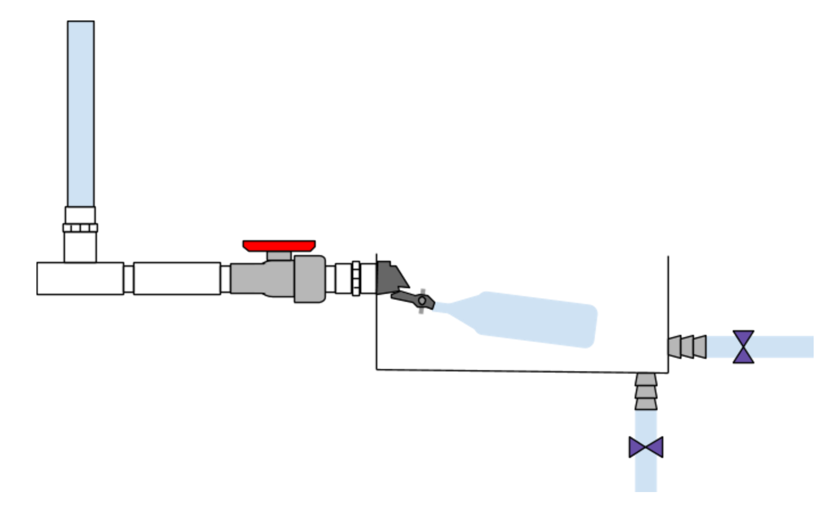
Pro: The current CHT design is modular and chlorine resistant
Chemical Dose Controller | Fabrication | Symposium Presentation Fall 2016
Notes:
The figure below shows a side view of the CHT design for the Fall 2016 semester. The influent water will flow through the calibration columns and pipes, into the tank, then out through the outflow tube. The drainage tube is not shown but will have the same layout as the outflow tubes.
From the single pipe that contains chlorine and diverts to the calibration column, the pipe splits into two pipes that are inlets to the constant head tank. The two pipes with the same chemical will have valves on them so only one needs to be in use at a time. This allows one constant head tank to be taken offline for maintenance while another is still functional. The calibration column and offset layout are chosen because of sizing constraints due to the pipe size and the tank compartment width.
An issue with the previous design is that the four CHTs were not constrained to one another, so when the plant operator took one down for maintenance and placed it back, it could be at a different height, giving a different head loss for each CHT.

Slide 7
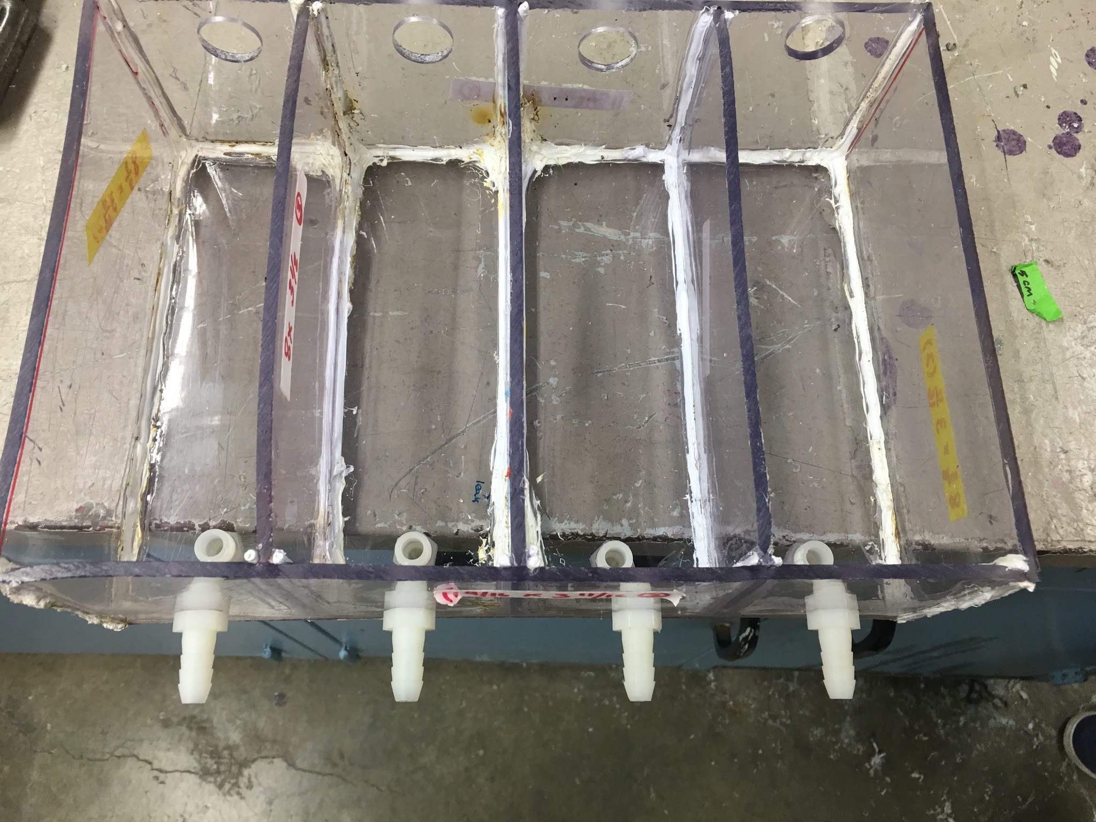
Con: The current CHT design requires a lot of welding
Either there will be:
Need for a welding tool in Honduras
Train a welder
Or
Fabrication will continue in US
Chemical Dose Controller | Fabrication | Symposium Presentation Fall 2016
Notes:
The welding of the tank is very time consuming and with the team exerted a lot of effort and time going over the corners in each tank to ensure a watertight seal.
Figure caption: The new design for the constant head tank requires a lot of precision welding. The corners need to be welded multiple times to ensure a watertight seal.

Slide 8
Problems Identified
Compared to the current CHT design,
Fabrication is more difficult and time consuming
  PVC welding is difficult and requires practice
  Watertight seals are difficult to obtain
Cost of fabrication is much higher
More fittings leaves more room for error
  Fittings can more easily be misplaced/lost
  Increased risk of failure
Chemical Dose Controller | Fabrication | Symposium Presentation Fall 2016

Slide 9
Regular Operation
Inlet valve is open
Effluent flows through exit valve
Drain valve is closed
Chemical Dose Controller | Fabrication | Symposium Presentation Fall 2016
Notes:
From our report on Overleaf:
The figure below shows a top view of the CHT design for the Fall 2016 semester. The influent water will flow through the calibration columns and pipes, into the tank, then out through the ouflow tube. The drainage tube is not shown but will have the same layout as the outflow tubes.
From the single pipe that contains chlorine and diverts to the calibration column, the pipe splits into two pipes that are inlets to the constant head tank. The two pipes with the same chemical will have valves on them so only one needs to be in use at a time. This allows one constant head tank to be taken off line for maintenance while another runs functional. The calibration column and offset layout are chosen because of sizing constraints due to the pipe size and the tank compartment width.

Slide 10
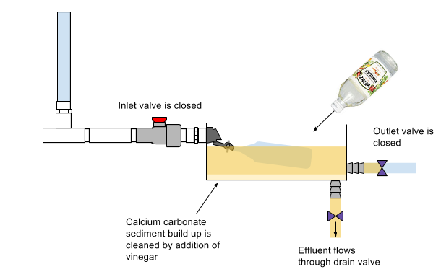
Operators will clean with vinegar
Chemical Dose Controller | Fabrication | Symposium Presentation Fall 2016
Notes:
Cite your sources here.
Caption your figure and explain its relevance to your presentation/thesis here. You can take the caption from your Final Report and modify it.
Write a summary of this slide here. A future team member or client should be able to read this note and understand this slide without having your team explain it to them.
If there are any appendix slides that are relevant to this slide, mention it in your notes.

Slide 11
Operation of calibration column
Inlet valve is closed
Exit valve is closed
Due to the inlet valve being closed, chemical rises in the calibration column (driven by head loss from stock tanks to CHT). Plant operators record the time it takes the chemical to decrease a certain amount, and from that determine the flow rate of chemicals into the plant.
Drain valve is closed
Chemical Dose Controller | Fabrication | Symposium Presentation Fall 2016

Slide 12
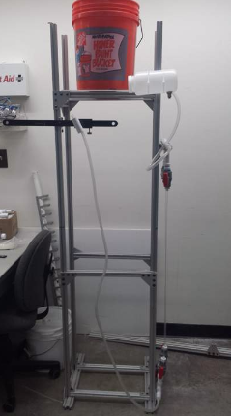
Future Work
Construction of adjustable shelf for the
CHT
Testing of calibration columns
Implementation in future AguaClara
treatment plants
Chemical Dose Controller | Fabrication | Symposium Presentation Fall 2016
Notes:
After a talk with Ethan and Skyler in Honduras, the CDC team has decided to incorporate an adjustable shelf system, which has still yet to be designed and fabricated.An adjustable shelf design is preferred to permanently mounting it somewhere in the plant because there will likely be error in placement in the inital set up.
The figure shown above is the CDC system with an adjustable shelf from the Fall 15 semester.
If this design is taken into practice, fabrication will need to keep occurring in the AguaClara lab in the US unless a PVC welder is sent to Honduras.

Slide 13
Questions
and
Recommendations
Cynthia Chan
B.S. Environmental Engineering
cc2467@cornell.edu
Anna Doyle
B.S. Environmental Engineering
ard73@cornell.edu
Ashish Sangai
B.S. Chemical Engineering
aas298@cornell.edu
Chemical Dose Controller | Fabrication | Symposium Presentation Fall 2016

Slide 14
Appendix Slides
Chemical Dose Controller | Fabrication | Symposium Presentation Fall 2016
Notes:
From this point on, add any slides with figures that will help support your thesis. You might pull these figures from your Final Report.

Slide 15
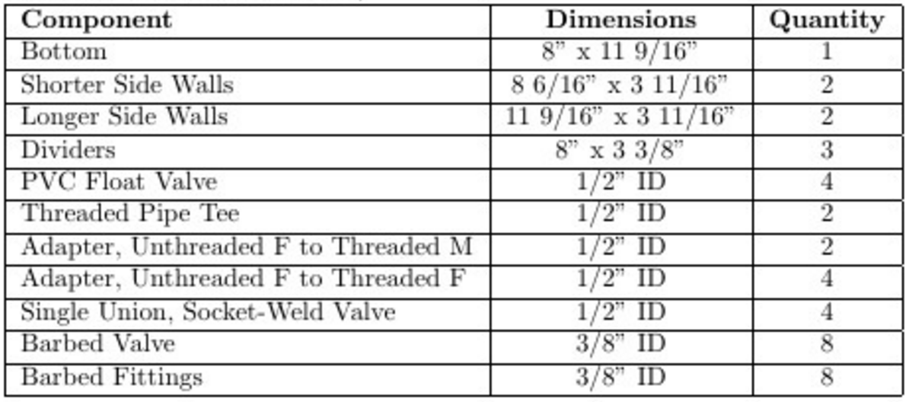
Fabrication Materials for First Iteration Tank Design (available from McMaster-Carr and US Plastic)
Chemical Dose Controller | Fabrication| Symposium Presentation Fall 2016
Notes:
Cite your sources here.
Caption your figure and explain its relevance to your presentation/thesis here. You can take the caption from your Final Report and modify it.
Write a summary of this slide here. A future team member or client should be able to read this note and understand this slide without having your team explain it to them.

