Slide 1

Chemical Dose Controller
Annie Cashon,
Christine Leu,
Auggie Longo
Notes:
Annie

Slide 2
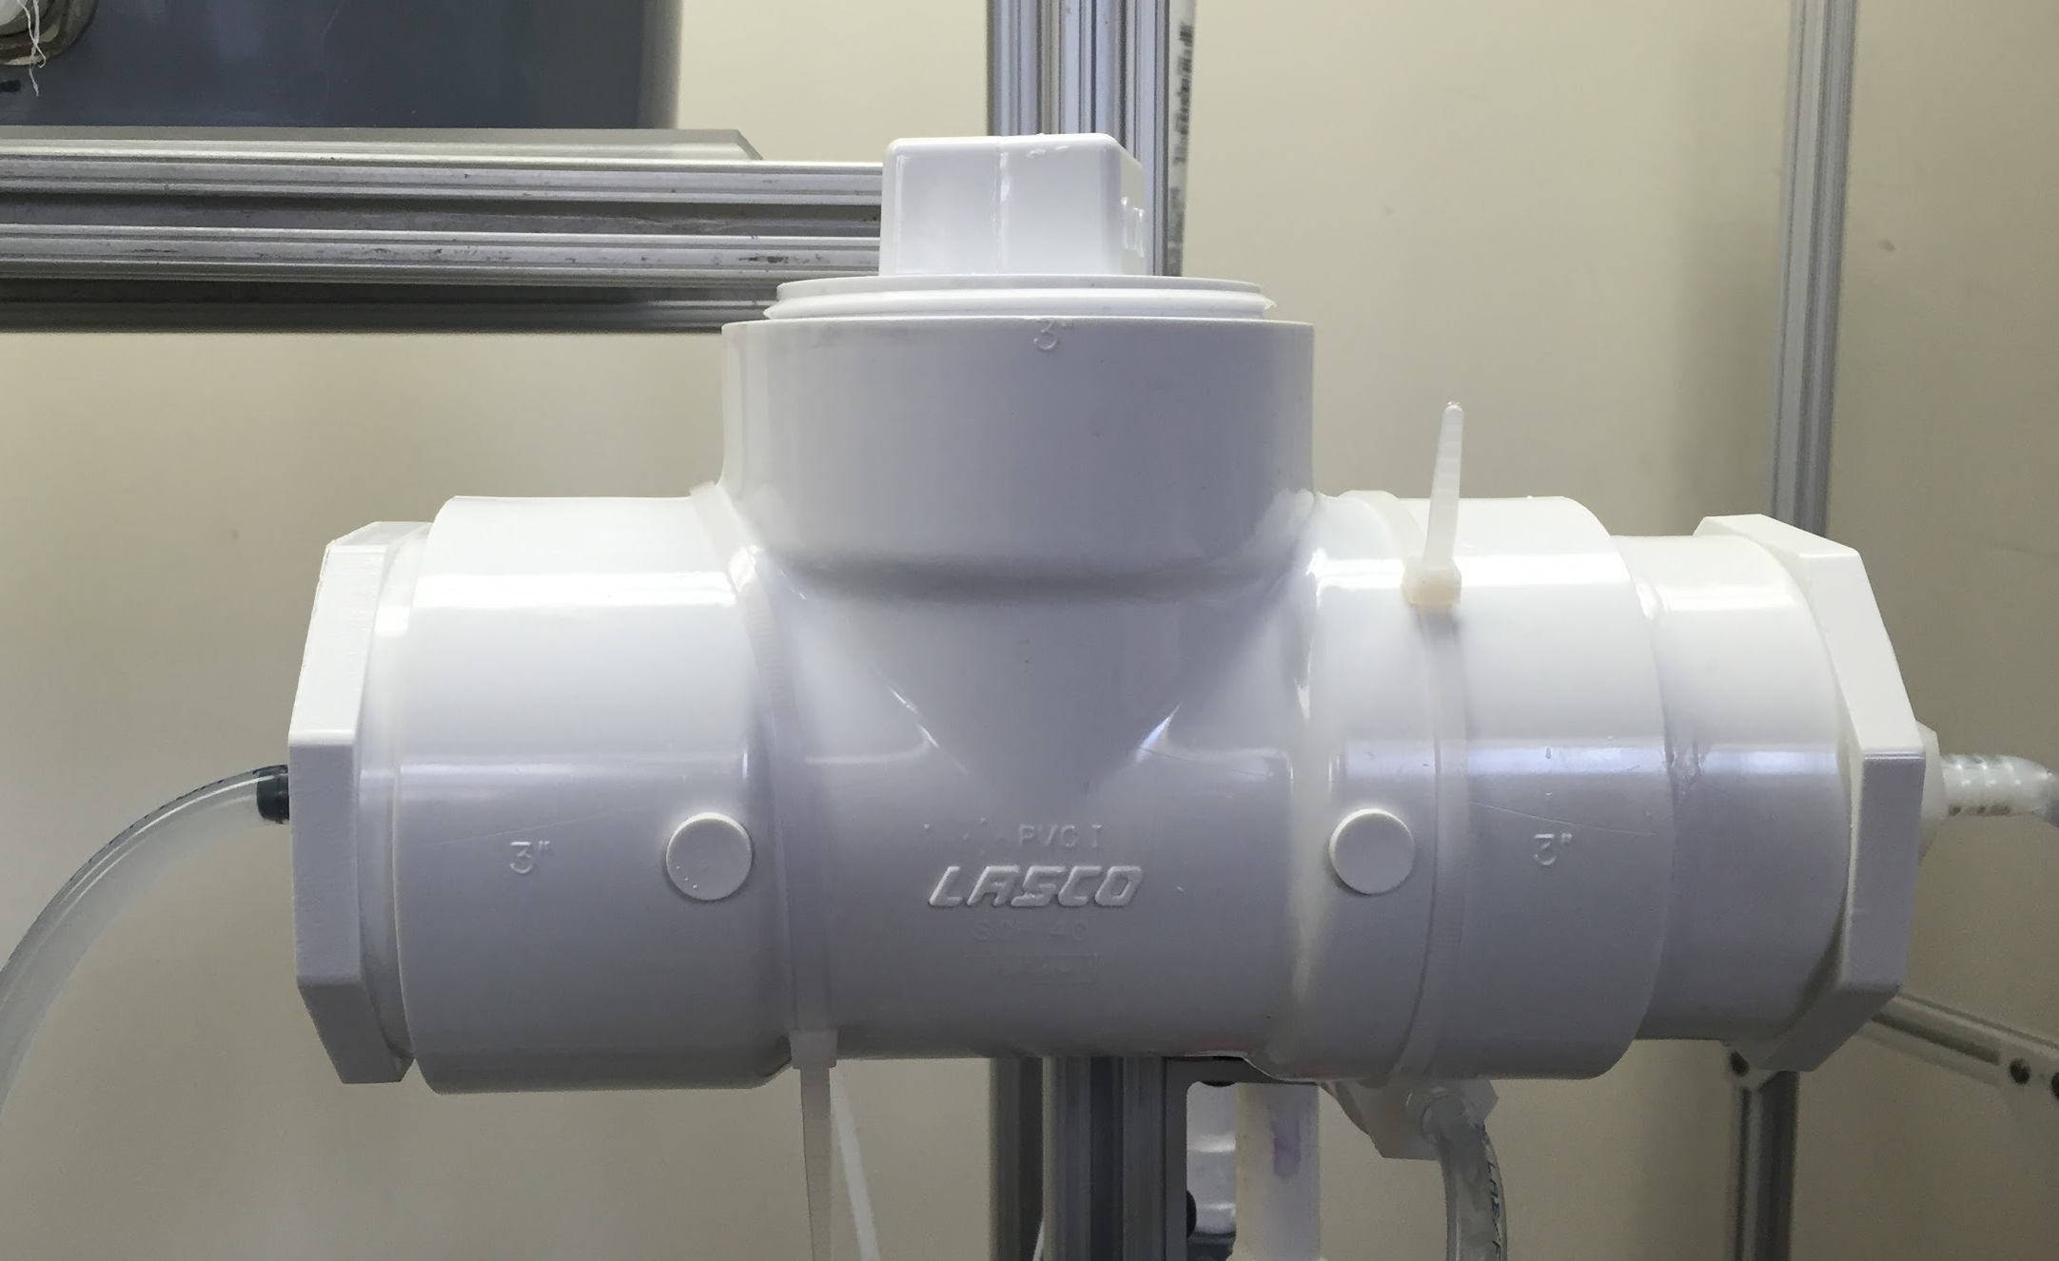
Constant Head Tank
Design criteria
  Chlorine resistance
  Transparent
  Stratification control
  Locally-sourced
  Easy cleaning/maintenance
Future designs

Slide 3
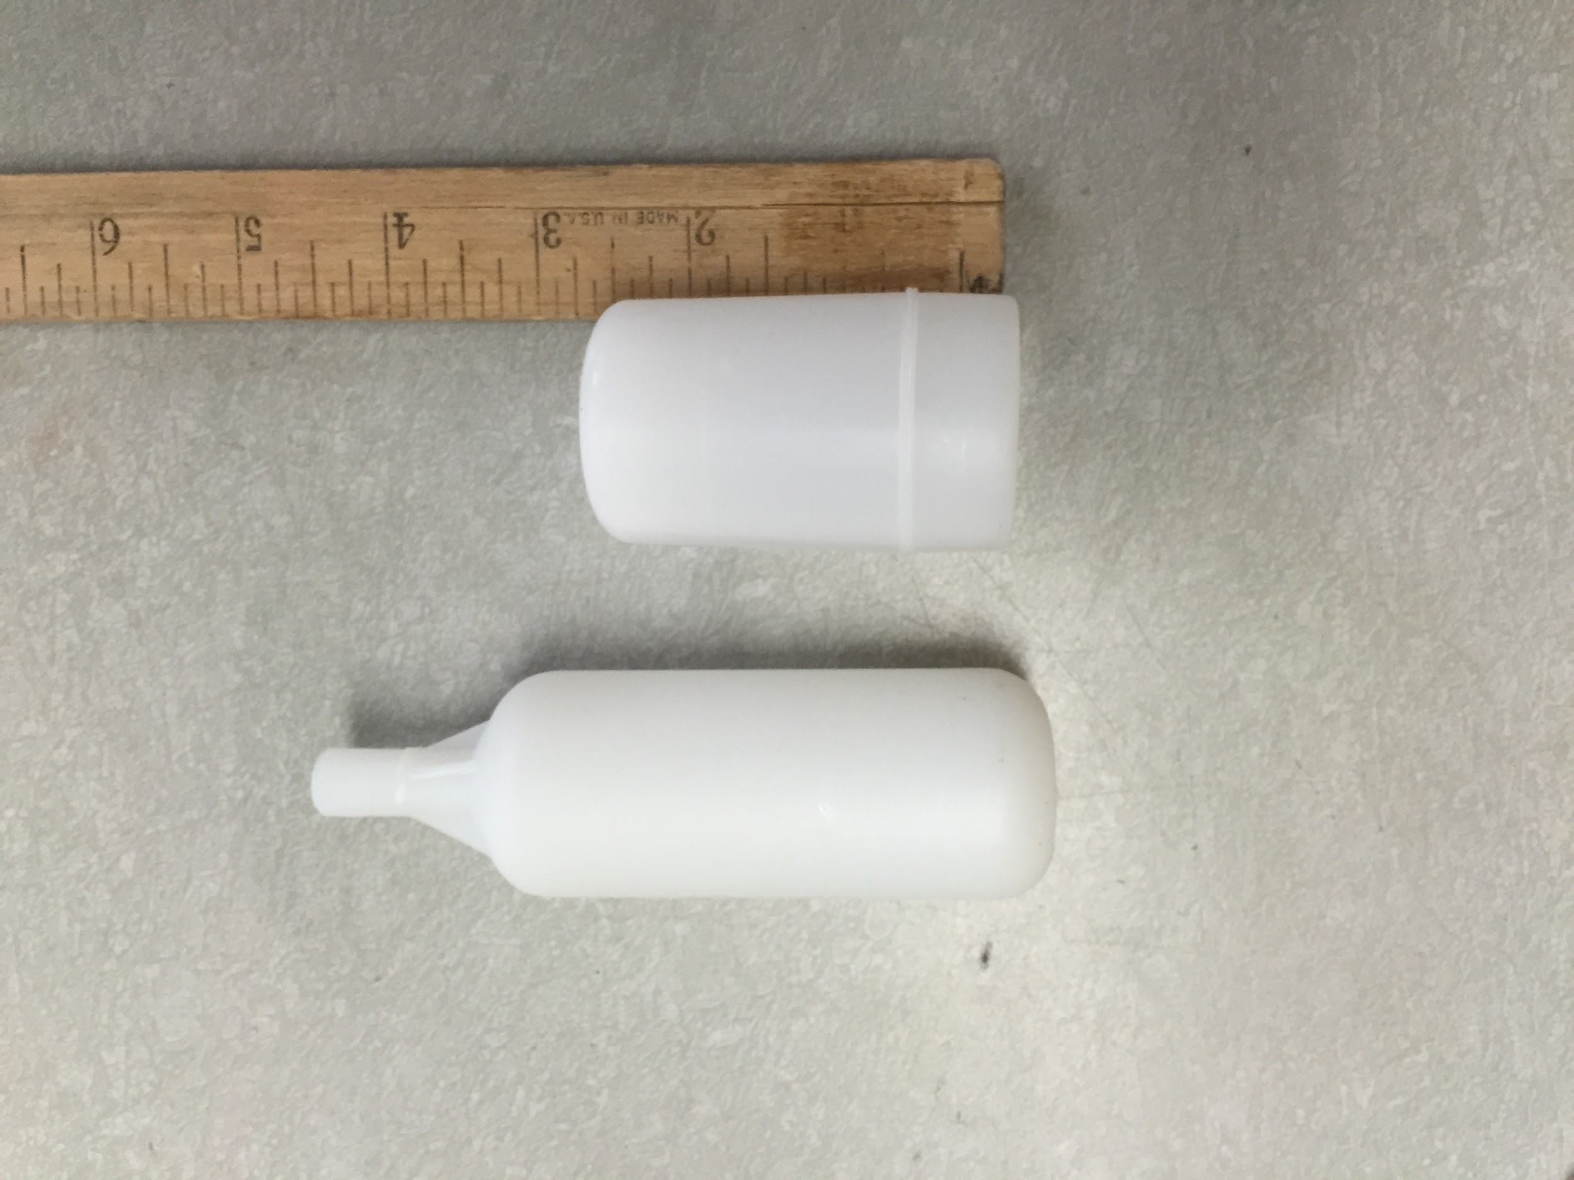
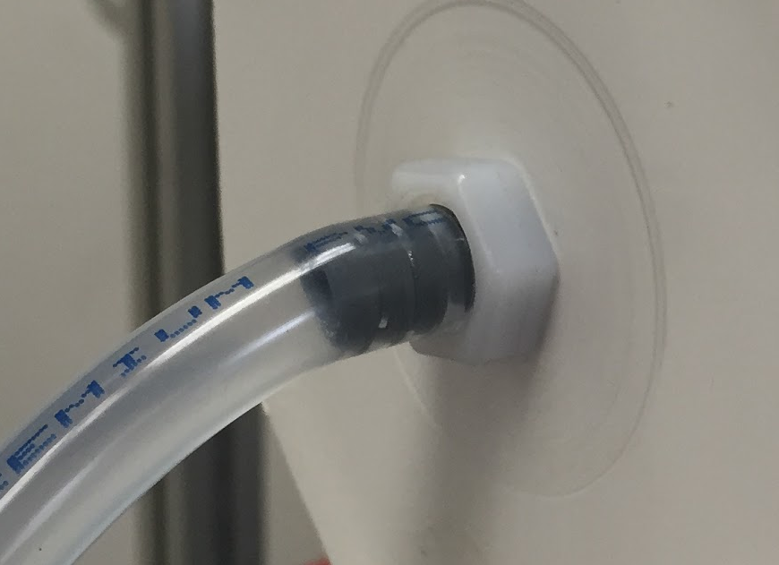
Mini Float-Valve
Ease of removal from CHT
  Unthreaded attachment
  Smaller size
Linearity during testing

Slide 4
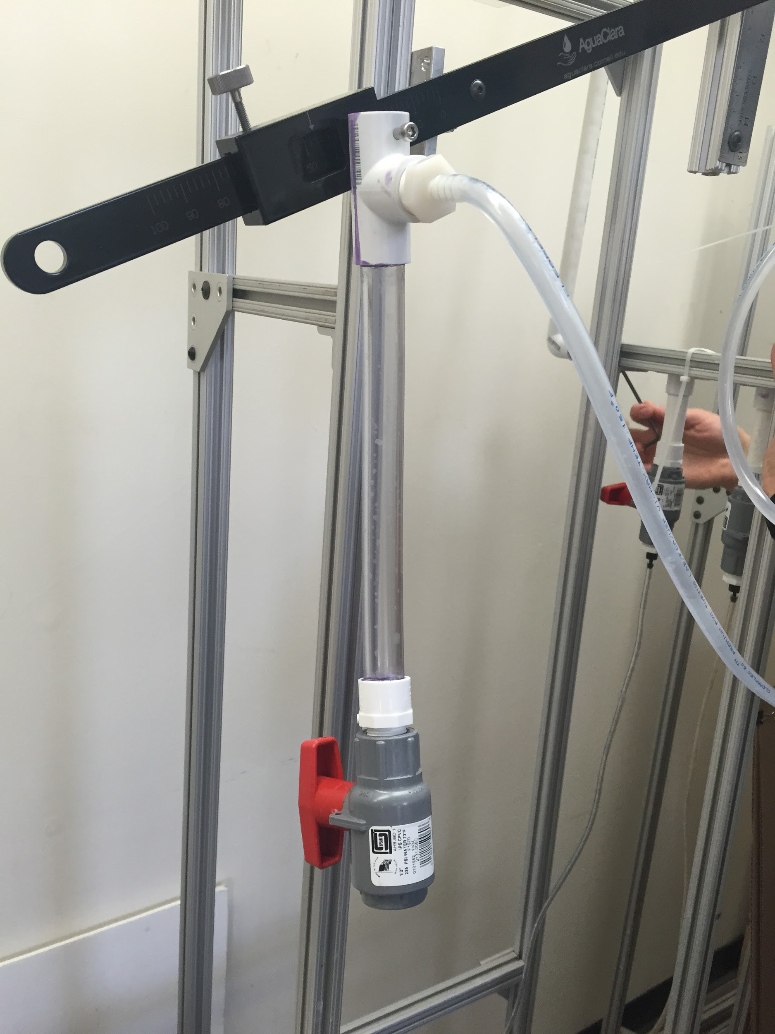
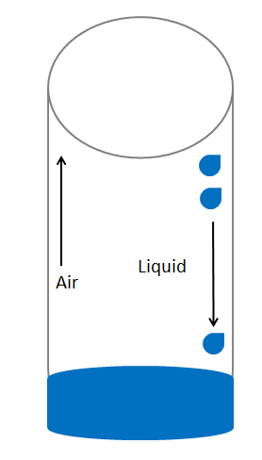
Flexible Drop-tube Unit
Removal of calibration column
“Free fall”
Minimum length
Feasibility of flex-tubing

Slide 5
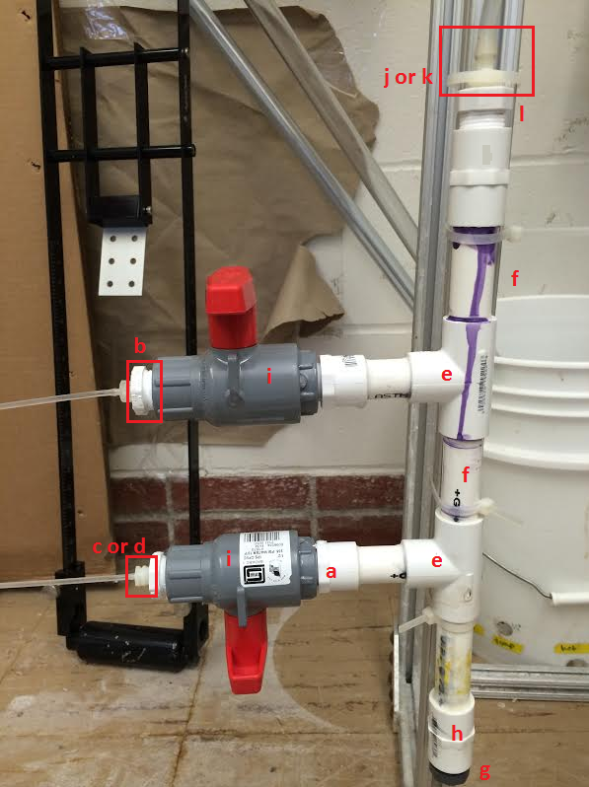
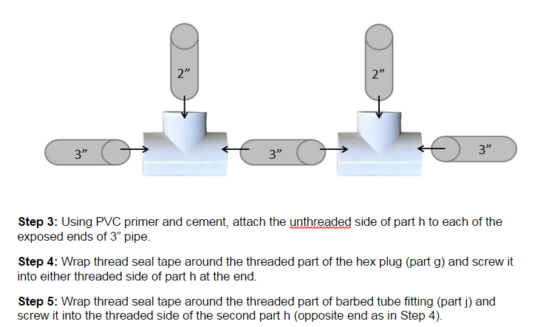
Set-up Manual
1. Label diagrams with item references
2. Step-by-step assembly instructions

Slide 6
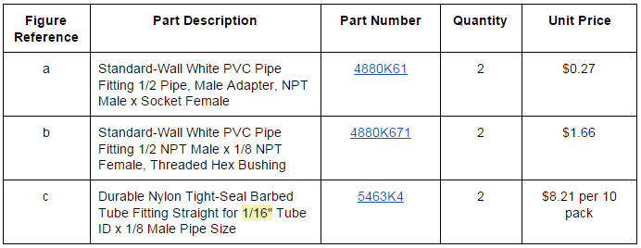
Set-up Manual
3. Table of parts and item numbers

Slide 7





MathCAD Equations
Notes:
Looking into mathcad equations to standardized the system for making packages.
Given a plant flow, output stuff
Looked at different equations that given a set of parameters, outputs Length, diameter and number of tubes for the manifold through a system of equations

Slide 8
Plant Flow Rates
Range from 6-32 L/s
Plant Location | Flow Rate (L/s)
Ojojona | 6
Tamara | 12
Marcala | 30
Cuatro Comunidades | 6
Agalteca | 6
Marcala Expansion | 22
Aluaca | 12
Atima | 16
San Nicolas | 32
Notes:
Want to accomadate all plants that range from 5 to 35

Slide 9
Mathcad Equations Used
Unstandardized
Lengths too long
Larger diameter gives too much error
Inverse relationship
Q.plant (L/s) | Length of Tubes (m) | Number of Tubes | Diameter (in)
1 | 1.141 | 1 | 1/16
5 | 0.445 | 2 | 1/16
10 | 1.781 | 1 | 1/8
15 | 1.141 | 1 | 1/8
20 | 1.781 | 2 | 1/8
25 | 2.582 | 1 | 3/16
30 | 2.936 | 1 | 3/16
35 | 2.468 | 1 | 3/16
40 | 2.109 | 1 | 3/16
Notes:
making stuff from 1 to 40
Through the formulas, the table was developed, very unstandardized.
Length is too long, want to standardize it, bigger diameter more error, longer length
Spatial efficieny vs accuracy in tubing

Slide 10
Standardizing the CDC
Set a diameter and length
Only change is number of tubes
Plant Flow Rate (L/s) | Diameter (in) | Length (m) | # of tubes
0-12 | 1/8 | 0.7 | 1
13-24 | 1/8 | 0.7 | 2
25-36 | 1/8 | 0.7 | 3
Notes:
Want to make it so theres a set length and diameter and only change the number of tubes
Found the minimum length is around .7 with 1/8 10% error, one tube accomidates 12 L/s

Slide 11
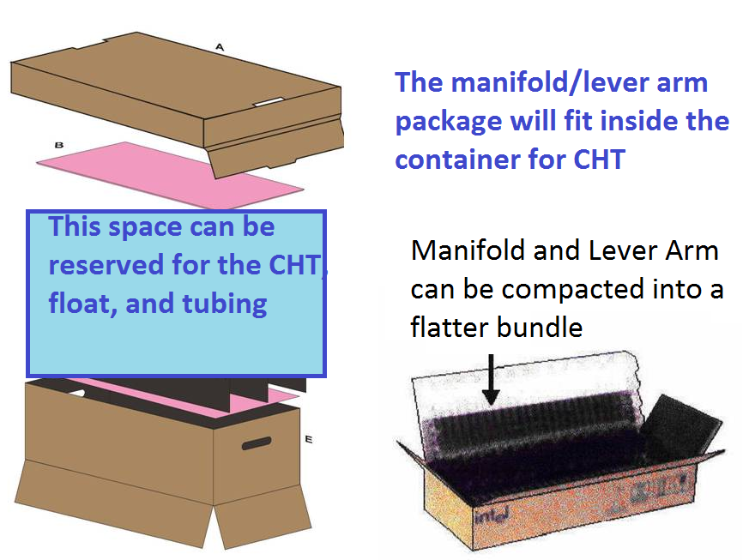
Packages and Future Work
Make CDC packages for different flow rates
Test MathCad hypotheses
Notes:
Testing this hypothesis will help to see if we can use this idea in the plants
If we standardize it, it will make it a lot easier for current and future plants to get systems.

Slide 12
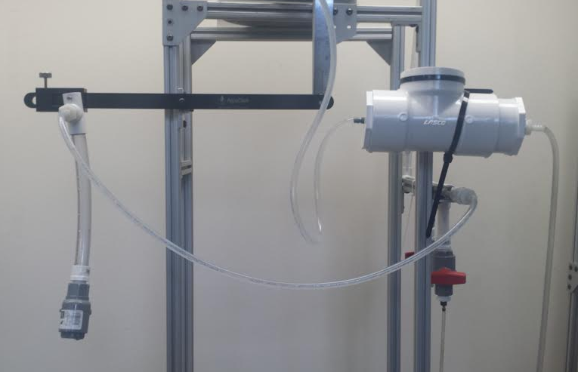
Experimentation: Testing for Head Loss
Purpose: Determine which sizes allow accuracy and spatial efficiency.
Procedure:
System at steady state
Measure effluent water
Vary system parameters to match MathCAD

Slide 13
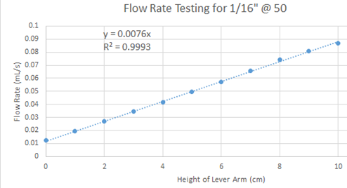

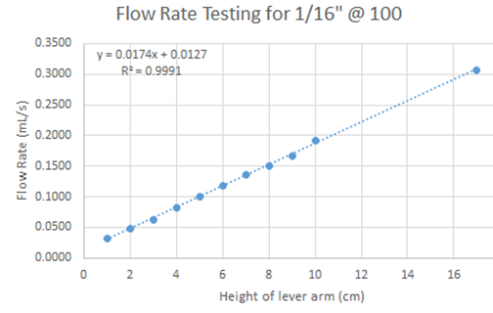
Testing the Slider with 1/16 inch tubing at 1.35 meters
Very linear
No issues with flow
Can we make dosing tubes shorter?
Notes:
Shorter tubes would make the system cheaper, less materials, etc

Slide 14
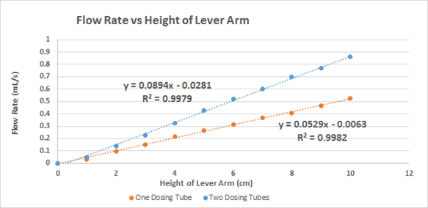
Testing with ⅛ inch Tubing
System Settings:
Length: 0.7 meters
Connecting Tubing: ¼ inch
Ratio of Flow 2 Tubes: Flow 1 Tube: 1.69

Slide 15
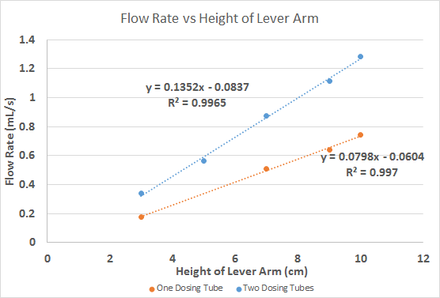
Testing with ⅛ inch Tubing
System Settings:
Length: 1.06 meters
Connecting Tubing: ¼ inch
Ratio of Flow 2 Tubes: Flow 1 Tube: 1.63
Where are we going wrong with our ratio?

Slide 16
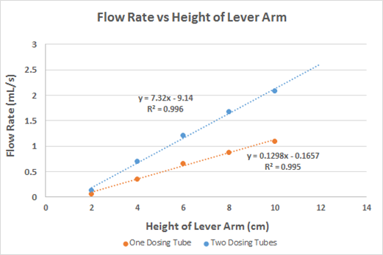
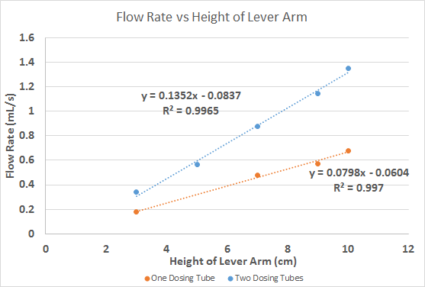
Testing with ⅛ inch Tubing
System Settings:
Length: 0.7 meters
Connecting Tubing: ½ inch
System Settings:
Length: 1.06 meters
Connecting Tubing: ½ inch
Ratio: 1.90
Ratio: 1.99
Notes:
Conclusion:
The ratio was off at first because of the connection tubing. With 2 tubes, there’s a larger flow rate going through the system. Therefore, the original 1/4th tubing was including a lot of loss due to friction to the system. By changing the diameter to ½, these losses seemed to be minimized. This wasn’t really accounted for in our governing equations
Furthermore. the accuracy of the system seems to be less linear. Compare the .7 meters to the 1.06 meters

Slide 17
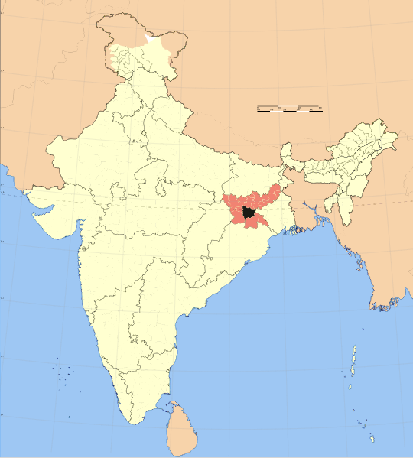
Future Goals
Finalizing MathCAD relationships
Pre-made package CDC kit
Team India

Slide 18

Questions?

