Slide 1
Chemical Dose Controller
Annie Cashon
Saugat Ghimire
Jeanette Liu

Slide 2
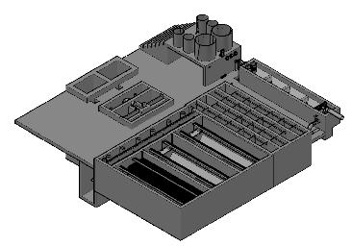
Background
Purpose: To dose coagulant prior to flocculation and to dose chlorine prior to water leaving the plant
Location within an AguaClara Plant

Slide 3
Completed Tasks
Single lever-arm fulcrum modification
Air removal system
Entrance tank float
Constant head tank float valve
CHT height adjustment system
Items catalog

Slide 4
Completed Tasks
Demonstrations
  Simplicity of switching components for different flow rates
  Manifold assembly

Slide 5
Single Lever-arm
Removed counterweight
Modified mounting system
4 times lighter
Less material

Slide 6
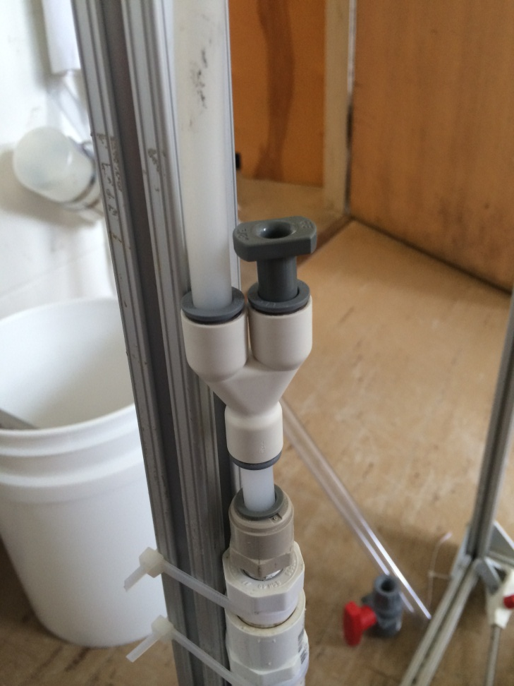
Air Removal System
Modified the air outlet in the manifold
A two way outlet in the manifold, one for air, one for the coagulant and chlorine

Slide 7
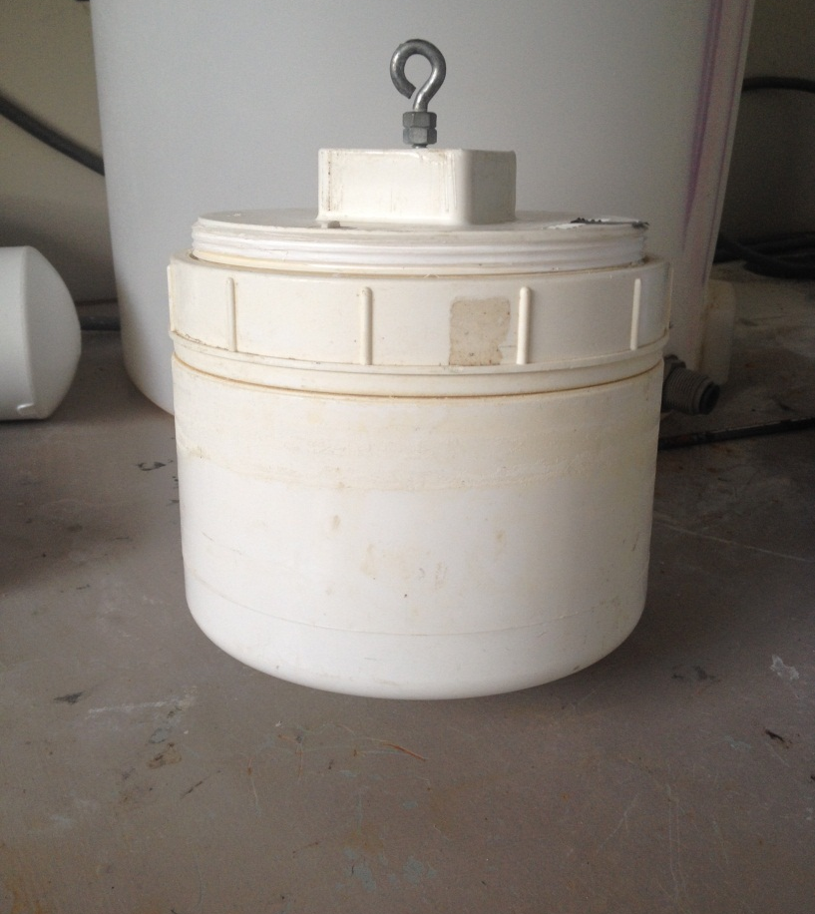
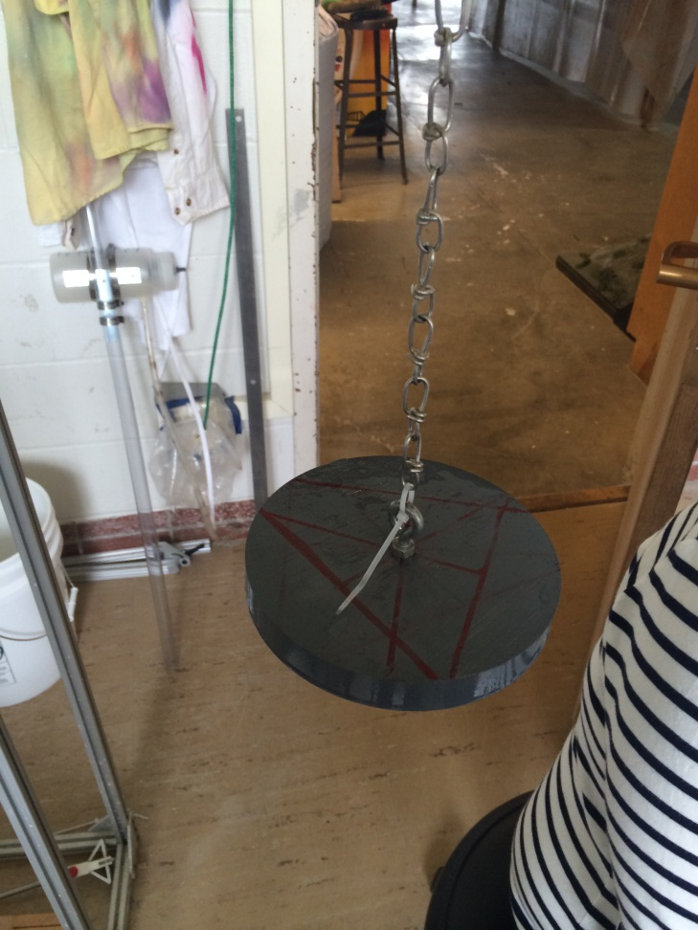
Entrance Tank Float

Slide 8
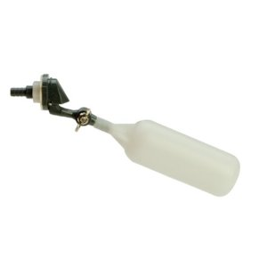
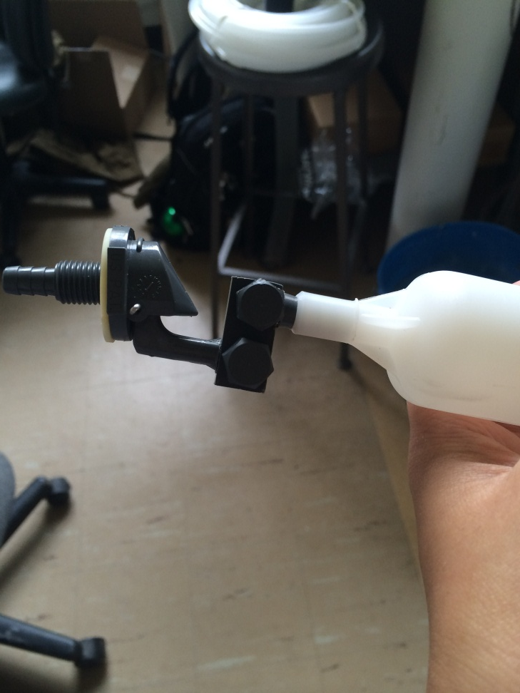
Constant Head Tank Float Valve
v

Slide 9
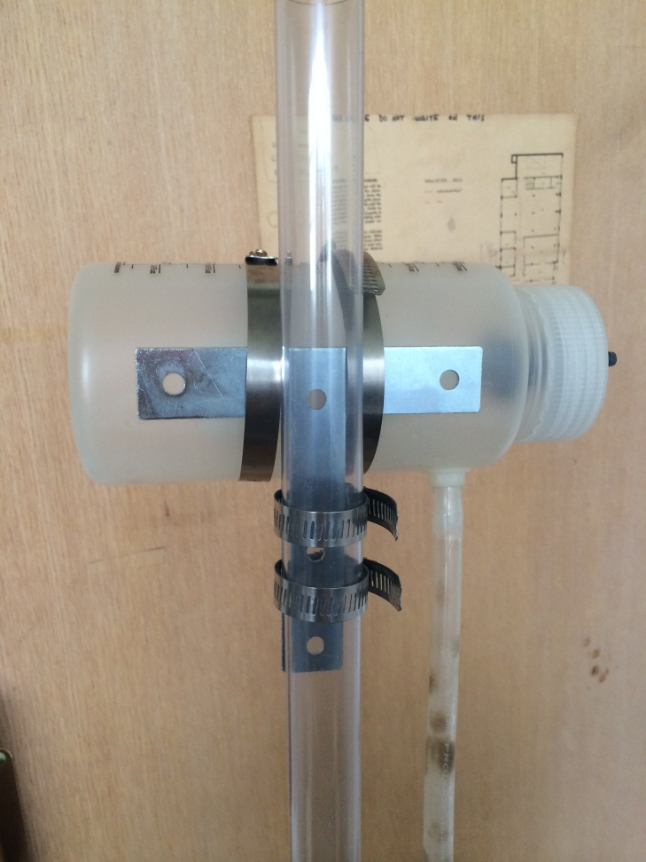
CHT Height Adjustment System
Adjustable hose clamps

Slide 10
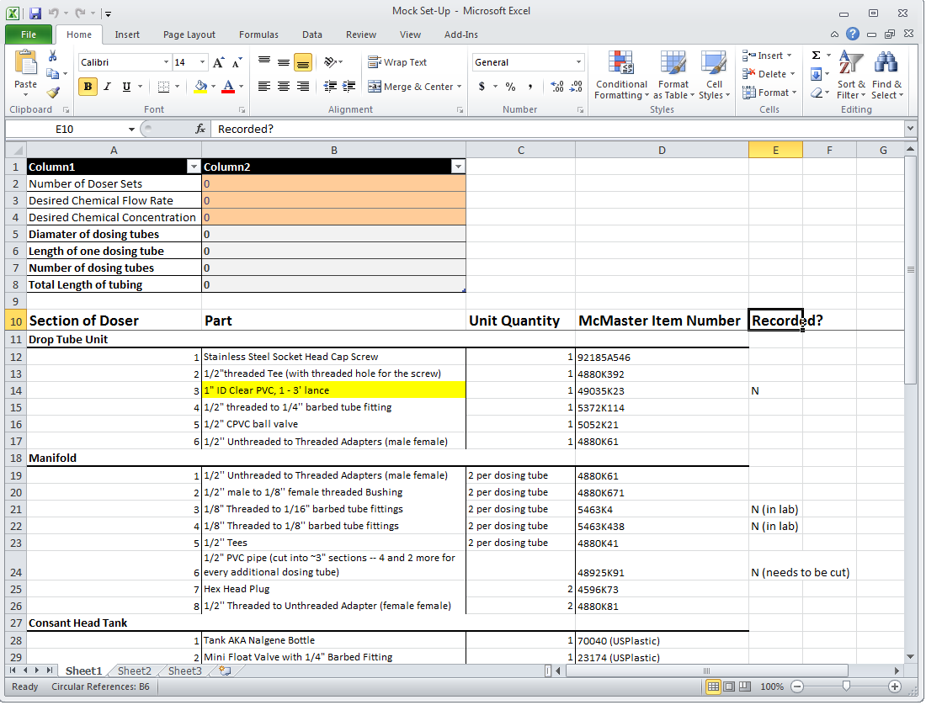
Items Catalog

Slide 11
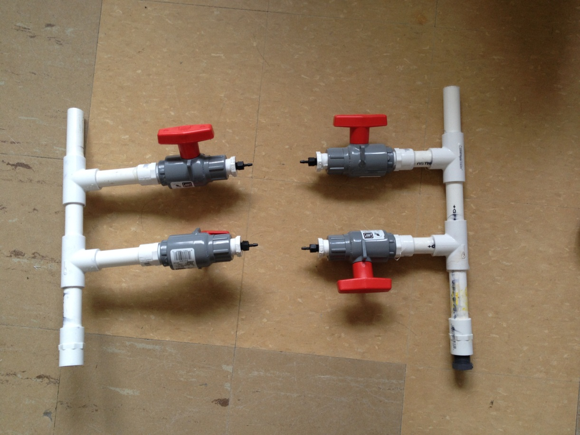
Demonstrations
Simplicity of switching components for different flow rates
Manifold assembly

Slide 12
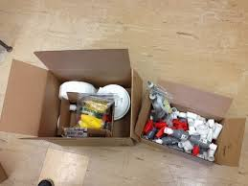
Future Work
Complete assembly manual for future CDC
Update assembly manual for plant operators
Run tests with single lever arm.

Slide 13
Questions?

