Slide 1
Linear Chemical Dose Controller
Fall 2013
Zeyu Yao Saugat Ghimire

Slide 2
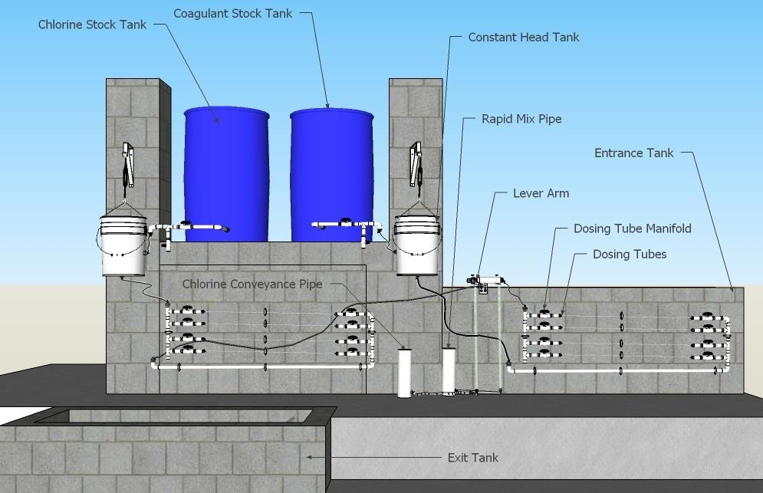
Chemical Dose Controller

Slide 3
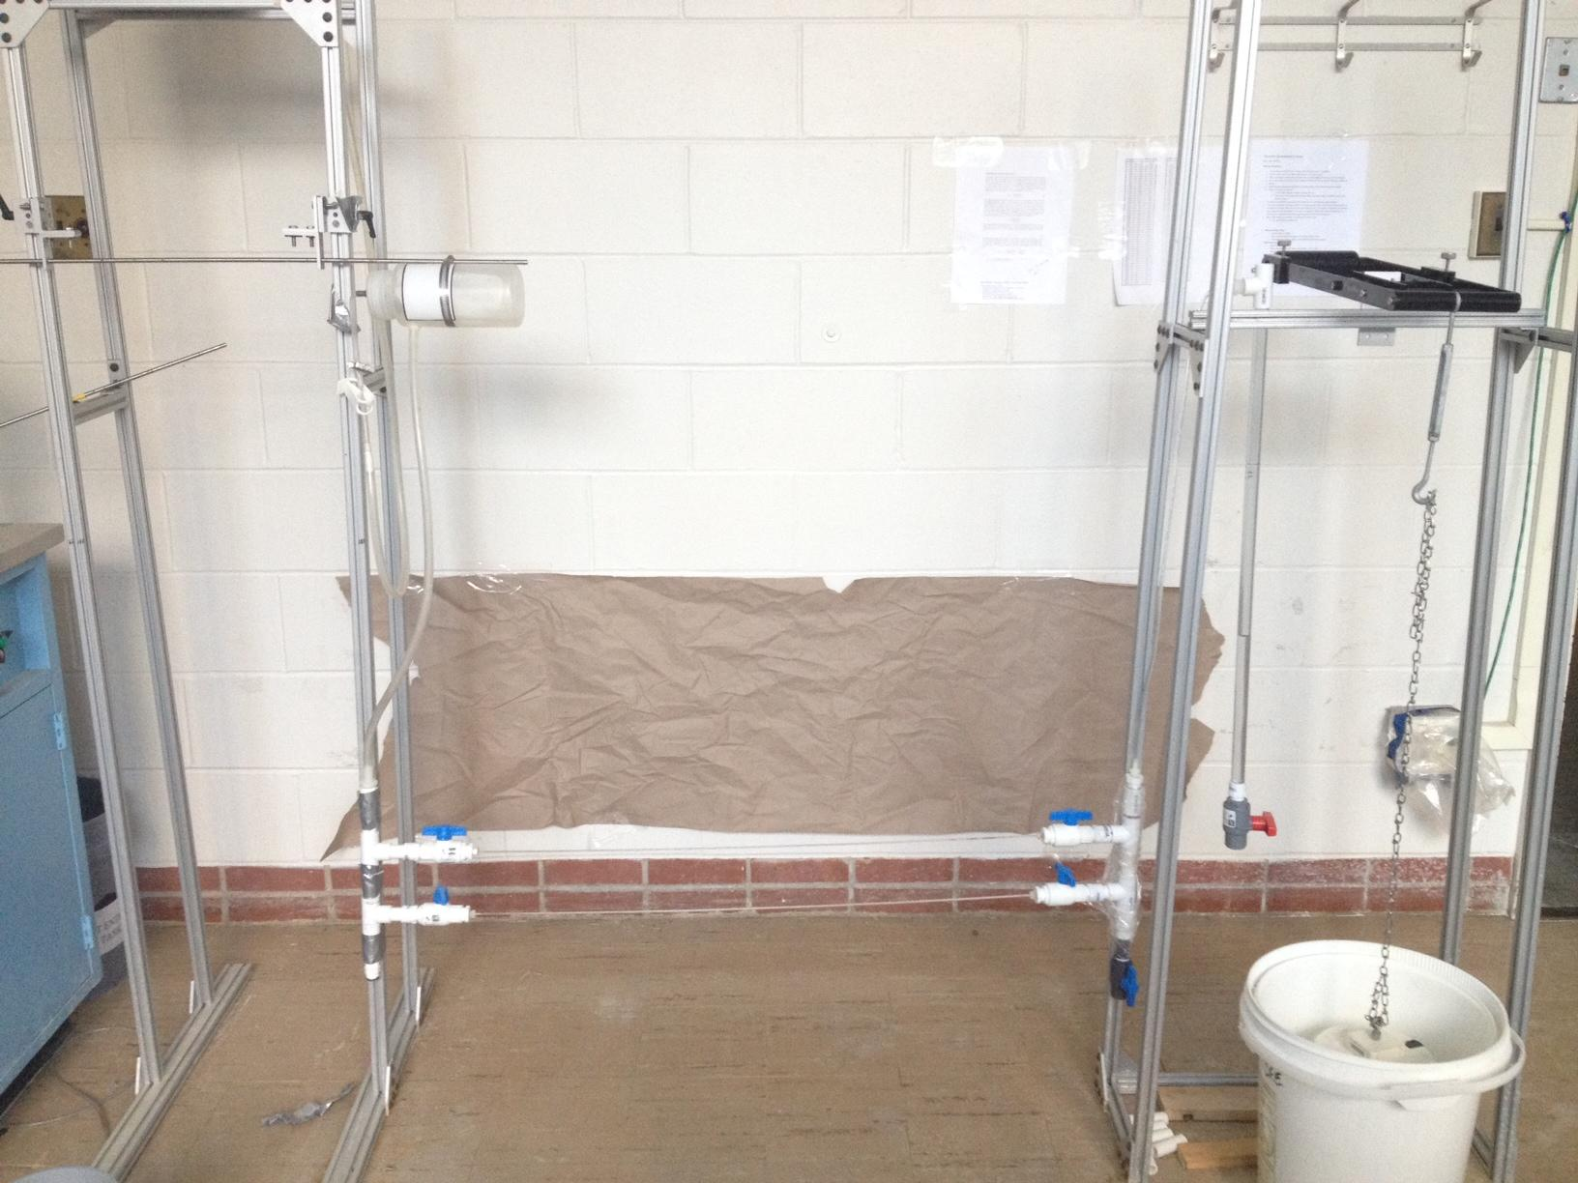
Current Lab Set up
1. No more long tubes.
2. New Ball Valves.
3. Drop tube has a ball valve too.

Slide 4
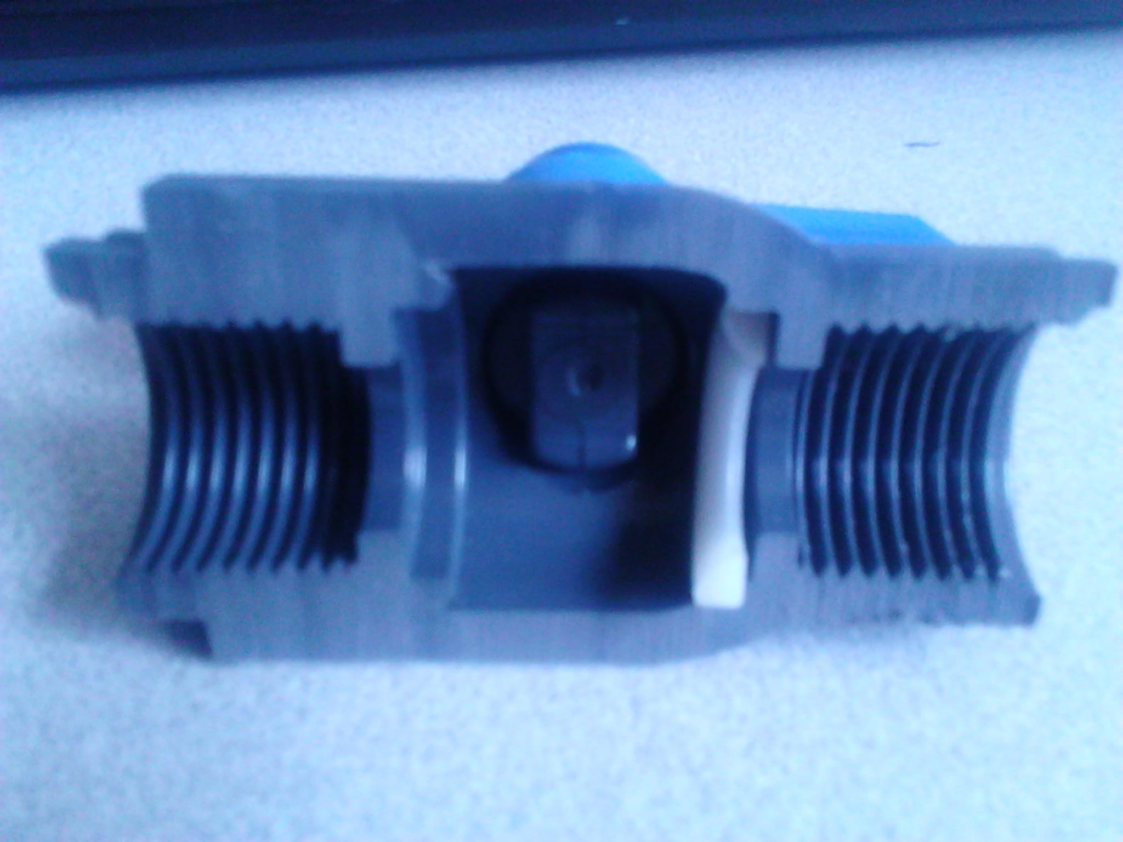
Current Lab Set up
PVC valve
EPDM seal--low resistance to chlorine
CPVC valve
Fluoroelastomer seal
High chlorine resistance but more expensive

Slide 5
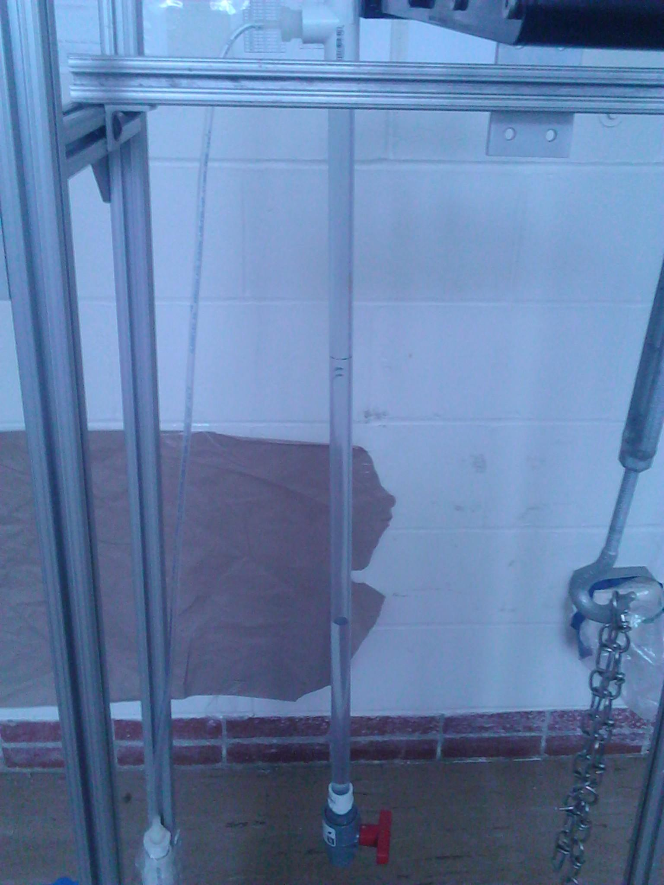
drop tube
  adding ball valve
    negligible change to flow rate
    added weight: glue tube to couple or use threaded tube
Allows the operator to determine chemical flow rate

Slide 6
India/packaging
Packaging spreadsheet
  Inputs: chemical flow rate and concentration, and number of sets needed
  Outputs: Diameter, length, and number of dosing tubes required, and the quantity of all the components
  Need to embed mathcad codes
Chlorinator setup manual
  Need to update the manual since the design has changed since then
Notes:
- large amount of different components need to be assembled and packed. the quantity of each component varies based on the characteristics of the plant.

Slide 7
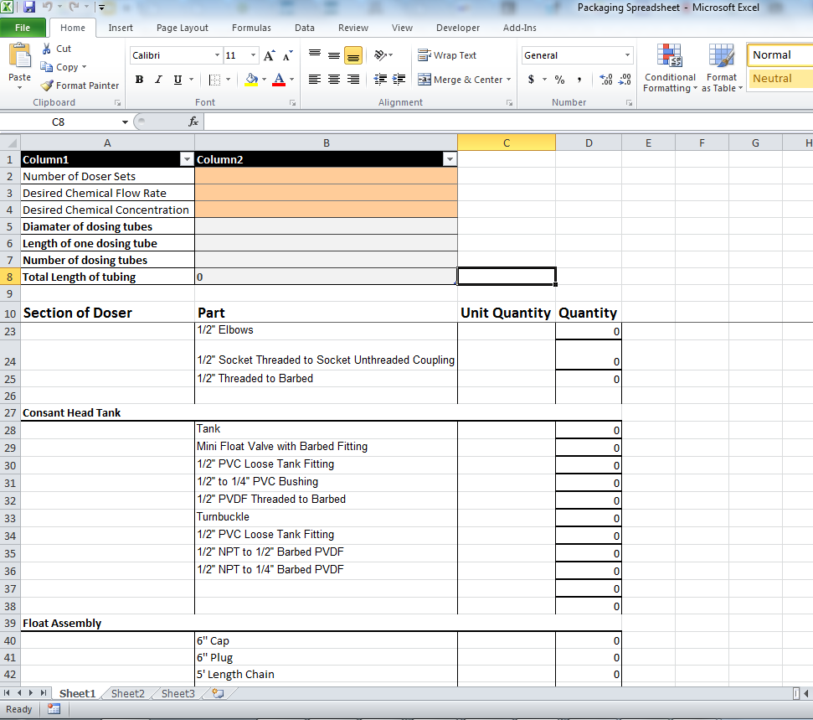

Slide 8
India/packaging
Packaging spreadsheet
  Inputs: chemical flow rate and concentration, and number of sets needed
  Outputs: Diameter, length, and number of dosing tubes required, and the quantity of all the components
  Need to embed mathcad codes
Chlorinator setup manual
  Need to update the manual since the design has changed since then
Notes:
- large amount of different components need to be assembled and packed. the quantity of each component varies based on the characteristics of the plant.

Slide 9
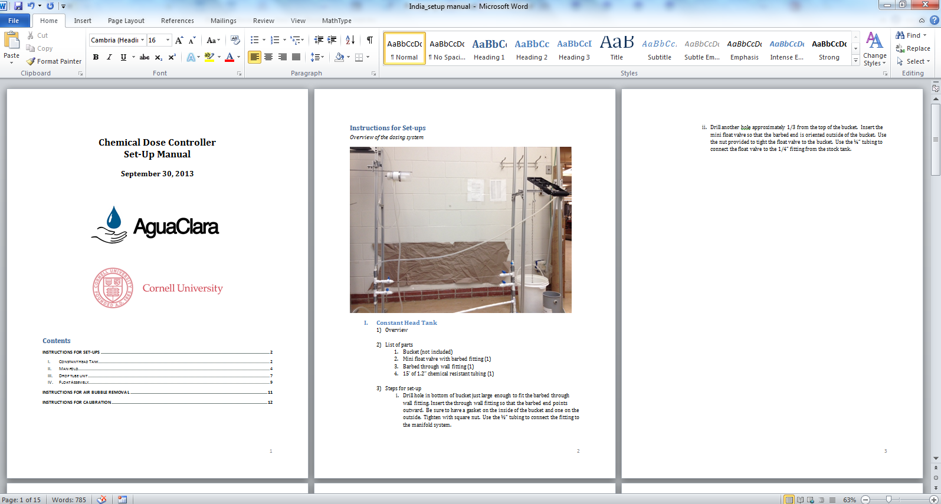

Slide 10
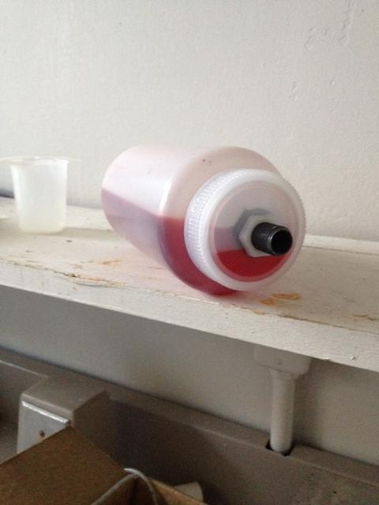
Constant Head Tank
1. PVC pipe and expensive bottles - cap liner
2. lock and lock/tupperware
3. bucket/turnbuckle

Slide 11
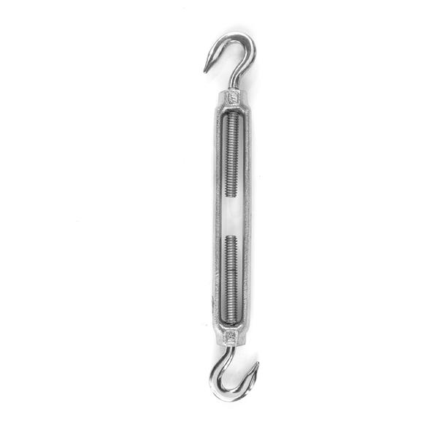
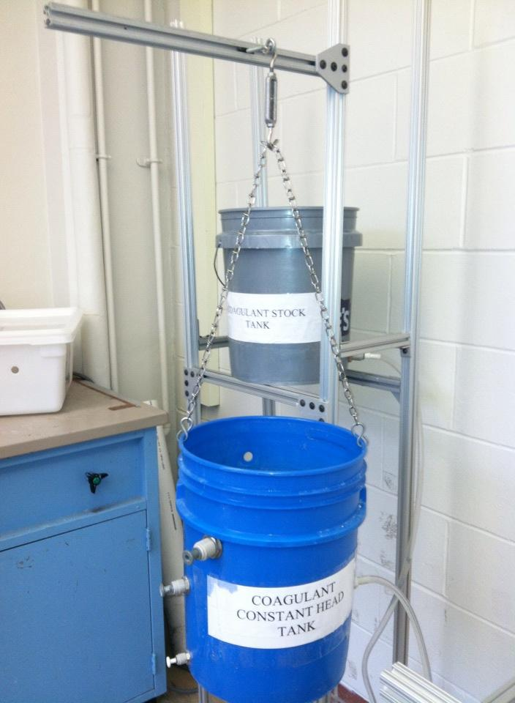
CHT Height Adjustment

Slide 12
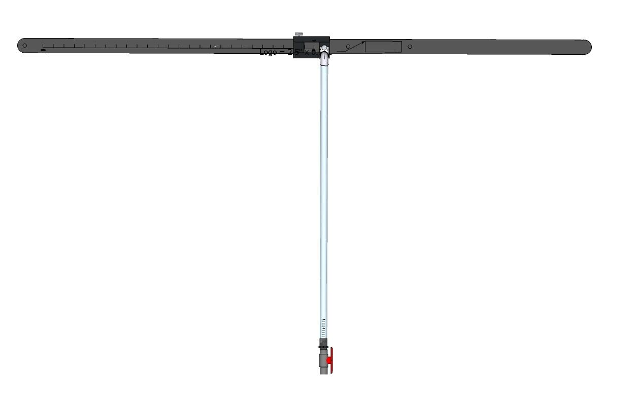
Single Lever
Notes:
based on the double lever design but has only one arm to dose single chemical. We need this design because some plants in India only need chlorinator from AguaClara

Slide 13
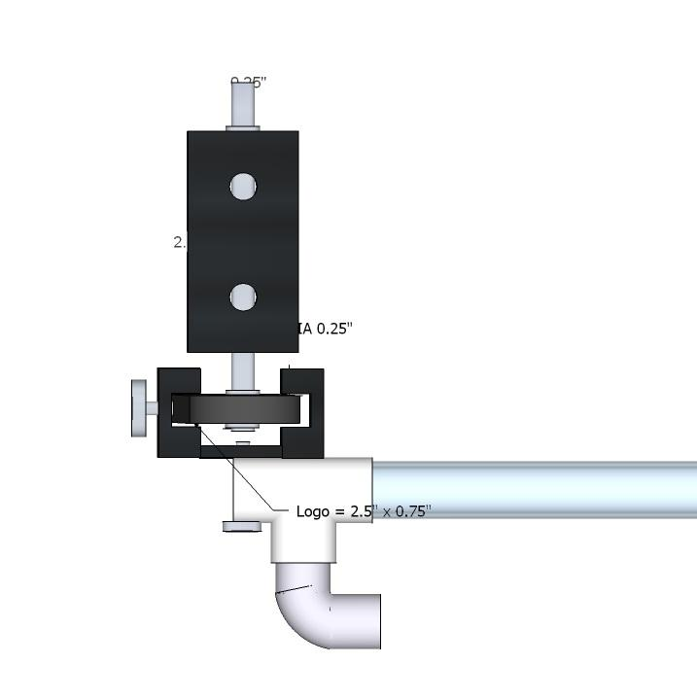
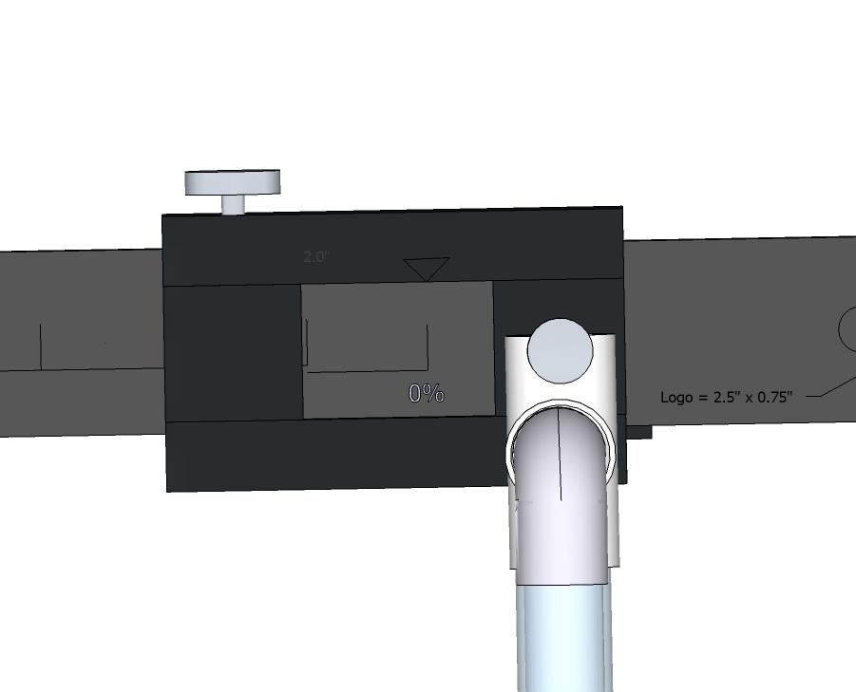
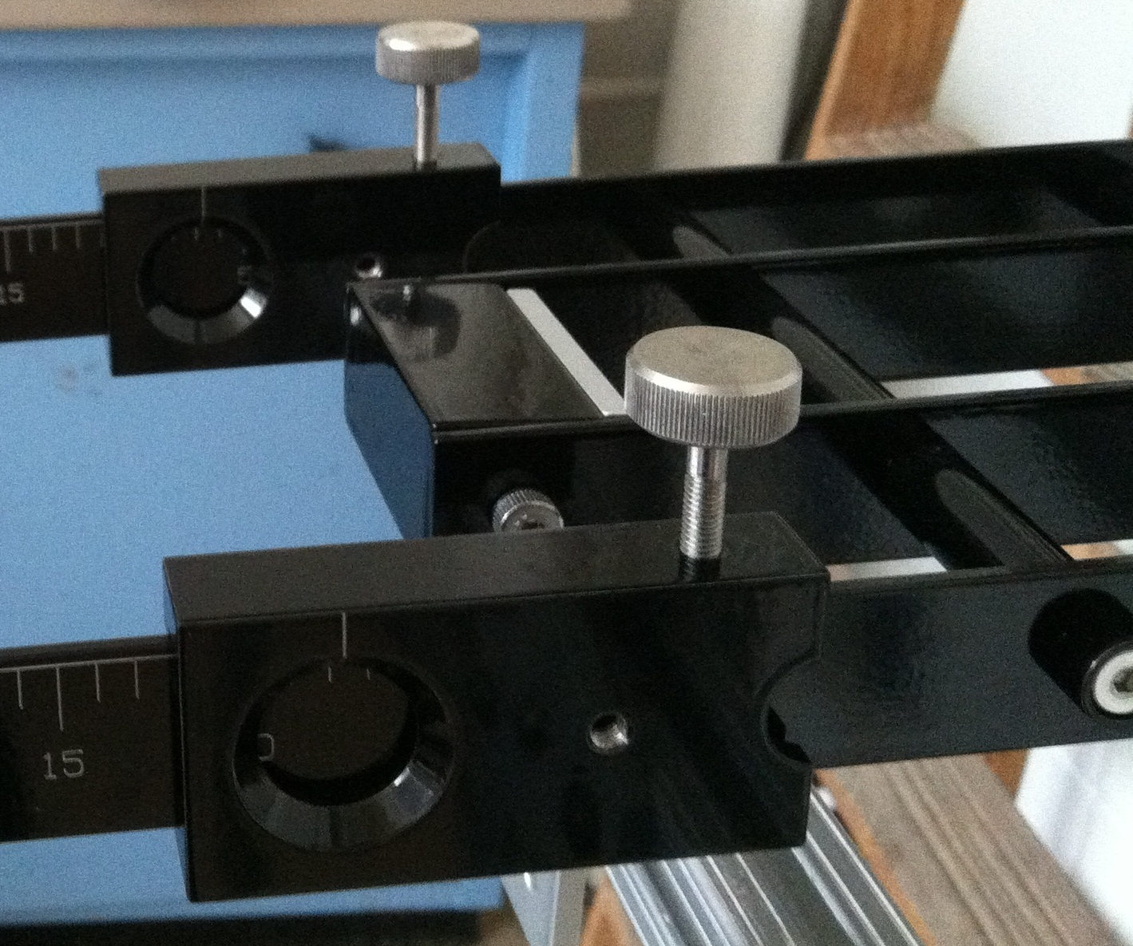
Single Lever Design
Fulcrum
- length and position
Slider
- drop tube attachment
- thickened but lighter
Double lever design
Notes:
Old design: cross bracing, single lever design has to be stable
Firstly, made lever arm slightly thicker to make it more rigid
the box fulcrum design is kept but attached to the lever arm.
- long rotating rod, so the heavier side will not cause the lever to tilt
the slider is redesigned so that the drop tube can be attached at the same height as the fulcrum (drawing not accurate, needs to move it up)
We also made a carving to allow reading the dose percentage, and it is also lighter as a result.
Design constraints: the position of the fulcrum and the height of the drop tube

Slide 14
Future Tasks
Packaging spreadsheet: mathcad code
constant head tank set up
determine feasibility of using smaller diameter tubes: too much minor loss? surface tension?
finalize single lever design
  apply same design to double and full size lever
drop tube markings

Slide 15
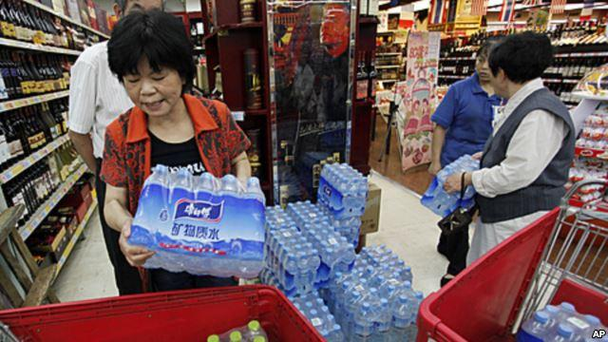

AguaClara Two for One Treatment Plants
Campaign
Your water is clean, but is it GREEN?
Stop buying bottled water! Go AguaClara
*You can get it customized!
Help the people in need by getting an AguaClara plant for your community!

