Slide 1

Plate Settler Spacing
Alexandra Cheng
Roxanne Li
Ying Zhang

Slide 2
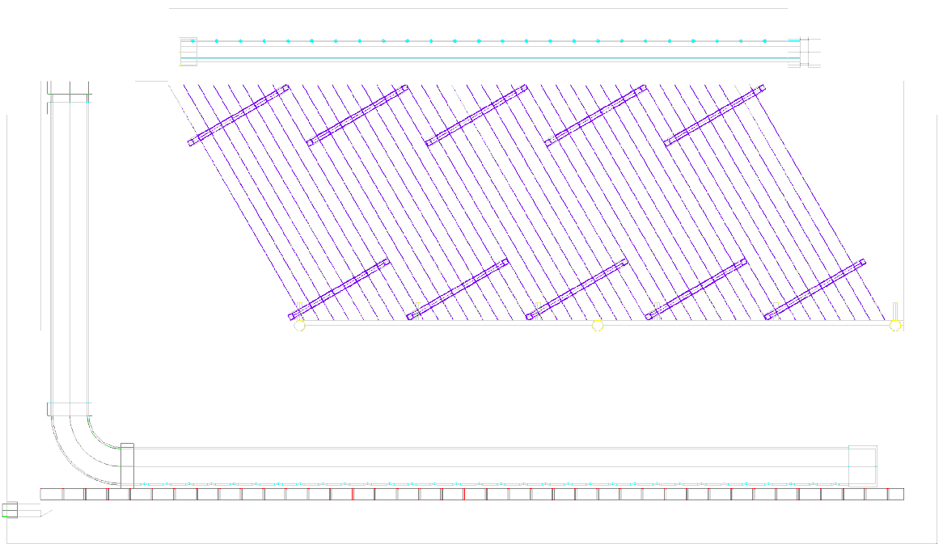
Purpose of Plate Settlers
Used after flocculation and before filtration
Plate Settlers reduce sedimentation tank costs
Plate Settlers
Sedimentation tank

Slide 3
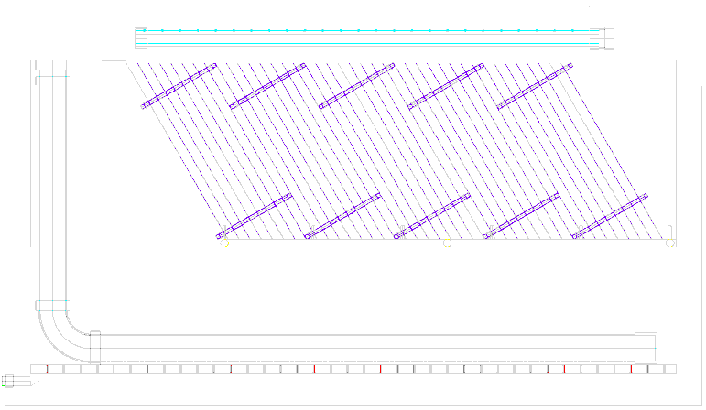
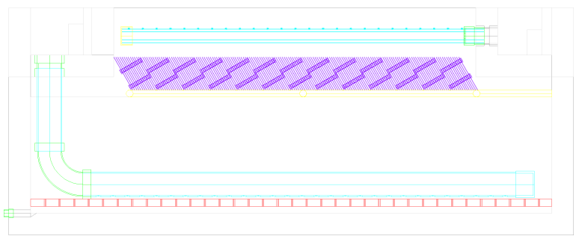
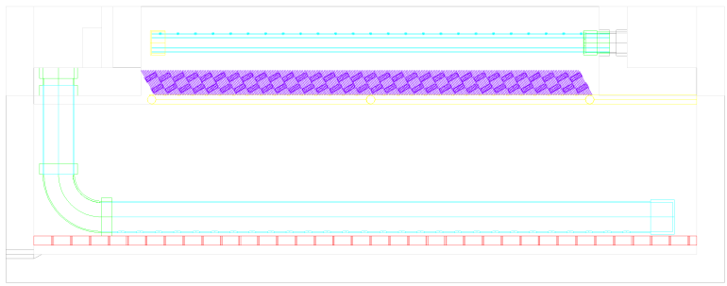
Purpose of Plate Settlers
Guideline 5 cm spacing
  AguaClara uses 2.5 cm
Objective of the team:
Find optimal spacing to…
  Decrease sedimentation tank volume
  Facilitate more uniform flow distribution through the plates
5 cm
2.25 m deep
1 cm
1.42 m deep
0.5 cm
1.32 m deep

Slide 4
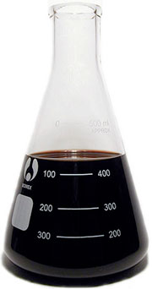
Introducing…NOM
  Previous experiments modeled turbid water with kaolin clay but no NOM
  Natural Organic Matter (NOM)
    From decomposition of plants, animals and microbes
    Causes odor, brown discoloration
    Formation of carcinogens
    Formation of lighter flocs

Slide 5
The Experiment
Summer goal:
  Determine threshold at which NOM removal is no longer feasible with current plate settler spacing (0.25”)
Prediction:
  Tube settler performance will decrease with increasing NOM:Clay ratio.

Slide 6
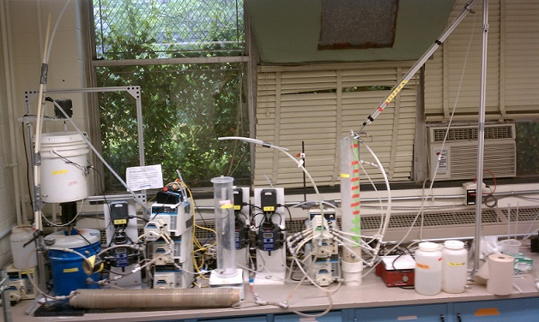
Materials and Methods
Turbidity = 25 NTU (constant)
NOM = 0-40 mg/L (variable)
Tube settler = plate settler in actual plant

Slide 7
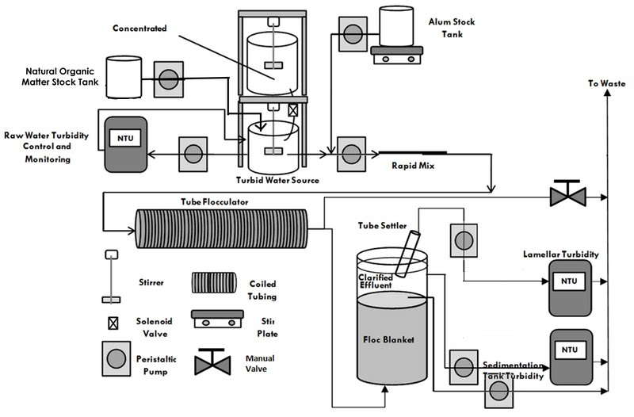
Apparatus
3 States:
Raw Water Turbidity

Slide 8
Apparatus
3 States:
Raw Water Turbidity
Floc Blanket formation

Slide 9
Apparatus
3 States:
Raw Water Turbidity
Floc Blanket formation
Loading State

Slide 10
Results
25 NTU
<1 NTU

Slide 11
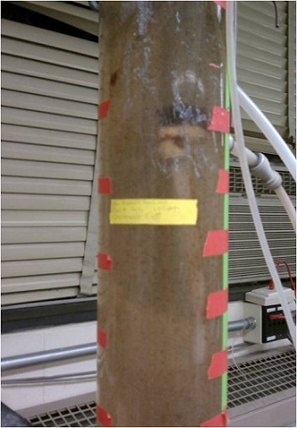
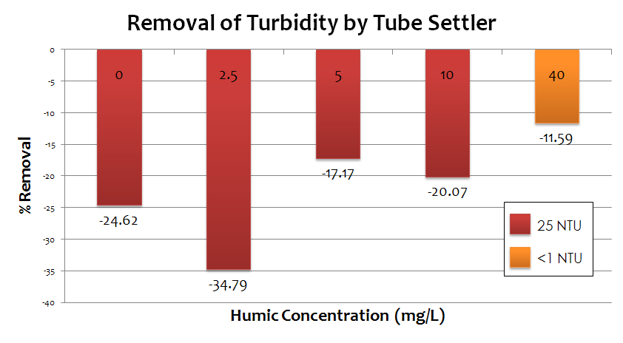
What Happened
Failure to create floc blanket
Floc roll-up
Tube settler increased turbidity

Slide 12
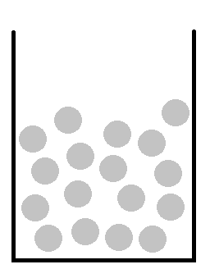
Conclusions
Low raw water turbidity leads to a porous floc blanket, from which particles can easily escape
Presence of humics can increase floc blanket density, increasing tube settler performance
Notes:
Particle density of blanket = explanation from report about smaller flocs escaping blanket at low humic concentration

Slide 13

Future Challenges
Use of PACl instead of Alum
Varying turbidities
  Determine ideal clay: humic ratio
Achieve this (<1 NTU!)

