Slide 1

Plate Settlers Spacing
Adela Kuzmiakova,
Ashleigh Sujin Choi,
Cosme Somogyi
Ying Zhang,

Slide 2
Outline
Introduction
  Why a PSS team
  Reminder of where we were last semester
Theory
  Floc roll-up model summary
  Improvements for Vc
Experimental methods
  Summary on the way we collected/analyzed data
Results and discussion
  Results
    Vc=0.10 mm/s
    Ramp experiment
Conclusions
  Final proposal for AC plants in general, with a FB ! = Before/After PSS team
  Challenges for next team

Slide 3
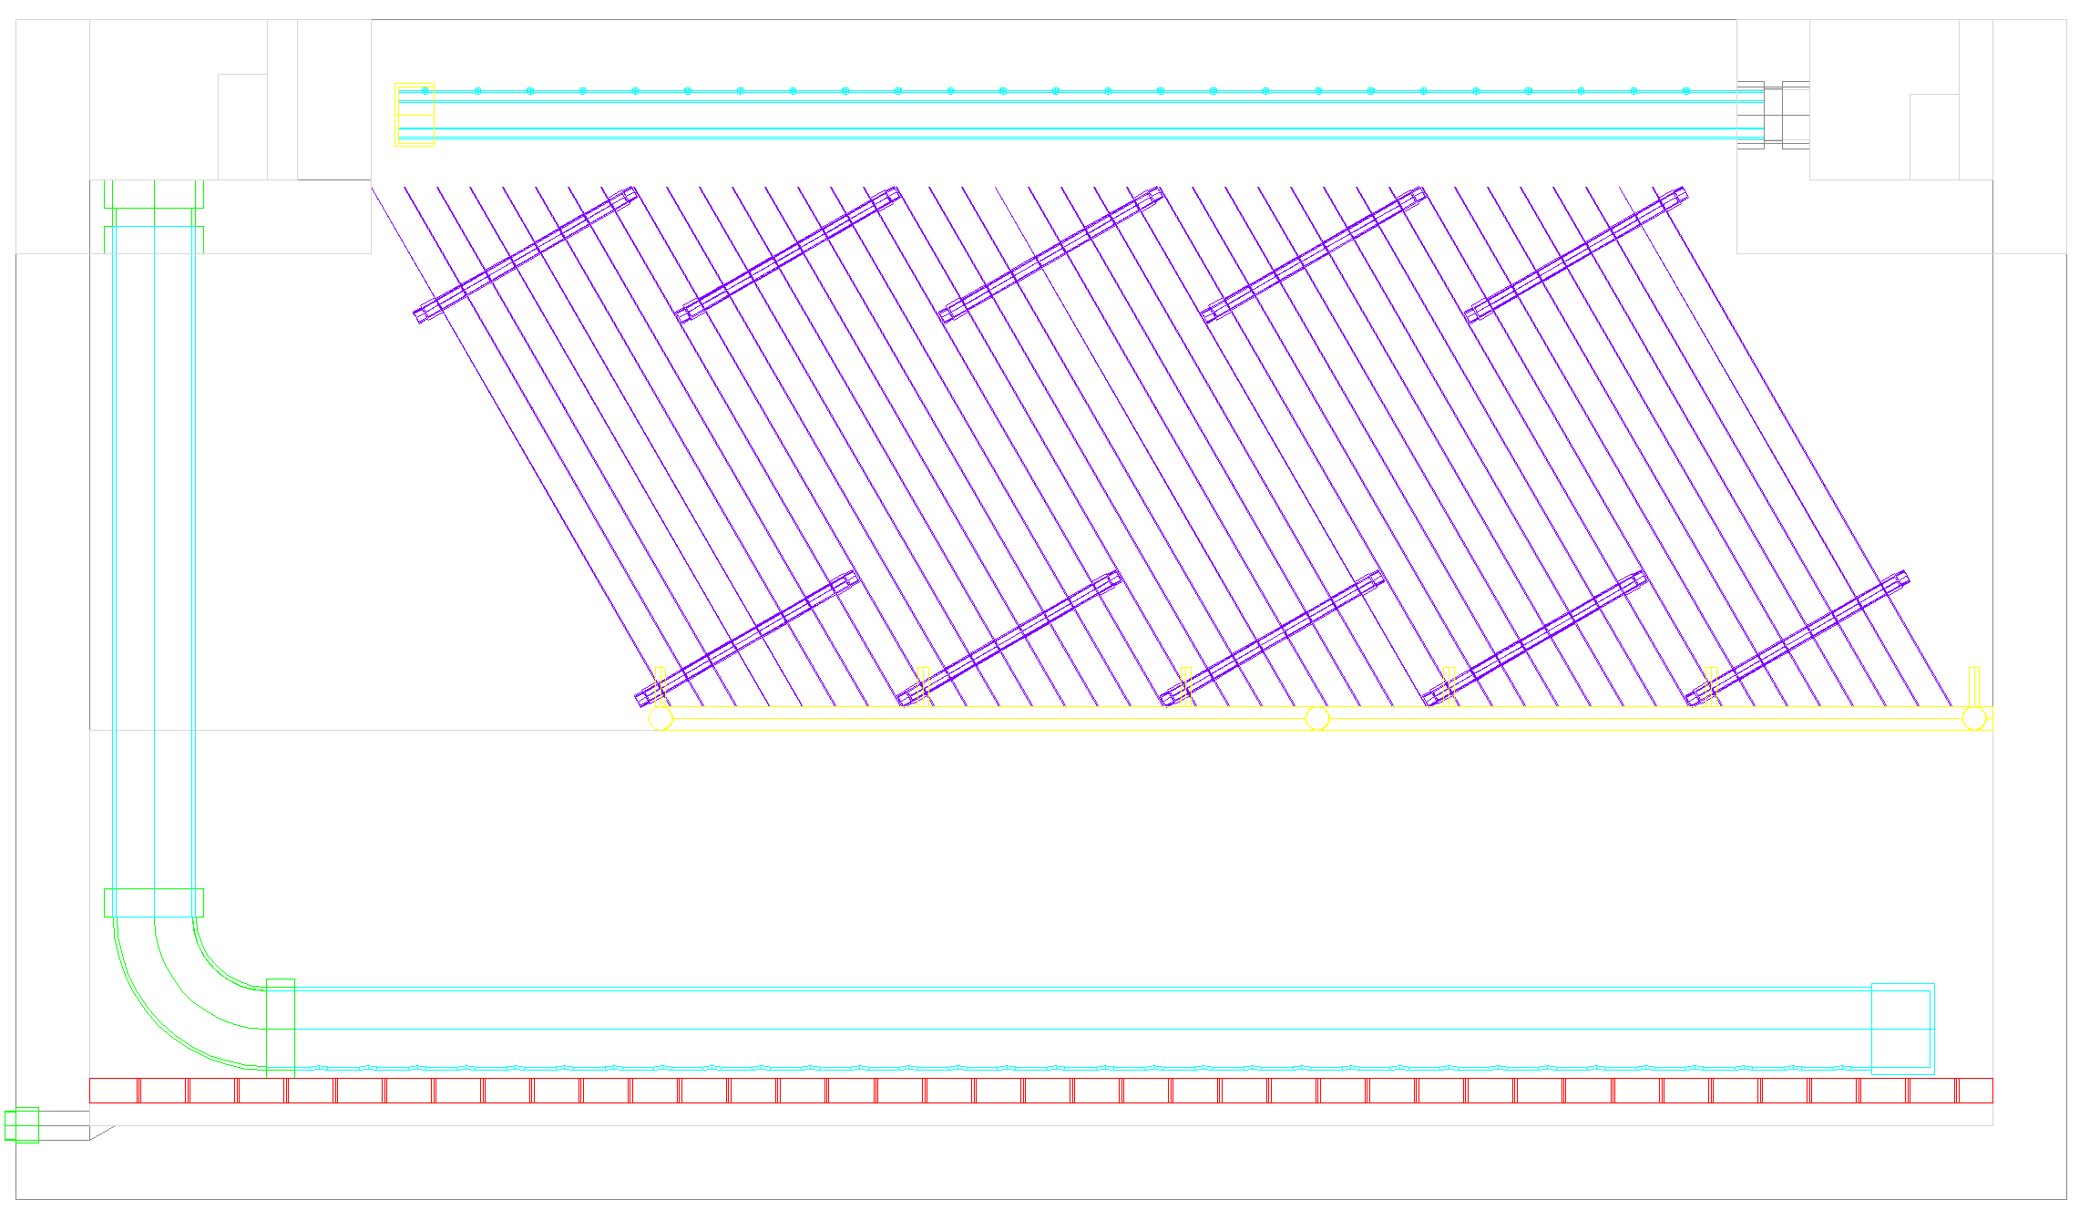
Introduction
Where ?
  After flocculation
  Before filtration
Why plate settlers?
  Reduces sedimentation tank costs
Plate Settlers
Sedimentation tank

Slide 4
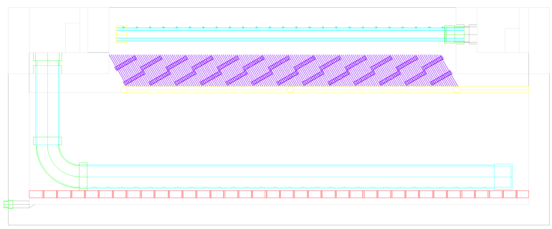
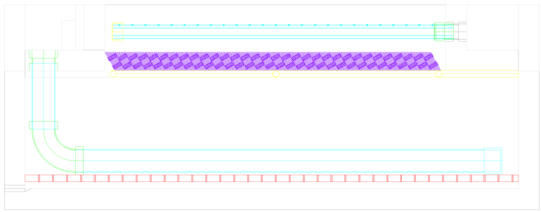
Introduction
Guideline 5 cm spacing
  Aguaclara uses 2.5 cm
Objective of the team:
Find optimal Spacing
  Decreases sed tank volume
  More uniform flow distribution through the plates
5 cm
2.25 m deep
1 cm
1.42 m deep
0.5 cm
1.32 m deep

Slide 5
Introduction
Before our teach-in
  Designing and running Velocity gradient experiments
  Theory and Modeling of the dimensionless Pi ratio
Since our teach-in
  Compiled our results in a research paper
  Designing & running settling velocity distribution

Slide 6
Theory
Capture velocity for Tube settlers
  Define V_{T}
  Define V_{c}
D
V_{c} sinα
g sinα
L
g
V_{T} sinα
g
𝛼
V↑
V_{α}
Notes:
To understand what we’ve been doing I have to explain the background theory. First I would like to define the design parameter for tube settlers which we refer to as the capture velocity. but in order to do this I need to explain the terminal velocity of flocs. Flocs in water have a terminal velocity due to gravity which pulls them down. So if I have a floc entering the plate settler at the top plate, it is going to experience the pull of gravity and the push of the fluid. The resulting distance it will have to travel before hitting the bottom plate will be a function of its terminal velocity. Once it hits the bottom plate, the floc should slide down the incline with a terminal velocity multiplied by the sine of the angle alpha. Now that we have an idea about what the terminal velocity does to the flocs, we can define the capture velocity. The capture velocity will be the terminal velocity of the slowest settling floc. If we look at the diagram on the right the capture velocity of the plate settler here would be related to the settling velocity of the red particle. What is fortunately convienent for us is that the capture velocity of settlers is dependent on geometric factors as well as the velocity of the fluid.

Slide 7
Theory
V_{T}
Floc roll up theory
  Velocity gradient
    Flocs at the wall experience
    d_{Floc} . V_{gradient,α} > V_{T,α} ?
  Ratio used by PSS team
    Compares the two velocities on a ratio
    “ Is V_{c} design = V_{c} observed ? ”
?
α
V_{gradient}
V_{gradient}
α
V_{T}
α
Notes:
Now that you’re more familiar with terminal velocity I can explain what we refer to as floc roll up theory.
Flocs falling down the incline

Slide 8
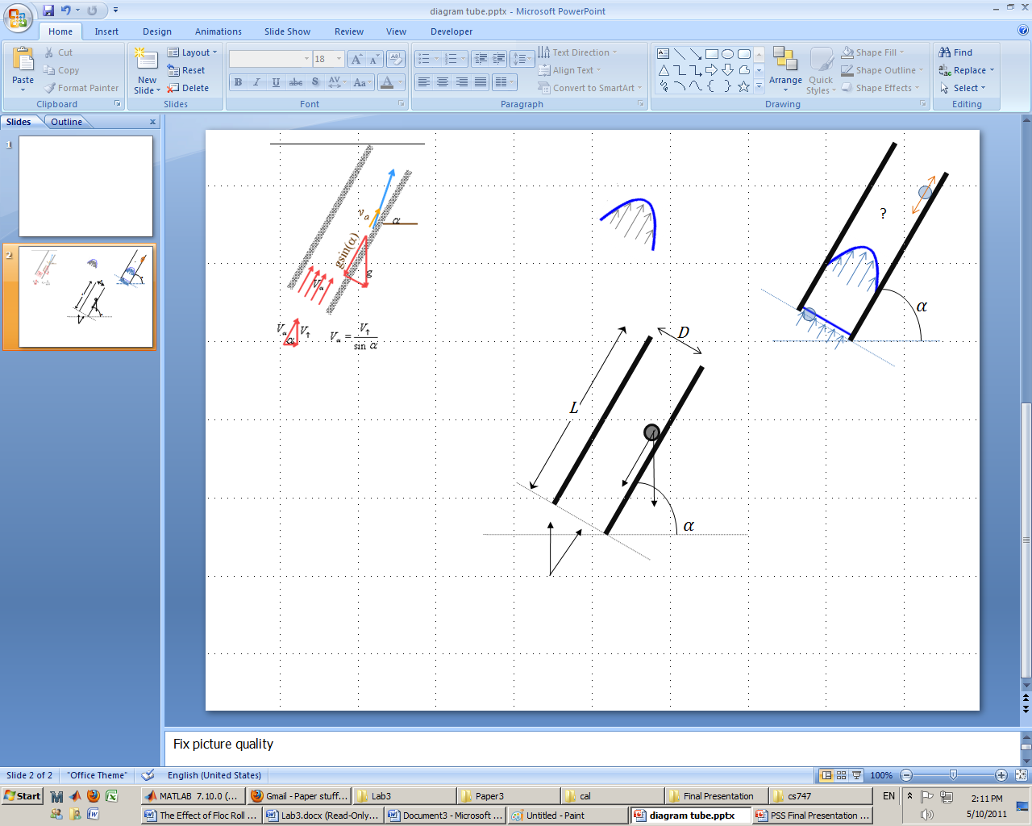
Theory
Assumes
  Linear model for the flow profile
  Fully developed laminar flow
Numerical simulation without #1
Focus on V_{c}
Velocity profile v_{z}(r):
D
v_{z}
Systematically
L
r
z
𝛼
V↑

Slide 9



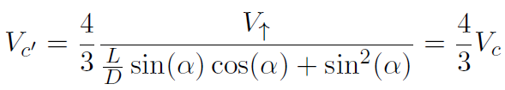
Theory
v_{z}(r)
(re)deriving the equations for tubes
Initial conditions:
Solution:
We used V_{c} !
r
z

Slide 10
Velocity Gradient Experiment: Concept
Objective:
  Validate velocity gradient theory with experimental evidence
Fixed parameter:
  V_{c} = 0.10 mm/s
Varied parameters:
  Velocity gradients (via changing V_{α} )
  Adjusting L/D

Slide 11
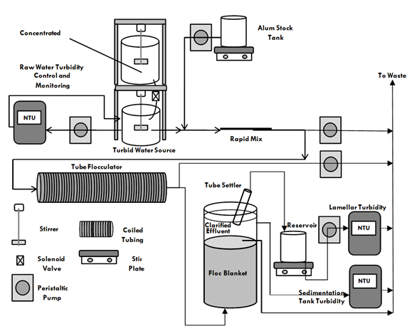
Velocity Gradient Apparatus
4 States:
Raw Water Turbidity
Notes:
Draw boxes/change layout.
Emphasize on the turbidity measurements we collect

Slide 12
Velocity Gradient Apparatus
4 States:
Raw Water Turbidity
Floc Blanket formation
Notes:
Draw boxes/change layout.
Emphasize on the turbidity measurements we collect

Slide 13
Velocity Gradient Apparatus
4 States:
Raw Water Turbidity
Floc Blanket formation
Loading State
Notes:
Draw boxes/change layout.
Emphasize on the turbidity measurements we collect

Slide 14
Velocity Gradient Apparatus
4 States:
Raw Water Turbidity
Floc Blanket formation
Loading State
Withdrawal State
Notes:
Draw boxes/change layout.
Emphasize on the turbidity measurements we collect

Slide 15
Settling Velocity Experiment: Concept
Objective:
  Obtain a V_{settling} distribution to be able to use turbidity to relate the velocity gradient to the effective capture velocity
Fixed parameters:
  D = 2.54 cm (1 in)
  L = 33.0 cm (13 in)
Varied parameters:
  V_{capture} (through Q)

Slide 16
Settling Velocity Apparatus
START
Q = Q + 10 mL/min
Loading State
Yes
Withdrawal State
Max runs completed?
Notes:
Draw boxes/change layout.
Emphasize on the turbidity measurements we collect

Slide 17
V_{α} Experiment: Results
Graphs & discussion

Slide 18
Settling Velocity Experiment: Expected Results
Predictions of what the settling velocity experiment results will look like
CDF
“particle distribution”
Tube Effl. NTU
Capture Velocity
Capture Velocity

Slide 19
Settling Velocity Experiment: Results
Graphs & discussion
Π_{V} > 1
L=33 cm, D= 2.54 cm
Q: 80 ~160 mL/min

Slide 20
Conclusion: AguaClara Application
How this can be good for AguaClara
  Clay /Alum/ Floc Blanket experiments shows that:
      V_{c} = 10 m/day
      V↑ = 1 mm/s
      D = 6.35 mm (=1/4 in)
      L = 16 cm
    While achieving same performance
  Cost savings
  More uniform flow distribution
0.64 cm
1.4 m deep

Slide 21
Conclusion: Future Challenges
Need to test combinations of the following:
  Natural Organic Matter (NOM) / Clay
    Simulate real field conditions
  Performance w/ Floc Blanket or w/out Floc Blanket
    AguaClara plants do not have a FB at the moment
  PACl / Alum
    A few plants in Honduras have switched to PACl

Slide 22

Questions?

Slide 23
Pi ratio
Numerical simulation
Shear flocculation/breakup

Slide 24
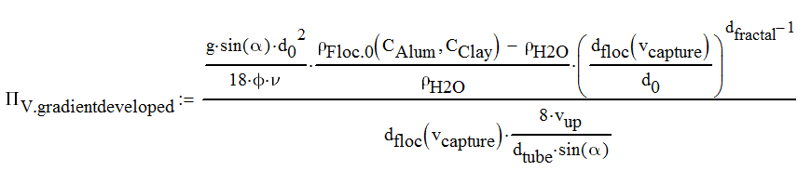
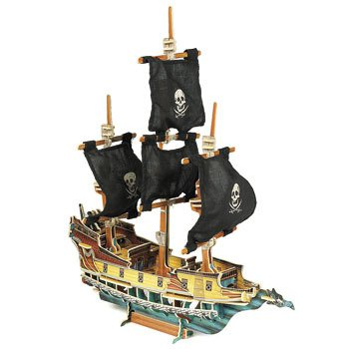

Pi-ratio

Slide 25
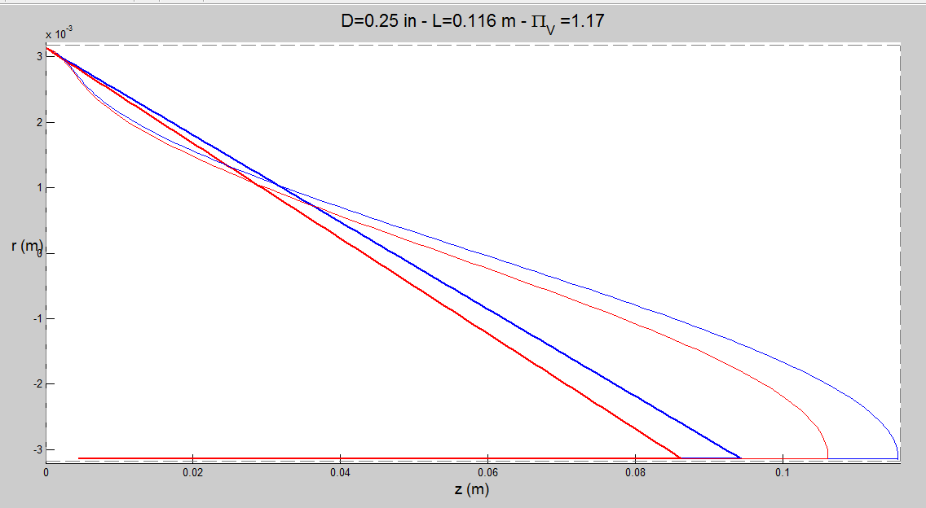
Numerical simulation

Slide 26
Shear flocculation/breakup
Shear flocculation
Number in system
Number in system
carried out with effluent
carried out with effluent
captured
captured
Particle Size
Particle Size
Shear breakup
Combination of breakup and flocculation
Number in system
????
carried out with effluent
captured
Particle Size

Slide 27
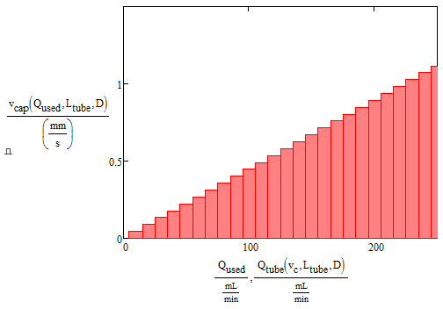
Ramp experiment design
Increments of 0.045 mm/s

