Slide 1
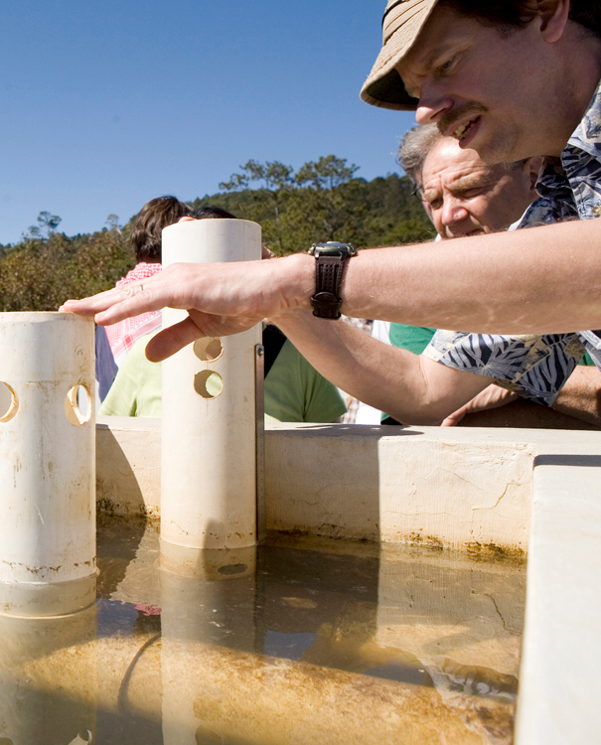
Join AguaClara!
AguaClara is a program in Civil and Environmental Engineering that is improving drinking water quality through sustainable water treatment systems in Honduras.
Come to our next meeting:
Monday 5pm
Hollister 366
to learn how you can become a part of this innovative project.
Students from all majors and colleges are welcome!
E-mail vg56@cornell.edu for more information.
AGUACLARA.CEE.CORNELL.EDU

