Slide 1
The Resource Foundation
August 24, 2009
Monroe Weber-Shirk
Senior Lecturer
Civil and Environmental Engineering

Slide 2

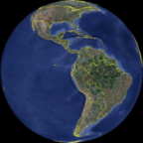
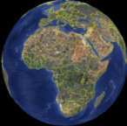
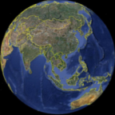
The AguaClara Story
The Niche
5 years of growth
Research – Design - Education
Opportunities

Slide 3
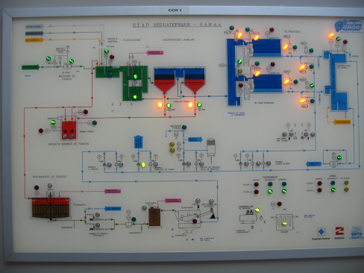
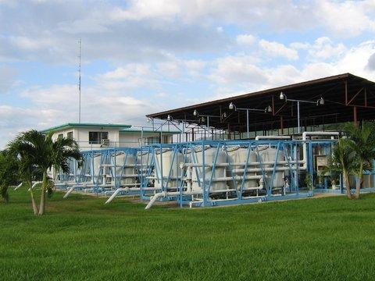
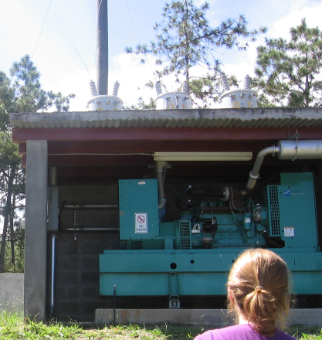
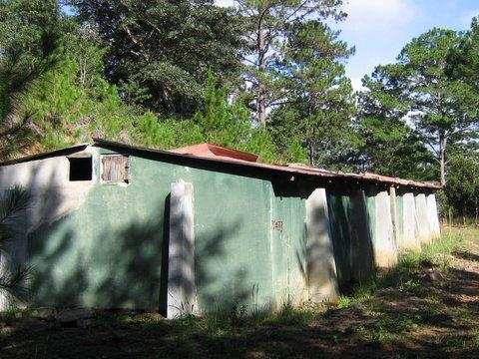
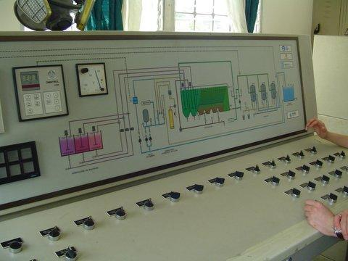
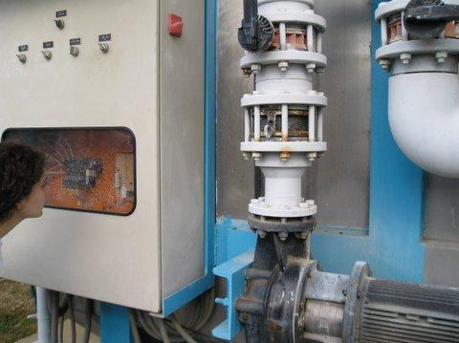
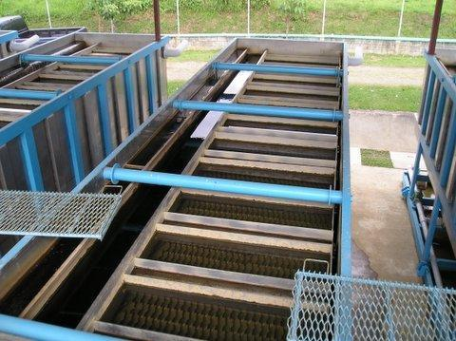
Examples of Technology Misfits in the Global South
El Progreso, Honduras
  Modular Package plant
  Dependent technology
Siguatepeque
  Built in place
  Dependent technology
Marcala, Honduras
  No chemical feeds
  Upflow filtration
  Worthless technology
Notes:
Ethics of Engineering Experimentation

Slide 4
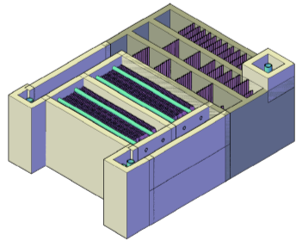

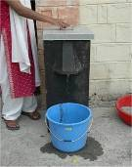

Robust Surface Water Treatment Niche
POU
Municipal
1000
Roughing
100
NTU
Flocculation Sedimentation
10
Filtration
Disinfection
1
1
10
100
1000
10,000
100,000
Population
Notes:
4
Reasonably sustainable technologies! (not dependent on advanced infrastructure)
Disinfection: (if the water is always less than about 15 NTU you could probably get away with only using a disinfectant (chlorine/ozone/ultraviolet). Note that this does NOT change the turbidity and that some pathogens are resistant to the disinfectants.
Filtration: if the water is always less than 50 NTU than filtration could be used prior to disinfection.
POU
Ceramic candles
Pots
slow sand
Municipal
SSF
RSF
For turbidities that are normally found in many surface waters either Roughing Filtration or Flocculation Sedimentation must be used.
Roughing filters are simple, but are capital intensive (10x larger facilities than AguaClara) and they haven’t figure out a way to clean them.
PUR created flocculation sedimentation in a packet for POU
Prior to AguaClara technology robust flocculation sedimentation was only available for communities that were larger than about 100,000 because the engineers didn’t know how to scale the flocculation process down.

Slide 5
The AguaClara Hypothesis
The planet needs a new model for disseminating water treatment technology that empowers rather than creating dependency
Open Source Engineering combined with Smart, Robust Technologies is succeeding where conventional water treatment has failed

Slide 6
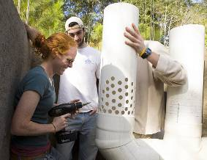
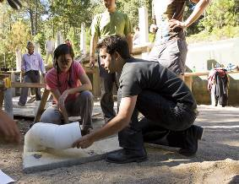
The AguaClara Niche
Globally we estimate that 125 million could benefit from AguaClara water treatment plants
To meet that need in 10 years our partners would need to be building approximately
3 plants per day
Notes:
6

Slide 7
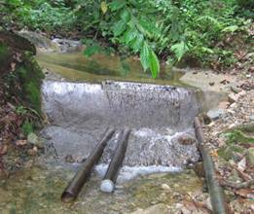
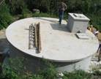
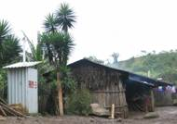
Gravity Water Supply
In 2004 Jacobo asked, “What can WE do about this muddy water?”
Drip Chlorinator
Distribution Tank
Spring box or dam

Slide 8
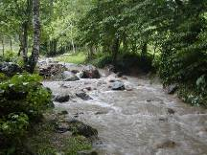
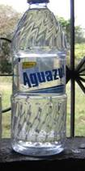
Flocculation – Sedimentation
Shear collisions
Chlorine
Aluminum sulfate
Without any electricity!
Rapid Mix
Flocculation
Sedimentation

Slide 9


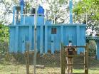

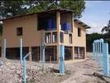
Population Served
16000
14000
12000
10000
Cumulative Population Served .
8000
6000
4000
2000
0
Jan-05
Jan-06
Jan-07
Jan-08
Jan-09
Jan-10
Date

Slide 10
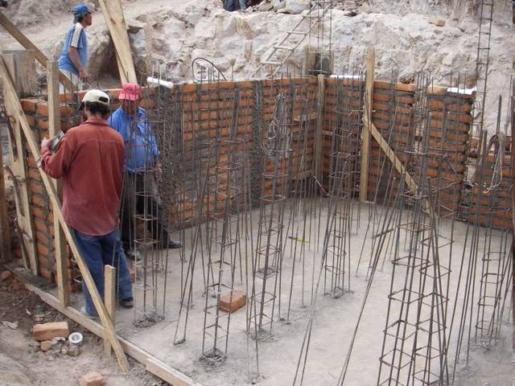

Slide 11
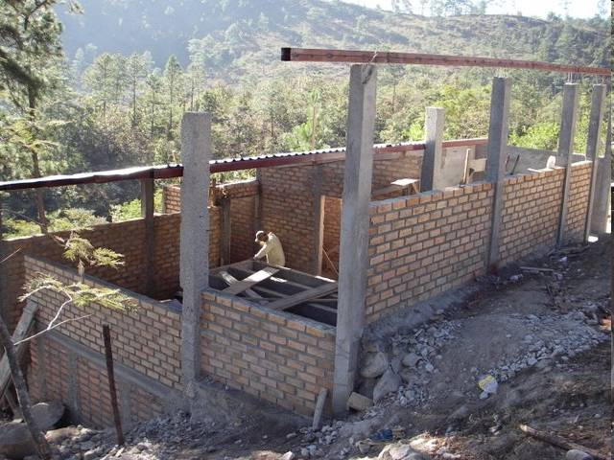

Slide 12
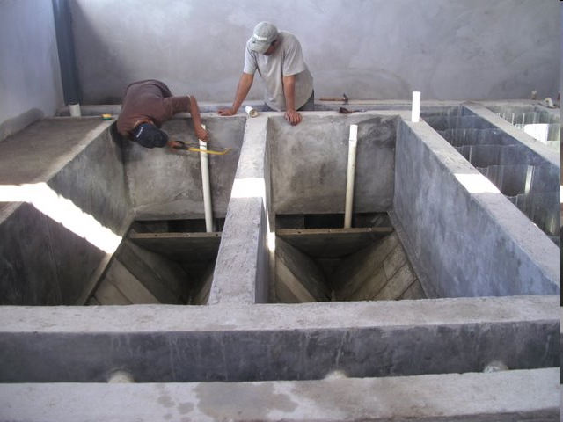

Slide 13
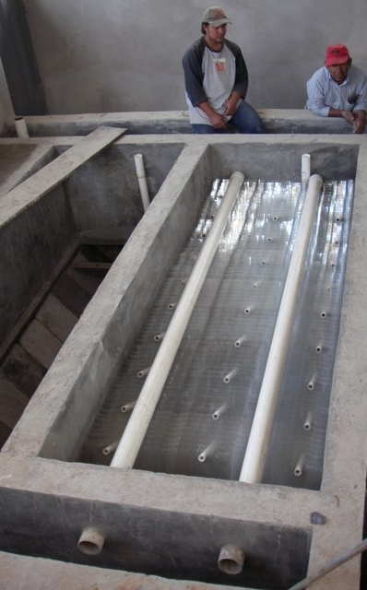
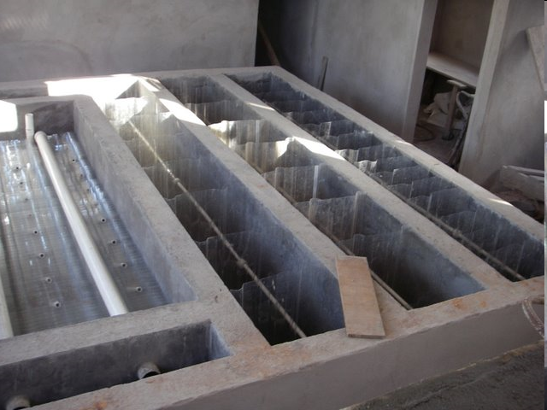
Flocculation
Sedimentation

Slide 14
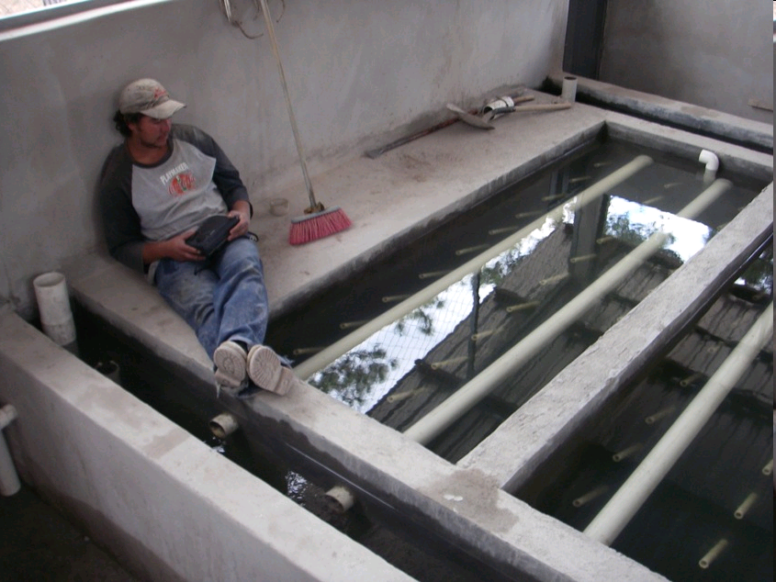

Slide 15
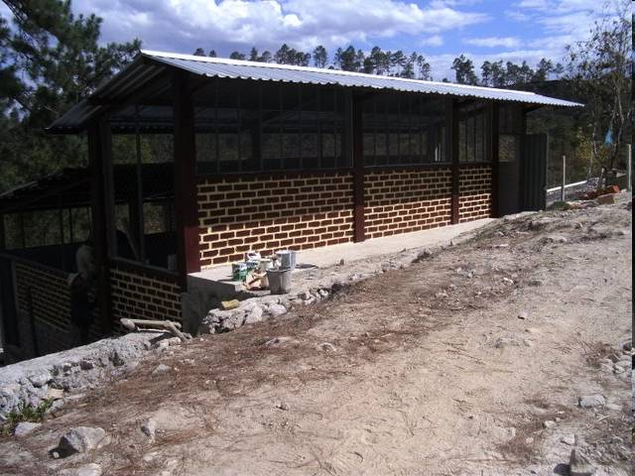
Local Labor
Local Materials
Open Source Technology
Community Owned and Operated

Slide 16
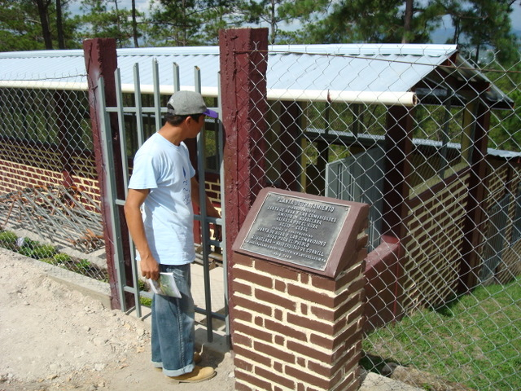
Cuatro Comunidades Plant

Slide 17
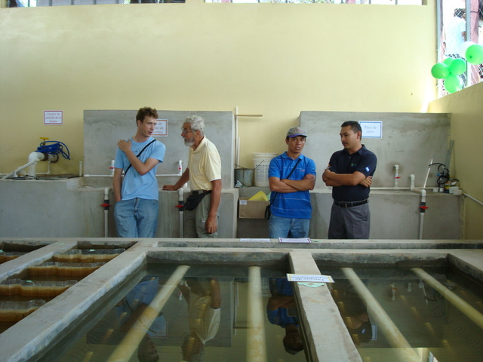
Chemical tanks

Slide 18
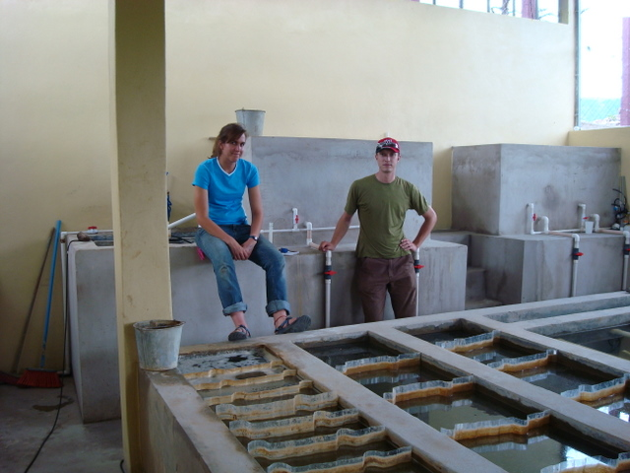

Slide 19
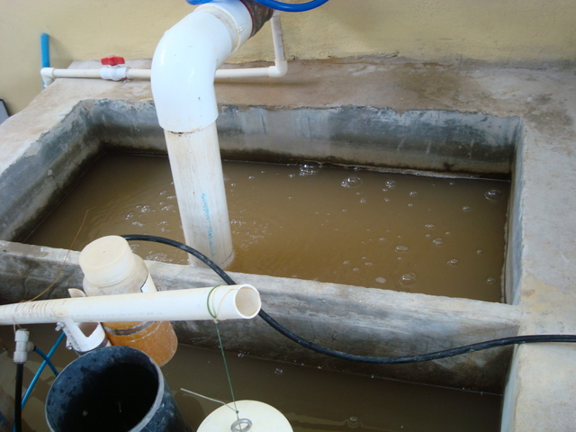
Raw Water (Entrance tank)

Slide 20
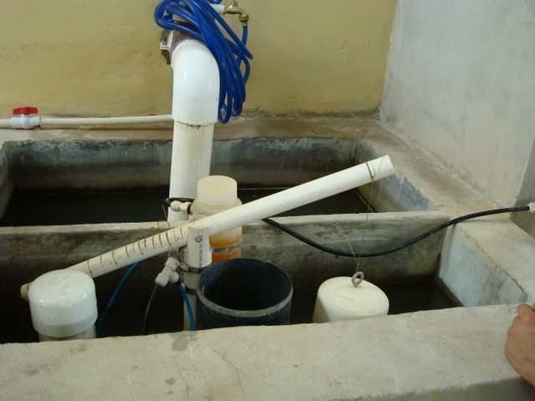
Chemical Doser

Slide 21
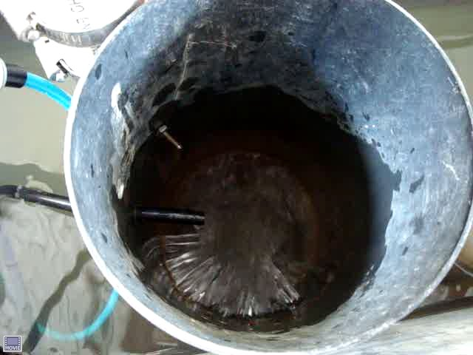
Water leaving the entrance tank

Slide 22
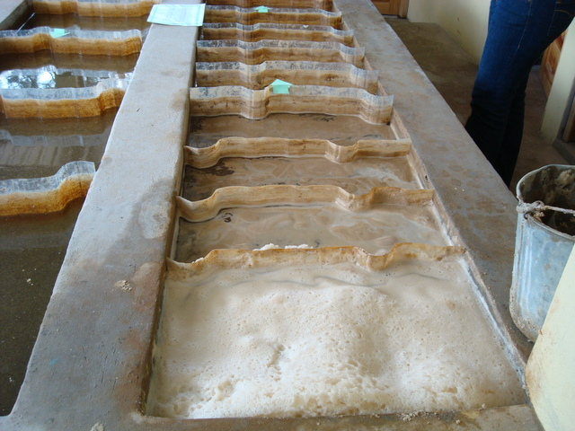
Flocculator

Slide 23
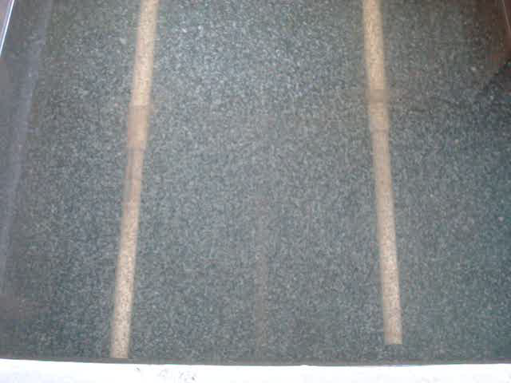
Flocs!

Slide 24
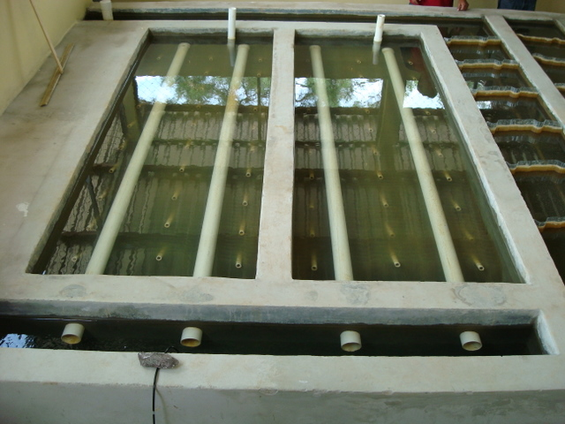
Sedimentation tank

Slide 25
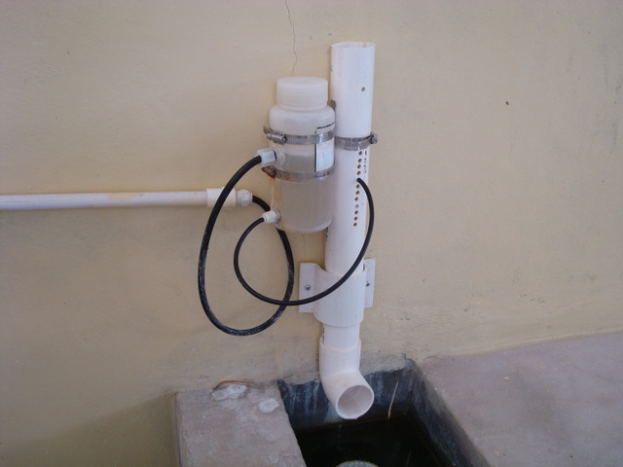
Chlorinator

Slide 26
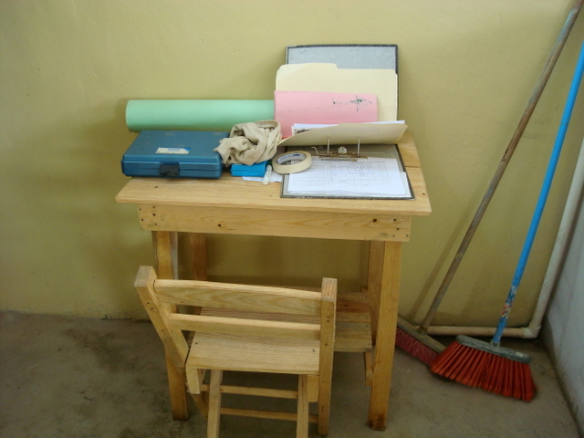
Desk for recording plant performance

Slide 27
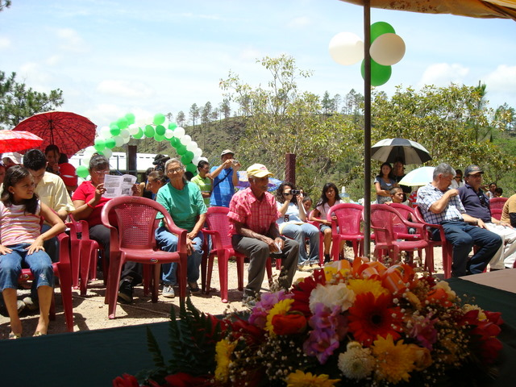
Inauguration Day

Slide 28
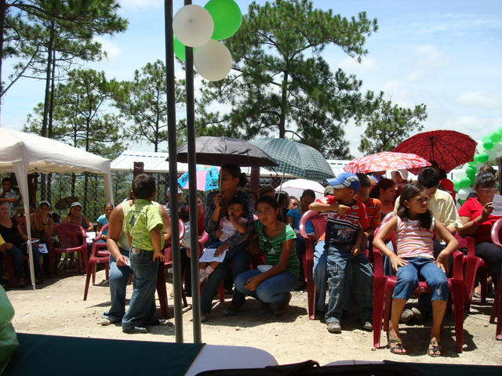

Slide 29
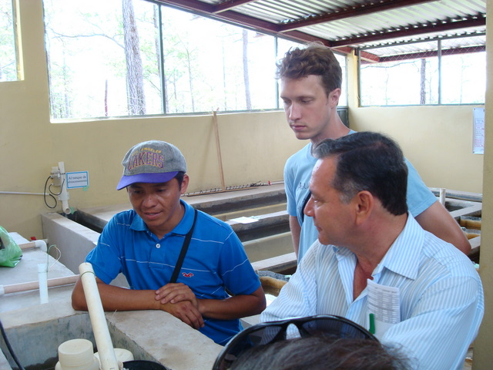

Slide 30
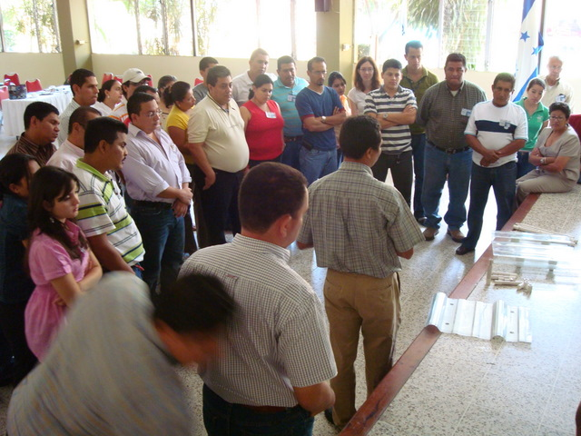
Workshop

Slide 31
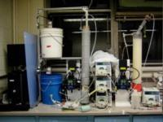

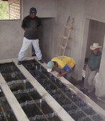

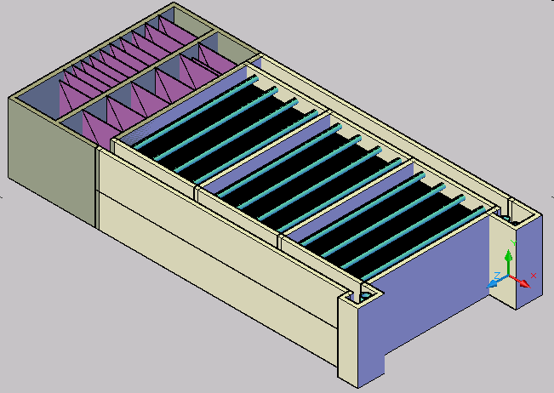
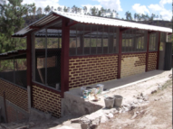
What does a team of 40 students do?
Laboratory Research
Analytical
Modeling
CFD
Evaluation
Normalized energy dissipation
Full Scale Implementation,
Capacity Building, Training, and Empowerment
Automated Design

Slide 32
Research
Approximately 1/2 of the student team is engaged in research to better understand the fundamental science of water treatment
We have the goal of consistently producing water that has less than 1 NTU (turbidity unit) without using electricity.

Slide 33


Slide 34
Automated Design Tool
A 3-year major team effort creating a tool that produces complete water treatment plant designs
Placed online May 2009 for global dissemination of designs
The tool is powerful and makes it possible to quickly check the effects of different design assumptions

Slide 35
Project Expansion
The need for surface water treatment is great in
  Latin America
  Sub-Saharan Africa
  South and South East Asia
Our model for scaling is to empower local partners to build the AguaClara plants using local materials and local construction techniques

Slide 36
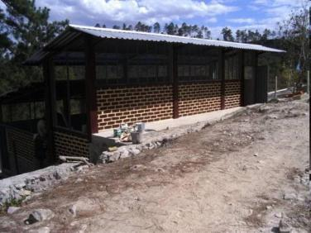
How much does it cost?
$20/person for the design-build-train-operate-transfer costs
About ¼ the cost of conventional water treatment technologies
Benefits from the free design service provided by the AguaClara team

Slide 37




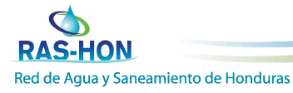

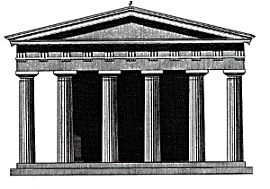

Partnerships
Funding
Sanjuan Fund
Cornell University
Friends of AguaClara
R&D
Design
Team trip to visit project sites
Water Treatment Plant
Municipal Government
Notes:
Partnerships are crucial for the sustainability of AguaClara.
Our success is measured partly by knowledge transfer. We need to have good relationships with our partners for this to happen. If knowledge transfer doesn’t happen, then AguaClara is a drip in a bucket rather than a river of life.

Slide 38
Growth within and beyond Honduras
New implementation partners (design, build, train, operate, monitor) selected through the RRAS-CA network
Funding in the initial stages organized by The Resource Foundation to support:
  Training of engineers and technicians
  Construction of demonstration AguaClara plants for cities near the capital cities
Gradual transition to funding provided by municipalities and central governments

Slide 39
Creating a win-win-win-win-win partnership
Communities in Latin America
Implementing Partners
The Resource Foundation
Donors
AguaClara

Slide 40
as a partner
We deliver the designs for the water treatment plants at no charge
We provide technical support
Cornell students get to work on a project with meaning
“I’ve been looking for a project that combines my interest in fluids with something that has more purpose than just building a fast car. Therefore, I am very interested in joining the AguaClara team and am especially interested in related CFD projects.”

Slide 41
as a partner
Funds projects that will provide excellent publicity and that provide a sustainable improvement to the lives of millions in Latin America
High visibility projects
Enthusiastic community support
High level institutional support from Cornell and national governments

Slide 42


Why we do what we do...
Find out more at AguaClara.cee.cornell.edu

Slide 43
Next steps…

