Slide 1
CFD for the AguaClara project: Connecting Advanced Simulation to Robust, Sustainable Tech
Swanson Engineering Simulation Program
Advisory Council
Oct 26, 2009
Monroe Weber-Shirk
Civil and Environmental

Slide 2

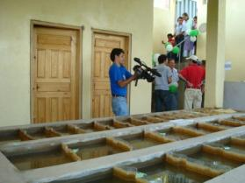
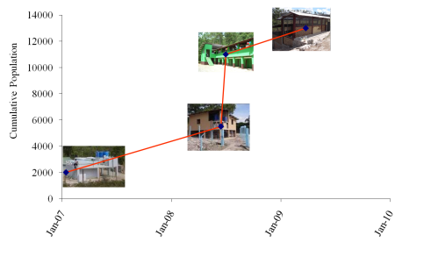

The AguaClara Story
The context
5 years of growth
The CFD connection
Reflections

Slide 3
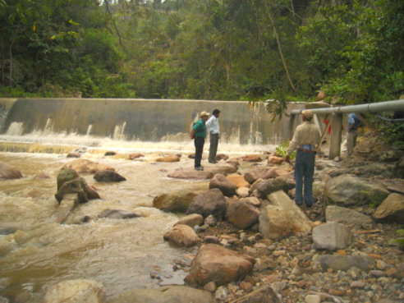
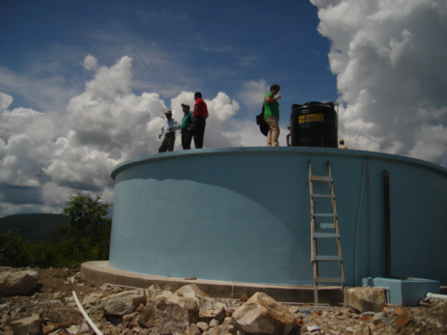
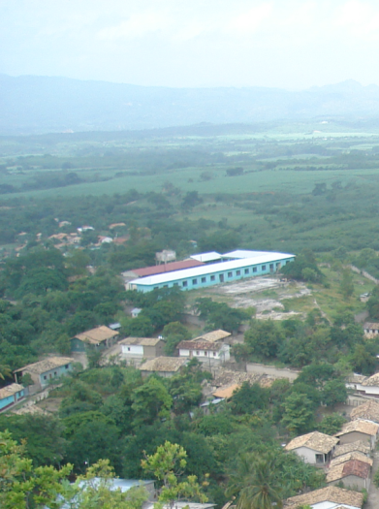
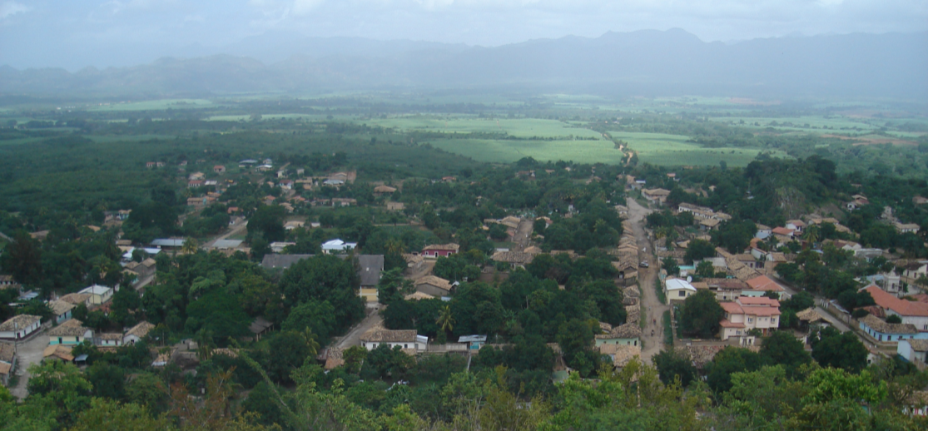
Tap Water: What you didn’t want to know

Slide 4
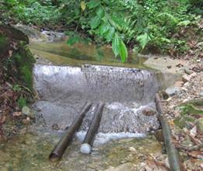
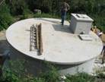
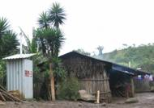
Gravity Water Supply
Drip Chlorinator
Distribution Tank
Spring box or dam

Slide 5
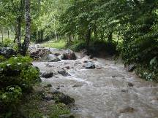
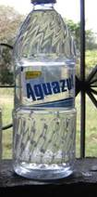
Flocculation – Sedimentation
Shear collisions
Chlorine
Aluminum sulfate
Without any electricity!
Rapid Mix
Flocculation
Sedimentation

Slide 6
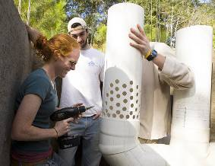
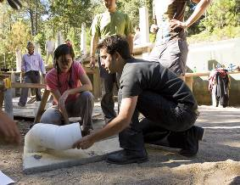
The AguaClara Niche
Globally we estimate that 125 million could benefit from AguaClara water treatment plants
To meet that need in 10 years our partners would need to be building approximately
3 plants per day
Notes:
6

Slide 7
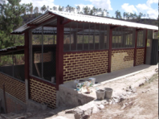
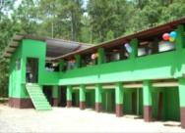
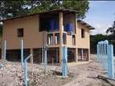

Population Served by AguaClara

Slide 8
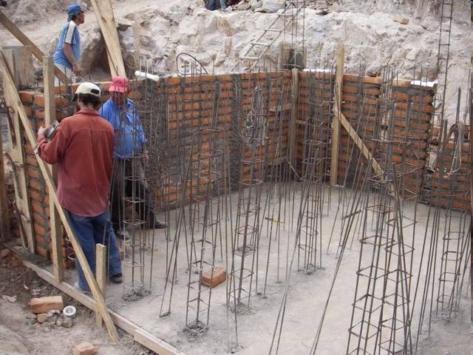

Slide 9
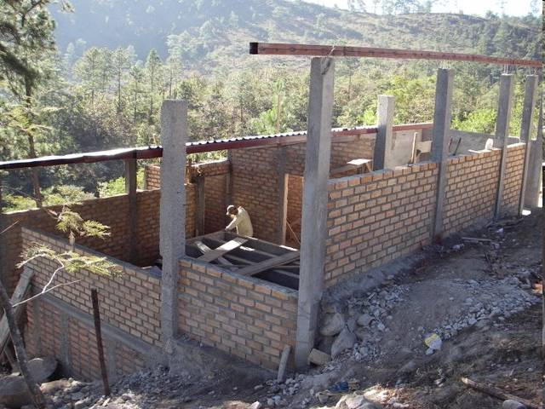

Slide 10
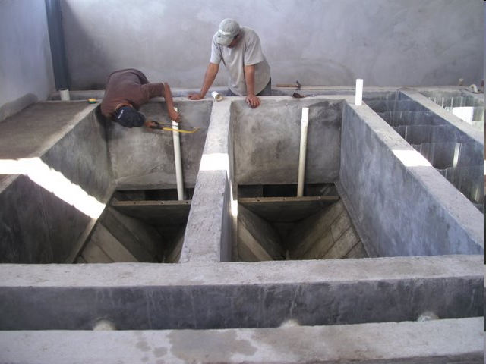

Slide 11
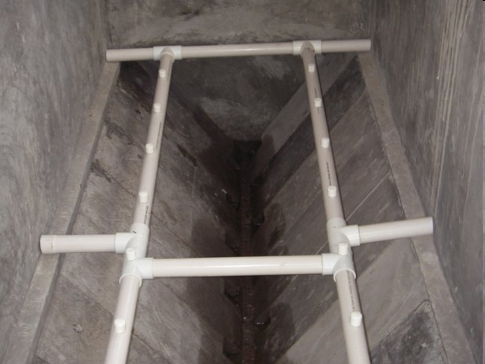

Slide 12
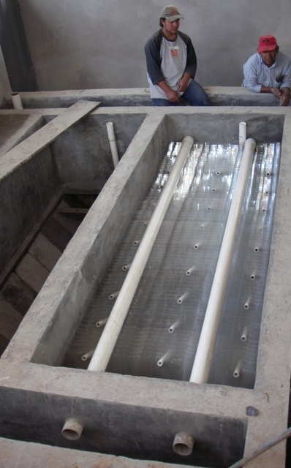
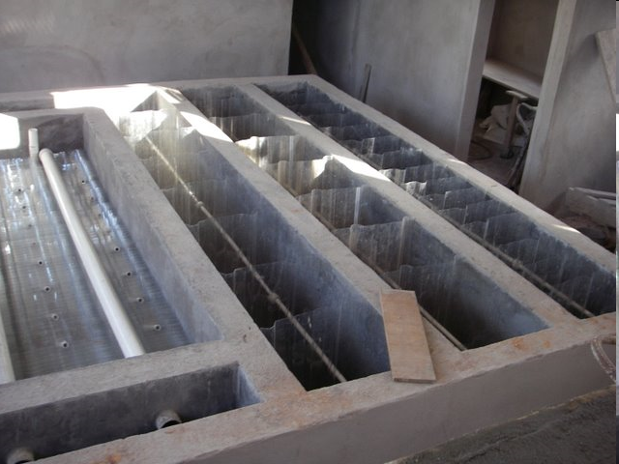
Flocculation
Sedimentation

Slide 13
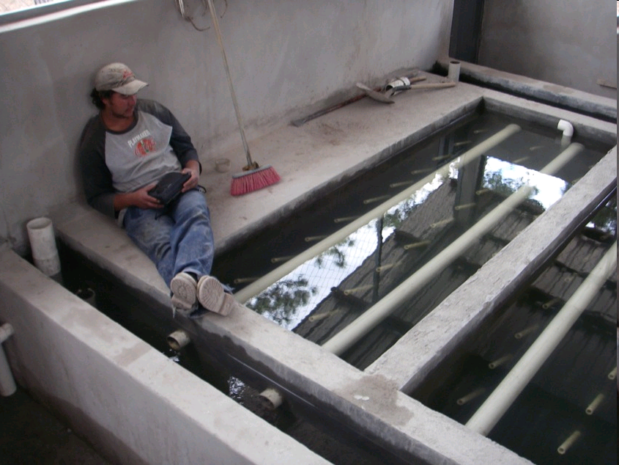

Slide 14
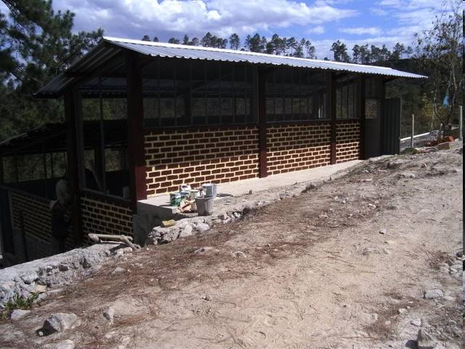

Slide 15
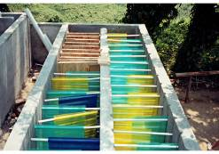
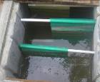
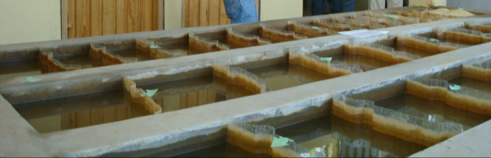
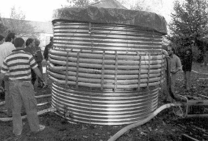
Hydraulic Flocculators
Horizontal baffle
Vertical baffle
Pipe flow

Slide 16
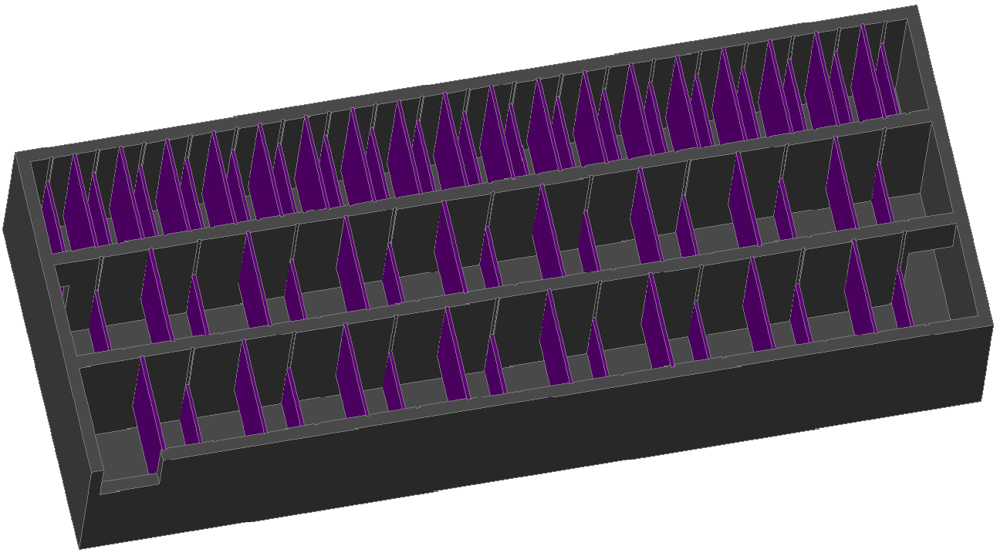
Flocculator Geometry
Rapid mix orifice (not yet drawn)
Channels
Ports between channels
Upper Baffles
Lower Baffles
Exit to sedimentation tank entrance channel
Notes:
planta de 50 Lps con 2 cámaras de sedimentación

Slide 17
How do the flocs grow?

Slide 18
Exponential growth
It takes about 30 sequential collisions to make a 1 mm particle starting from 1 μm particles!
The challenge is to understand how much time is required by each collision

Slide 19
Collision Time between two flocs
D_{Fractal} = 2.3
d₀ = 1 μm
ε = 1 mW/kg
Viscous
Turbulent

Slide 20
Collision Potential
The Collision Potential required to make large flocs is a characteristic of the suspension
  Analytical flocculation model
The Collision Potential provided by the flocculator is a characteristic of the flocculator.
  Computational Fluid Dynamics

Slide 21
Enter CFD
We need to characterize the collision potential provided by a reactor
We need to characterize the spatial distribution of the energy dissipation rate as a function of reactor geometry

Slide 22
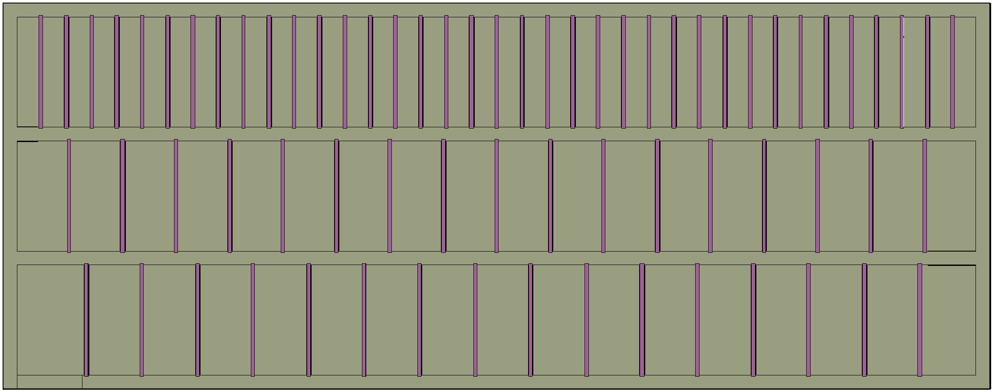
Top View
W = Width of the flocculator channel
S = Space between baffles
L = Length of a flocculator channel
S
W
L
Notes:
planta de 50 Lps con 2 cámaras de sedimentación

Slide 23
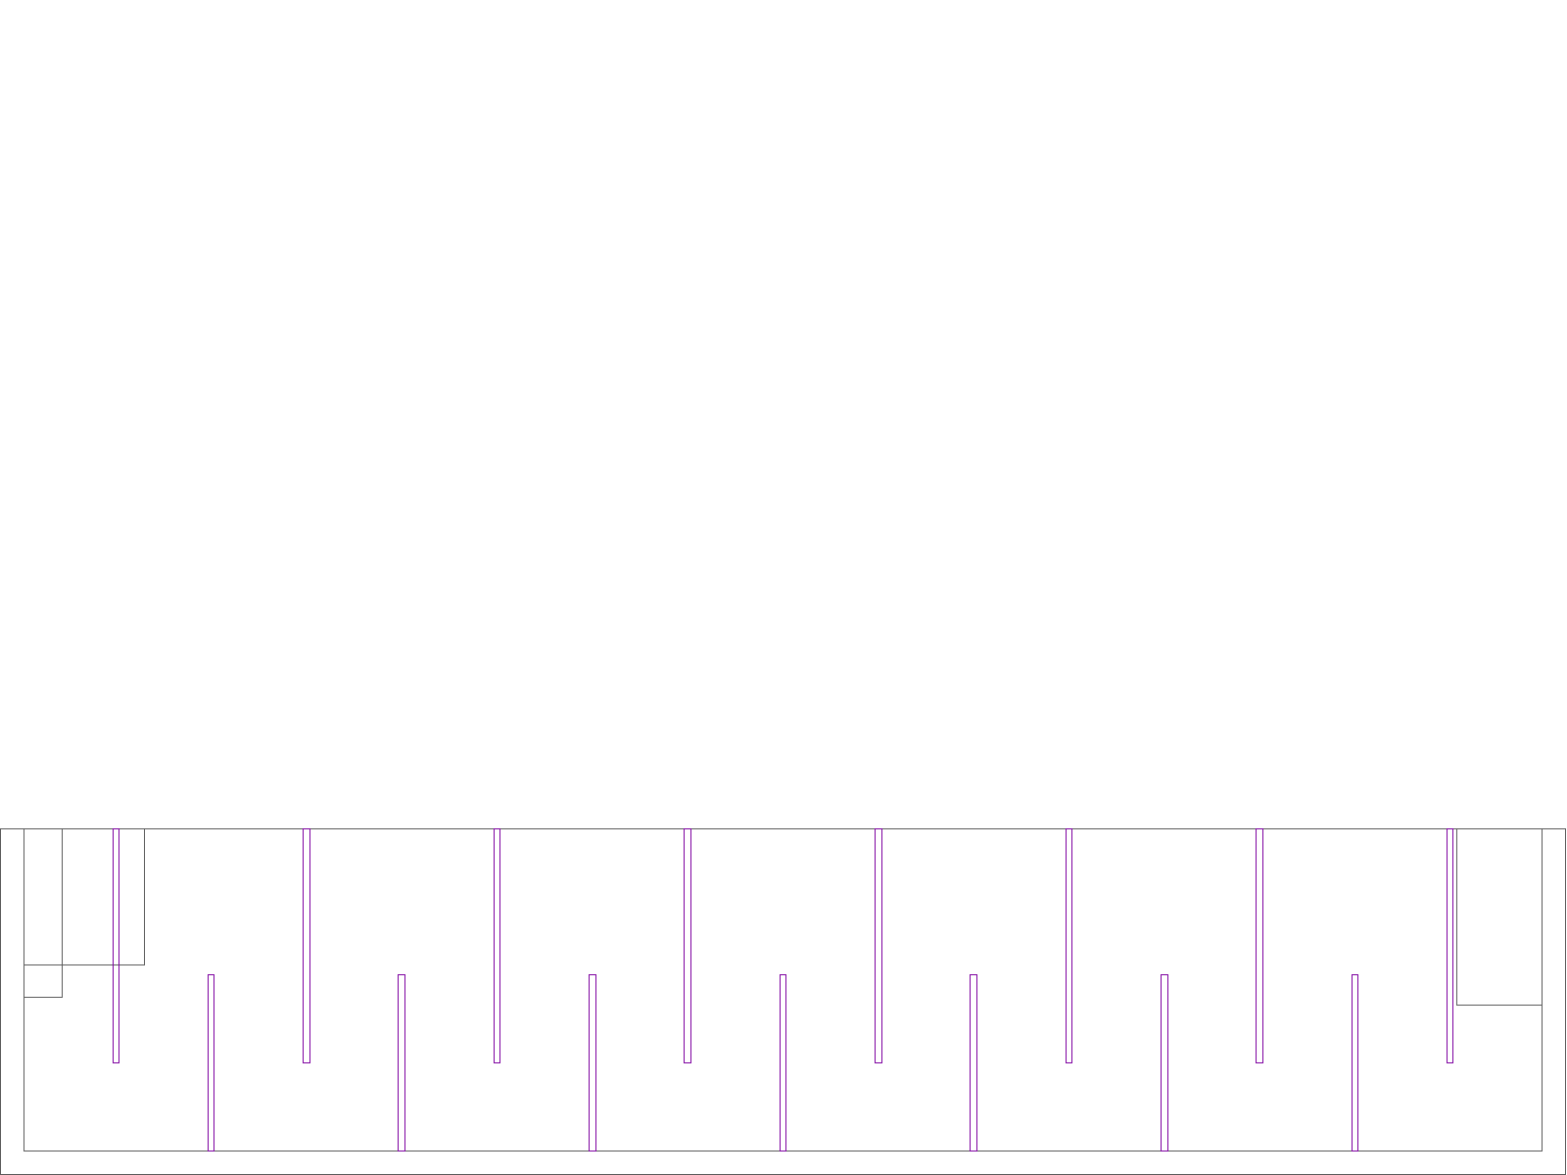
Side View
HW = Water depth
L = Length of the flocculator channel
S = Space between baffles (and between the bottom of the tank and bottom of the upper baffles)
T = Thickness of the baffles
B =Perpendicular center to center distance between baffles
T
Upper baffles
S
H
B
S
S
L
Lower baffles
Notes:
planta de 50 Lps con 2 cámaras de sedimentación

Slide 24
How can we optimize the design of the flocculator?
The H to S ratio influences the efficiency of the flocculator
We used computational fluid dynamics (CFD) and the software FLUENT
From that analysis we were able to create relationships between the reactor geometry and the collision potential
H
S

Slide 25

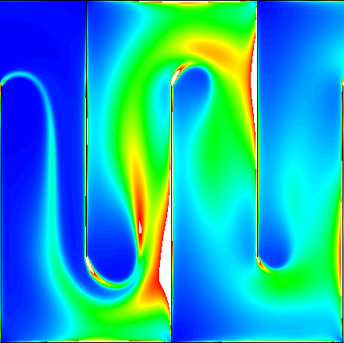
Results of the CFD analysis: H/S = 4
S = 0.1 m
H = 0.4 m
V = 0.1 m/s
2d analysis
The energy dissipation rate is an indicator of the collision rate

Slide 26
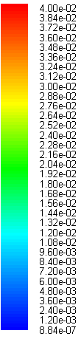

The Energy Dissipation Rate isn’t uniform
Ideally (for optimal efficiency) the flocculator would have a completely uniform energy dissipation rate
We can evaluate the efficiency of various designs as a function of H/S

Slide 27
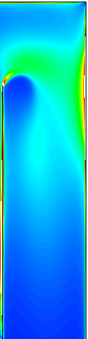
Flocculation Efficiency
Which space between baffles is better considering the uniformity of the energy dissipation rate?
This space with very low energy dissipation rate doesn’t contribute much
H/S = 4
H/S = 10

Slide 28






Flocculation Efficiency
Flocculation Efficiency given the non uniform energy dissipation rate
2
3
4
5
6
7
8

Slide 29
Pressure Coefficient
Effect of the high velocity jet from the previous contraction
Effect of wall shear
K_{P}
K_{P} head loss (or pressure) coefficient due to the expansion and wall shear

Slide 30
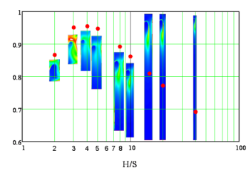
Why evaluate designs that are far from the optimum?
Prior to AguaClara it was assumed that hydraulic flocculators couldn’t be scaled to work for small flows
We proved that it is possible, but the geometric requirements of construction forced us to use suboptimal geometry
With CFD we obtained the tradeoff from the suboptimal geometry
Small plants will need longer residence time and more baffles to achieve adequate flocculation

Slide 31
Results of CFD Analysis
ψ_{P} is the collision potential in the space between two baffles.
CFD data
This equation is thought to be valid for all designs, but additional work must be done to verify that it is independent of Re
This graph is only valid for the case of S = 0.1 m

Slide 32
A Surprising (and beautiful) Result
This simple relationship is the result of curve fitting the CFD data
It is possible that the collision potential will be somewhat affected by the Reynolds number, but this effect will probably be small
We can design a flocculator for the maximum flow rate and be confident that the flocculator will also work for lower flow rates

Slide 33
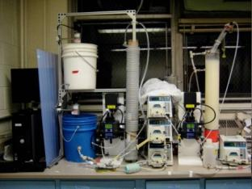

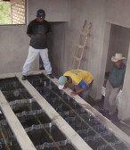
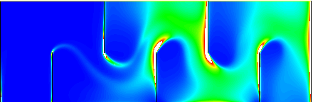
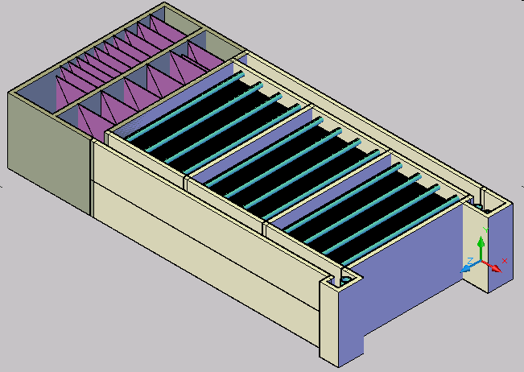
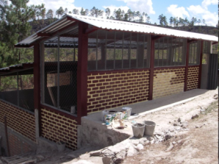
Integration of CFD into R&D
Laboratory Research
Analytical
Modeling
CFD
Evaluation
t?
Normalized energy dissipation
Full Scale Implementation,
Capacity Building, Training, and Empowerment
Automated Design

Slide 34
Reflections
I don’t have access to any other research tools or facilities that could provide the information that we needed to characterize hydraulic flocculators, except PIV…
We plan to compare the CFD results to a limited number of PIV observations to check the results
The CFD approach allows us to quickly vary the geometry and the Reynolds number over the range of interest

Slide 35
Challenges of using CFD
Computers lack intelligence
All forms of research benefit from prior experience and knowledge
The great flexibility of a research tool comes at the cost of a large number of ways to use it incorrectly and to produce large quantities of useless results
Dr. Bhaskaran provides the experience and knowledge to guide students to success

Slide 36
Acknowledgements
Wenqi Li, Yong Sheng Khoo, and Jesse Pragar: did the CFD work presented here
Dr. Bhaskaran: adviser for the AguaClara CFD team
Over 100 students who have contributed to the AguaClara project
…
…

Slide 37
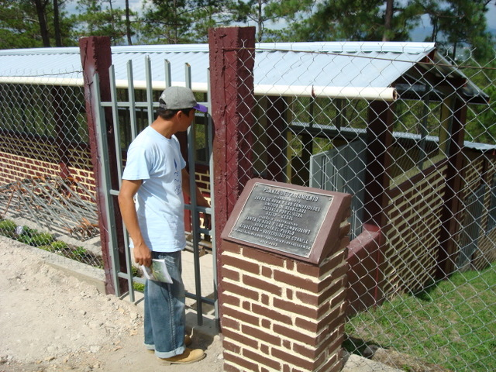
Cuatro Comunidades Plant

Slide 38
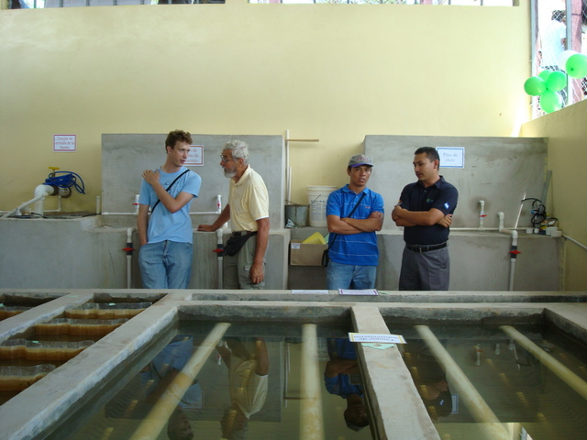
Chemical tanks

Slide 39
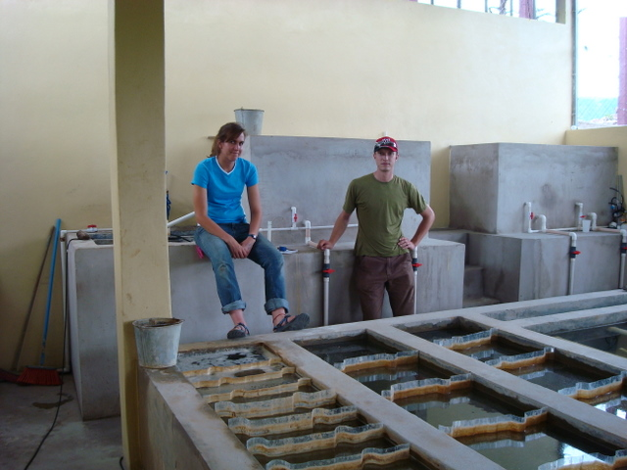

Slide 40
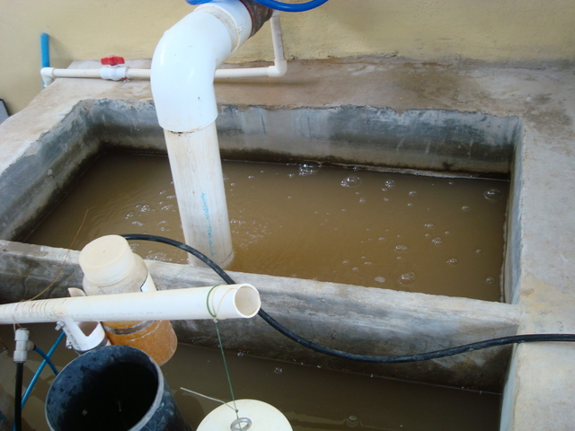
Raw Water (Entrance tank)

Slide 41
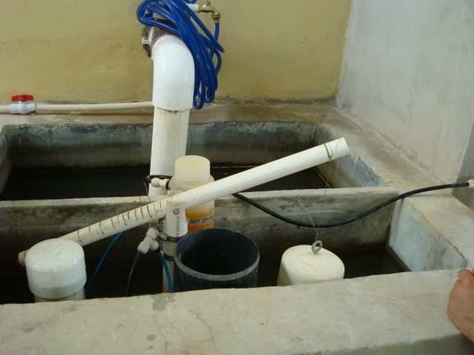
Chemical Doser

Slide 42
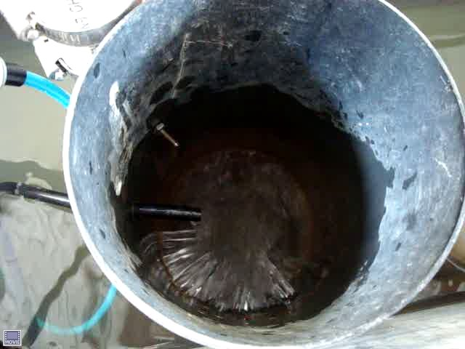
Water leaving the entrance tank

Slide 43
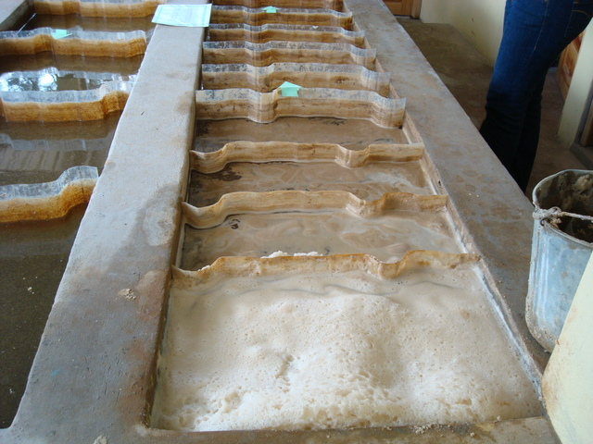
Flocculator

Slide 44
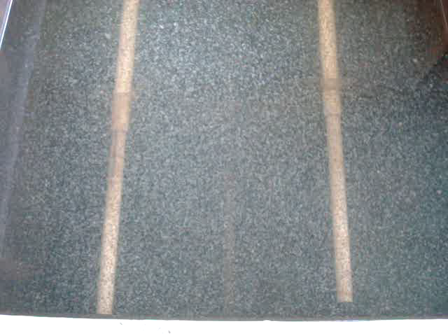
Flocs!

Slide 45
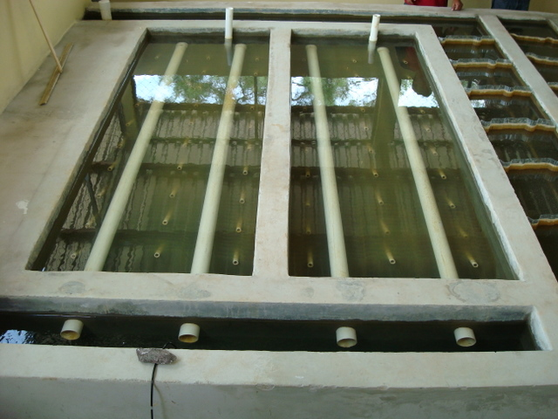
Sedimentation tank

Slide 46
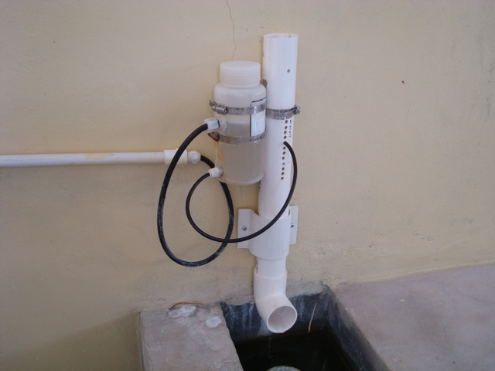
Chlorinator

Slide 47
Integration of CFD into R&D
Laboratory Research
Analytical
Modeling
CFD
Evaluation
t?
Normalized energy dissipation
Full Scale Implementation,
Capacity Building, Training, and Empowerment
Automated Design

