Slide 1
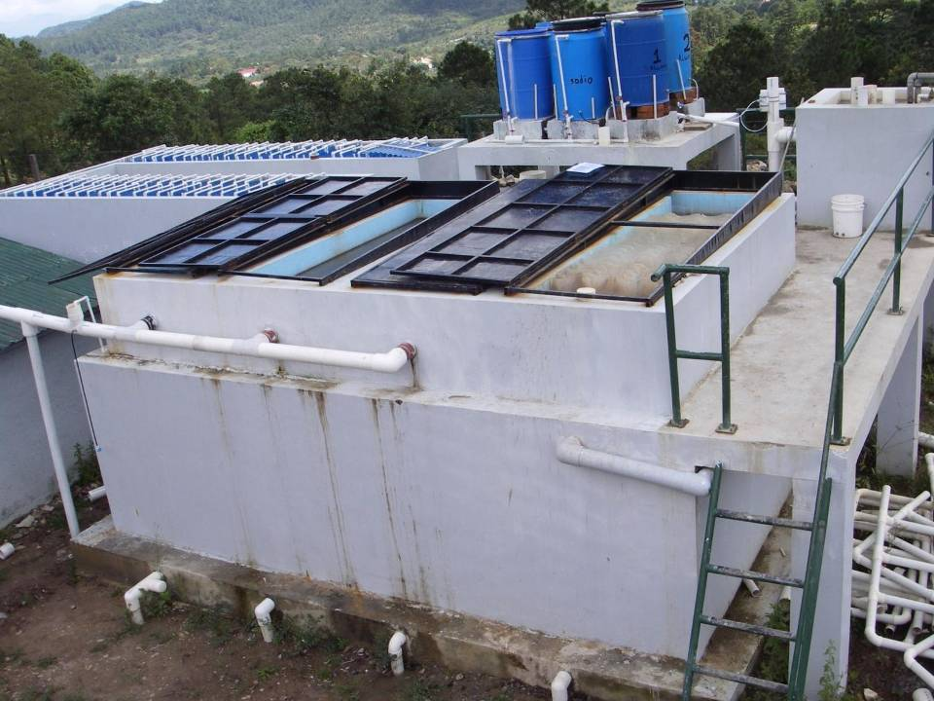


AguaClara:
State of the Project in Honduras
AguaClara Advisory Council Meeting
March 5, 2010
Phone conference: Cornell University, New York and Tegucigalpa, Honduras

Slide 2
Goals of the presentation
Update the AguaClara Advisory Council on the current state of the project in Honduras
  State the overall goals and aspirations of the project
  Report on recent and current activities in Honduras and Central America
  Report on the near and mid-term outlook for the future
  Collaborate with the Advisory Council to direct the future course of the project

Slide 3
AguaClara
Goals and Aspirations
1) To expand drinking water treatment coverage through the construction of non-mechanized, gravity-powered drinking water treatment plants and the provision of the technical and social support that ensures their sustainability.
  Outreach – a resource for communities with water quality problems that need technical and organizational support to solve them.
  Design – non-mechanized, gravity-powered, and operationally simple water treatment plants.
  Construction – infrastructure built as much as possible with local materials, oversight, and labor.
  Operator and Administrator Training – education of the treatment plant operators and the local leaders responsible for plant administration
  Technical Support – constant on-the-job training and education for the plant operators and the local administration for a period after plant construction
  Social support
  Long-term Assistance

Slide 4
AguaClara
Goals and Aspirations
2) To continue to innovate and implement new technology for the treatment of drinking water at the community scale where conventional strategies may not be appropriate.
  University teaching and research
    Undergraduate research and classes
    Graduate level research and design
    Research grants related to non-mechanized water treatment
  Field research and documentation
    Estudio de documentación de las plantas AguaClara
    Student on-location field research in AguaClara plants
    Implementation of new component designs in the field in conjunction with local partners
    Encouraging innovation and idea exchange between local operators and administrators
  Construction of water treatment plants with design improvements for each plant

Slide 5
AguaClara
Goals and Aspirations
3) To develop relationships with local, national, and regional institutions as collaborating partners in the improvement of water quality through the development of water treatment plant projects.
  Disseminate the experiences of implementing AguaClara projects to national and international organizations via the internet, conferences, presentations, and publications.
  Develop relationships with national level organizations that could assist with the regulation and continuity of adequate water treatment in communities with an AguaClara treatment plant.
  To make the AguaClara design and methodology known as a viable choice for drinking water treatment interventions amongst the principal players in the sector.

Slide 6
AguaClara
Goals and Aspirations
4) To continue to foster the technical and cultural exchange between local and international partners for the advancement and dissemination of water treatment knowledge.
  Empower and educate resident AguaClara staff to spearhead the development and implementation of water treatment innovations and projects.
  Maintain the link between Cornell University engineering students and AguaClara’s Honduran partners through student trips and exchange experiences in Honduras.
  Support the creation of a program that allows Honduran university students and/or young professionals to work as interns with the AguaClara staff in all facets of the project, especially technical field work and interfacing with the communities served.
  Maintain an emphasis on including the members of the communities served in the water treatment plant projects and the transfer of knowledge that supports them.

Slide 7
Current Project Organization and Staff in Honduras
Jacobo Nunez and Arturo Diaz
Daniel Smith, Sarah Long, Antionio Elvir, and Wilfredo Serrano

Slide 8
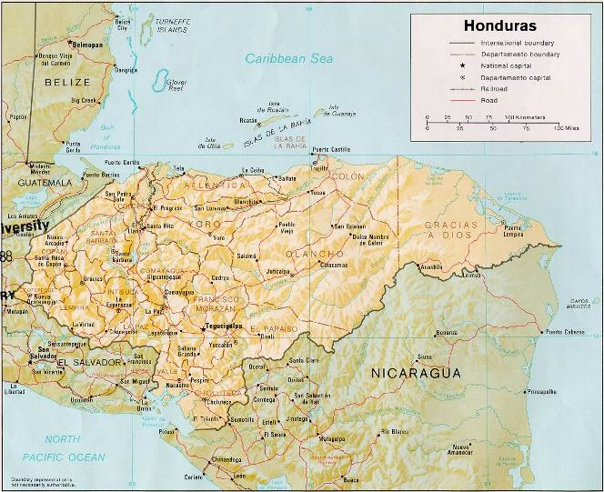
Recent and Current Activities:
Current Treatment Plants
Agalteca,
Francisco Morazán
Marcala,
La Paz
Cuatro Comunidades,
Francisco Morazán
Támara,
Francisco Morazán
Ojojona,
Francisco Morazán

Slide 9
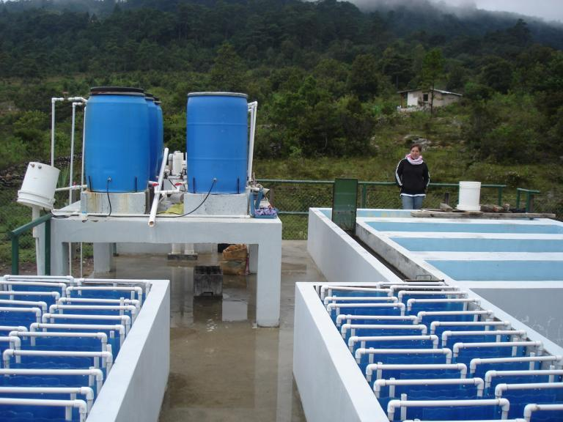
Ojojona
Notes:
9

Slide 10
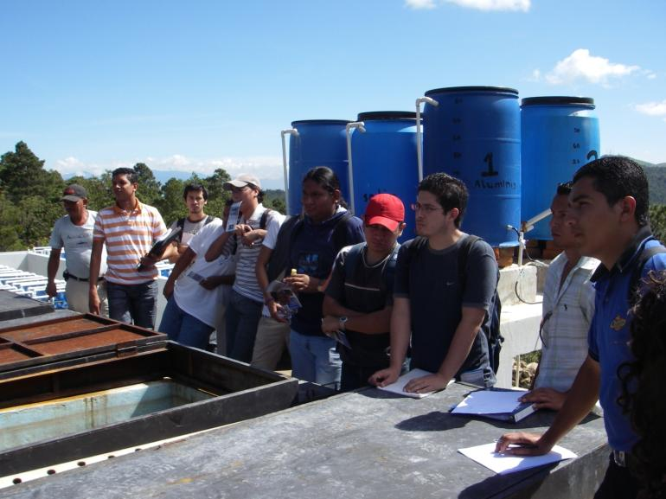
Ojojona
Notes:
10

Slide 11
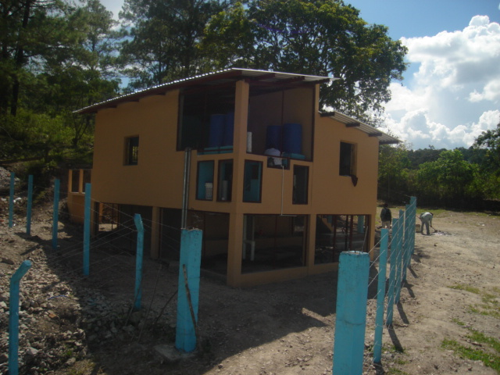
Tamara
Planta de tratamiento de Támara, Francisco Morazán
Notes:
11

Slide 12
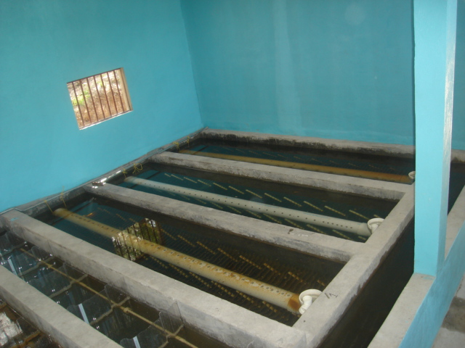
Inside Tamara
Sedimentation Tanks
Distribution
Canal
Notes:
12

Slide 13
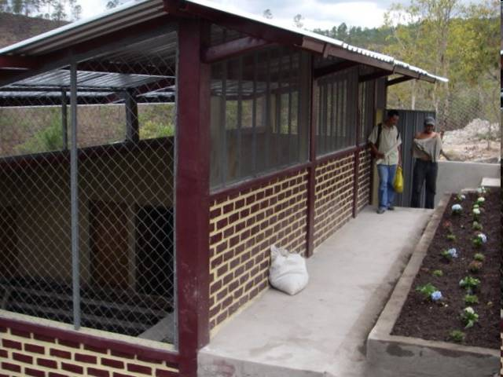
Cuatro Comunidades
Notes:
13

Slide 14
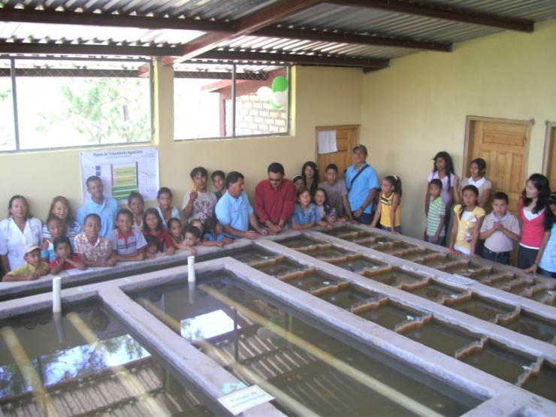
Inside Cuatro Comunidades

Slide 15
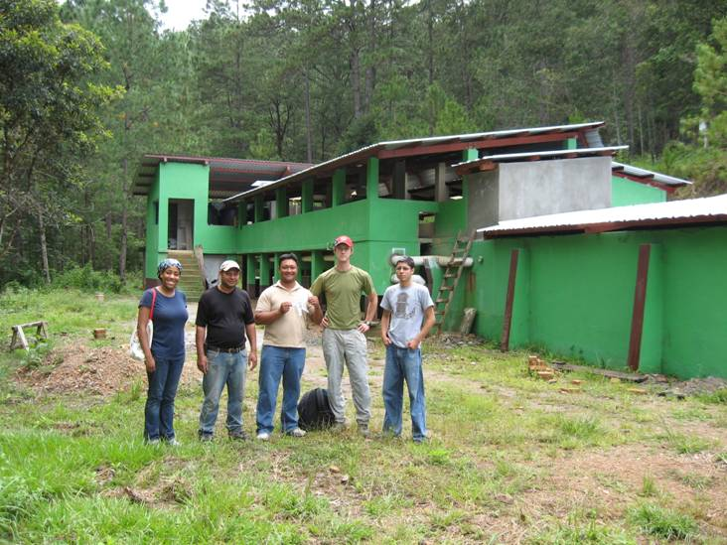
Marcala
Notes:
15

Slide 16
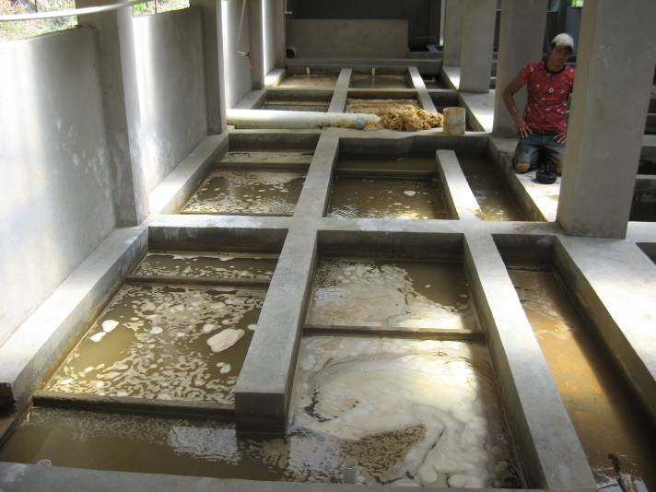
Marcala Inside
Operator Edwin
Notes:
16

Slide 17
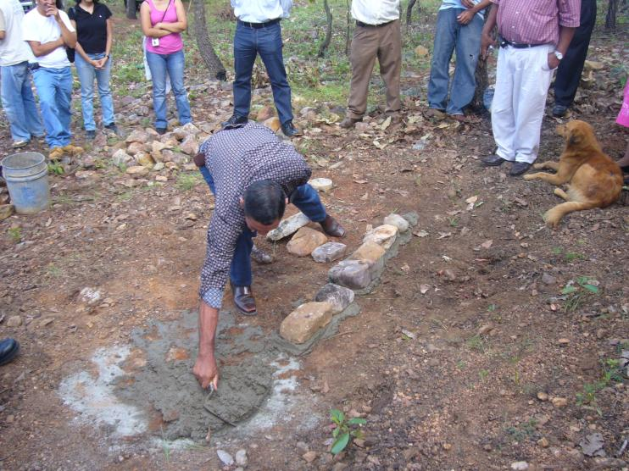
Construction Advances in
Agalteca

Slide 18
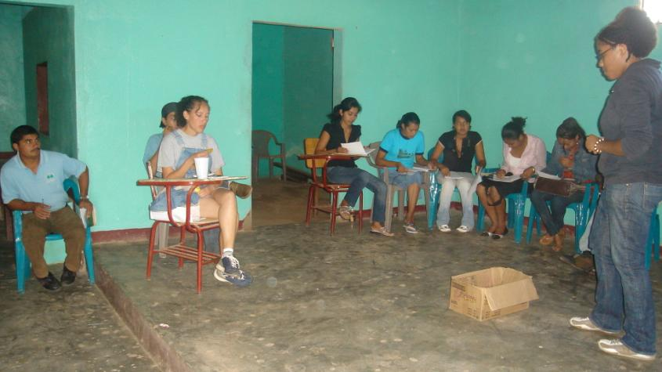
Construction Advances in
Agalteca

Slide 19
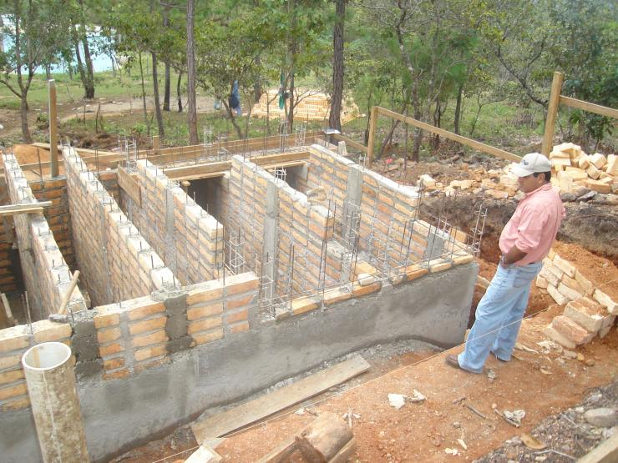
Construction Advances in
Agalteca

Slide 20
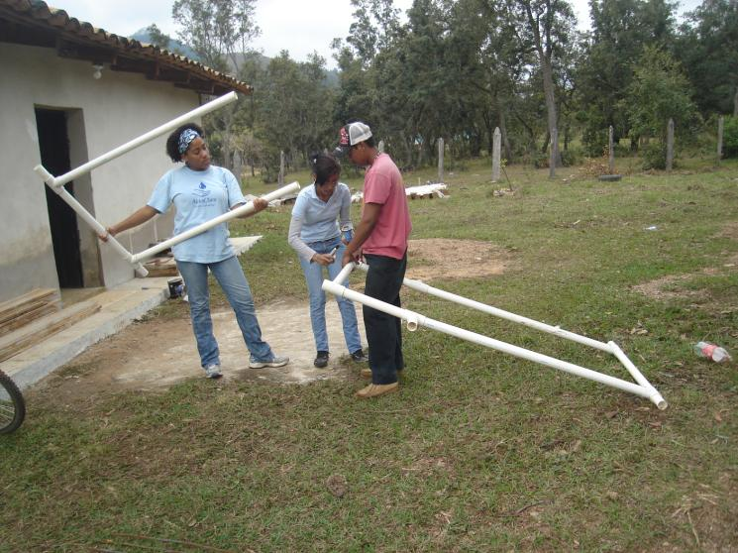
Construction Advances in
Agalteca

Slide 21
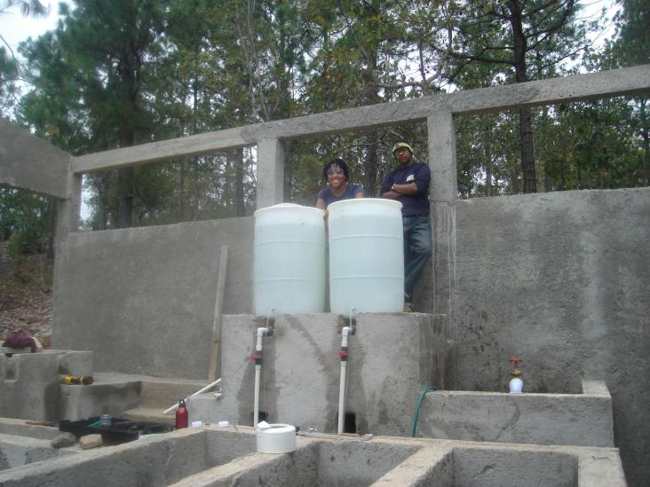
Construction Advances in
Agalteca

Slide 22
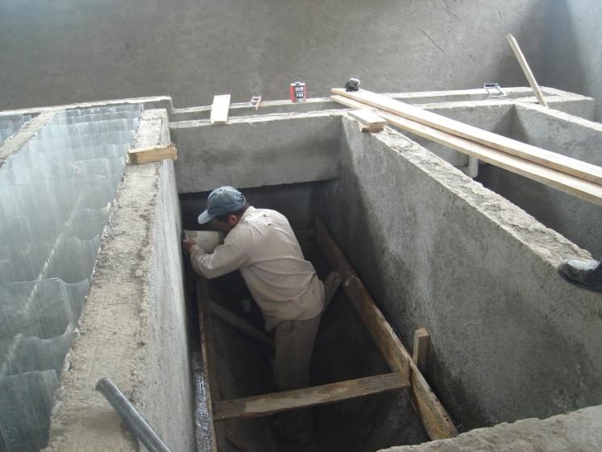
Construction Advances in
Agalteca

Slide 23
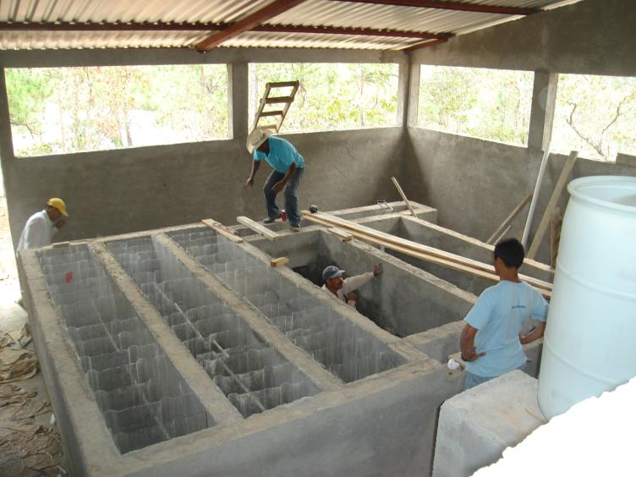
Construction Advances in
Agalteca

Slide 24
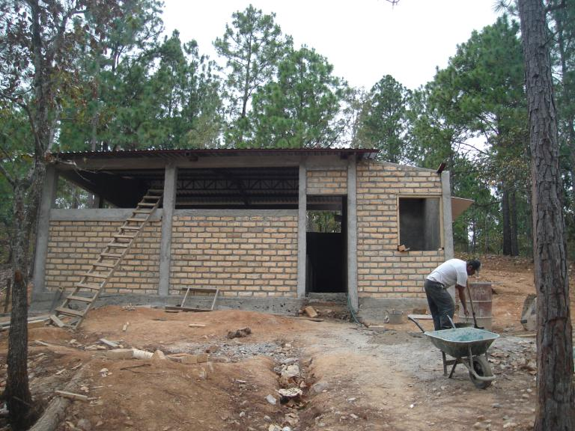
Construction Advances in
Agalteca

Slide 25
Recent and Current Activities:
Potential or Proposed Treatment Plants
Siguatepeque,
Comayagua
Atima,
Santa Bárbara
Santa Rosa de Copán,
Copan
Jalaca,
Francisco Morazán
Gracias,
Lempira

Slide 26
Documentation and Publicity
Documentation and publicity efforts in 2009-2010:
  Monroe’s short course at the UPI in Tegucigalpa, June 2009
  Documentation study – Dan’s Fulbright project
  Presentation at the AIDIS Conference in Guatemala City, November 2009
  Presentation to RAS-CA in San Salvador, December 2009
  Presentations to various organizations in Guatemala, January 2010

Slide 27
Institutional Connections
In 2009 AguaClara made connections with the following institutions in the region to promote projects or as potential collaborators:
  Regional water sector organizations and academic institutions
    RAS-HON - Water and Sanitation Network of Honduras
    RAS-GUA - Water and Sanitation Network of Guatemala
    RAS-NIC - Water and Sanitation Network of Nicaragua
    RAS-CA - Water and Sanitation Network of Central America
    Universidad Politecnica de Honduras – Tegucigalpa, Honduras
    ERIS – Regional School of Sanitary Engineering, Universidad de San Carlos, Guatemala
    Universidad Santo Tomas en Tunja – Tunja, Colombia

Slide 28
Institutional Connections
In 2009 AguaClara made connections with the following institutions in the region to promote projects or as potential collaborators:
  Current and potential project implementation partners:
    Honduran National Congress – Congressman from the district that includes Agalteca secured national funds for project
    Alianza Para el Agua – Spanish NGO that funded materials for Cuatro Comunidades and Agalteca and could fund more
    PROMOSAS (Honduras Secretariat of Finance) – Funds municipal water companies with Inter-American Development Bank funds:
      Aguas de Siguatepeque
      Aguas de Comayagua
      Aguas de Choluteca
    Solidaridad Internacional – Spanish NGO working in Central America with funds from the Cooperacion Espanola
      Project to refurbish water system in Gracias, Lempira including a treatment plant
    ACRA – Italian NGO working in Marcla, La Paz
    FHIS – Fondo Hondureno de Inversion Social that has numerous Multiple-Stage Filter projects

Slide 29
Outlook for the Future:
New Projects
Potential treatment plant projects with significant progress:
  Gracias, Lempira (50 L/s) – partnership with Solidaridad Internacional is strong, funds approved, but still suspended
  Atima, Santa Barbara (6 L/s) – design complete, project proposed to but declined by Japanese cooperation
  Jalaca (6 L/s) – Local water board motivated and potential to revitalize old infrastructure
  Siguatepeque (16 L/s) – Municipal water company and its funding source have said they definitely want an AguaClara plant, delays due to political changes and Inter-American Development Bank funding policies
  Santa Rosa de Copan – preliminary design presented to the water company which is motivated, stalled due to political changes and suspension of aid from the Cooperacion Espanola

Slide 30
Outlook for the Future:
Continuing Outreach Efforts
AguaClara’s current plans for continuing to make the project and treatment strategy more widely known:
  Meetings with mayors offices, CARE, and a university on the rainy North Coast of Honduras (March 22-25, 2010)
  Presentation of the documentation study results (April 2010)
  Short course to be given by Monroe at the Universidad de San Carlos, Guatemala (June 2010)
  Presentation at the II Civil and Environmental Engineering Congress, Universidad de Tunja, Colombia (May 5-6, 2010)
  Presentations to the RAS-NIC in Managua, Nicaragua (pending)
  XX World Water Week, Stockholm, Sweden (Hopefully September 2010 – abstract pending acceptance)

Slide 31
Outlook for the Future:
Continuing Projects
We need to find a way to continue supporting the plants we built and the Juntas de Agua that we trained:
  Ojojona, Francisco Morazan (6 L/s) – Though badly in need of updates, the plant works but suffers from under use (drought, Junta de Agua organization and low motivation)
  Tamara (10 L/s) – Recent improvements to flocculation dramatically improved plant ease to operate, operational situation relatively stable
  Cuatro Comunidades (6 L/s) – going into second year of operation, functions well overall though treatment of very high turbidity is made difficult by extremely low alkalinity
  Agalteca (6 L/s) – Construction nearly complete, tanks now holding water, should be running within a month (before the rains!)
  Marcala, La Paz (33 L/s) – Though not officially built by AguaClara, benefits from our support and has a large impact on its beneficiaries. Potential project for plant expansion through the municipality’s connection with the Italian NGO ACRA.

Slide 32
Present and Future Challenges
Funding for Projects
  Double-whammy of the world economic crisis and the Honduran coup of June 28, 2009 decimated investment in the water sector in the county
  We have several potential projects that our collaborators want to do but their funding sources are still suspended
  Personnel – uncertainty in future projects makes the Honduran staff nervous about job security
  Downturn also affects APP which is integral to supporting AguaClara projects

Slide 33
Present and Future Challenges
Supporting past projects
  These projects are never done and we feel they need a certain amount of long-term support
  How to support these plants and people in a regulatory vacuum and system geared towards construction only?
Choosing an organization model
  We want the project to be self-sufficient with income from projects
  In the absence of new projects, and with the need to support past projects, we must find a way to sustain the project and its goals

Slide 34
Reflections on the Experience
We are operating in a vacuum of a culture of attention, knowledge and support for public water treatment
Unlike other government agencies or NGOs we are virtually independent from a larger organization, which gives immense freedom but some insecurity
If there is one thing that sets us apart, it is that we keep going back and supporting the projects as much as we can

