Slide 1

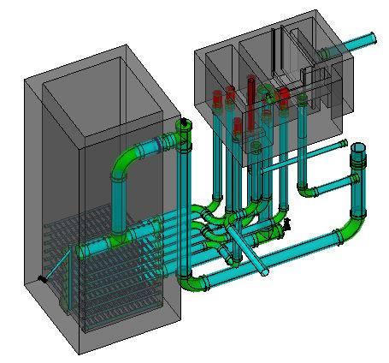
Evaluation of the Performance of the AguaClara Stacked Rapid Sand Filter (SRSF)
Authors:
  Jeffrey C. Will
  Michael J. Adelman
  Monroe L. Weber-Shirk
  José Jacobo Núñez Vásquez
  Leonard W. Lion
  Gilberto Arturo Diaz Ordóñez
  Santiago Alberto Garcia Ochoa
  Daniel W. Smith

Slide 2
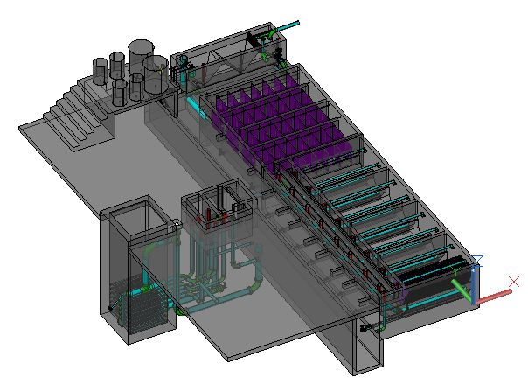
Contents
The AguaClara Technology and Program
SRSF vs. Other Filters
Siphon Hydrostatics
Hydraulic Control System
Performance Data
Conclusions and Recommendations

Slide 3
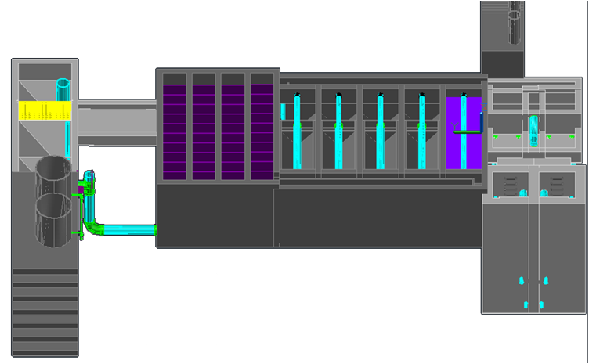
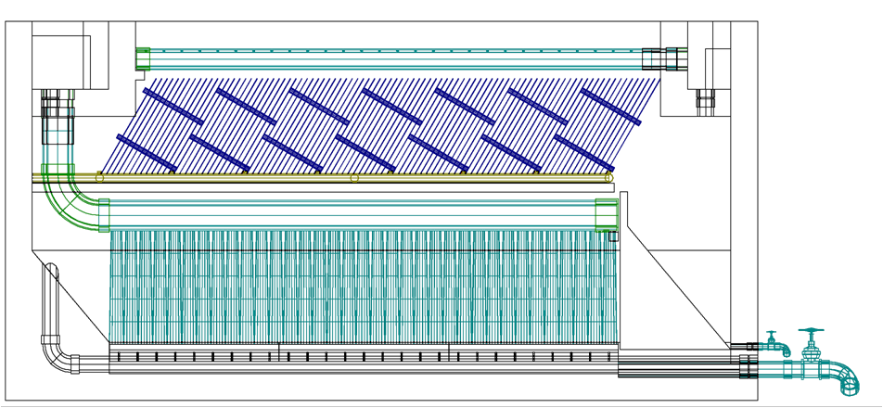
AguaClara Technology
Entrance Tank
Flocculator
Sedimentation
Filters
Stock Tanks

Slide 4

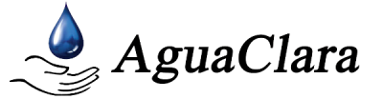
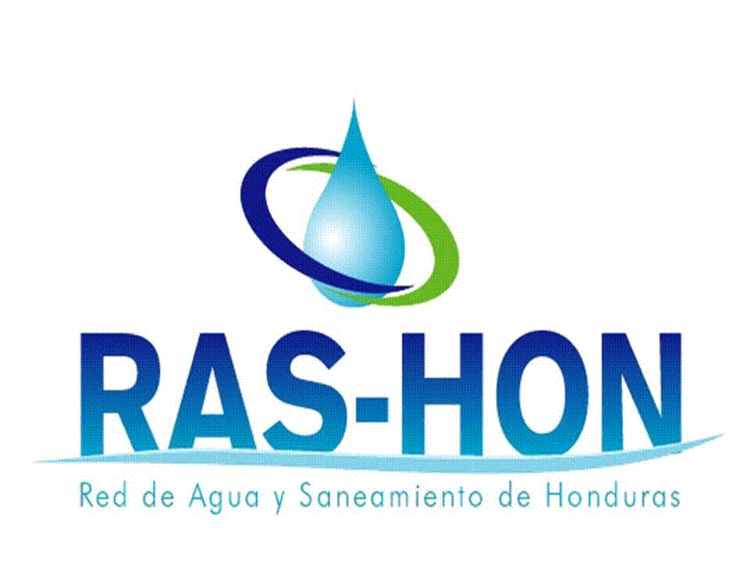



AguaClara Program
With Support From:
Notes:
AguaClara is a network of organizations with the goal of providing clean and safe drinking water
Cornell University researches and invents technology that does not require the use of electricity
Agua Para el Pueblo constructs, tests, and evaluates new technologies as well as trains communities to manage plants
SANAA, AIDIS, RAS-HON and other organizations in the WASH sector play an advisory role

Slide 5
Contents
The AguaClara Technology and Program
SRSF vs. Other Filters
Siphon Hydrostatics
Hydraulic Control System
Performance Data
Conclusions and Recommendations

Slide 6
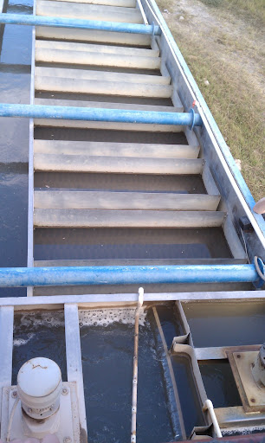
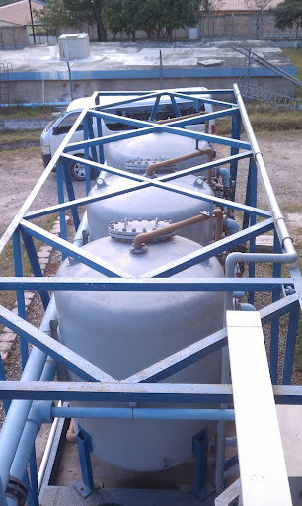
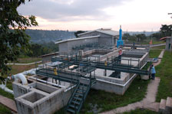
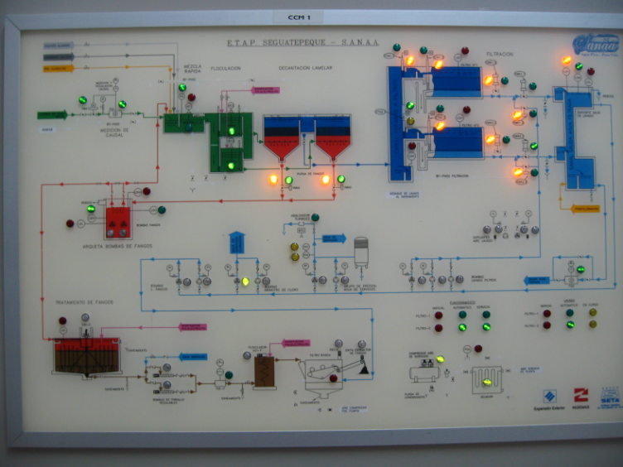
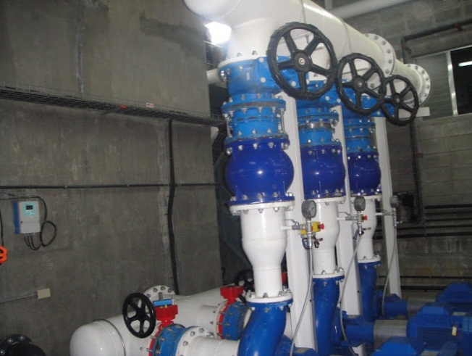
SRSF vs. Other Filters
Mecanized Plants
  Example: Package Plants
AguaClara’s Advantage:
  Does not use electricity or pumps

Slide 7
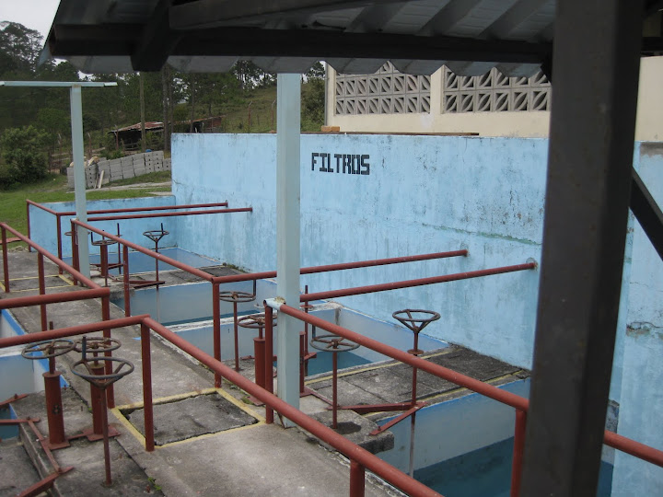
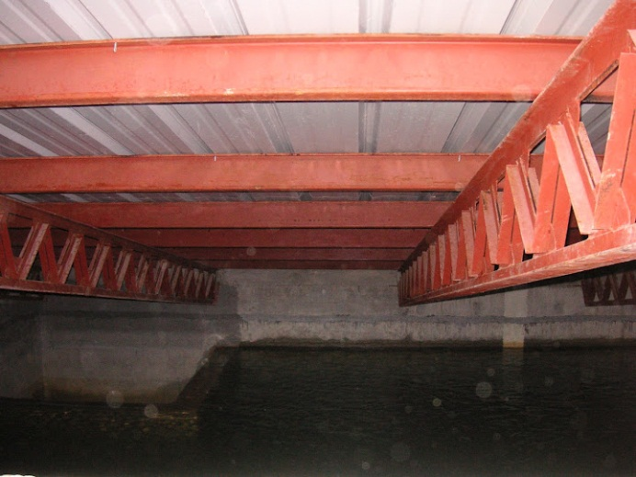
SRSF vs. Other Filters
Technology that uses large tanks
  Example: CEPIS, SETA
AguaClara’s Advantage:
  It does not use large tanks

Slide 8
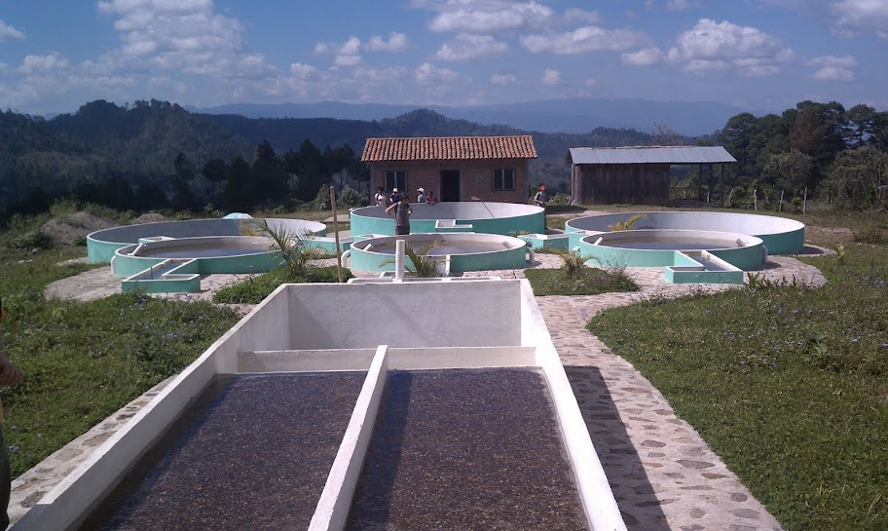
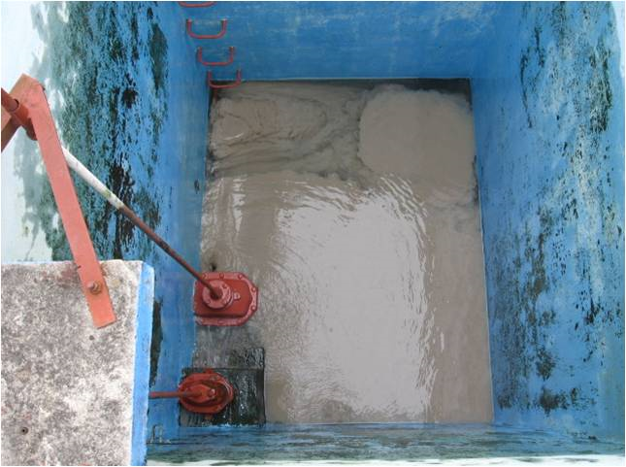
SRSF vs. Other Filters
Technology that requires a large investment
  Examples: CEPIS, FiME
AguaClara’s Advantage:
  Requires less space and less water for backwashing

Slide 9

SRSF vs. Other Filters
An entire filter gallery becomes just one

Slide 10
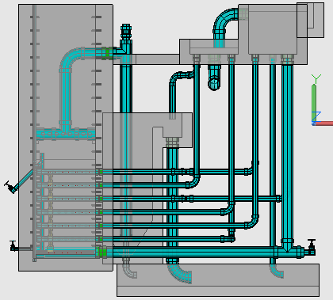
SRSF vs. Other Filters
Exit Box
Filter Entrance Box (from the sedimentation tanks)
Notes:
El FRAMCa es una tecnología innovadora que mejora la eficiencia de las plantas AguaClara

Slide 11
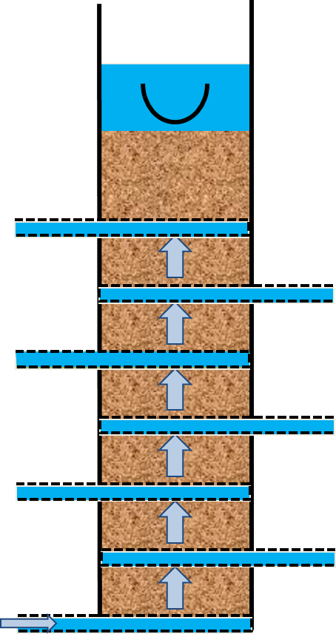
SRSF vs. Other Filters
During backwash, the entire flow enters the bottom most inlet

Slide 12
SRSF vs. Other Filters
Comparison of the required area:
For a 12 L/s plant
Tecnología | Velocidad de filtración | Área
Filtro Lento | 0.05 mm/s | 240 m²
Filtro Rápido | 1.4 mm/s | 8.6 m²
Filtro Rápido en Capas | 1.8 mm/s por numero de capas | 1.09 m²
Notes:
But it would scale linearly for whatever flow rate

Slide 13
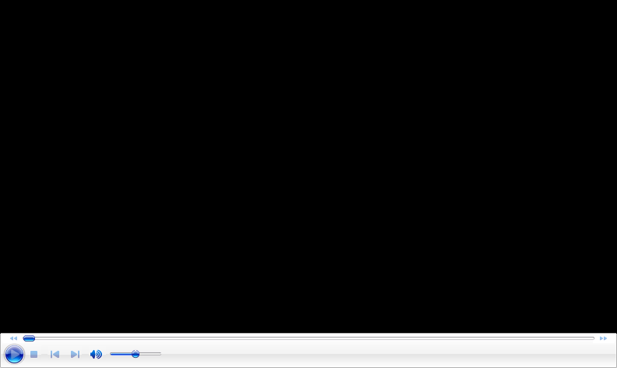
SRSF vs. Other Filters

Slide 14
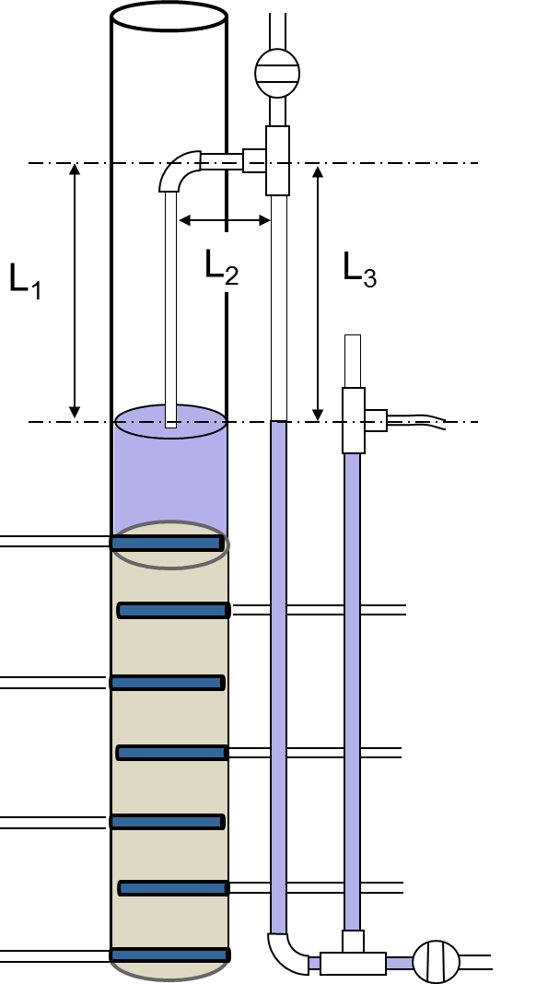
Contents
The AguaClara Technology and Program
SRSF vs. Other Filters
Siphon Hydrostatics
Hydraulic Control System
Performance Data
Conclusions and Recommendations

Slide 15
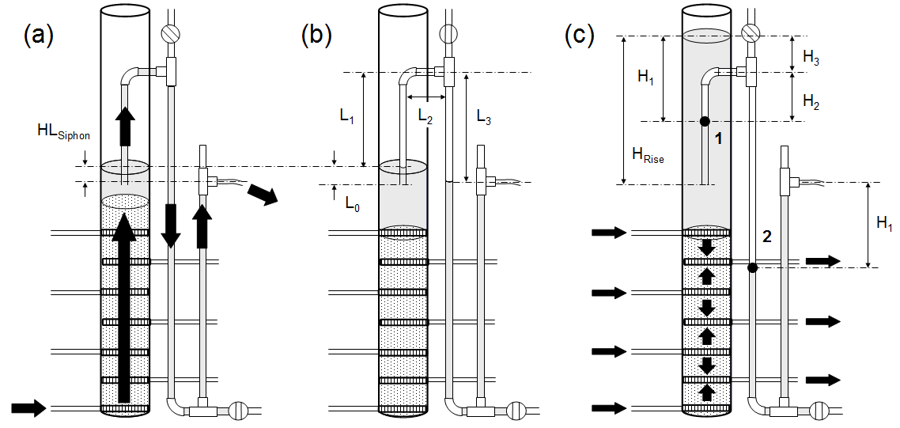
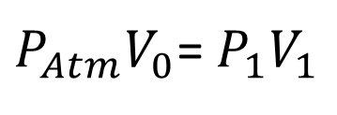

Siphon Hydrostatics
$P_{Atm}V_{0}$= $P_{1}V_{1}$
$$V_{0}=A_{Siphon}(L_{1}+L_{2}+L_{3})$$

Slide 16

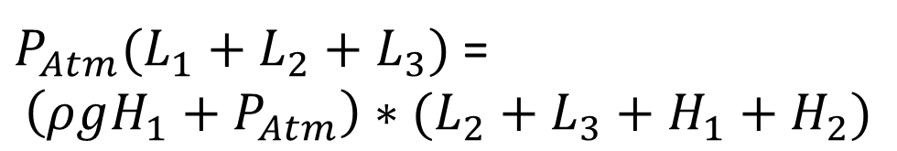
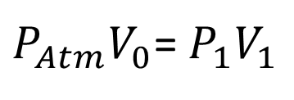

Siphon Hydrostatics
$P_{Atm}V_{0}$= $P_{1}V_{1}$
$$P_{1}=ρgH_{1}+P_{Atm}$$
$$V_{1}=A_{Siphon}(L_{2}+L_{3}+H_{1}+H_{2})$$
$P_{Atm}(L_{1}+L_{2}+L_{3})$ =
$$\left(ρgH_{1}+P_{Atm}\right)∗(L_{2}+L_{3}+H_{1}+H_{2})$$

Slide 17
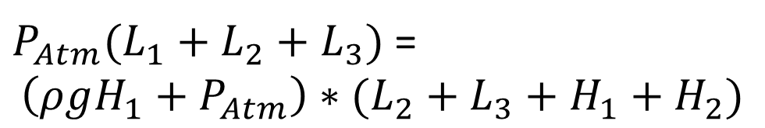
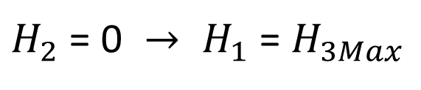
Siphon Hydrostatics
$P_{Atm}(L_{1}+L_{2}+L_{3})$ =
$$\left(ρgH_{1}+P_{Atm}\right)∗(L_{2}+L_{3}+H_{1}+H_{2})$$
Failure Point:
$H_{2}\text{ = 0 }→ H_{1}$ = $H_{3Max}$

Slide 18
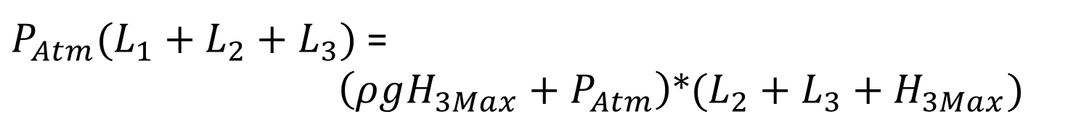
Siphon Hydrostatics
$P_{Atm}(L_{1}+L_{2}+L_{3})$ =
$\left(ρgH_{3Max}+P_{Atm}\right)$*$(L_{2}+L_{3}+H_{3Max})$
0 =$ρg{H_{3Max}}^{2}+(ρg{(L}_{2}+L_{3})+P_{Atm})H_{3Max}$- $P_{Atm}(L_{1})$

Slide 19
Siphon Hydrostatics
Filtration Cycle
Air blocks the siphon tube
Water enters through the 4 inlets and exits through the 3 outlets

Slide 20
Siphon Hydrostatics
Backwash Cycle
The air trap is released by opening the air valve and closing it again
Water enters through the bottom most inlet and leaves through the siphon
The sand bed is fluidized

Slide 21
Siphon Hydrostatics
New Filter Cycle
The siphon is broken by opening and closing the valve again
The water level rises until water exits via the outlet box

Slide 22
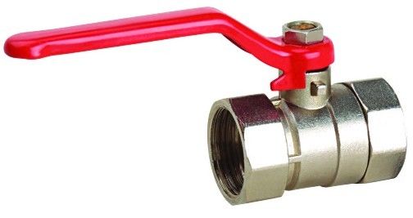
Contents
The AguaClara Technology and Program
SRSF vs. Other Filters
Siphon Hydrostatics
Hydraulic Control System
Performance Data
Conclusions and Recommendations

Slide 23
Hydraulic Control System
A
B
C
D
E
Zone A: Filtration
Zone B: Transition to backwash
Zone C: Backwash
Zone D: Transition to filtration
Zone E: Filtration
Backwash head loss
Riser pipe elevation
Notes:
• Zone A. The system is in filtration mode, with the water level high enough in both the inlet box and the filter column for flow to exit over the outlet weir. The inlet box level is a few centimeters above the water level in the filter column, which represents the head loss in the inlet plumbing. The siphon pipe is completely submerged by the water in the filter column, but is maintaining an air trap to prevent this water from escaping to the backwash weir.
• Zone B. The air valve is opened for about 5 s and then closed in the lab and about equal in the field, allowing the trapped air to escape so the siphon can fill and water can begin flowing out over the backwash weir. Once there is flow in the siphon, the water level quickly drops from its former level above the siphon pipe in both the filter and the inlet box. This transition takes about 1 minute in the laboratory filter and about 3 minutes in the field.
• Zone C. The system is in backwash mode. The water level in the filter column is a few centimeters above the elevation of the backwash weir, representing the head loss in the siphon pipe. The water level in the inlet box is high enough to provide the 1.2 m backwash head loss (equal to the depth of the sand bed), but below the top of the three riser pipes. This directs all flow from the inlet box to the bottom inlet of the filter.
• Zone D. The air valve is opened and closed again in about a 5 s period and in about equal in the field. This allows air to be pulled into the siphon, cutting off flow in the siphon pipe and re-forming the air trap. Because the water can no longer exit via the backwash siphon, it must rise in both the inlet box and the filter column so it can once again exit over the outlet weir. The elevation of the riser pipes in the inlet box is evidenced by the short horizontal section on the inlet box curve, between about 12 and 14 minutes of run time.
• Zone E. The system has returned to filtration mode. Once again, the height of water in the filter column reflects the elevation of the outlet weir plus the clean-bed filtration cycle head loss.

Slide 24
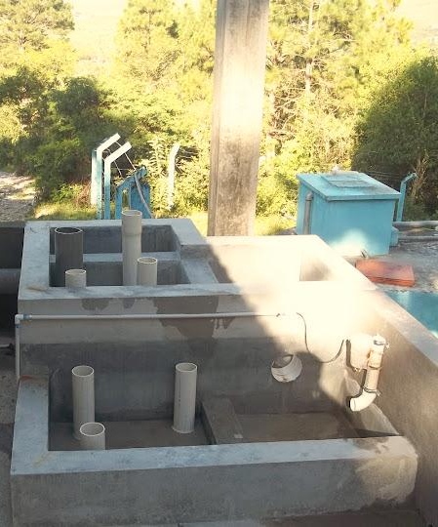
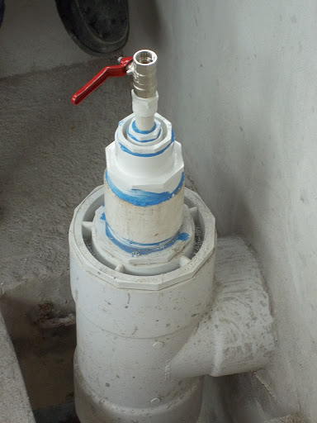
Control boxes for the SRSF
Hydraulic Control System
Small-diameter control valve

Slide 25
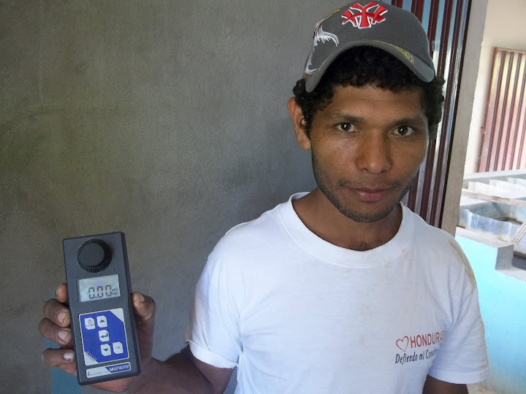
Contents
The AguaClara Technology and Program
SRSF vs. Other Filters
Siphon Hydrostatics
Hydraulic Control System
Performance Data
Conclusions and Recommendations

Slide 26
Performance
Honduran Standard
US Standard
WHO Recomendation

Slide 27

Performance

Slide 28
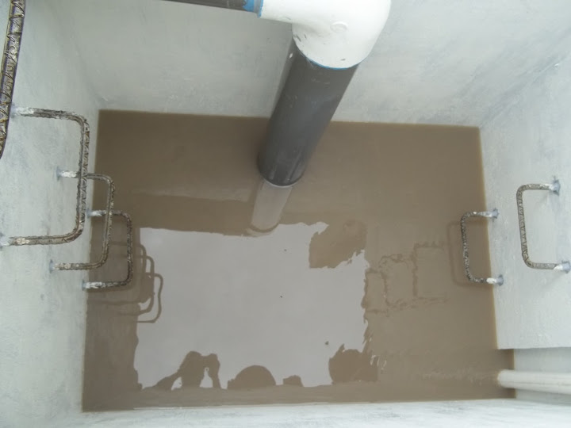
Performance
Backwash Water

Slide 29
Contents
The AguaClara Technology and Program
SRSF vs. Other Filters
Siphon Hydrostatics
Hydraulic Control System
Performance Data
Conclusions y Recommendations

Slide 30
Conclusions
Replicability
Capital Costs | Cost (USD)
Filter (12 L/s) | 25,000
Per L/s of capacity | 2,083
Operation and Maintanence Costs | Cost (USD)
Chlorine | 120
Coagulant | 110
Plant Operator | 30
Total (monthly) | 460
Notes:
No hay nada adicional

Slide 31
Conclusions
The siphon pipe was successfully characterized and the hydraulic control system validated
The SRSF complies with both the Honduran drinking water standard and the recommendation of the World Health Organización (WHO)

Slide 32
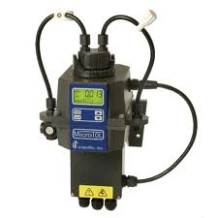
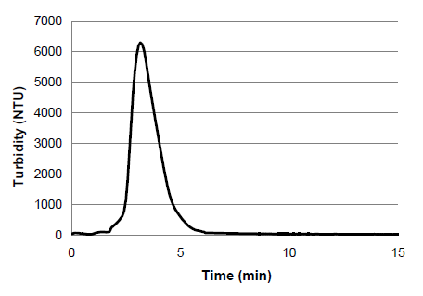
Recommendations
Backwash efficiency – it may be possible to use less water
Better data collection- using continuous flow turbidimeters

Slide 33
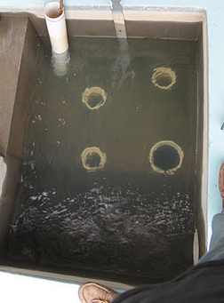
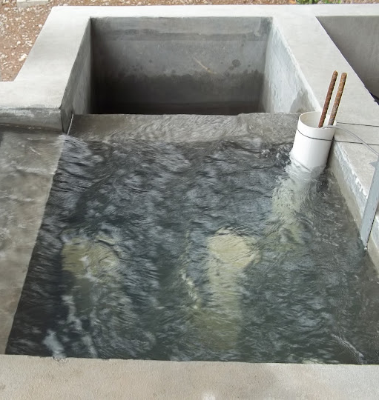
Recommendations
Filtration Cycle Duration – it would useful to recommend cycle times based on various influent conditions

Slide 34
www.apphonduras.org
http://aguaclara. cornell.edu
www.cee.cornell.edu

Slide 35
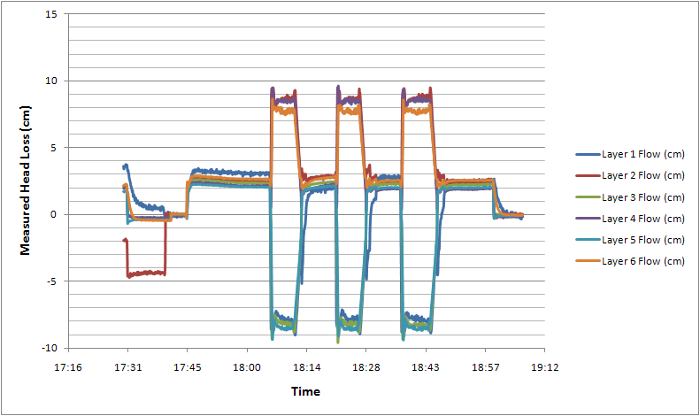
Flow Distribution

