Slide 1
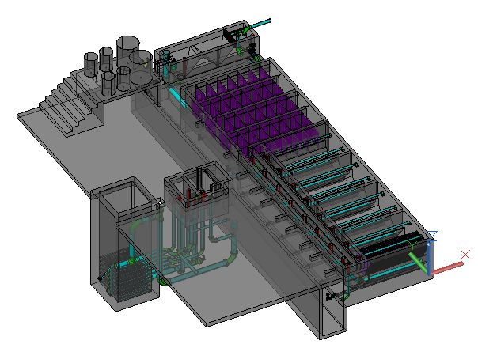
An Automated Design Tool (ADT) for Sustainable, Gravity-Powered Water Treatment Plants
Authors:
  Monroe L. Weber-Shirk
  Leonard W. Lion
  Maysoon Sharif
  Jeffrey C. Will
Notes:
Click on the picture of the plant to design a plant

Slide 2
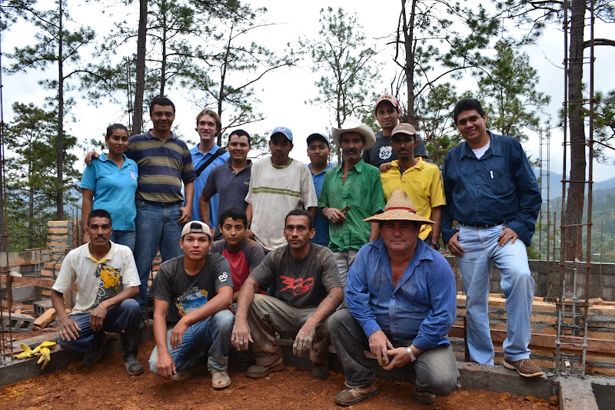
Contents
Who Are We?
Why Conventional Technologies Fail
Our Design Philosophy
The Automated Design Tool
How We Innovate
The Proof

Slide 3

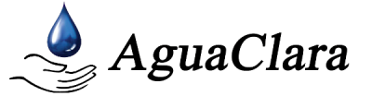
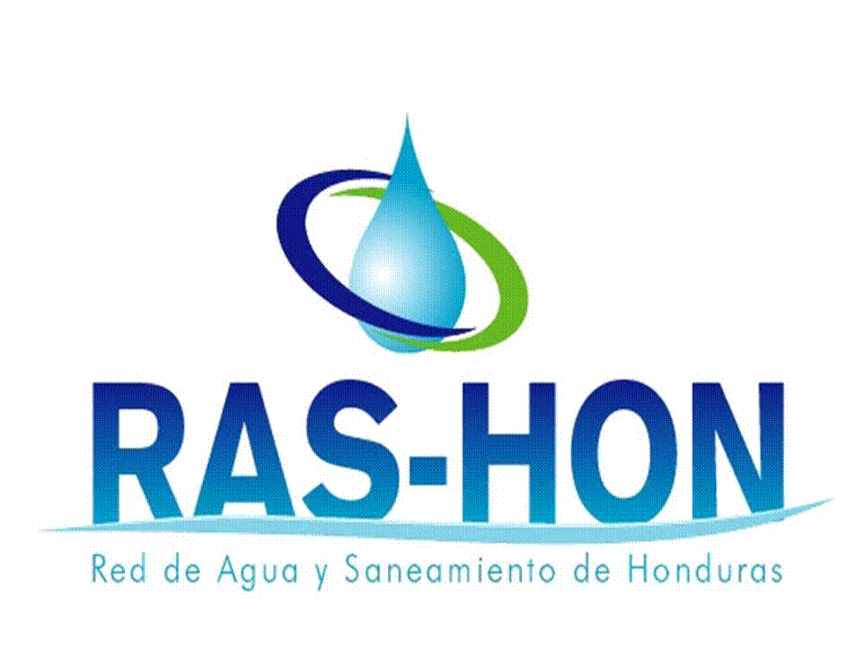



Who Are We?
With Support From:
Notes:
AguaClara at Cornell is a group of students and faculty who conduct research and provide hydraulic designs for gravity-powered (electricity-free) water treatment plants

Slide 4
A Visual Summary
Honduran Technician
Honduran Engineer
Assistants from the community
Hondran Foreman
Bricks made in the community
Honduran Mason
Construction of the plant in Atima, Sta. Bárbara, Honduras
Notes:
AguaClara includes the engineers, specialists, and community members that conduct the outreach and manage involvement to ensure that plants operate successfully in the long-term

Slide 5

Our Network
Cornell University
AguaClara R&D
AguaClara Inc.
Implementation
& Innovation
Partner (APP)
Ethiopia AP
Bahir Dar U
Colombia AP
AguaNova
Guatemala AP INFOM
Nicaragua AP CARE
University
Private Contractor
Government Ministry
International NGO
Innovation support
The number of AguaClara Partners (AP) will increase. Each AP will create a network of communities with AguaClara facilities.
Implementation technical support
Design and implementation support
Notes:
AguaClara Inc. Si a collaborative partner with implementers, not competitive, offering technical support, design review, and implementation support

Slide 6
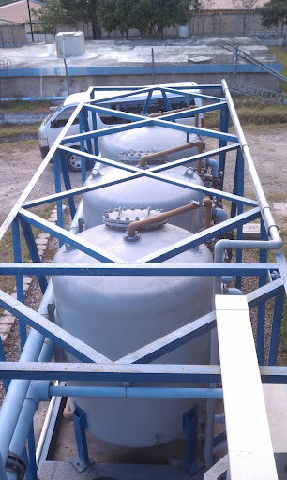
Contents
Who Are We?
Why Conventional Technologies Fail
Our Design Philosophy
The Automated Design Tool
How We Innovate
The Proof

Slide 7
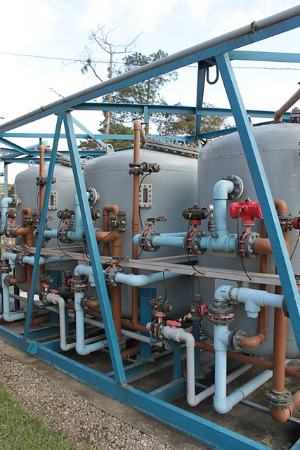
Challenges AguaClara Overcomes
Closed reactors
Highly specialized parts
No technical support
Lack of highly-skilled labor
Difficult to operate

Slide 8
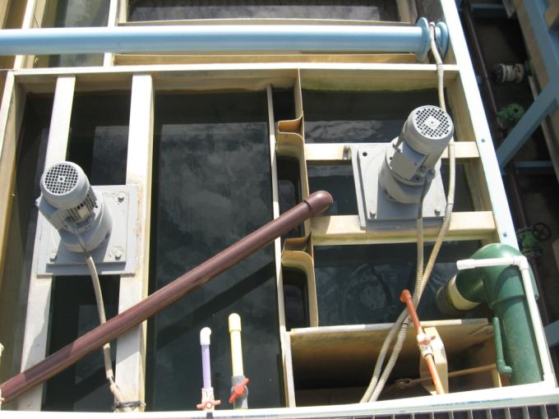
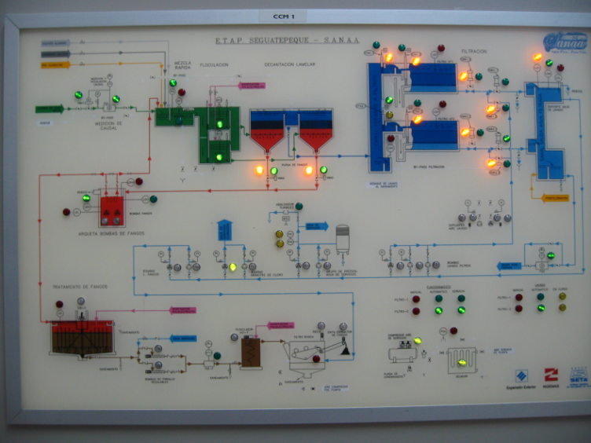
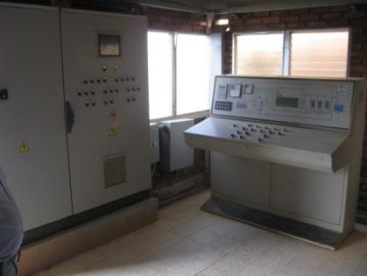
Why Do Conventional Technologies Fail?
Design approach not based on fundamental physics
Notes:
Most advances in water treatment technology in the last fifty years have focused on automation, rather than innovation or optimization of the treatment processes themselves. You end up with complicated control boards that people don’t know how to use. This is the actual control board at Siguatepeque. When we asked the operator how to read the control board, he said he had no idea and that they don’t use it.

Slide 9
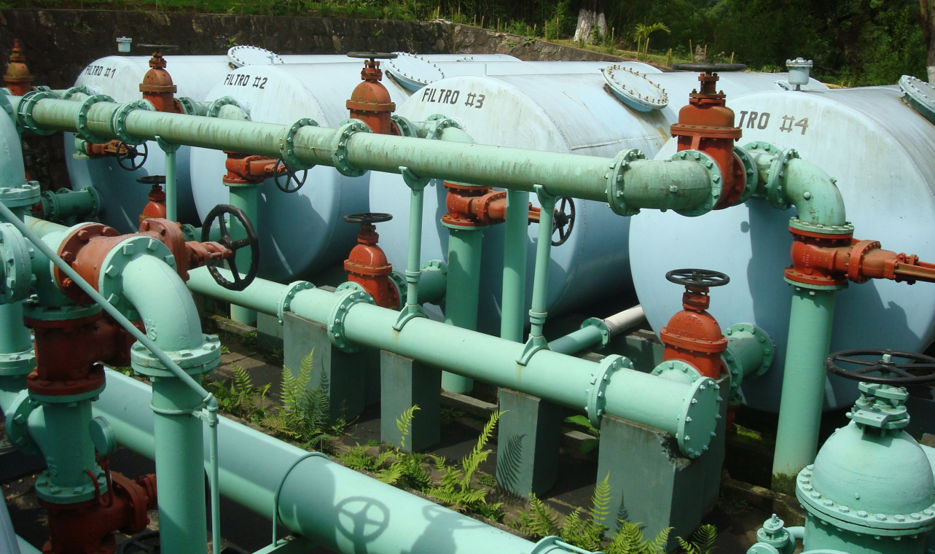
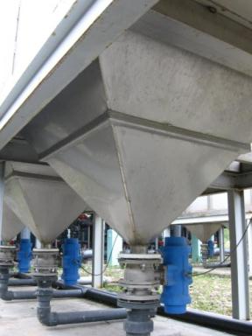
Inappropriate Technologies
Abandoned rapid sand filters in
Guatemala City
Pneumatic control valves in
Santa Rosa de Copán
Notes:
Pressurized filters – closed so you can’t see inside. Can’t even be sure if sand is still in there. Complicated piping – it’s hard to tell what some valves are used for. Valves break easily, are expensive, and hard to replace. In Honduras they need to custom make valves to replace them.

Slide 10

Contents
Who Are We?
Why Conventional Technologies Fail
Our Design Philosophy
The Automated Design Tool
How We Innovate
The Proof

Slide 11
Design Principals
All reactors must be open an accessible
All parts must be inexpensive and locally available
Plants must be easy to operate
Plants may not use electricity
Notes:
The first four points are just mentioning that AguaClara does not make the mistakes that lead to abandonment. Mention that AguaClara plants can be operated by someone with a 6th grade education under “easy to operate.”

Slide 12
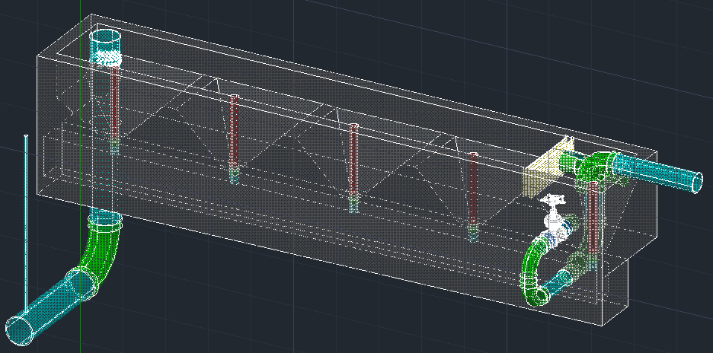
Meeting the Challenge
Notes:
A look at the entrance tank to see how we do things differently. Brief overview of how water flows through/particles settle in the hoppers. Instead of expensive valves to drain each hopper, use a removable stopper. Hoppers make it easy to clean, because all of the sludge settles at the base of the drain. Linear flow orifice meter that makes it easy to read flow rate through the tank.

Slide 13
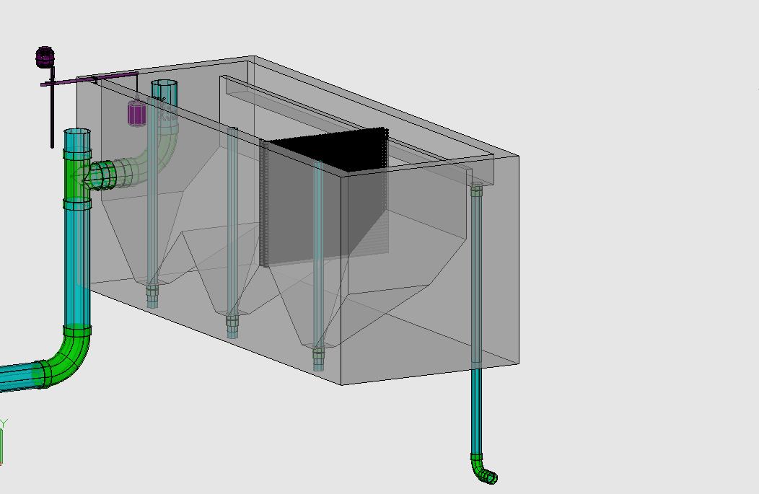

Chemical Dose Controller
Overflow Weir
LFOM
Trash Rack
Hopper
Primary Sludge Drain

Slide 14
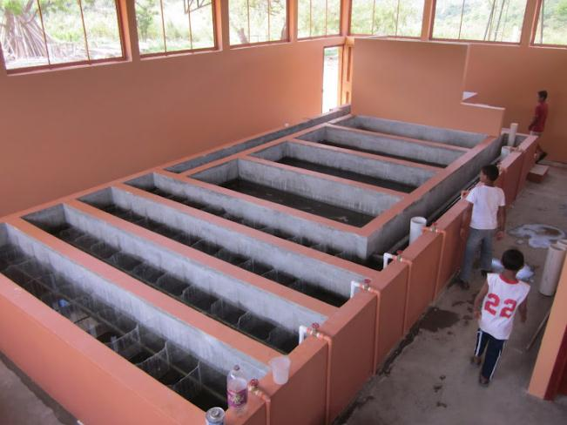
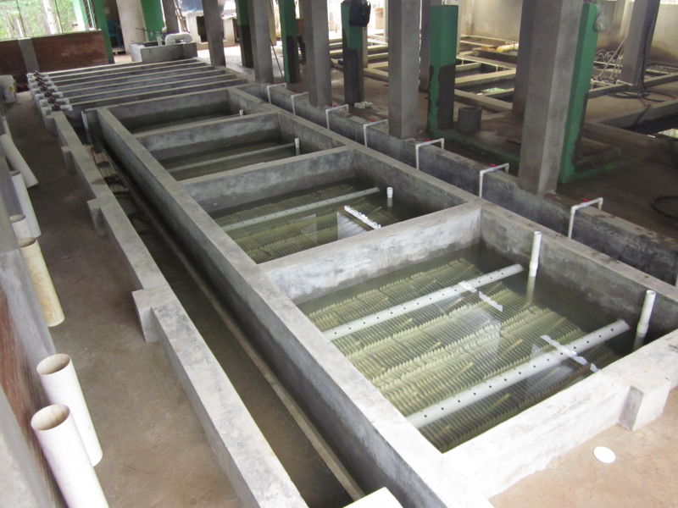
The Plant
Alauca, El Paraíso
Marcala, La Paz

Slide 15
Design Principals
Design algorithms must be based on fundamental physics
Success and improvement will rely primarily on continued relationships with communities served
Notes:
Now focusing on last two points.

Slide 16
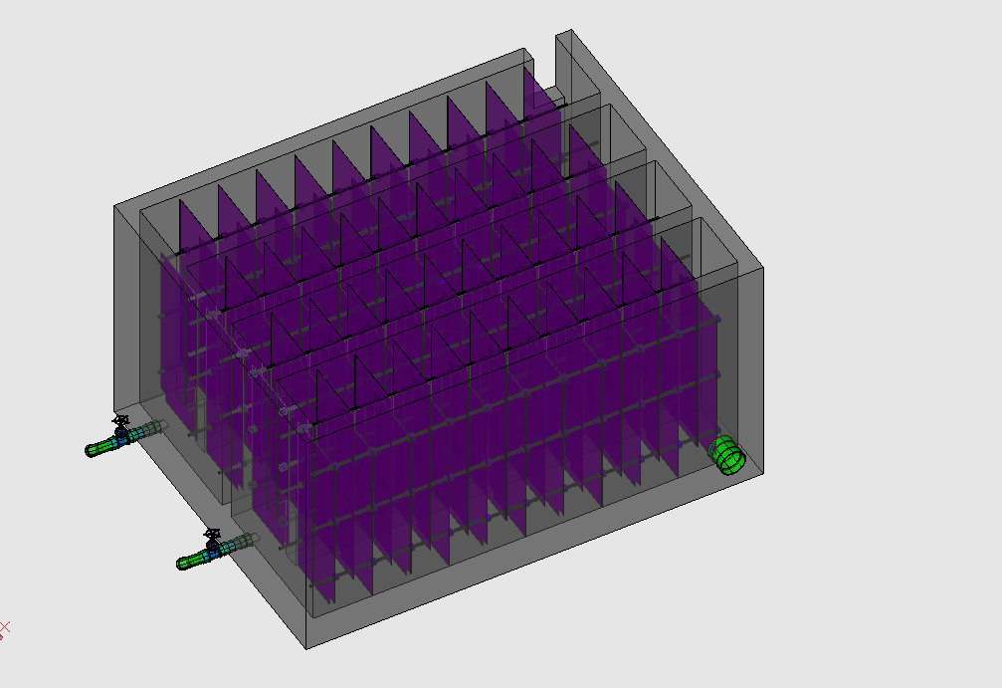
From Physics
Rapid Mix Pipe
Notes:
We specifically depart from empirical design values in the algorithms for rapid mix, flocculation, and flow transitions into the sedimentation tank. The design of these pieces is conventionally based on the turbulent energy dissipation rate rather than the velocity gradient method (Weber-Shirk and Lion, 2010) because the velocity gradient method only applies to laminar flow reactors (Cleasby 1984).

Slide 17
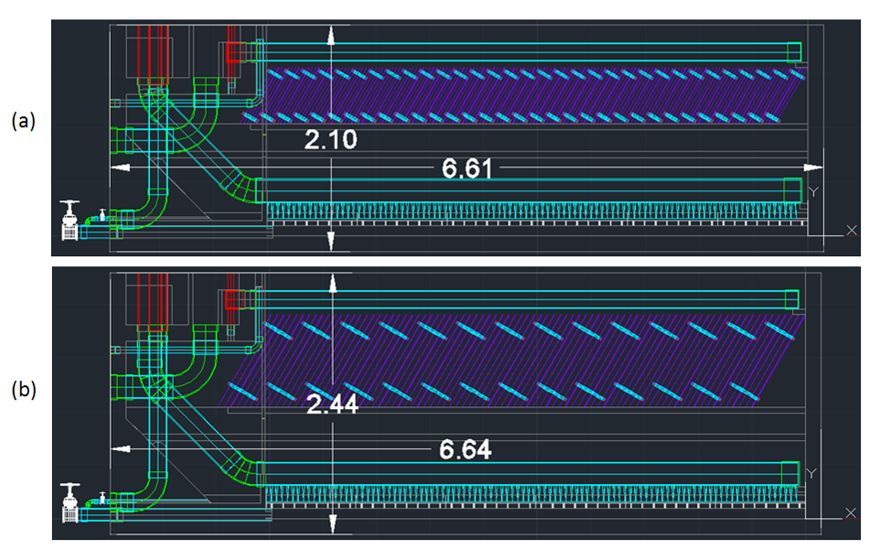
From Research
Notes:
Basing algorithms on physics means challenging the basis of conventional design parameters. Plate settler spacing research – determining spacing as a balance between decreasing tank size and preventing floc rollup. Convention says 5cm, but our research suggests 2.5 which we currently use in our designs. The upper picture uses 2.5cm spacing, saving more than 30cm in depth as compared to the conventional spacing shown below.

Slide 18
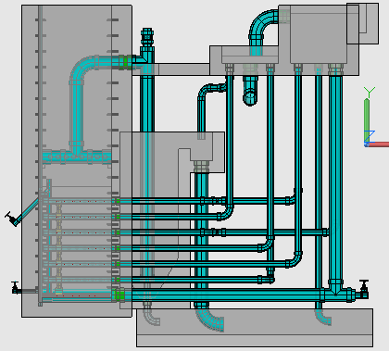
From Users
Exit Box
Filter Entrance Box (from the sedimentation tanks)
Notes:
Mention lessons learned and improvement and innovation cycle

Slide 19
Contents
Who Are We?
Why Conventional Technologies Fail
Our Design Philosophy
The Automated Design Tool
How We Innovate
The Proof

Slide 20
What is the ADT?
LabVIEW
User Inputs
Plant
Design
AutoCAD
Mathcad
Calculations
Mathcad
Drawing Files
MS Word

Slide 21
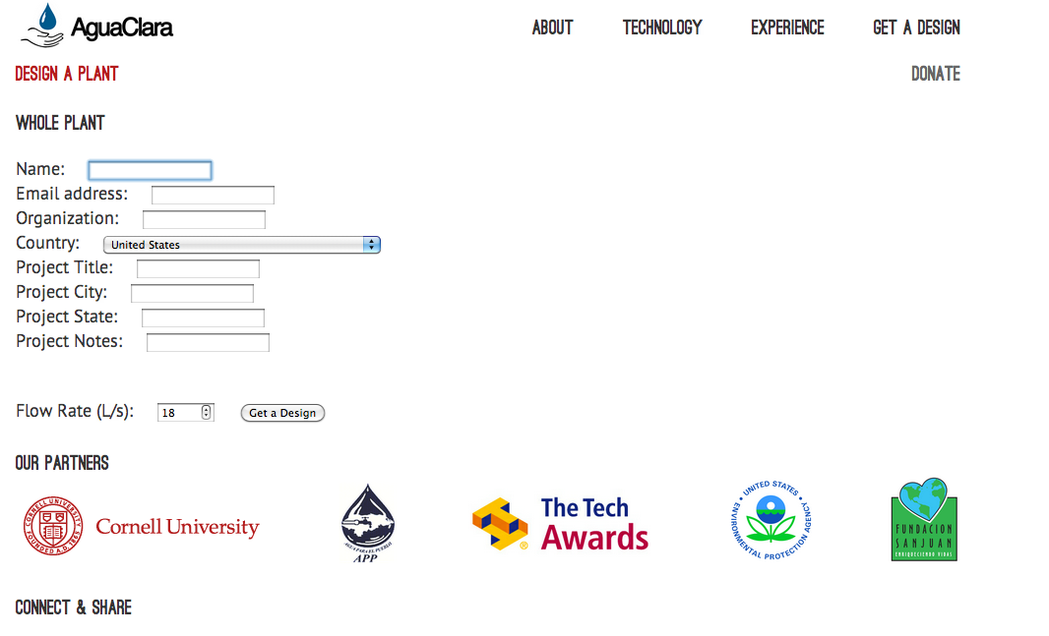
What is the ADT?

Slide 22
The Design
Notes:
Sample AutoCAD output from a design request.
Because of our approach, we have plants that are as old as 7 years. Conventional plants are often abandoned in 2 years.
The ADT combines the knowledge generated at Cornell and communities currently served by AguaClara plants to create robust, scalable designs that are appropriate for the social, environmental, and financial context of the regions they serve.

Slide 23
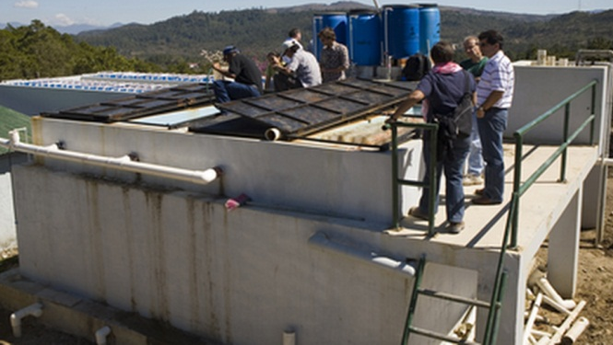
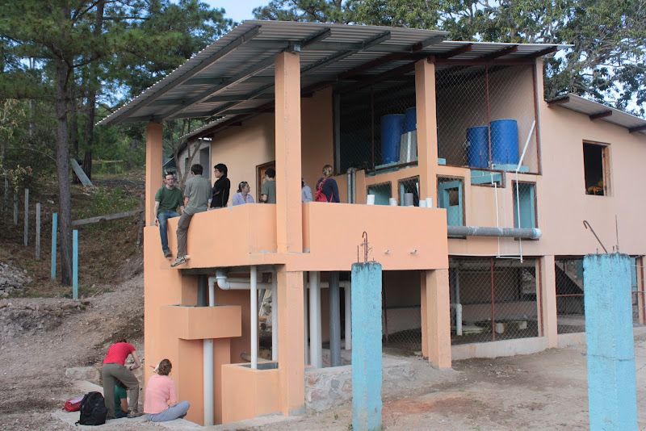
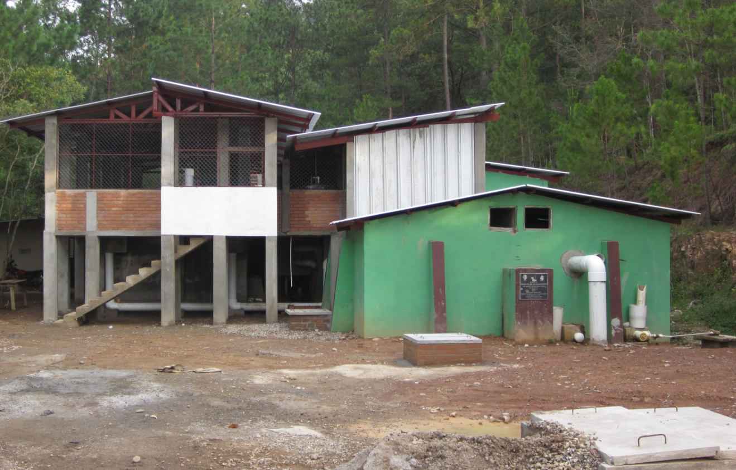
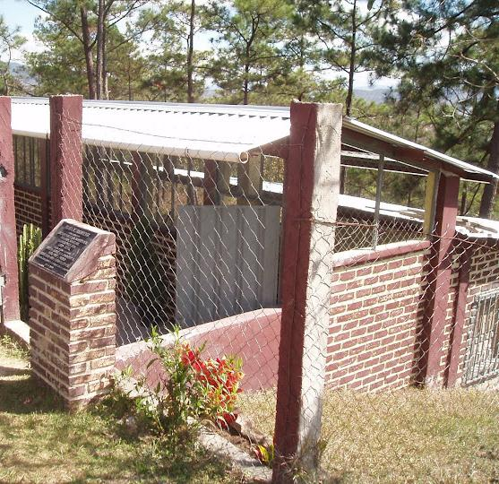
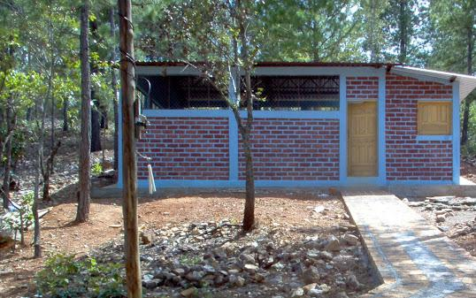
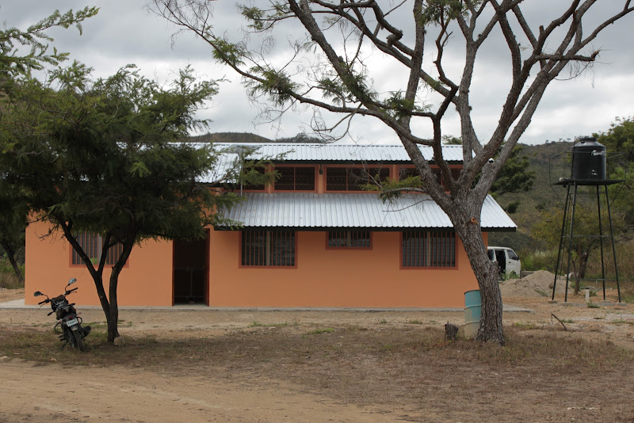
Sustainable Designs
Ojojona, 2007
Támara, 2008/2012
Marcala, 2008/2011
Cuatro Comunidades, 2009
Algalteca, 2010
Aluaca, 2012
Notes:
NOT JUST ENVIRONMENTALLY!
6 Fully-operation plants in Honduras, operated and maintained independently by the community
Community members have independently voted to increase their water tariffs, and water boards now have extra savings.
Water Boards are increasing their savings for emergencies and upgrades. Some using savings for sanitation like latrines and sewers

Slide 24
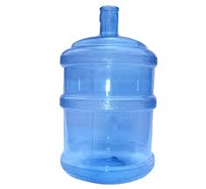
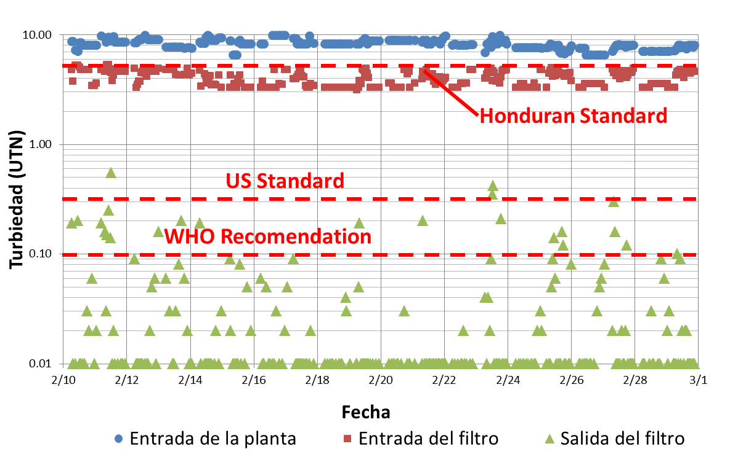
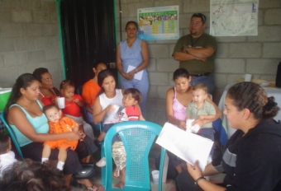
Cause and Effect
Community members are no longer purchasing bottled water
All plants meet WHO standards; new filter frequently meets US standards
Health centers and community members are noticing the health effects
Fewer children with severe diarrhea
Notes:
Community members save money on bottled water. Before AguaClara plants, health centers did not keep a record of diarrhea cases because the numbers were so high. After AguaClara plants the number has decreased significantly, and they now keep record.

Slide 25
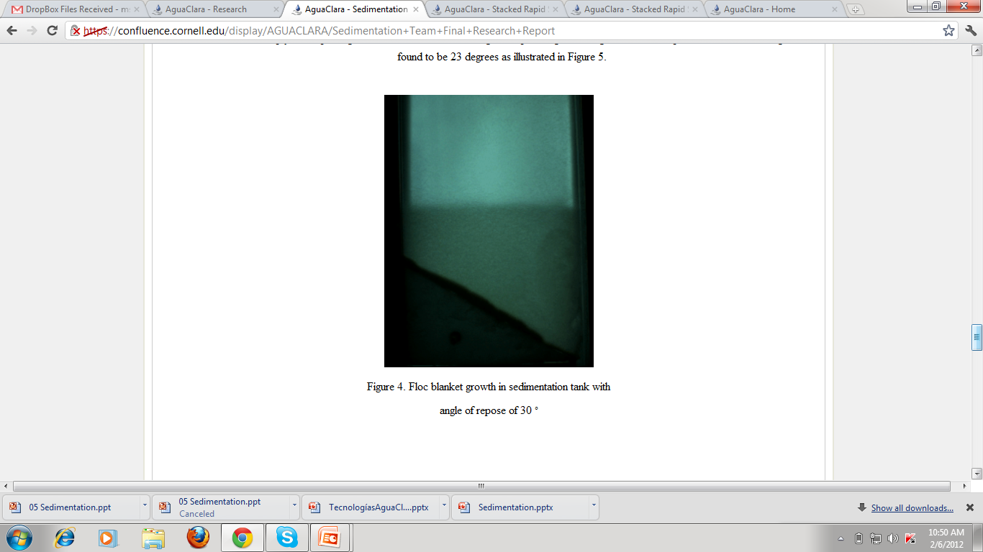
Contents
Who Are We?
Why Conventional Technologies Fail
Our Design Philosophy
The Automated Design Tool
How We Innovate
The Proof

Slide 26
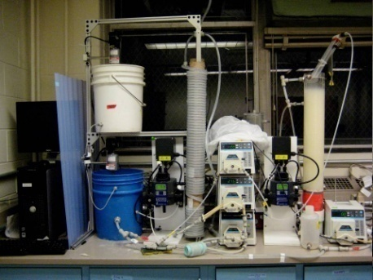
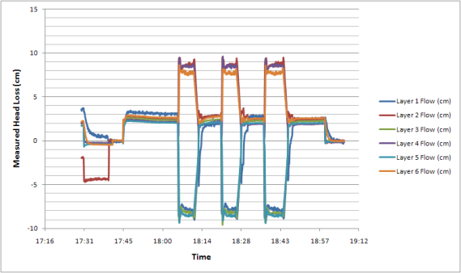

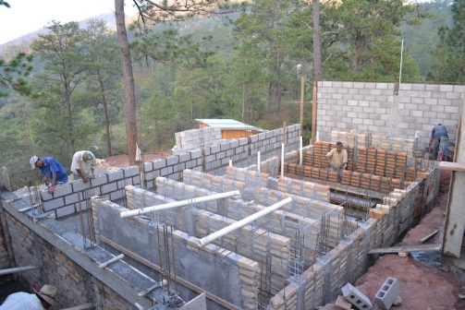
AguaClara
Innovation Cycle
Laboratory Research
Analytical
Modeling
Evaluation
Automated Design
Full Scale Implementation,
Capacity Building, Training, and Empowerment
Notes:
Incorporating feedback from the field ensures that ease of use is accounted for in designs. Two-way relationship of technical support to ensure plant longevity and feedback to improve designs.

Slide 27
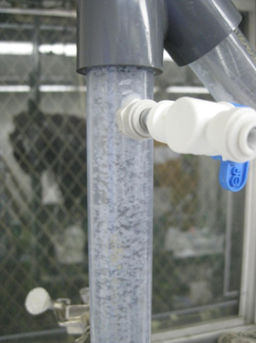
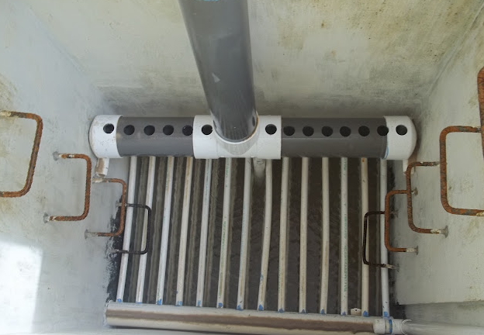
Innovations
Floc blankets
Stacked Rapid Sand Filters
Floc recycle
Notes:
The first bolded point – basing algorithms on fundamental physics gives us an edge in terms of innovation. We built the designed and built a one-of-a-kind stacked rapid sand filter, which incredibly successful. We are also beginning to understand how to create floc blankets, which will allow us to decrease the size of our sedimentation tanks. Also we are conducting research on floc recycle: returning sedimentation sludge to the start of the flocculator, to increase flocculation efficiency and therefore hopefully reduce the size of our flocculators.

Slide 28
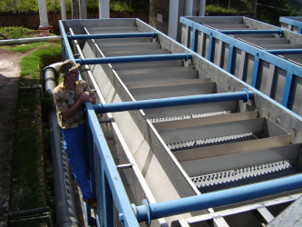
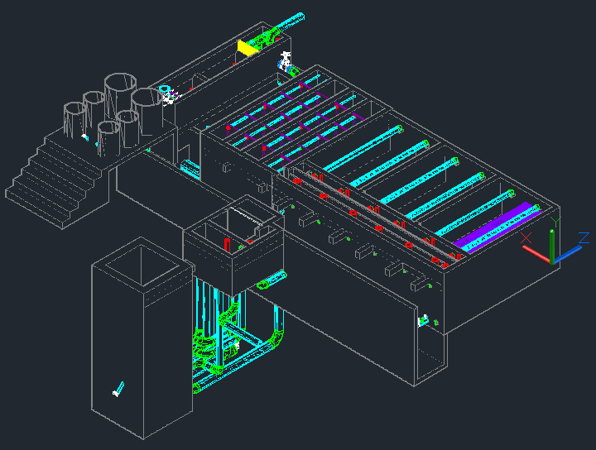
Disruptive Technology
Instead of delivering hardware
AguaClara delivers knowledge
Instead of locking up the knowledge with patents
AguaClara shares the knowledge and improves performance with a systems approach
We design for the context and use feedback to improve

Slide 29
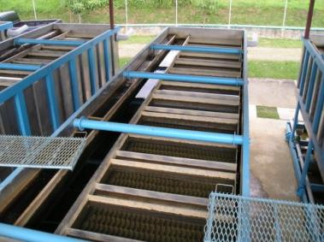

Cost Savings
No penalty to mechanized plants for short life and expensive proprietary repairs
Assuming both plants last 25 years and that no components fail for 25 years!
Electricity cost is $0.16/kWhr, Interest is 5%, 2012 chemical costs in Honduras.
Notes:
Current capital cost (15 – 20 USD per person served) is about a third of that of conventional plants of comparable size, and future innovations will make our capital costs even more competitive
Operation and maintenance costs (2 – 4 USD per person per year) are low enough that community members have volunteered to pay more
Cap cost = 4,000 – 8,000 USD/L/s

Slide 30
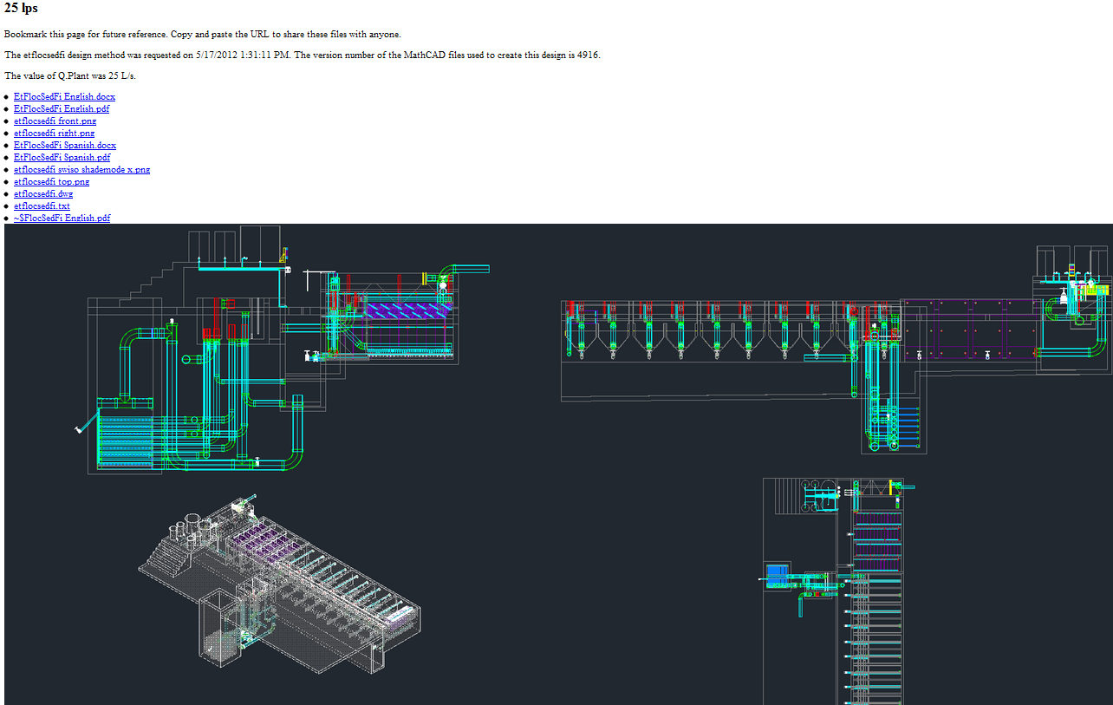
Proofed Designs
Notes:
In the future, there will be already proofed hydraulic designs that can be downloaded freely, without the need to wait for a new design.
6,9,12,15,20,25,30, 40,....90
The image links to the design server site.

Slide 31
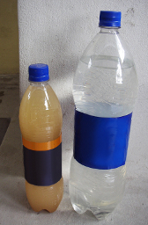
Contents
Who Are We?
Why Conventional Technologies Fail
Our Design Philosophy
The Automated Design Tool
How We Innovate
The Proof

Slide 32
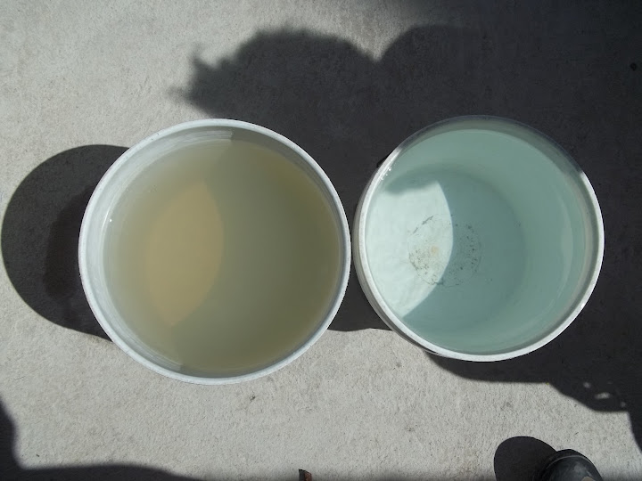
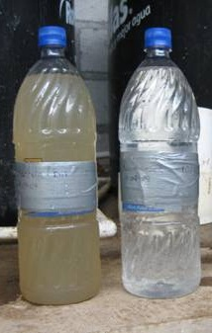
It Works

Slide 33
Turbidity Removal
Honduran Standard
Results from Cuatro Comunidades – September 2011
Fuente: datos del operador

Slide 34
Thank You!
http://aguaclara. cornell.edu
www.apphonduras.org
www.cee.cornell.edu

Slide 35
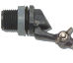
Chemical Dose Controller
Dosing tube
H
Open channel supercritical flow
Notes:
This is a basic schematic of what research and design teams have come up with after many years of work. The stock tank holds a stock chemical solution which is connected to a constant head tank. The constant head tank is regulated by a float valve which keeps the chemical depth constant. A small diameter tube leads from the stock tank to a drop tube, where the chemical flows to be added to the plant’s influent water. The drop tube is connected to a lever via a slider. The plant operator sets the slider at the desired coagulant dose based upon characteristics of the influent water. The float attached to the lever changes position as flow rate into the plant changes, thus changing the elevation of the small diameter tube’s outlet, and maintaining a constant chemical dose.

Slide 36
Decrease Dose
H
Notes:
This is a basic schematic of what research and design teams have come up with after many years of work. The stock tank holds a stock chemical solution which is connected to a constant head tank. The constant head tank is regulated by a float valve which keeps the chemical depth constant. A small diameter tube leads from the stock tank to a drop tube, where the chemical flows to be added to the plant’s influent water. The drop tube is connected to a lever via a slider. The plant operator sets the slider at the desired coagulant dose based upon characteristics of the influent water. The float attached to the lever changes position as flow rate into the plant changes, thus changing the elevation of the small diameter tube’s outlet, and maintaining a constant chemical dose.

Slide 37
Increase Dose
H
Notes:
This is a basic schematic of what research and design teams have come up with after many years of work. The stock tank holds a stock chemical solution which is connected to a constant head tank. The constant head tank is regulated by a float valve which keeps the chemical depth constant. A small diameter tube leads from the stock tank to a drop tube, where the chemical flows to be added to the plant’s influent water. The drop tube is connected to a lever via a slider. The plant operator sets the slider at the desired coagulant dose based upon characteristics of the influent water. The float attached to the lever changes position as flow rate into the plant changes, thus changing the elevation of the small diameter tube’s outlet, and maintaining a constant chemical dose.

Slide 38
Decrease Plant Flow
H
Open channel supercritical flow
Notes:
This is a basic schematic of what research and design teams have come up with after many years of work. The stock tank holds a stock chemical solution which is connected to a constant head tank. The constant head tank is regulated by a float valve which keeps the chemical depth constant. A small diameter tube leads from the stock tank to a drop tube, where the chemical flows to be added to the plant’s influent water. The drop tube is connected to a lever via a slider. The plant operator sets the slider at the desired coagulant dose based upon characteristics of the influent water. The float attached to the lever changes position as flow rate into the plant changes, thus changing the elevation of the small diameter tube’s outlet, and maintaining a constant chemical dose.

Slide 39
Plant Off
Notes:
This diagram shows what happens when the plant flow rate reduces to zero. As the plant flow rate decreases, the depth of the water in the entrance tank drops. The float also drops which changes the angle of the lever. As you can see (point to the dotted line), the head loss between the water level in the constant head tank and the outlets in the drop tube reduces to zero when there is zero flow through the plant (indicate the bottom right where the water level is just below the LFOM’s bottom row of orifices). The lever’s connection to the float allows this relationship to be maintained.

