Slide 1
Cornell Center for a Sustainable Future
November 20, 2009
Monroe Weber-Shirk

Slide 2
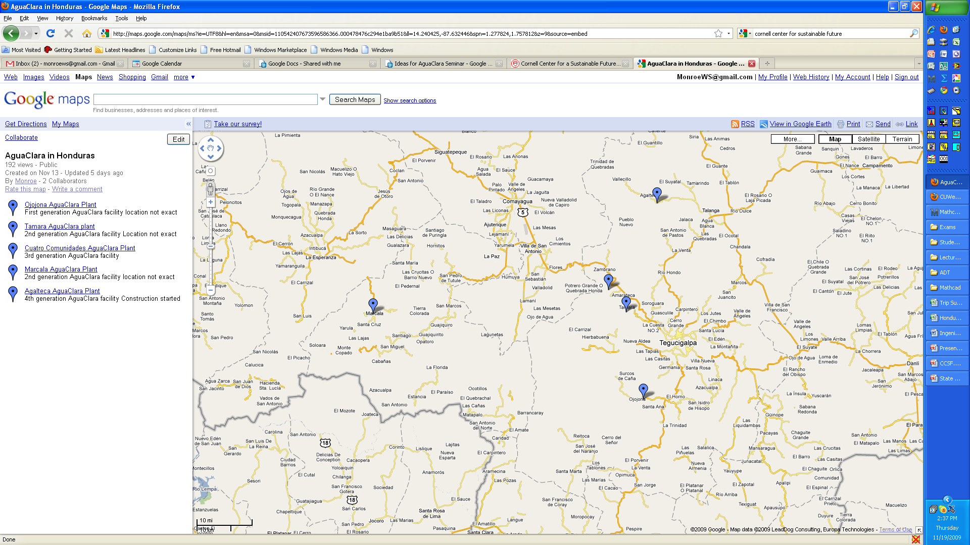
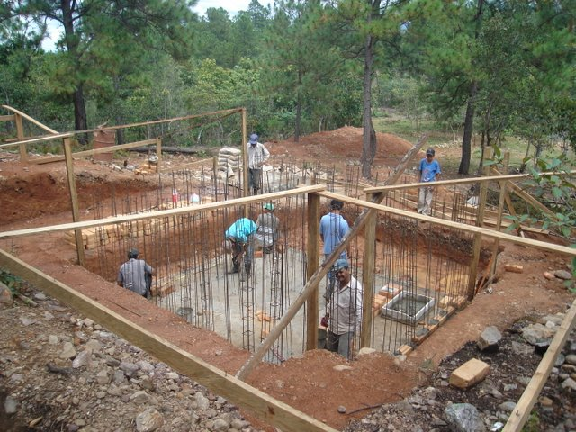
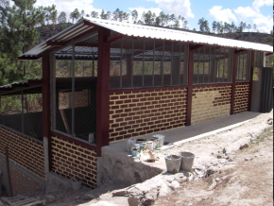
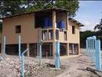
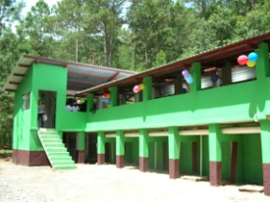

AguaClara in Honduras

Slide 3
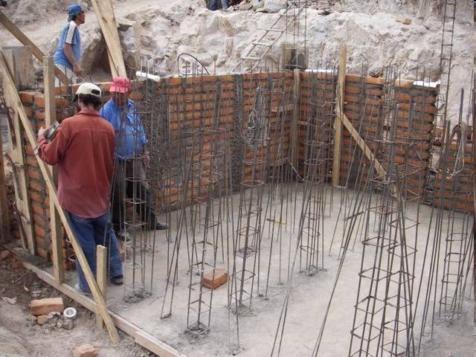
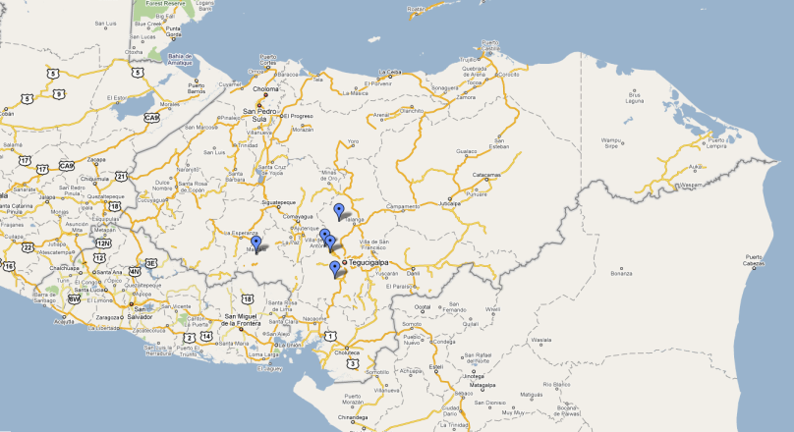
Cuatro Comunidades

Slide 4
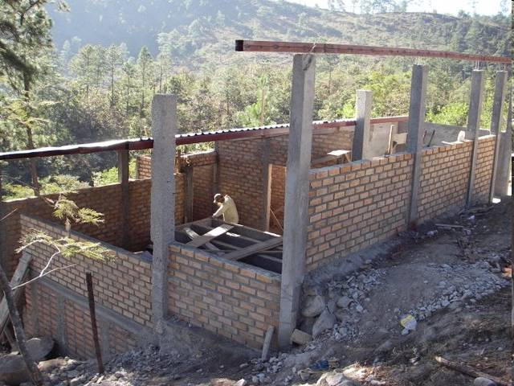

Slide 5
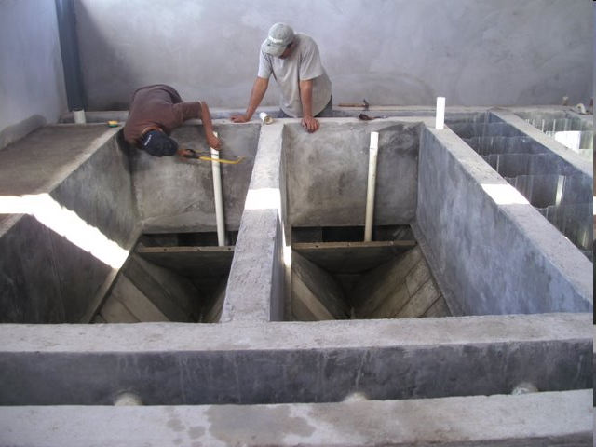

Slide 6
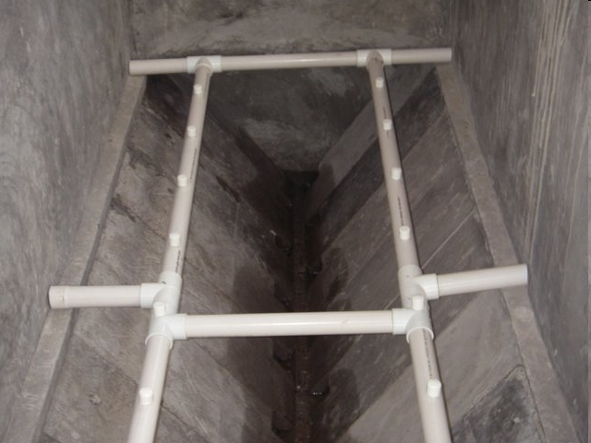

Slide 7
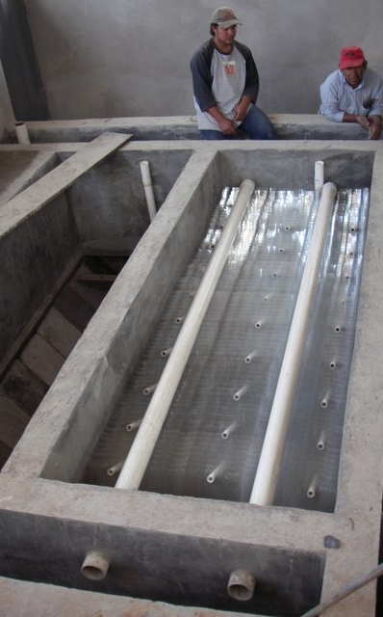
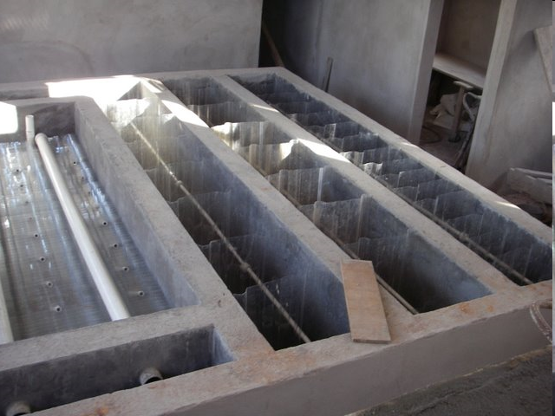
Flocculation
Sedimentation

Slide 8
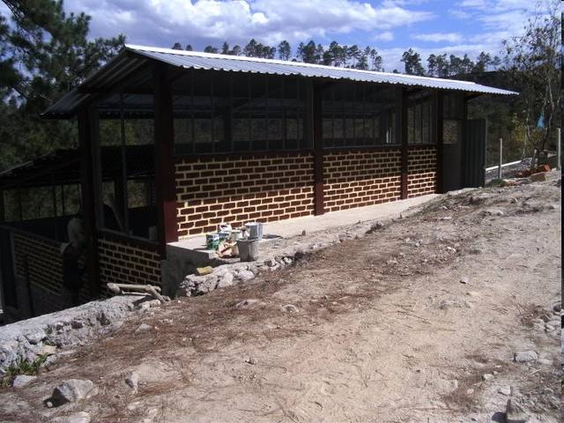

Slide 9
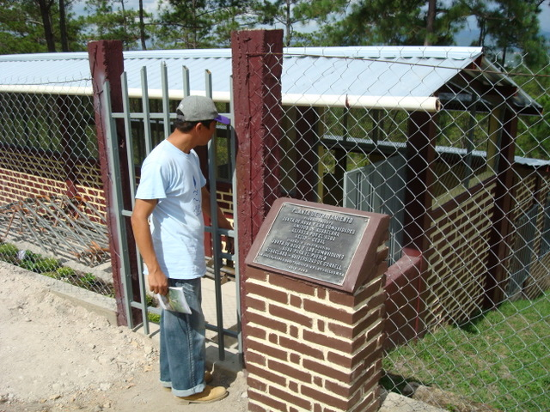
Cuatro Comunidades Plant

Slide 10
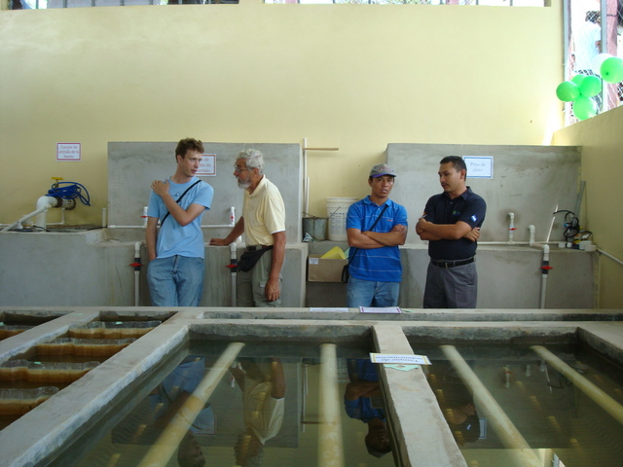
Chemical tanks

Slide 11
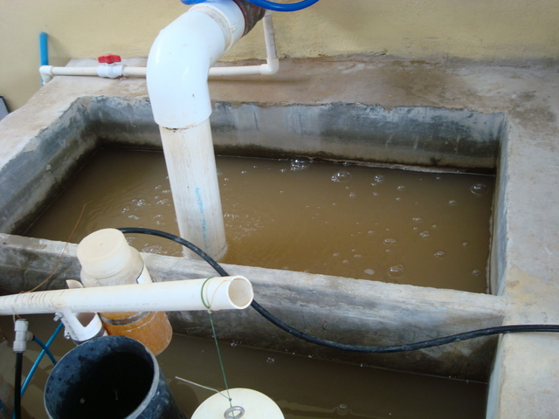
Raw Water (Entrance tank)

Slide 12
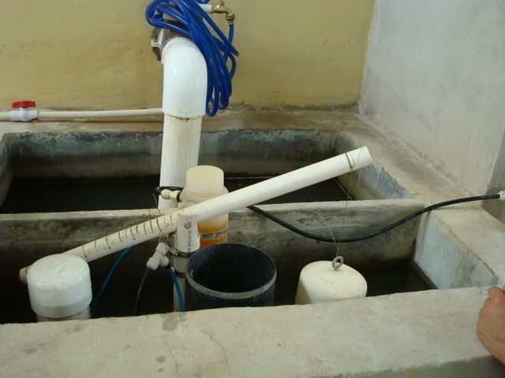
Chemical Doser

Slide 13
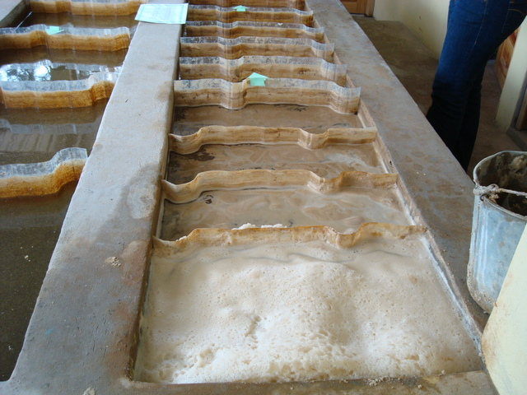
Flocculator

Slide 14
Flocs!

Slide 15
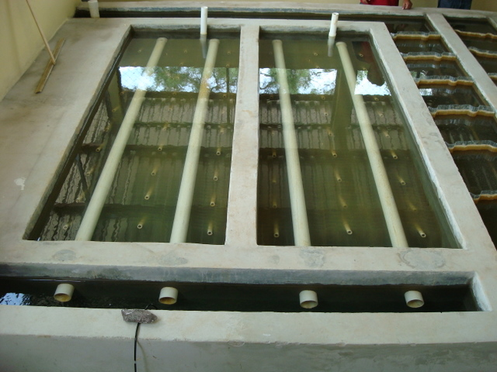
Sedimentation tank

Slide 16
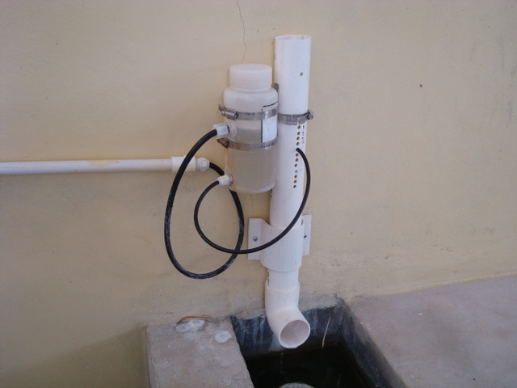
Chlorinator

Slide 17
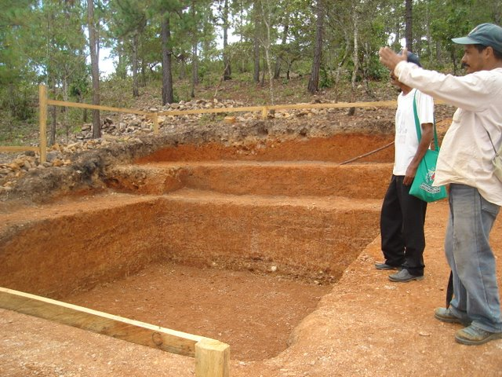

Agalteca

Slide 18
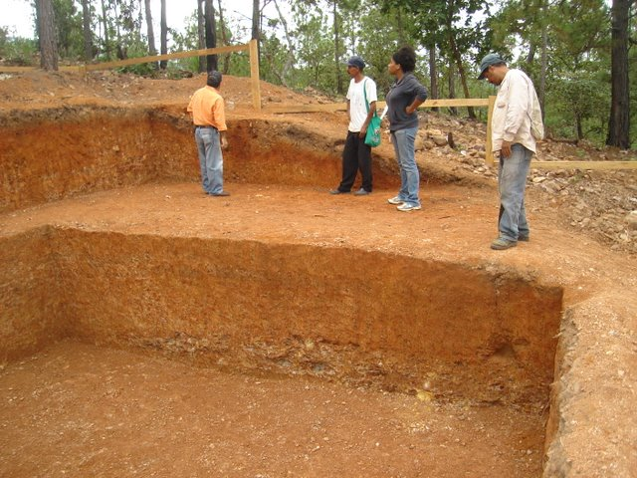

Slide 19
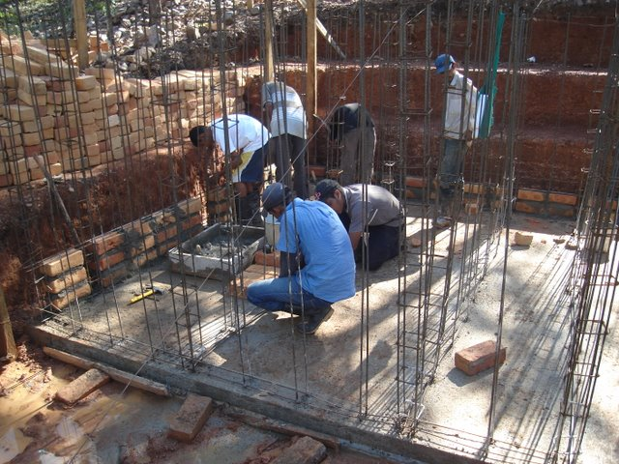

Slide 21
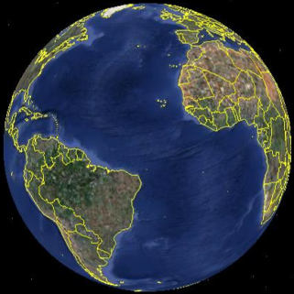
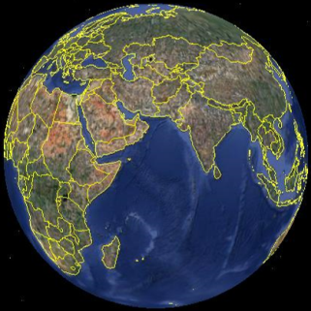
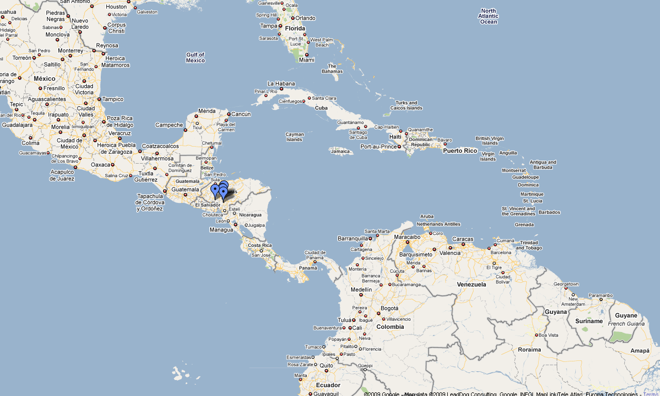
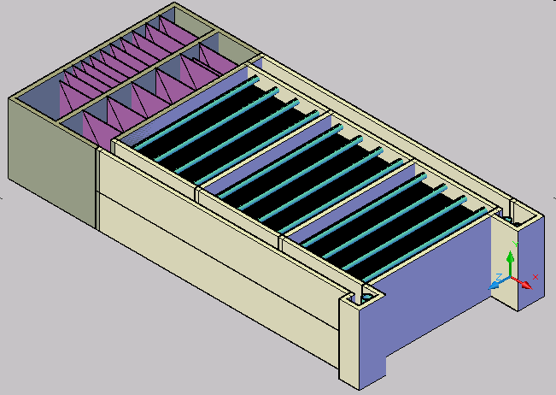

Project Expansion

Slide 22
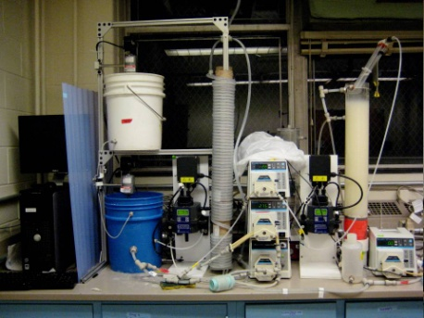
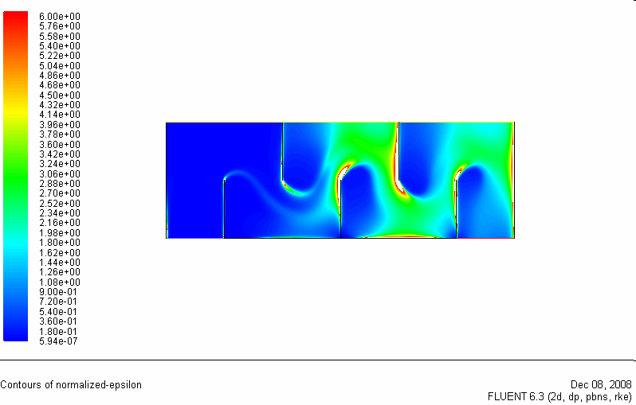
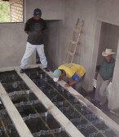

AguaClara Process
Laboratory Research
Analytical
Modeling
CFD
Evaluation
Normalized energy dissipation
Full Scale Implementation,
Capacity Building, Training, and Empowerment
Automated Design

Slide 23
Team Growth
Over 60% women. Majority of student team leaders have been women.
Team Project
Theory

Slide 24
M. Eng. Growth

Slide 25
A Novel Approach to Technology Dissemination
Open source engineering
Online automated design
Empowerment instead of the supply chain
Economic advantage by using generic locally available materials
Low carbon footprint (no electricity)
Empowerment of implementation partners
Implementation partners take the lead in spreading the technology

Slide 26
An Opportunity…
…for Cornell to become the knowledge source for a technology that is needed by over 100,000,000 people (and billions if you include infrastructure upgrades)
We have carefully structured the dissemination model so that the team at Cornell doesn’t limit the growth rate
Using our current technology we can already deliver about 300 designs per day

Slide 27
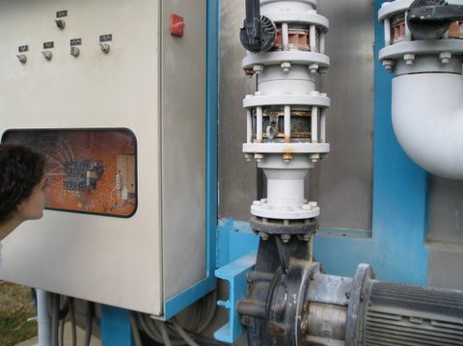
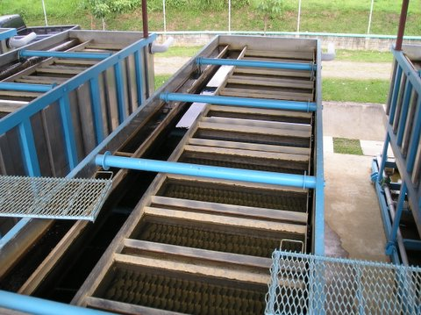
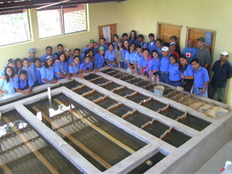
A Robust and Sustainable Model
Dependency
Empowerment
Knowledge
Closed Proprietary
Open Source
Primarily to a single multinational firm
local labor/small business some multinationals
Capital flow
Hardware
Specialized Proprietary
Generic – locally available
Energy Source
Electricity
Renewable

Slide 28
Reflections on a New Generation of Students
Students are asking for meaning rather than money (they view the salary rankings for engineers as evidence that Cornell doesn’t get what matters)
Students are asking for a broader education that goes beyond science and engineering

Slide 29
AguaClara as a CCSF program
Include AguaClara as a CCSF program with our focus on a Sustainable Future
  include AguaClara when you showcase CCSF projects
  Beneficial to both CCSF and AguaClara

Slide 30
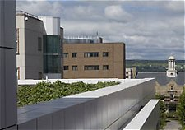
Built Environment
Several leading research teams investigate aspects of the built environment as it relates to green design and architecture, human health issues, energy efficiency, and the hospitality industry. Research in this area spans several Cornell Colleges and work is conducted locally (using campus buildings as research laboratories) to internationally.
(Jack Elliott, Ann Forsyth, Ying Hua, Alan Hedge, Joseph Laquatra, Mark Milstein, Kevin Pratt, Arturo-Ignacio Sanchez, Stephan Schmidt, Nancy Wells)

Slide 31
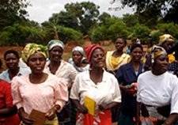
Community Empowerment
The institutional arrangements by which communities allocate scarce resources and set and enforce rules shape the development experience. Many Cornell faculty study the institutions of development, from local institutions of land tenure and community groups, to national political economy and multinational institutions. China, Ghana, India, Kenya, Madagascar, South Africa, and Sri Lanka, are sites of current activity.
(Chris Barrett, Kaushik Basu, Ralph Christy, Chuck Geisler, Ravi Kanbur, Jim Lassoie, Kevin Morrison, Victor Nee, David Pelletier, Terry Tucker, Nic van de Walle)

Slide 32
Safe Drinking Water
Built Environment - Community Empowerment
The lack of robust, sustainable technologies for drinking water treatment has prevented resource poor communities from gaining access to the health benefits of safe drinking water. The AguaClara program is creating a knowledge base and empowering implementation partners to build community-based water treatment facilities. Honduras, Guatemala, El Salvador, Panama, and Columbia are sites of current activity.
(Monroe Weber-Shirk, Len Lion, Mildred Warner, ?)

Slide 33
A Model for Knowledge Generation
Undergraduates as core participants in the innovation process
State-of-the-art process control to automate experiments
Multiple collaborative research teams
Action and reflection from research lab to implementation and back again
Open source - wiki
Implementation partners
MEANING!

Slide 34
Extending the Model
Students are looking for programs with meaning
  Open source
  Making the world a better place
  Connecting to a larger perspective
I have students who are in AguaClara, but who really want to be working in the field of energy
Could CCSF help replicate the model?

