Slide 1
Preparing for Multidimensional Scale-up
February 17, 2010
Monroe Weber-Shirk

Slide 2
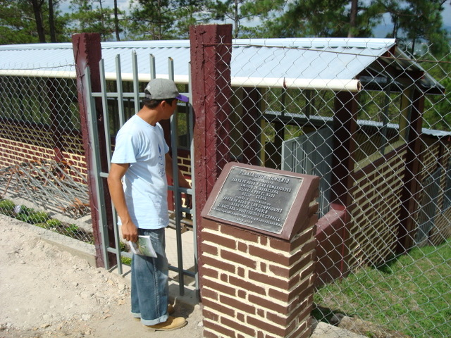
Cuatro Comunidades Plant

Slide 3
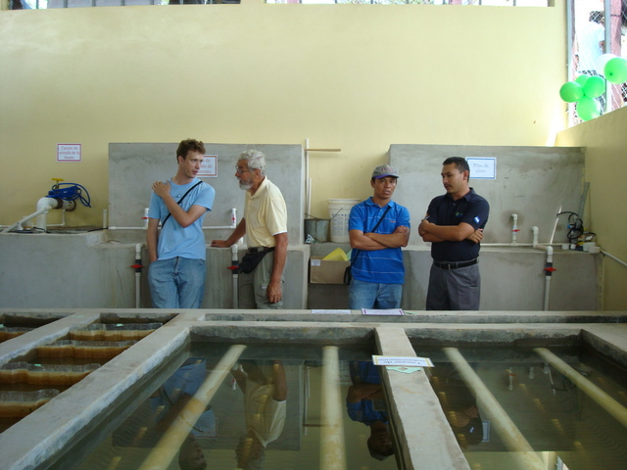

Slide 4
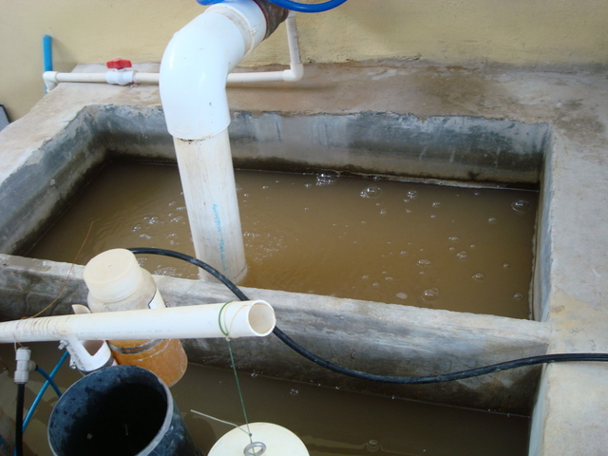
Raw Water (Entrance tank)

Slide 5
AguaClara: 4 key ideas
Innovative Design of Municipal Scale Drinking water treatment plants
Free design service – going to a fully automated online client server model (delivering detailed customized designs)
Partnership model – each partner contributing from their expertise
Scalable – replicable dissemination model

Slide 6
AguaClara: 4 key ideas
Resilient and Sustainable Infrastructure
Open Source Design
Partnerships - synergy
Viral spread of the knowledge

Slide 7
Why is this going to go viral?
Powerful latent demand for clean water by populations that previously assumed they couldn’t afford it
Even Costa Rica only has one rural community with a water treatment plant
We’ve proven that even communities as small as 1500 can sustain a plant

Slide 8
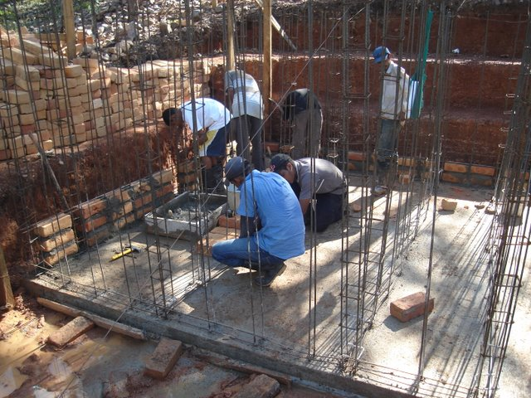
Sustainability
Local materials
Local labor
No electricity or
fossil fuels
Designed with the
operator in mind
Community pays for the chemicals and plant operator

Slide 9
Dissemination Model
AguaClara provides the technology and a online automated design service
Implementation Partners take those designs and work with communities to implement (structural and site design/build/train/operate/transfer)
Implementation Partners share knowledge and train new implementation partners so the spread can be viral

Slide 10
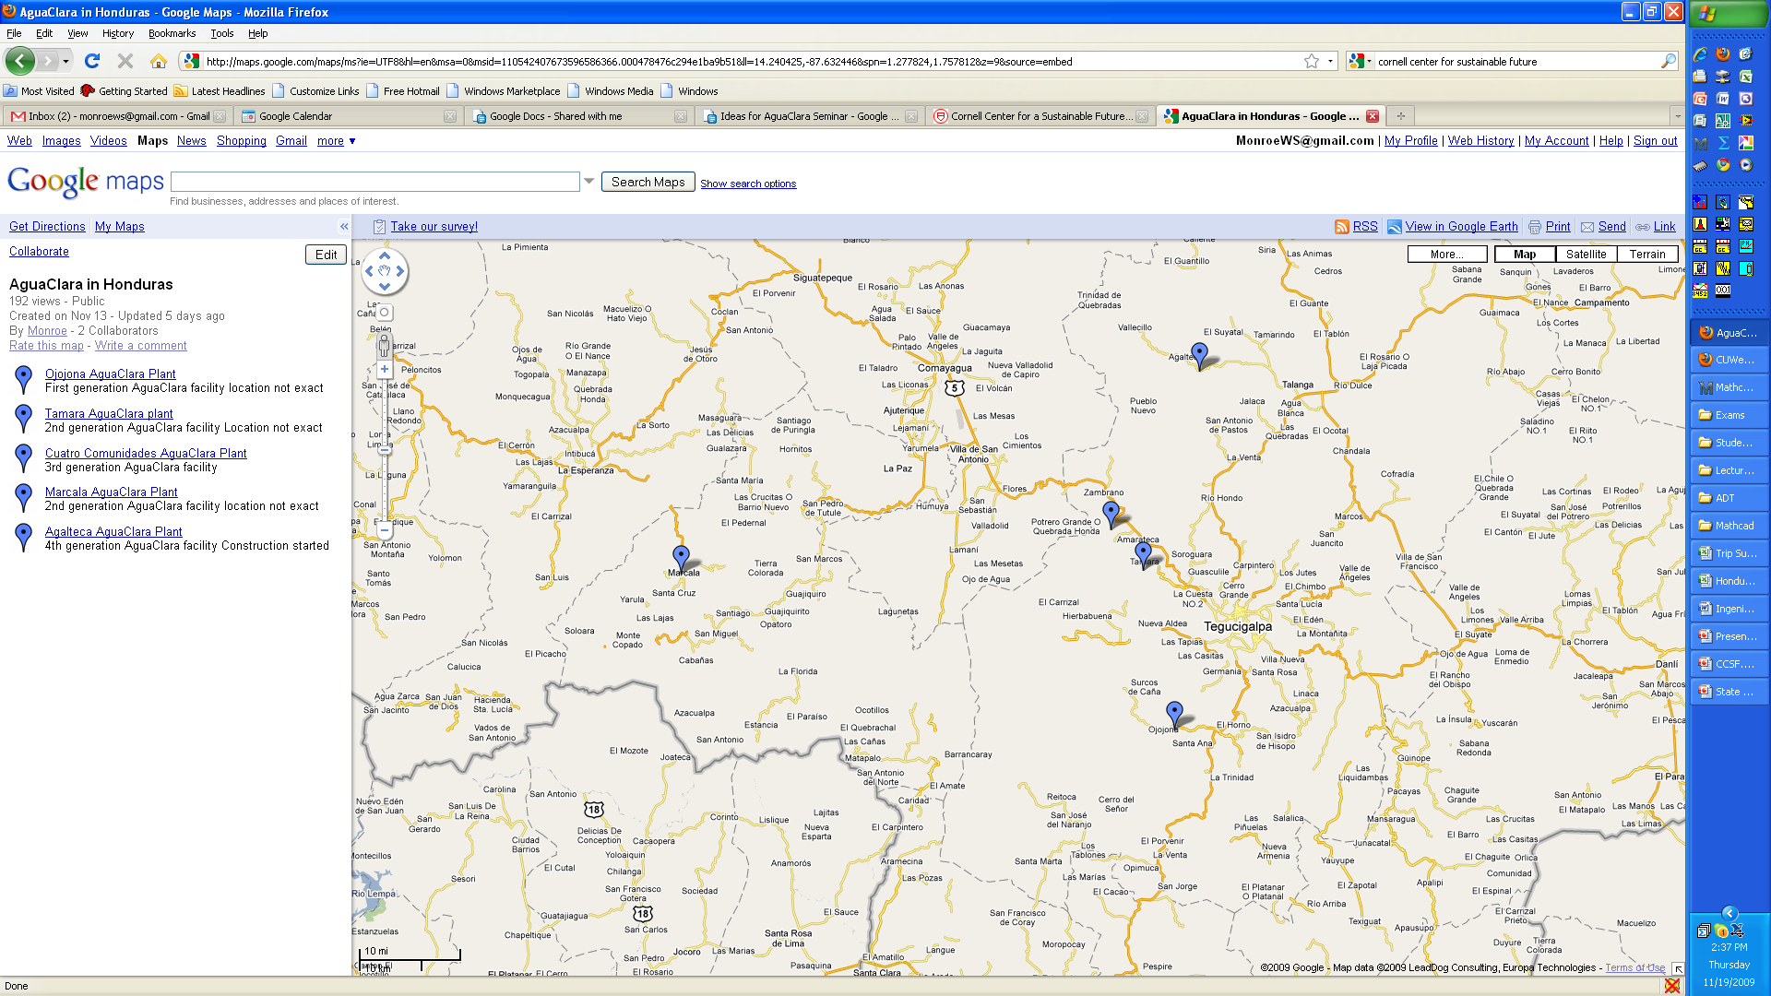
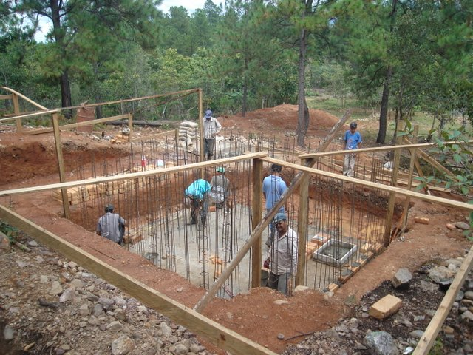
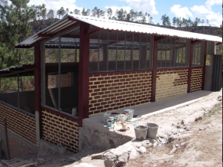
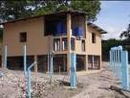
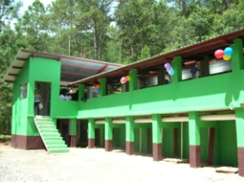

AguaClara in Honduras

Slide 11
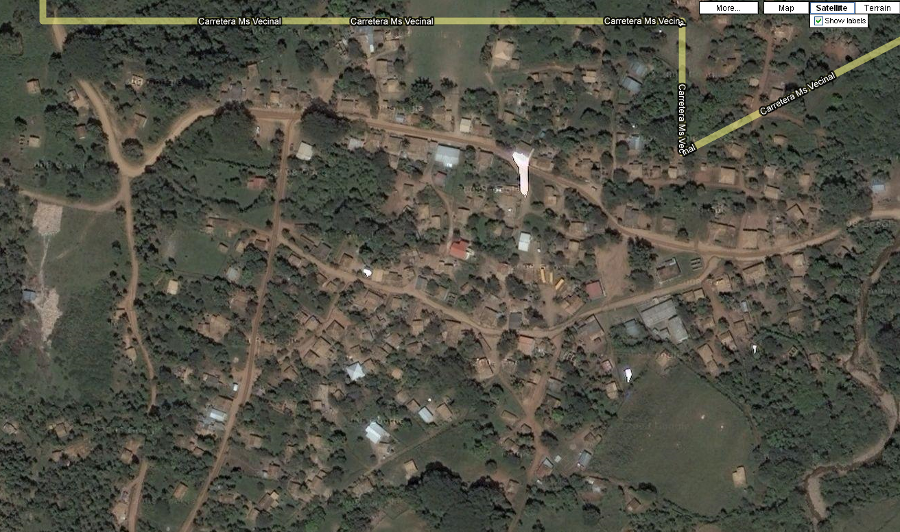
Agalteca – 2000 People

Slide 12
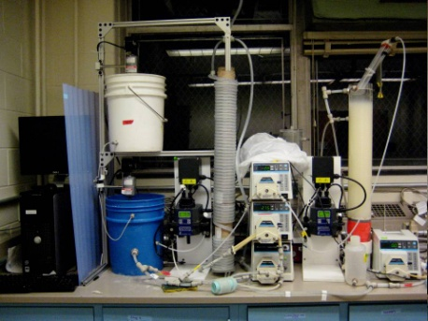
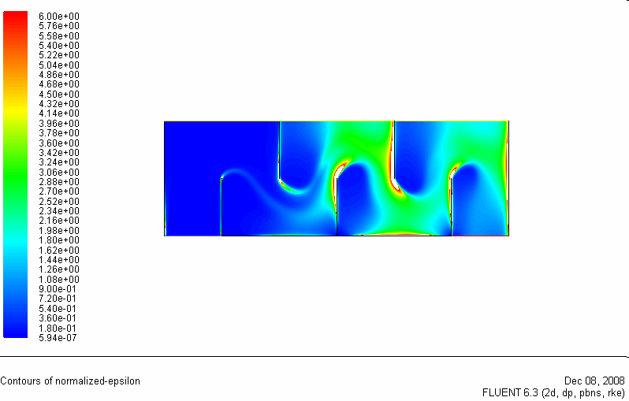
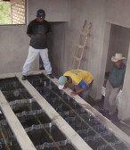
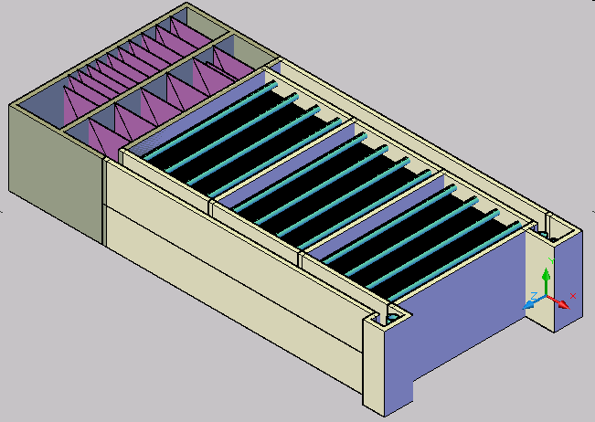

AguaClara Process
Laboratory Research
Analytical
Modeling
CFD
Evaluation
Normalized energy dissipation
Full Scale Implementation,
Capacity Building, Training, and Empowerment
Automated Design

Slide 13
Team Growth
Over 60% women. Majority of student team leaders have been women.
Team Project
Theory

Slide 14
An Opportunity…
…for Cornell to become the knowledge source for a technology that is needed by over 100,000,000 people (and billions if you include infrastructure upgrades)
We have carefully structured the dissemination model so that the team at Cornell doesn’t limit the dissemination rate
Using our current technology we can already deliver about 300 designs per day

Slide 15
Objectives
Broaden the scope of the AguaClara team and identify associated research and outreach opportunities that cut across disciplines and departments.
There are great latent questions about multi-dimensional impacts including disease burdens, child growth and health, time use, expenditure patterns, willingness to pay, etc.
The challenges of scale include appropriate implementation methodologies for communities of different sizes as well as the scale-up to multiple countries and global regions

Slide 16
Discussion Questions
Where do we want this project to be in 2 to 5 years?
How can we leverage the growing influence of the AguaClara project to obtain funding for research that would evaluate the health/economic/quality of life impact of AguaClara?

Slide 17
Discussion Questions
What are the research questions that we would want to investigate?
What are the potential funding sources for the research?
How might the AguaClara project be made more sustainable?

Slide 19
AguaClara: Transitioning from Technology Development to Dissemination
The AguaClara program has developed a novel approach to developing and disseminating sustainable water treatment technologies. The approach incorporates open source engineering, web-based delivery of customized engineering designs, and a strong research program. Cornell designed AguaClara municipal water treatment plants in Honduras are providing over 13,000 people with drinking water.
The AguaClara program is much more than engineering. Technology implementation in Honduras is managed by a non governmental organization that emphasizes community participation and education, collaboration with government agencies concerned with public health and water supply, and training workshops for continuing education at national universities.
The AguaClara program is beginning to spread the technology to additional countries. We now have the opportunity to create broader visions and to add expertise to handle the challenges of scale-up. The objectives of this faculty luncheon are to broaden the scope of the AguaClara team and identify associated research and outreach opportunities that cut across disciplines and departments. There are great latent questions about multidimensional impacts including disease burdens, child growth and health, time use, expenditure patterns, willingness to pay, etc. The challenges of scale include appropriate implementation methodologies for communities of different sizes as well as the scale-up to multiple countries and global regions.

