Slide 1
Take Back the Tap
November 18, 2009
Monroe Weber-Shirk

Slide 2
Acknowledgements
The AguaClara project is only possible through the very hard work of hundreds of people
Special thanks go to the AguaClara team members who spend long hours conducting research and writing code to make safe water possible
School of CEE, Engineering College, Sanjuan Foundation, many donors

Slide 3
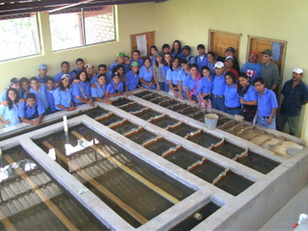
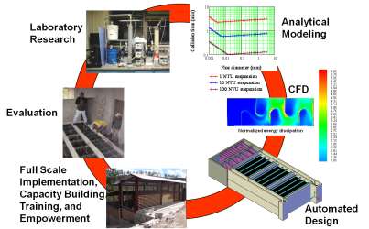
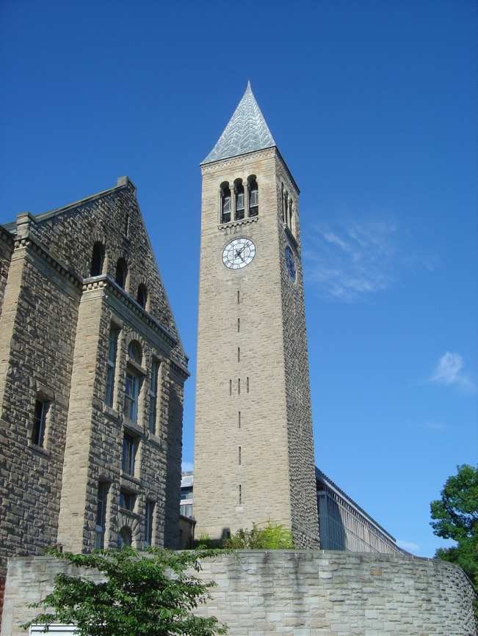
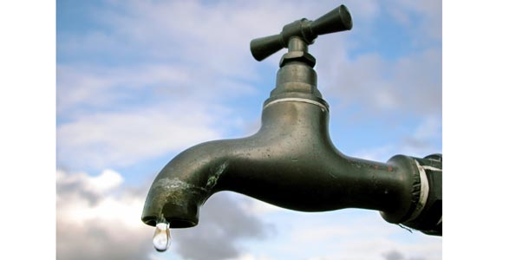
Themes
Intro to AguaClara: Creating an alternative to Dirty water and Bottled water
  Product
  Process
Reflections on Taking Back the Tap(s)
  Knowledge
  Capital
  Hardware
  Energy
  and Water!

Slide 4
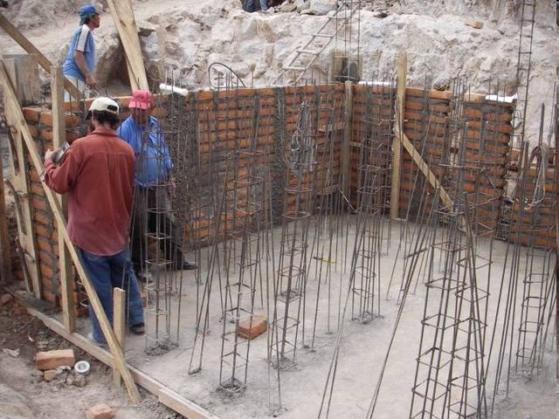

Slide 5
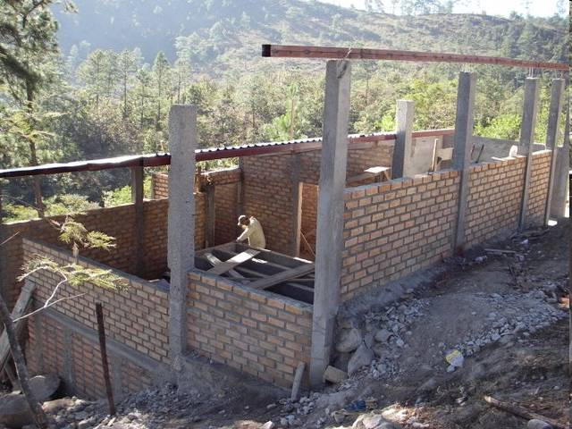

Slide 6
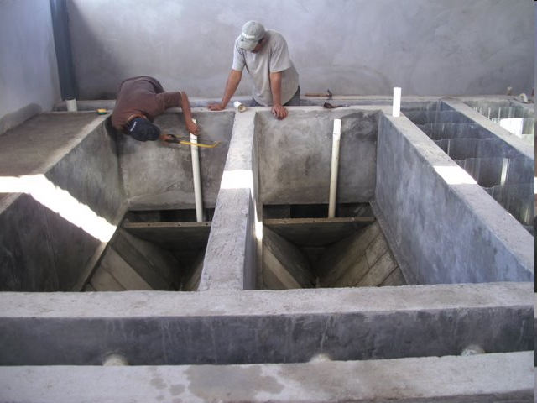

Slide 7
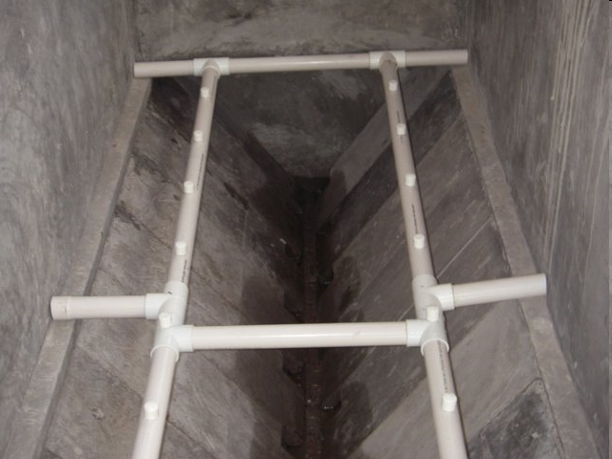

Slide 8
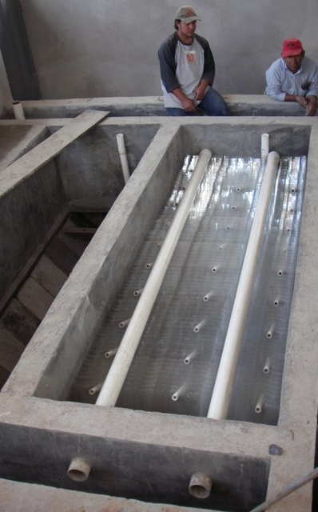
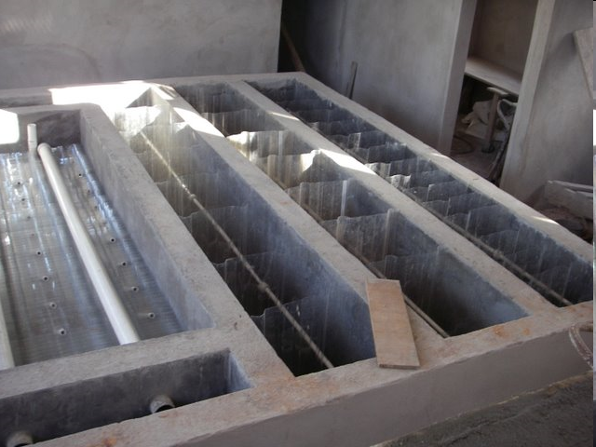
Flocculation
Sedimentation

Slide 9
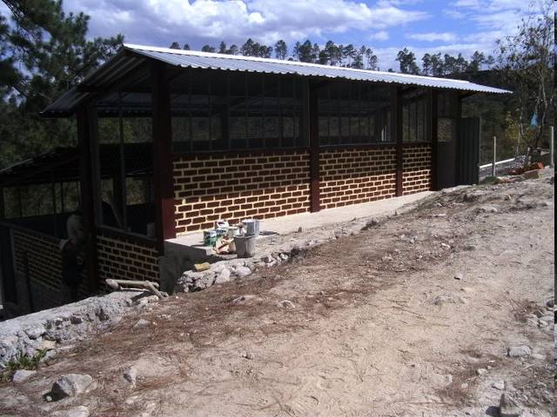

Slide 10
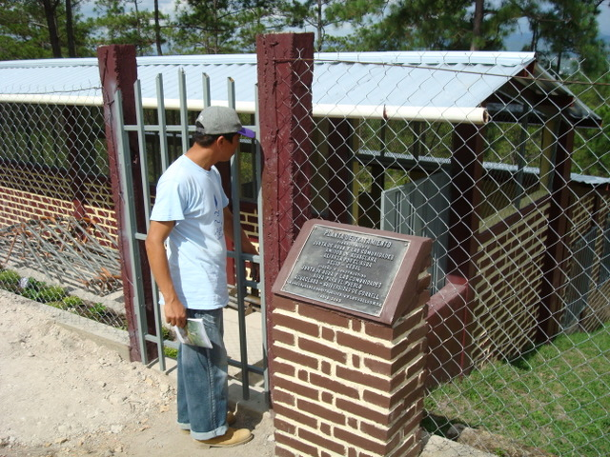
Cuatro Comunidades Plant

Slide 11
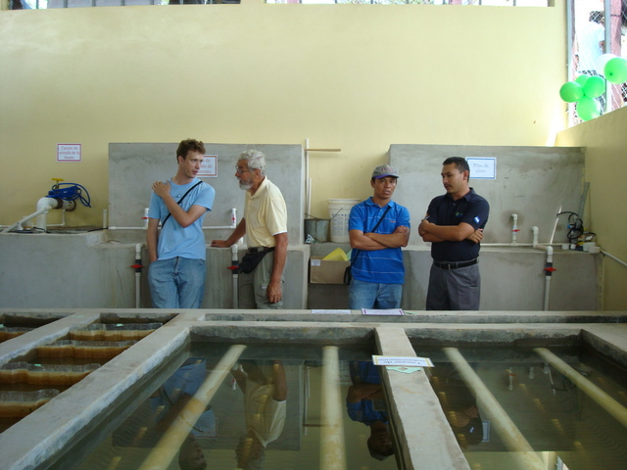
Chemical tanks

Slide 12
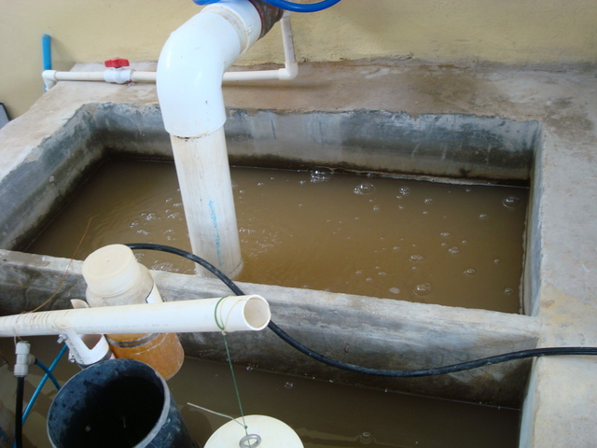
Raw Water (Entrance tank)

Slide 13
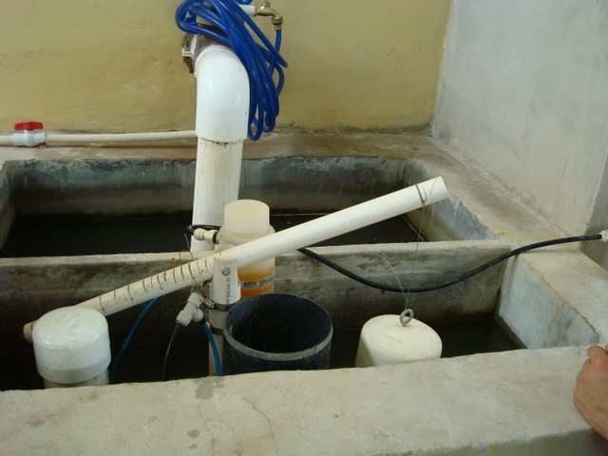
Chemical Doser

Slide 14
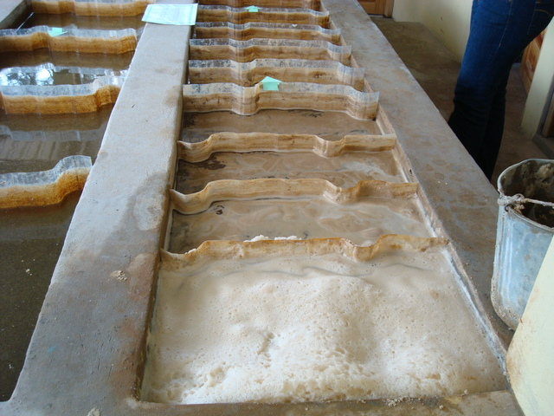
Flocculator

Slide 15
Flocs!

Slide 16
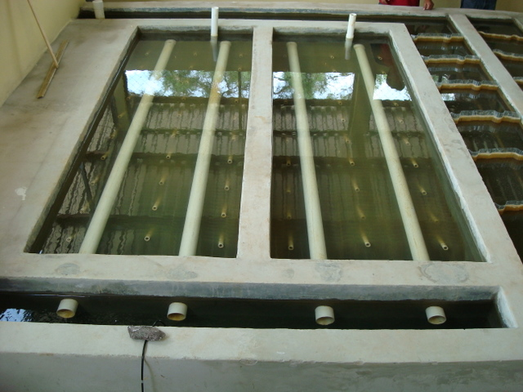
Sedimentation tank

Slide 17
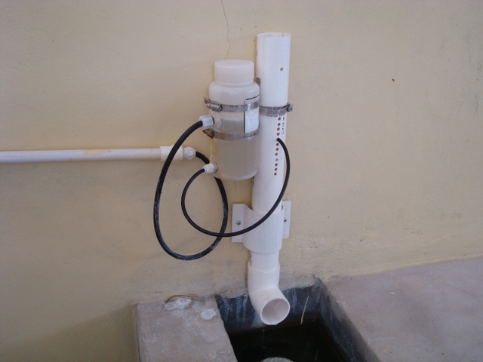
Chlorinator

Slide 18
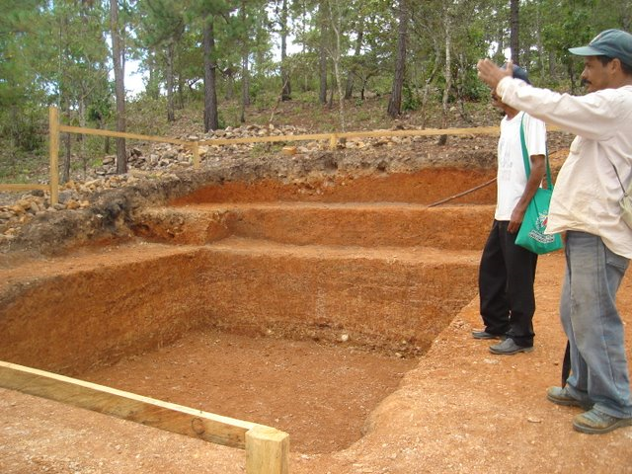

Slide 19
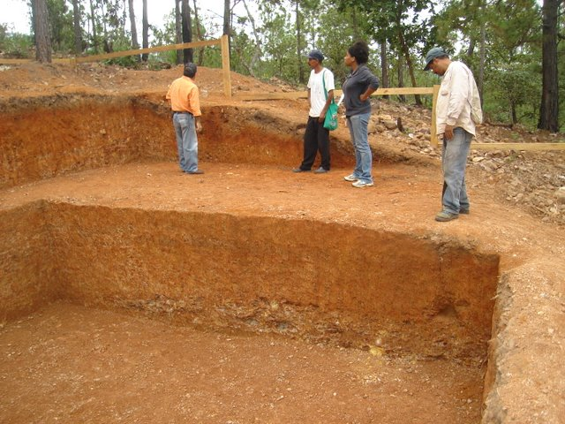

Slide 20
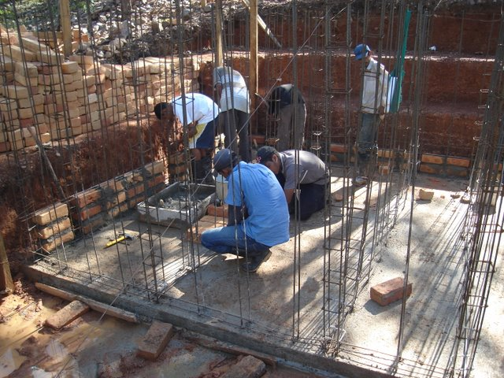

Slide 21
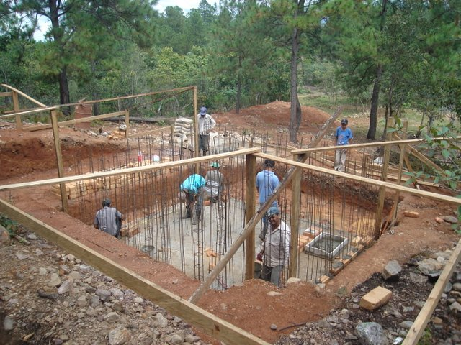

Slide 22
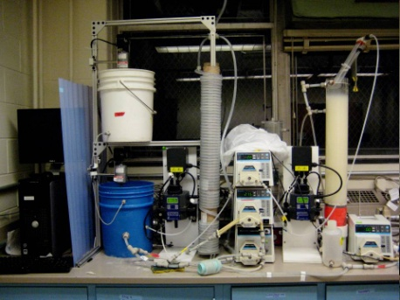
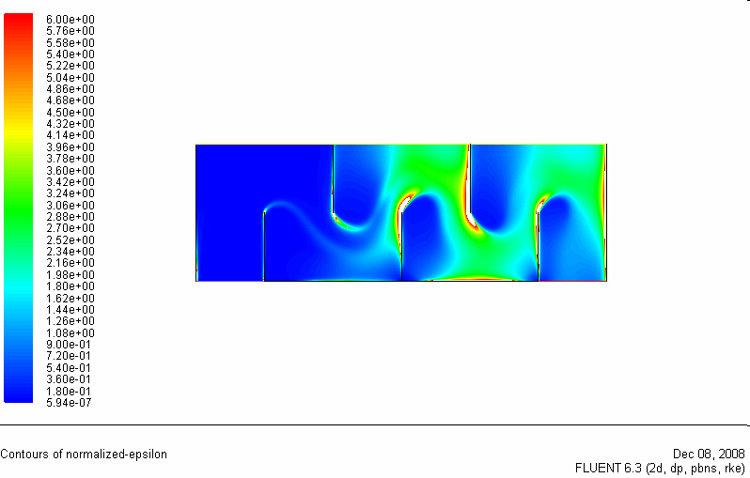
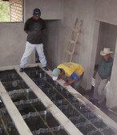
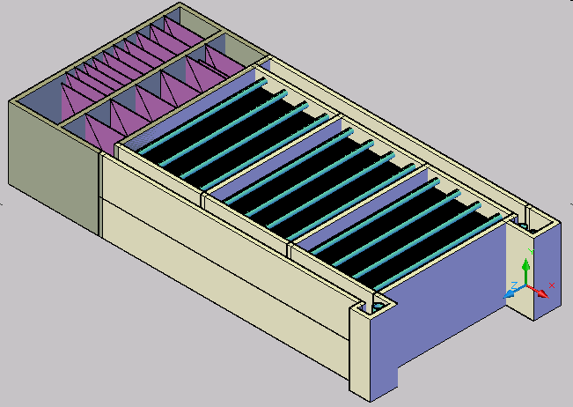
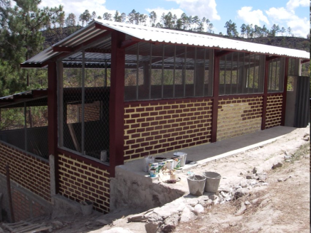
AguaClara Process
Laboratory Research
Analytical
Modeling
CFD
Evaluation
Normalized energy dissipation
Full Scale Implementation,
Capacity Building, Training, and Empowerment
Automated Design

Slide 23
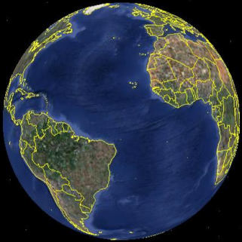
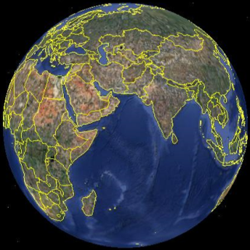
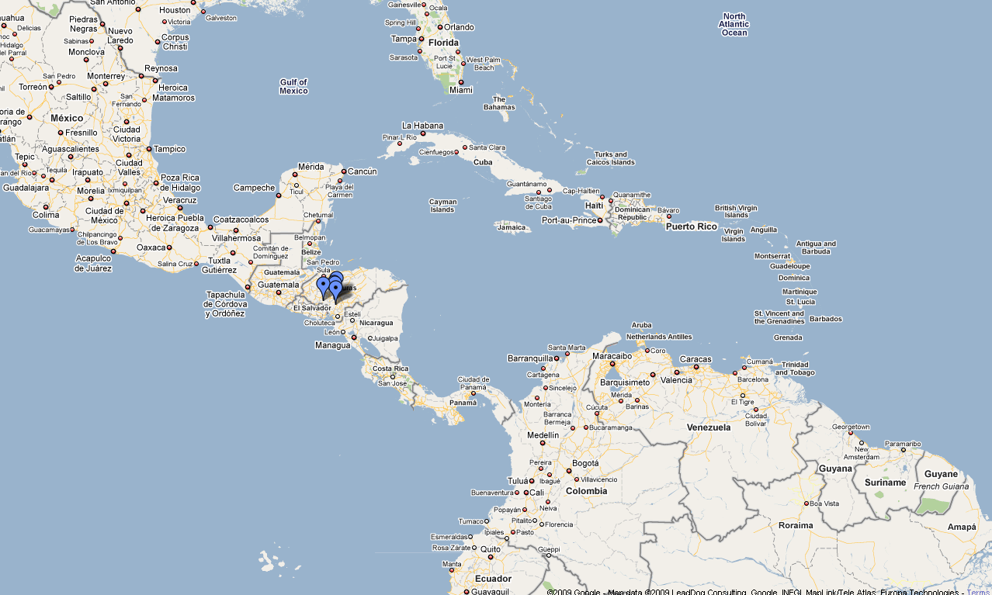

Project Expansion

Slide 24
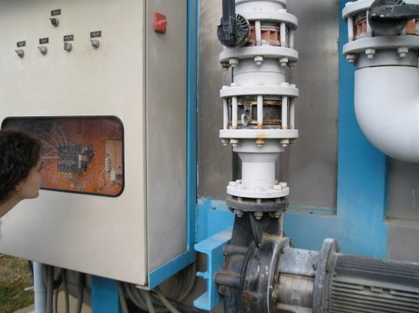
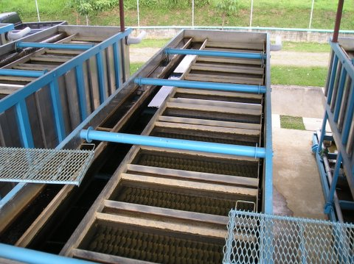
Taking Back the Tap(s)
Dependency
Empowerment
Knowledge
Closed Proprietary
Open Source
Primarily to a single multinational firm
local labor/small business some multinationals
Capital flow
Hardware
Specialized Proprietary
Generic – locally available
Energy Source
Electricity
Renewable

Slide 25
The numbers…
If we could give up our bottles
The global bottled water industry has exploded to over $45 billion per year*
There are roughly 2 billion people that don’t have access to safe drinking water
AguaClara costs $20 per person
http://www.icbwa.org/2000-2003_Zenith_and_Beverage_Marketing_Stats.pdf

Slide 26


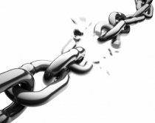
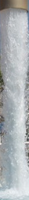
Opening the Tap
Knowledge
How can we unlock the knowledge trap at Cornell?
Work with groups and individuals who are both good at dreaming and wise
Extend the Open Source Model of creating Robust-Sustainable Communities to other areas
  Economy, natural resources, wastewater, energy…

Slide 27
We didn’t Discuss
Community Support for their Infrastructure
  Point of Use – unintended consequences
An Engineering Solution for reducing bottled water consumption that we could apply here at Cornell

Slide 28
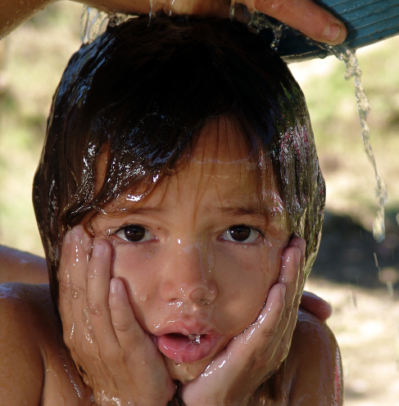
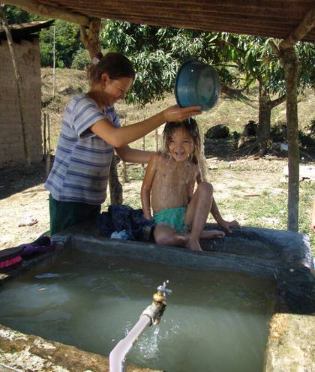
Why we do what we do...
Find out more at AguaClara.cee.cornell.edu

