Slide 1
RStudio Project Workflow
Adam Chandler
Director, Automation, Assessment, and Post-Cataloging Services
Library Technical Services
Cornell University Library
alc28@cornell.edu
https://orcid.org/0000-0003-2204-3522
Cornell R Users Group
April 7, 2026

Slide 2
Presentation overview
How I use R in my job at the Library
Desired improvements
My RMarkdown workflow
Alternatives explored
Revised workflow
Brief intro to using SQL within RStudio

Slide 3
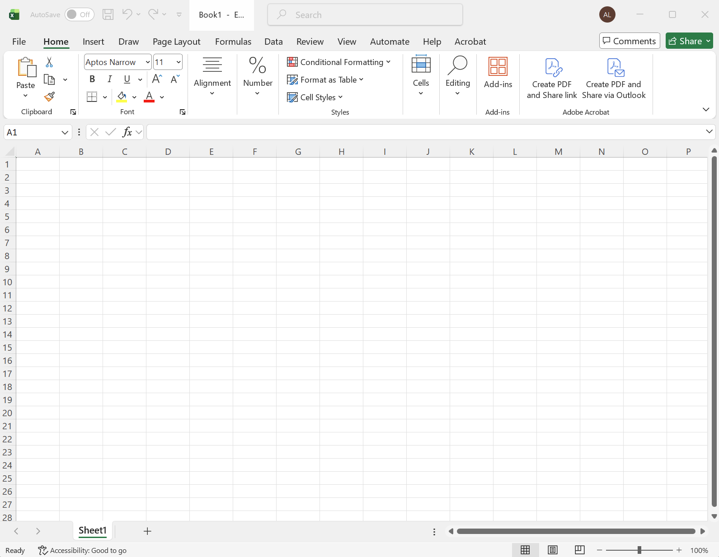

Slide 4
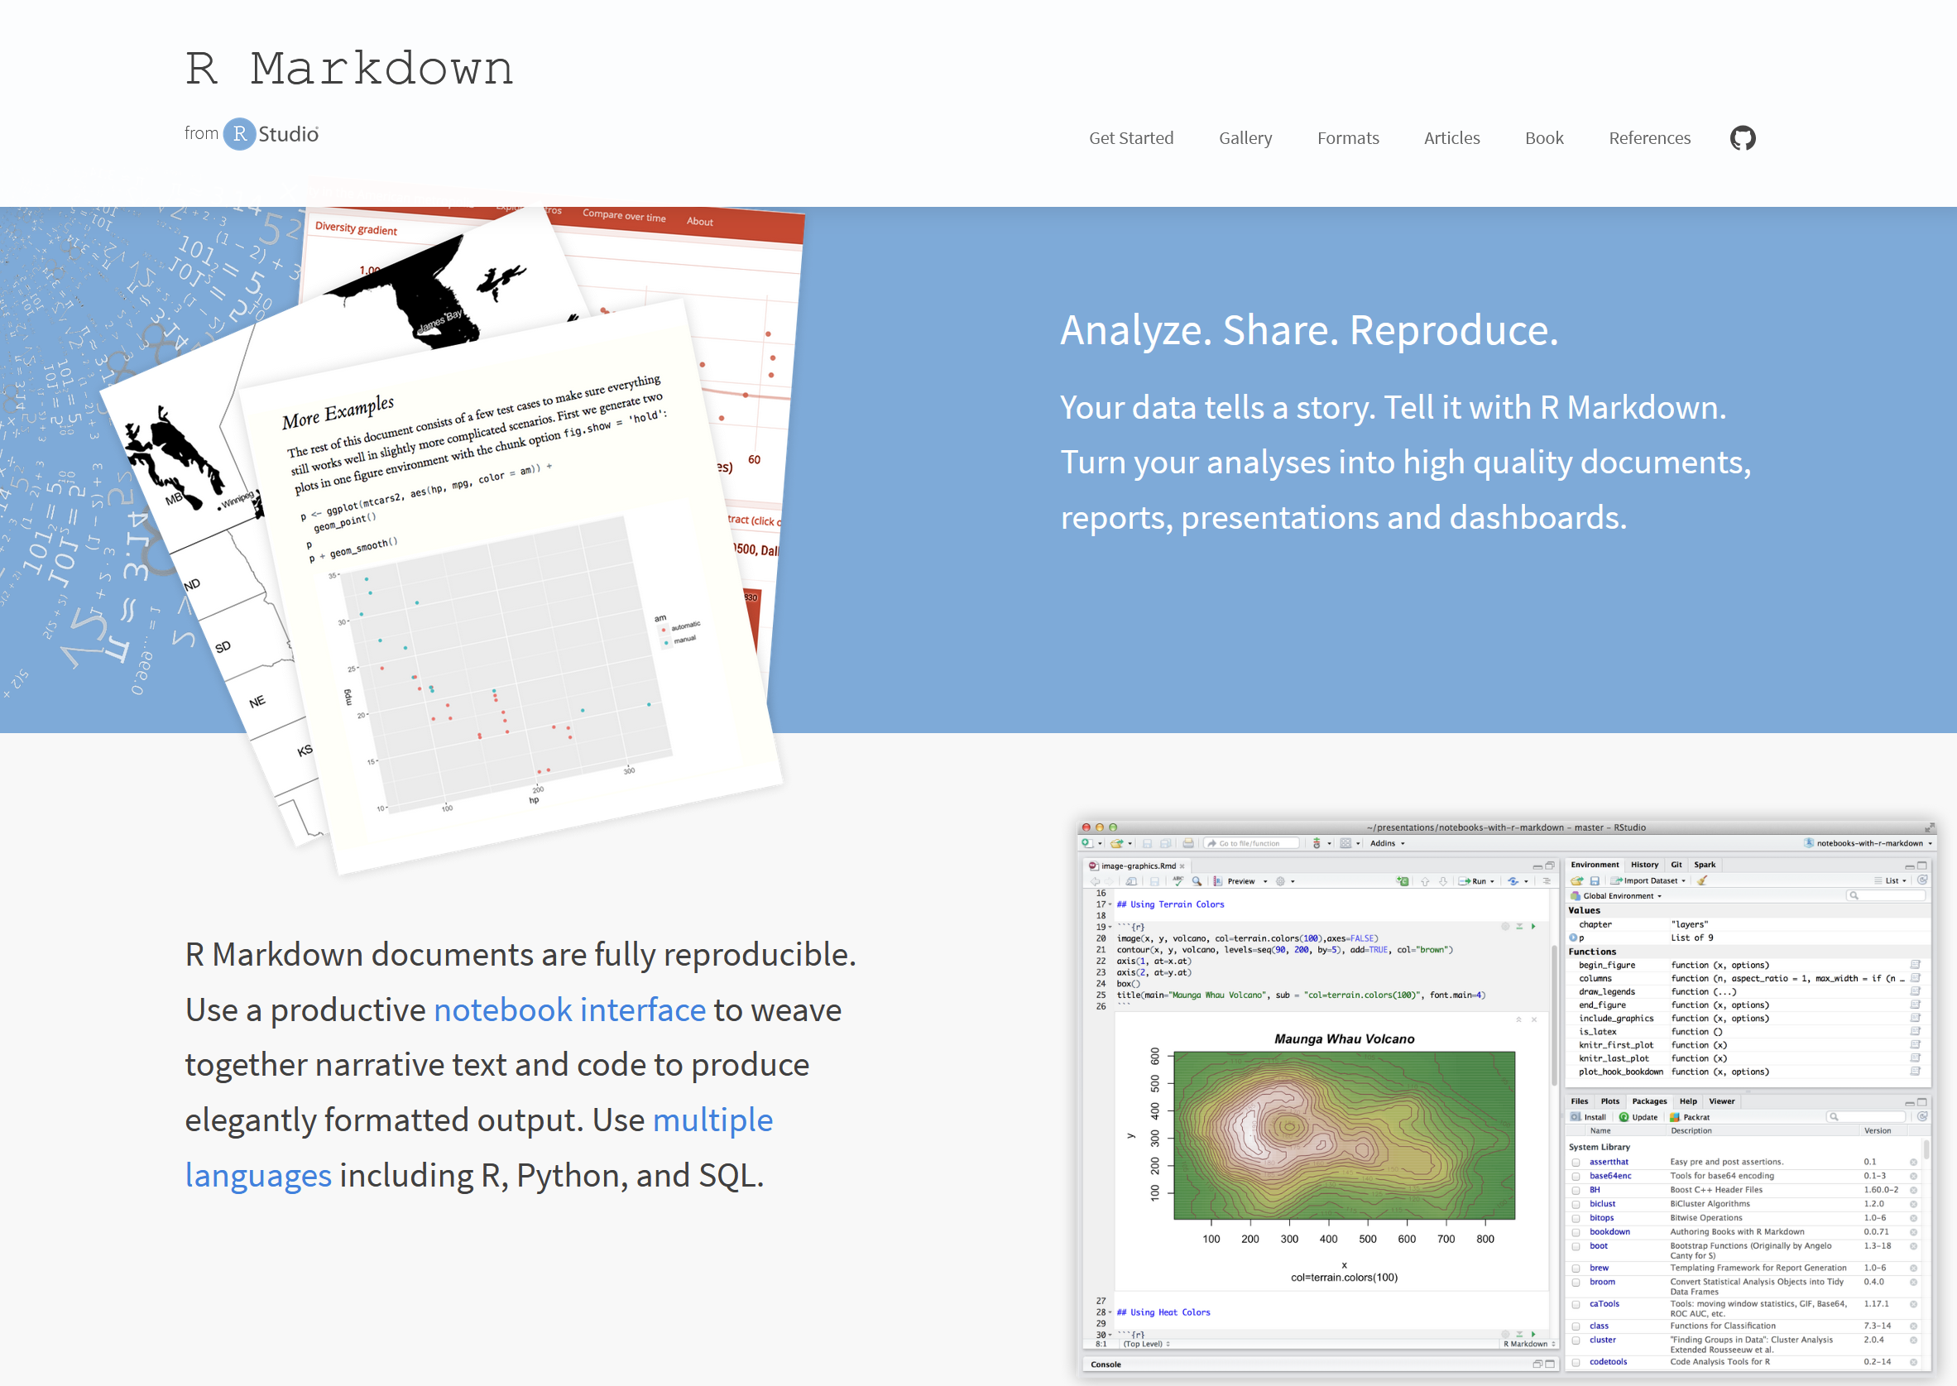

Slide 5
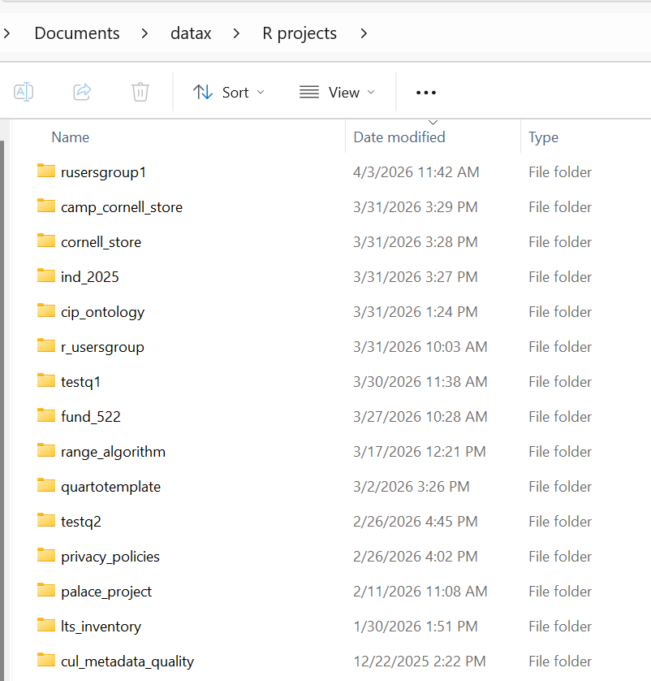
~240 RStudio projects since 2017. Some projects are tiny, with only one script.
Other projects are large and complicated, with many scripts and data files.

Slide 6
My reliable
(but slightly irritating) RMarkdown workflow

Slide 7
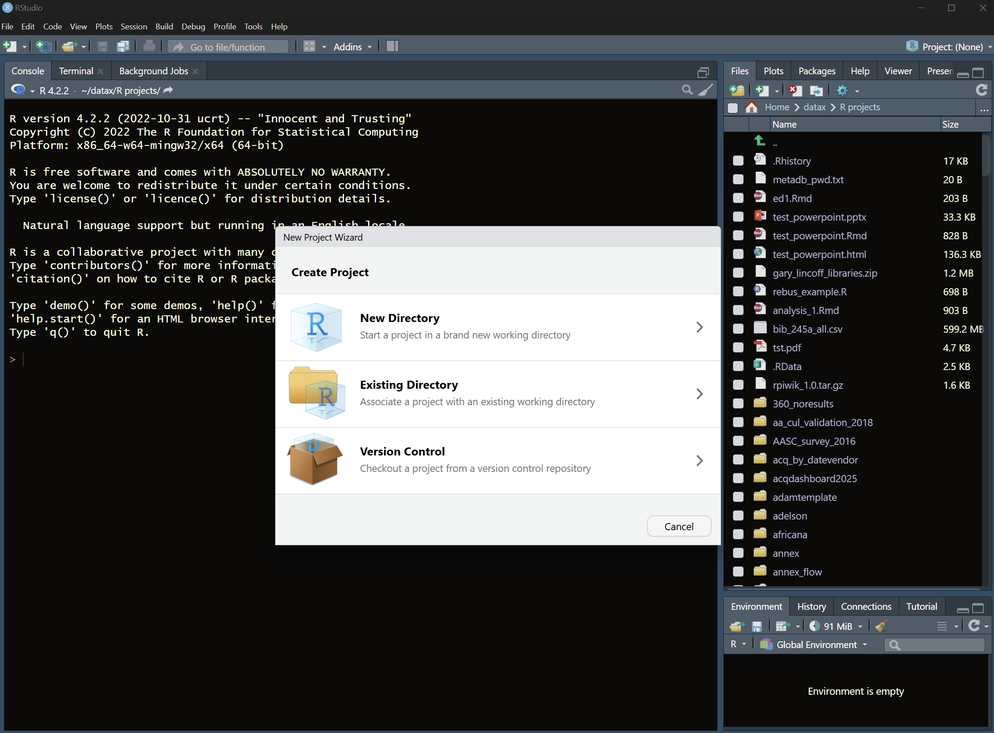

Slide 8
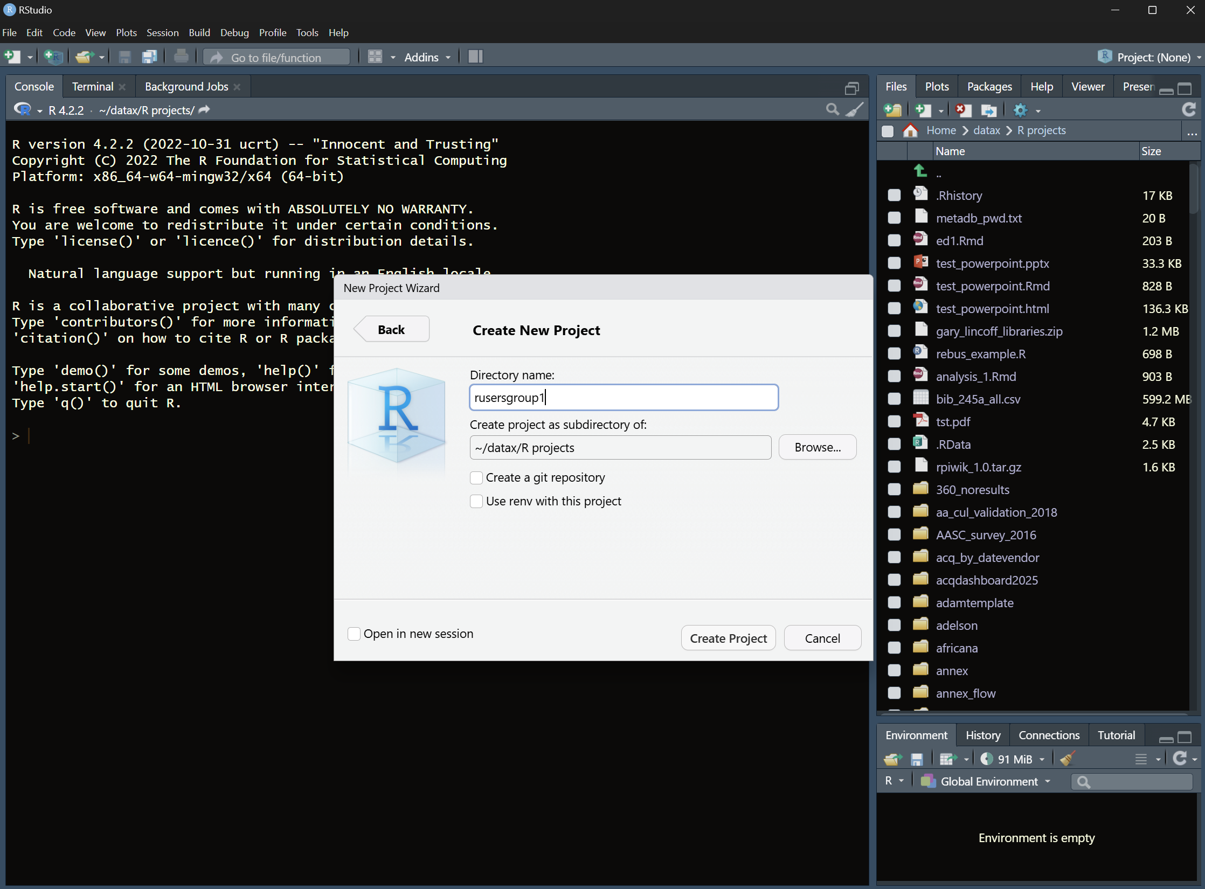

Slide 9
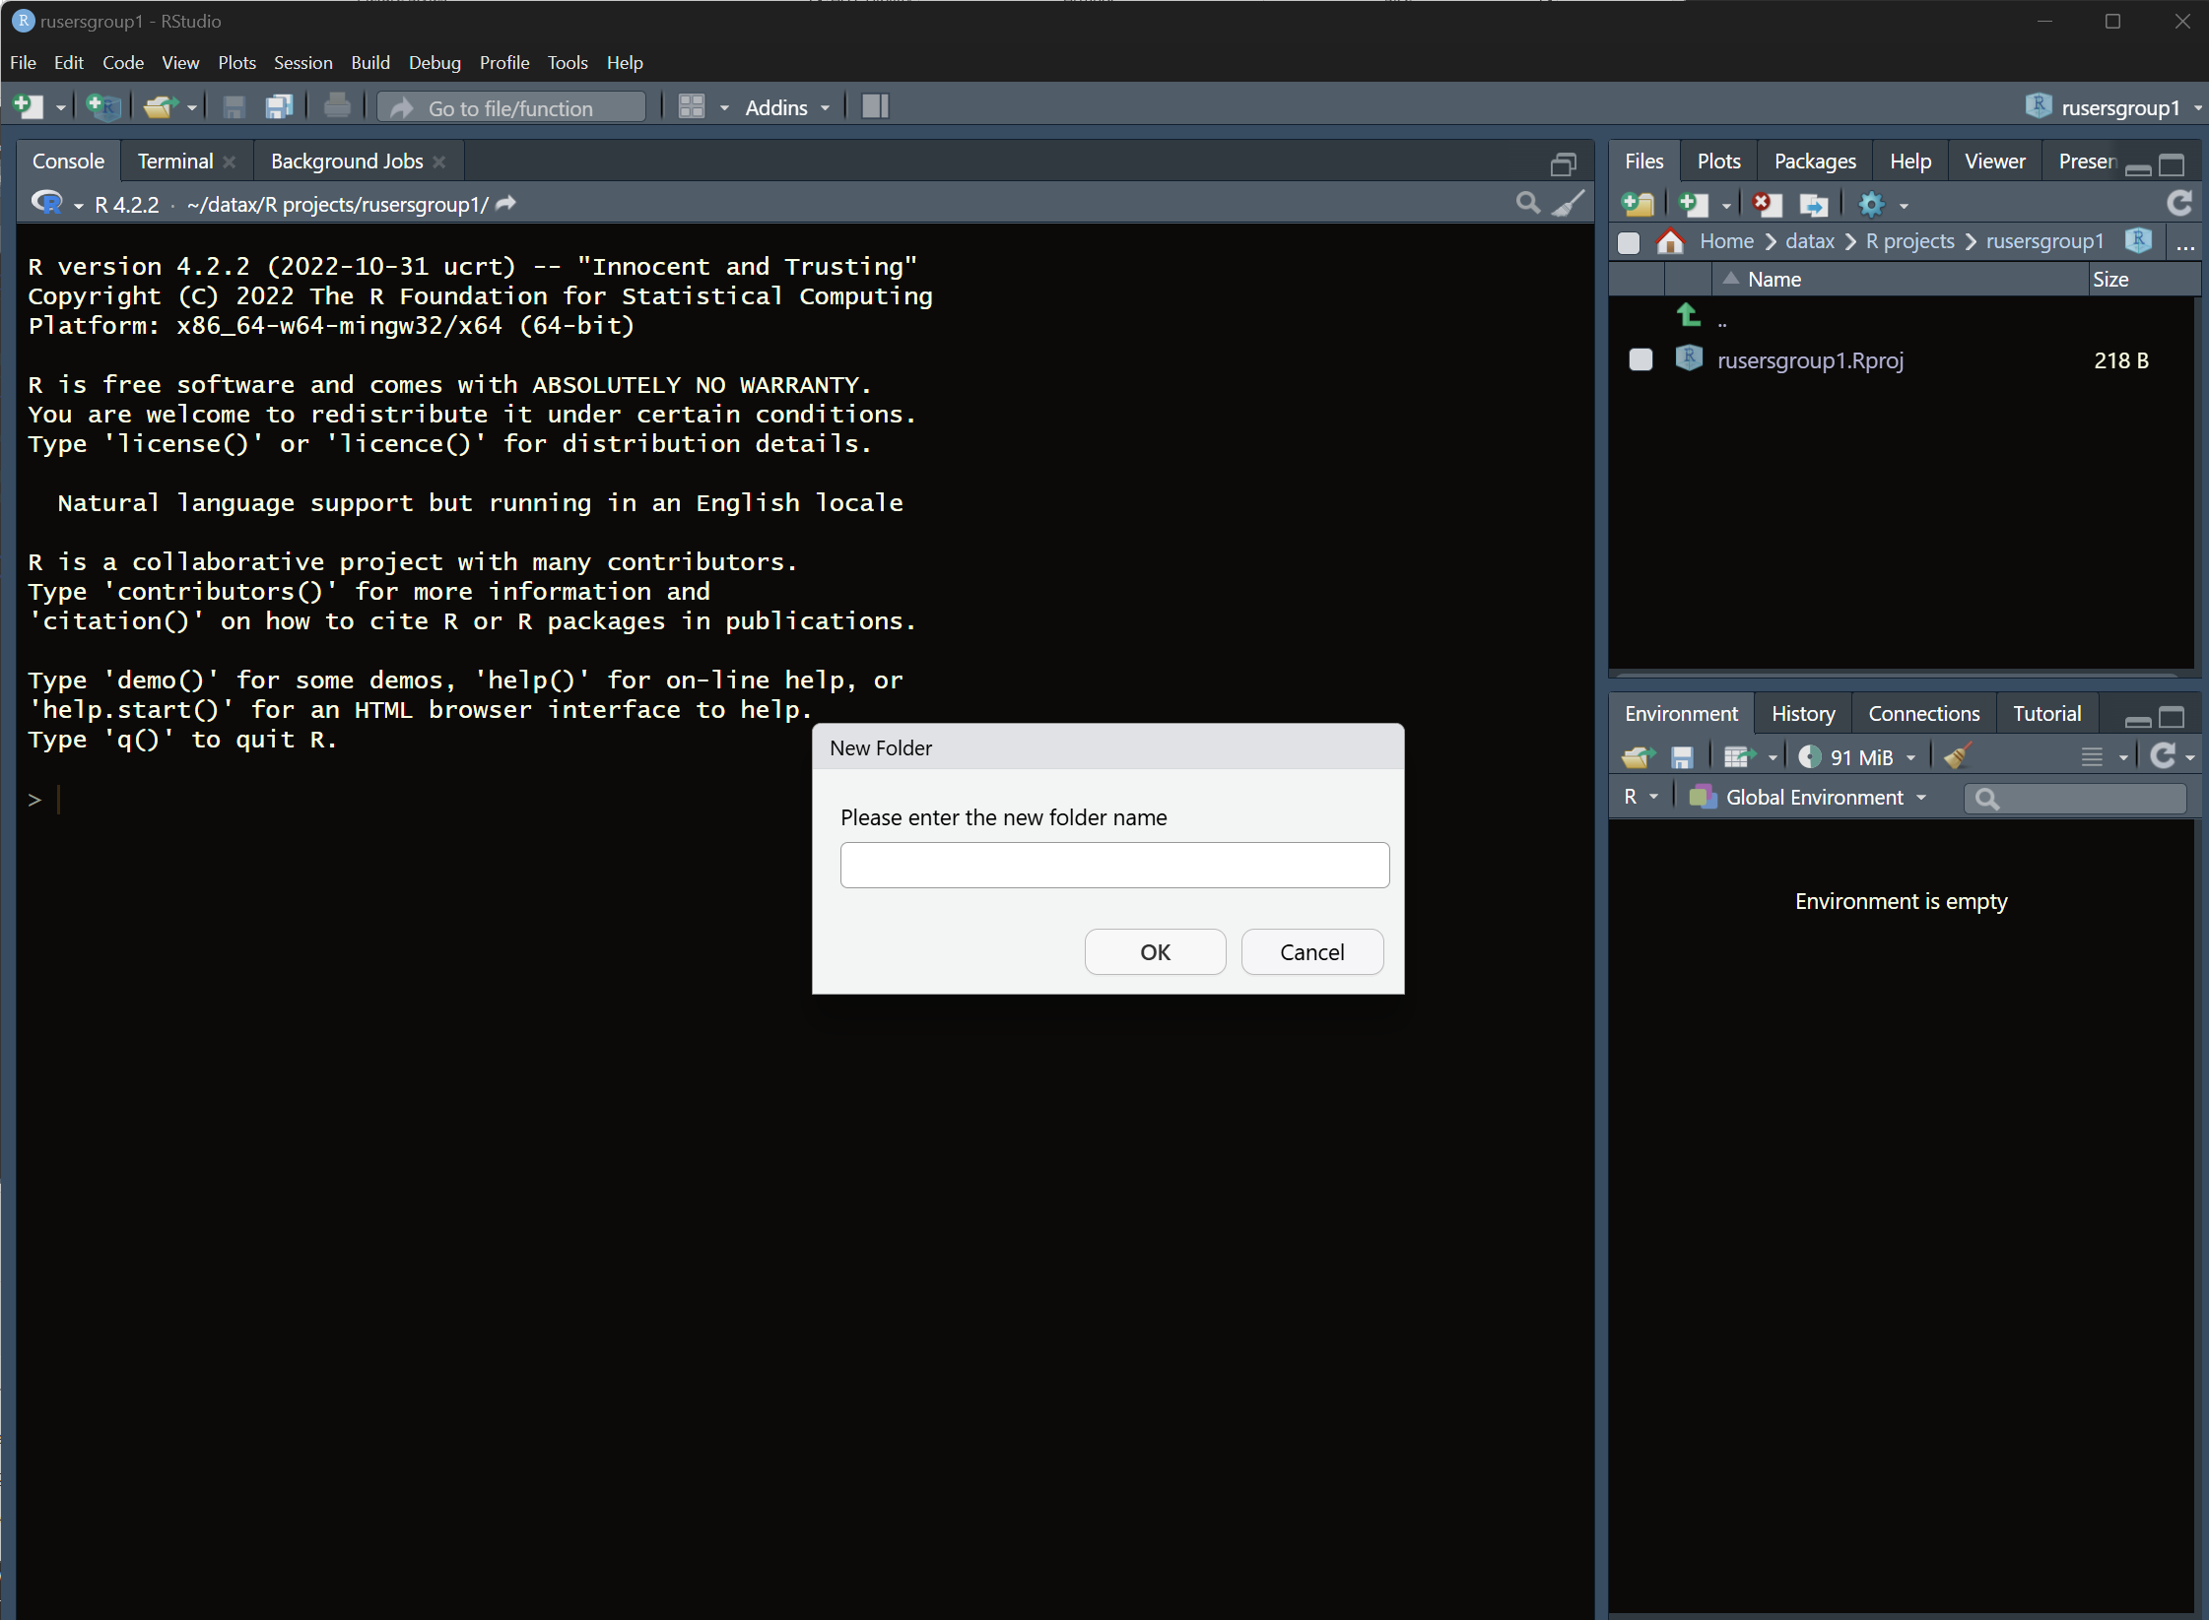
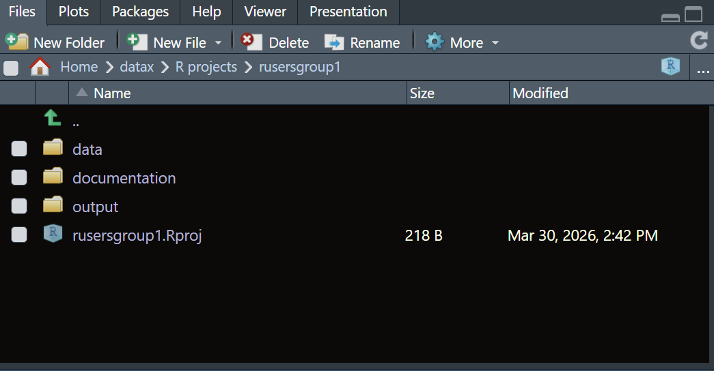

Slide 10
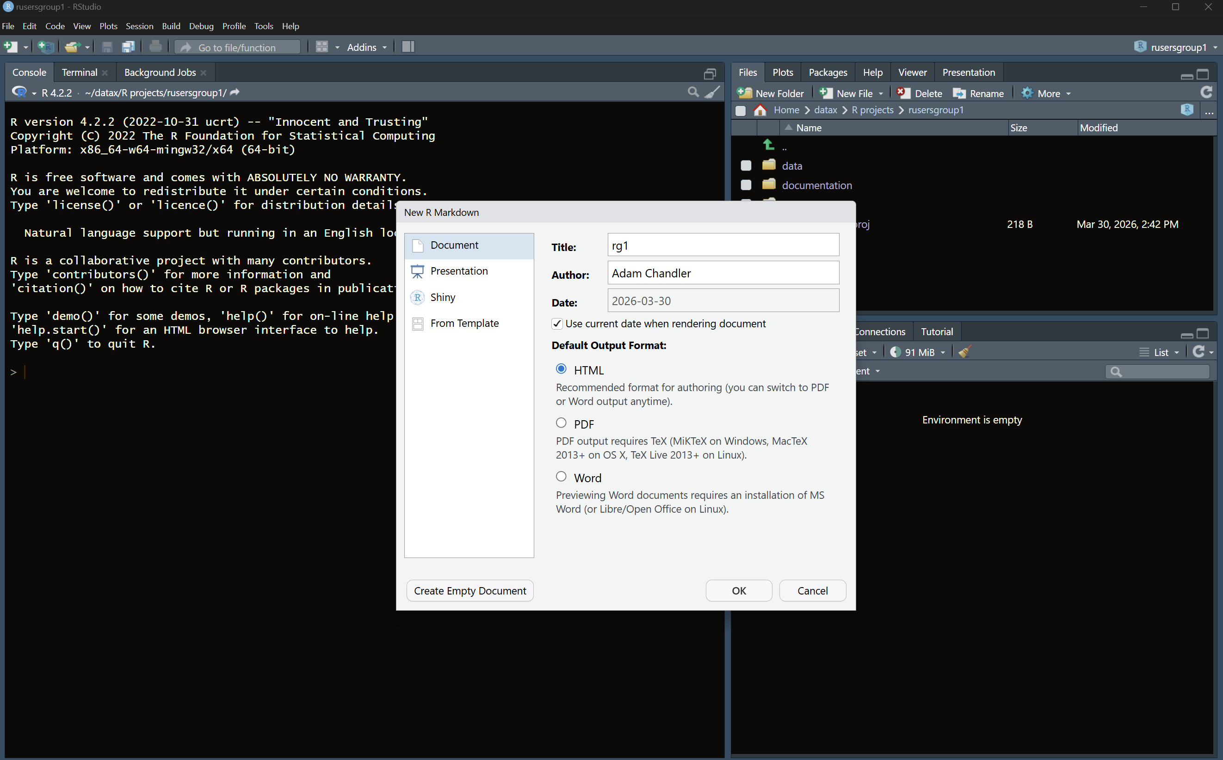

Slide 11
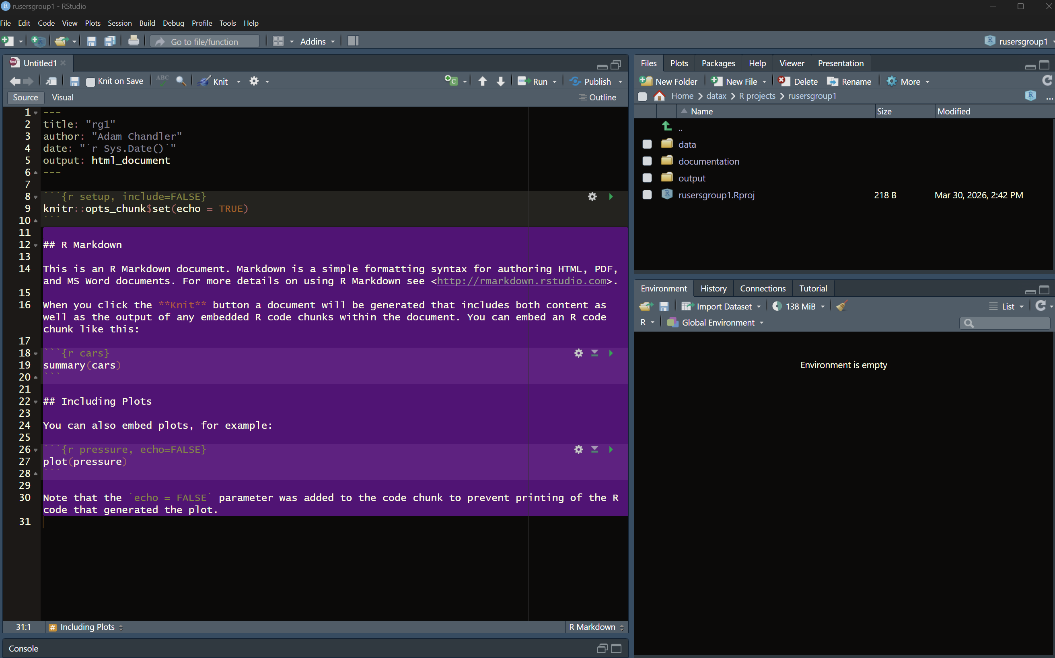

Slide 12
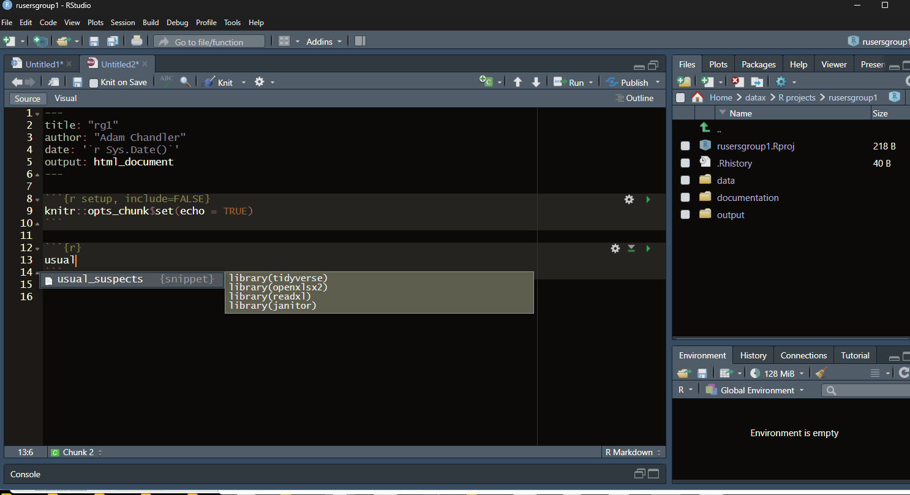

Slide 13
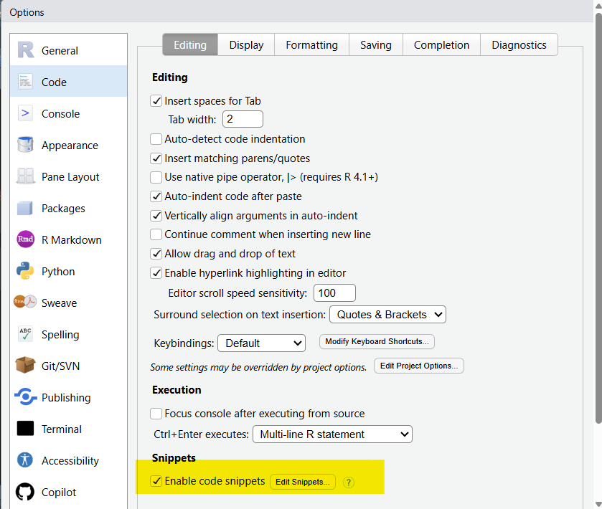

Slide 14
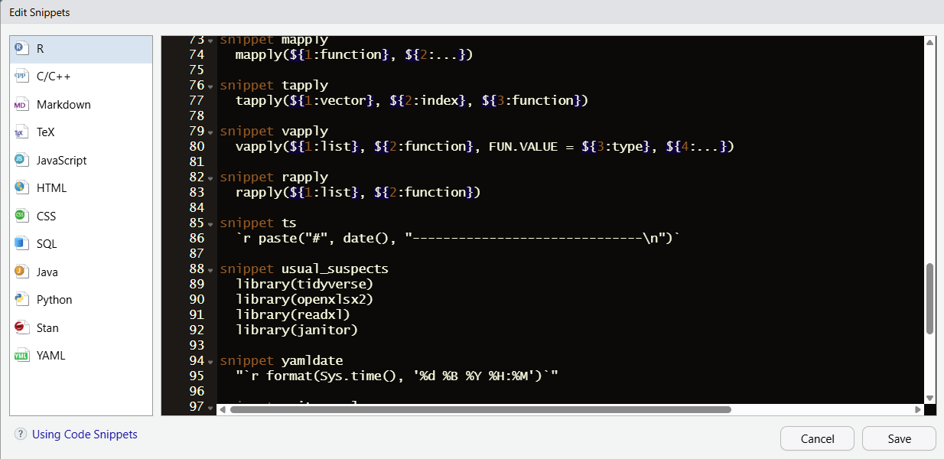

Slide 15
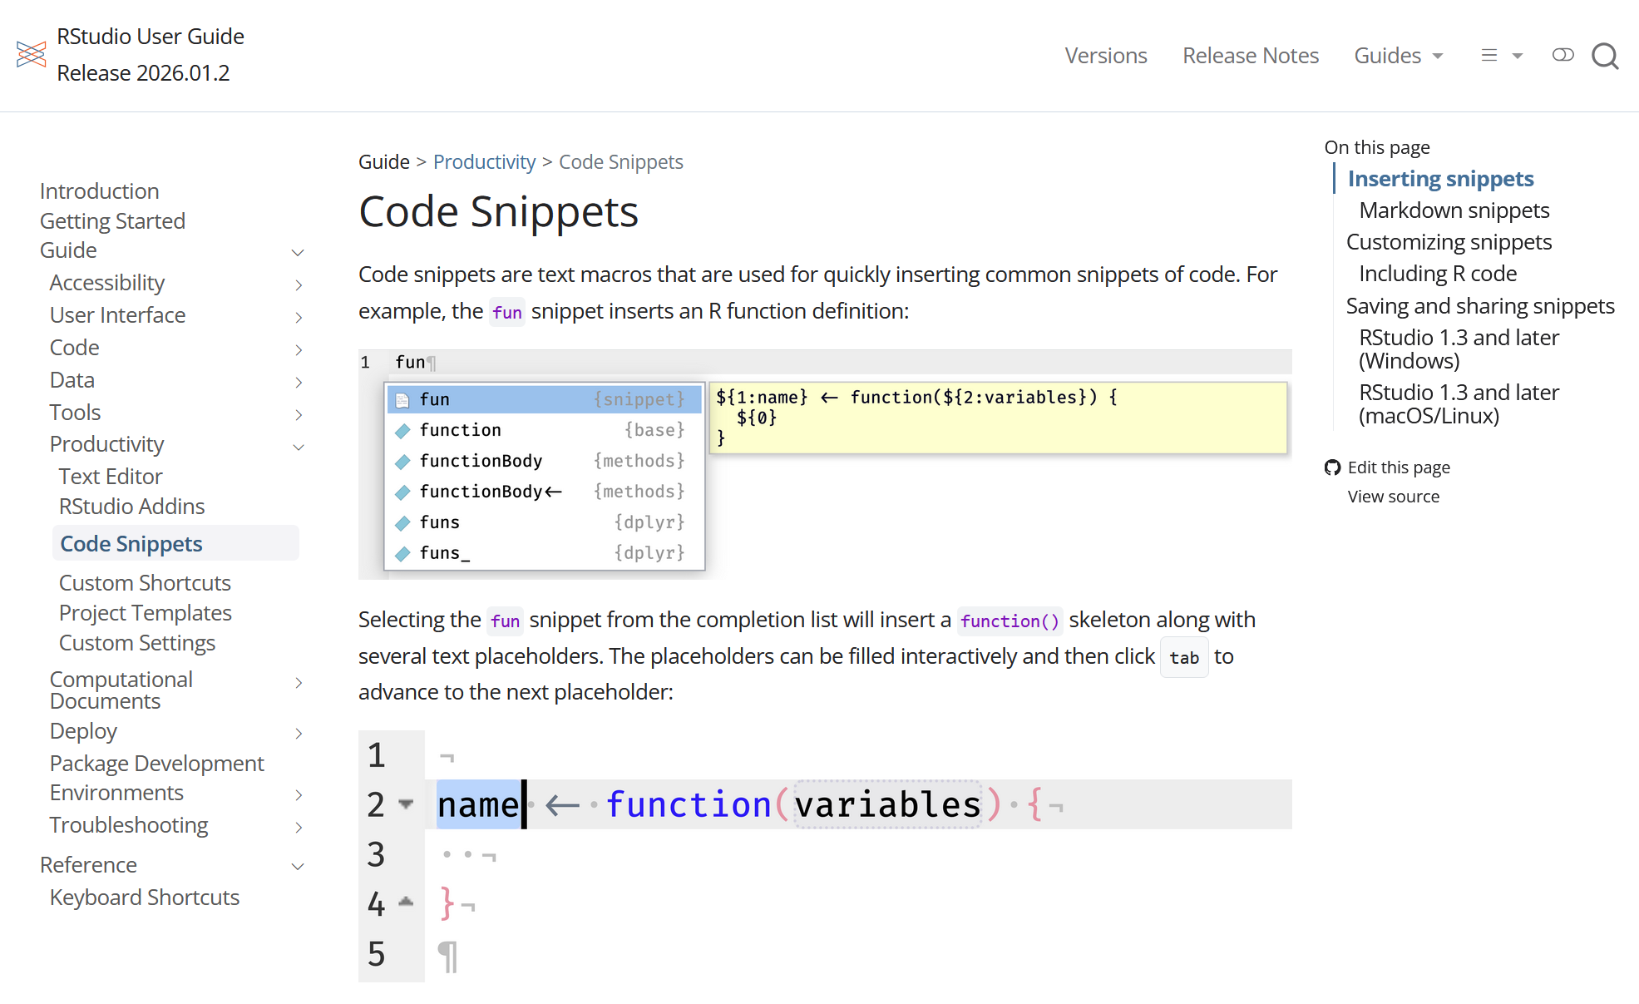
https://docs.posit.co/ide/user/ide/guide/productivity/snippets.html

Slide 16
Desired improvements
Adopt Quarto
  Clearly Quarto is the future for RStudio/Posit; no more development on RMarkdown
Automate common project setup tasks
  My common setup tasks are predictable
Preference for lightweight solution
  I am mostly a manager, not a full-time software engineer. I have other work to do
  Biased towards solution that is not prone to disruption by software/OS updates.

Slide 17
Alternatives explored (and rejected)
Create RStudio project template
Clone custom GitHub repo

Slide 18
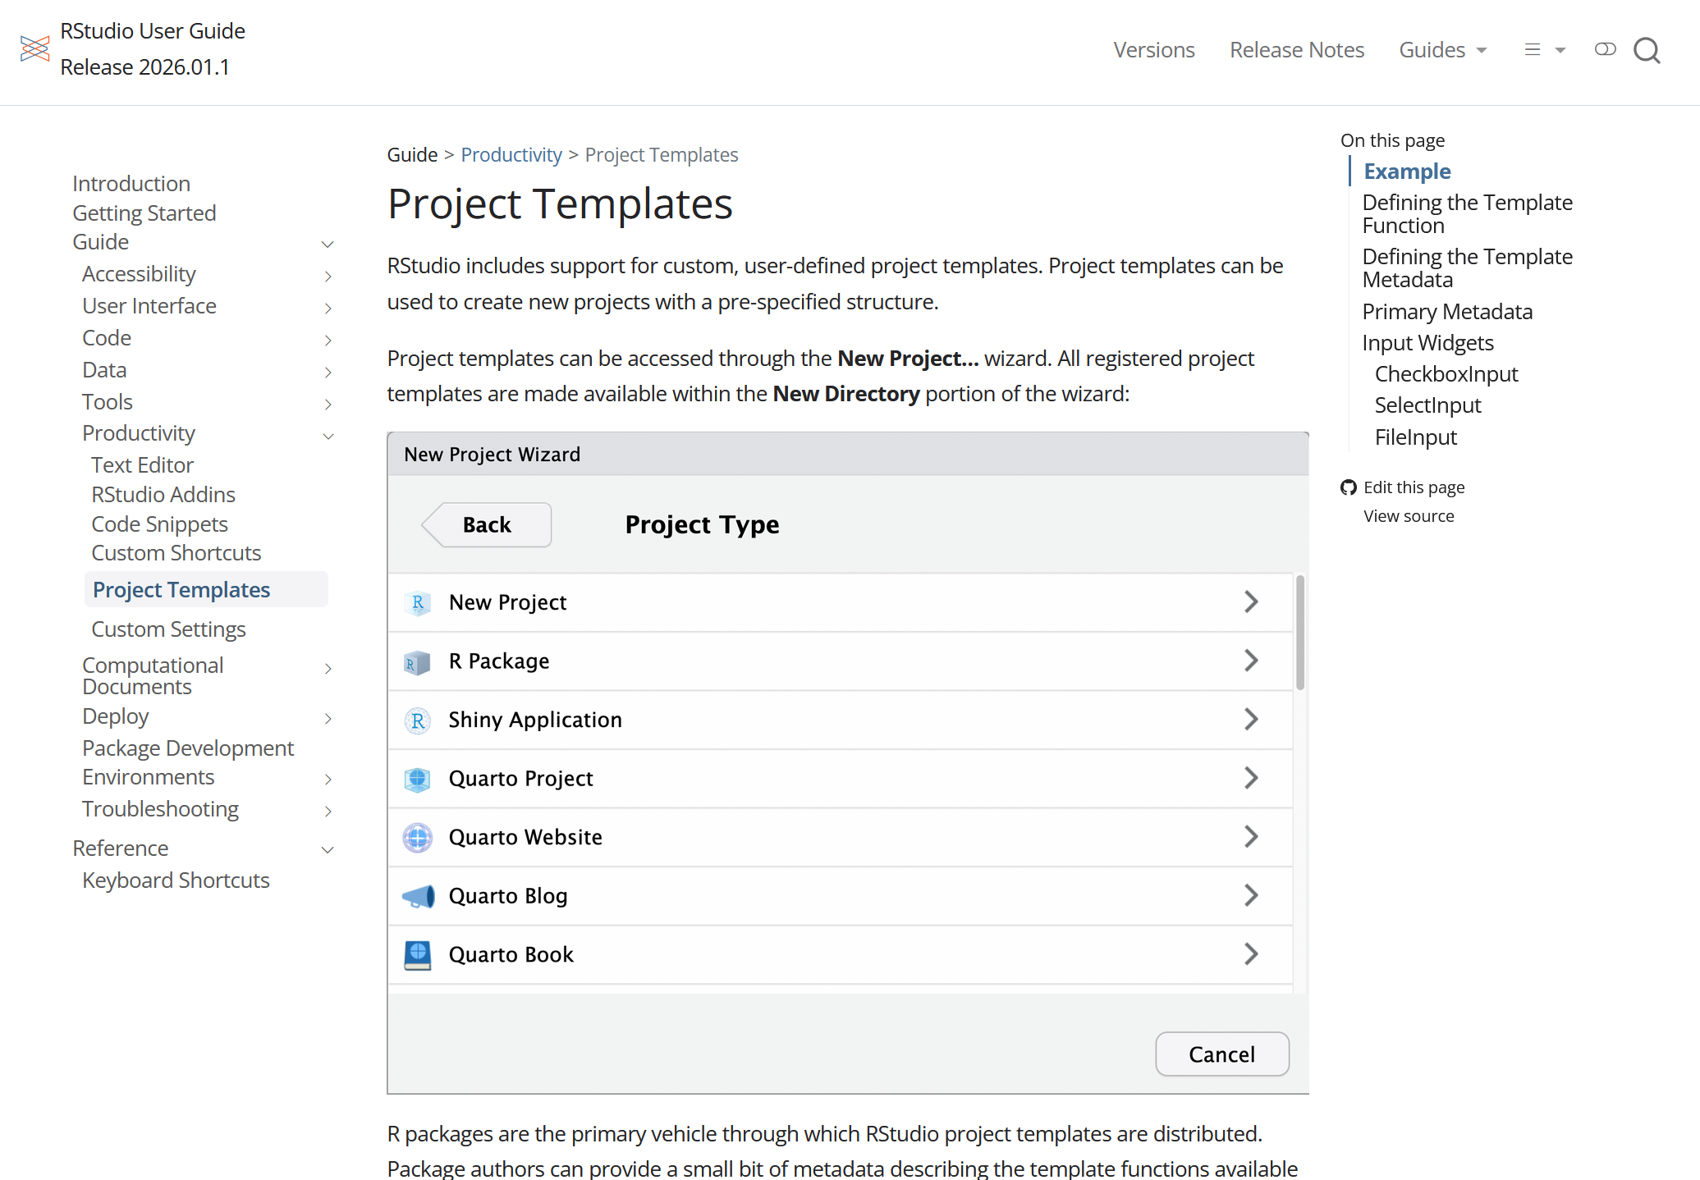

Slide 19
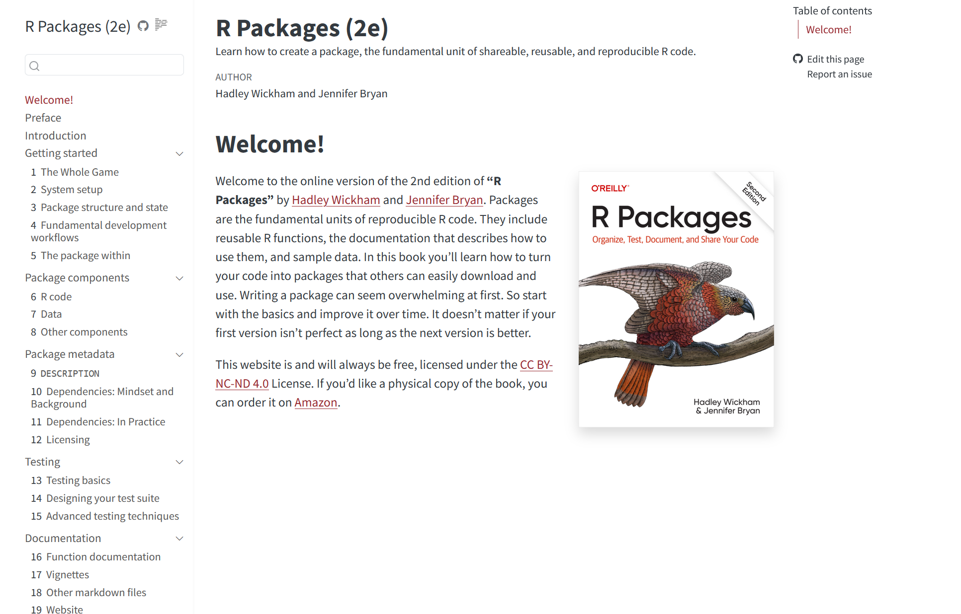

Slide 20
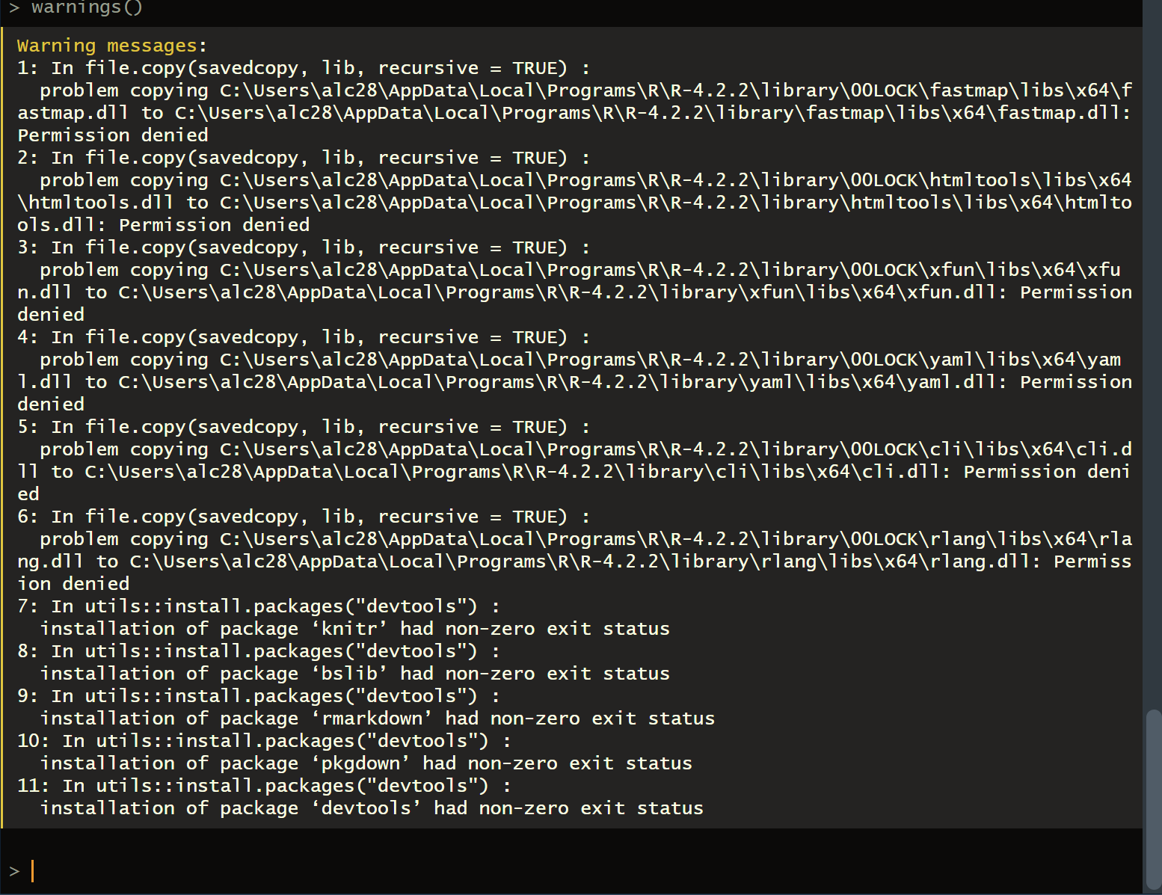
☹
Deadend: Error installing library(devtools)

Slide 21
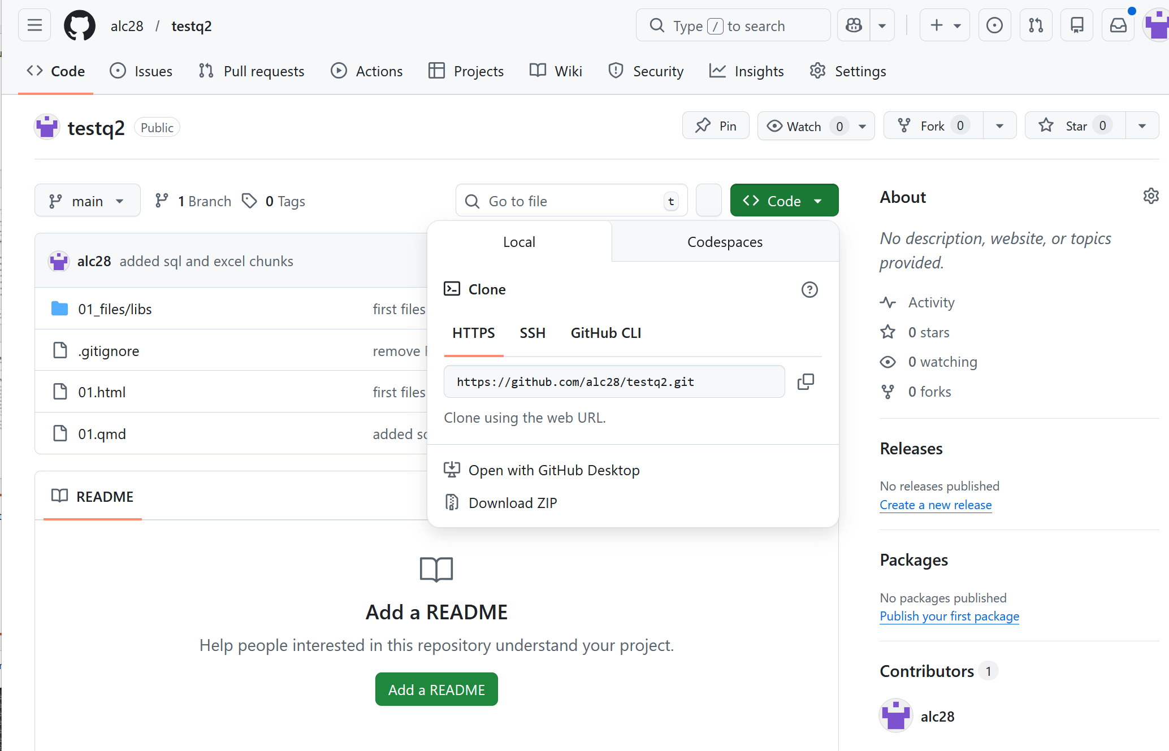
Clone Github project

Slide 22
My improved workflow

Slide 23
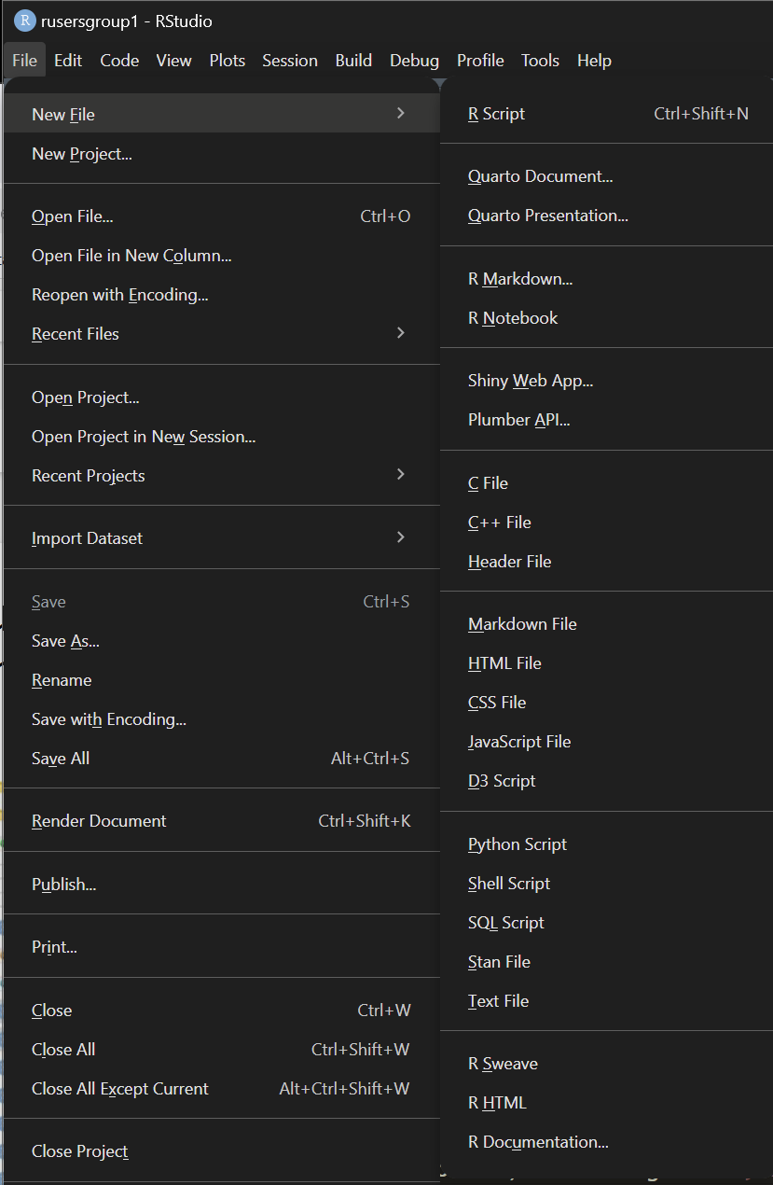
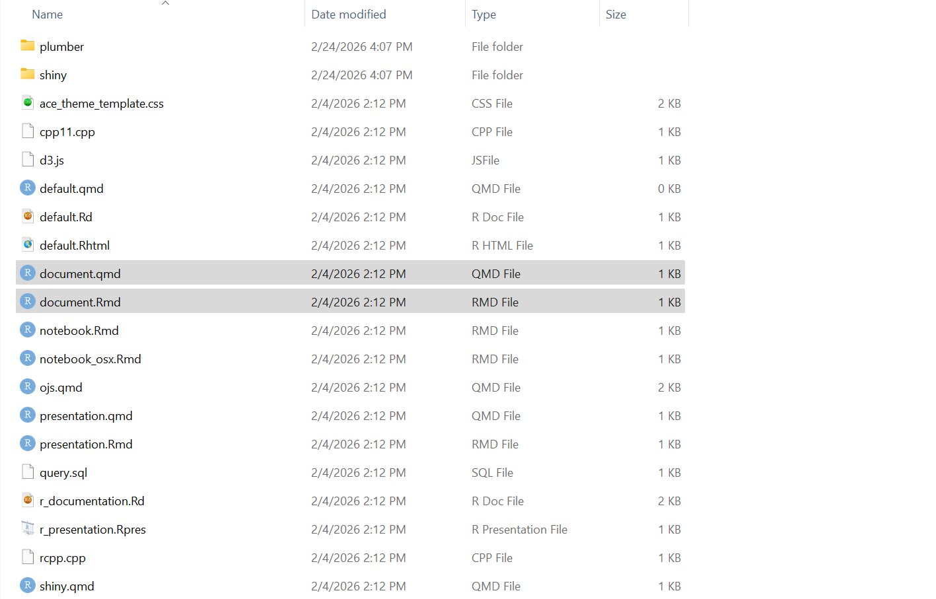
Huh. What if I simply edit the document.qmd template?
C:\Program Files\RStudio\resources\app\resources\templates

Slide 24
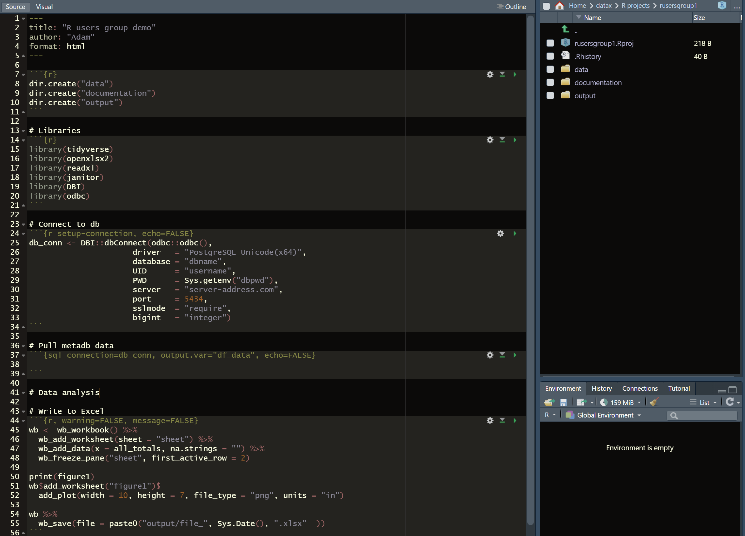
☺ Revised workflow

Slide 25
Brief intro to using
SQL within RStudio

Slide 26
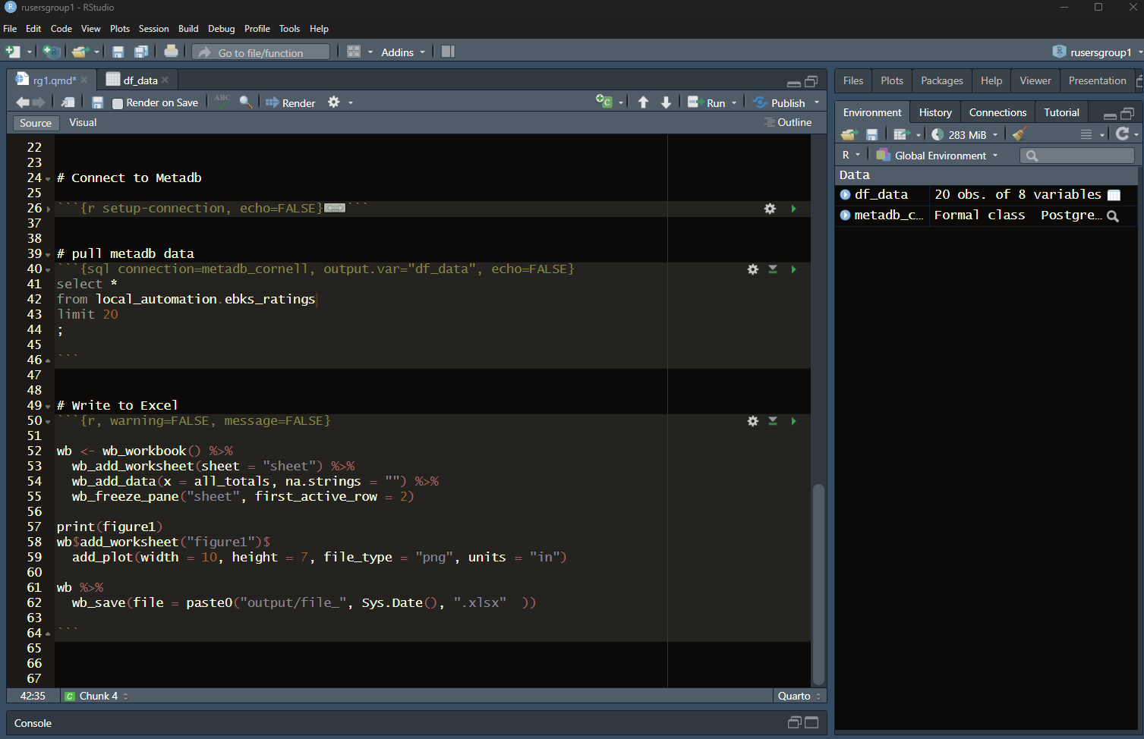
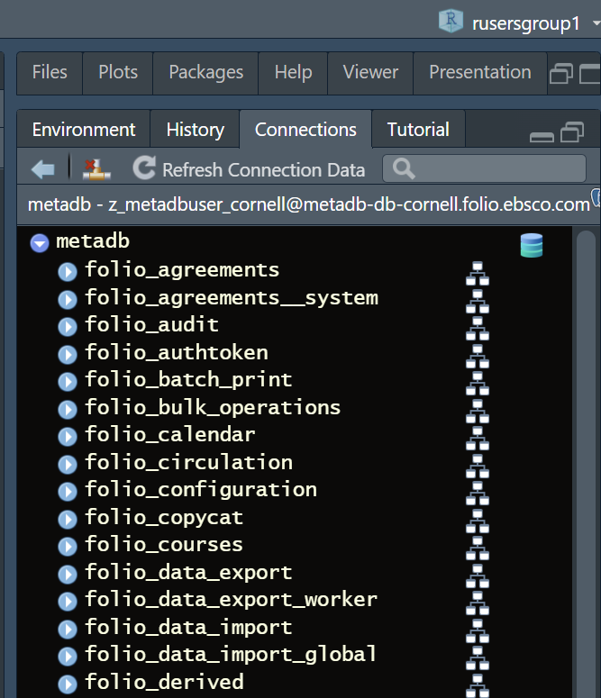

Slide 27
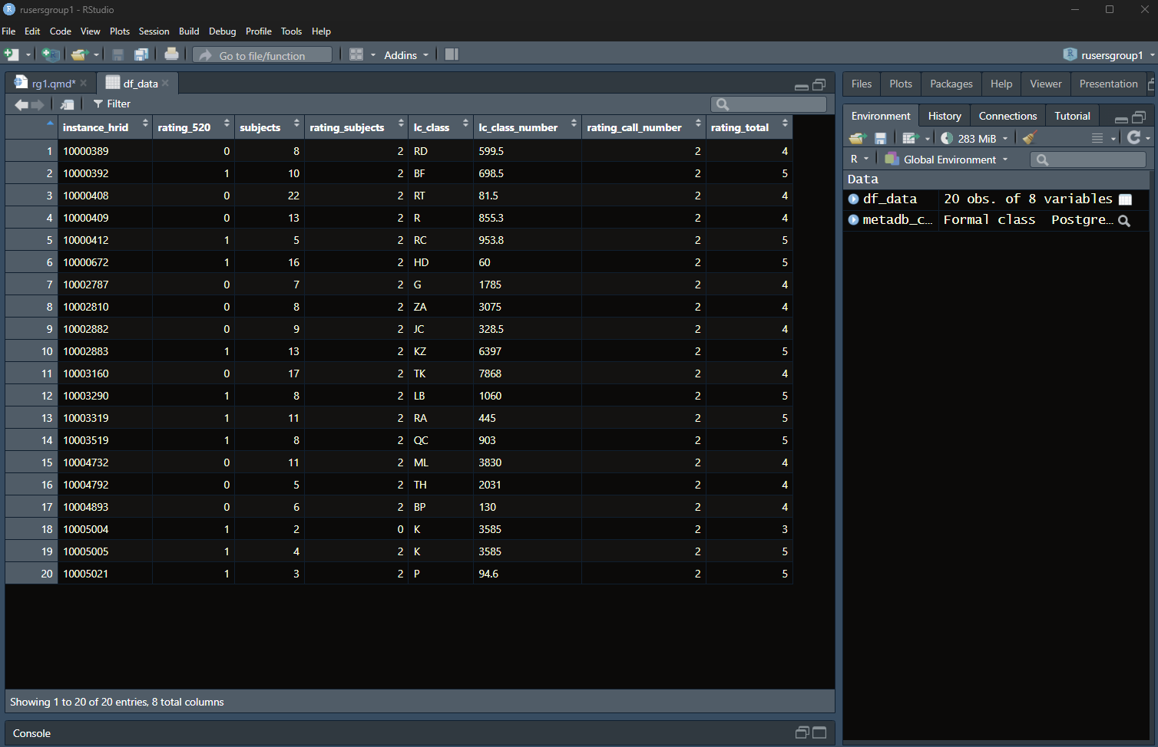

Slide 28
SQL connection code
```{r setup-connection, echo=FALSE}
# Libraries
library(DBI)
library(odbc)
# SQL Connection
```{r setup-connection, echo=FALSE}
db_conn<- DBI::dbConnect(odbc::odbc(),
driver = "PostgreSQL Unicode(x64)",
database = "dbname",
UID = “username",
PWD = Sys.getenv(""),
server = “server-address.com",
port = 5434,
sslmode = "require",
bigint = "integer")
```
# SQL query
```{sql connection=db_conn, output.var="df_data", echo=FALSE}
select * from local_automation.ebks_ratings limit 20 ;
```

Slide 29
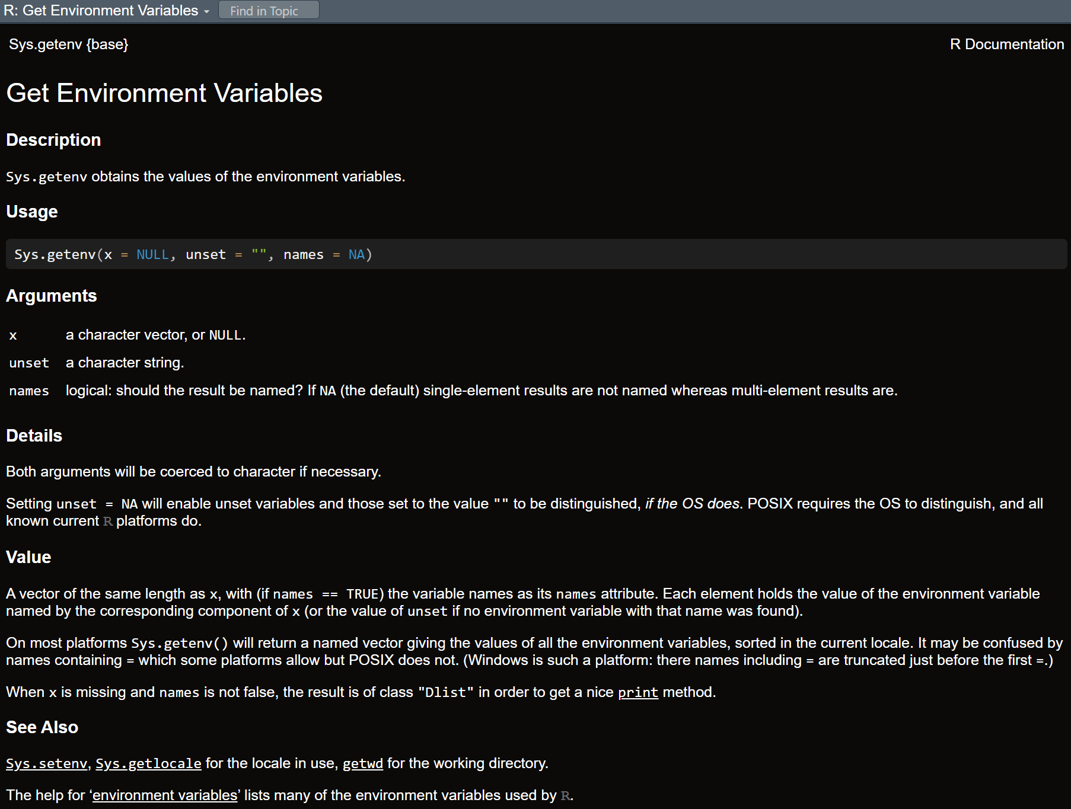

Slide 30
Discussion
Slides
https://cornell.box.com/s/pe1iem3691b6fj8rzff38tm7mbbo98r9

