Slide 1
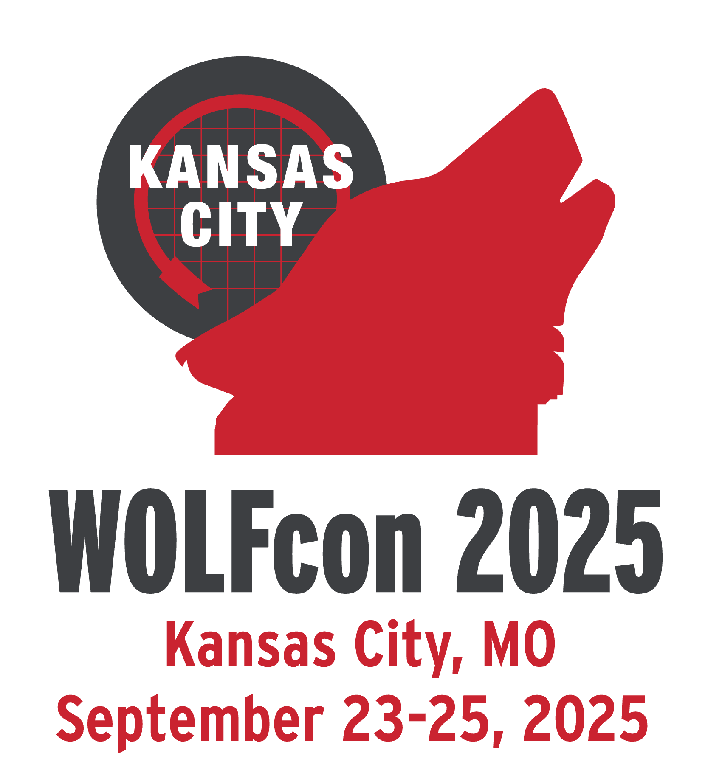
Introducing the Community Directed Development Framework
Stephen Pampell • Martin Scholz • Jeremy Huff • Charlotte Whitt

Slide 2
Overview
Historical Context
CDD Framework Explained
Implementation Plan
Q&A
Workshop Prep
Introducing the Community Directed Development Framework

Slide 3
Stephen Pampel
Historical Context

Slide 4
Three Initial Proposals
Program Plan for Developing a Blueprint for FOLIO Community & Software Ecosystem (The Blueprint)
FOLIO Contribution Network
Development Initiative Proposal Process (The DIP)
Introducing the Community Directed Development Framework

Slide 5
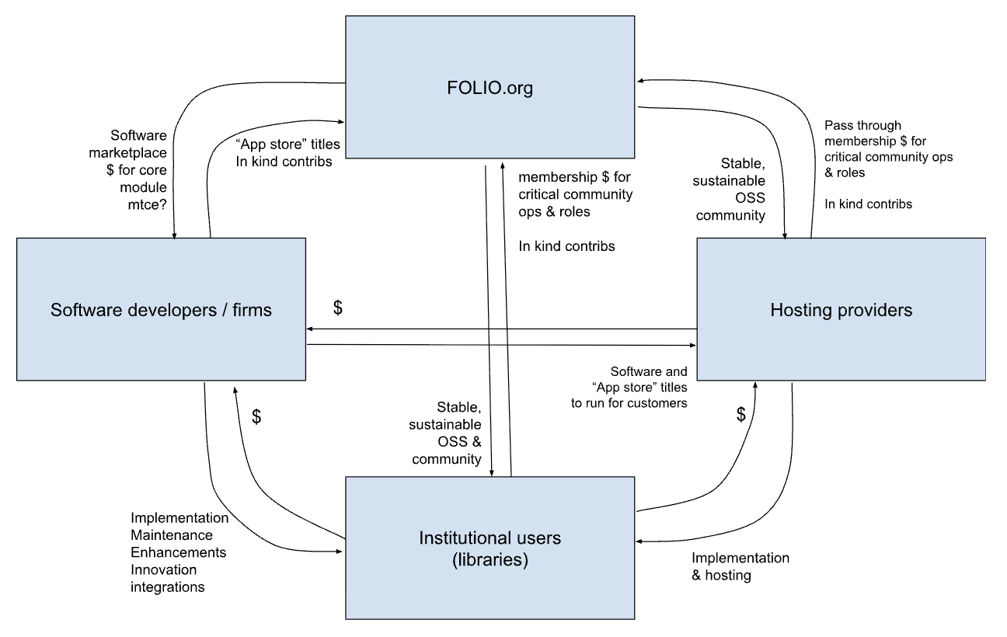
The Blueprint
Updated Vision Statement
Short-Term AWS Funding Request
Long-Term Operations Model
Active Developer Marketplace
Progress Toward Eureka Architecture
Introducing the Community Directed Development Framework

Slide 6
FOLIO Contribution Network
Developer Marketplace
Sustainable Revenue Streams
Collaborative Funding Mechanisms
Structured Maintenance Options
Centralized Payment Infrastructure
Three-Tier Support Services
Points-Based Cost Assessment
Governance by FOLIO Contribution Network Committee(new)
Introducing the Community Directed Development Framework

Slide 7
The DIP
A Seven Layer DIP
  Expression of Interest
  Iterative Refinement
  Governance Council Approval
  RFP and Funding MOUs
  Contractor Implementation
  Delivery and Integration
  Project Archival or Sunsetting
Introducing the Community Directed Development Framework

Slide 8

Opportunity for Synthesis
The Blueprint
The Contribution Network
The CDDF
The DIP
Introducing the Community Directed Development Framework

Slide 9
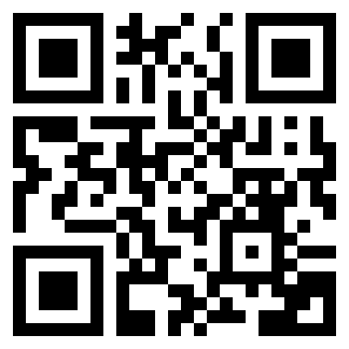
See the document here!
The CDD Framework Explained

Slide 10

The Major Components
Funding
Governance
Communication
Process
Introducing the Community Directed Development Framework

Slide 11
Funding
The CDD Supports Multiple Funding Sources:
Pooled Funding
Directed Funding
In-Kind Contributions
Community Development Team Funding
Independent funding*
Introducing the Community Directed Development Framework

Slide 12
Funding
An Abstraction Layer
Community Resource Points (CRPs)
Support Score
&
Development Score
Currency
Price Tag
Introducing the Community Directed Development Framework

Slide 13
“The inclusion of a piece of software in any component or module of FOLIO is an implicit commitment of resources.”
Jeremy Huff
Introducing the Community Directed Development Framework

Slide 14
Q
How do you effectively manage finite resources across multiple spending goals?
Introducing the Community Directed Development Framework

Slide 15
A
You prioritize your goals!
Introducing the Community Directed Development Framework

Slide 16
Governance
Tiered Component Categorization
Core
Community
Participating
Introducing the Community Directed Development Framework

Slide 17
Governance
Tiered Component Categorization
Core
  Modules, applications, and frameworks that form the platform
  Technically defined by the Technical Council
  The Support Score of all Core Components must be covered by any available CRPs
Community
Participating
Introducing the Community Directed Development Framework

Slide 18
Governance
Tiered Component Categorization
Core
Community
  Components Central to the Operation and Identity of FOLIO
  Subjectively Defined by the Product Council
  Only Community Components are eligible for funding through the CDDF
Participating
Introducing the Community Directed Development Framework

Slide 19
Governance
Tiered Component Categorization
Core
Community
Participating
  Everything Else
  No less a part of FOLIO, but these components are not prioritized for development funded through the CDDF for a given fiscal cycle
Introducing the Community Directed Development Framework

Slide 20
Governance
New Governance Roles and Responsibilities:
Community Council
Technical Council
Product Council
Introducing the Community Directed Development Framework

Slide 21
Governance
New Governance Roles and Responsibilities:
Community Council
  Valuate CRPs
  Allocate Community Development Pool (Pooled Funding)
  Fund the Community Development Team
  Provide PC With a CRP Budget
Technical Council
Product Council
Introducing the Community Directed Development Framework

Slide 22
Governance
New Governance Roles and Responsibilities:
Community Council
Technical Council
  Identify Core Components
  Apply Support Scores
  Define Technical standards for Community and Core Components
  Engage in the DIP Process
Product Council
Introducing the Community Directed Development Framework

Slide 23
Governance
New Governance Roles and Responsibilities:
Community Council
Technical Council
Product Council
  Select Community Components
  Engage in the DIP Process
  Publish Community Priorities
Introducing the Community Directed Development Framework

Slide 24
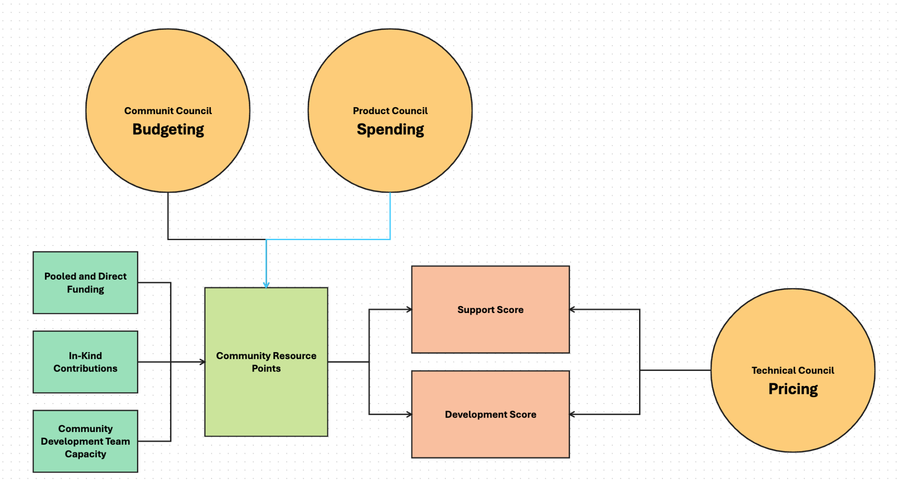
The CDD Economy

Slide 25
Communication Elements
Community Priorities Dashboard
Developer Marketplace
Developer Initiative Proposal (DIP) Dashboard
Introducing the Community Directed Development Framework

Slide 26
Communication Elements
Community Priorities Dashboard
Managed by the PC
Surfaces top SIG priorities
An example already exists! (here)
Developer Marketplace
Developer Initiative Proposal (DIP) Dashboard
Introducing the Community Directed Development Framework

Slide 27
Communication Elements
Community Priorities Dashboard
Developer Marketplace
  A way to identify qualified development partners
  Designed around self-reporting, community validation
  Participation in the Marketplace implicitly indicates participation in the CDD Framework, its processes and its standards
Developer Initiative Proposal (DIP) Dashboard
Introducing the Community Directed Development Framework

Slide 28
Communication Elements
Community Priorities Dashboard
Developer Marketplace
Developer Initiative Proposal (DIP) Dashboard
  A central, transparent view of all DIPs
  Point of management for the DIP process
  A space for proposals seeking funding to “advertise” their needs
Introducing the Community Directed Development Framework

Slide 29
Process
The DIP is the Process Mechanism of the CDD Framework
Introducing the Community Directed Development Framework

Slide 30
Process: The DIP
Step 1: DIP Submission (Initial Expression of Interest)
Submitted to DIP Dashboard.
Must include:
  Working title.
  High-level description of the problem or opportunity.
  Proposed coordinator.
  Preliminary list of stakeholders (e.g., SIGs, backing organizations)
  Optional early notes on scope or resources
Step 2: Iterative Refinement
Councils and stakeholders provide feedback.
The DIP is updated to include:
  Clear scope and functional goals.
  Technical feasibility and integration considerations.
  Stakeholder validation.
  Estimated resourcing needs in the form of a Development Score
  Estimated impact on Support Score if any
  Confirmation of coordinator and stakeholder support
  The association of the DIP with relevant RFCs and Jira Artifacts
Step 3: Council Approval
Final DIP is submitted to the PC and TC for approval:
  Technical Council:
      Validates architectural fit
      Designates technical standards
      Confirms all Development and Support Score calculations.
    Product Council:
      Evaluates user value
      Roadmap alignment
      Optionally allocates Community Resource Points
      If the allocated Community Resource Points are insufficient, the DIP sponsors will need to directed funding for the DIP.
      If a sufficient number of Community Resource Points cannot be found, the DIP cannot be approved.
Approval from both the TC and the PC results in the DIP being marked as Endorsed.
The CC is not involved in the DIP Approval process
Introducing the Community Directed Development Framework

Slide 31
Process: The DIP
Step 4: RFP
If the DIP is assigned to the Community Development Team then the RFP step may be skipped
If the work is not assigned to the Community Development team then the FOLIO Org must take the following actions:
  Issue a Request for Proposal (RFP) based on the Endorsed DIP.
  Coordinates contractor selection from approved community contractors using the Developer Marketplace
  Sign a contract with the selected contractor.
Step 5: Implementation
Coordinator responsibilities:
  Acts as liaison to the councils, stakeholders, and development team.
  Facilitates reporting and communication.
  Ensures ongoing stakeholder engagement.
Development team responsibilities:
  Works collaboratively with module owners, SIGs, and QA teams.
  Submits work via the standard FOLIO community process, including the creation and assignment of all Jira artifacts.
Step 6: Delivery and Integration
Upon completion:
  Deliverables are reviewed by relevant stakeholders.
  Code is merged and documented.
  The project is integrated into FOLIO’s release planning.
  Final Summary Report submitted by the Coordinator.
Step 7: Archival or Sunset
If incomplete:
  Marked as Dormant (paused) or Sunset (closed).
  If any Community Resource Points remain, they will be returned to the community pool
If complete:
  Archived with links to outcomes, code, and final report.
Introducing the Community Directed Development Framework

Slide 32
Stephen Pampel
Implementation Plan

Slide 33
Multi-Phase Rollout
Phase 1: Pilot
Phase 2: Core Concept Rollout
Phase 3: Complete Rollout
Introducing the Community Directed Development Framework

Slide 34
Phase 1: Pilot
All Three Councils: Selection of Pilot Initiative
Community Council: Earmark funds for the pilot
Technical Council:
  Identify Implicated Components
  Categorizing Components (Core or Community)
  Apply Support Scores
PC and TC: Execute DIP process
CDD Working Group: Compile Report
Introducing the Community Directed Development Framework

Slide 35
Phase 2: Core Concept Rollout
Community Council: Create CRP budget
Technical Council: Core Module Identification
Product Council:
  DIP Dashboard
  Community Module Selection
Introducing the Community Directed Development Framework

Slide 36
Phase 3: Complete Rollout
CC and TC:
  Community Development Team
  Developer Marketplace
PC: Community Priorities Dashboard Integration
Introducing the Community Directed Development Framework

Slide 37
Ask Us Anything!
Q&A

Slide 38
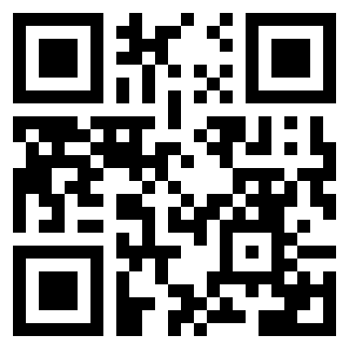
See the feedback form here!
Workshop Prep

Slide 39
Workshop Prep
What works well?
Funding
Governance
Communication
Process
Introducing the Community Directed Development Framework

Slide 40
Workshop Prep
What needs work?
Funding
Governance
Communication
Process
Introducing the Community Directed Development Framework

Slide 41
Workshop Prep
What work is next?
Funding
Governance
Communication
Process
Introducing the Community Directed Development Framework

Slide 42
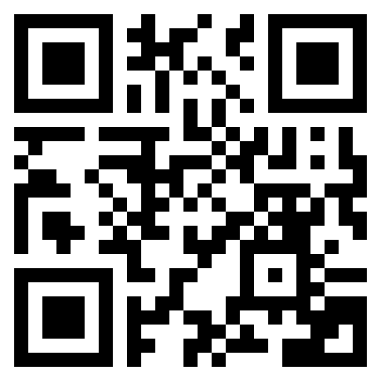
See the document here!
Exploring Scenarios

Slide 43
Thank You
See you in the feedback session!

