Slide 1
Solidification Modeling using Ansys Finite Element Software
MAE 4240/5240
Rajesh Bhaskaran
Swanson Director of Engineering Simulation
Cornell University

Slide 2

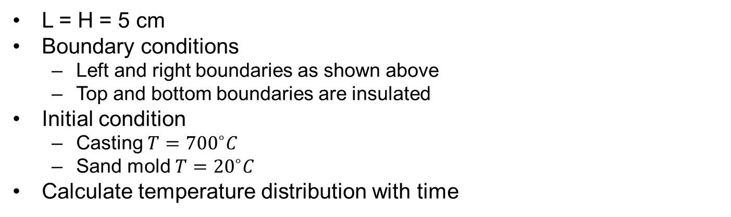

Solidification Problem Statement from Prof. Hassani
H
Al Casting
Sand mold
T = ${20}^{∘}C$
Symmetry
3L
L
L = H = 5 cm
Boundary conditions
  Left and right boundaries as shown above
  Top and bottom boundaries are insulated
Initial condition
  Casting $T={700}^{∘}C$
  Sand mold $T={20}^{∘}C$
Calculate temperature distribution with time
Notes:
To do: Add figure, CAD download

Slide 3
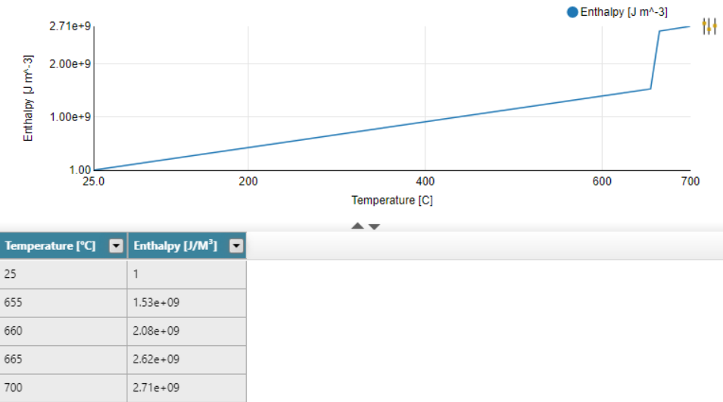

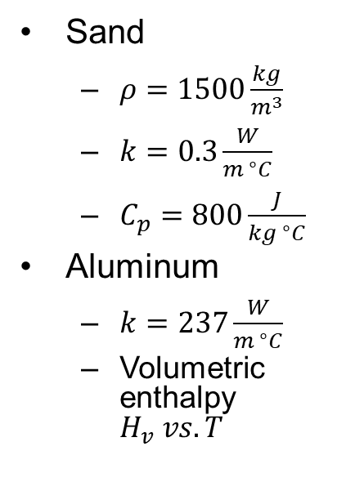
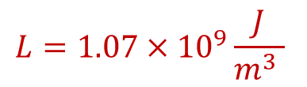

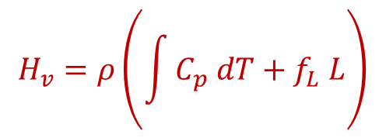
Material Properties
Sand
  $ρ=1500\frac{kg}{m^{3}}$
  $k=0.3\frac{W}{{m }^{∘}C}$
  $C_{p}=800\frac{J}{k{g }^{∘}C}$
Aluminum
  $k=237\frac{W}{{m }^{∘}C}$
  Volumetric enthalpy
  $H_{v} vs. T$
$$C_{p}=900\frac{J}{kg C }$$
$$L=1.07×{10}^{9}\frac{J}{m^{3} }$$
$$H_{v}=ρ\left(\int{C_{p} dT+f_{L} L}\right)$$
$$f_{L}=0≤f_{L}≤1$$

Slide 4
What’s Inside the Ansys Blackbox?
Post-processing
Mathematical Model
Numerical
Temperature at
selected points & times
Color pictures
& other results
User inputs
Solution
Physical principles
Blackbox
Assumptions
Solidification
Notes:
Peel the outer layer of the onion
The expert knows the major elements of what is underneath the b-box
Tool figures out what mathematical model to solve based on user inputs
Important point: one is not solving the physical problem but rather a math representation of the physical problem
Assumptions are embedded
Tool solves the m-model nuemrically
When you are in the tool, you need to be able to determine what you are affecting … mm, nss, pp

Slide 5
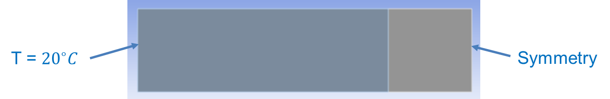



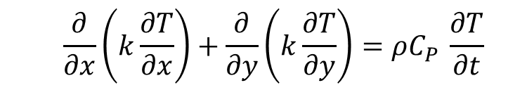
2D Initial-Boundary Value Problem for Sand Mold
Governing equation for transient 2D conduction
  $$T=T(x,y,t)$$
  $$\frac{∂}{∂x}\left(k\frac{∂T}{∂x}\right)+\frac{∂}{∂y}\left(k\frac{∂T}{∂y}\right)=ρC_{P }\frac{∂T}{∂t}$$
Boundary conditions
Initial condition
  T= 20 C
  Specify either T or $\frac{∂T}{∂n}$
  Insulated$−k\frac{∂T}{∂n}=0$
Notes:
To do: Include figure

Slide 6


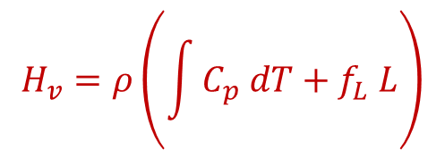


2D Initial-Boundary Value Problem for Al Casting
Governing equation for transient 2D conduction
  $$T=T(x,y,t)$$
$$H_{v}=ρ\left(\int{C_{p} dT+f_{L} L}\right)$$
  $$\frac{∂}{∂x}\left(k\frac{∂T}{∂x}\right)+\frac{∂}{∂y}\left(k\frac{∂T}{∂y}\right)=\frac{∂H_{v}}{∂t}$$
Boundary conditions
Initial condition
  T= 700 C
  Insulated$−k\frac{∂T}{∂n}=0$
Notes:
To do: Include figure

Slide 7

What’s Inside the Ansys Blackbox?
Post-processing
Mathematical Model
Numerical
Temperature at
selected points & times
Color pictures
& other results
User inputs
Solution
Physical principles
Blackbox
Assumptions
Solidification
Notes:
Peel the outer layer of the onion
The expert knows the major elements of what is underneath the b-box
Tool figures out what mathematical model to solve based on user inputs
Important point: one is not solving the physical problem but rather a math representation of the physical problem
Assumptions are embedded
Tool solves the m-model nuemrically
When you are in the tool, you need to be able to determine what you are affecting … mm, nss, pp

Slide 8

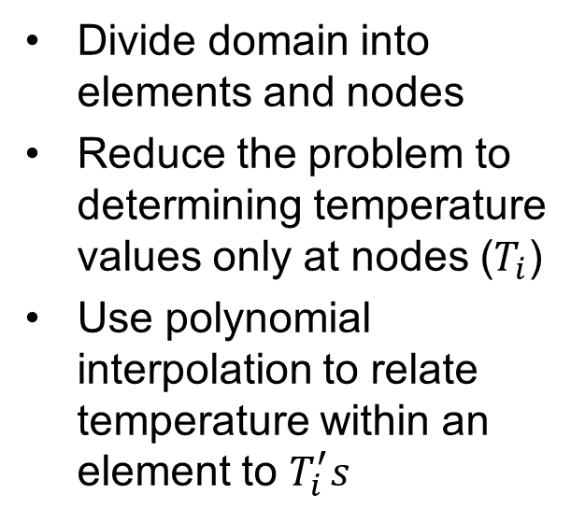

Numerical Solution using Finite-Element Method
Divide domain into elements and nodes
Reduce the problem to determining temperature values only at nodes ($T_{i}$)
Use polynomial interpolation to relate temperature within an element to $T_{i}^{′}s$
Notes:
To do: Replace figure

Slide 9
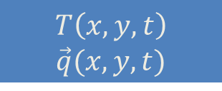
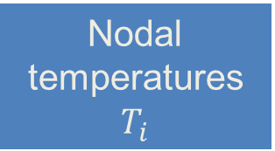
How to Find Nodal Temperatures $T_{i}$?
System of algebraic equations in nodal temperatures
Mathematical Model (IBVP)
Invert
Nodal temperatures $T_{i}$
Element-by-element polynomial interpolation for T
Post processing
$T\left(x,y,t\right)$ $\vec{q}(x,y,t)$

Slide 10
Initial Condition Implementation
Set units
Add command object
  IC, Casting, Temp, 700
  IC, Mold, Temp, 20

Slide 11
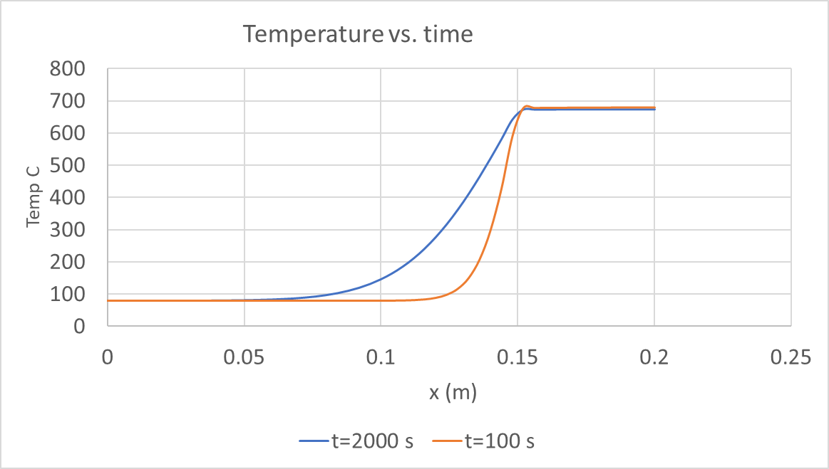
Temperature vs time

Slide 12
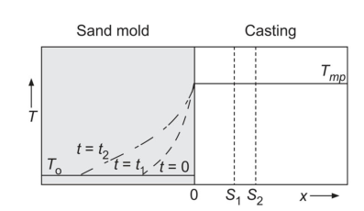
Temperature vs time

Slide 13
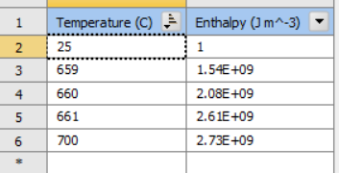
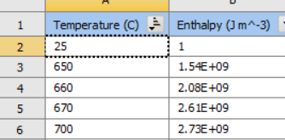

Questions
Enthalpy approach theory
  Verified with temperature approach for case without solidification
Need H vs T for Aluminum
Doesn’t converge if initial T is higher than melting point
Convection BC
Solidification front calculation
Doesn’t converge
Converges

