Slide 1

WOLFCon 2025
Pre-conference Workshop
Pershing Place West
Monday, September 22, 9:00am - 12:00pm
Kansas City, MO
Got Data? Introduction to
FOLIO Reporting Applications

Slide 2
Description
We will provide a broad overview of the various applications, solutions, and methods used to report on data coming from the FOLIO system. Reporting tools such as Metadb, the Reporting App, LDLite, Dashboards, the Lists App, DBeaver, CloudBeaver, and Tableau will be covered, along with additional methods of downloading data from FOLIO applications.

Slide 3
Speakers
Scott Perry, University of Chicago
  Co-convener, FOLIO Reporting SIG
  Head, Collection Support, University of Chicago
Sharon Markus, Cornell University
  Co-convener, FOLIO Reporting SIG
  Senior Library Systems Analyst, Cornell University

Slide 4
Overview
9am - (15 min) Setting Up and Using a Metadb Reporting Database to Provide Your Institution with Real-Time Data Reports from FOLIO (Scott)
9:15am - (75 min) Getting Started with Building Reports Using Metadb Software with FOLIO Data (Sharon and Scott)
and Using Report Samples, Derived Tables, and Other Tools on the Folio-Analytics GitHub repository
10:30am - (15 min) BREAK
10:45am - (30 min) Using the Reporting App in FOLIO to Build and Run Real-Time Data reports right from the FOLIO Application Interface (Scott and Sharon)
11:15am - (10 min) Using Tableau to Deliver FOLIO Data Dashboards from Metadb (Sharon) - connection steps to ref env, dashboard examples from Stanford
LDLite (10 min)
Lists (10 min)
In-App (10 min)
11:45am - (15 min) Getting to Know the FOLIO Reporting Community (Scott)
12pm noon - end
(Each section will include time at the end for questions)

Slide 5

Setting Up and Using a Metadb Reporting Database to Provide Your Institution with Real-Time Data Reports from FOLIO
Scott Perry
University of Chicago

Slide 6

Introduction
*slides provided by Mike Taylor, Index Data
If your library runs FOLIO, you need reports.

Slide 7
Introduction
Why not just run SQL queries against the FOLIO database?
No record is kept of old data.
All the data is in JSON so queries would have to transform it.
The records are highly denormalized with data fragments split across tables.
Running expensive reports has performance implications for regular users.

Slide 8
How Metadb works
FOLIO stores its data in a Postgres database.
When changes are made in this database by the day-to-day operation of the FOLIO ILS, change records are written to a Postgres replication slot.
Metadb harvests these change records to keep its own database up to date.

Slide 9
How Metadb works
Invokes
UI
Web
browser
DBeaver
Flow of Data
Software
FOLIO
Metadb
Data
Postgres
Postgres

Slide 10
How Metadb works
Old versions of changed records are retained and accessible via historical tables that record all previous versions of each record with the start and end of their validity period.
Each record coming into Metadb has its JSON blob extracted and transformed into SQL-level fields.
MARC records, which are stored as opaque blobs in FOLIO, are expanded into queryable tables.

Slide 11
How Metadb works
Periodic queries, run automatically, generate derived tables that contain denormalized versions of FOLIO records which include data from related records.
For example, user records in Metadb's users_groups table contain not just a patron_group ID column but also a group column containing the name of the group that the user belongs to.

Slide 12
How Metadb data can be interrogated
The Metadb database can be queried using SQL:
On the command-line with psql
Using a GUI like DBeaver or Tableau
Directly within FOLIO
Programatically by client software
And what kinds of queries might you run? Coming up next!

Slide 13
Getting Started with Building Reports Using Metadb Software with FOLIO Data
Sharon Markus,
Scott Perry

Slide 14
This Section will Cover
Choosing a reporting application
Getting connected to your Metadb reporting database
Using the Metadb table structure
Report exercises and demos
Getting report output

Slide 15



Choosing a Reporting Application
DBeaver used by most FOLIO institutions to develop queries and deliver reports, but there are other apps being used as well
DBeaver Community vs DBeaver Enterprise
Tableau and Power BI are used at some institutions to create visualizations of FOLIO data
Any reporting application that can use a PostgreSQL database works with Metadb

Slide 16

Download and Install DBeaver Community
If you wish to do the training exercises on our Training Metadb reporting database, you'll need to download and install DBeaver Community (free, open source)
https://dbeaver.io/download/

Slide 17
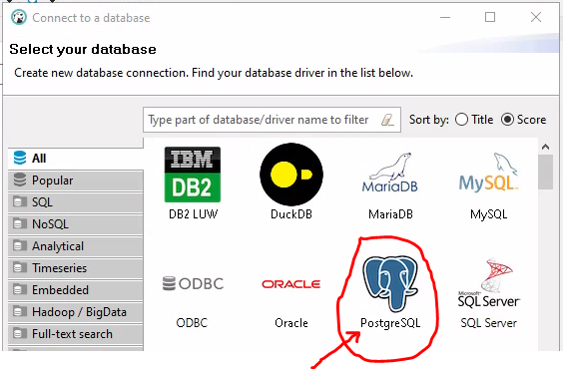
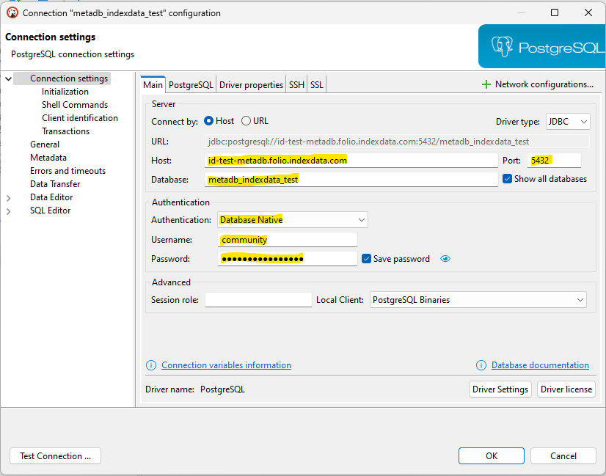
Getting Connected to the Training Metadb Reporting Database

Slide 18

Training Metadb Reporting Database Login
Host: id-test-metadb.folio.indexdata.com
Port: 5432
Database: metadb_indexdata_test
Username: community
Password: (see your email)

Slide 19
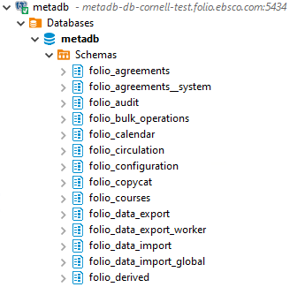
Using the Metadb Table Structure
In Metadb, the main schemas we use are organized as follows:
  folio_* application schemas: schemas with main and transformed tables for each FOLIO application
  folio_derived: where derived tables get created automatically
  folio_source_record.marc__t: schema and table where transformed MARC records are stored in tabular form
  individual schemas: each Metadb user has their own account and has read access to see all the schemas, but individual users are the only ones who can write to their own schemas and to schemas to which they have been granted “write” access

Slide 20
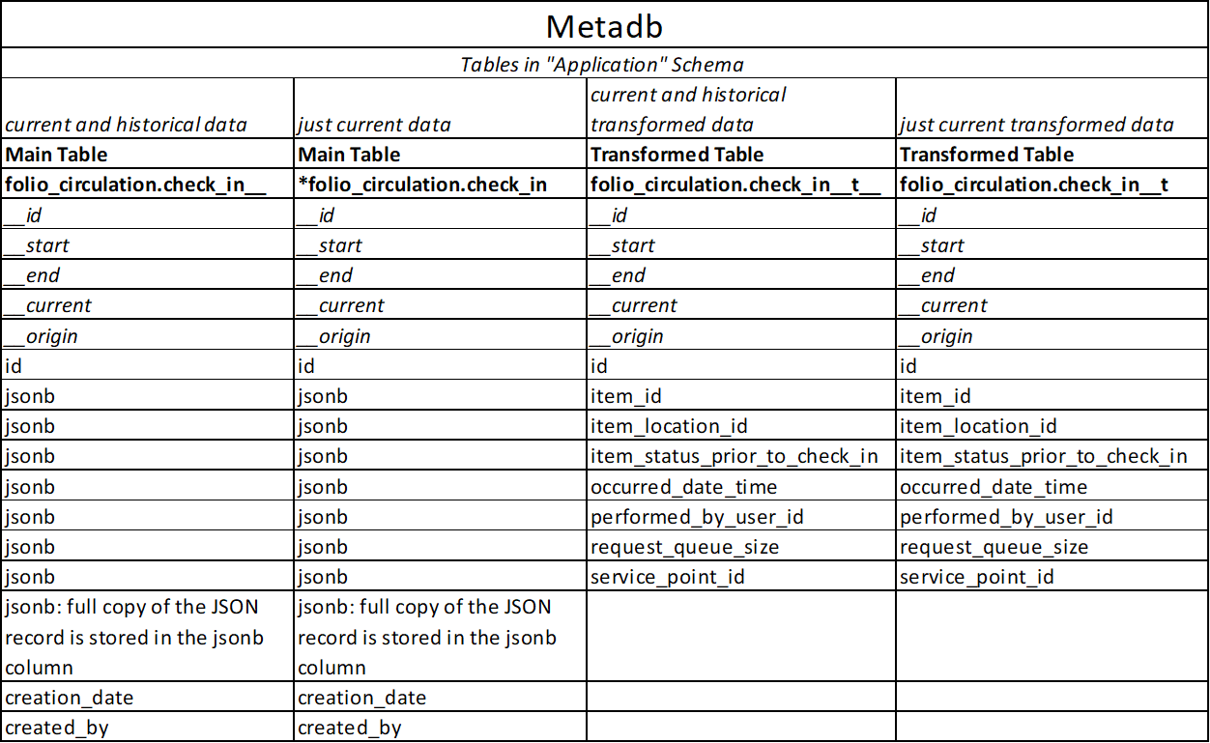

Slide 21
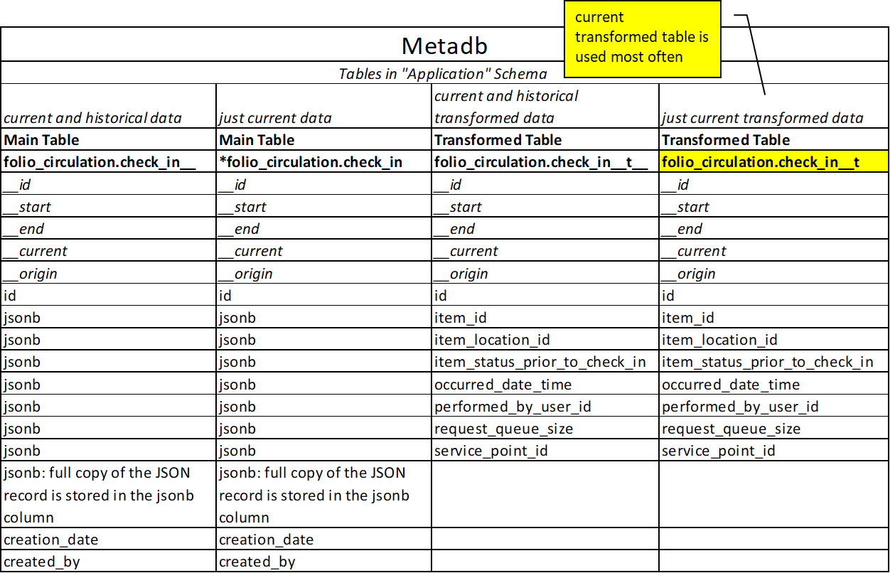

Slide 22
Table Naming Conventions
Table Naming Convention | Description
application schema.table__t | table that stores current records (transformed for Metadb)
application schema.table__t__ | table that stores current and historical records (transformed for Metadb)

Slide 23
Table Naming Conventions - Example
Table Naming Convention Example | Description
folio_circulation.loan__t | table that stores current loan records
folio_circulation.loan__t__ | table that stores current and historical loan records (transformed for Metadb)

Slide 24
Table Naming Conventions - Why 2 Underscores?
Why use 2 underscores?
Table names in a database must be unique. Because some table names already use one underscore, we must make sure the Metadb tables have unique names, so they are given 2 underscores.
Metadb
SELECT
COUNT (cl.id)
FROM
folio_circulation.loan__t AS cl
;
loan _ _ t

Slide 25
Report Exercise 1
getting current records from a current transformed table
Metadb
SELECT
COUNT (cl.id)
FROM
folio_circulation.loan__t AS cl
;
loan _ _ t

Slide 26
Report Exercise 2
getting current and historical records from a current and historical table
total count should be higher than current because you are counting both current and historical loans
Metadb
SELECT
COUNT (cl.id)
FROM
folio_circulation.loan__t__ AS cl
;
loan _ _ t_ _

Slide 27
Report Exercise 3
getting current records using SQL against the main table with current and historical records
SELECT
COUNT (cl.id)
FROM
folio_circulation.loan__ AS cl
WHERE cl.__current IS TRUE
;
loan _ _
_ _ current

Slide 28
Demo 1: Using MARC
MARC example
find records with English in the 008 MARC language field
SELECT
sm.instance_id,
sm.field,
ii.title,
substring(sm.content, 36,3) AS language
FROM
folio_source_record.marc__t AS sm
LEFT JOIN folio_inventory.instance__t
AS ii ON ii.id::UUID = sm.instance_id::UUID
WHERE
sm.field = '008'
AND substring(sm.content,36,3)IN('eng')
LIMIT 10;
marc _ _ t

Slide 29
Data Fields in JSON Array
What if the data field you need cannot be found on the current transformed table?
  review the main table
  extract from JSON
  use SQL to filter current data

Slide 30
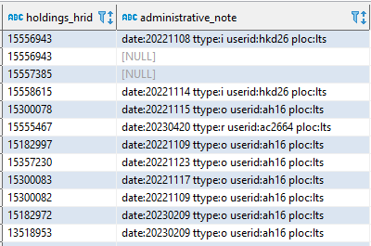
Demo 2: Extract Current Records from a Data Array
SELECT
jsonb_extract_path_text(hr.jsonb, 'hrid')
AS holdings_hrid, admin_notes.jsonb #>> '{}' AS administrative_note
FROM folio_inventory.holdings_record__ AS hr
CROSS JOIN LATERAL jsonb_array_elements(jsonb_extract_path
(hr.jsonb, 'administrativeNotes')) AS
admin_notes (jsonb)
WHERE hr.__current IS TRUE
LIMIT 100 ;

Slide 31
Report Output
DBeaver Community (free version) allows you to export your report results as CSV
DBeaver Enterprise (paid version) allows you to export your report results as Excel

Slide 32
Additional Resources
Metadb Documentation from Index Data
  https://metadb.dev/doc/#_user_guide
Metadb Report Samples from Reporting SIG
  https://github.com/folio-org/folio-analytics/tree/main/sql_metadb/report_queries
Metadb Report Samples from Various Institutions
  https://folio-org.atlassian.net/wiki/x/eYB1PQ

Slide 33

Questions?

Slide 34
Using Report Samples, Derived Tables, and Other Tools on the Folio-Analytics GitHub repository
Sharon Markus
& Scott Perry

Slide 35
This Section will Cover
using the folio-analytics Github repository
derived tables on folio-analytics
report exercise
  using derived tables in your report
more report samples on folio-analytics
folio-analytics wiki

Slide 36
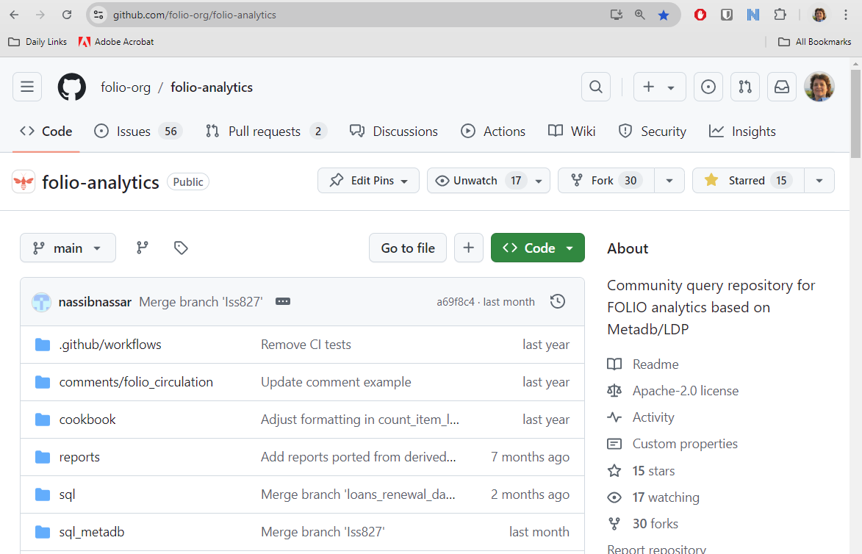
FOLIO Analytics

Slide 37
FOLIO Analytics
Go to https://github.com/folio-org/folio-analytics
  Metadb
  reports
  derived tables
  wiki

Slide 38
Demo 3: Using Derived Tables
folio_derived.loans_items
ties loan to material type, location, and other item-related information by loan
SELECT
loans_items.loan_date::date AS action_date,
loans_items.material_type_name,
loans_items.item_effective_location_name_at_check_out,
loans_items.item_status,
COUNT(DISTINCT loans_items.loan_id) AS ct
FROM
folio_derived.loans_items
GROUP BY
action_date,
material_type_name,
item_effective_location_name_at_check_out,
item_status
LIMIT 10
;
loans_items

Slide 39
Questions?

Slide 40
Using the Reporting App in FOLIO to Build and Run Real-Time Data reports right from the FOLIO Application Interface
Scott Perry,
Sharon Markus

Slide 41
This section will cover
Setting up the Reporting App
Writing queries for the Reporting App
Running queries from the Reporting App

Slide 42
Settings
Record limits (defaults for display and export)
Table availability
  Suppress tables from access in the reporting app
Database configuration
  Metadb or LDP
Report repositories
  Link Github repositories

Slide 43
Writing reports for the FOLIO Reporting App
*Slides for this section created by and used with permission of Stefan Dombek from Leipzig by Stefan Dombek from Leipzig University
What do you need?
You need 2 files to create a report and 1 optional file for the documentation.*
SQL file
JSON file
Documentation file (optional)
These files are stored in a repository in your institution and are not part of the software. You decide what reports are available!
*All files must have the same name. Only the file type is different. Example: test.sql, test.json, test.md

Slide 44
Writing reports for the FOLIO Reporting App
SQL file
The SQL file contains a user defined function (UDF). A UDF is a custom function that can be stored in the database. Postgres has built-in functions like MAX(), MIN() etc. With a UDF you can create your own function.
There is a cookbook in the folio-analytics wiki that provides the basics to write these functions.
https://github.com/folio-org/folio-analytics/wiki/Cookbook:-User-Defined-Function

Slide 45
Writing reports for the FOLIO Reporting App
Tips for UDF (SQL file)
Use explicit type cast for each attribute and parameter.
  The data types for the parameters must match those of the attributes in the database. Otherwise there is an error message. → WHERE Clause (Be careful with NULL values)
  The data types of the attributes in the query (PROCEDURE section) must match those that are then used in the output table (return section).
Everything must be unique, that means the table names must be added to the attributes.
SQL and PL/pgSQL can be used.
Test your function in your personal schema before publishing.

Slide 46
Writing reports for the FOLIO Reporting App
JSON file
The JSON file defines the web form within the FOLIO App. Each report needs other parameter values, that means each web form is individual. With the JSON file you can define which fields in the form exists.
The file also contains the field names that are needed to map the values ​​from the web form with the parameters in the UDF. (See next slide)

Slide 47
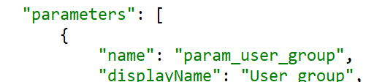
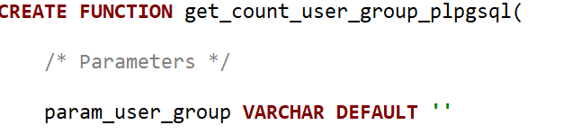
Writing reports for the FOLIO Reporting App
Mapping
JSON file
Web form
LDP/Metadb
UDF
Function call in the database via named notation:
SELECT function(a => 'Hello', b => 'World');
https://www.postgresql.org/docs/current/sql-syntax-calling-funcs.html

Slide 48

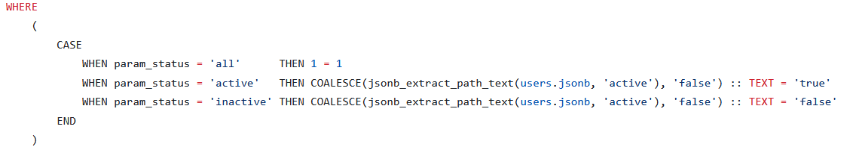
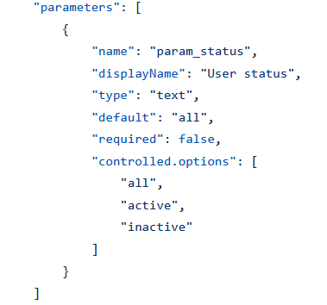
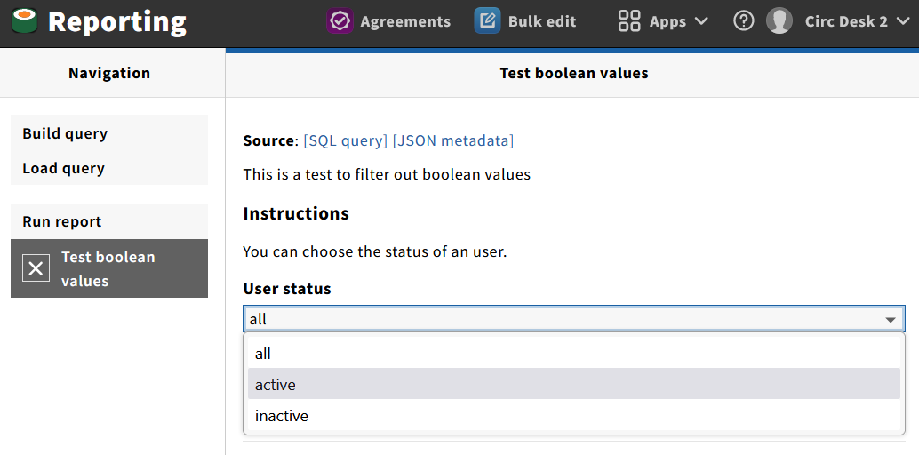
Writing reports for the FOLIO Reporting App
Boolean
SQL: parameters
SQL: WHERE Clause
JSON: controlled.options

Slide 49
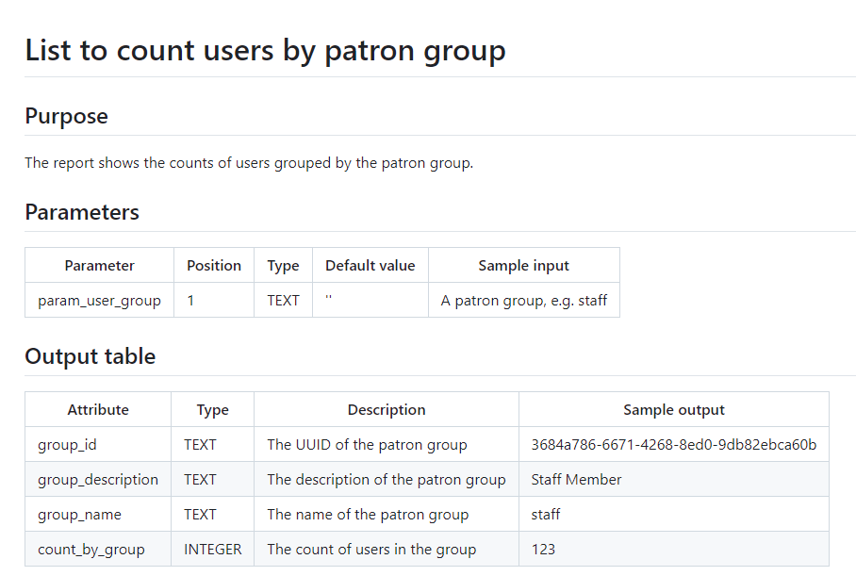
Writing reports for the FOLIO Reporting App
Documentation file
This file is optional. It is a good approach to have 3 sections.
Purpose
Parameters
Output table

Slide 50
Running reports in the Reporting App
Build query
Load query
Run Report

Slide 51
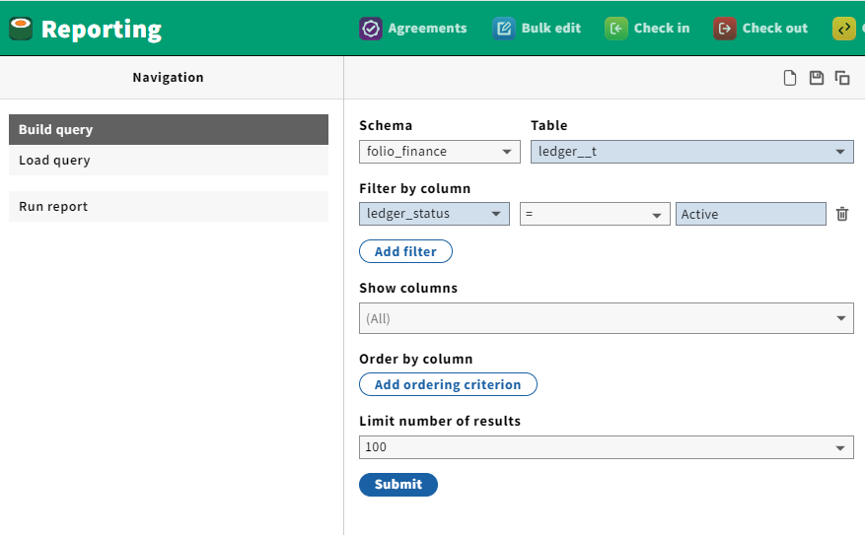
Build Query
Use to view tables and derived tables directly and apply filters.

Slide 52
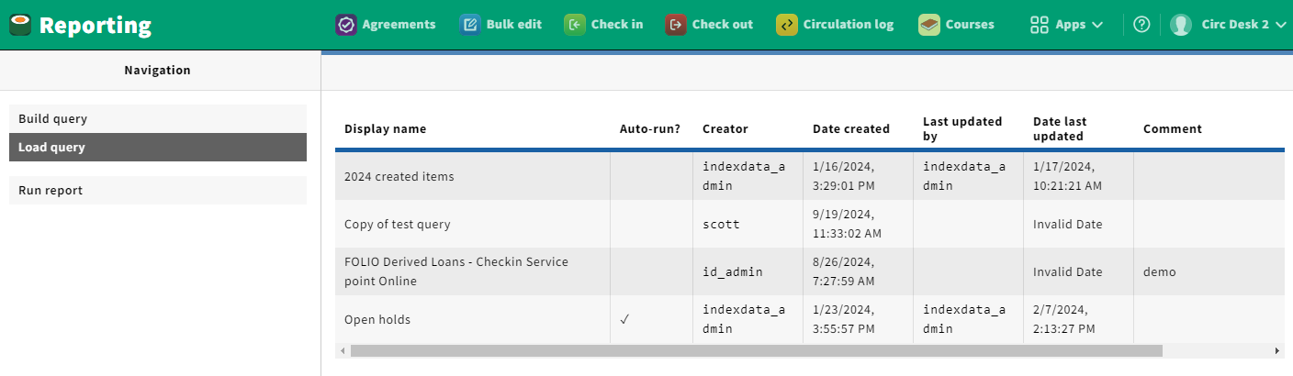
Load Query
Use to view retrieve a saved query using a saved build query.

Slide 53
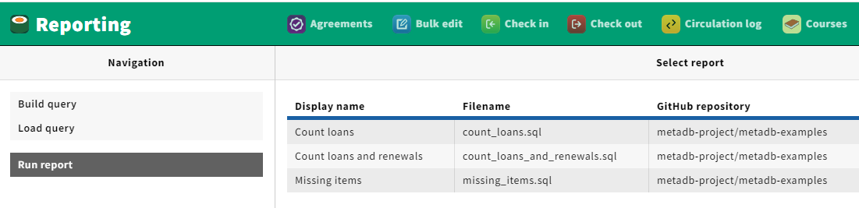
Run Report
Use to run queries stored in the Github repository(ies)

Slide 54
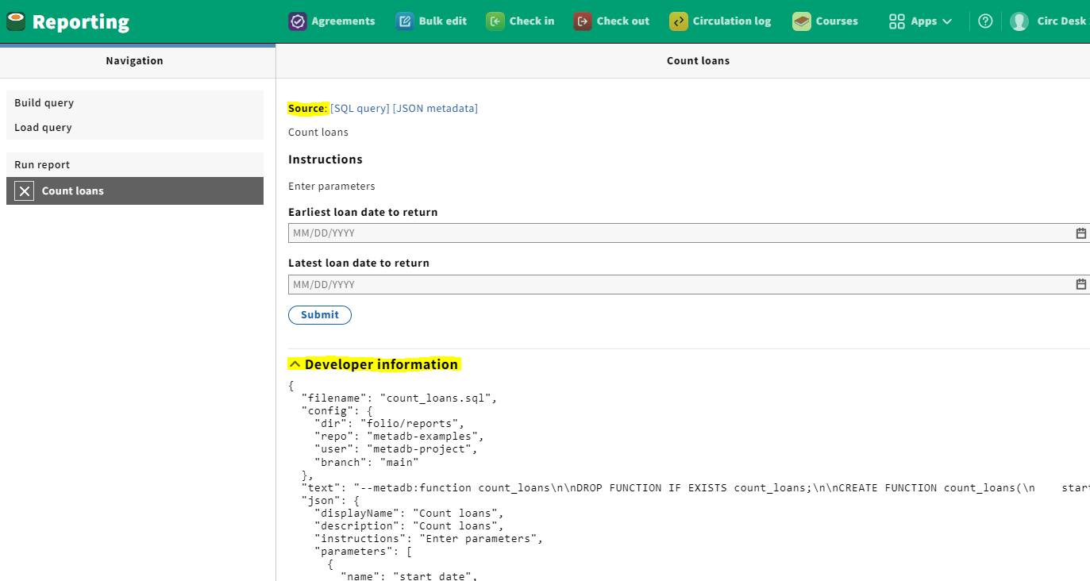
Run Report example

Slide 55
Run Report - sample from Cornell
Reports that are delivered through the FOLIO Reporting App require some setup and configuration before they can be published for users.
Configure FOLIO Reporting App Settings
Create the Query and JSON file for the report
Set Reporting App Permissions for the report

Slide 56
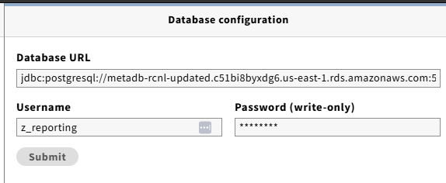
Run Report - configure FOLIO Reporting App Settings (1)
create a reporting app user account on your Metadb database
enter your Metadb database URL and your reporting app user account and password under Database configuration in your FOLIO Reporting App Settings

Slide 57
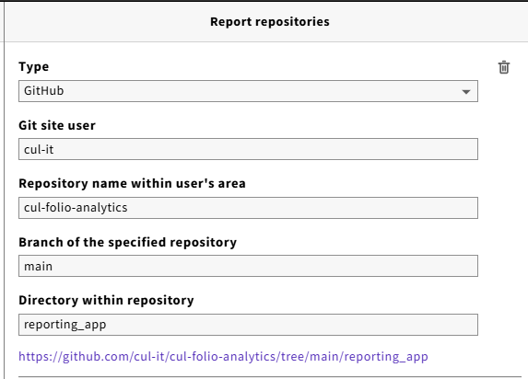
Run Report - configure FOLIO Reporting App Settings (2)
enter your Git site user account, repository name and branch
enter the directory within your GitHub repository where your Reporting App queries and accompanying JSON files will be published

Slide 58
Run Report - Create query and JSON file for report
write the query as a FUNCTION
in addition to the SQL query, set up a JSON file to configure the report display and parameters
use naming conventions to organize your reports if you plan to have more than one, e.g., LTS_ACQ_1_sopo.sql
test the report by running it as a FUNCTION in Metadb using your Metadb reporting app user account
to publish, post the query and its companion JSON file to the reporting_app directory on your GitHub repository (the same one you point to in your FOLIO Reporting App Settings)
test your report under Run Report in FOLIO

Slide 59

Run Report - Live Demo
Configure FOLIO Reporting App Settings
Create the Query and JSON file for the report
Set Reporting App Permissions for the report

Slide 60
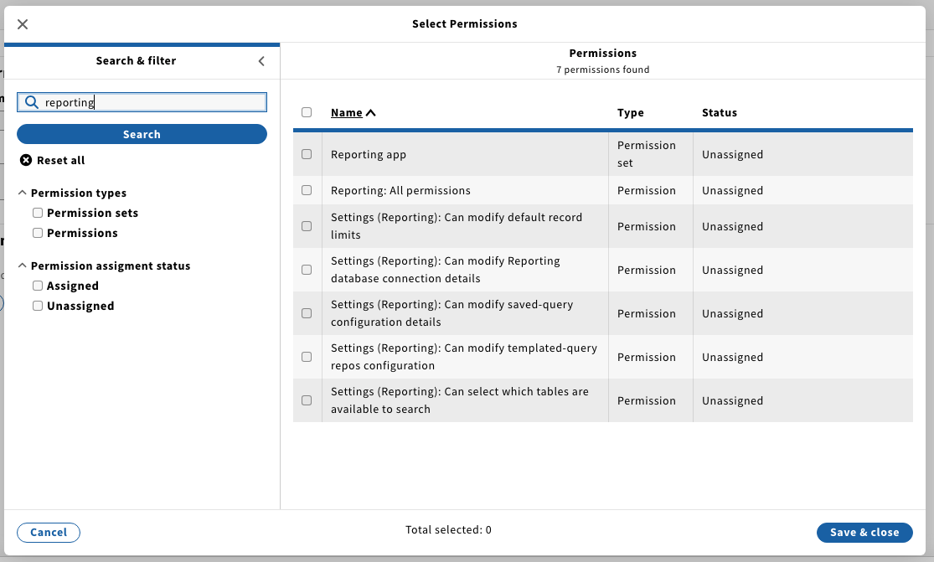
Run Report - Set Reporting App Permissions for the report (1)

Slide 61
Run Report - Set Reporting App Permissions for the report (2)
give all permissions to the person setting up your Reporting App configuration
give Reporting App users permissions to build query, load query, and run report, but not to modify any FOLIO Reporting App Settings
"Reporting App User" permissions set developed for Trillium
  see https://folio-org.atlassian.net/browse/UILDP-178

Slide 62

Reporting App documentation links
Specific instructions for creating Reporting App reports:
https://github.com/folio-org/ui-ldp/blob/master/doc/reports.md
Stefan Dombek created a nice set of information on the folio-analytics wiki on UDFs (User Defined FUNCTIONS), which includes information on writing Reporting App functions:
https://github.com/folio-org/folio-analytics/wiki/Cookbook:-User-Defined-Function
We also have the FOLIO documentation info, which is helpful for Reporting App Settings and Permissions in FOLIO:
https://sunflower.docs.folio.org/docs/reporting/reporting-app/

Slide 63
Questions?

Slide 64
Using Tableau to Deliver FOLIO Data Dashboards from Metadb
Sharon Markus
Cornell University

Slide 65
What is Tableau?
data visualization tool
create and share interactive dashboards
drag-and-drop interface
user-friendly
learning curve for advanced dashboards

Slide 66
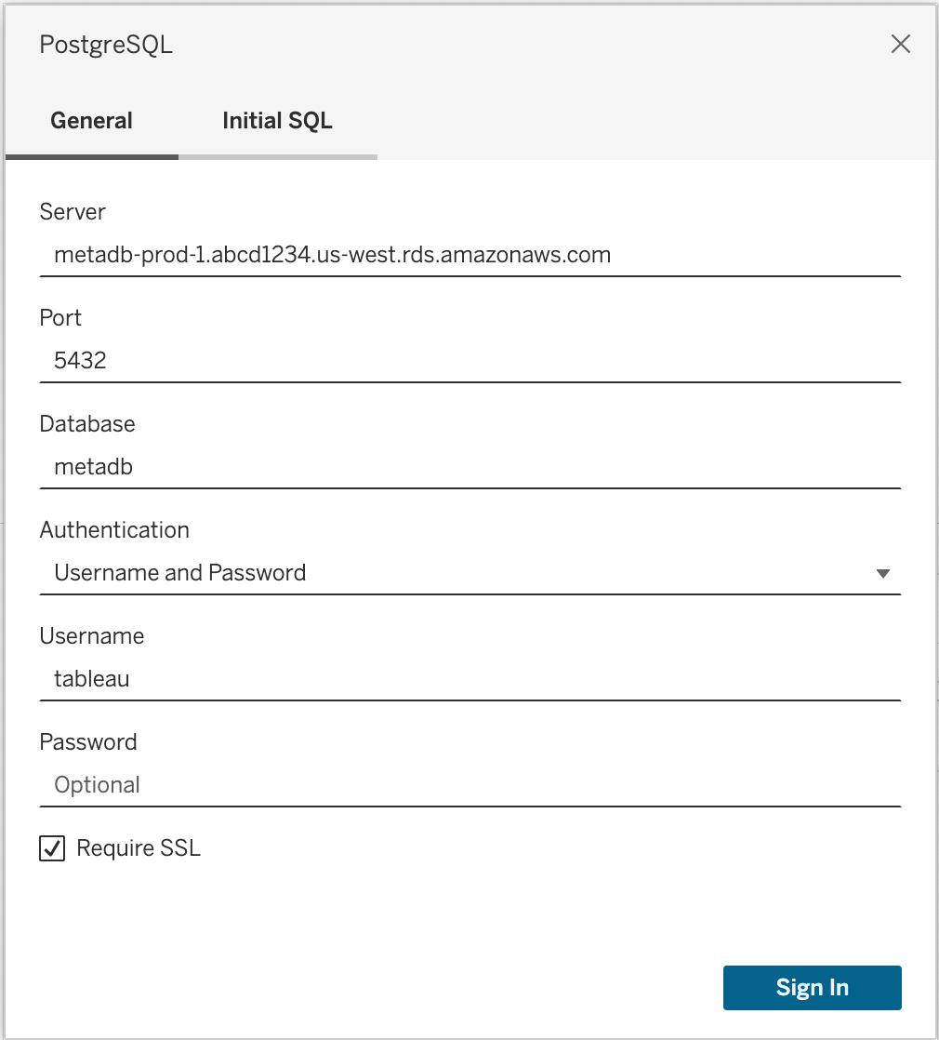
Connect to Metadb
PostgreSQL connector
server
port
database
username
password
SSL

Slide 67
Data Sources
Access the tables directly in Metadb database or use custom SQL queries to get the data
Live connection vs Extract

Slide 68
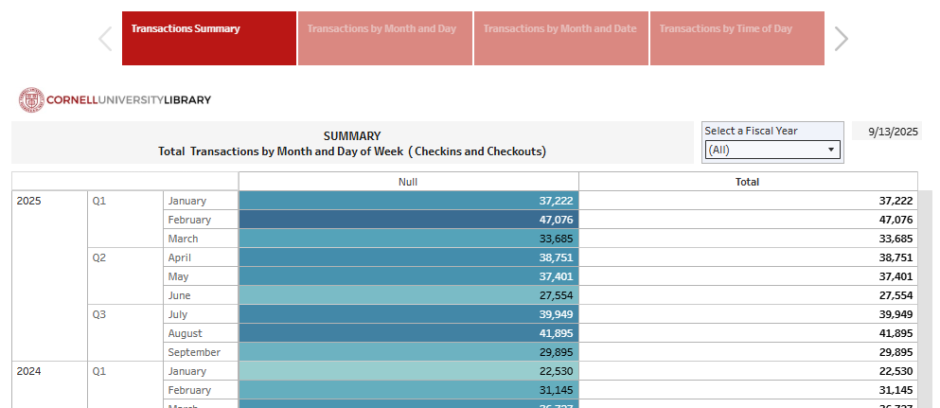
Tableau Dashboard Samples - Circulation Desk Transactions
*dashboard created by Vandana Shah, Cornell University
Link to Circulation Desk Transactions

Slide 69
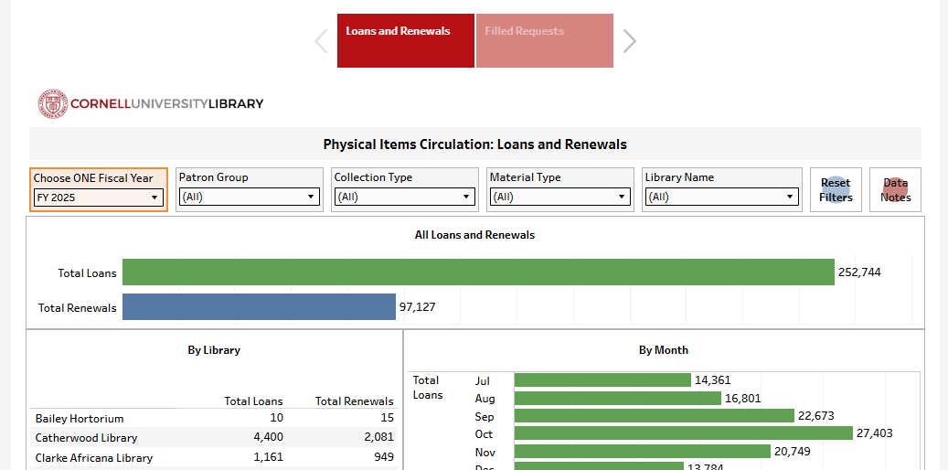
Tableau Dashboard Samples - Physical Item Circulation Counts
*dashboard created by Vandana Shah, Cornell University
Link to Physical Item Circulation Counts

Slide 70
Questions?

Slide 71
LD Lite
Scott Perry

Slide 72
LD Lite - Vision
*content prepared by Katherine Barger and Patrick Waite
LDLite Vision from LDLite Charter:
all users of FOLIO have access to their data regardless of their budget or hosting provider
LDLite Charter link

Slide 73
LD Lite
A self-hosted lightweight alternative to MetaDB, focused on smaller institutions and stability over new features
Part of the Library Data Platform
Currently in use by
  Five Colleges Consortium
  Missouri State University
  Oakland University
  Villanova University
Does not rely on FOLIO database access
Check out Joshua Lambert’s talk Tuesday at 3:30 to see it in action!

Slide 74
LDLite Resources
LDLite Repository for documentation
ldlite-support@fivecolleges.edu for support requests
#folio-ldlite in Open Library Foundation Slack for general questions

Slide 75
Questions?

Slide 76
Lists App
Sharon Markus

Slide 77
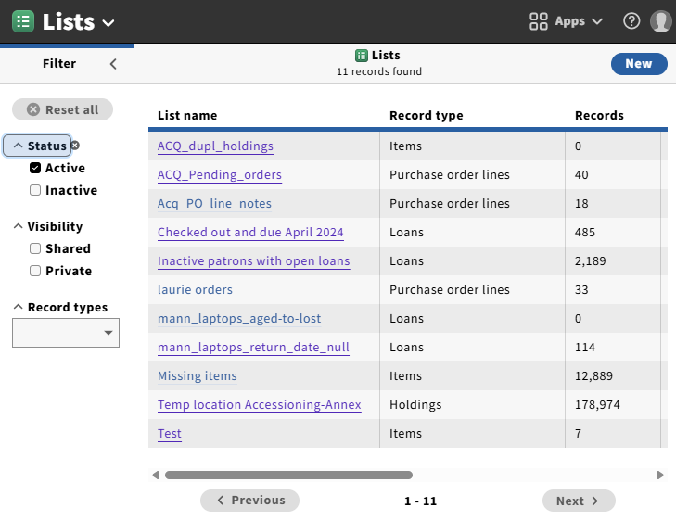
Lists App (1)
available through FOLIO interface
create lists of FOLIO records filtered by criteria
download list of records to your computer as a CSV (comma-separated values) file, which you can open in Excel

Slide 78
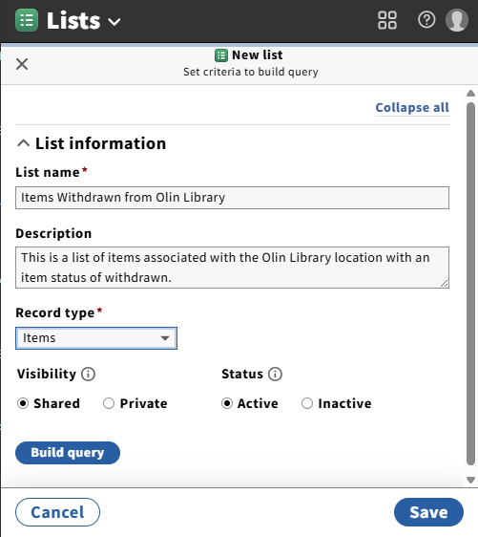
Lists App (2)
click New to create new List
give the list a name, description, choose Record Type
Creat as Shared to share with others, or private for yourself
Click Build query

Slide 79
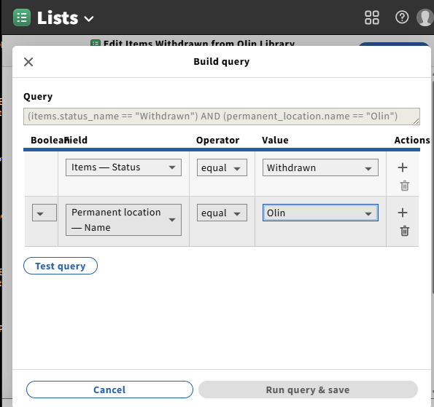
Lists App (3)
build query by choosing fields, operators, and values
Edit query under Actions if necessary

Slide 80
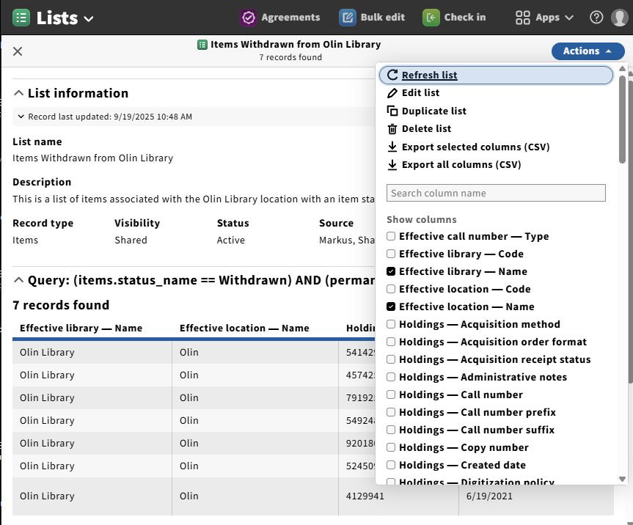
Lists App (4)
Export all or selected columns to CSV if desired, then open in Excel
Choose Refresh List under Actions each time you use the list later to get the latest records

Slide 81
Lists App - data areas covered (5)
Ramsons | Sunflower Additions
holdings instances items loans organizations purchase order lines users | budgets fund with ledger invoice lines invoices purchase order lines with titles purchase orders transactions voucher lines with fund voucher lines with invoice, fund, organization vouchers

Slide 82
Lists App - data areas covered (5)
Lists App | Metadb
currently limited to certain data areas covered, but will be extended in future versions does not include MARC | can report on all data areas in FOLIO includes MARC

Slide 83
Questions?

Slide 84
In-App Reports
Scott Perry

Slide 85
In-App Reports
What are In-App Reports?
  Accessed via the various FOLIO apps usually via searching/filtering (Acquisitions Apps)
  As formal reports within the apps (Users)
  As logs in some apps (Bulk edit)
  Easy to use on demand
Many allow export of the data
  Usually via the actions option in the upper right
  as CSV (Many apps such as Finance, Licenses)
  PDF (Users)
  Logs
Notes:
Inconsistent across apps

Slide 86
In-App Reports
Circulation log
Finance (Budgets CSV and Groups)
Invoices (CSV)
Licenses (CSV)
Orders
Users

Slide 87
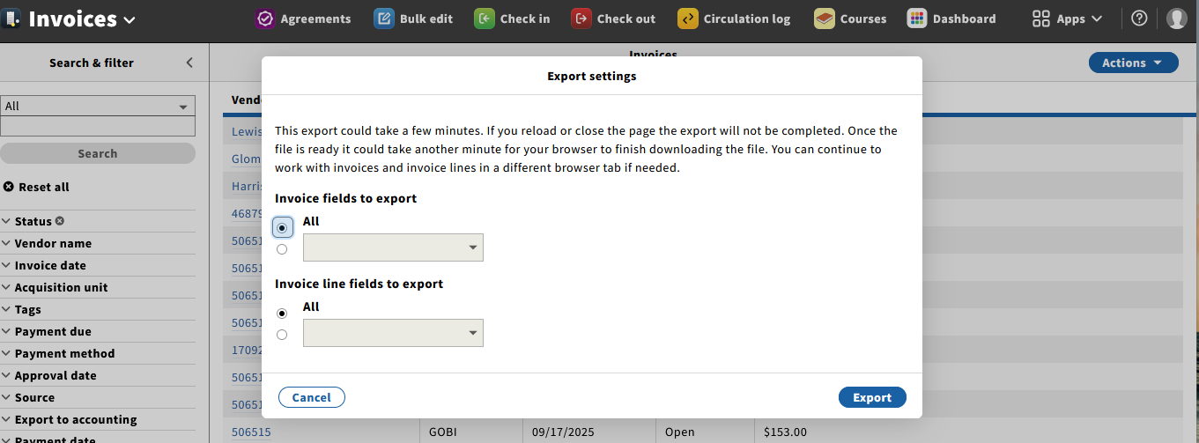
In-App Reports (examples–Invoices)
Notes:
Note action and choice of e

Slide 88
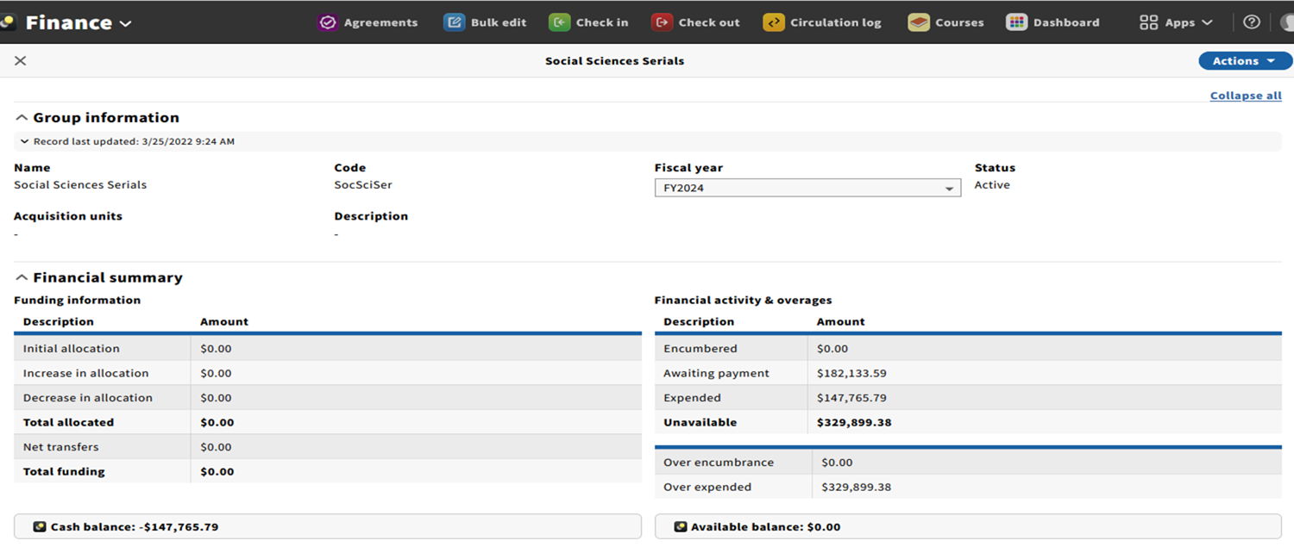
In-App Reports (examples–Finance Group)
Notes:
Mention fiscal years and expense classes

Slide 89
Questions?

Slide 90
Getting to Know the FOLIO Reporting Community
Scott Perry, University of Chicago

Slide 91

Getting to know the FOLIO Reporting community
Emphasis on community/collaboration
Almost weekly meetings alternating between business/education and development/workshopping queries
  Presentations on many different reporting tools/options
    Metadb, LDLite, Lists App, etc.
  Teams create and maintain derived tables

Slide 92
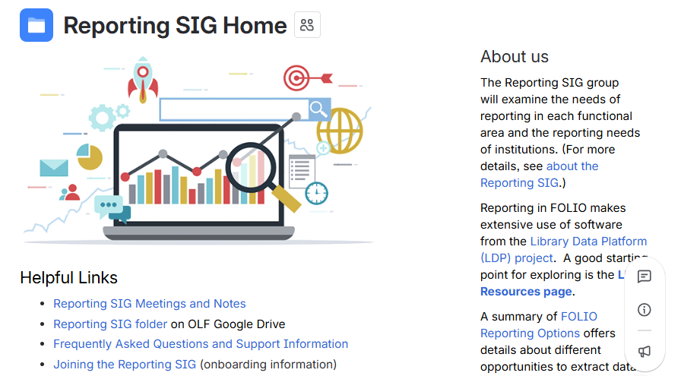
FOLIO Reporting SIG

Slide 93
Getting to know the FOLIO Reporting community
For minutes and recordings of Reporting SIG meetings see our home page https://folio-org.atlassian.net/wiki/spaces/RPT/pages/4490541/Reporting+SIG+Meetings+and+Notes
  See https://folio-org.atlassian.net/wiki/spaces/RPT/pages/edit-v2/4490908 for onboarding information
  Contact Scott Perry or Sharon Markus in Slack to be added to the calendar invitation for Reporting SIG meetings

Slide 94

FOLIO Project Slack Channels for FOLIO Reporting
#folio-reporting-general
#folio-metadb-general
#folio-ldlite
#ldp-dbeaver*
#ldp-devops*
#ldp-folio-general
#ldp-folio-docs*
#ldp-marc-handling
#ldp-reporting-app
#ldp-sql-language
#ldp-wolfcon
*we recommend you join bolded channels first

Slide 95
Questions?

Slide 96
END

