Slide 1
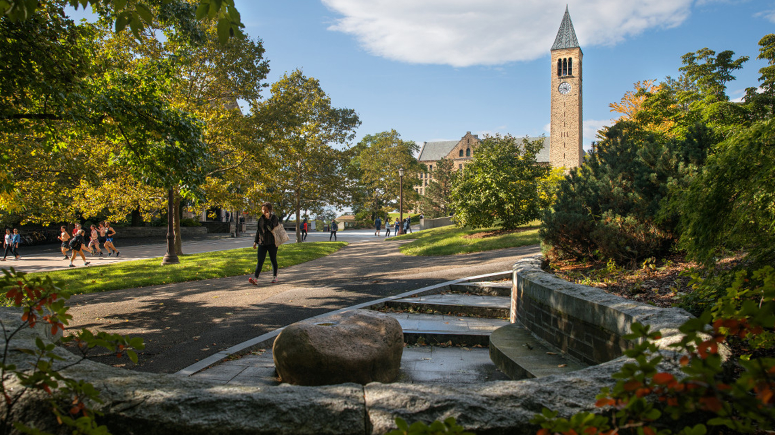
Cornell University Library & Student Success
Student Library Advisory Council Meeting
March 24, 2025

Slide 2
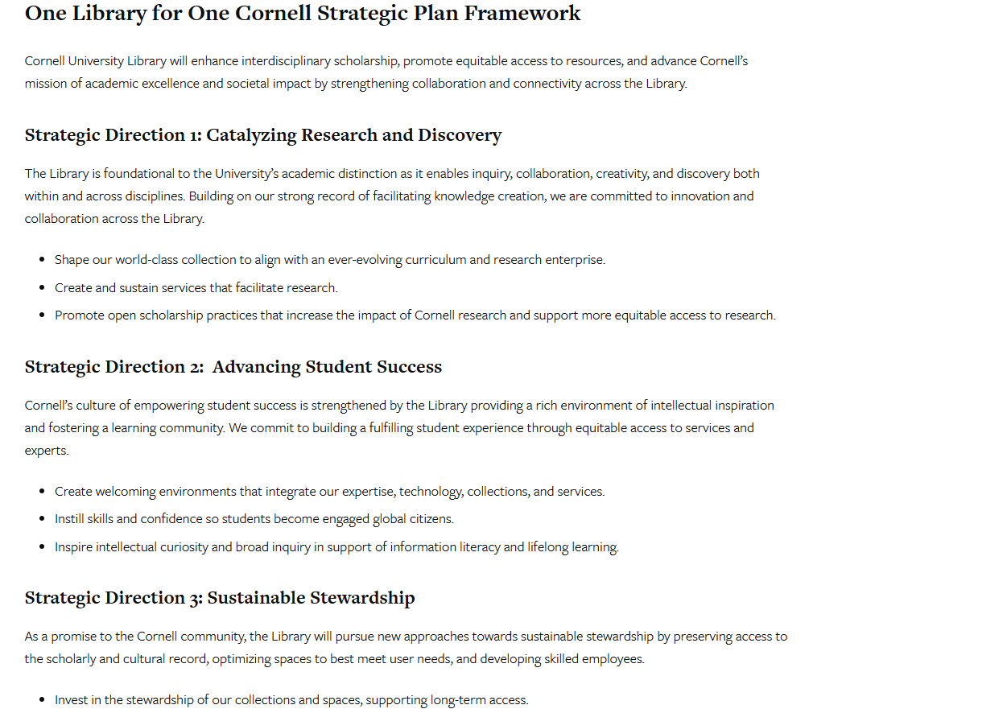

Image Source

Slide 3
Advancing Student Success
Cornell’s culture of empowering student success is strengthened by the Library, which provides a rich environment of intellectual inspiration and fosters a learning community. We commit to building a fulfilling student experience through equitable access to services and experts.

Slide 4
What does student success mean for you?

Slide 5
How can the library help you be successful?

Slide 6
Advancing Student Success Goals:
Create welcoming environments that integrate our expertise, technology, collections, and services.
Instill skills and confidence so students become engaged global citizens.
Inspire intellectual curiosity and broad inquiry to support information literacy and lifelong learning.

