Slide 1
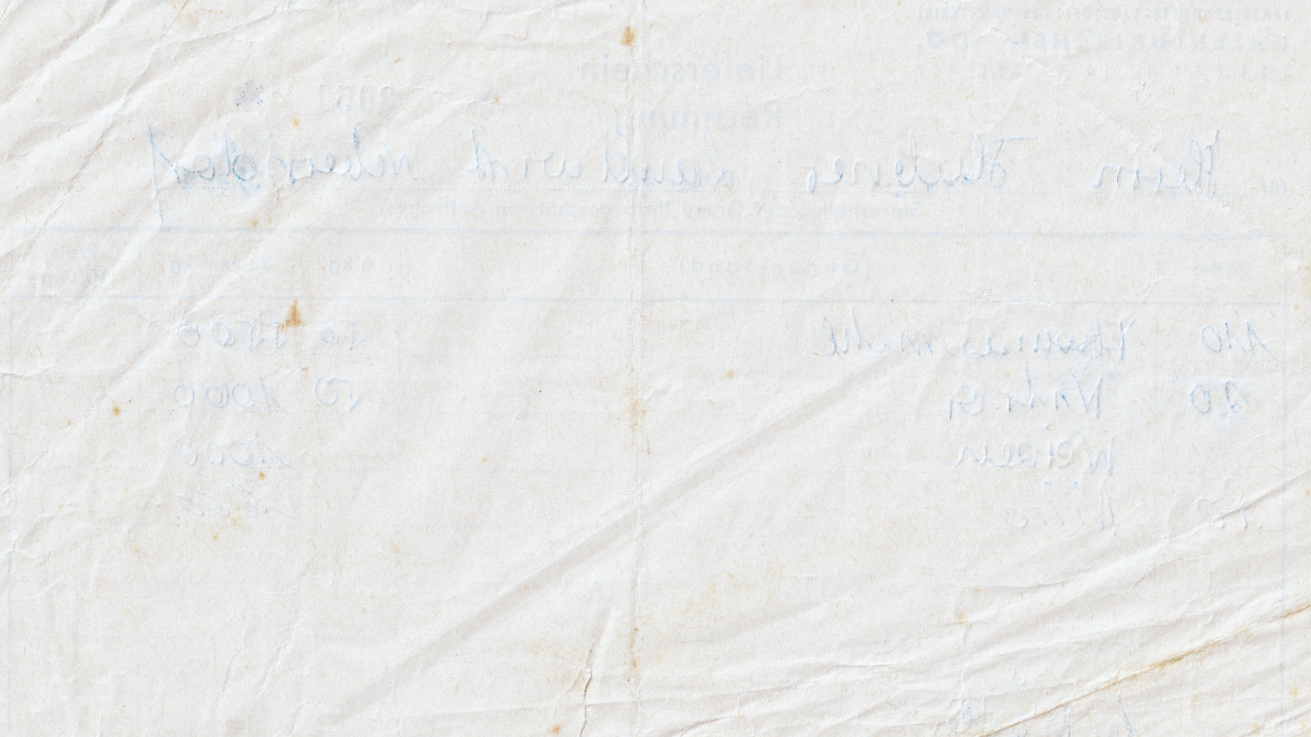
Reparative Description in the CUL Catalog
Inclusive Descriptive Practice Task Force,
Outreach Working Group
11/18/2024

Slide 2
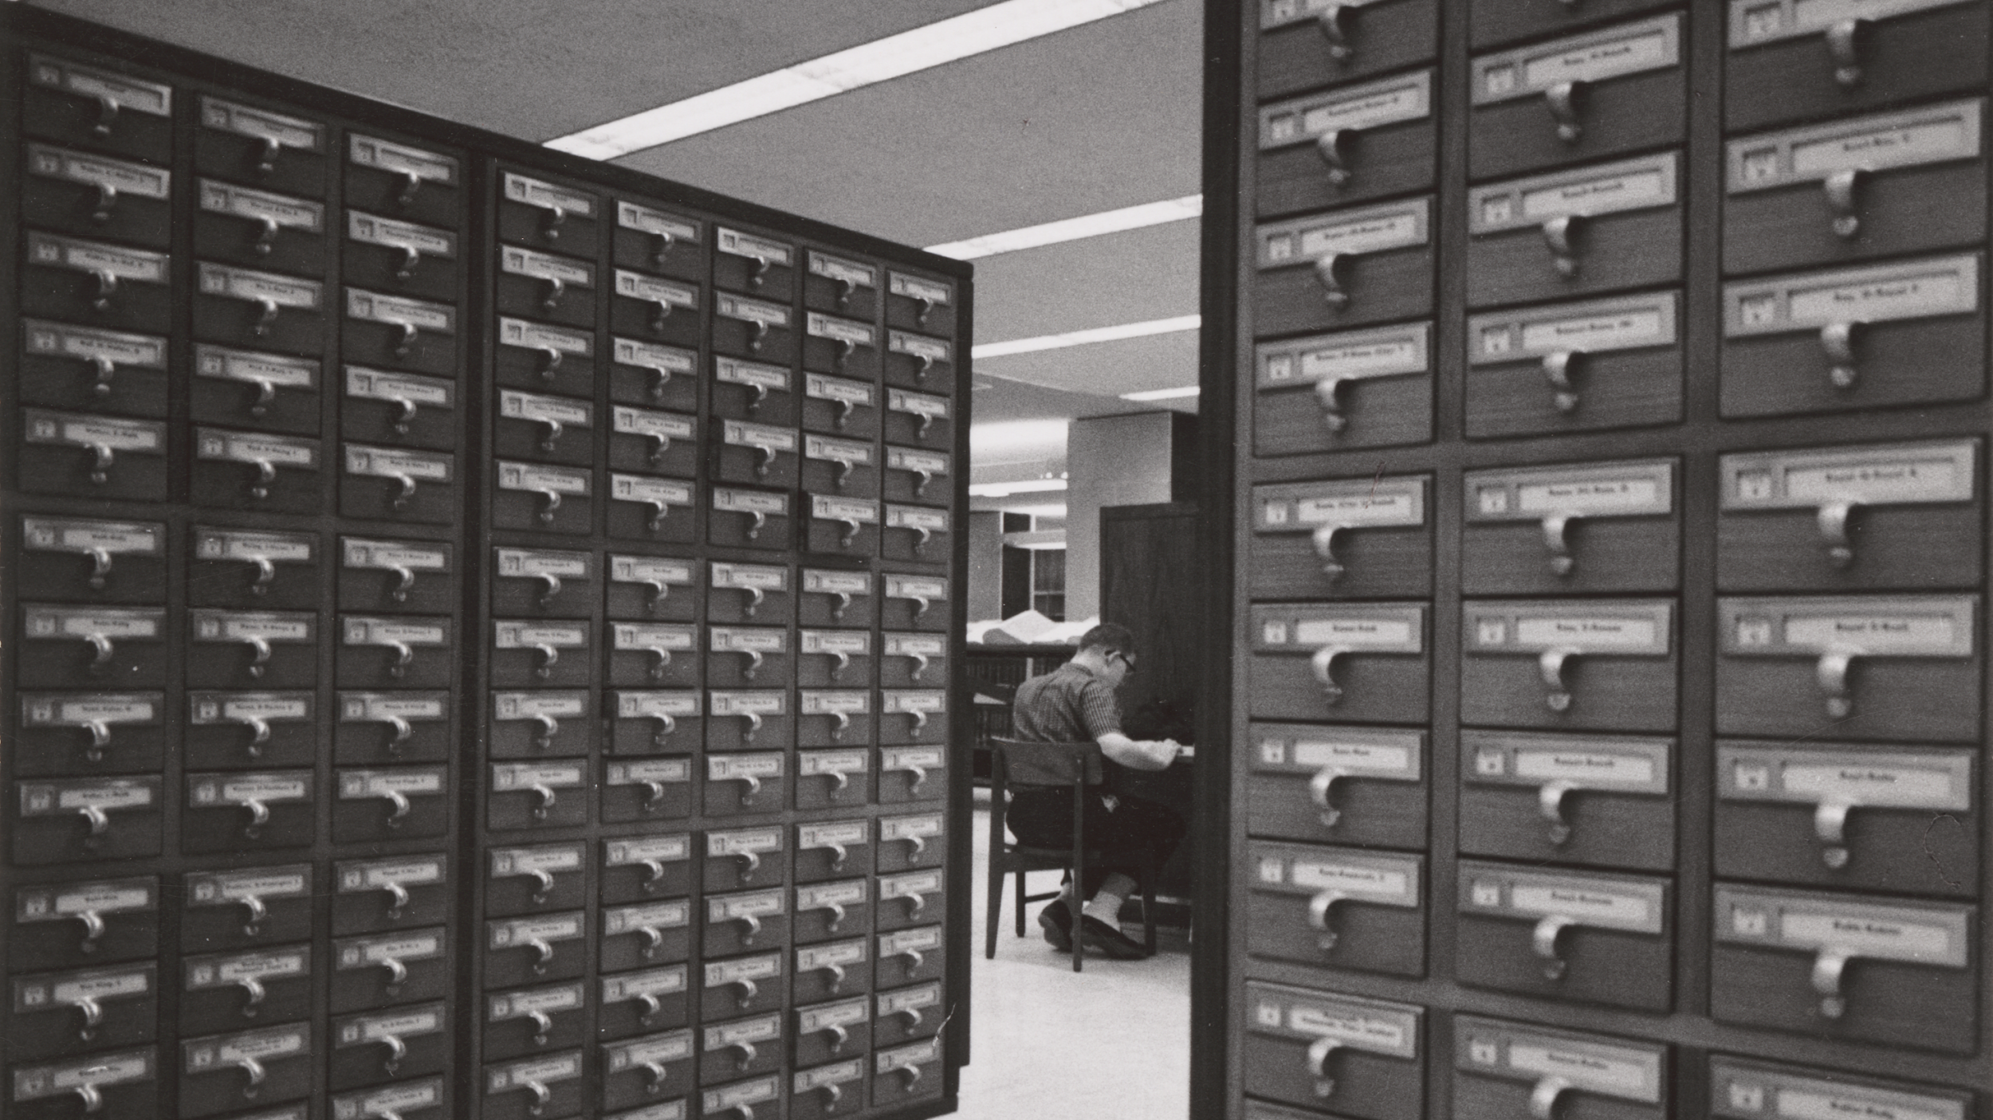
What is a library classification system?
What comes to mind when you think of a library catalog?
What have your experiences been with the library catalog at Cornell (or elsewhere)?
Library classification keeps similar items together and dissimilar items separate in an attempt to help library users to locate the materials needed in the quickest time possible (Manoff, 2004).
Organizing knowledge using a hierarchical system.
Who’s knowledge is emphasized?
Notes:
Initial question to get SLAC members thinking about the catalog

Slide 3
Inclusive Descriptive Practice Task Force (IDPTF)
Descriptive practice is never objective. While performed with the best intentions, library materials are described by humans with their own cultural backgrounds and competencies.
Libraries and archives aren’t neutral spaces, and the vocabularies and classification systems that we use to describe and organize materials are over a century old and built on racist, homophobic, misogynistic, ableist, colonial foundations.
The IDPTF seeks to contribute to a growing body of literature and work regarding reparative description, providing a space for library staff to have conversations about harmful language within CUL’s catalog.

Slide 4
What is a library classification system?
What comes to mind when you hear a term like reparative description?
What might this look like in practice? Why might this concept matter?
Library classification keeps similar items together and dissimilar items separate in an attempt to help library users to locate the materials needed in the quickest time possible (Manoff, 2004).
Organizing knowledge using a hierarchical system.
Who’s knowledge is emphasized?
Notes:
Let's revisit a term we used to describe IDPTF’s work: reparative description. What comes to mind? What might this look like in practice? Why does it matter?
Has also been called radical cataloging, conscious editing, metadata justice
Follow-up question: Can language ever be truly neutral? If we created an entirely new body of unbiased subject headings from the ground up, would we still feel that way 50 years from today?
Idea that the catalog can be read critically, both by users and librarians/archivists (open and honest discussion), and that we can design evolving best practices to guide our descriptive work

Slide 5
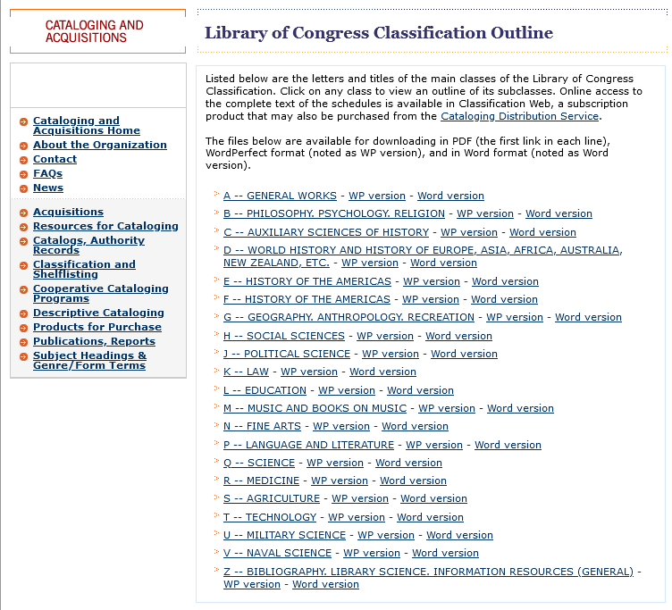
Whose knowledge?
https://www.loc.gov/catdir/cpso/lcco/
Notes:
Looking at the Library of Congress classification system, which is used by CUL (and most university and research libraries!) to organize information; designed to help users find the information that they’re looking for, but was published in 1904 and, although it has undergone many changes and revisions since then, we can still see these foundations today.
If you’d like, go to:
https://www.loc.gov/catdir/cpso/lcco/: where would you find women?

Slide 6
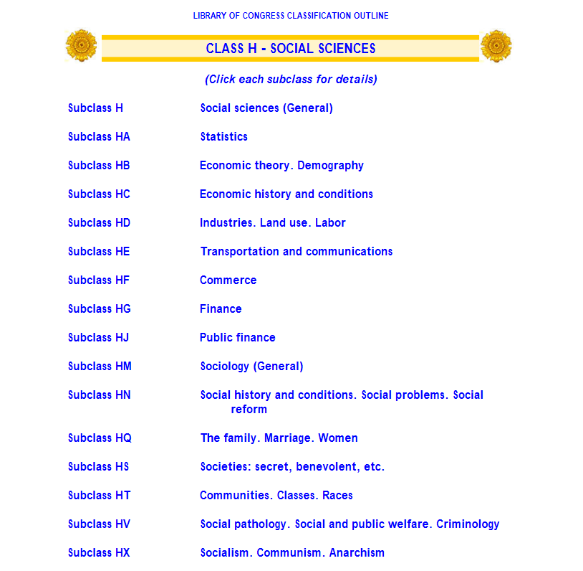
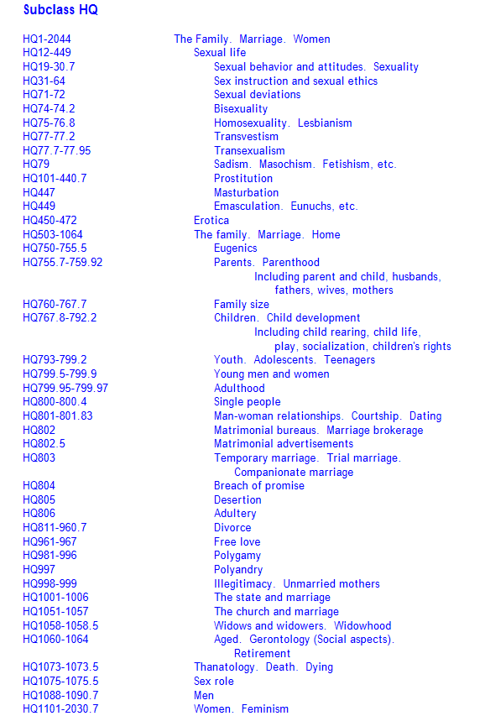
Notes:
Women are located squarely within family and marriage. Remember, this is the turn of the 20th Century thinking and we will see the ramifications for women in some of the examples of authorities.
But as it turns out, there’s a lot within this subclass. If you’re looking for books on LGBTQIA studies many of those would be under this heading too.
Think about how sexuality would have been considered at the beginning of the 20th century and why it was placed here.
Think about how this looks when books in this range are sitting next to each other on the shelf, organized by classification scheme. What message does that send about LGBTQ subjects? Women?
Have you ever come across something in the catalog or searching for a book that made you wonder why is was arranged this way?

Slide 7






Controlled Vocabularies
Subject Headings, Name Authorities, Geographical Locations, Form and Genre Terms
These appear as links, and allow researchers easy access to all resources that share that term in a library’s collection
Examples:
Library of Congress Subject Terms (LCSH)
Getty Art & Architecture Thesaurus (art terms)
Homosaurus (LGBTQ+-related terms)
Notes:
Help connect users to similar information; but, as we saw with classification schemes, these can have their own descriptive issues; sometimes materials can have harmful subject headings that should be changed or replaced with different language; or some materials might be underdescribed and could lack subject headings that would more accurately represent a resource; in the next slides we’ll show you some examples, and we’ll ask what you might notice about these catalog records

Slide 8
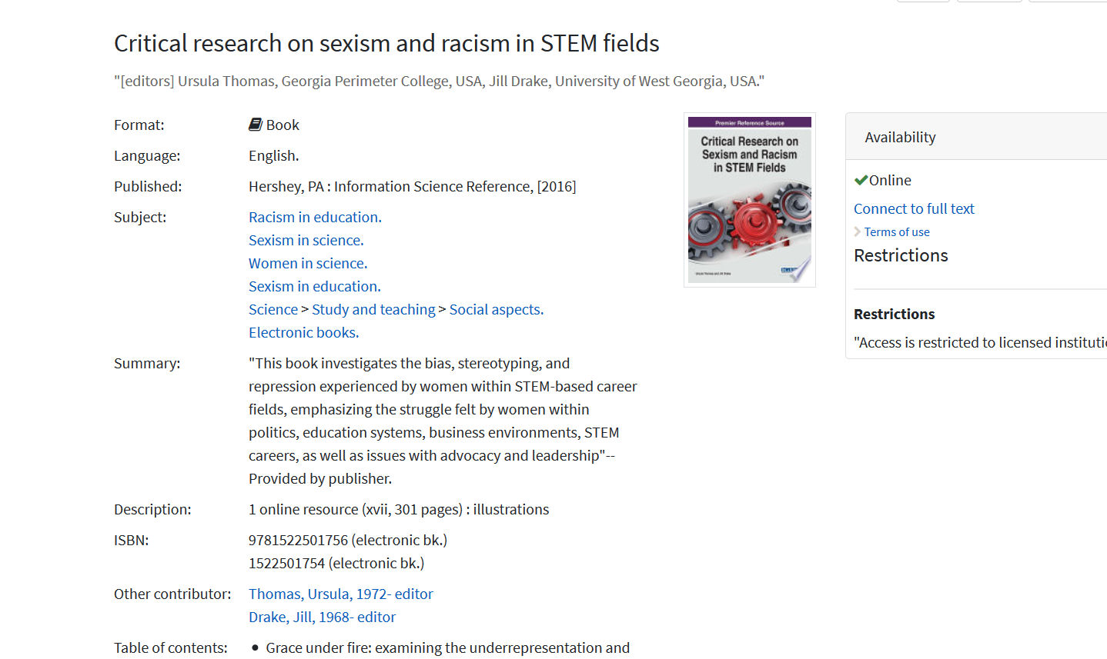
Notes:
Examples from the catalog: “Women in science” (because default is in Library of Congress Subject Headings is male!)

Slide 9
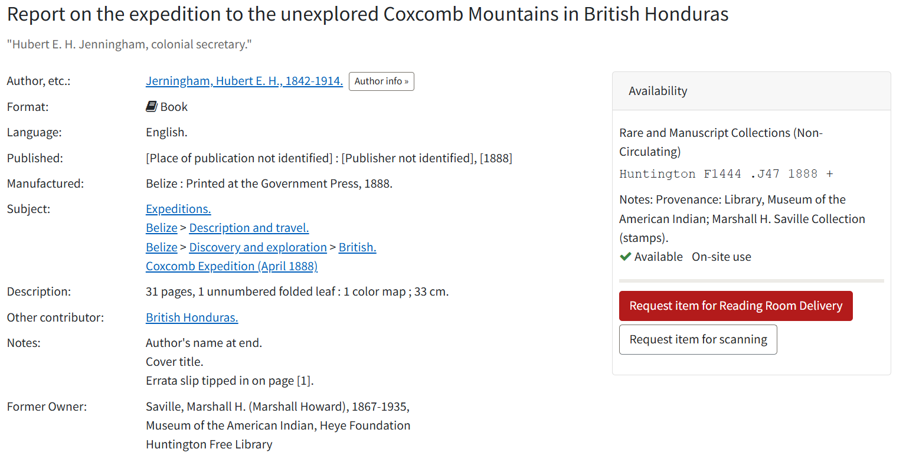
Notes:
Examples from the catalog: “Discovery and exploration” as a heading for a place where people had lived for 8,000 years before British “discovery”?

Slide 10
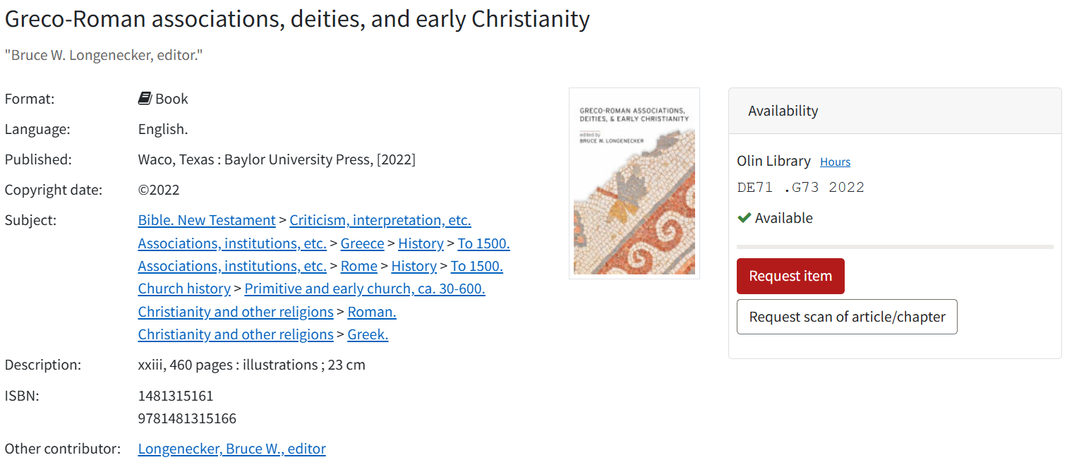
Notes:
Examples from the catalog: What do you think they mean by “primitive”? Which church is meant for the heading “Church history”?

Slide 11
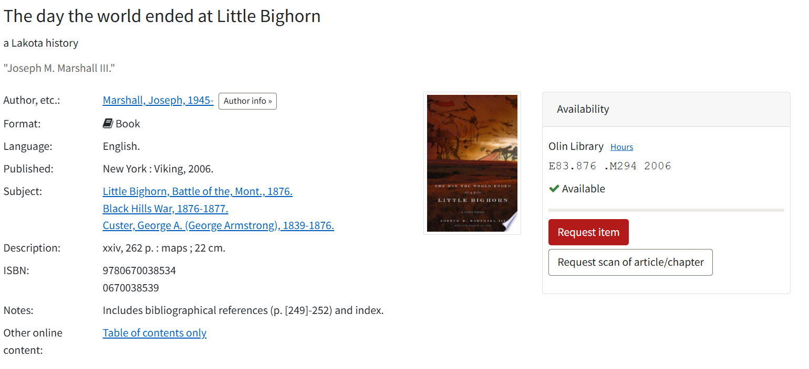
Notes:
Examples from the catalog: No subject headings present about the Lakota people for a book about the Lakota?

Slide 12
Examples of changed/proposed LCSH headings
“Blacks” changed to “Black people”; “Gays” to “Gay people”
“Illegal aliens” to
“Undocumented immigrants”
“Bears (Gay culture)” and
“Butch and femme (Lesbian culture)” added
Notes:
Good news is, these controlled vocabularies can be changed! Often easier said than done, but it is possible to change existing terms in LCSH and to propose new ones. Examples of changed LCSH terms in slide.
So to go back to our original question about how you use the catalog...Have you ever come across a subject term that made you think, that's not the word I would use? Or that's strange that that this term doesn't exist?
How best can our work be guided by our users – you?
Are you part of other student groups that you think we should go to for their input?

