Slide 1
Hemotropic mycoplasms anaplasma

Slide 2

Arlo, 2 yo MC DSH
Presented as a referral for severe anemia
3 day history of progressive lethargy and weakness
Indoor/outdoor
Not on any medications
Blood work from rDVM HCT of 9%

Slide 3
Physical Exam & Initial Diagnostics
T: 103, P: 170, R: 48, MM white
Bounding femoral pulses, grade II/VI left parasternal murmur
Otherwise NSF
PCV/TS 9%/8.6, AZO 50-80
VBG: pH 7.221 pCO2 22.6 BE -18.6 Lact 6.34, Na 144.3, HCT 7
POCUS: unremarkable

Slide 4
Problem List and Differentials
Severe anemia
  r/o hemolysis vs bone marrow disorder (primary/secondary) vs hemorrhage
Fever
Murmur
Notes:
Hemolysis: Infectious (FeLV, hemoplasmosis, Babesia, cytauxzoonosis), oxidant (toxins/onions), secondary IMHA, primary IMHA, hypophosphatemia
Bone marrow: pure red cell aplasia, aplastic anemia, myelodysplastic syndromes, myeloproliferative diseases, inflammatory disease, renal failure, retrovirus associated

Slide 5
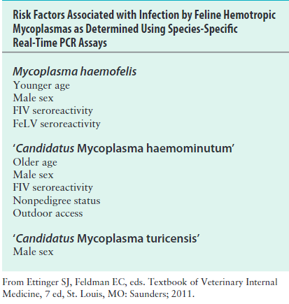
Hemoplasma Infections
Hemotropic mycoplasmas: small unculturable mycoplasmas that reside on surface of erythrocytes
Feline hemoplasms:
  Mycoplasma haemofelis
  Candidatus Mycoplas turicensis
  Candidatus Mycoplasma haemominutum
Canine mycoplasms
  Mycoplasma haemocanis
  Candidatus Mycoplasma haemoparvum
Risk factors
Notes:
Hemotropic mycoplasmas (hemoplasmas) are small (0.3-0.8μm), unculturable mycoplasmas that reside on the surface of erythrocytes and can cause variable degrees of hemolytic anemia in infected hosts.
At least three hemoplasma species infect domestic as well as wild cats, Mycoplasma haemofelis, ‘Candidatus Mycoplasma haemominutum,’ and ‘Candidatus Mycoplasma turicensis.’ The ‘Candidatus’ prefix is applied to newly discovered hemoplasmas until more information is available to support their classification. This is because hemoplasmas cannot be cultured in the laboratory, which limits full characterization of these organisms.
M. haemofelis is the most pathogenic organism and can cause moderate to severe hemolytic anemia in immunocompetent cats. The resulting disease has been referred to as feline infectious anemia. Using cytologic evaluation of blood smears, M. haemofelis organisms are cocci that sometimes form short chains of three to six organisms. M. haemofelis is the least prevalent of the three feline hemoplasmas. It has been found using PCR in 0.5% to 5% of sick cats at veterinary hospitals. ‘Ca. M. haemominutum’ generally smaller than M. haemofelis and has not clearly been associated with disease in immunocompetent cats. ‘Ca. M. haemominutum’ is common in the cat population worldwide, infecting as many as 20% of cats that visit veterinary hospitals.
Several hemoplasma species also infect dogs. Infection with Mycoplasma haemocanis has been associated with hemolytic anemia in splenectomized dogs, and rarely in dogs with other immunosuppressive disease or concurrent infections. M. haemocanis is a coccoid organism that often forms long chains of organisms. The prevalence of this infection is particularly high in kennel-raised dogs, which are often infected sub-clinically

Slide 6
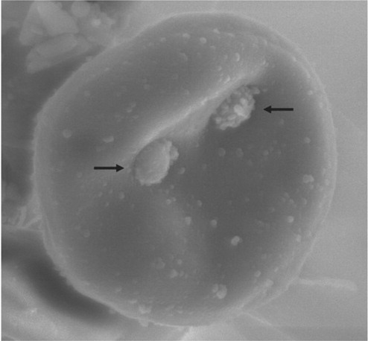
Pathogenesis
Following infection delay before onset of clinical signs
Acute phase
  Anemia persists for about to 18-30 days
Hemolysis
  Predominantly extravascular
  Antibodies, fragility, decreased life span
  Splenic trapping
Organism replication and clearance
Notes:
Because only M. haemofelis infection is associated with significant anemia in cats, only the pathogenesis of disease induced by this species is described here. After experimental infection, there is a delay of 2 to 34 days before the onset of clinical signs. Anemia then occurs and persists for about 18 to 30 days (acute phase),although its severity and chronicity vary considerably between infected cats. Anemia predominantly results from extravascular hemolysis, and the onset of anemia is usually followed by a strong regenerative response with reticulocytosis. The organ-ism resides in an indentation on the erythrocyte surface.
Production of both cold and warm reactive erythrocyte-bound antibodies (agglutination is often observed in blood tubes stored in the refrigerator), increased osmotic fragility, and decreased erythrocyte life span have been noted in infected cats. The organisms can also “bridge” adjacent erythrocytes, which might promote splenic trapping and removal of red blood cells. In contrast, erythrocyte-bound antibody formation and significant reticulocytosis have not been documented in cats infected with ‘Ca. M. haemominutum’ or ‘Ca. M. turicensis. Can see persistent autoagglutination or positive Coombs’ tests
In some infected cats, cyclical changes in the hematocrit and numbers of infected erythrocytes occur, with sharp declines in the hematocrit correlating with appearance of large numbers of organisms in blood smears. The proportion of erythrocytes associated with visible organisms on blood smears can decline from 90% to less than 1% in less than 3 hours. These dramatic fluctuations in organism numbers appear to result from rapid replication of M. haemofelis, followed by rapid clearance from the blood as a result of the host’s immune response. Repeated antigenic variation in M. haemofelis may allow the organism to again proliferate in the face of this immune response, which contributes to ongoing fluctuations in organism numbers.

Slide 7
Pathogenesis
Recovery phase
  Hematocrit returns to normal or near normal
  Organism no longer visualized
  Recovered cats may can remain persistently infected
What would happen if you splectomized a cat following recovery?
Notes:
In cats that survive the acute phase, the hematocrit then returns to normal or near-normal (recovery phase), and organ-isms can no longer be visualized in blood smears. It is possible that at least some of these recovered cats remain persistently infected, whereby the organism evades the host immune system, and that recrudescence of anemia may follow stress, pregnancy, intercurrent infection, or neoplasia
However, evidence is accumulating that differences may exist in the ability of hemoplasmas to persist within the host, the carrier state being more frequent for ‘Ca. M. haemominutum’ but less frequent for M.haemofelis and ‘Ca. M. turicensis.’ In cats, splenectomy has a variable effect on the course of hemoplasmosis. Recrudescence of anemia and bacteremia has been documented in some chronically infected cats after splenectomy, although other studies suggest that splenectomy increases the number of visible organisms in blood smears without causing significant anemia. Infection of splenectomized cats with ‘Ca. M. haemominutum’ does not appear to enhance the pathogenicity of this organism
Dogs that develop clinical hemoplasmosis have usually had a history of splenectomy or, less commonly, concurrent immuno-suppressive illness or drug treatment or co-infections with other bloodborne pathogens such as Babesia spp. and Ehrlichia Canis. Clinical signs include weakness, lethargy, and pallor, and some dogs are in appetent.

Slide 8
Clinical signs and physical exam
Signs related to anemia
Pica
Weight loss
Physical exam
  Anemia
  Fever (cats)
  Splenomegaly
  Icterus

Slide 9
Diagnostics - General
Complete blood count
Biochemistry
Urinalysis
Imaging
Notes:
The most characteristic CBC abnormality in dogs and cats infected with M. haemocanis and M. haemofelis, respectively, is regenerative anemia, with macrocytosis, anisocytosis, reticulocytosis, polychromasia, Howell-Jolly bodies, and, especially in cats, sometimes marked normoblastemia. Manual reticulocyte counts should be interpreted with caution in cats infected with M. haemofelis, because both hemoplasma-infected erythrocytes have the same appearance as reticulocytes in blood smears stained with methylene blue. Autoagglutination may be noted in blood smears. Nonregenerative anemia can be present when sufficient time for a regenerative response has not yet elapsed, or as a result of concurrent FeLV infection or any other disease that suppresses the regenerative response. Concurrent occult hemoplasma infection should be considered in any anemic FeLV-positive cat, even in the absence of reticulocytosis. Neutrophil counts may be normal, elevated, or low, and lymphopenia may be present. Thrombocytopenia can also occur in affected dogs and cats, but often the platelet count is within the reference range.
The serum chemistry profile in cats with hemoplasmosis may reveal increased activities of ALT and AST as a result of hypoxia; metabolic acidosis; mild to moderate hyperbilirubinemia; and prerenal azotemia. Hyperproteinemia may be seen in some cats.
The most common radiographic finding in cats with hemoplasmas is splenomegaly

Slide 10
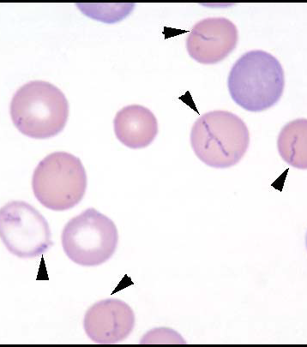
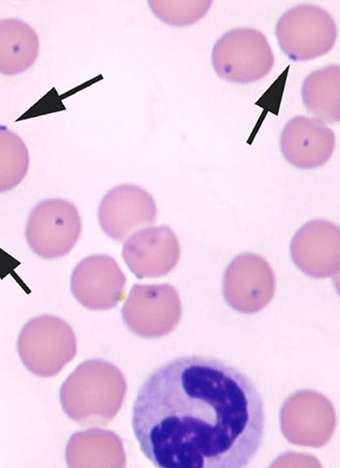
Diagnostics
Cytology
Culture
PCR
Serology
Notes:
Cytologic detection of hemoplasmas has low sensitivity and specificity, especially for diagnosis of feline infectious anemia. M. haemofelis is visible less than 50% of the time in acutely infected cats, because organisms can disappear for days before reappearing on blood smears over the course of infection. Because organisms detach from erythrocytes within hours of blood collection, fresh blood smears should be submitted. False-positive diagnoses occur when stain artifacts such as precipitate are confused with organisms; thus, careful staining with a properly prepared, uncontaminated Romanowsky-type stain solution is essential. Organisms also need to be distinguished from basophilic stippling and Howell-Jolly bodies. ‘Ca. M. haemominutum’ is small and is not usually visible in chronically infected cats. ‘Ca. M. turicensis’ has never been seen on blood smears with light microscopy. Hemoplasmas are visible in many clinically affected dogs, and because M. haemocanis tends to form chains, it is more readily differentiated from stain artifacts and erythrocyte morphologic changes than is M. haemofelis. However, hemoplasmas are not usually visible in chronically infected dogs or in dogs infected with ‘Ca. M. haematoparvum.’
PCR assays are currently the tests of choice for diagnosis of hemoplasmosis in dogs and cats. Numerous assays have been described to date, which are generally based on detection of the 16S rRNA gene. These are significantly more sensitive than blood smear evaluation, although they occasionally do not detect infection in apparently healthy carrier cats when organism numbers in the blood are below the detection limit of the PCR Assay. Real-time PCR assays are usually species specific. Because the pathogenic potential of each hemoplasma species differs, the laboratory should be consulted to determine the species specificity of the assay(s) offered. Alternative causes of anemia should always be considered, especially in cats that test positive for ‘Ca. M. haemominutum’ or ‘Ca. M. turicensis,’ because infection with these organisms is not commonly associated with anemia.
Specifically, an ELISA that detects antibodies to an immunodominant protein of M. haemofelis, DnaK, has been developed. Cats produce antibodies to this antigen after infection, and in a study that examined the immune response to ‘Ca. M. turicensis’ infection, antibody titers to DnaK declined with antimicrobial drug treatment. Serologic cross-reactivity occurs to this antigen for all three feline hemoplasma species herefore, the assay does not discriminate between infection with M. haemofelis and other hemoplasmas, but determination of acute and convalescent titers may be helpful to distinguish acute from chronic infection. Currently this assay is available only on a research basis.

Slide 11

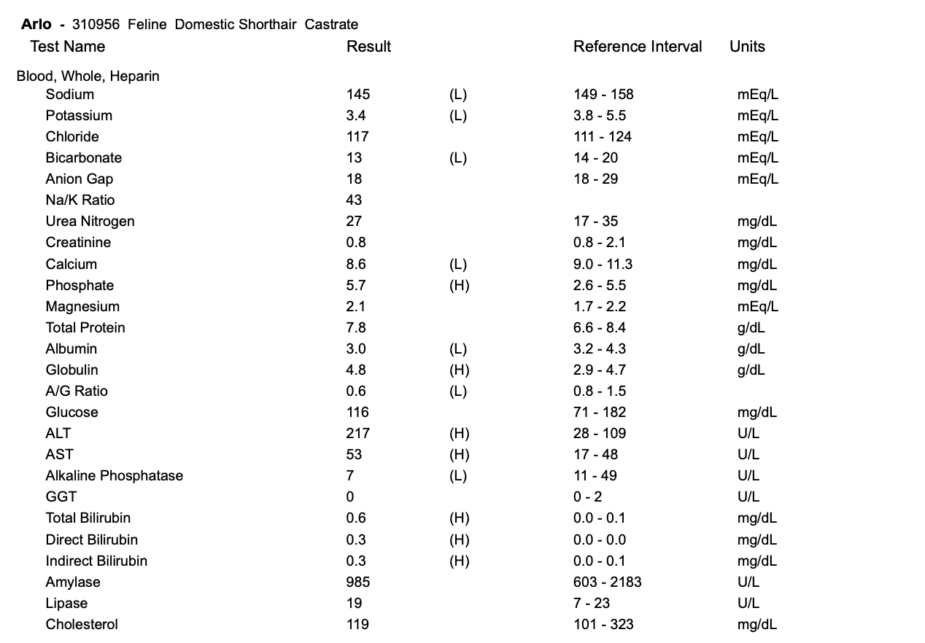
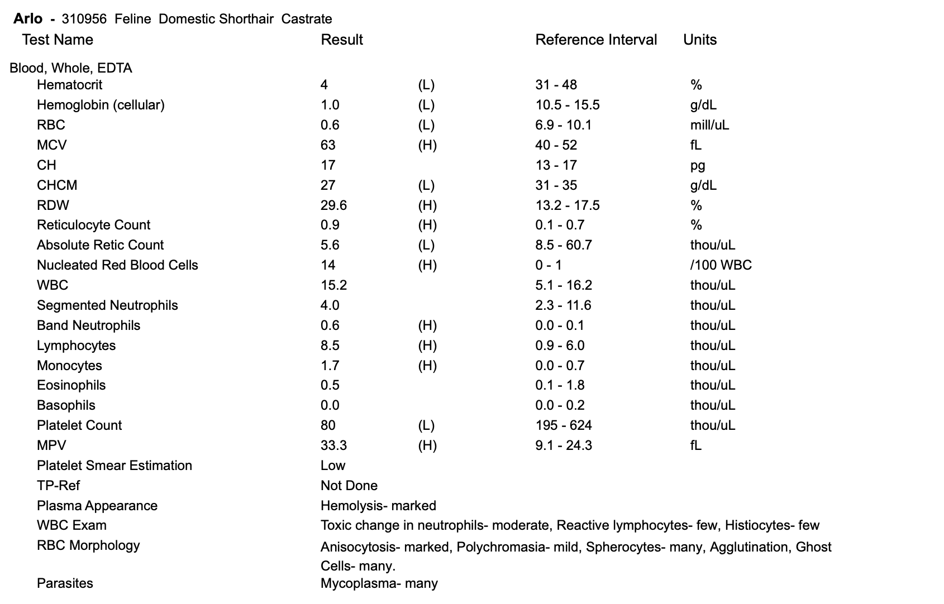
Arlo next steps?

Slide 12
Arlo’s owner asks how did he get infected?
Arthropod vectors?
Do they need to be concerned for the other cats in the household?
What if Arlo was a dog?
Notes:
The mode of transmission of hemoplasmas remains unclear. To some extent, fleas and other arthropod vectors may be capable of transmitting feline hemoplasmas, but experimental evidence for vector-borne transmission of feline hemoplasmas is weak. Transmission of M. haemocanis by the brown dog tick, Rhipicephalus sanguineus, has been demonstrated experimentally, although this was before PCR assays were available to confirm infection. Geographic variation in the prevalence of hemoplasma infection in dogs and cats supports a role for arthropod vectors in transmission. Vertical (e.g., transplacental) spread has also been hypothesized and has been documented for bovine hemoplasmas. Biting has been suggested as a means of transmission of feline hemoplasmas, and the strong male sex predilection, recent history of cat bite abscessation in some cats, and association with FIV infection in some studies supports this mode. Additionally, studies in Switzerland found that subcutaneous inoculation of blood that contained Ca. M. turicensis’ resulted in transmission, whereas inoculation of saliva that contained ‘Ca. M. turicensis’ did not. This suggests that hemoplasma transmission by social contact (saliva via mutual grooming etc.) is less likely than transmission by aggressive interaction (blood transmission during a cat bite incident). Because infection can also be transmitted by ingestion of blood, it may be that the biting cat (rather than the bitten cat) is most at risk for acquisition of infection. Transmission of M. haemocanis through ingestion of infected blood has also been described, so aggressive interactions between dogs may also have the potential to transmit hemoplasmas; however, this mode of transmission remains to be proven in field circumstances. Transmission can also occur following blood transfusion

Slide 13
Treatment Plan for Arlo
pRBC transfusion
Antibiotics
  Which one?
  How long?
Steroids?
Treatment if Arlo was a dog?
Notes:
The treatment of choice for hemoplasmosis is doxycycline for a minimum of 2 weeks. some have suggested using longer courses of treatment (6 to 8 weeks) to ensure that infection is eliminated. Real-time PCR could be used to monitor response to antibiotic treatment if quantitative information is available. Fluoroquinolones are an alternative; marbofloxacin and pradofloxacin, when available, are both efficacious. Enrofloxacin is also usually effective, but diffuse retinal degeneration and acute blindness have been reported following the use of this fluoroquinolone and, although this is rare, caution must be exercised with its use in cats. The response of the different hemoplasma species, and indeed different strains of the same species, to antibiotics varies. Most successful studies that have demonstrated treatment efficacy have evaluated the response of M. haemofelis to treatment. Clinical improvement usually occurs within 2 to 3 days. The use of immunosuppressive doses of glucocorticoids to suppress the associated immune-mediated hemolytic process is controversial, given that glucocorticoids can cause reactivation of latent infection, but may be necessary in cats that fail to respond to antimicrobial therapy alone, or when the diagnosis is uncertain, especially if erythrocyte-bound antibodies are identified.
Doxycycline is the drug of choice for treatment of M. haemocanis infection. Treatment of a splenectomized dog with oxytetracycline for approximately 1 month was associated with clinical improvement, but infection persisted as determined with quantitative PCR, and relapse occurred when treatment was withdrawn. Infection also persisted after treatment with enrofloxacin, despite eventual recovery from anemia. In contrast, in M. haemocanis–infected dogs with intact spleens, doxycycline treatment for 4 weeks appeared to result in resolution of infection as determined by PCR assay, whereas ‘Ca. M. haematoparvum’–infected dogs remained
PCR positive. A splenectomized dog was apparently cured of M. haemocanis infection after 12 weeks of doxycycline treatment

Slide 14
Will Arlo be protected in the future?
Will he ever get Mycoplasma haemofelis again?
What about other hemoplasmas?
Notes:
Little information is available in regard to the immune response to hemoplasma infection, and no vaccines are available. Because co-infections with multiple hemoplasma species occur, infection with one species does not appear to protect against infection with other species

Slide 15
Livi, 12 YO FS MBD
Presented for hyperthermia, panting
Received 3 vaccines day prior
Decreased appetite and thirst
No medications

Slide 16
Initial Exam and Diagnostics
T: 105.1 P: 150 R: 60 MM: pink CRT 1-2
PE: fair pulses, 2 wet coughs, lungs clear, multiple soft freely moveable subcutaneous masses
POCUS: unremarkable
VBG: unremarkable
QATS: PCV 43%, TS 9.4 g/dL, AZO 5-15

Slide 17
Next Diagnostics and Why?
CBC
  WBC 8.23, neutrophils 6.21, suspected bands, lymphocytes 0.94, PLT 49k
Chem
  Mild ALP elevation (262), remainder within reference
Lepto witness
  Negative
4DX
  Anaplasma positive
Notes:
Slide review: 4-5 PLT/hpf

Slide 18
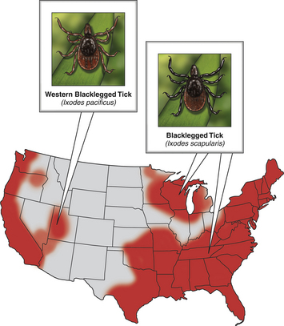
Anaplasma phagocytophilum
Granulocytic anaplasmosis
Geographic distribution determined by….
  Tick vectors
Seroprevalance in some regions exceeds 50%
  Cross-reactivity
No breed predispositions
Co-infection with Borrelia burgdorferi
  Why?
Notes:
In North America, the tick vectors of A. phagocytophilum are Ixodes scapularis in the northeastern and upper midwestern states, and Ixodes pacificus in the West. In Europe, the primary vector is Ixodes Ricinus
A study that used a commercially available ELISA assay to determine the prevalence of seroreactivity to A. phagocytophilum in more than 400,000 dogs from the United States revealed wide variation in seroprevalences. Some counties in the upper Midwest and northeastern United States had seroprevalences that exceeded 40%, although the overall seroprevalence in these regions were 6.7% and 5.5%, respectively. Serologic cross-reactivity with A. platys may also influence these data. The seasonal pattern of disease reflects times of peak nymphal and adult tick activities, as well as periods when humans and their dogs are active outdoors. In the western United States, A. phagocytophilum infection occurs most frequently in dogs between April and July, when nymphal ticks are abundant. Some infections occur in October, during early questing of adult ticks. In Minnesota and Wisconsin, most cases are diagnosed in late spring (May, June) and fall (October, November).

Slide 19
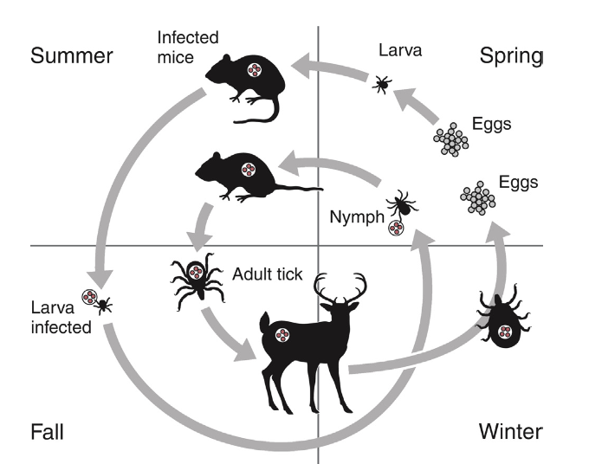
Pathogenesis
Transmission
  Within tick
  To animal
Once in animal
  Incubation period
  Enters neutrophil
  May also infect other cell types
Notes:
A. phagocytophilum is transmitted transstadially within the tick (i.e., from larva to nymph to adult), and not transovarially (from adult to egg). Dogs and cats thus become infected after exposure to infected nymphs or adult ticks, which acquire infection when they feed on wild animal reservoir hosts as larvae or nymphs. Ticks must attach for 36 to 48 hours for transmission to occur. show no clinical signs. Some dogs and cats develop a self-limiting febrile illness, which in dogs occurs after an incubation period of 1 to 2 weeks. Lethargy occurs in almost all clinically affected cats and dogs.
Infection with A. phagocytophilum results in mild to moderate thrombocytopenia, although other cytopenias may also occur. The mechanism(s) of these hematologic abnormalities remain unclear. Anti-platelet antibodies occur in serum from humans and dogs with granulocytic anaplasmosis, and so immune-mediated mechanisms may contribute to thrombocytopenia. However, thrombocytopenia occurs in acute disease, before antibodies are noted, so other mechanisms may be important. The bone marrow of infected dogs shows megakaryocyte hyperplasia, so platelet destruction may be involved
A. phagocytophilum may also infect other cell types, such as bone marrow cells, endothelial cells, and megakaryocytes, although the importance of these cells in the pathogenesis of infection is not clear.

Slide 20
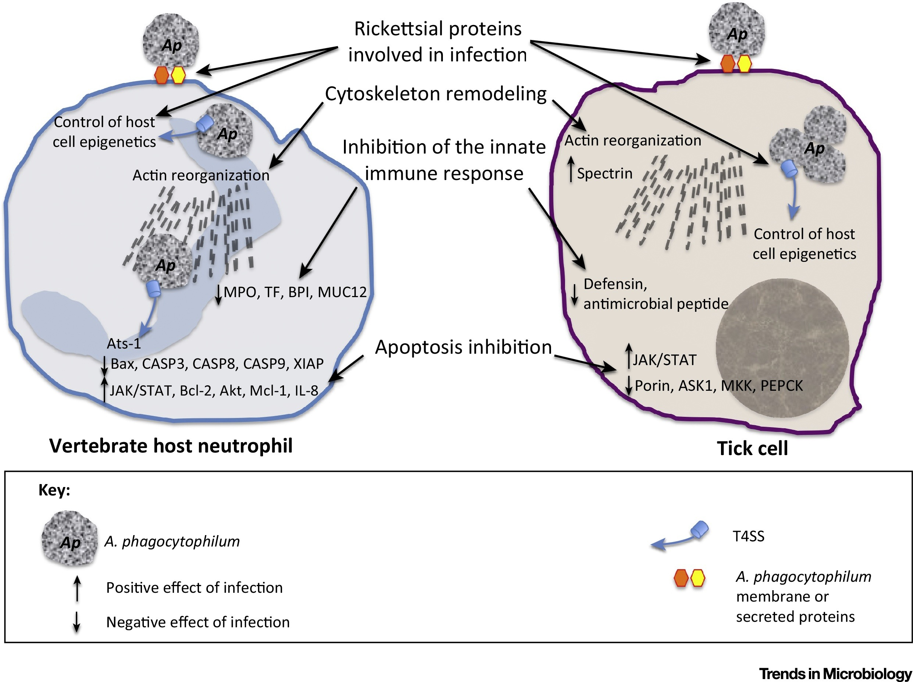
A. phagocytophilum and the neutrophil
Attachment to neutrophil
Caveolae-mediated endocytosis
Survival in neutrophil
  Dysregulation and bypassing phagolysosomal pathways
Reduction of neutrophil adherence
Normal neutrophil lifespan in circulation _____
Notes:
Once A. phagocytophilum enters the bloodstream, it attaches to the sialylated ligands on the surface of neutrophils, such as P-selectin glycoprotein ligand-1. The organism then enters the neutrophil through caveolae-mediated endocytosis. A. phagocytophilum survives in the harsh neutrophil environment through dysregulation of neutrophil function and by bypassing phagolysosomal pathways. It inhibits neutrophil superoxide production and can reduce neutrophil motility and phagocytosis. A. phagocytophilum also reduces neutrophil adherence to endothelium and inhibits neutrophil transmigration into tissues, possibly through downregulation of selectin molecule expression. This may promote its survival in peripheral blood. Normally, neutrophils circulate for 10 to 12 hours before they enter tissues and undergo death through apoptosis. A. phagocytophilum delays neutrophil apoptosis, which allows it to survive longer periods of time within the neutrophil
Impaired neutrophil function as a result of A. phagocytophilum infection may predispose to development of secondary opportunistic infections or influence the outcome of co-infections with other tick-borne pathogens such as B. burgdorferi. Although uncommon, opportunistic infections have been occasionally documented in humans and dogs with granulocytic anaplasmosis and are well in small ruminants

Slide 21
Back to Livi
Which of Livi’s clinical signs are consistent with anaplasmosis?
What are other common clinical signs?
Less common clinical signs?
Notes:
The most common findings on physical examination in dogs include lethargy, fever (up to 106.7°F [41.5°C]), dehydration, tachypnea, mild peripheral lymphadenopathy, and splenomegaly. Scleral injection may be noted. Lameness, reluctance to move, swollen joints, and pain on joint manipulation may also be detected in some dogs. Increased lung sounds, abdominal pain, epistaxis, petechial hemorrhages, and neurologic signs
such as circling, cervical pain, and decreased placing reactions occur uncommonly. Physical examination findings reported in cats have been similar to those described in dogs, and include fever, lethargy, tachypnea, increased lung sounds, mild abdominal pain, hepatomegaly, splenomegaly, vomiting, ataxia, hyperesthesia, muscle and joint pain, lameness, conjunctivitis, and ocular discharge. Neurologic signs and detection of the organism in the CSF have been uncommonly reported in humans

Slide 22
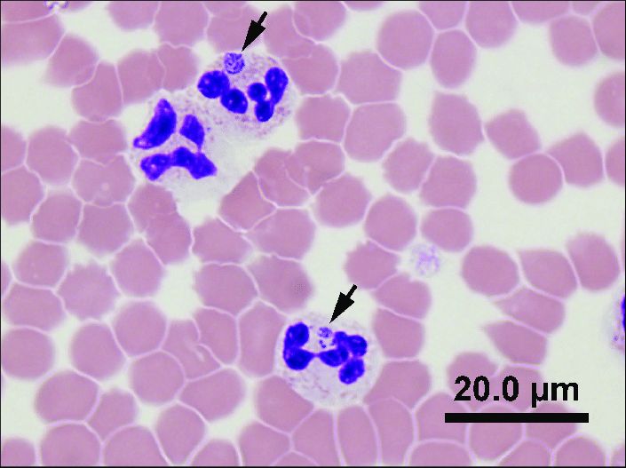
Diagnostics
CBC
  Thrombocytopenia
  Morulae
Biochemistry
Urinalysis
Imaging
Notes:
Thrombocytopenia occurs in approximately 90% of dogs with granulocytic anaplasmosis. The platelet count in thrombocytopenic dogs may occasionally be as low as 5000 platelets/µL, although more often it is mild to moderately decreased. The majority of affected dogs are lymphopenic, but lymphocytosis can occur. Circulating reactive lymphocytes may be present. Anemia is common and typically mild and nonregenerative. Both neutrophilia and neutropenia occur, but most dogs have neutrophil counts that lie in the lower half of the reference range. Low numbers of band neutrophils, as well as mild neutrophil toxicity, are often present. Monocytopenia or monocytosis can occur. Cytologic examination of blood smears often reveals morulae within granulocytes. Morulae were detected in neutrophils from 36%, 56%, 67%, and 100% of dogs in four respective case series. Morulae appear as early as 4 days after experimental inoculation of dogs and persist for 4 to 8 days. The morulae are indistinguishable from those of Ehrlichia ewingii, so serology or PCR assays are needed to confirm A. phagocytophilum infection. In contrast to dogs, thrombocytopenia appears uncommon in cats infected with A. phagocytophilum. None of 15 sick, PCR- positive cats from the northeastern United States were thrombocytopenic. The most common hematologic abnormality in cats has been lymphopenia. Morulae have been detected in some cats with granulocytic anaplasmosis.
The most frequent serum biochemistry finding in dogs with granulocytic anaplasmosis is mild to moderate hypoalbuminemia. Mild hyperglobulinemia, mild electrolyte abnormalities (hypokalemia, hyponatremia, and metabolic acidosis), and a mild increase in the activities of serum ALP and to a lesser extent ALT may occur
Urinalysis in dogs with granulocytic anaplasmosis may reveal isosthenuria, hyposthenuria, and proteinuria. Urine protein-to-creatinine ratios in two affected dogs from the United States were 1.5 and 2.2, but there is no evidence that A. phagocytophilum infection causes severe glomerulonephritis in dogs
Thoracic radiographs are usually normal in dogs with granulocytic anaplasmosis but may show a mild interstitial infiltrate. Focal alveolar infiltrates occur as well. Sonographic Findings Abdominal ultrasound may reveal splenomegaly, with a hypoechoic spleen, or mild abdominal lymphadenopathy

Slide 23
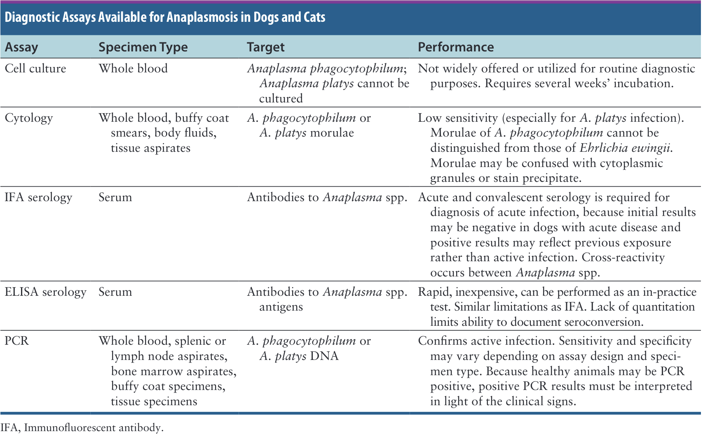
Microbiologic Tests
Notes:
Diagnosis of granulocytic anaplasmosis can be accomplished with acute and convalescent serology. Many veterinary laboratories perform serologic testing using immunofluorescent antibody (IFA) techniques. IgG antibodies are first detectable approximately 8 days after exposure, 2 to 5 days after morulae appear. As a result, early in the course of illness, antibodies may be undetectable, so PCR assays may be more useful for diagnosis of acute infection in the absence of detectable morulae. Because positive titers can reflect previous exposure, demonstration of a fourfold rise in titer is required. Antibody titers may persist for many months.
In the United States, a silicon disc-based ELISA assay is available commercially for detection of antibodies to A. phagocytophilum (Accuplex 4, Antech Diagnostics, Irvine, CA). The performance of this assay when compared with IFA requires further study. An in-clinic lateral-flow ELISA device (IDEXX SNAP 4Dx Plus), which uses a recombinant Msp2/p44 protein, is also available for the detection of antibodies to Anaplasma species in dog serum. Positive results obtained with these ELISA assays do not imply that A. phagocytophilum is the cause of illness, and as with IFA testing, negative results can occur in dogs with acute illness due to the lag in antibody production relative to the onset of clinical signs
Assays that detect the msp2 gene are usually specific for A. phagocytophilum, whereas assays that detect the 16S rRNA gene may detect other Anaplasma species, and even other bacteria. A. phagocytophilum DNA has occasionally been amplified from healthy dogs, so results must be interpreted in light of the clinical signs

Slide 24
Treatment and Prognosis
Antibiotic prescription
  Duration?
Expected timeline of improvement
Prognosis
Notes:
The treatment of choice for granulocytic anaplasmosis in dogs is doxycycline (5 mg/kg PO q12h). The optimum duration is unknown, but 2 weeks may be sufficient. The prognosis is excellent. Most dogs show clinical improvement within 24 to 48 hours of treatment, although some dogs require more than 1 week of treatment before clinical signs resolve. Platelet counts normalize 2 to 14 days after treatment is initiated. In
one study, 30% of 23 owners reported that their dog returned to normal activities in 1 to 2 days after treatment was initiated, 30% reported this took 3 to 5 days, 21% 1 to 3 weeks, and 17% reported that it took a month or longer for their dogs to return to normal activity. Death due to granulocytic anaplasmosis has not been described in dogs. Intravenous crystalloid fluids and antiemetics may be required for supportive care until
clinical signs improve

Slide 25
Immune Response
Not fully characterized
Both humoral and cell-mediated
Re-infection has not been reported in dogs
Notes:
The immune response to A. phagocytophilum infection is not fully characterized. Both humoral and cell-mediated immune responses appear to be important in clearance of infection. Host cytokines such as IFN-γ may play a role in the initial control of A. phagocytophilum infection but may also contribute to the inflammatory process associated with disease. In lambs, A. phagocytophilum evades the host immune response through differential expression of MSP2, an outer surface protein involved in immune recognition. Variation in MSP2 also occurs in chronically infected woodrats. Further research is required to document whether persistence occurs through similar mechanisms in other host species. It is possible that recovery from natural infection confers long-term protection against development of disease. Reinfection has not been reported in dogs, but was described in one human patient. A vaccine for granulocytic anaplasmosis is not available for companion animals

Slide 26
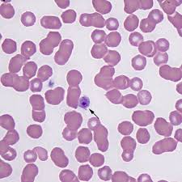
Anaplasma platys
Epidemiology
  Vector
Pathogenesis
  Timeline
Diagnosis
  CBC
  Direct fluorescent antibody
  Serology
Treatment
Notes:
Anaplasma platys infects and forms inclusions within platelets and is the cause of canine cyclic thrombocytopenia, or thrombocytotropic anaplasmosis. It does not appear to infect cats. The organism is very widespread. R. sanguineus ticks are believed to transmit A. platys, because the DNA of A. platys has frequently been found in R. sanguineus ticks worldwide, and dogs infected with A. platys are often co-infected with E. canis. However, in a single attempt, experimental transmission of A. platys by R. sanguineus ticks failed. Different strains of A. platys exist that appear to vary in pathogenicity. The organism has never been isolated in cell culture Anaplasma platys causes thrombocytopenia in dogs, most often in the absence of other clinical signs, although fever, lethargy, lymphadenopathy, uveitis, pallor, and mucosal hemorrhages have been described. Co-infections with other vector-borne pathogens may contribute to clinical signs in some dogs.
Thrombocytopenia occurs 1 to 2 weeks after experimental inoculation. This initial episode is associated with the highest number of organisms in platelets, as detected using light microscopic examination of stained blood smears. The platelet count nadir occurs 2 to 3 weeks postinfection and in some dogs may be lower than 20,000 platelets/µL. Visible organisms then disappear from platelets, and the platelet count returns to normal or near-normal limits within 3 to 4 days. This also corresponds with a decrease in organism load and failure to detect the organism in peripheral blood with real-time PCR, although bone marrow and splenic aspirates may remain positive. Cycles of thrombocytopenia and bacteremia then occur at intervals of 7 to 14 days, after which infection and thrombocytopenia persist in some dogs but morulae or inclusions become more difficult to detect within platelets. The mechanism of thrombocytopenia is unknown, but direct damage to platelets, sequestration of platelets in the spleen, and immune-mediated destruction have been hypothesized to play a role. Co-infection of dogs with A. platys and E. canis may lead to more severe anemia than occurs with isolated E. canis infection. The duration of A. platys infection may also be prolonged.
Usually, the only abnormality present on the CBC, biochemistry panel, and urinalysis in dogs with A. platys infection is thrombocytopenia. A mild, nonregenerative anemia may be found. The diagnosis can be made when morulae are seen within platelets on blood smears, but this is insensitive, and other inclusions or stain precipitate may be mistaken for organisms.
A positive result on commercially available ELISA assays also only indicates previous exposure to an Anaplasma species. Dogs with recent infection may be seronegative, because antibodies to A. platys are not detectable for 1 to 2 weeks after inoculation.
Infection could not be detected with PCR for a 3-week follow-up period after just 8 days of doxycycline treatment (10 mg/kg PO q24h), which was initiated in the acute phase of infection. However, one dog remained infected after 2 weeks of treatment with tetracycline. In another study, doxycycline treatment was administered for 28 days, and infection could not be detected after this time point, even after pharmacologic immunosuppression with dexamethasone several months later.49 Whether the duration of infection at the time of treatment affects treatment efficacy is unknown

