Slide 1

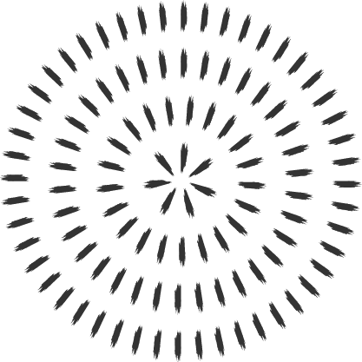
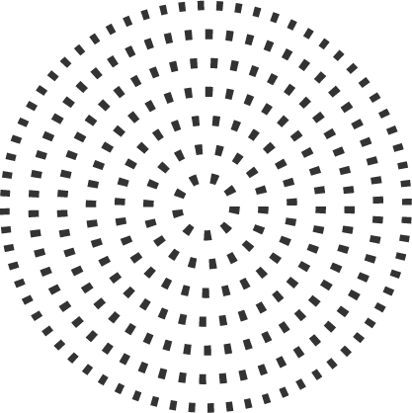
Cardiovascular physiology
Cece Zhu
Board Review Aug 22, 2023

Slide 2
Vasculature
Arteries
  Thick walled, elastic, smooth muscle, connective tissue
Arterioles
  Smooth muscle in walls is tonically active (always contracted)
  A1 receptors: cause constriction
  B2 receptors: cause dilation
Capillaries
  Lined with a single layer of endothelial cells
  Lipid soluble substances (O2, CO2) cross by dissolving and diffusion
  Water soluble substances (ions) cross through water-filled clefts between cells or through large pores
  Selective perfusion by arteriole dilation/constriction and precapillary sphincters (smooth muscle bands)
Venules and veins
  Contains less elastic tissue than arteries
  Have larger capacitance
Notes:
What is the site of the highest resistance to blood flow?
Arterioles

Slide 3
Blood flow
Velocity of blood flow (V=Q/A)
  V (distance per unit time): velocity of blood flow (cm/s)
  Q (volume per unit time): flow (mL/s)
  A: cross sectional area (cm^2) = πr²
  Larger vessel diameter, velocity of flow decreases (velocity highest in aorta, lowest in capillaries)
Ohm’s Law for blood flow (Q = ∆P/R)
  Q: flow (ml/min)
  ∆P: pressure difference (mmHg)
  R: resistance (mmHg/ml per min)
  Blood flow through a vessel is determined by pressure and resistance
Poiseuille equation to determine resistance of vessel to blood flow (R = 8ηl / πr4)
  R: resistance
  η: viscosity of blood
  l: length of blood vessel
  r^4: radius of blood vessel to the fourth power
Notes:
Low flow in capillaries maximizes time for exchange across capillary walls

Slide 4

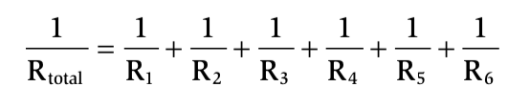
Blood flow
Series resistance
  Arrangement of blood vessels within a given organ
  Total flow at each level of the system is the same (eg arteries = arterioles = capillaries)
  Flow is constant at each level, but pressure decreases progressively as resistance decreases (∆P = Q x R)
Parallel resistance
  Distribution of blood flow among various major arteries off the aorta
  The total resistance in a parallel arrangement is less than any of the individual resistances
  No loss of pressure in the major arteries
  If resistance to one of the individual vessels increases, then total resistance increases
Laminar flow
  Highest velocity of blood flow at vessel center
  Layer of blood next to vessel wall adheres to wall and essentially doesn’t move
Turbulent flow
  Streams mix radially and axially, flow is audible
  More energy (pressure) is required to drive turbulent blood
Notes:
Series: total resistance is equal to the sum of the individual resistances
-largest drop in pressure is at the arterioles b/c they contribute the largest resistance
Parallel
-adding a resistance to the circuit causes total resistance to decrease, not increase

Slide 5
Question
What is Reynold’s number useful for?
What factors are involved in the Reynold’s number?
Notes:
-what is Reynold’s number used for? To predict whether blood flow will be laminar or turbulent (higher number, more turbulent)
-what factors are involved in the Reynold’s number?
-density of blood, diameter of blood vessel, velocity of blood flow, viscosity of blood

Slide 6
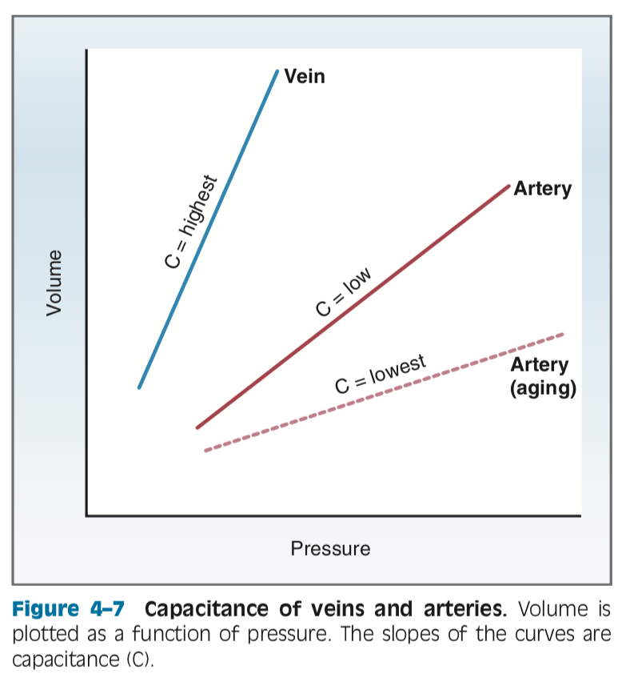
Blood flow
Reynold’s number (N_{R} =ρdv / η)
  ρ: density of blood
  d: diameter of blood vessel
  v: velocity of blood flow
  η: viscosity of blood
  N_{R} < 2000, flow will be laminar
  N_{R} > 3000, flow is turbulent
  Anemia will affect viscosity and velocity (inc #)
  Thrombi will narrow diameter of vessel-> inc in velocity (inc #)
Shear
  Consequence of the fact that blood travels at diff velocities within a blood vessel
  Highest at vessel wall
  Consequence: breaks up RBC aggregates and dec blood viscosity
Compliance (C = V/P)
  V: volume (mL)
  P: pressure (mmHg)
  Describes the volume of blood a vessel can hold at a given pressure
Notes:
-decreasing vessel size will also affect velocity of blood flow (v = Q/pi r²) , so velocity increases as radius decreases to second power (hence, velocity is more powerful impact on Reynold’s number than diameter)
-slope is compliance

Slide 7
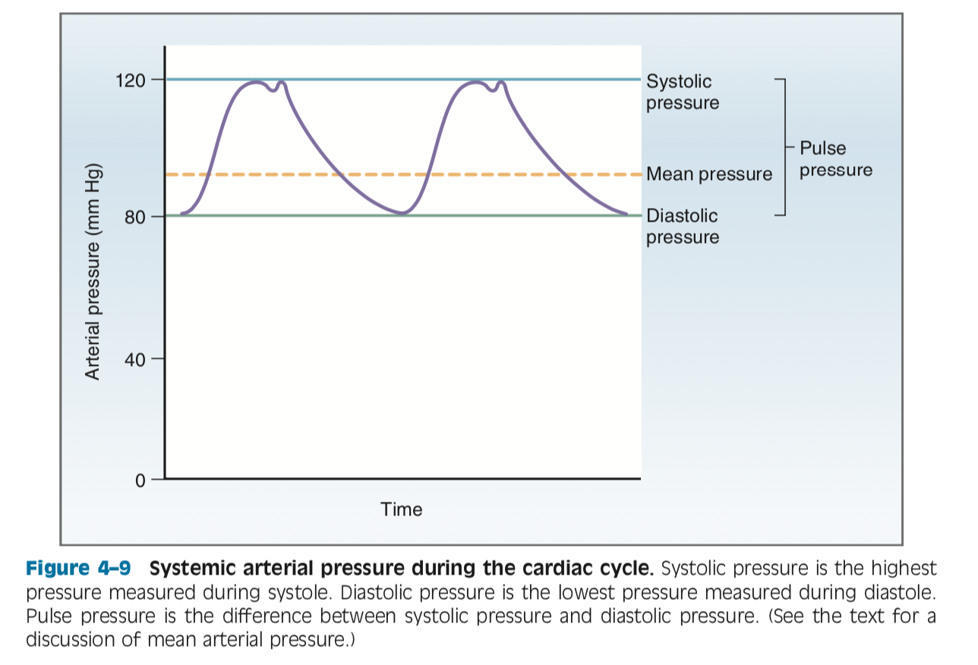
Blood pressure
Diastolic pressure
  Lowest arterial pressure measured during cardiac cycle; pressure in arteries during ventricular relaxation
Systolic pressure
  Highest arterial pressure measured during cardiac cycle; pressure in arteries after blood is ejected from LV during systole
  Dicrotic notch (incisura)
Pulse pressure
  Difference between systolic and diastolic pressure (reflects stroke volume)
Mean arterial pressure
  The average pressure in a complete cardiac cycle
  MAP = diastolic pressure + 1/3 pulse pressure
Notes:
Question: dicrotic notch: produced when aortic valve closes (aortic valve closure produces a brief period of retrograde flow back towards valve)

Slide 8
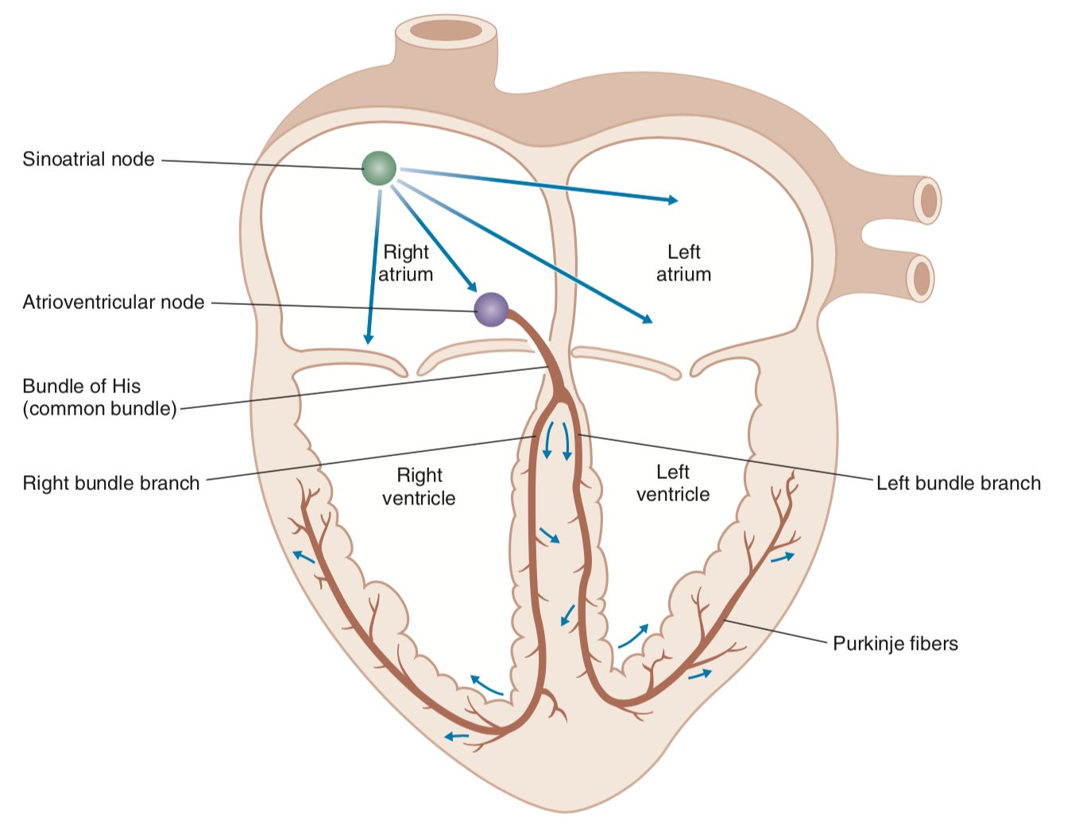
Electrophysiology
Heart contains 2 kinds of muscle cells
  Contractile cells: majority of atrial and ventricular tissues
  Conducting cells: tissues of SA node, atrial internodal tracts, AV node, bundle of His, Purkinje fibers
    Generates APs spontaneously
Notes:
SA node initiates AP (pacemaker)
AP spreads from SA node to L and R atria via internodal tracts, simultaneously to AV node
AV node conduction velocity is considerably slower than in other cardiac tissues (slow conduction ensures ventricles have sufficient time to fill before they are activated and contract)
AP enters conducting system (common bundle-> L and R bundle branches), very fast conduction

Slide 9
Concepts: Cardiac APs
RMP is determined by the relative conductances (or permeabilities) to ions and the concentration gradients for the permeant ions
RMP of cardiac cells is determined primarily by ___ ions (high conductance at rest, and RMP is close to ___ equilibrium potential)
Conventionally, intracellular potential is expressed relative to extracell (-85mV = cell interior negative)
2 ways to produce a change in membrane potential
  Change in the electrochemical gradient for a permeant ion (decreasing extracell K will make RMP more negative)
  Change in conductance to an ion (resting permeability to Na is low, but during upstroke, Na conductance drastically increases, Na flows into cell, membrane potential briefly driven toward Na equilibrium potential)
Notes:
-RMP determined primarily by potassium ions

Slide 10
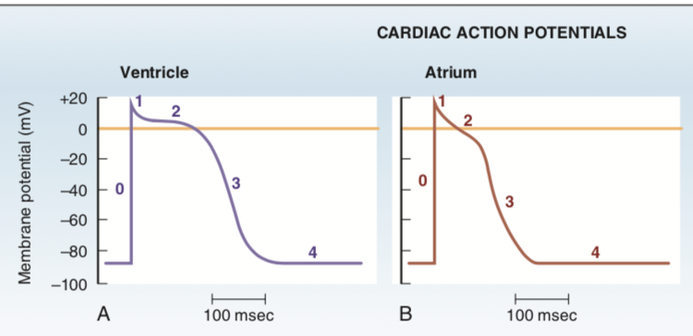
Concepts: Cardiac APs
Depolarization (less negative): net movement of positive charge into the cell (inward current)
Hyperpolarization (more negative): net movement of positive charge out of cell (outward current)
Threshold potential: potential difference at which there is a net inward current
  At threshold, depolarization becomes self-sustained and gives rise to the upstroke of the AP
APs of ventricles, atria, Purkinje system
  Long duration (ex: 150 ms in atria, 1-2 ms in nerve and skeletal muscle)
  Longer AP=longer the cell is refractory to firing another AP
  Stable RMP
  Plateau period of sustained depolarization accounts for long duration of AP

Slide 11
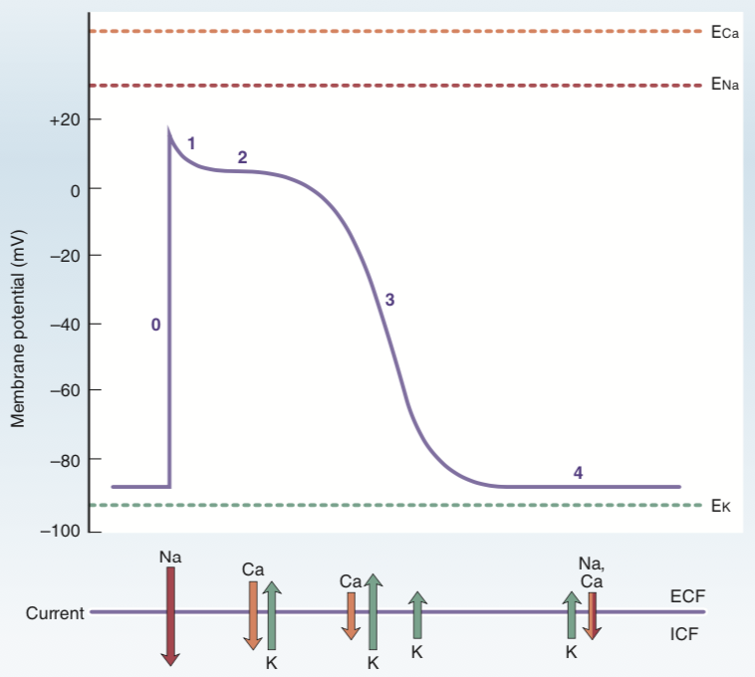
Phases of the AP (atria, ventricles, purkinje)
Phase 0 (upstroke): rapid depolarization
  Caused by transient increase in Na conductance by voltage-induced opening of Na channels
  Inward Na current, drives membrane potential toward Na equilibrium potential (but doesn’t reach it b/c inactivation gates on Na channels close in response to depolarization)
  Na channels open briefly then close
  Membrane potential reaches + 20 mV
  Rate of rise of upstroke is called dV/dT (rate of change of the membrane potential as a function of time) (V/s)
  dV/dT has a “responsiveness relationship” (dV/dT is greatest/rise of upstroke is fastest when RMP is most negative)
  This correlation is based on the relationship b/w membrane potential and position of inactivation gates on Na channel (when RMP is hyperpolarized, inactivation gates are open and many Na channels available for upstroke)
Phase 1 (initial repolarization):
  Brief period of repolarization after upstroke
  Net outward current
  Na inactivation gates close, inward Na current stops
  Concurrently, there’s an outward K current (chemical and electrical forces force K out of cell)
Notes:
Phase 1 K: intracell K concentration is higher, cell interior is electrically positive

Slide 12
Phases of the AP (atria, ventricles, purkinje)
Phase 2 (plateau):
  Long period of relatively stable depolarized membrane potential (atrial plateau is shorter)
  Inward and outward currents are equal, no net current flow across membrane
  Inward calcium current: Increase in calcium conductance (L type calcium channels, inhibited by calcium channel blockers such as diltiazem, verapamil)
    This inward Ca current also initiates the release of more calcium from intracellular stores for excitation-contraction coupling (calcium-induced calcium release)
  Outward K current: electrochemical driving force
Phase 3 (repolarization):
  Begins at end of phase 2, then rapidly back to RMP during phase 3
  Outward currents greater than inward currents
  Decrease in calcium conductance from plateau (decrease inward Ca)
  Increase in K conductance (increase outward K)
    At the end of phase 3, outward K current is reduced b/c repolarization
    brings membrane potential closer to K equilibrium potential (decreasing driving force)

Slide 13
Phases of the AP (atria, ventricles, purkinje)
Phase 4 (RMP/electrical diastole)
  Returns to stable resting level of -85mV
  Outward K current: K channels in phase 4 are not the same ones in phase 3
  Inward Na and Ca current

Slide 14
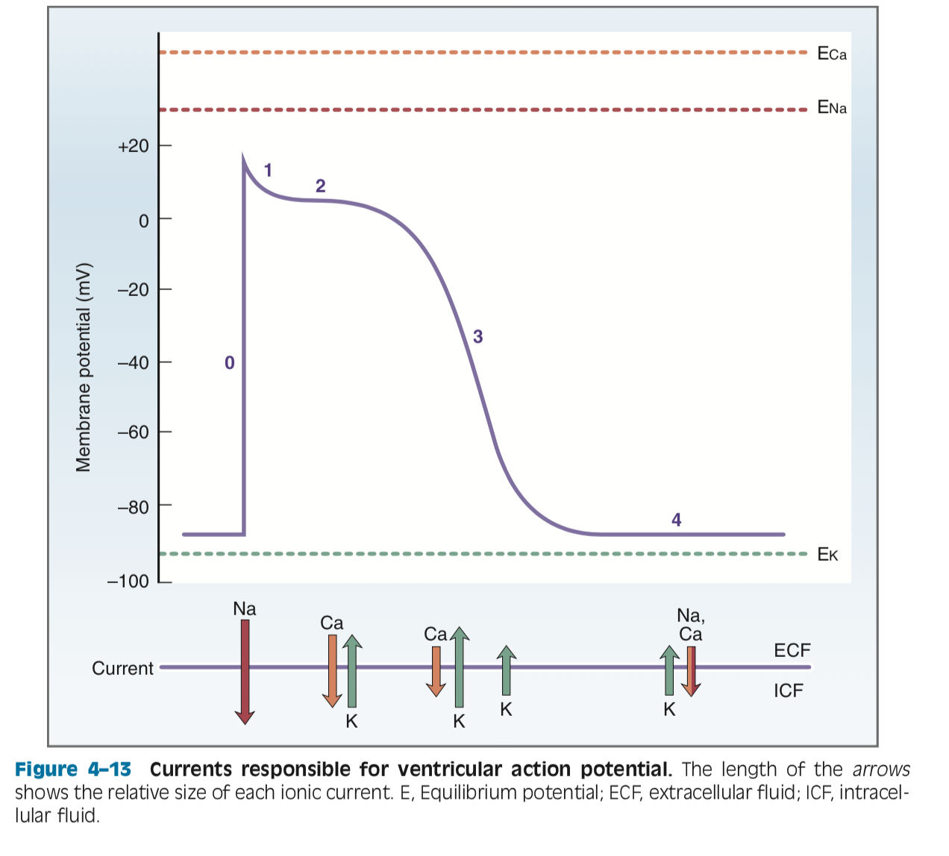
Notes:
Phase 1 missing: potassium outward current

Slide 15
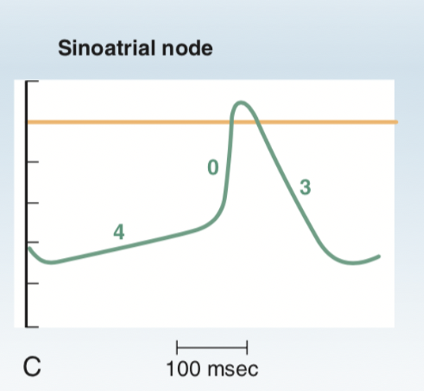
Phases of the AP (SA node)
SA node is different
  Automaticity (spontaneously generate APs without neural input)
  Unstable RMP
  No sustained plateau
Phase 0 (upstroke)
  Not as rapid or as steep
  Ionic basis differs: due to inward calcium current (L type Ca channels mainly, and T type Ca channels)
Phases 1 and 2 are absent
Phase 3 (repolarization)
  Outward K current: increase in K conductance from both chemical and electrical driving forces
Phase 4 (spontaneous depolarization or pacemaker potential)
  Longest portion
  Accounts for the automaticity of SA nodal cells
  Slow depolarization produced by opening of Na channels and inward Na current (funny current, indicating this is different from the fast Na current for upstroke in ventricular cells)
  Funny current is turned on by repolarization from preceding AP

Slide 16
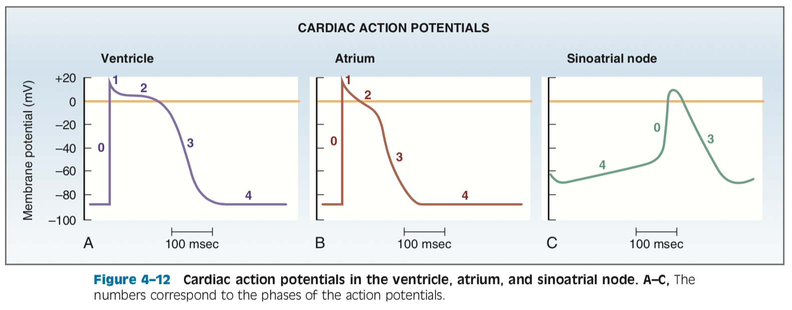

Slide 17
Electrophysiology
Latent pacemakers also have the capacity for spontaneous phase 4 depolarization
  AV node, bundle of His, Purkinje fibers
Pacemaker with fastest phase 4 depolarization controls the HR
Overdrive suppression: when SA node drives HR, latent pacemakers are suppressed
Cardiac APs are propagated by inward current of upstroke to establish local currents and cable properties of myocardial fibers
  Cable properties are determined by membrane resistance, internal resistance (low in myocardial tissue b/c of low resistance connections called gap junctions)

Slide 18
Question
In atrial, ventricular, and purkinje fibers, the inward current of the upstroke is carried by which ion?
How about in the SA node?
Notes:
Atrial, ventricular, purkinje: Na
SA node: Calcium

Slide 19
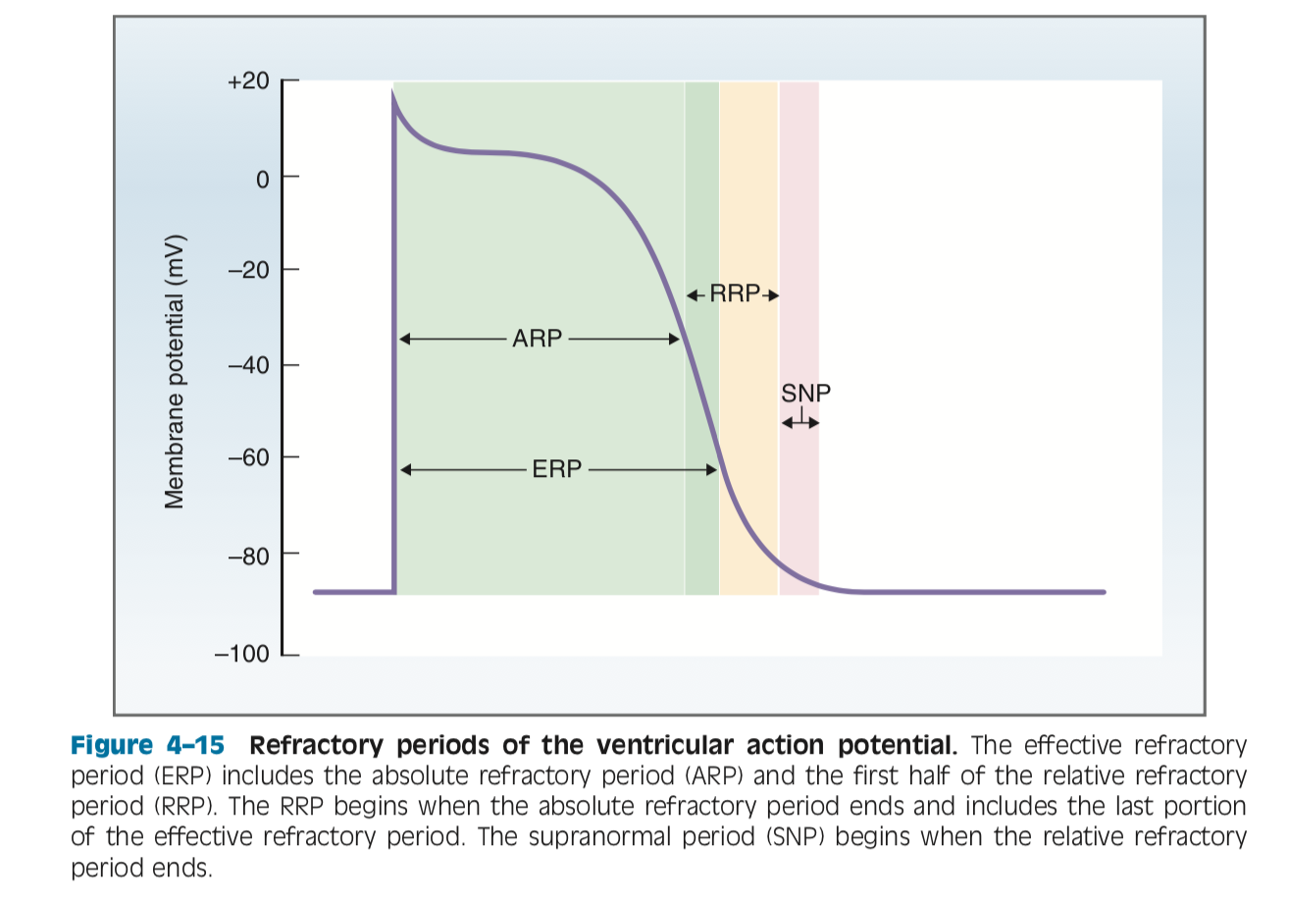
Excitability and refractory periods
Excitability: the capacity of myocardial cells to generate action potentials in response to inward depolarizing current (the amount of inward current required to bring a cell to threshold potential)
  This changes over the course of the AP (reflected in the refractory periods)
Na channels open to allow for influx (upstroke), but inactivation gates on Na channels also close with depolarization (just more slowly)
  So when memb potential is depolarized, there is a portion of Na channels that will be closed b/c inactivation gates are closed
  When Na channels are closed, inward depolarizing current cannot flow, so no upstroke, and cell is called refractory
Refractory periods:
  Absolute refractory period (ARP): completely refractory to fire another AP no matter how large the stimulus (inward current)
    B/c most of the Na channels are closed and unavailable to carry inward current
    Includes upstroke, plateau, a portion of repolarization
    Concludes when cell is approx. -50mV
  Effective refractory period (ERP):
    Includes and is slightly longer than the ARP
    At end of ERP, Na channels start to recover
    A conducted AP cannot be generated (not enough inward current to conduct to next site)

Slide 20
Refractory periods
  Relative refractory period (RRP):
    Begins at end of ARP and continues until cell has fully repolarized
    More Na channels recovered to closed but available state and is possible to generate another AP
    A greater than normal stimulus is required (second AP will have abnormal configuration and shortened plateau)
  Supranormal period (SNP):
    SNP follows RRP
    Begins when membrane potential is -70 mV and continues until -85 mV
    Cell is more excitable than normal (less inward current required to depolarize cell)
    Na channels are recovered, and membrane potential is closer to threshold than at rest, so easier to fire AP

Slide 22
Autonomic effects
Effects on HR (chronotropy):
  Positive chronotropy by SNS: inc HR
    1. released by sympathetic nerve fibers activate 2. receptors in SA node
    Receptors are coupled to adenylyl cyclase through G_{s} protein
    Activation of B1 receptors in SA node produces increase in I_{f} -> inc rate of phase 4 depolarization, as well as inc in I_{ca} -> more fxnl Ca channels and less depolarization required to reach threshold
    SA node fires more APs per unit time (inc HR)
  Negative chronotropy by PNS: dec HR
    3. released from parasympathetic nerve fibers activate 4. receptors in SA node
    Receptors are coupled to G_{i} protein called G_{k} that inhibits adenylyl cyclase and produces decrease in I_{f} (decreases phase 4 depolarization)
    G_{k} also directly increases conductance of K channel called K-Ach and increases outward K current (hyperpolarizes max diastolic potential, SA cells are further from threshold potential) (I_{K-Ach})
    Also dec in I_{ca} (fewer functional Ca channels) and so more depolarization is needed to reach threshold
Notes:
Norepi
B1
Ach
Muscarinic

Slide 23
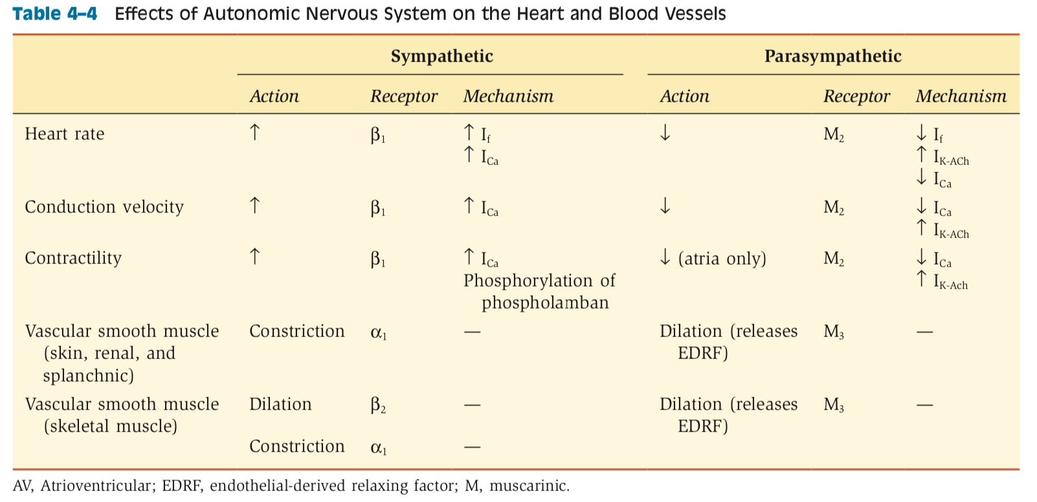
Autonomic effects

Slide 24
Autonomic effects
Effects on conduction velocity (dromotropy):
  Most important is effects on AV node (conduction from atria to ventricles)
  Correlates to size of inward upstroke current and rate of rise of upstroke (dV/dT)
  Positive dromotropy from SNS: increase I_{ca} (increases inward Ca current, upstroke of AP in AV node)
    Increased I_{ca} also shortens ERP so that AV node cells recover earlier and can fire faster rate
  Negative dromotropy from PNS: decrease I_{ca} (dec inward current) and increase I_{K-Ach} (inc outward K)
    ERP of AV nodal cells is prolonged

Slide 25
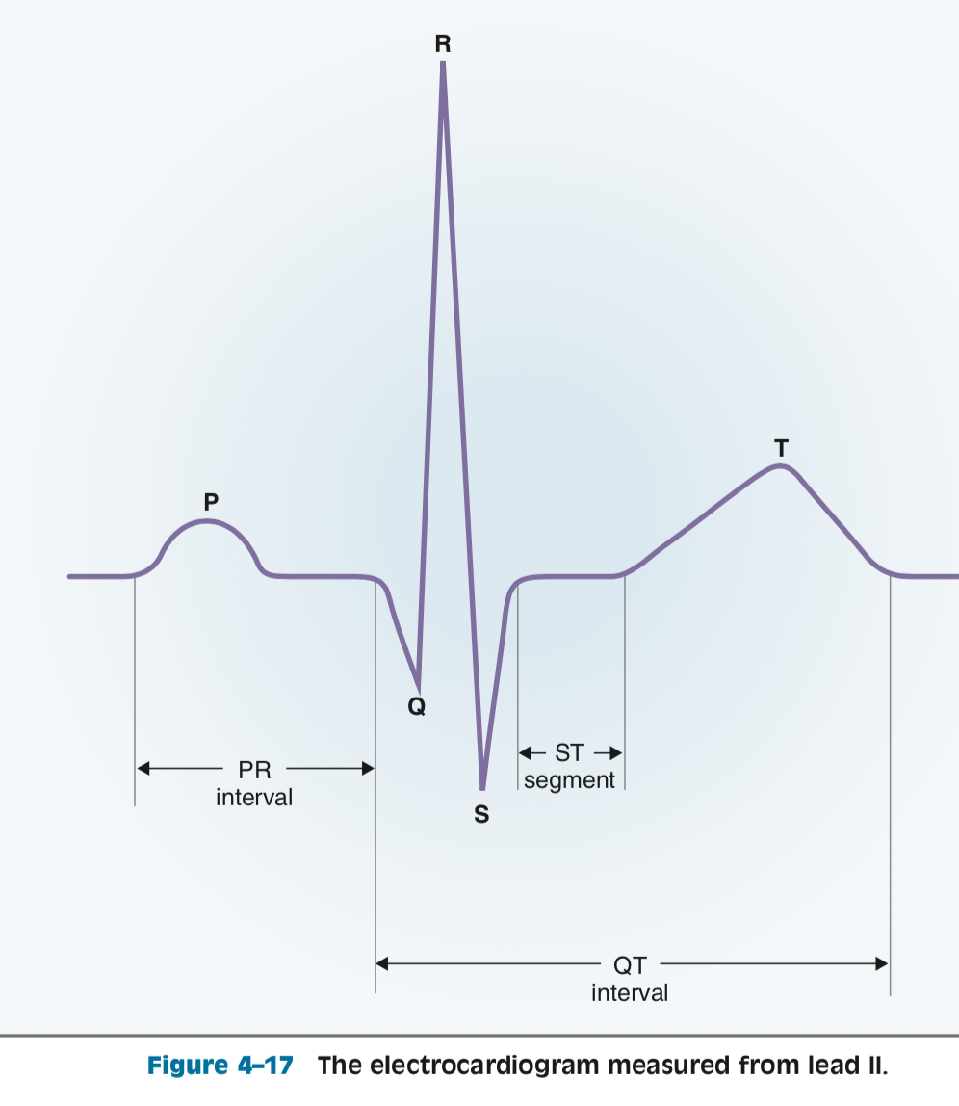
ECG
P: depolarization of atria
  Duration of P wave correlates with conduction time through atria
PR interval: time from atria depolarization to initial depolarization of ventricles
  Includes PR segment, the isoelectric portion that corresponds to AV node conduction
  Normal: 160ms
QRS complex: 3 waves, represents depolarization of ventricles
T wave: repolarization of ventricles
QT interval: includes QRS complex, ST segment, and T wave
  Represents first ventricular depolarization to last ventricular repolarization
  ST segment: correlates with plateau of ventricular AP

Slide 26
Cardiac muscle contraction
Composed of sarcomeres (made of thick and thin filaments)
  Thick filaments: composed of myosin (globular heads have actin-binding sites of ATPase activity)
  Thin filaments: composed of actin, tropomyosin, and troponin (3 subunits)
Excitation-contraction translates AP into production of tension
  Cardiac AP initiated in myocardial membrane-> depolarization spreads to interior of cell via T tubules
    Phase 2 plateau has inward Ca current, in which Ca flows through L type Ca channels (dihydropyridine receptors) from ECF to ICF
  Entry of Ca into cell raises intracell Ca-> calcium induced calcium release: triggers more Ca from stores in SR through Ca release channels (ryanodine receptors)
  Ca binds to troponin C-> tropomyosin moves out of way-> actin and myosin bind, form cross-bridges, thick and thin filaments move past each other
    Cross bridge cycling, fueled by ATP continues as long as intracell Ca is high enough to occupy Ca binding sites on troponin C
  *Magnitude of tension developed is proportional to intracellular Ca concentration
  Relaxation occurs when Ca is reaccumulated in SR by action of Ca ATPase and Ca-Na exchange

Slide 27
Cardiac muscle contraction: SNS and PNS
Contractility (inotropy) is the intrinsic ability of myocardial cells to develop force at a given muscle cell length
Contractility correlates directly with intracellular Ca concentration
  Depends on size of inward Ca current during plateau of AP (size of trigger Ca) and amount of Ca previously stored in SR
SNS on inotropy:
  B1 receptors, coupled via G protein to adenyl cyclase-> cAMP-> activates protein kinase A-> phosphorylation of proteins (phosphorylation of sarcolemmal Ca channels that inc inward Ca current and of phospholamban that regulates Ca ATPase in SR, increasing Ca storage)
PNS on inotropy: negative effect on atria
  Muscarinic receptors are coupled via inhibitory G protein to adenylyl cyclase
  Ach dec inward Ca current during plateau, Ach inc I_{k-Ach}, shortening duration of AP and indirectly decreases inward Ca current

Slide 28
Question
True or false: when HR increases, contractility increases
Notes:
True

Slide 29
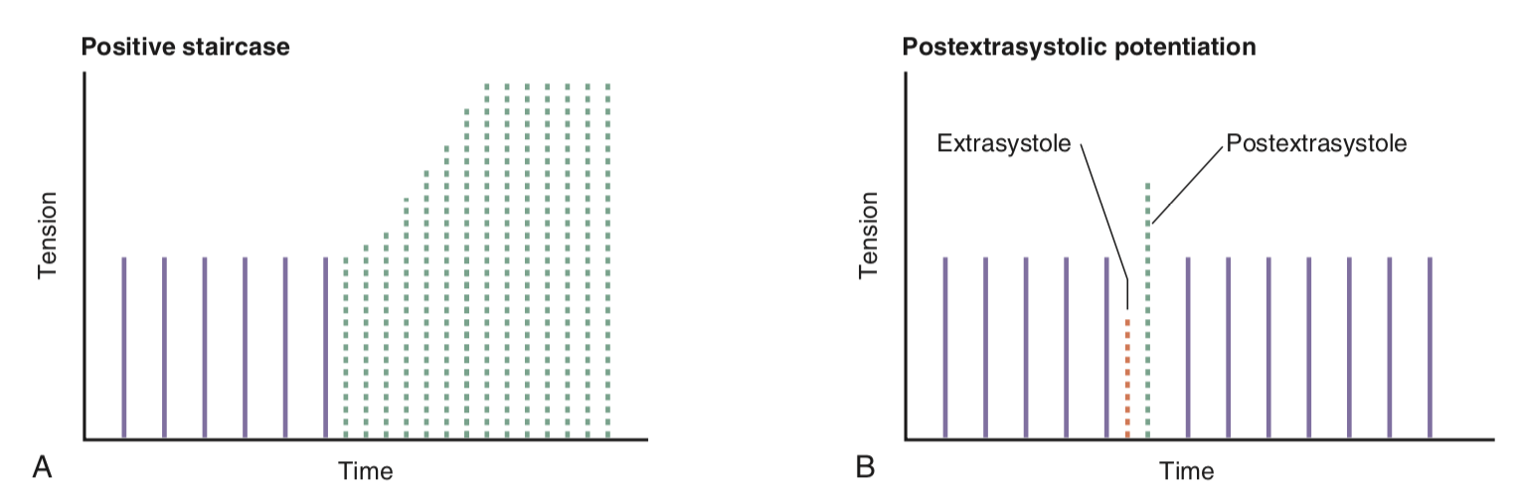
Cardiac muscle contraction: HR
HR on inotropy: inc in HR increases contractility
  When HR increases, there are more APs per unit time, and an increase in the total amount of trigger Ca enters cell
  If inc in HR is caused by sympathetic stimulation or by catecholamines, then size of inward Ca current with each AP is also increased
    Phospholamban will be phosphorylated (inc Ca uptake by SR)
  Since there’s greater Ca influx during APs, SR accumulates more Ca for subsequent release
Positive staircase/Bowditch effect: increase in tension with increasing HR is b/c there are more APs per unit time, more total calcium entering cell during plateau, and more Ca accumulation by SR
  Very first beat after inc in HR shows no increase in tension b/c extra Ca not accumulated yet
Postextrasystolic potentiation: when anomalous beat is generated by a latent pacemaker, tension developed on the next beat is greater than normal
  An unexpected amount of Ca entering cell during extrasystole and was accumulated by SR

Slide 30
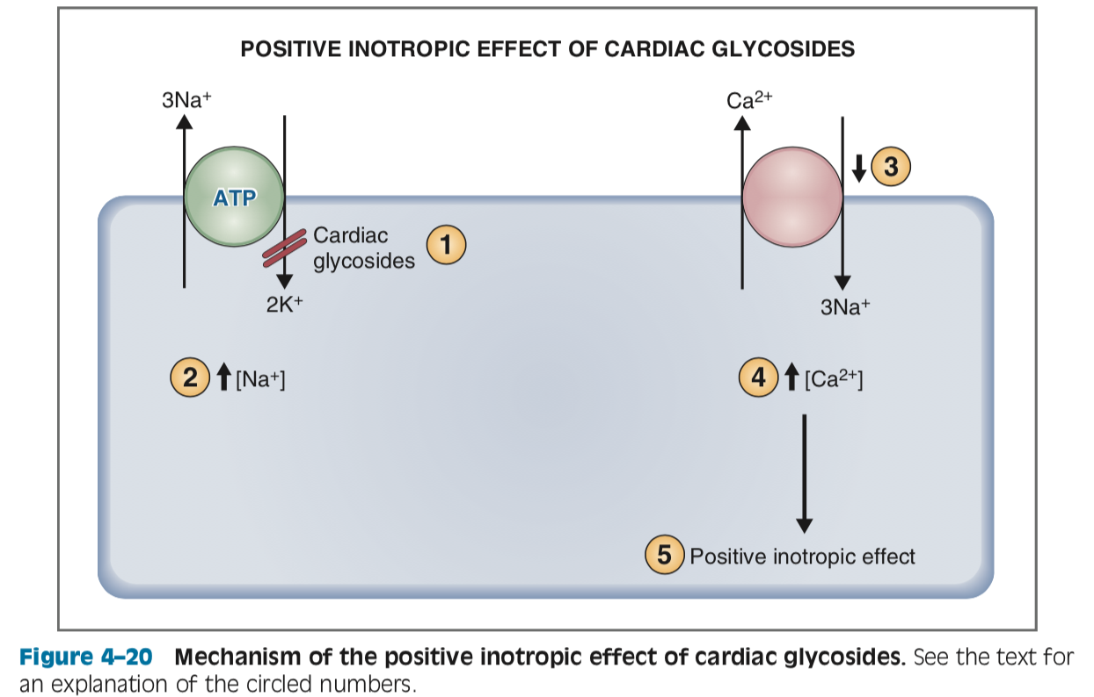
Cardiac contractility: cardiac glycosides
Digoxin, derived from foxglove plant: inhibits Na-K-ATPase at extracellular K binding site
Na-K-ATPase is located in cell membrane of cardiomyocyte
When Na-K ATPase is inhibited, less Na is pumped out of cell, increasing intracell Na which alters gradient
  This alters fxn of Ca-Na exchanger (normally pumps Ca out of cell against electrochemical gradient in exchange for Na moving into cell down gradient)
Less Ca is pumped out of cell, increasing intracellular Ca concentration-> pos inotropic effect

Slide 31
SV, EF, CO and Frank Starling
SV: amount of blood ejected by ventricle on each beat
  SV = EDV - ESV
EF: fraction of the end diastolic volume ejected in each SV (measure of ventricle efficiency)
  Normally approximately 55%
  EF = SV/ EDV
CO: total volume ejected by ventricle per unit time
  CO = SV x HR
Question: What is the Frank Starling relationship
Notes:
F-S relationship:
The volume the ventricle ejected in systole was determined by the end diastolic volume
The volume present at end of diastole in turn depends on venous return

Slide 32
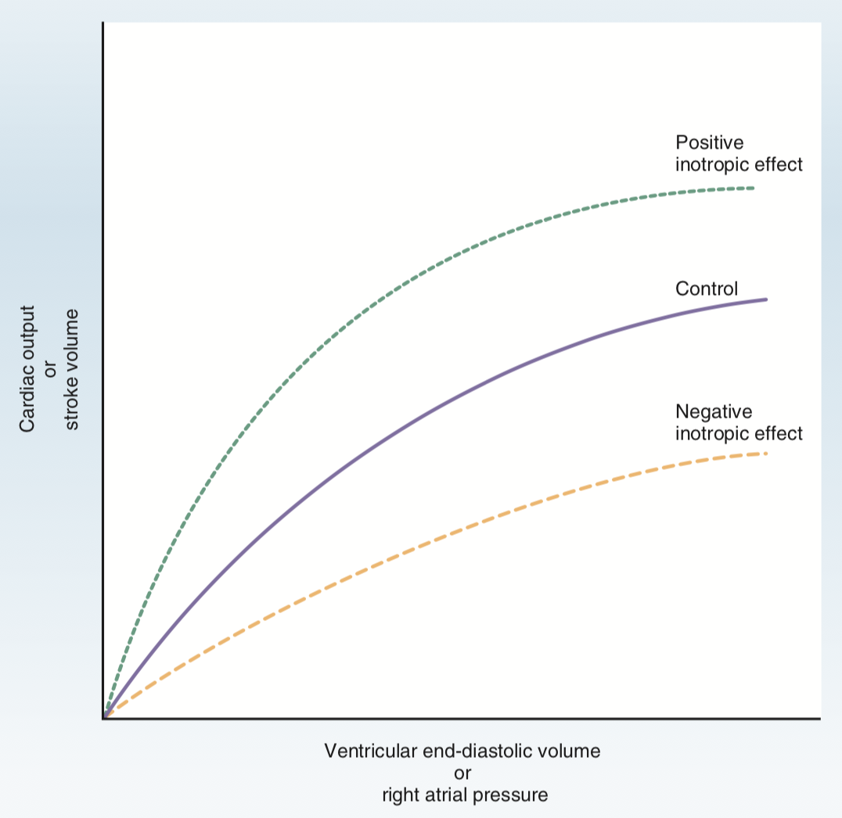
Frank-Starling
In physiologic range, relationship is nearly linear
When EDV becomes high, curve starts to bend b/c ventricle reaches a limit
Pos inotrope: inc in SV and CO for a given EDV, inc in EF
Neg inotrope: dec in SV and CO for a given EDV, dec in EF
Notes:
EDV and RA pressure can be substituted b/c both are related to venous return

Slide 33
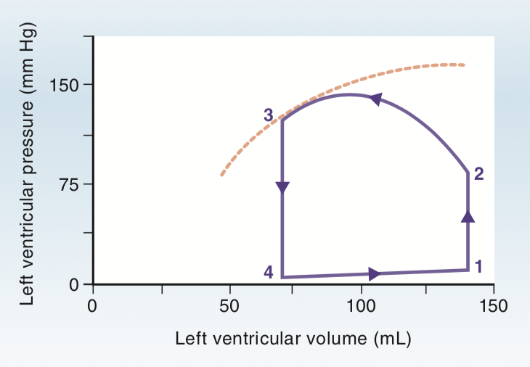
Ventricular P-V loops
Observes function of LV over entire cardiac cycle
Dashed line: shows max possible pressure that can be developed for a given ventricular volume during systole

Slide 34
Isovolumetric contraction 1-> 2
Begin cycle at point 1 (end of diastole), LV is filled
Pressure is quite low b/c ventricle is relaxed
Pressure then increases dramatically as vent contracts
Question: are any valves open at this time
Notes:
Answer: all valves are closed, no blood can be ejected (so volume is constant)

Slide 35
Ventricular ejection 2-> 3
LV pressure becomes higher than aortic pressure, causing aortic valve to open
Blood is rapidly ejected
LV pressure remains high b/c ventricle is still contracting but volume decreases dramatically
Question: what is the width of the PV loop
Notes:
Answer: Width of the PV loop is the stroke volume

Slide 36
Isovolumetric relaxation 3-> 4
Question: what does point 3 correlate to in the cardiac cycle
Ventricular pressure decreases below aortic pressure and aortic valve closes
Ventricular volume remains constant at the end b/c all valves are closed
Notes:
Answer: at point 3, contraction/systole ends and ventricle relaxes

Slide 37
Ventricular filling 4-> 1
At point 4, ventricular pressure has fallen to less than LA pressure, causing mitral valve to open
LV fills with blood passively and actively from atrial contraction
LV is relaxed, pressure increases only slightly

Slide 38
Notes:
1->2: isovolumetric contraction, systole, all valves closed
2->3: ventricular ejection, aortic valve opens
Point 3: systole ends
3-> 4: aortic valve closes, all valves closed
4-> 1: mitral valve opens, vent filling

Slide 39
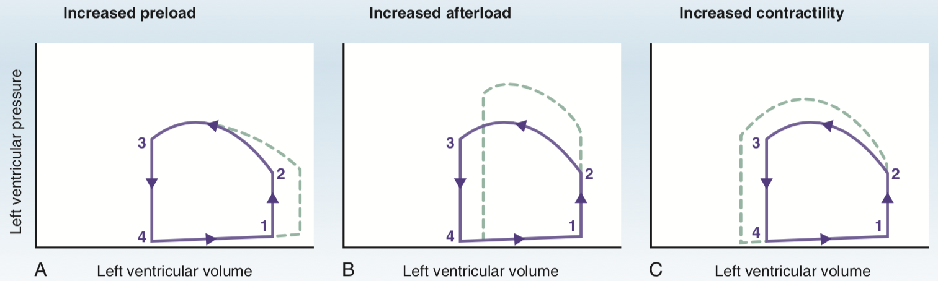
Increased contractility
Increased afterload
Increased preload
Notes:
A) Increased preload
B) Increased afterload
C) Increased contractility

Slide 40
Changes in ventricular PV loops
Increased preload:
  Increased EDV due to increased venous return
  Afterload and contractility remain constant
  SV increases
Increased afterload:
  Increased aortic pressure
  Ventricle must rise to greater than normal pressure during point 2 and 2->3 (ejection)
  Less blood is ejected during systole, so SV dec, ESV increases
Increased contractility:
  Ventricle can develop greater tension and pressure during systole and eject a larger volume than normal
  SV and EF increases
  ESV decreases b/c less blood remains in ventricle at end of systole

Slide 41
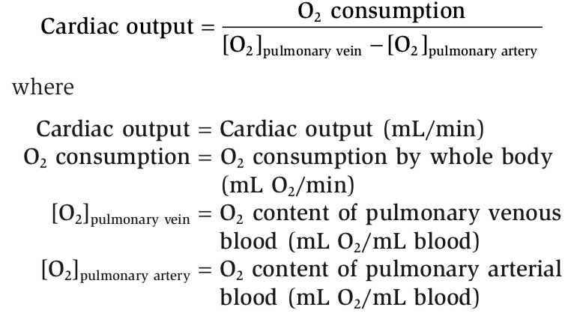
Cardiac work
Work is force x distance
Myocardial work is stroke work
For LV, work is stroke volume x aortic pressure
  AKA area within the PV loop
Minute work: cardiac output x aortic pressure (volume work and pressure work)
Increases in CO (inc in SV , HR) or inc in aortic pressure will increase energy consumption of heart
Myocardial oxygen consumption related directly with cardiac minute work
Question: pressure or volume work demand more oxygen consumption?
Fick principle: there is conservation of mass (applied to utilization of O2 by the body)
  In steady state, the rate of O2 consumption by the body must equal the amount of O2 leaving lungs in the pulmonary vein minus the amount of O2 returning to the lungs in the pulmonary artery
Notes:
Answer:
-Pressure work is far more costly than volume work (ex: aortic stenosis, systemic hypertension)
-LV also must work harder

Slide 42
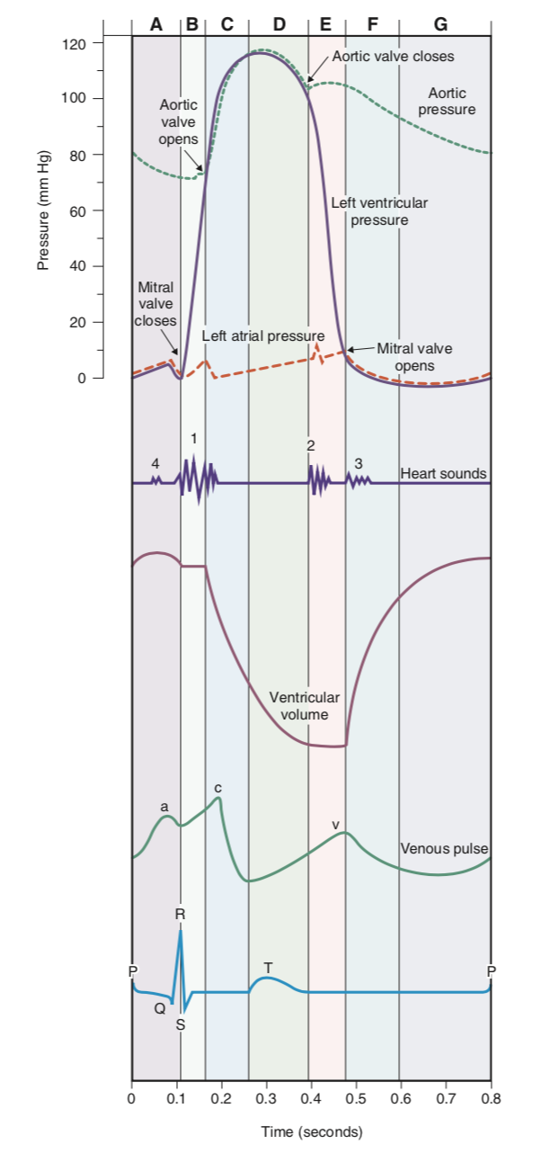
Cardiac cycle
Cycle is divided into 7 phases (labeled A through G)
ECG can be used as a time/event marker
Cycle begins with depolarization and contraction of atria

Slide 43
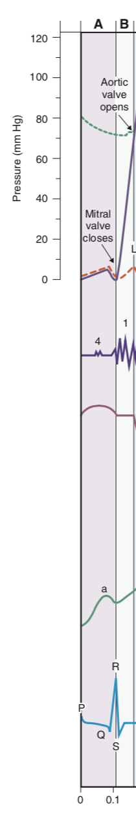
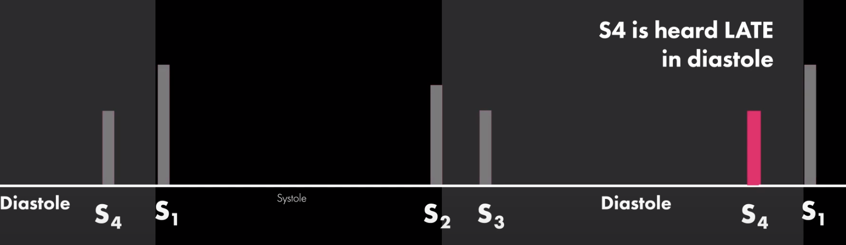
Cardiac cycle
Aortic pressure
A) Atrial systole:
  Preceded by P wave on ECG
  Atrial contraction causes inc in LA pressure
  When this atrial pressure is reflected back to veins, appears on the venous pulse as “a” wave
  LV is relaxed during this phase
  MV is open, ventricle is filling with blood (atrial systole further increases LV volume, which is the “blip” in the LV pressure tracing)
  Question: What is the S4 heart sound?
    S4 is low pitch in late diastole
LV pressure
LA pressure
Heart sounds
Vent volume
Venous pulse
Notes:
Fourth heart sound (S4) not audible normally, but may be heard in ventricular hypertrophy, where ventricular compliance is decreased
S4 coincides with atrial contraction, caused by atrium contracting against a stiffened ventricle

Slide 44
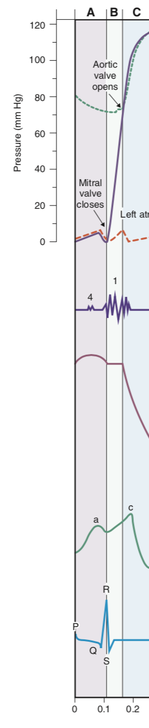
Cardiac cycle
Aortic pressure
B) Isovolumetric ventricular contraction
  Begins during QRS complex (activation of ventricles)
  LV pressure increases, exceeding LA pressure, which closes MV
  Tricuspid valve closes in R heart
  Question: what is the S1 heart sound?
  All valves are closed, so ventricular pressure increases but volume stays constant
LV pressure
LA pressure
Vent volume
Venous pulse
Notes:
Answer: S1 sound = AV valves closing

Slide 45
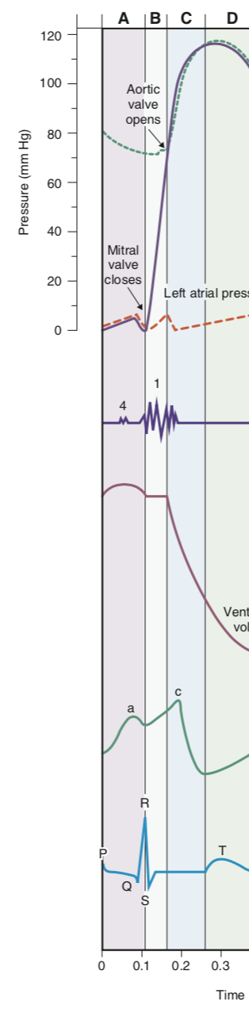
Cardiac cycle
Aortic pressure
LV pressure
C) Rapid ventricular ejection
  When ventricular pressure > aortic pressure, aortic valve opens
  Blood is rapidly ejected from LV to aorta
  Aortic pressure drastically increases
  Atrial filling begins and LA pressure slowly increases as blood is returned to L heart from pulmonary circulation
  End of this phase coincides with end of ST segment (or beginning of T wave) on ECG and end of ventricular contraction
LA pressure
Vent volume
Venous pulse

Slide 46
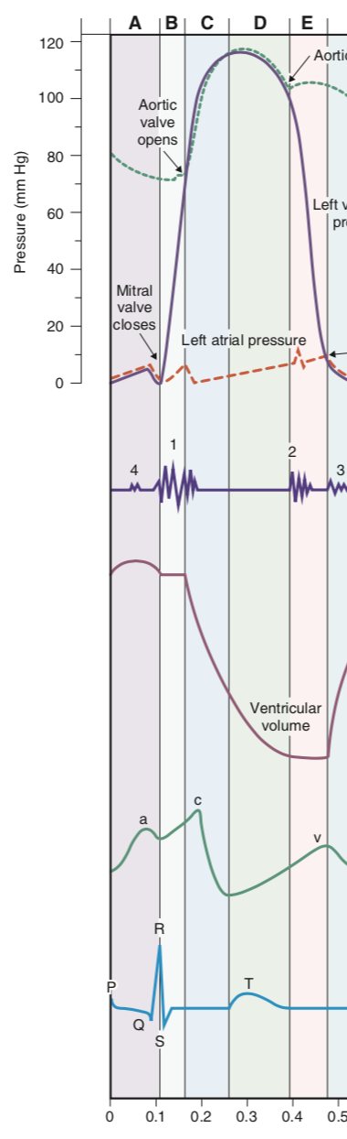
Cardiac cycle
Aortic pressure
D) Reduced ventricular ejection
  Ventricles begin to repolarize (beginning of T wave on ECG)
  Ventricular pressure falls b/c ventricles no longer contracting, aortic valves open, blood continues to be ejected into aorta
  LA pressure inc as blood returns to L heart from lungs
LV pressure
Venous pulse

Slide 47
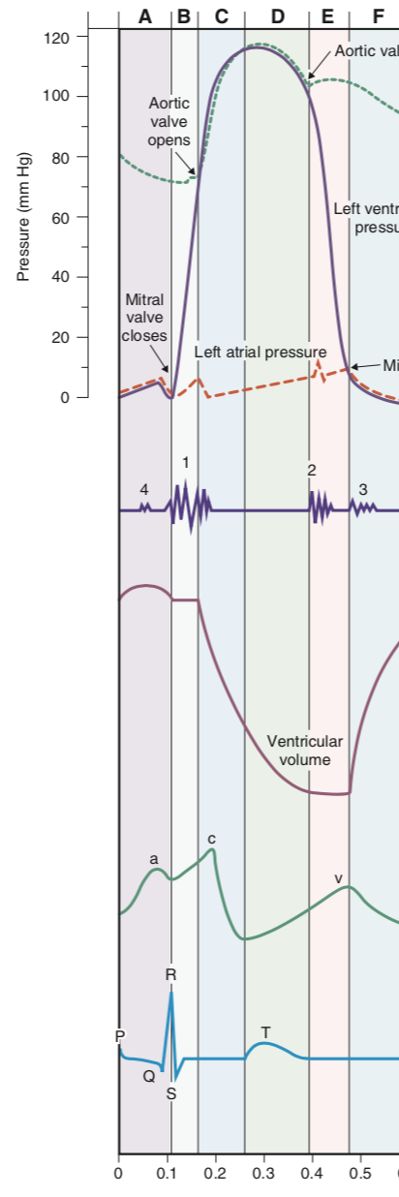
Cardiac cycle
E) Isovolumetric ventricular relaxation
  Begins after ventricles are fulling repolarized (end of T wave)
  LV relaxed, pressure decreases
  When LV pressure < aortic pressure, aortic valve closes
  Question: what is the S2 heart sound?
  Question: is a split S2 heart sound normal? Under which circumstances?
  Dicrotic notch: point where aortic valve closes
  All valves are closed, no blood ejected or filled = constant volume
Venous pulse
Notes:
S2 sound= aortic valve closing slightly before pulmonic valve
Splitting occurs during inspiration because decreased intrathoracic pressure produces an increase in venous return to R heart-> increase in RV stroke volume and prolongs RV ejection time (longer to pump out blood b/c inc volume)-> delays closure of pulmonic valve relative to aortic valve
Split S2 during expiration is abnormal: pulmonic stenosis

Slide 48
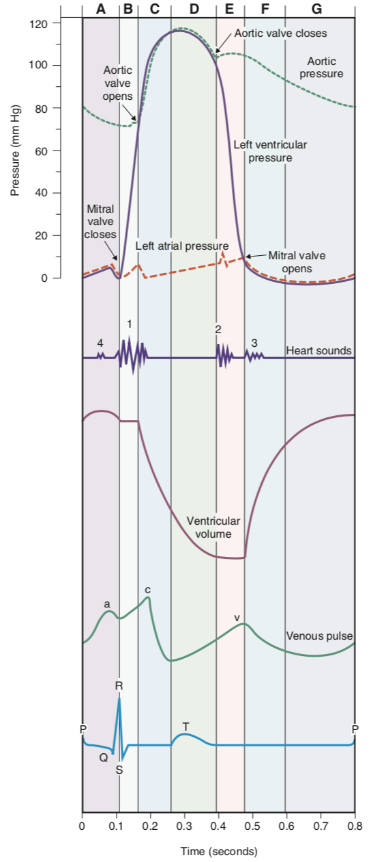
Cardiac cycle
F) Rapid ventricular filling
  When ventricular pressure < LA pressure, mitral valve opens
  LV begins to fill, volume increases but pressure remains low b/c ventricle is still relaxed
  Question: What is the S3 heart sound? What pathologic conditions can it represent?
  Aortic pressure decreases as blood runs off from aorta into arterial tree, veins
Notes:
S3 sound: rapid flow of blood from atria to ventricles
In adults, S3 sound indicates volume overload (CHF, advanced mitral or tricuspid regurgitation)

Slide 49
Cardiac cycle
G) Reduced ventricular filling (diastasis)
  The longest phase of cardiac cycle
  Includes final portion of ventricular filling
  Atrial systole marks the end, at which point the LV volume is the EDV
  Changes in heart rate alter the time available for diastasis b/c it is the longest phase

Slide 50
S3 v S4 sound (1:00): https://www.youtube.com/watch?v=7J72wFtBdU4
Split S2 sound (0:13): https://www.youtube.com/watch?v=KHw_kxK8siE

Slide 51
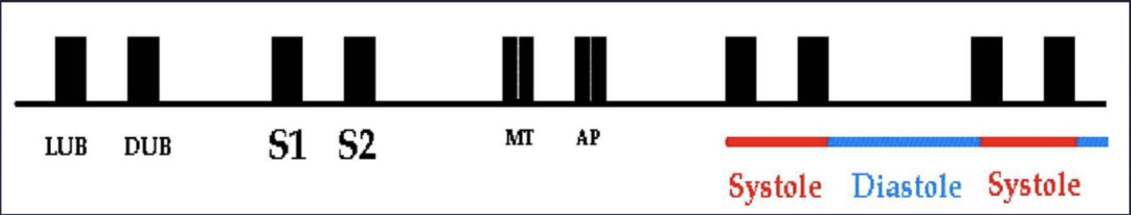
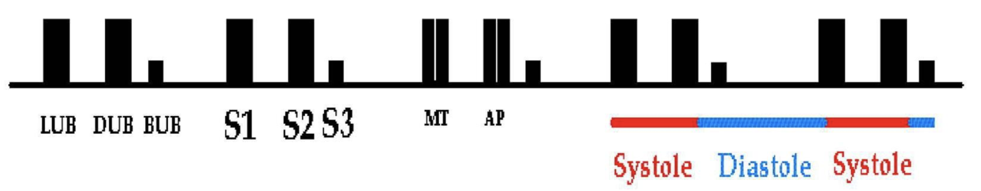
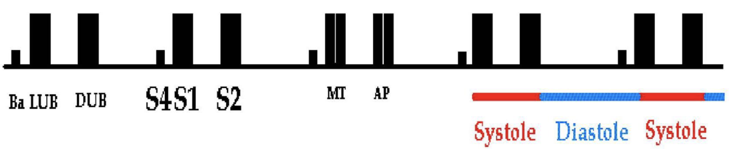
Notes:
S1 and S2= lub dub
S3= early diastole (rapid flow of blood from atria to ventricles such as in volume overload)
S4= late diastole (atrial contraction, caused by atrium contracting against a stiffened ventricle. Heard in ventricular hypertrophy, where ventricular compliance is decreased)

Slide 52
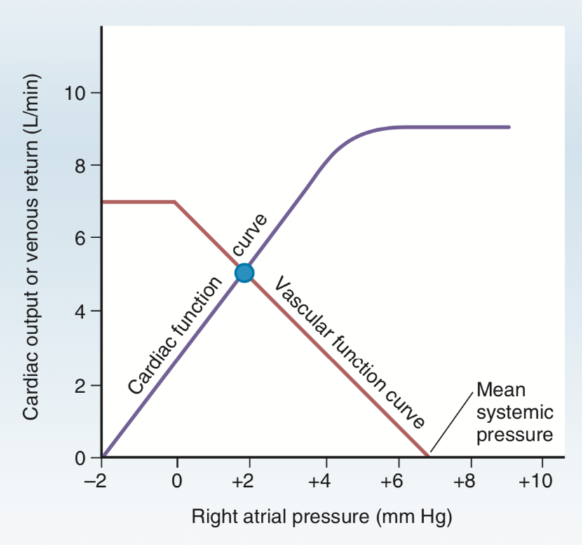
Relationship b/w CO and venous return
Cardiac function/output curve
  Based on the Frank Starling relationship
  A plot of the relationship b/w CO of LV and RA pressure
    RA pressure is related to venous return, EDV, end diastolic fiber length
  Increases in EDV/RA pressure produce increases in CO up to a certain point
    When RA pressure is at approx. 4 mmHg, CO can no longer keep up with venous return

Slide 53
Relationship b/w CO and venous return
Vascular function/venous return curve
  A plot of the relationship b/w venous return and RA pressure
  Venous return has an inverse relationship with RA pressure: lower RA pressure creates larger pressure gradient that encourages venous return
  Flat portion of curve occurs at negative values of RA pressure
    At such negative values, veins collapse, impeding flow back to heart
  RA value at which venous return is zero is called mean systemic pressure

Slide 54
Relationship b/w CO and venous return
Mean systemic/circulatory pressure
  The pressure that would be measured throughout the CV system if the heart were stopped
  Thus zero venous return
  This point matters b/c it determines where the cardiac function curve intersects with the vascular function curve (steady state operating point)
  2 factors influence this value:
    Blood volume
      When blood volume is 0-4L, blood is in unstressed volume= produces no pressure
      When volume >4L, some will be in stressed volume
      Less blood shifts vascular function curve to the L
    Distribution of blood b/w unstressed volume (volume in veins) and stressed volume (volume in arteries)
      Ex: venodilation or venoconstriction
      Venodilation-> increased unstressed volume-> shifts vascular function curve to the L

Slide 55
Relationship b/w CO and venous return
Slope of vascular function curve
  If mean systemic pressure is fixed, the slope of the vascular function curve can be changed by rotating it
  Question: what is the slope determined by?
    Mainly determined by resistance of arterioles
  Dec in TPR causes clockwise rotation of vascular fxn curve
    For a given RA pressure, venous return is increased
Combining curves
  Summary:
    Cardiac fxn curve: as RA pressure and EDV are increased, there is inc SV and CO
    Vascular fxn curve: as RA pressure is increased, venous return decreases
Notes:
Answer: the slope is determined by total peripheral resistance (TPR)

Slide 56
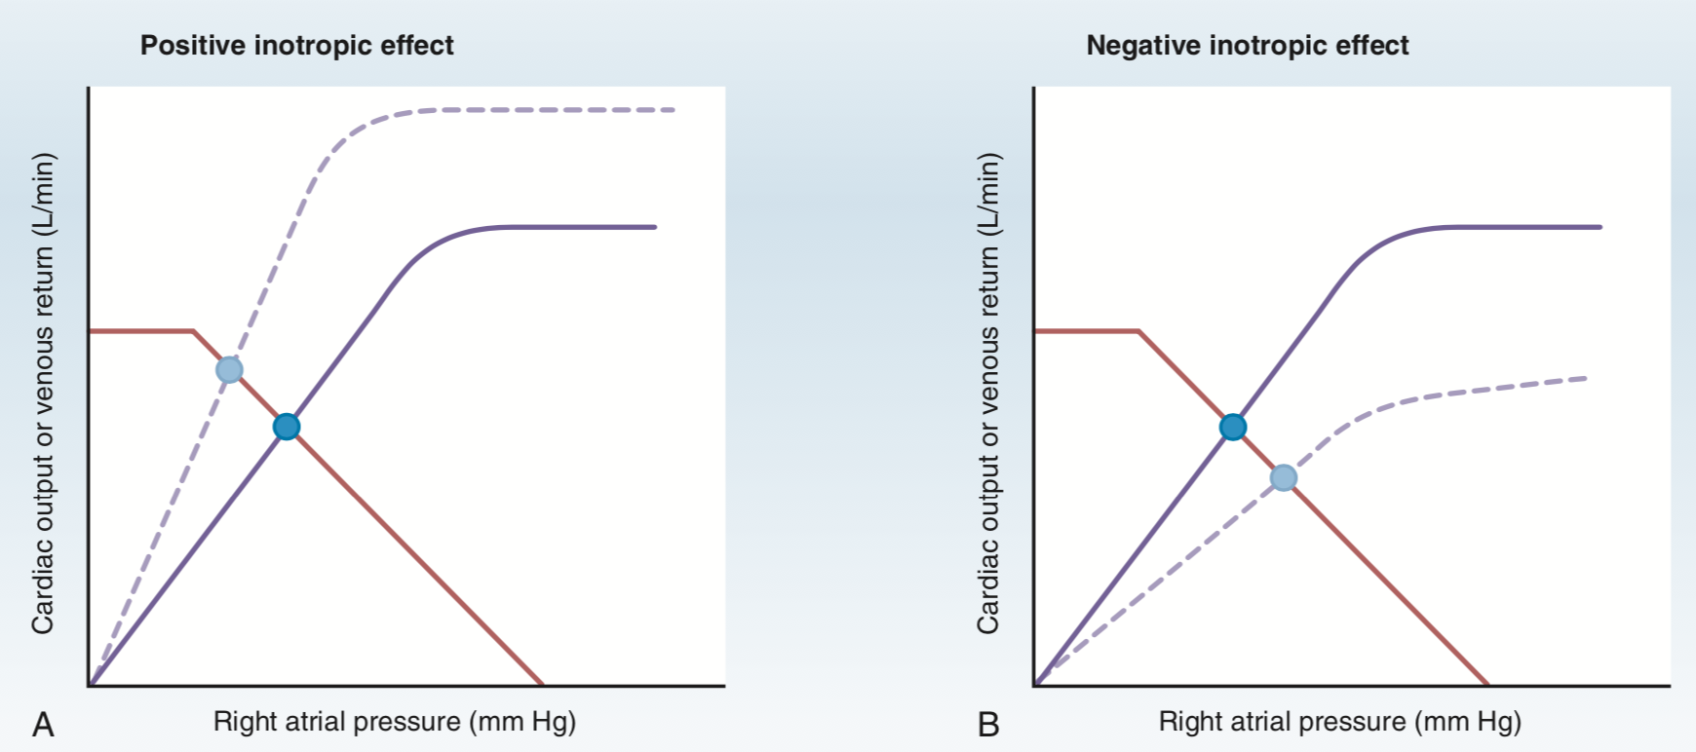
Relationship b/w CO and venous return
Inotropic effects
  Inotropic agents alter the 1._____ function curve
  Positive inotropic:
    Causes inc in contractility, SV, CO for any level of RA pressure
    Cardiac fxn curve shifts upward but vascular fxn curve unaffected
    Steady state point shifts upward and to the L
      New steady state: CO is 2.____ , RA pressure is 3. _____ (more blood is ejected from heart on each beat)
  Negative inotropic:
    Cardiac fxn curve shifts downward
    New steady state: CO is decreased and RA pressure is increased
Notes:
Cardiac
Increased
Decreased

Slide 57
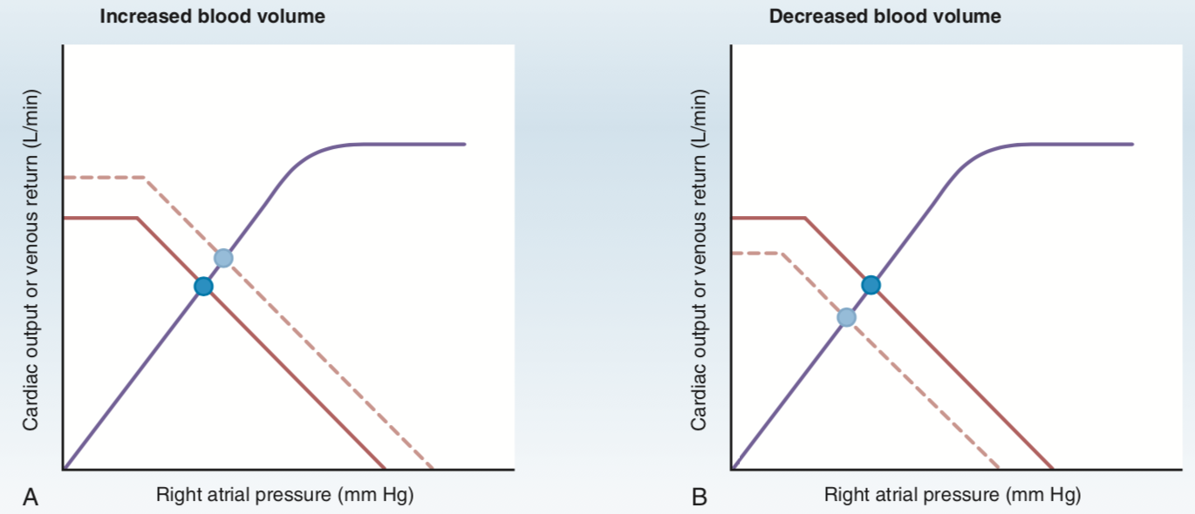
Relationship b/w CO and venous return
Changes in blood volume
  Alters mean systemic pressure -> 1.____ function curve
  Increases in blood volume
    Increases blood in stressed volume and therefore mean systemic pressure (which shifts the point where venous return is zero)-> shifts this intersection point to the R in a parallel manner (b/c no change in TPR which determines the slope)
    New steady state: CO is increased, RA pressure is increased
  Decreases in blood volume
    New steady state: CO is decreased, RA pressure is decreased
Notes:
Vascular

Slide 58
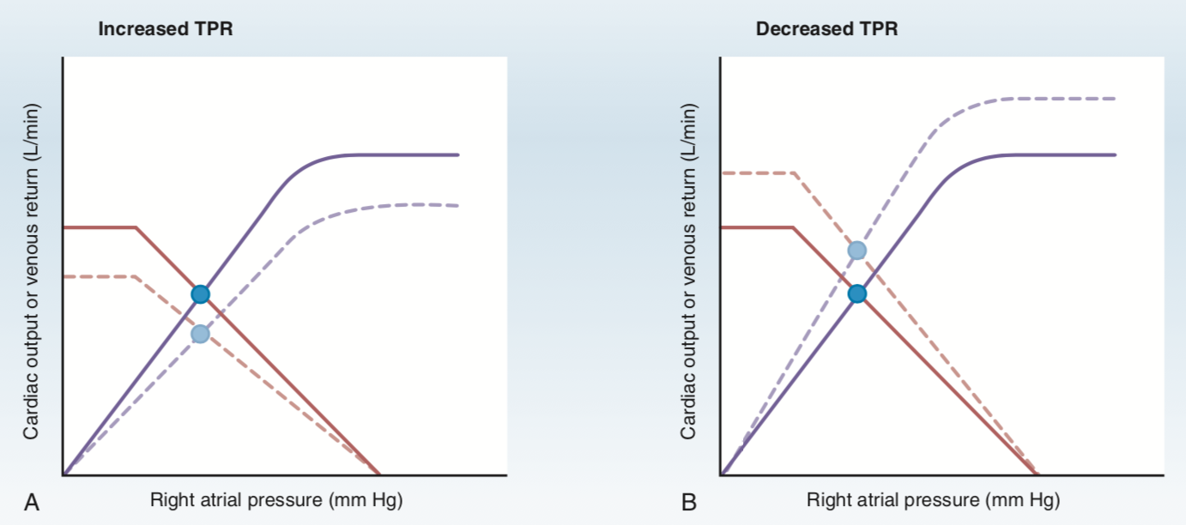
Relationship b/w CO and venous return
Changes in venous compliance
  Similar effects as those produced by changes in blood volume
  Dec in venous compliance: causes shift of blood out of unstressed volume and into stressed volume (same effects as inc in blood volume)-> parallel shift to the R
Changes in TPR (degree of arteriole constriction)
  Alters both curves: cardiac fxn curve changes bc of a change in afterload (art BP) and vascular function curve changes bc of change in venous return
  Inc in TPR:
    Restricts flow of blood out of arteries-> inc art pressure-> inc afterload-> dec CO-> cardiac fxn curve shifts downward
    Inc in TPR produces counterclockwise rotation of vascular fxn curve (less blood returns to heart for a given RA pressure)
    Final result on RA pressure is not easily predictable b/c TPR has diff directional effects on the curves (graphically represented as RA being unchanged)
    New steady state: CO and venous return are decreased

Slide 59
Relationship b/w CO and venous return
Changes in TPR (degree of arteriole constriction) cont
  Dec in TPR: arteriole dilation/decreased afterload
    Cardiac function curve shifts upward
    Clockwise rotation of vascular function curve (more blood returns to heart for a given RA pressure)
    Final result on RA pressure is not easily predictable b/c TPR has diff directional effects on the curves (graphically represented as RA being unchanged)
    New steady state: both CO and venous return are increased

Slide 60
Regulation of arterial pressure
Arterial pressure = CO x TPR
  CO and TPR are no independent variables
MAP must be maintained at approximately 100mmHg
Maintained by 2 systems: baroreceptor reflex, RAAS
Baroreceptor reflex
  Fast, neurally mediated reflexes via changes in output of sympathetic and parasympathetic nervous systems t o the heart and blood vessels
  Baroreceptors are mechanoreceptors sensitive to pressure or stretch
  Baroreceptors are located within walls of the carotid sinus and aortic arch-> relay info about BP to CV vasomotor centers in the brainstem
    Carotid sinus receptors responsive to inc or dec in pressure; aortic arch receptors primarily responsive to increases in pressure
    More sensitive to changes or rate of change in pressure, rather than absolute level of pressure
    Increased arterial pressure-> inc stretch-> inc firing rate in afferent nerves
    Vasomotor centers then coordinate a change in output of autonomic nervous system
  Ex: in chronic hypertension, baroreceptor reflex is altered (either dec sensitivity or an inc in BP setpoint of brainstem)

Slide 61
Regulation of arterial pressure: BR
Baroreceptor reflex cont
  Brainstem CV centers are located in reticular formations of medulla and lower 1/3 of the pons
    Centers are tonically active
  Afferent info sent to medulla via glossopharyngeal (9) and vagus (10) nerves
  Information is integrated in nucleus tractus solitarius (directs changes in activity of CV centers- inc or dec in outflow)
  Parasympathetic outflow is the effect of the vagus nerve to dec HR
  Sympathetic outflow has 4 components:
    Effect on SA node to inc HR
    Effect on cardiac muscle to inc contractility and SV
    Effect on arterioles to produce vasoconstriction and inc TPR
    Effect on veins to produce venoconstriction and dec unstressed volume
  Brainstem centers:
    Vasoconstrictor center (C1): in upper medulla and lower pons
    Cardiac accelerator center: causes inc firing of SA node, inc conduction velocity through AV node, and inc contractility
    Cardia decelerator center: causes dec in HR

Slide 62
Regulation of arterial pressure: BR
Baroreceptor reflex in response to increase in arterial pressure
  Increase in art pressure detected by baroreceptors in carotid sinus and aortic arch-> inc firing rate of carotid sinus nerve (glossopharyngeal nerve, CN 9) and in vagus nerve (CN 10)
  Glossopharyngeal and vagus nerves synapse in the nucleus tractus solitarius of the medulla to send info about BP
  NTS directs coordinated responses using the medullary CV centers to reduce arterial pressure back to normal
    Includes inc parasympathetic outflow to heart and dec in sympathetic outflow
  Dec HR and contractility, together producing a decrease in cardiac output to reduce arterial pressure
  Dec in sympathetic activity also affects vascular tone (dec TPR)
Baroreceptor response to hemorrhage
  Hemorrhage produces dec in arterial pressure
  Dec in art pressure decreases firing rate of carotid sinus nerve
  Dec parasympathetic activity and inc sympathetic activity to heart and blood vessels
Valsalva maneuver (expiring against a closed glottis as during coughing, defecation, or heavy lifting)
  Inc in intrathoracic pressure-> dec venous return-> dec in CO (F-S mech)-> dec in art pressure
  If baroreceptor reflex is intact, will result in inc in HR

Slide 63
Regulation of arterial pressure: RAAS
Renin-angiotensin II-aldosterone system
Regulates art pressure primarily by regulating blood volume
Dec in art pressure causes dec in renal perfusion pressure (sensed by mechanoreceptors in afferent arterioles of kidney)
Dec in pressure causes prorenin to be converted to renin in the juxtaglomerular cells (mech unknown)
  Renin secretion by JG cells also increased by stimulation of renal sympathetic nerves and by B1 agonists such as isoproterenol (dec by B1 antagonists such as propranolol)
Renin catalyzes conversion of angiotensinogen to angiotensin 1
In lungs and kidneys, ang I is converted to ang II by ACE
Ang II activates G coupled ang II receptors in adrenal cortex, vascular smooth muscle, kidneys, brain
  Ang II acts on zona glomerulosa cells of adrenal cortex to stim synth and secretion of aldosterone
Aldosterone acts on principal cells of renal distal tubule and collecting duct to inc Na reabsorption
  Increases ECF volume and blood volume (takes hours to days to occur)
Ang II stimulates Na-H exchange in the renal proximal tubule and inc reabsorption of Na and bicarb
Ang II also acts on hypothalamus to inc thirst and water intake
Ang II also stimulates secretion of ADH (inc water reabsorption in collecting ducts)
Ang II acts directly on arterioles by binding to G protein coupled ang II receptors and activating IP3/Ca second messenger system to cause vasoconstriction -> inc TPR and inc in art pressure

Slide 64
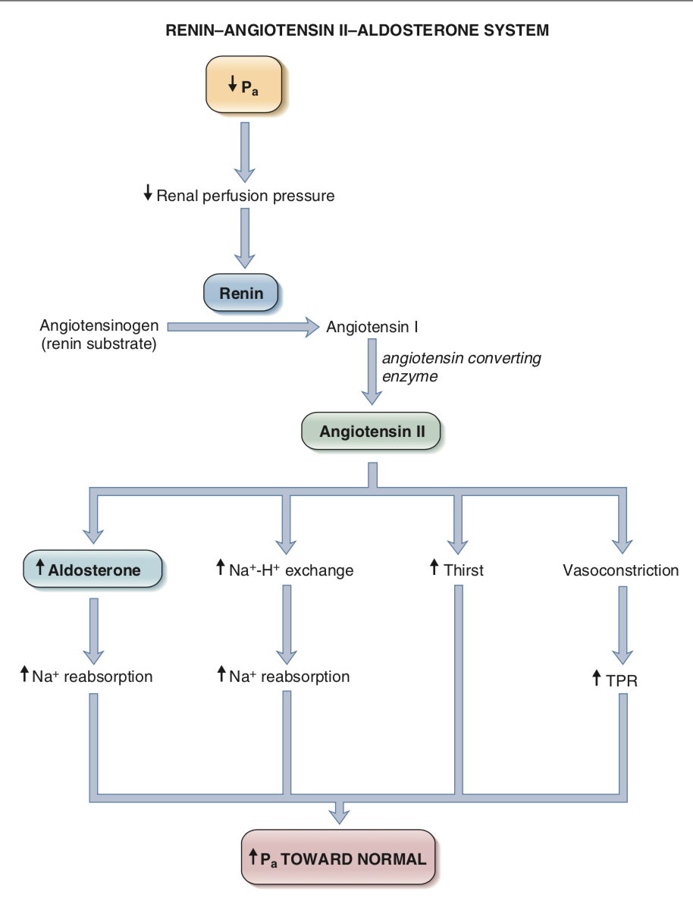

Slide 65
Regulation of arterial pressure: other mech
Peripheral chemoreceptors for O2, chemoreceptors for CO2 in brain, ADH, ANP
Peripheral chemoreceptors for O2
  Located in carotid and aortic bodies
  Sensitive to dec in PO2 (but also inc PCO2, dec pH)
  When arterial PO2 dec, there’s an inc firing rate of afferent nerves from carotid and aortic bodies-> activates sympathetic vasoconstrictor centers-> arteriolar constriction in skeletal muscle, renal, and splanchnic vascular beds
Central chemoreceptors in medulla
  Most sensitive to CO2 and pH, less to O2
  If brain is ischemic (inc PCO2, decc pH), medullary chemoreceptors inc sympathetic outflow-> arteriolar vasoconstriction and inc TPR to redirect blood flow to brain
  Cushing’s reflx is this demonstration of central chemoreceptors
ADH
  2 receptors for ADH: V1 in vascular smooth muscle and V2 in principal cells of renal collecting ducts
  ADH secretion from post pituitary is inc by 2 types of stimuli:
    Inc in serum osmolarity
    Dec in blood volume and blood pressure

Slide 66
Regulation of arterial pressure: other mech
There are also low pressure baroreceptors in veins, atria, and pulm arteries that sense inc in blood volume
Inc in blood volume:
Inc ANP secretion
  Secreted by atria in response to inc atrial pressure
  ANP binds to vascular smooth muscle receptors to cause relaxation, vasodilation, and dec TPR (in kidneys, causes inc Na and water excretion)
Dec ADH secretion
  Atrial pressure receptors also project to hypothalamus
  Inc atrial pressure-> inhibits ADH secretion-> dec water reabsorption in CDs
Renal vasodilation
  Inhibition of sympathetic vasoconstriction in renal arterioles-> renal vasodilation and inc Na and water excretion
Inc HR
  Info from low pressure atrial receptors travels in vagus nerve to NTS
  Inc in pressure at venous low pressure receptors produces an inc in HR (Bainbridge reflex)
  Inc in HR leads to inc renal perfusion and inc Na and water excretion

