Slide 1
Endocarditis, brucella, bartonella

Slide 2

Rosie, 7 YO FS, Mixed Breed
Presented to ER for progressive paraparesis and new diarrhea and anorexia
  Approximately 2-3 month history of RHL lameness
  Primary DVM: 4DX negative, CBC leukocytosis, chem unremarkable
  Treated with doxycycline and carprofen
  During these 2-3 months persistently lame/weak in pelvic limbs
  Last week progressive lethargy with new diarrhea dark in color
  Current meds: carprofen, doxycycline, gabapentin, entyce

Slide 3
Physical Exam
T: 102.4ºF, P: 170 BPM, R: 60, Wt: 28.9 kg
CV: Slightly bounding pulses, otherwise NSF
Neuro: Markedly abnormal gait: normal in the forelimbs, markedly short-strided gait in the hind with crossing over, pain on palpation of lumbosacral spine, remainder NSF
MSK: Marked HL muscle atrophy and exaggerated internal rotation of the stifles bilaterally (R > L). No patellar luxations or cranial drawer/tibial thrust elicited bilaterally. Moderate discomfort on hip extension bilaterally. Tarsal hyperflexion bilaterally
Rectal: dark brown to red tinged diarrhea

Slide 4
Initial ER diagnostics
VBG: mild alkalemia characterized by mild metabolic alkalosis (pH 7.39, pCO2 34.2, HCO3 20.2, BE -4.7), normal anion gap (14.4), Na 145.3, K 4.29, iCa 1.32, Cl 115, BG 90, HCT 36%, lact 1.45
Qats: PCV 35%, TS 7.4, azo 15-26
NIBP: 166/120 (140) mmHg, 178/114 (137) mmHg, 173/107 (126) mmHg ; HR 113 bpm
TFAST: no pleural or pericardial effusion, no B-lines, normal glide sign bilaterally. Normal cardiac contractility with possible hyperdynamic LV free wall. Subjectively normally sized R heart
AFAST: no peritoneal effusion in any quadrant. Abnormally heterogenous mottled spleen with suspect mass effect towards the head.
3-view CXR (not discussed with radiology): no obvious pulmonary metastasis

Slide 5
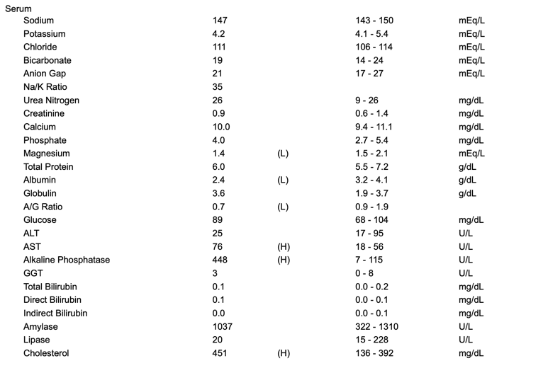
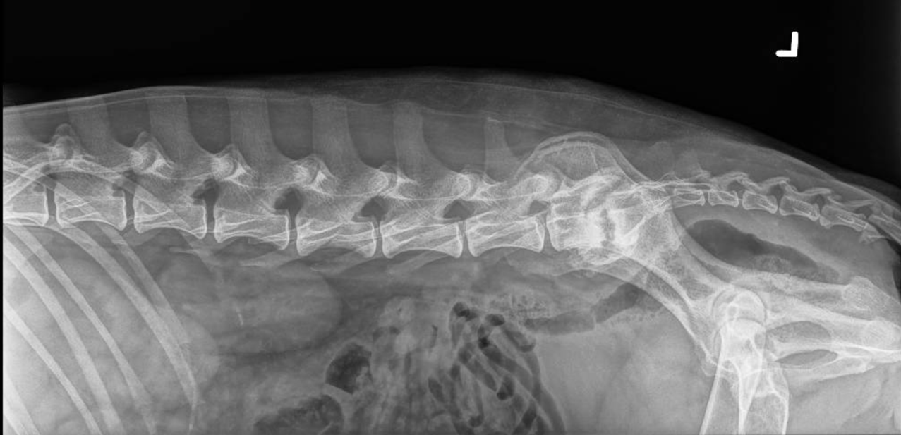
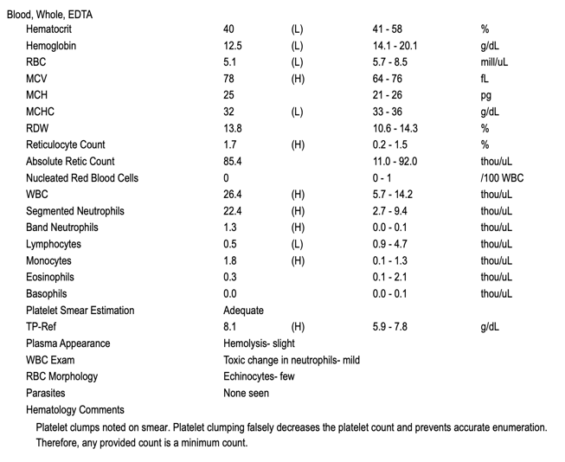
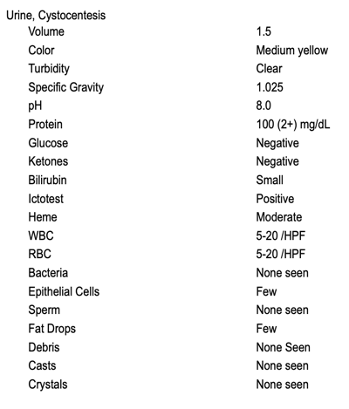
Transferred to Medicine
Next diagnostics?
Anything else… ?
Notes:
The L7-S1 intervertebral disc space is moderately widened and irregular. The associated endplates are severely lytic with undulating, irregular margins surrounded by marked sclerosis. Diskospondylitis
AUS: Moderately enlarged, diffusely mottled heteroechoic spleen with generalized multifocal hypoechoic nodules. Scant peritoneal effusion

Slide 6
Diskospondylitis
Differentials?
Notes:
Penetrating wounds, surgery, or plant material migration can cause direct infection of the disk space or vertebra. Staphylococcus intermedius is the most common etiologic agent identified in dogs with diskospondylitis.Other frequently documented pathogens include Streptococcus species, Brucella canis, and Escherichia coli, but virtually any bacterial agent can be causative. Some spinal infections are caused by fungal organisms, including Aspergillus species, Paecilomyces species, and Coccidioides immitis. Urinary tract infections often implicated as source

Slide 7
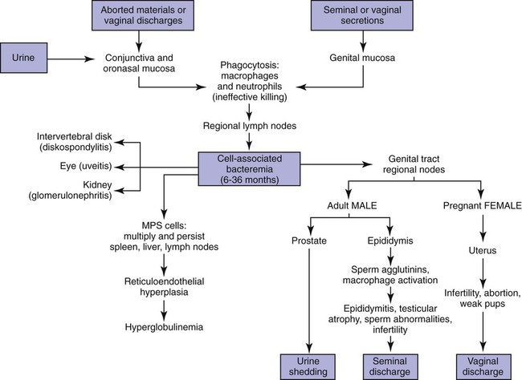
Brucella canis
Gram negative coccobacilli
Transmission
Pathogenesis
Clinical signs
Notes:
gram negative coccobacilli, non-encapsulated, non-spore forming. Transmitted through genital, conjunctival, and oronasal secretions, primary sources are reproductive fluids. Shed in vulvar secretions up to 6 weeks after abortion and during estrus, shed in semen in high concentrations for 6-8 weeks after infection, then shed intermittently for up to 2 yr in semen
Minor routes of transmission: in utero, broken skin, blood transfusions, feces, milk, and fomites
Attaches to mucus membranes, penetrates epithelial barrier and taken up into mononuclear phagocytic system where it resides intracellularly, intracellular organism then travel through reticuloendothelial system to local lymph nodes
- after 7-30 days bacteria move into blood stream and cause intermittent bacteremia
- targets steroid dependent reproductive tissues (prostate, testicles, gravid uterus, placenta)
- non-reproductive systems become affected as bacteremia spreads organisms and antibody-antigen complexes to end-arterial circulation of the intervertebral disk (diskospondylitis) or eye (anterior uveitis or endophthalmitis)
- bacteremic episodes can last for years, seroconverts as early as 2-4 weeks, but as long as 8-12 weeks post-infection
- two options: cell-mediated immune response typically result in self-elimination within 2-3yr VS humoral immune response does not eliminate the organism resulting in persistently infected dogs
- typically associated with reproductive abnormalities (failure to conceive, spontaneous abortion late stage, or infected bitches have apparently normal pups that are infected and manifest disease later in life
- male dogs may display scrotal dermatitis, epididymitis and scrotal edema, orchitis less frequent, chronic stage of testicular atrophy
- non-reproductive manifestations include chronic uveitis, endophthalmitis (blepharospasm, aqueous flare, constricted pupils, synechia, hypopyon, hyphema), diskospondylitis, lymphadenitis (common), pyogranulomatous dermatitis (rare), endocarditis (rare), appendicular osteomyelitis (rare), meningoencephalitis

Slide 8
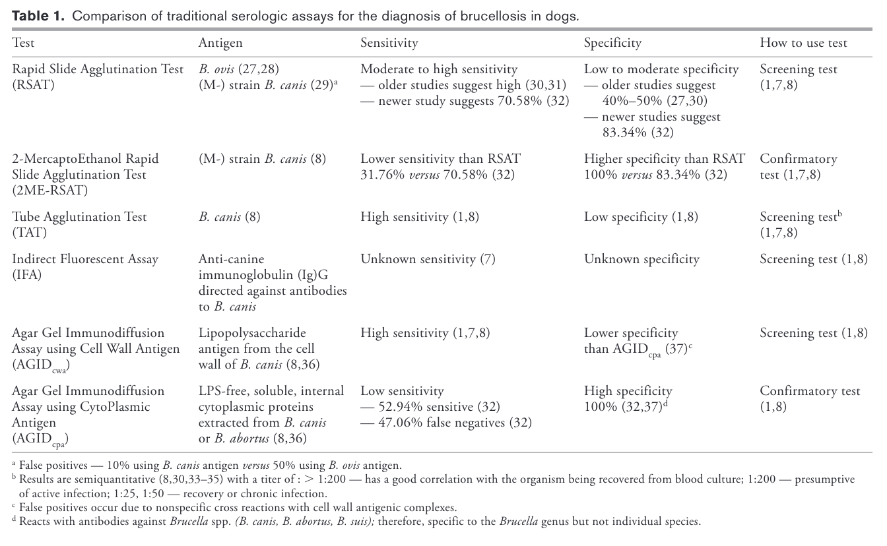
Brucella canis
Diagnosis
  Gold standard culture
  Screening tests
  Confirmatory tests
Notes:
- traditional gold standard diagnostic is culture of blood, urine, vaginal discharge, semen, or aborted tissue
- culture low sensitivity, fastidious organism, inappropriate screening test, good confirmatory test
- serologic assays (RSAT, TAT, IFA) used as screening tools, false negatives if prior to seroconversion and low circulating antibodies
- false positive serologic assays due to shared surface antigens with pseudomonas aeruginosa, bordatella bronchiaseptica, actinobacillus, strep, staph and gram neg bacteria
- screening test must be followed by confirmatory test such as 2 mercaptoethanol RSAT or agar gel immunodiffusion assay - PCR should be used in conjunction with clinical information and serology

Slide 9
Brucella canis
Treatment?
Notes:
- generally treatment is discouraged and truly infected animals should be euthanized due to risk to human populations and canines
- Brucellosis canis is not a reportable disease, but other brucella species are? reportable in some states
- if euthanasia declined then isolation, patient with no clinical manifestations should isolated to self-eliminate if possible
- those who are clinical and you are treating, notoriously unsuccessful, antibiotic therapy does not guarantee elimination of organism
- combination abx therapy, tetracycline base abx orally for min of 1-2 months, second abx is aminoglycoside administered parenterally with daily dosing for 7-14 days
- potentially monitoring AGID

Slide 10
Back to Rosie
After seeing the radiographs what additional diagnostics would you run?
  Brucella multiplex: negative
  Urine culture: negative
  Fungal serology panel: negative
  Blood cultures: gram positive coccobacilli, too fastidious to allow further classification
Discharged with enrofloxacin and clavamox
Notes:
B. canis antigens, are coupled to fluorescent beads. (2) Canine serum samples are incubated with the beads, and if present, antigen-specific antibodies binds. (3) A biotinylated anti-canine immunoglobulin antibody is added to detect bound antibodies. (4) Streptavidin- phycoerythrin (PE) is added as a reporter. The bead and
associated PE fluorescence is measured.
Clip and aseptically prep a sight for venipuncture
While wearing sterile gloves collect between 1-10 mLs of blood from site and transfer to aerobic and anaerobic blood culture medium
Repeat aseptic preparation and blood collection as above from two separate anatomical locations 10 minutes second to prior and again in 60 minutes
If patient is already on antibiotics blood should be collected during the trough

Slide 11
Recheck Exam in 3 Weeks
Initially following discharge was inappetent and having tarsal swelling
Had epistaxis and seen by primary DVM, given short course of prednisone
In last 2 weeks has had intermittent tarsal swelling and pain
Primary DVM started second course of steroids during this time

Slide 12
Physical Exam
Vitals within reference
CV: grade V/VI systolic murmur with PMI over heart base, bounding pulses peripherally with evidence of jugular distension. Lung sounds clear, intermittent tachypnea
Musculoskeletal- Mild RH pelvic lameness on gait analysis. Mild to moderate muscle mass loss. R hind musculature more reduced compared to LH. No back pain.
Neuro Exam (if applicable): Cranial nerves intact. Mild proprioceptive deficit RH with paw placement, but normal hopping x 4. No lumbar pain appreciated.
Ortho Exam (if applicable): No lumbar pain. Mild RH pelvic lameness on gait analysis.
Notes:
What are you concerned about? What is your top differential?

Slide 13
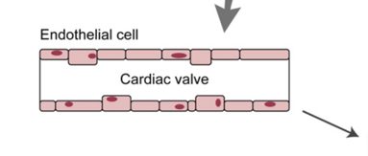
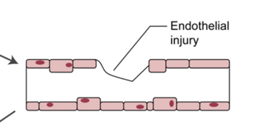
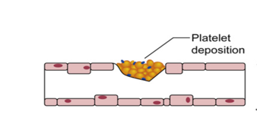
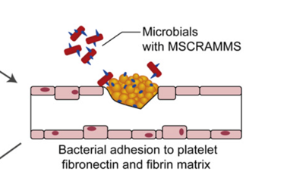
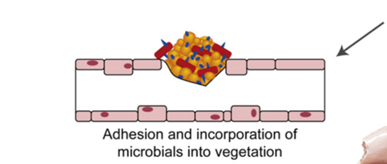
Infective Endocarditis
Pathophysiology
Notes:
- endothelial surface susceptible when damaged
- formation of IE initiated with damage to endothelial surface allowing for deposition of platelet-fibrin which serves as environment for bacterial colonization, bacterial adherence to coagulum
- mechanical lesions or inflammatory lesion can promote bacterial seeding
- disruption of endothelium -> thromboplastin and TF trigger coagulation -> coagulum forms -> fibrinogen and fibrin and platelet proteins bind bacteria -> inflammation induces endothelial expression of integrins that bind bacteria and fibronectin -> Fibronectin facilitates adherence of bacteria to vegetation
- bacteremia must be present (common causes including disco spondylitis, prostatitis, pneumonia, urinary tract infections, pyoderma, long term indwelling intravenous catheters)
- bacterial adherence mediated by microbial surface components recognizing adhesive matrix molecules (MSCRAMMS)
- bacteria that commonly cause IE possess receptors for MSCRAMMS
- bacteria can trigger TF production and induce platelet aggregation building a larger vegetative lesion
- fibrinous vegetative lesion shields bacteria from blood stream and host defenses and makes antibiotic penetration difficult

Slide 14
Next Diagnostic steps?
Notes:
- pathognomonic lesion is hyperechoic, oscillating, irregularly shaped adhered to endothelial surface
- valvular insufficiency of affected valve is always present
- aortic IE murmur more difficult to appreciate, soft diastolic basilar murmur
- bounding femoral pulses with severe aortic insufficiency due to widened pulse pressure and low diastolic pressure from run-off

Slide 15
Additional Diagnostics
Blood culture
  Most common isolates
CBC
Chemistry
Urine culture is a must
ECG
Notes:
The most common bacterial isolates are Staphylococcus spp (aureus, intermedius, coagulase positive and coagulase negative),Streptococcus spp (canis, bovis, and b-hemo-lytic), and E coli
- high incidence of negative blood cultures in dogs with IE 60-70%
- most common clinicopathologic abnormality is leukocytosis on CBC
- mild to severe thrombocytopenia seen in more than half, may also have anemia
- often pro-coagulable state including elevated D-dimer
- Chem shows hypoalbuminemia, ELE, azotemia
- must get urine culture
- UPC if proteinuria
- ECG arrythmias are present in 40-70% of dogs

Slide 16
What about Bartonella?
Testing options
  Traditional blood culture
  Serology
  PCR
Notes:
- Bartonella is gram negative, intracellular, aerobic fastidious bacteria
- Dogs were determined to have presumed Bartonellaas an etiologicagent of IE if (a) serologic titers were >1 : 512, (b) If Bartonellaculture or PCR was positive, or (c) if serologic titers were positive and conventional blood cultures were negative
- Bartonella primarily affects the aortic valve, characteristic lesions with fibrosis, mineralization, endothelial proliferation and neovascularization
- Bartonella also colonizes RBC without causing hemolysis and impairs immune system by reducing number of CD8+ lymphocytes and cell adhesion molecule expression, inhibition of monocyte phagocytosis and impairment of Bcell antigen presentation

Slide 17
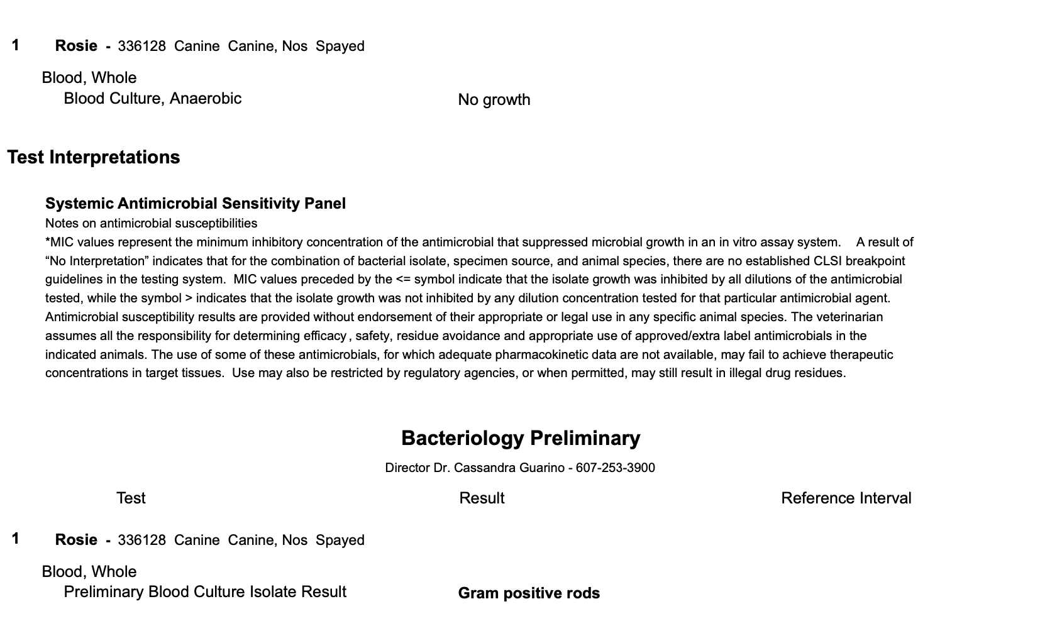
Notes:
Did you diagnose IE?

Slide 18
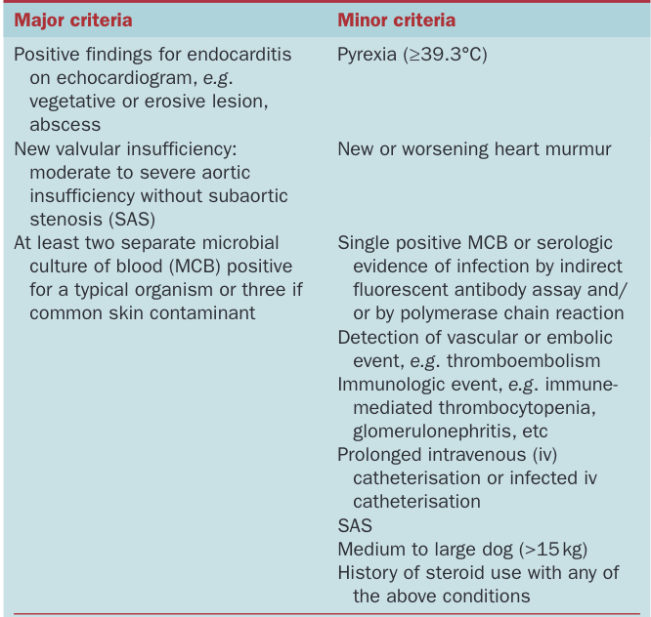
Diagnosing Infective Endocarditis
[NP1]Try with these headers
Presumptive vs confirmatory
Presumptive
  2 major criteria
  1 major and 3 minor
  5 minor
Possible
  1 major and 1 minor
  3 minor
Unlikely
  Firm alternative diagnosis
  Resolution in <4 days treatment
  No pathologic evidence
Notes:
To get a confirmatory diagnosis of infective endocarditis requires histopathology of the lesion.

Slide 19
Treatment
Antibiotic selection
Anti-thrombotics?
Monitoring?
Notes:
- long-term bactericidal antibiotics, abx with high serum concentrations and good tissue and intracellular penetration
- IV antibiotics for 1-2 weeks
- long-term oral antibiotics for 6-8 weeks longer
- At present, anticoagulant therapy is not recommended as a result of a trend in increased bleeding episodes and absence of benefit in vegetation resolution or reduced embolic events in humans with IE treated with aspirin. (MacDonald, 2010)
- Dogs treated with anti-thrombotic medications had markedly better outcomes (Regan, 2022)
- challenging to know when to d/c abx - serial monitoring of echo and CBC
- lack of improvement of oscillating lesion in first week of abx may indicate more aggressive resistant bacteria and consider changing abx
- repeat culture in 1 week after starting abx and 2 weeks after finishing
- echo 1-2 weeks after starting abx, then in 4-6 weeks and 2 weeks following discontinuation of abx
- in bartonella repeat serology in a month

Slide 20
Back to Rosie
Why do you think she had tarsal effusion?

Slide 21
Sequelae
Congestive heart failure
Polyarthritis
Glomerulonephritis
Thromboembolism
Notes:
- CHF most common sequelae and most common cause of death
- aortic IE causes insufficiency which increases left ventricular end-diastolic volume and pressure
- IE of mitral leads to regurgitation and valvular erosion, can lead to chordae rupture, which increases left ventricular end-diastolic pressure
- continuous formation of immune complexes with impaired ability to solubilize immune complexes may lead to large immune complexes
- deposition of immune complexes in glomerular basement membrane, joint capsule or dermis
- commonly see polyarthritis (75%) and glomerulonephritis (36%)
- thromboembolism (septic and non-septic) commonly occurs in 70-80% of dogs with IE
- thromboembolism more common with mitral valve
- infarction of kidneys and spleen most common followed by myocardium, brain and systemic arteries - presenting complaint often non-specific (lethargy, anorexia, weakness, weakness)

Slide 22
Prognosis
Prognosis/MST
Prognostic factors
Notes:
- prognosis: mitral >>> aortic, bartonella (bartonella tends to affect aortic valve)
- mortality 33% in first week and 92% in 5 months
- CHF has greatest impact on poor prognosis
- mortality 56% in Sykes 2006, 68% STD in UK study 2023
- Survival to discharge was observed in 79/113 (69.9%) dogs. Of the 113 dogs, 47 (41.6%) survived beyond 1 month after diagnosis,57 (50.4%) died- MST of 72 days - Bartonella previously associated with poorer prognosis, but in this study was not different - Bartonella in this study was all associated with aortic valve - Valve affected not predictive of survival (Regan, 2022)
congestive heart failure, azotemia, and thromboembolic disease were associated with mortality

Slide 23
References
Berrezaie, M., Connolly, D., Cruzado, J., Mederska, E., Dukes‐McEwan, J., & Humm, K. (2022). Infective endocarditis in dogs in the UK: 77 cases (2009‐2019). Journal of Small Animal Practice, 64(2), 78–87. https://doi.org/10.1111/jsap.13561
Cosford K. L. (2018). Brucella canis: An update on research and clinical management. The Canadian veterinary journal = La revue veterinaire canadienne, 59(1), 74–81.
MacDonald, K. (2010). Infective endocarditis in dogs: Diagnosis and therapy. Veterinary Clinics of North America: Small Animal Practice, 40(4), 665–684. https://doi.org/10.1016/j.cvsm.2010.03.010
MacDonald, K. A., Chomel, B. B., Kittleson, M. D., Kasten, R. W., Thomas, W. P., & Pesavento, P. (2004). A prospective study of canine infective endocarditis in Northern California (1999-2001): Emergence of bartonella as a prevalent etiologic agent. Journal of Veterinary Internal Medicine, 18(1), 56–64. https://doi.org/10.1111/j.1939-1676.2004.tb00136.x
Reagan, K. L., Visser, L. C., Epstein, S. E., Stern, J. A., & Johnson, L. R. (2022). Outcome and prognostic factors in infective endocarditis in dogs: 113 cases (2005‐2020). Journal of Veterinary Internal Medicine, 36(2), 429–440. https://doi.org/10.1111/jvim.16380
Sykes, J. E., Kittleson, M. D., Chomel, B. B., MacDonald, K. A., & Pesavento, P. A. (2006). Clinicopathologic findings and outcome in dogs with infective endocarditis: 71 cases (1992–2005). Journal of the American Veterinary Medical Association, 228(11), 1735–1747. https://doi.org/10.2460/javma.228.11.1735
Thomas, W. B. (2000). Diskospondylitis and other vertebral infections. Veterinary Clinics of North America: Small Animal Practice, 30(1), 169–182. https://doi.org/10.1016/s0195-5616(00)50008-4

