Slide 1

Invoices in reviewed Status
Tableau Dashboard instructions
Cornell University Library
Finance and Budget Office
Last updated date: 03/30/2022

Slide 2
Purpose
This Workbook was created to help with the invoice approval process by providing the Invoice Lines and Adjustments in Reviewed status that do not have any Expense Class or a Fund attached to them.
It also provides a list of invoices that are using Fund 8510, which requires additional approval.
There is also a possibility to search Invoices Lines and Adjustments using multiple filters.
Note: The Data for this workbook is from the LDP. As of May 10th, the data is updated every night, therefore the results presented in these views will not include invoice lines and adjustments created after 6 PM the previous day.
Notes:
Time consuming to click on all lines. This Dashboard should save us time.

Slide 3
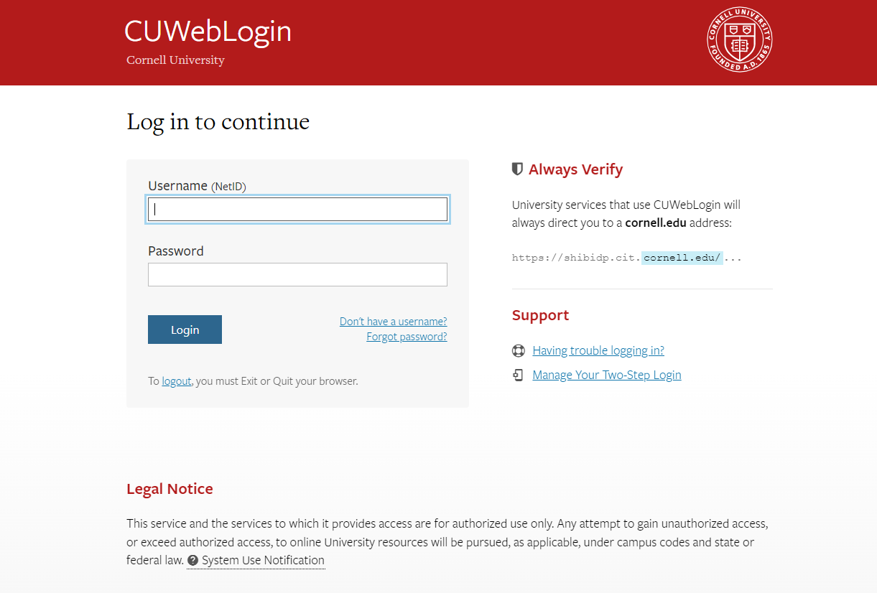
Steps to access the Workbook
Copy the link in your browser and hit “Enter”. It should bring you directly to the FBO Invoices in Reviewed Status Workbook.
Link: https://tableau.cornell.edu/views/FolioInvoicesinReviewedStatus/InvoicesinReviewedStatus?:origin=card_share_link&:embed=n
You should then be taken to the Tableau Server log-in page. You should be able to log in using your CU credentials. Enter your Net ID and your Password.
Bookmark this page for quick access.

Slide 4
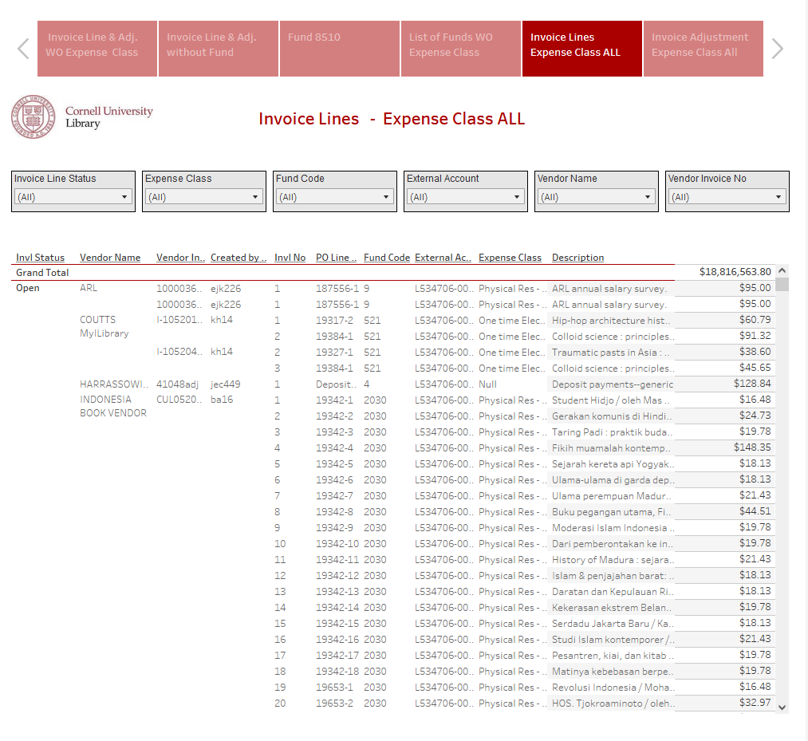
The Workbook should look like this.
This workbook was created to identify Invoices in Reviewed Status that have Invoice Lines and Adjustments with a fund that don’t have an Expense Class selected. It also provides the list of Funds that don’t have Expense Class associated with them and an option to look for these invoices at the Invoice Line and Adjustment level.

Slide 5
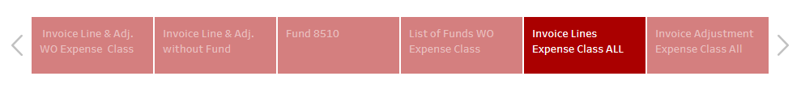
This Workbook contains 6 different view options.
You can see them at the top of the page, in red or light red.
Click on the tab to move from one page to the other.
As you select a page, the data will change.

Slide 6
Navigation bar (top left):
Undo: Will bring you to the previous page without changing anything
Revert: Will bring you back to the original view of the dashboard
Refresh: Will refresh the data. If your views have been opened for a while and a change was submitted by the owner of the dashboard, it will update if you click Refresh.

Slide 7
Navigation bar (top right):
View Original: Click to go back to the original view.
Subscribe: Click to subscribe to the Dashboard and get updates delivered directly to your inbox on a set schedule.
Edit: Let you edit the Dashboard. Should not be available to all users
Share: Click the share icon in the toolbar, copy the URL in the Link field, and past it into your email.(If permitted)
Download: Click Download to download data in PDF, image, Excel, CSV etc.
Comments: Click to add a comment
Full screen: Click for a full screen view
Note: depending on permissions, not all options may be available to you.

Slide 8
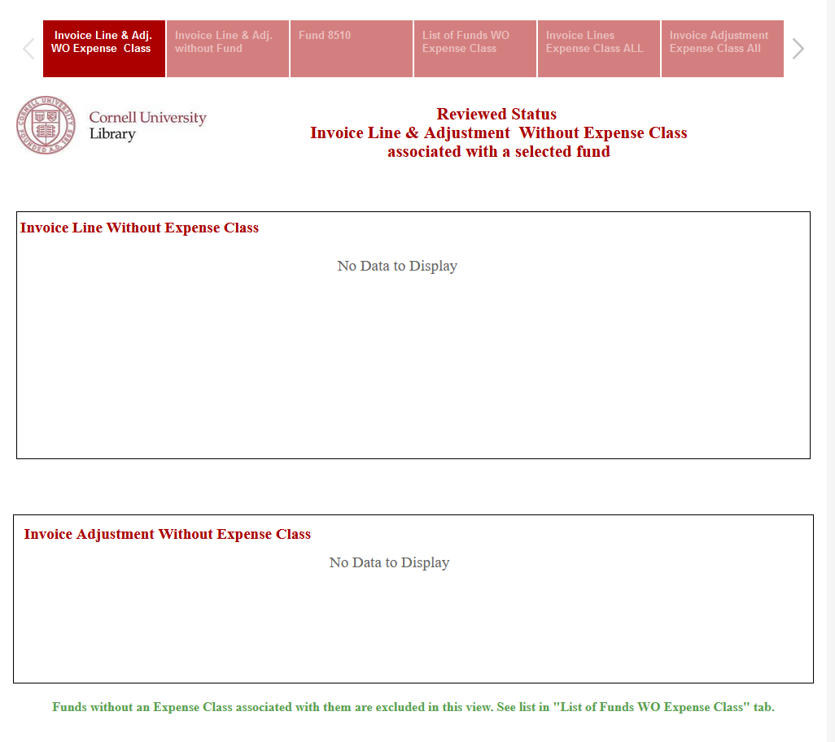
First Tab: Invoice Line & Adjustment without an Expense Class
If there is an Invoice Line in Reviewed Status without an Expense Class, it will show here.
If there is an Invoice Adjustment in Reviewed Status without an Expense Class, it will show here.
Notes:
Let's go from top to bottom.

Slide 9
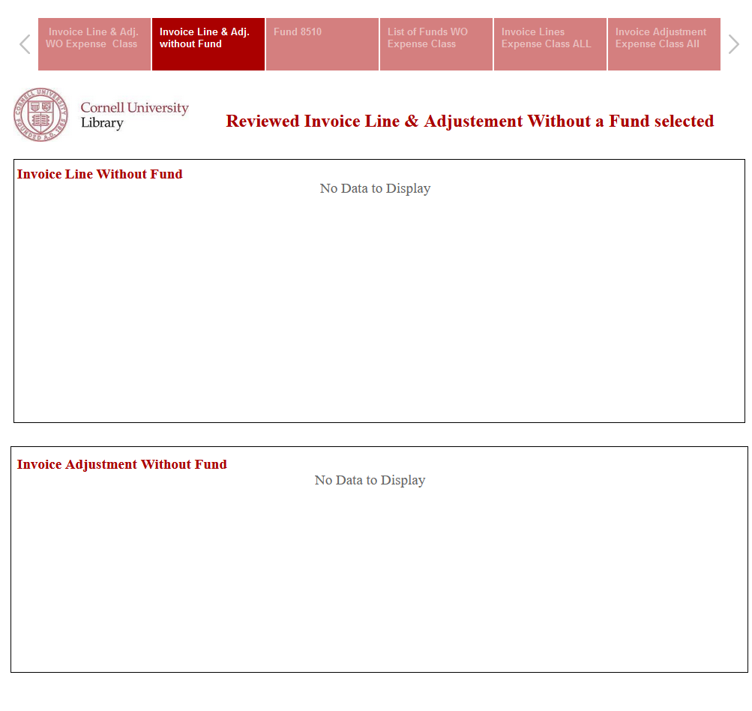
Second tab: Invoice Line and Adjustment without a Fund selected
Downloadsteps
If there is an Invoice Line in Reviewed Status without a Fund, it will show here.
If there is an Invoice Adjustment in Reviewed Status without a Fund, it will show here.

Slide 10
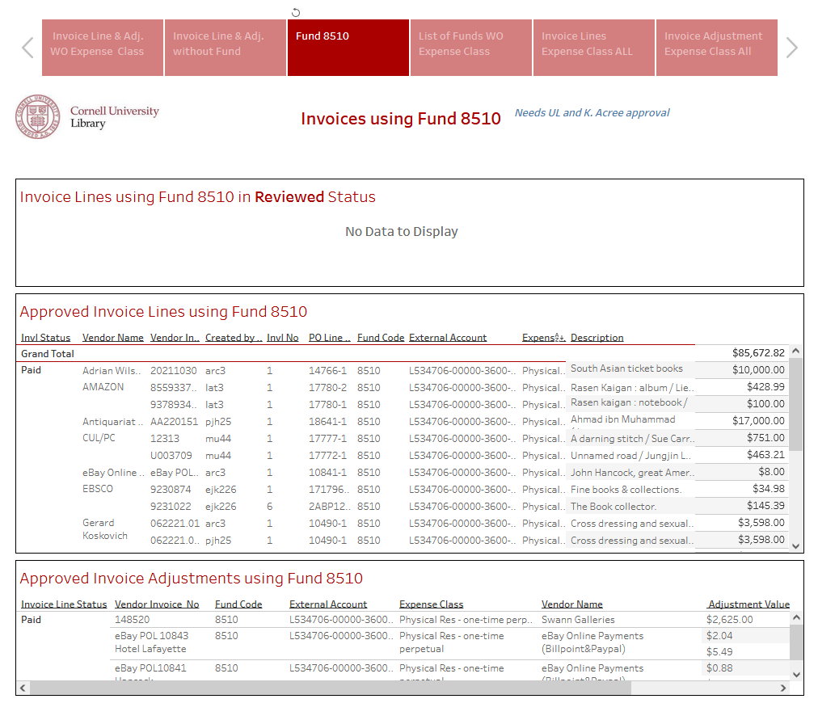
Third tab: Fund 8510
If there is an Invoice Line in Reviewed Status using Fund 8510, it will show here.
This is the list of all Invoice Lines using Fund 8510 for this fiscal year.
This is the list of all Invoice Adjustments using Fund 8510 for this fiscal year.

Slide 11
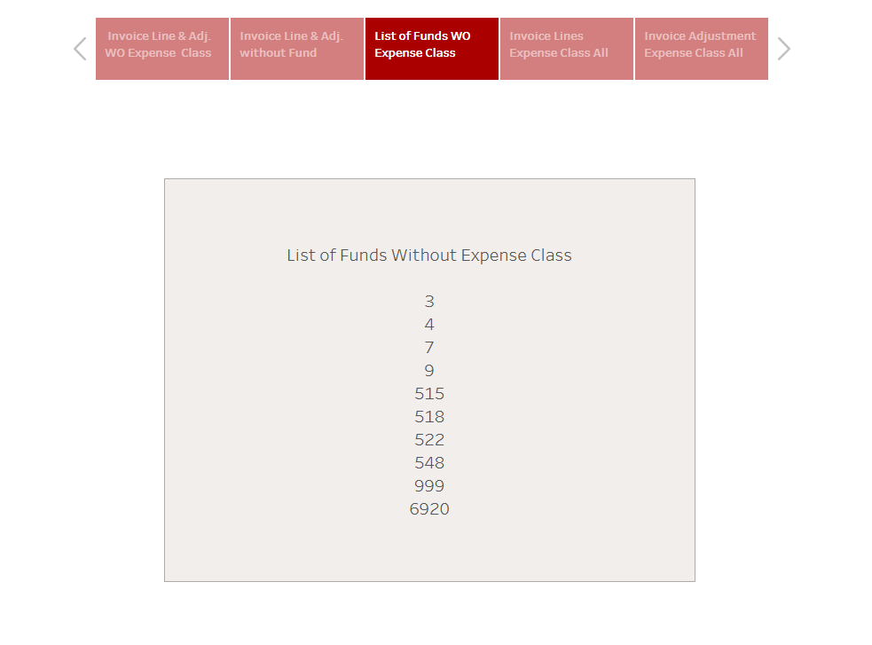
Fourth tab: List of Funds without Expense Class
This is the list of Funds that do not have an Expense Class assigned to them

Slide 12
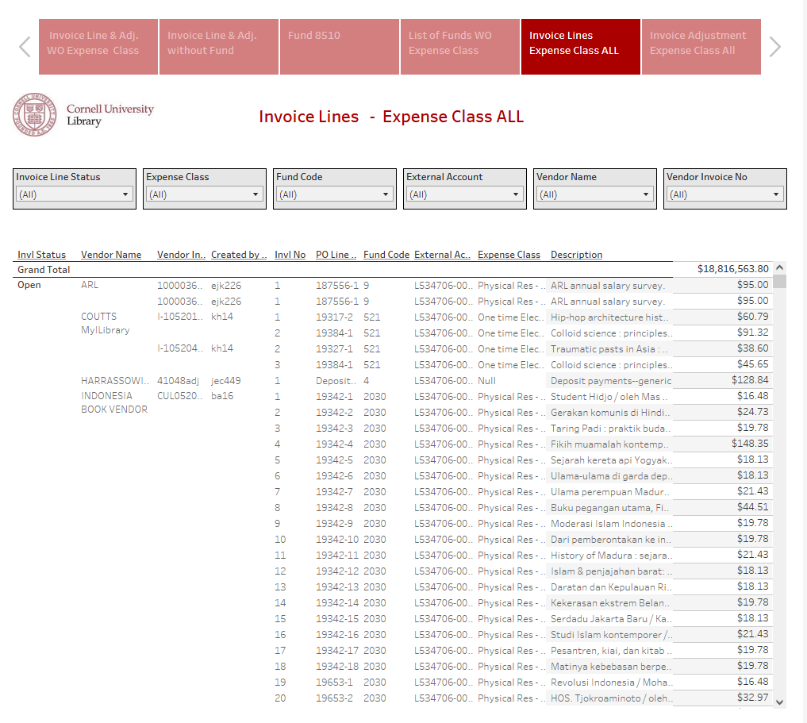
Fifth tab: Invoice Lines Expense Class ALL
Select an option from the dropdown arrow to filter results.
This view provide the list of all Invoice Lines per invoice. The search can be filtered by Invoice Line Status. Expense Class, Fund Code and Vendor Invoice number.

Slide 13
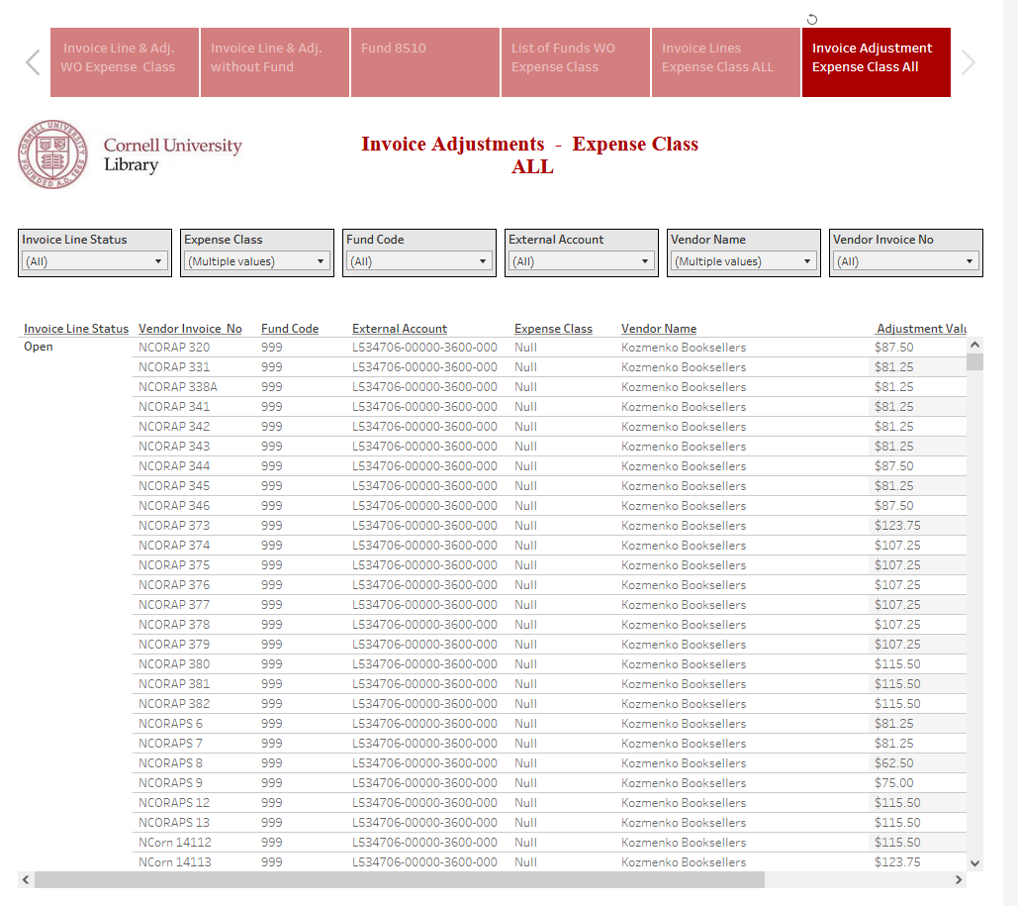
Sixth tab: Invoice Adjustments Expense Class ALL
Select an option from the dropdown arrow to filter results.
This view provide the list of all Invoice Adjustments per invoice. The search can be filtered by Invoice Line Status. Expense Class, Fund Code and Vendor Invoice number.

Slide 14
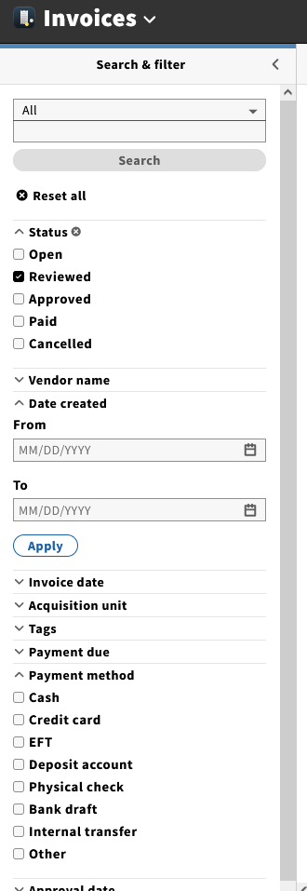
Reminder
Before approving in Folio, make sure the “To” Created Date is selected to the previous day. This way, it will prevent you from approving an invoice that has just been entered and is not recorded in the LDP.
In addition, if an invoice was created 2 days ago and some Invoice Lines were added late the previous day, the Dashboard will not show the late entries, but the invoice will be “partially” there.
Select previous day

Slide 15

I hope you will enjoy using this dashboard!
Nancy Bolduc
nb299@cornell.edu
607-255-5102

