Slide 1
Endocrine Neoplasia: Insulinoma, Pheochromocytoma
Katie Sotos, DVM
June 6th, 2023

Slide 2

Case 1: Porridge

Slide 3
Case 1: Porridge
Signalment, History
PE
11 yo MN Shih Tzu
Collapse
Blindness
PU/PD
Intermittent vomiting and diarrhea
Distended abdominal contour
Uncomfortable abdomen on palpation
No cataracts
Dental disease

Slide 4
What diagnostics will you order?
CBC
Chemistry
Urinalysis
3-view CXR
AUS
NIBP

Slide 5
CBC
Mild nonregenerative anemia (HCT 39%, MCV 68, MCHC 33, abs retic 44.7, 0 nRBC)
Chem
ALP 290 (H), otherwise WNL
UA
USG 1.045, pH 7.0, ptn 2+, < 5 RBC and WBC/hpf
Mild stress leukogram (WBC 16k, segs 12k, bands 0, lymph 900, monos 600)
3-view CXR
AUS
Cardiomegaly
Medium-sized solitary R adrenal mass with extension into the caudal vena cava
Mild left adrenomegaly
NIBP
Doppler: 210, 204, 188 mmHg

Slide 6
Pheochromocytoma

Slide 7
- Chromaffin (a.k.a. APUD cells)
- Medulla
Pheochromocytoma is a tumor of the _______ cells of the adrenal ____
Notes:
APUD: amine precursor uptake and decarboxylation

Slide 8
Make, store, and secrete catecholamines in response to sympathetic stimulation
What do these cells do?

Slide 9
Most human pheochromocytomas secrete….
Epinephrine
Norepinephrine
Notes:
- Tyrosine hydroxylase normally converts tyrosine to dopa, leading to more NE synthesized
- Negative feedback of NE on tyrosine hydroxylase does not work normally in tumor cells OR the tumor metabolizes NE so quickly that levels required for negative feedback are never reached

Slide 10
Signalment
Clinical Signs
~ 10-12 yo
Males overrepresented
Manifestations of hypertension: blindness (retinal detachment)
Weakness
Collapse, syncope
Lethargy
Vomiting, diarrhea
PU/PD
Tachypnea
Abdominal distension, pain
Tachy- or bradyarrhythmias
Notes:
30-50% of dogs have clinical signs related to the tumor
Budd-Chiari-like syndrome resulting from tumor invasion and extension up the caudal vena cava has been reported in a dog.
Hepatic veins cannot drain into caudal vena cava, so peritoneal effusion develops

Slide 11
Clinical Signs (cont’d)
May have concurrent Cushing’s w/ overlapping signs
If ruptured → hemoperitoneum/hemoretroperitoneum
Neurologic defecits or paraparesis from spinal cord mets or aortic thrombus
Arrhythmias (3rd or 2nd AVB) from hypertension, SVT, paroxysmal tachycardias, ventribular ectopy
Cats:
  Lethargy
  Vomiting
  PU/PD
  Aggression
  Weight gain
  Hypertension effects:
    CHF
    Retinal detachment

Slide 12
Case 1: Porridge
Signalment, History
11 yo MN Shih Tzu
Collapse
Blindness
PU/PD
Intermittent vomiting and diarrhea
Notes:
Pheos secrete vasoactive intestinal peptide, which can contribute to diarrhea

Slide 13
True or False?
Clinical signs may be paroxysmal.
True
Notes:
- They can be sustained or paroxysmal (acute and violent in onset).
- Because pheochromcytomas are are innervated like a normal adrenal gland, the stimulation for secretion of catecholamines from the tumor is unclear.

Slide 14
Postmortem examination, followed by incidentallly
How are most pheochromocytomas diagnosed?
Notes:
48-80% of pheos are postmortem diagnoses
Others are incidental findings on ultrasound, without clinical signs
0.01-0.13% of all canine tumors, but nonfunctional tumors/not suspected tumors may have this number falsely low
Can be palpated in some dogs

Slide 15
CBC
Mild nonregenerative anemia (HCT 39%, MCV 68, MCHC 33, abs retic 44.7, 0 nRBC)
Mild stress leukogram (WBC 16k, segs 12k, bands 0, lymph 900, monos 600)
  RBCs:
    Mild nonregenerative anemia from chronic disease
    Increased MCV or PCV from catecholamines or erythropoietin-like stimulation of bone marrow
    Regenerative → hemorrhage
  Leukocytosis or stress leukogram from catecholamines or inflammatory changes from the tumor
  Thrombocytopenia → consumptive if f hemorrhage or intravascular coagulation from the tumor
Notes:
AXR: can show mineralization in the region of the adrenal glands, retroperitoneal effusion or abdominal mass effect (30-50% of cases)
CXR can show cardiomegaly and pulmonary venous congestion or pulmonary edema secondary to chronic hypertension or tachycardia
65-85% of pheochromocytomas are detected on AUS, so this is a good first-line diagnostic
Origin and architecture of the mass, blood flow and invasion into adjacent structures may be determined
Pheos have higher likelihood for vena caval invasion that do adrenal cortical tumors → Difficult to determine cellular origin of an adrenal mass based on ultrasonography and some masses may be too small for detection by AUS
**CAUTION** with ultrasound-guided biopsies

Slide 16
Chem
ALP 290 (H), otherwise WNL
  Elevated LEs: unrelated to metastasis
  May have hypercalcemia if MEN from elevated PTH or PTH-rp
  May be hyperglycemic from catecholamine stimulation of hepatic glucose production and decreased insulin release from alpha-receptor stimulation
  25% of dogs: hypercholesterolemic from increased fat mobilization from catecholamine secretion or because of concurrent Cushing’s

Slide 17
UA
USG 1.045, pH 7.0, ptn 2+, < 5 RBC and WBC/hpf
  50% of dogs are proteinuric, likely from hypertensive glomerulopathy

Slide 18
NIBP
Doppler: 210, 204, 188 mmHg
Notes:
Hypertension and tachycardia may be paroxysmal, so BP and ECG should be performed but can often be WNL
May need Holter or continuous ECG

Slide 19
3-view CXR
Cardiomegaly
  Cardiomegaly and pulmonary venous congestion or pulmonary edema secondary to chronic hypertension or tachycardia → confirm with echocardiograph
  Rare to find mets on CXR
Notes:
AXR: can show mineralization in the region of the adrenal glands, retroperitoneal effusion or abdominal mass effect (30-50% of cases)

Slide 20
AUS
Medium-sized solitary R adrenal mass with extension into the caudal vena cava
Mild left adrenomegaly
  65-85% of pheochromocytomas are detected on AUS → good first-line diagnostic
  Origin and architecture of the mass, blood flow, and invasion into adjacent structures may be determined
  May be too small to ID
  Difficult to determine cellular origin of adrenal mass on AUS
  **CAUTION** with biopsies

Slide 21
Which blood vessel is most commonly invaded by pheochromocytoma?
Caudal Vena Cava
Notes:
15-38% of dogs
Clinical signs are not reliably associated with extent or presence of vena caval invasion

Slide 22
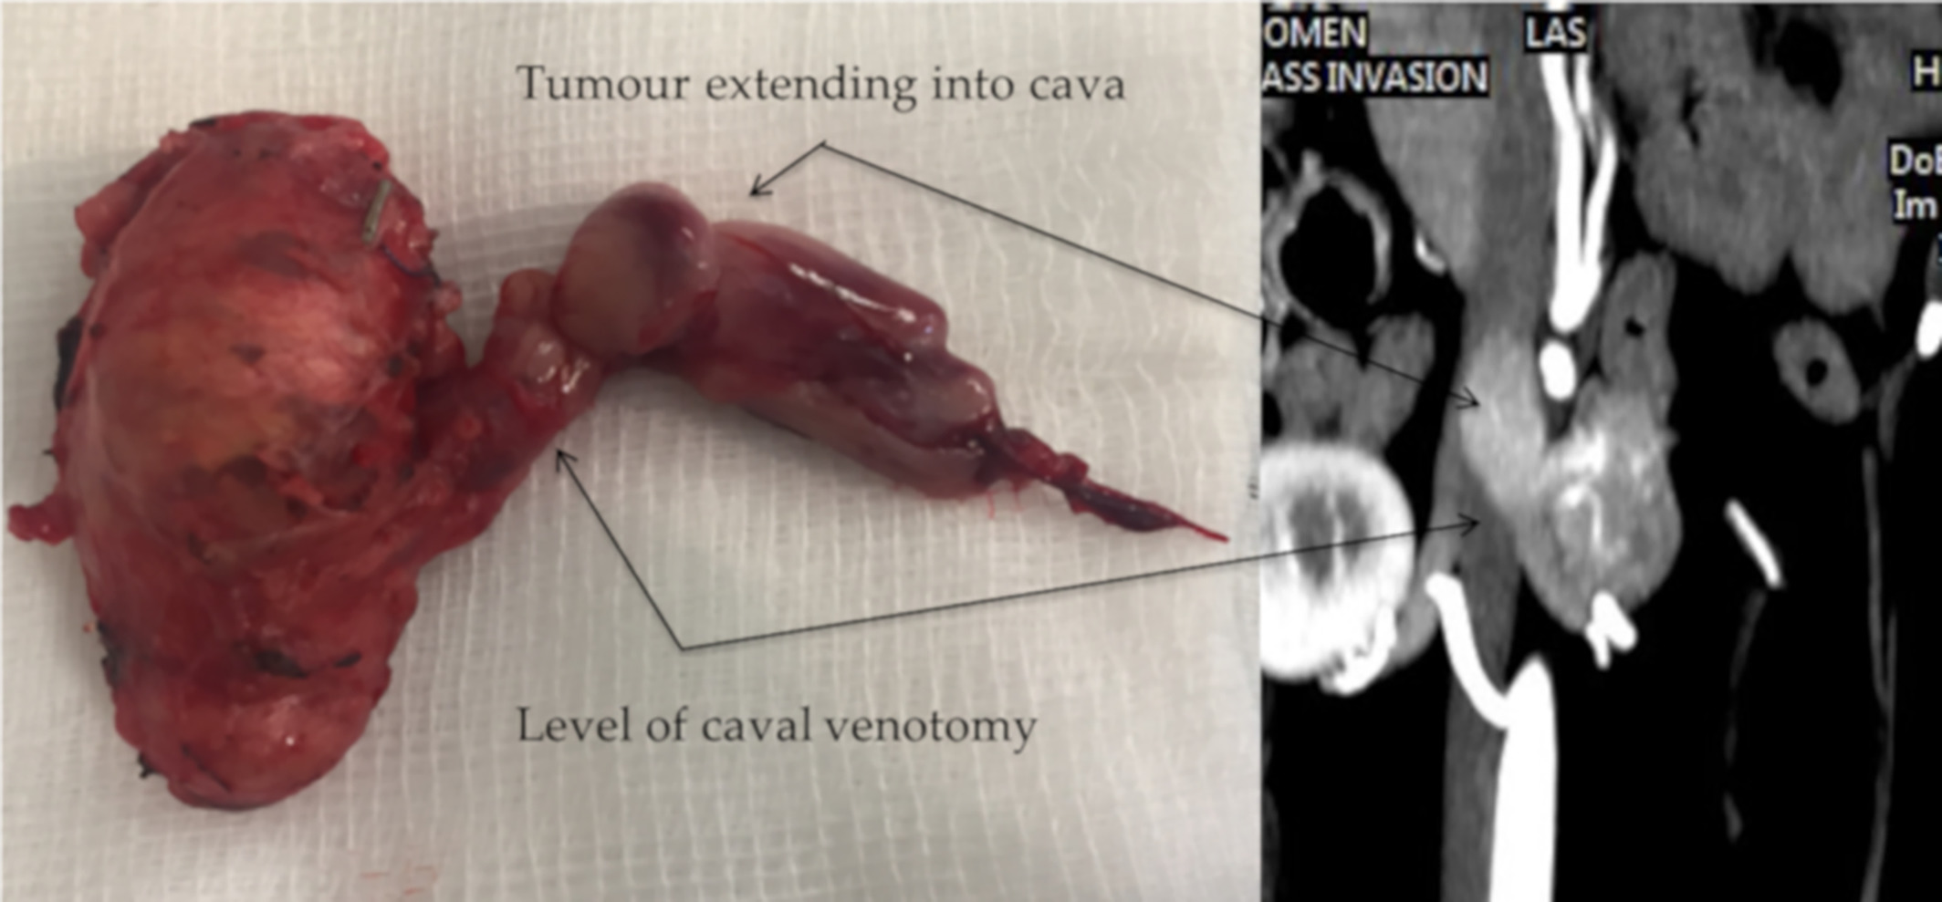
Notes:
They can also invade aorta, renal veins, and hepatic veins
Any tumor that invades adjacent structures should be considered malignant
Photo Source: Knight, RC, Lamb, CR, Brockman, DJ, Lipscomb, VJ. Variations in surgical technique for adrenalectomy with caudal vena cava venotomy in 19 dogs. Veterinary Surgery. 2019; 48: 751– 759. https://doi.org/10.1111/vsu.13168

Slide 23
True or False?
Pheochromocytoma are less likely to invade the caudal vena cava compared to adrenal cortial tumors.
False
Notes:
Pheos have higher likelihood for vena caval invasion that do adrenal cortical tumors

Slide 24
CT
Nonionic, low-osmolar contrast media (< adverse effects)
Lobulated irregularly-shaped mass associated with adrenal gland
MRI
Gadolinium contrast
May differentiate between histologic types of adrenal tumors
Scintigraphy
¹²³iodinemeetaiodobenzylguanidine (NE analog)
^{99m}technetium-methylene diphosphonate
Decreased intensity areas interspersed with highly vascular more intense areas
Sensitive and specific for invasion
Useful for identifying mets
p-[¹⁸F]fluorobenxylguani-dine on PET scan
Advanced Imaging
Notes:
- Very helpful for determining the size of the tumor and extent of invasion, but require GA

Slide 25
Catecholamine Testing
Urinary catetcholamine concentrations as a spot check referenced to urine creatinine over 24 hours are performed in humans

Slide 26
- Metanephrine
- Normetanephrine
- Vanillylmandelic acid
What are the urinary catecholamines measured?

Slide 27
Urinary normetanephrine 4x normal = highly suggestive
Dogs with Cushing’s can have increased concentrations of urinary catecholamines and normetanephrine compared to normal dogs. Excitement, exercise, vanilla-containing foods, phenoxybenzamine therapy, and radiographic contrast agents can also result in elevations. How does the urinary catecholamine test distinguish pheochromocytoma?
Notes:
Plasma metanephrine level have recently been described in cats → sick cats with non-adrenal illness had significantly higher normetanephrine levels than healthy cats and suspected pheo cat had markedly higher normetanephrine levels

Slide 28
Clonidine Suppression Test
Should decrease serum catecholamine levels in patients without pheochromocytoma, in which catecholamine release is not neurally mediated
Provocation Tests
Metoclopramide, histamine, tyramine, glucagon all cause increased catecholamine secretion from tumor
FNA
Difficult to obtain samples safely
Excisional biopsy preferred
IV Pentolamine
α-adrenergic antagonist
Will decrease BP if hypertension is catecholamine-mediated
Not recommended due to possibility of inducing a hypertensive crisis
LSA and pheochromocytoma appear similar cytologically when obtained from peritoneal effusion
Impression smear: round cell tumor
Tests Not Performed in Vet Med
Notes:
Clonidine and Pentolamine: varying sensitivity and specificity, especially considering paroxysmal hypertension. Not thoroughly evaluated in veterinary patients.
It is contraindicated to use Metoclopramide as an anti-emetic/pro-kinetic in these patients

Slide 29
Treatment
Preoperative Medications
  Non-competitive α-adrenergic blockade: Phenoxybenzamine 0.5-2.5 mg/kg PO q 12h
    At least 1 week prior to surgery
  Blunts hypertensive episodes during anesthesia
  Decreased mortality in people from 13-45% to 0-3%
Notes:
Definitive treatment = surgery

Slide 30
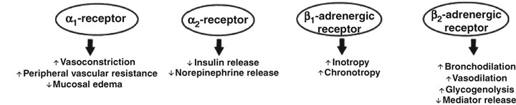
Treatment
Notes:
Photo Source: https://www.researchgate.net/figure/Adrenergic-effects-of-epinephrine-40-Reproduced-with-permission_fig2_23160006

Slide 31
Treatment
Preoperative Medications
  Non-competitive α-adrenergic blockade: Phenoxybenzamine 0.5-2.5 mg/kg PO q 12h
    At least 1 week prior to surgery
  Blunts hypertensive episodes during anesthesia
  Decreased mortality in people from 13-45% to 0-3%
  Competitive inhibition: α-Methylparatyrosine
    Inhibits tyrosine hydroxylase, thereby interfering with catecholamine biosynthesis
Notes:
Combination therapy has been reported, but is associated with significant side effects and is not studied in veterinary patients

Slide 32
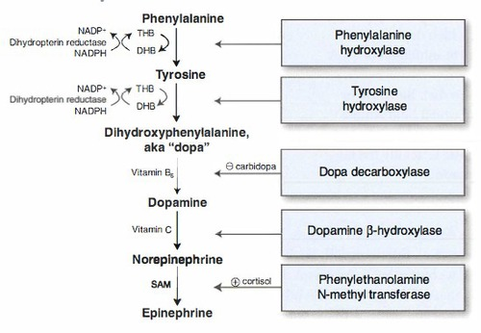
Treatment
Notes:
Photo Source: https://quizlet.com/142291331/catecholamine-synthesis-biochemistry-flash-cards/

Slide 33
Treatment
Anesthesia
  Which medications should be avoided and why?
    Anticholinergics → tachycardia
    Barbiturates → ventricular arrhythmias in the presence of excess catecholamines
    α-adrenergic antagonists (Acepromazine), especially if pre-treated with Phenoxybenzamine → can complicate BP
  Consider induction: opioid + benzodiazepine + propofol/etomidate
  Consider maintenance: Isoflurane/Sevoflurane (Halothane sensitizes myocardium to catecholamines; Desflurane→ sympathetic stimulation)

Slide 34
Treatment
Intraoperative Medications
  To maintain normal hemodynamics:
    Short-acting β-blockers: Esmolol (0.05-0.5 mg/kg IV, then 10-200 mcg/kg/min IV CRI)
    Nitroprusside (0.5-5 mcg/kg/min IV CRI)
    Magnesium sulfate: used in humans for vasodilation
  For arrhythmias
    Lidocaine (ventricular)
  If cardiovascular collapse after tumor removal:
    Phenylephrine (0.5-5 mcg/kg/min IV CRI)
    Norepinephrine (0.1-2 mcg/kg/min IV CRI)

Slide 35
Treatment
Monitoring
  Pre-op blood type
  Continuous ECG
  Direct arterial BP: maintain close to resting BP to prevent renal hypoperfusion
  Urine output
  Body temperature: active cooling may protect tissues from disrupted blood flow and ischemia during venotomy
  Central venous pressure
    Estimates intravascular volume
    Pulmonary arterial catheter placement = associated w/ increased morbidity, but gives valuable info ~ cardiac output and SVR

Slide 36
Treatment
Surgical Excision
  May require vena cava venotomy or nephrectomy to fully remove tumor
  Perioperative mortality for dogs:
    6% if elective
    50% if emergency due to adrenal hemorrhage
  Preoperative hypokalemia and elevated BUN + nephrectomy = shorter survival time
  Thorough abdominal explore: 15% mets, 39% locally invasive tumors

Slide 37
- Adrenal size
- Acute hemorrhage
What two factors are predictive of perioperative mortality for pheochromocytoma?

Slide 38
- Parathyroid and thyroid
- Multiple endocrine neoplasia: heritable in people with 2 or > endocrine neoplasias/hyperplasias
In addition to pheochromocytoma, what are the other neoplasias/hyperplasias commonly associated with MEN? What is MEN?
Notes:
In one study, concurrent neoplasia of various cellular origin was identified in 54% of dogs with pheochromocytoma

Slide 39
Treatment
Postoperative Monitoring
  24-72h = severe complications window:
    Hypotension
    Bradycardia
    Ventricular arrhythmias
    Tachypnea/dyspnea
    Vomiting
    Internal hemorrhage
    Incisional dehiscence
    DIC
    CPA

Slide 40
Treatment
Postoperative Monitoring
  Other complications
    PTE → mechanism = unclear; may need post-op anticoagulation
    AKI
    Acute pancreatitis
  Postoperatively, hypertension may not resolve even with complete tumor excision
  If bilateral adrenalectomy → glucocorticoid + mineralocorticoid supplementation
  Decreased sensitivity to catecholamines (from chronic stimulation) may require vasopressin for hypotension
Notes:
Vasopressin: non-catecholamine pressor

Slide 41
Treatment
Nonresectable or Metastatic Disease
  Phenoxybenzamine
  Oral β-blockers
    Not concurrently with α-blockade, though, as loss of β₂ receptor-mediated vasodilation may exacerbate hypertension
  Anti-arrhythmic agents PRN
  Diuretics if indicated based on clinical signs
  Chemotherapy or radiotherapy – not reported in vet med, but not rewarding in people

Slide 42
Guarded
Animals that survive surgery and immediate postoperative period can have good survival times: 18 mo – 4 yr
Factors associated with 10-day postoperative survival
Younger age
Factors Associated with poorer prognosis
Lack of intraoperative arrhythmias
Shorter surgical time
Preoperative Phenoxybenzamine
Neurologic deficits
Weight loss
Abdominal distension
Acute hemorrhage (tumor rupture)
>/= 5 cm major axis length
Neighboring structure invasion
Metastasis
Venous thrombosis
Recurrence of primary tumor = rare
Prognosis
Notes:
In people, multiploidy (i.e. aneuploidy or tetraploidy) in nuclear DNA of the tumor cells = assoc. w/ worse prognosis

Slide 43
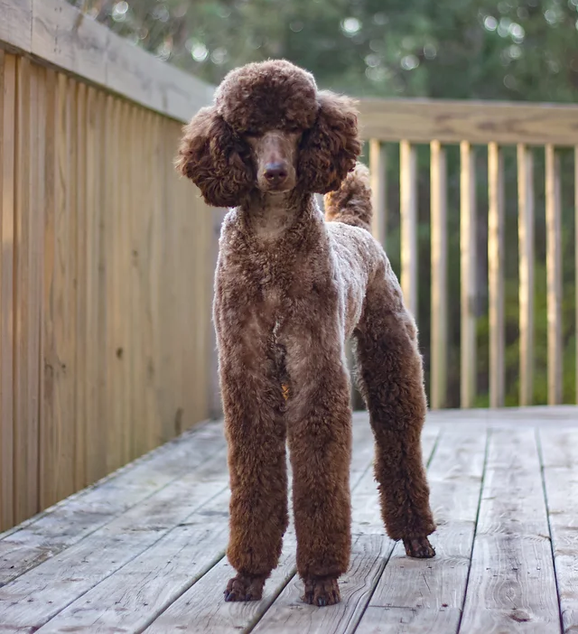
Case 2: Bliss
Notes:
Photo Source: https://www.kettlecovestandardpoodles.com/

Slide 44
Case 2: Bliss
Signalment, History
PE
7 yo FS Standard Poodle
Collapse
Possible seizure
Disorientation (bumping into things)
Restlessness
Dull mentation
Absent menace OU
Marked non-ambulatory generalized weakness

Slide 45
Case 2: Bliss
VBG: Mild acidemia characterized by mild respiratory acidosis (pH 7.33, pCO2 47), normal lytes, BG 40, HCT 47%, lact 1.8
POCUS: no effusion
0.5 mL/kg 50% Dextrose IV bolus diluted 1:1 with 0.9% NaCl
Recheck BG: 46 mg/dL
Bolus repeated → BG 22 mg/dL
Offered food: RAVENOUSLY ate

Slide 46
Case 2: Bliss
DDX
Diagnostics
Hypoadrenocorticism (atypical)
Sepsis
Insulinoma
Xylitol Intoxication
Paraneoplastic
Baseline cortisol: 6 mcg/dL
Normal leukogram, no fever, normotensive
Normal AUS and CXR
No xylitol in the house…

Slide 47
Paired Insulin-Glucose
What would expect if Bliss has an insulinoma?
HIGH insulin in the face of LOW glucose

Slide 48
- Beta
- Pancreas
Insulinoma is a tumor of the _______ cells of the ____

Slide 49
Make, store, and release insulin as well as glucagon, somatostatin, gastrin, serotonin, pancreatic polypeptide.
Insulinomas also contain amphicrine cells, expressing insulin and pancreatic lipase.
What do these cells do?
Notes:
- Occurrence of mixed clinical syndromes is rare despite these tumors/cells producing multople hormones

Slide 50
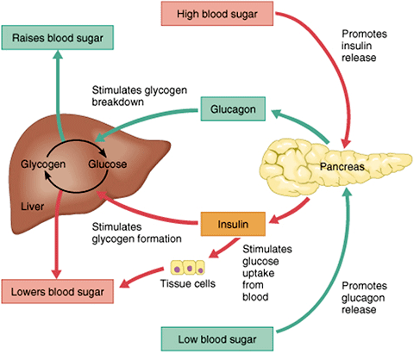
Glucose enters β-cells via GLUTs (facilitative glucose transporters) in an insulin-independent fashion
Insulin is released as BG increases and then plateaus until BG decreases below physiologic set point at which point negative feedback stops insulin release
Neoplastic cells do not respond to the negative feedback
  Maybe b/c of upregulated glucokinase (GCK): catalyzes 1st step of cellular glucose metabolism and acts as glucose sensor in cells
Notes:
- Insulin-independent glucose uptake in pancreatic beta cells is contrary to most other cells
Photo Source: https://www.atrainceu.com/content/4-regulation-blood-glucose

Slide 51
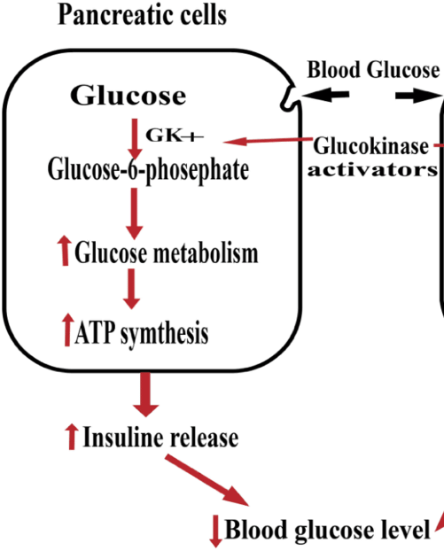
Neoplastic cells do not respond to the negative feedback, maybe b/c of upregulated glucokinase (GCK)
  Catalyzes 1st step of cellular glucose metabolism
  Acts as glucose sensor in cells
Notes:
Photo Source: https://www.researchgate.net/figure/The-role-of-Glucokinase-activators_fig1_338494533

Slide 52
If paired insulin-glucose is non-diagnostic…
Amended insulin/glucose ratio (AIGR)
  AIGR = (insulin * 100) / (plasma glucose – 30)
    Denominator of 1 is used if BG is < 30 mg/dL
  AIGR > 30 suggests insulinoma
  Rec. perform on 4 samples to improve sensitivity
Notes:
Some animals will have intermittent episodes of hypoglycemia and hyperinsulinemia that may require a supervised fast or multiple samples to identify

Slide 53
Problem with AIGR
Other Tests
Other causes of hypoglycemia can also have abnormal ratio
Low fructosamine
Provocative tests: not more sensitive, may cause hypoglycemia
  Glucagon tolerance
  Oral glucose tolerance
  Tolbutamide tolerance
  Epinephrine stimulation

Slide 54
True or False?
Abdominal ultrasound is a reliable test for insulinoma detection.
False
Notes:
- AUS may or may not reveal a mass or nodule in the pancreas
- Low sensitivity of 36%

Slide 55
Diagnostics for Insulinoma Detection
Contrast Enhanced CT
MRI scintigraphy
Surgical exploration
96% sensitive for primary tumor
67-75% sensitive for mets
Notes:
- PET-CT is also being used more now
- CXR are indicated for met check

Slide 56
Treatment
Emergency
  IV Dextrose can stimulate the release of more insulin → worse hypoglycemia
  Hyperinsulinemia depresses glucagon secretion, thereby removing one counterregulatory mechanism for maintaining euglycemia
  Consider glucagon CRI: 50 ng/kg IV, then 5-40 ng/kg min IV CRI
    Run as low as possible to eliminate clin signs and maintain low normal BG
  Consider glucocorticoids (prednisone, dexamethasone) to antagonize insulin effects and stimulate gluconeogenesis

Slide 57
Treatment
Medical
Surgical
Dietary: small frequent feedings of foods low in simple sugars
Diazoxide directly inhibit pancreatic insulin secretion
  If not available of not tolerated or too $$, consider glucocortidoids (prednisolone 0.25 mg/kg PO q 12h)
Streptozocin: selectively destroys β-cells
Octreotide: suppresses insulin synthesis and secretion
Alloxan: β-cell cytotoxin
Palliative: 50% of patients have mets at surgery and majority have occult mets
Feed canned food 6h pre-op to prevent hypoglycemia
  Liquid food preparations for up to 1-2h pre-op if becoming clinical for BG
Balanced electrolyte fluid with 2.5-5% dextrose intra-op → stopped once primary tumor is removed
Insulinoma enucleation vs. partial pancreatectomy based on tumor location
Notes:
If pt does not stabilize and is still seizuring/cannot get a meal, consider glucagon (50 ng/kg, then 5-10 ng/kg/min IV CRI)
Short leash walks
Diazoxide also stimulates hepatic gluconeogenesis and glycogenolysis and inhibits glucose uptake by tissues (5 mg/kg PO q 12h)
Octreotide: somatostatin analog
Potential future for insulinlike growth factor 1 (IGF-1) targeting, as it is expressed by primary tumor and mets

Slide 58
Post-Operative Complications
Acute pancreatitis (10%)
Inappetence, vomiting (24-27%)
Persistent hypoglycemia (23%) → guarded prognosis b/c tumor cells were left behind
Hyperglycemia (33%) → transient until remaining β-cells regain function
Diabetes mellitus (19%), especially if bulk of pancreas was resected

Slide 59
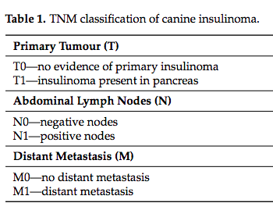
Prognosis
Guarded
Clinical hypoglycemia almost always returns
Medical + surgical > medical alone
  MST_{both} = 14 mo (12 mo disease free)
  MST_{med} = 4 mo
Prognostic factors
  TMN stage
  Age (worse if young)
  Postop BG (worse if low)
TMN Stage
  I: disease-free interval (DFI) = 14 mo
  II and III: DFI = 1mo
  I and II: MST = 18 mo
  III: MST = 6 mo
Biomarker: Ki67 > 2.5% -significantly shorter DFIs and MSTs
T1N0M0: clinical stage I
T1N1M0: clinical stage II
T0N0M1,T1N0M1, or T1N1M1: clinical stage III
Notes:
- TNM: tumor, node, metastasis
- Return of hypoglycemia d/t mets or tumor regrowth

Slide 60
Sources
Buishand, Floryne O. “Current Trends in Diagnosis, Treatment and Prognosis of Canine Insulinoma.” Veterinary sciences vol. 9,10 540. 29 Sep. 2022, doi:10.3390/vetsci9100540
Knight, RC, Lamb, CR, Brockman, DJ, Lipscomb, VJ. Variations in surgical technique for adrenalectomy with caudal vena cava venotomy in 19 dogs. Veterinary Surgery. 2019; 48: 751– 759. https://doi.org/10.1111/vsu.13168
Marchetti, Piero et al. “Pancreatic Beta Cell Identity in Humans and the Role of Type 2 Diabetes.” Frontiers in cell and developmental biology vol. 5 55. 23 May. 2017, doi:10.3389/fcell.2017.00055
Silverstein and Hopper. Chapter 71: Pheochromocytoma and Chapter 66: Hypoglycemia. Small Animal Critical Care Medicine, 2nd ed., Elsevier, St. Louis, MO, 2015, pp. 371-375.

