Slide 1
Ventilator Waveforms
Katie Sotos, DVM
November 11, 2022

Slide 2
Waveform Types

Slide 3
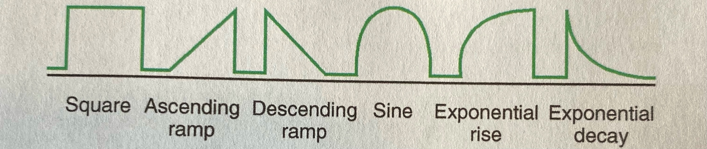
General Terminology
Scalars: single parameter plotted over time
  Square
    Abrupt change but held near constant over time
  Ramp: ascending, descending, exponential rise, exponential decay
    Gradual change with constant (ramp) or variable (exponential) rate of change
  Sine
    Patient efforts, i.e. CPAP or SIMV
Notes:
Six characteristic shapes of scalars

Slide 4
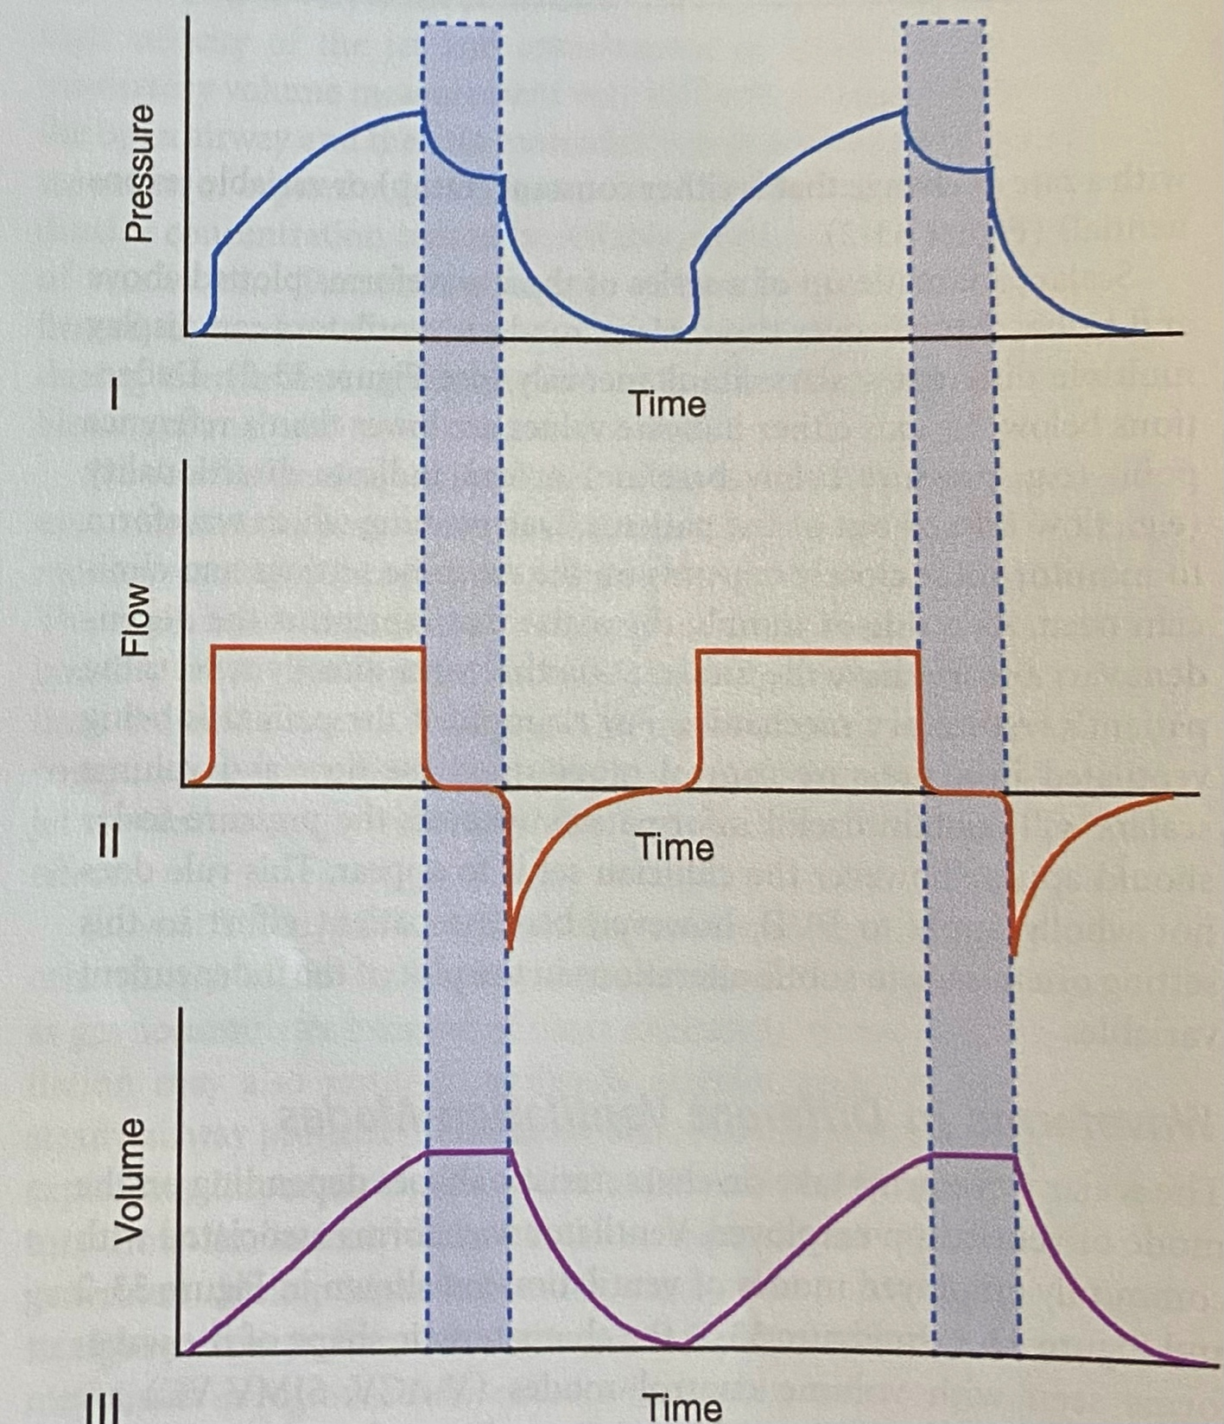
General Terminology
Scalars
Notes:
Many modern ventilators can display multiple different scalars at once
Deflections below the axis can indicate values are lower than a reference point (i.e. pressure below baseline) or can indicate directionality (i.e. flow into or out of the pt)

Slide 5
The scalar that represents the ______ variable will have the information that most directly reflects the patient’s respiratory mechanics
Dependent
Notes:
i.e. if you are in pressure control mode, the flow and volume scalars will have the most useful information and the pressure scalar will be how the clinician set it
Does not apply in patient-ventilator dysynchrony

Slide 6
General Terminology
Loops: two parameters plotted simultaneously
Notes:
More later

Slide 7
Recognizing Ventilation Modes

Slide 8
These scalars reflect a patient being ventilated in volume control.
(Plus an inspiratory hold)

Slide 9

How can you tell? & other questions
Pressure waveforms have exponential rise shape
Flow is constant (square)
What does an inspiratory hold allow us to do?
    Determine Pplat and thereby resistance of the system by allowing for intrapulmonary distribution of gas (“pendelluft”)
Notes:
Some ventilators do allow for a descending ramp flow profile which has several potential benefits
Scalar Source: Silverstein
Plateau Pressure Words Source: Deranged Physiology website

Slide 10
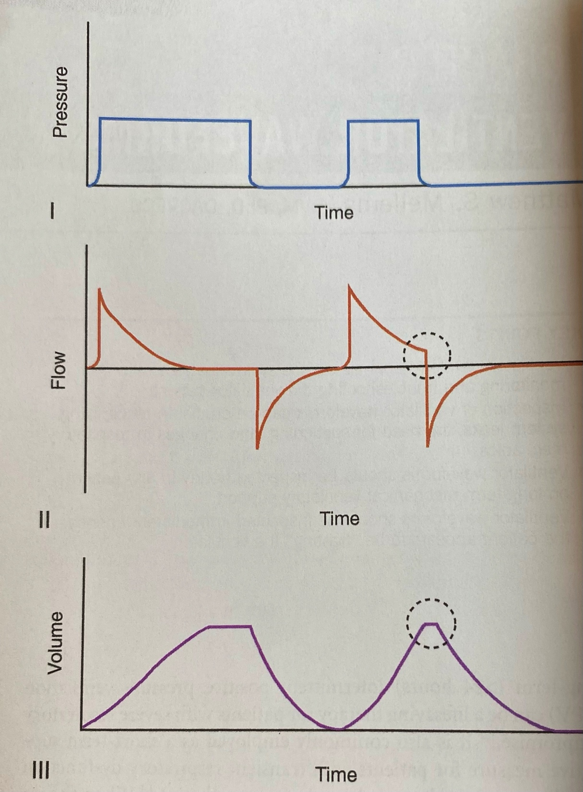
These scalars reflect a patient being ventilated in volume control.
PRESSURE CONTROL
(Note that you can still
apply an inspiratory hold
and when applied in pressure
control mode, the plateau
appears in the volume scalar,
too)

Slide 11
How can you tell?
Pressure waveforms now has the square shape
Flow waveform now has exponential decay
Volume scalar shape may be the same as volume control modes’
Notes:
Some ventilators do allow for a descending ramp flow profile which has several potential benefits
Scalar Source: Silverstein
Plateau Pressure Words Source: Deranged Physiology website

Slide 12
Volume control
Pressure control
Notes:
Volume control:
- Pressure waveforms = exponential rise
- Flow waveforms = square
Pressure control:
- Pressure waveforms = square
- Flow waveforms = exponential decay
The waveforms of the second breath in the pressure control mode are typical profiles for pressure support modes (i.e. SIMV + PS)
- Inspiratory flow reaches 30% of peak flow and this triggers the cycle off; in other words, inspiratory flow does not reach zero before exhalation begins
- Volume plateau is therefore minimal because flow does not reach zero

Slide 13
What does SIMV stand for?
Synchronized Intermittent Mandatory Ventilation

Slide 14
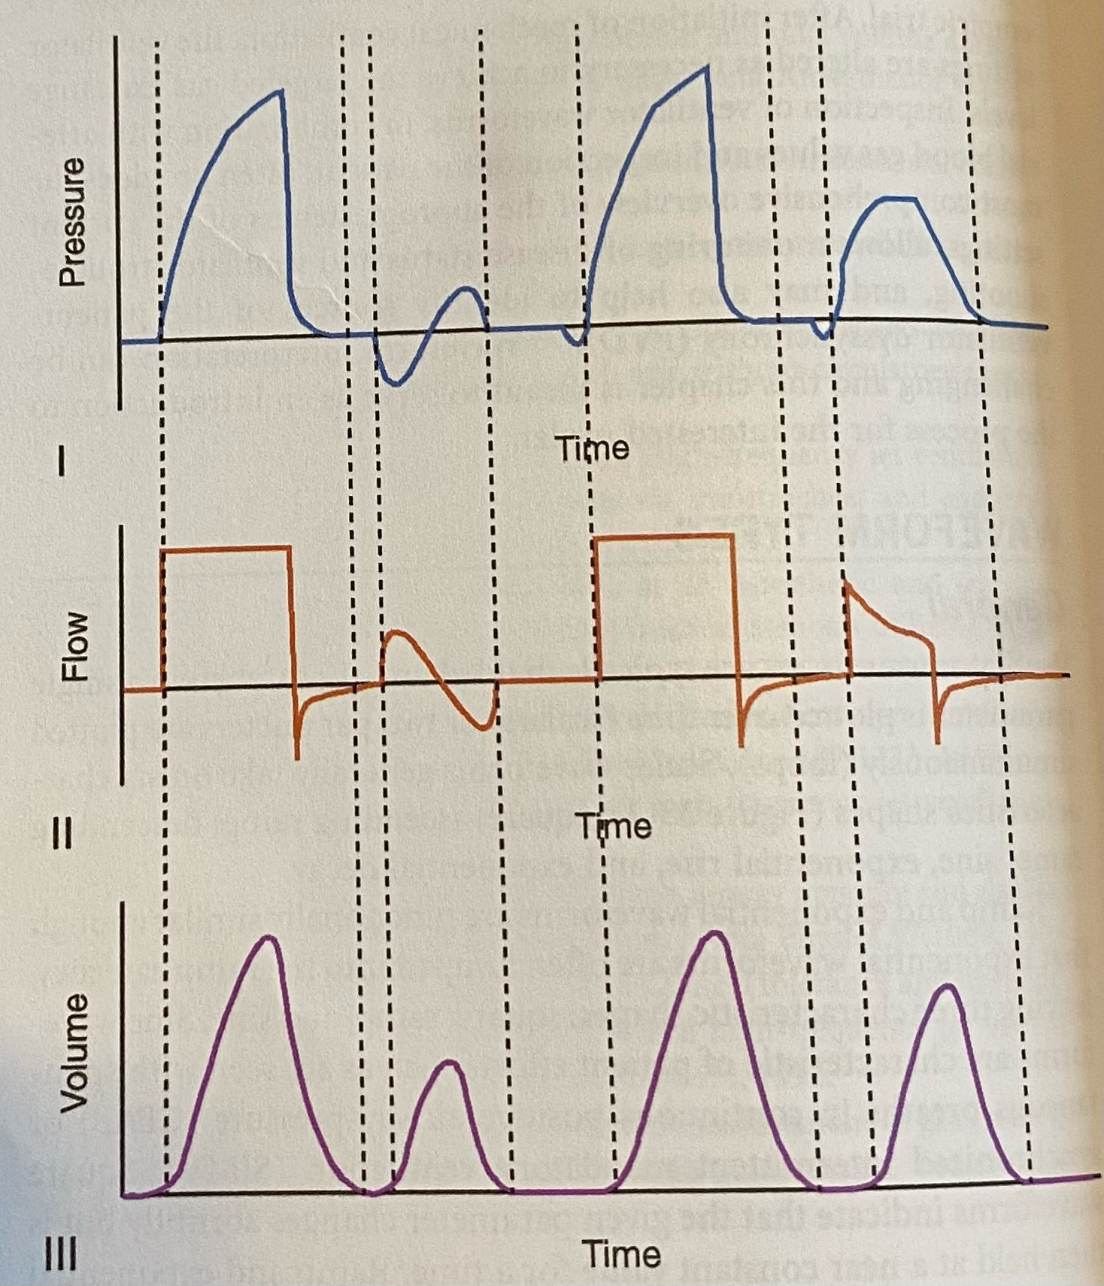
This is SIMV + ____ control
volume
Notes:
Volume because the flow is square

Slide 15
Waveforms seen in SIMV + VC
A
B
C
D
Notes:
A: mandatory breath; no inspiratory hold, so exhalation begins when the target tidal volume has been achieved
B: spontaneous breath, sine wave
- First part of the pressure scalar is negative because the patient is breathing against the machine in a normal negative pressure and not PPV-delivered breath; tidal volume is lower than mandatory breath
C: synchronized, patient-triggered but machine-delivered breath b/c pt’s inspiratory effort fell within the time the machine was supposed to delivered a mandatory breath
D: PRESSURE support, patient triggered, ceased @ 30% of peak inspiratory flow

Slide 16
Pressure Waveform
Notes:
Usually exponential rising (in VC modes with constant flow) or square (when in PC)
VC modes with exponential decay flow → more rounded, less square

Slide 17
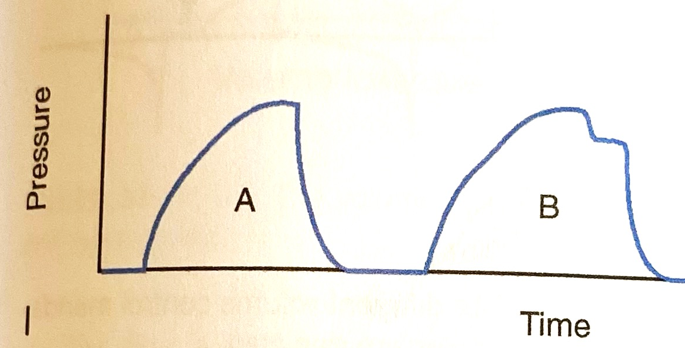
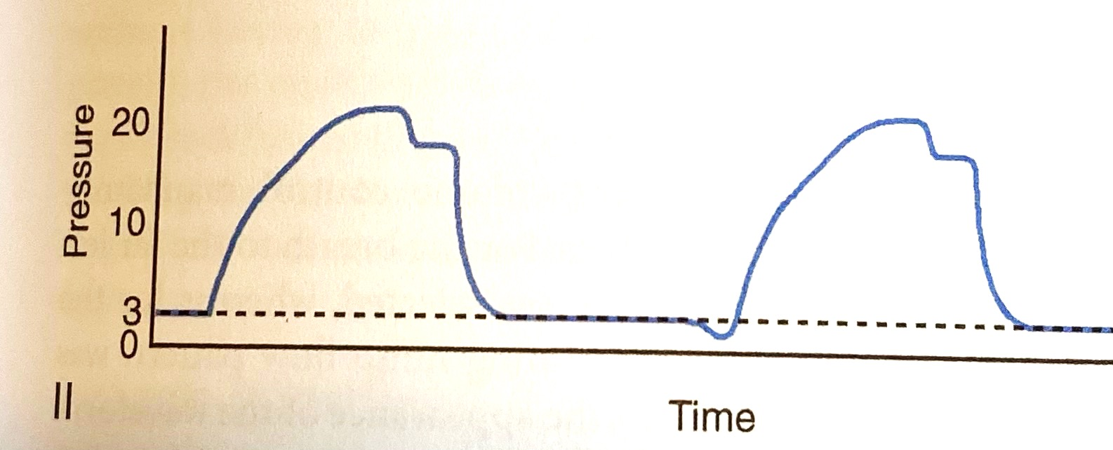
What is the difference between these two pressure waveforms?
The one on the right has PEEP applied
Notes:
Pressure does not return to baseline, but rather to PEEP

Slide 18
What does this divot in the pressure waveform mean?
Patient Effort
Notes:
If it stayed below baseline, that could indicate artifact or circuit leak, as well.

Slide 19
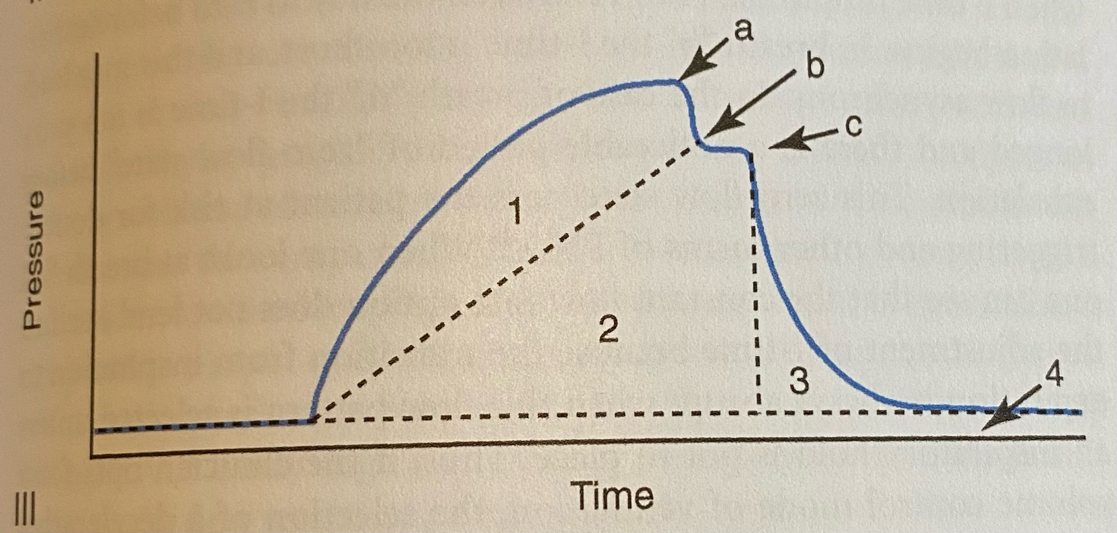
A
Work throughout expiratory flow phase
C
Work to overcome circuit & airway resistances
1
Peak inspiratory pressure (PIP)
2
Plateau pressure (Pplat)
3
Work to deform lung and expand alveoli
Notes:
B: if you do not hold an inspiratory hold long enough, you can use this value to calculate quasistatic compliance (Cqs)
4: PEEP
An increase in the surface area of any of the pressure regions without equivalent decrease in another will result in higher mean airway pressures

Slide 20
How do you calculate dynamic compliance?
Tidal volume / (PIP-PEEP)
PIP
Pplat
PEEP

Slide 21
How do you calculate static compliance?
Tidal volume / (Pplat-PEEP)
PIP
Pplat
PEEP
Notes:
With static compliance, you remove the component of resistance from the equation

Slide 22
Dynamic compliance is GREATER THAN static compliance
Compliance = ΔV/ΔP
Static compliance: ΔV/ΔP in the absence of air flow
Dynamic compliance: ΔV/ΔP in the presence of air flow
- When there is flow, there is resistance
- Resistance pressure drop increases with increasing airflow,
especially with turbulence
- Airway resistance increases the pressure at every volume
- Increasing the denominator thereby decreases the
product

Slide 23
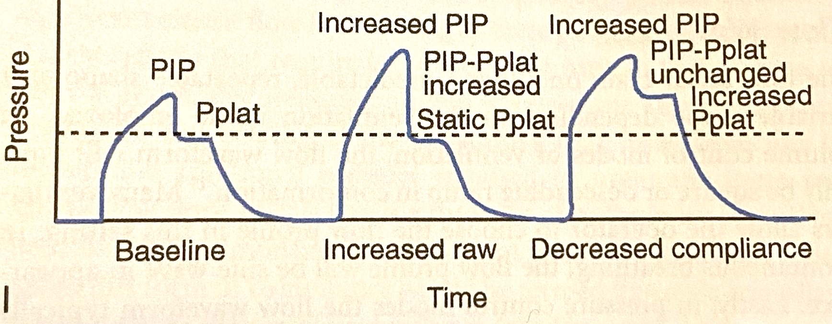
Troubleshooting Increased PIP: Inspiratory Hold
Airway resistance (Raw) = pressure/flow
Increased PIP without increased Pplat → increased Raw
Increased PIP with increased Pplat → decreased compliance
Notes:
Increased Raw: PIP-Pplat ends up being higher, so the numerator is higher as long as flow is the same, which it is if you do a hold and stop flow
Decreased compliance: PIP-Pplat is the same, so resistance has not changed, which means compliance has if the same volume delivered results in higher pressure

Slide 24
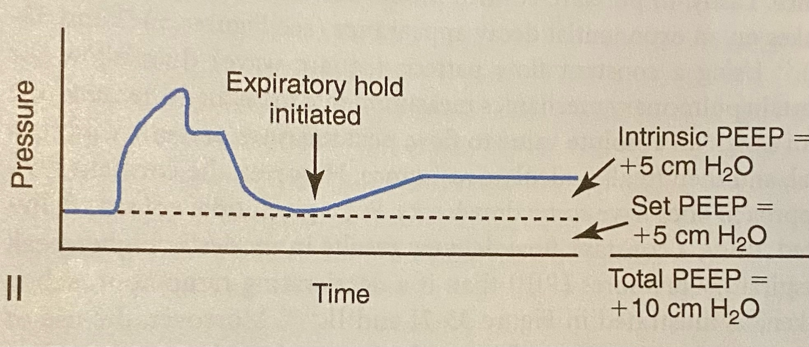
Expiratory Hold
Helps to determine if intrinsic PEEP is present and > set PEEP
Stop flow within the circuit, preventing the ventilator from delivering another breath in this time
The pressure from hyperinflated alveoli pendelluft around the respiratory circuit to be shared by all components and to be measured as intrinsic or auto-PEEP

Slide 25
Flow Waveform
Notes:
- Usually square or descending ramp (in VC modes), sine in spontaneous breathing, and exponential decay (in PC modes)

Slide 26
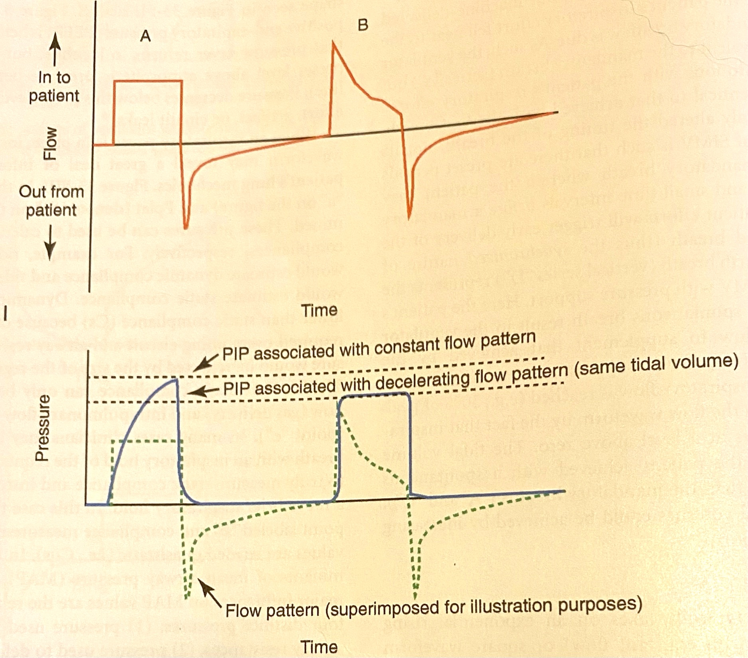
What is one benefit to descending ramp flow when in volume control mode?
Improved patient comfort

Slide 27
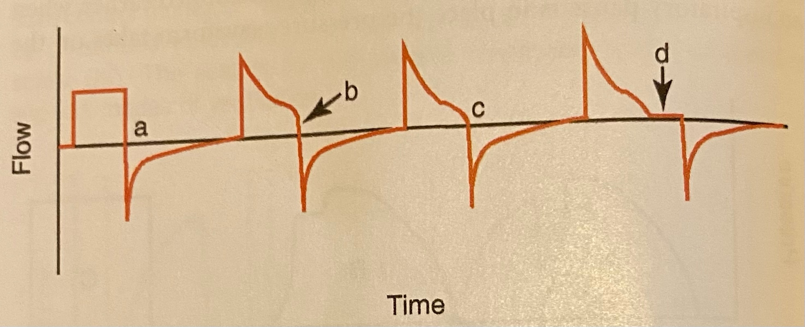
A
B
Optimal I-time
C
Constant Flow
D
I-time too short
I-time too long
Notes:
These are all volume control mandatory breaths
A: Transition from inspiration to expiration is always abrupt unless an inspiratory hold is put in place
B: May lead to flow asynchrony
C: Flow drops to 30% of peak inspiratory pressure before exhalation begins
D: noticeable period of “zero-flow state” before exhalation; puts pt at risk of double triggering and other forms of dysynchrony

Slide 28
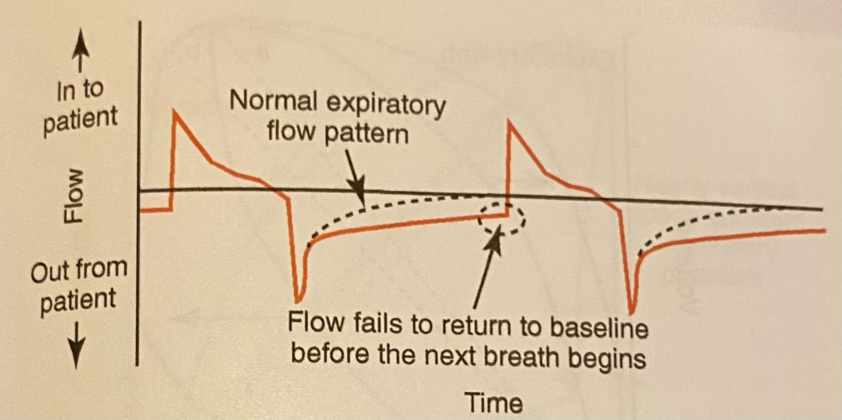
Flow scalar can be used to detect auto-PEEP without an expiratory hold
Notes:
When the expiratory flow does not return to zero before the next breath is delivered, auto-PEEP can occur

Slide 29
Volume Waveform
Notes:
Of the pressure, flow, and volume scalars, volume usually contains the least amount of info that might lead to a ventilator setting being changed because most ventilators provide numerical volume outputs in addition to scalar/graphical ones
They can be helpful, though, for obtaining a relative size of spontaneous vs. mandatory breaths during SIMV or CPAP
Volume and flow parameters are linked to each other

Slide 30
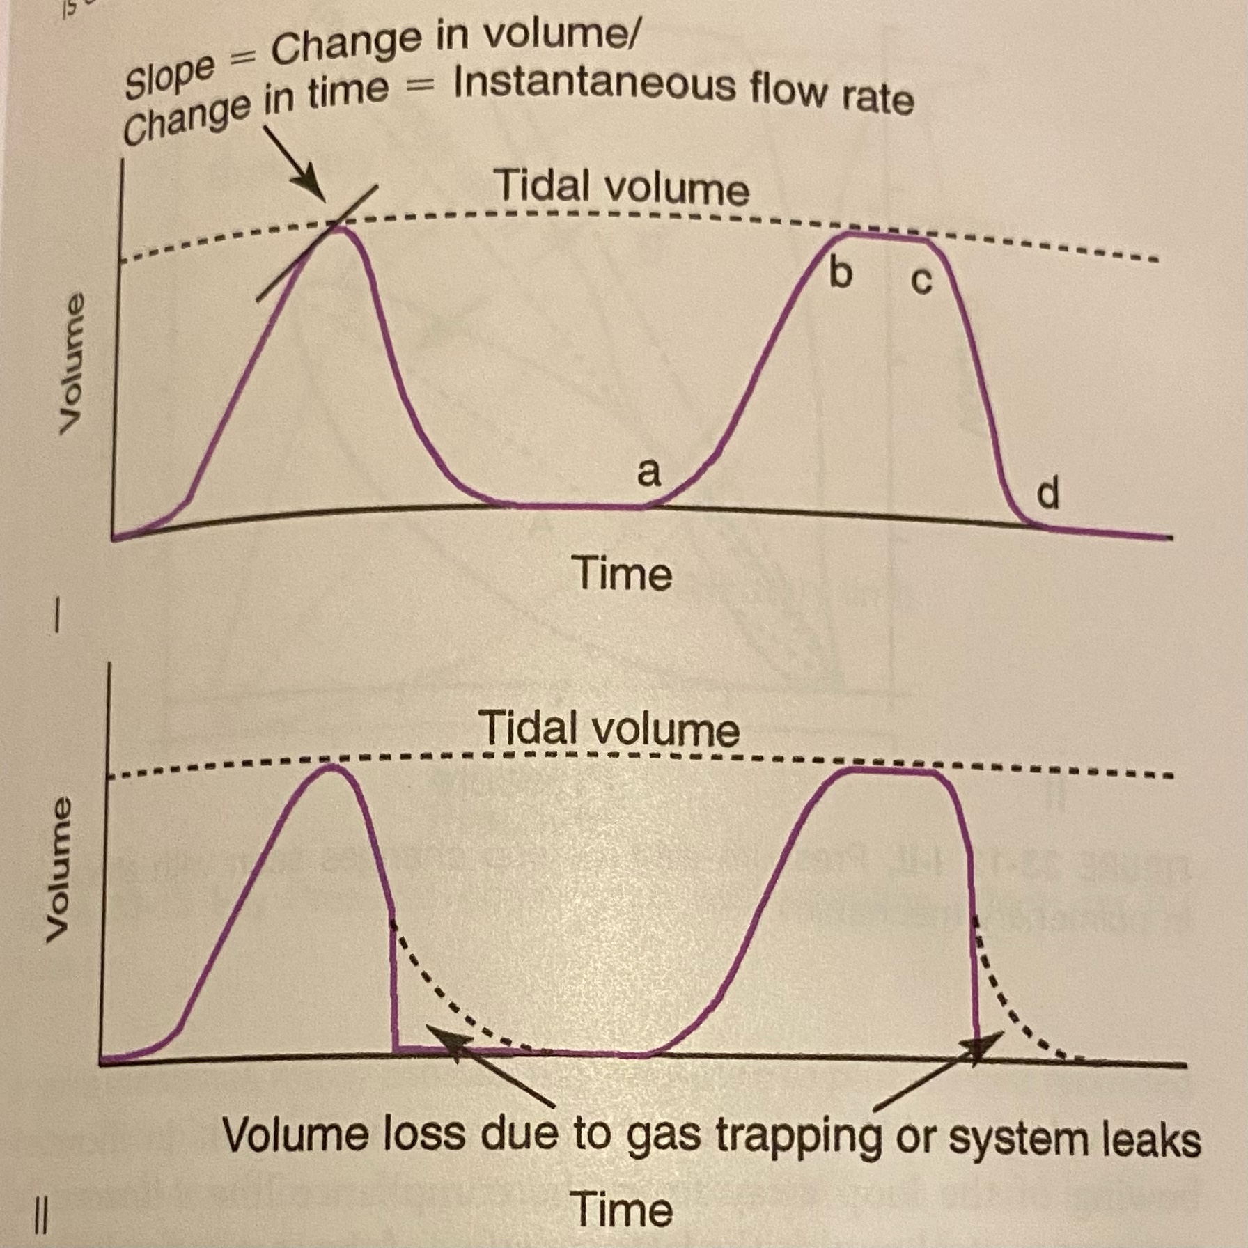
Volume Waveform Uses
  Slope of volume curve = instantaneous flow rate
  What to expect from the flow scalar (next slide)
  Tidal volume determination
  ID circuit leaks or air trapping
Notes:
Instantaneous flow rate = delta V / delta t
If a volume waveform makes a vertical plunge to baseline in mid-late expiratory phase, more volume came IN across the flow sensor than came BACK → leak in circuit or air trapping

Slide 31
What would you expect to see on the flow scalar between points…
A and B
Plateau (not at 0)
B and C
Negative deflection
C and D
Positive deflection
Zero flow

Slide 32
Pressure-Volume Loops
(PV Loops)

Slide 33
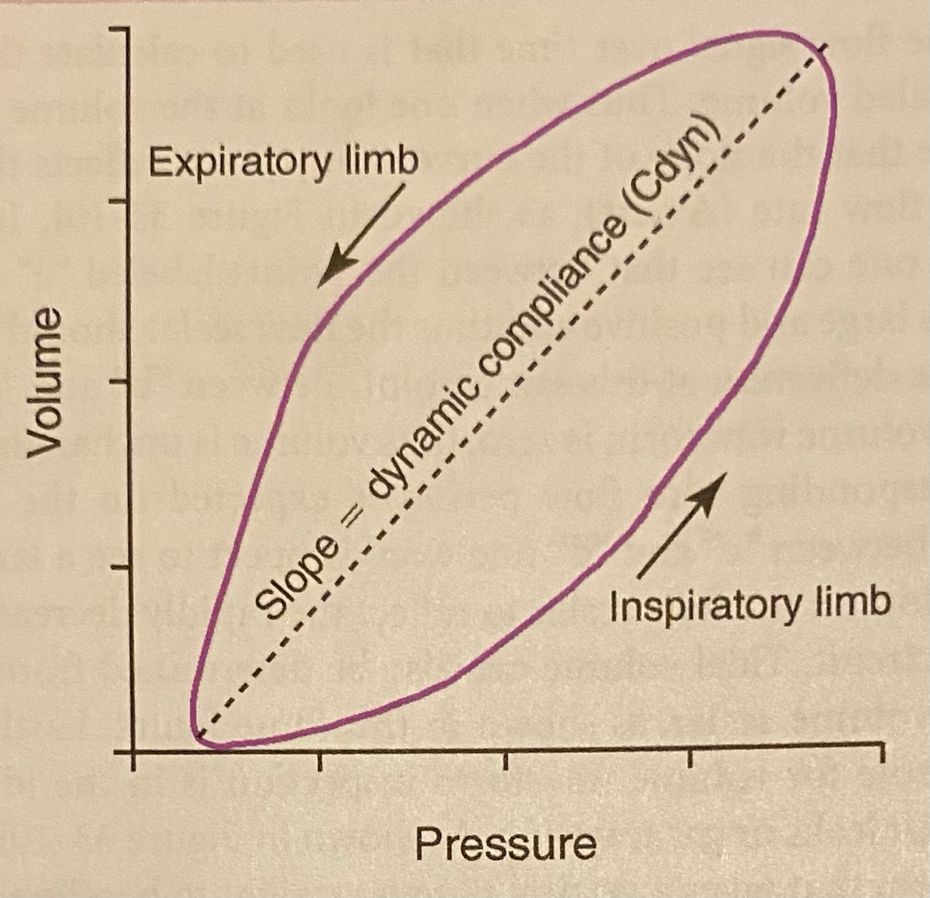
Machine-Triggered Breath
V_{T}
PEEP
PIP
Notes:
Inspiratory limb: lung inflation corresponds with a rise in circuit pressure
Pressure does not begin at zero, indicating this patient is receiving PEEP
Highest pressure reading = PIP
Highest volume reading = Vt
Dashed line connects starting and end-inspiratory points → constant flow is going through the circuit at these times, so the slope = delta V / delta P = dynamic compliance
Bowing of the inspiratory limp away from this line reflects the pressure required to overcome resistance

Slide 34
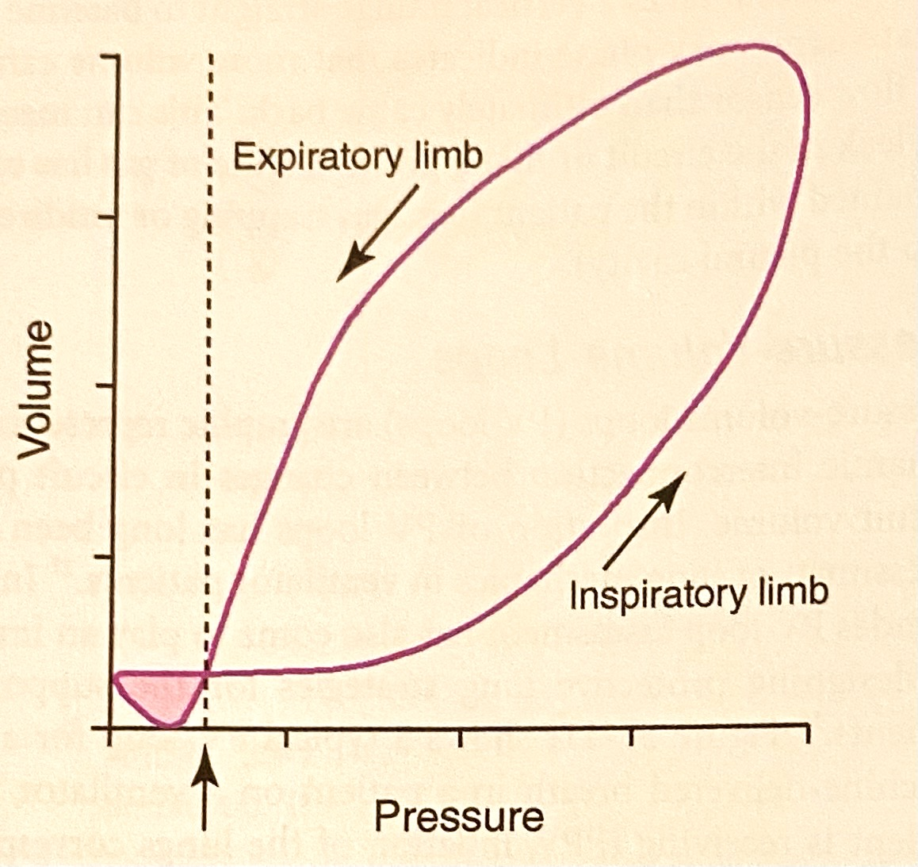
How can you tell this is a patient-triggered breath?
Initial volume added to the circuit results in a decrease in circuit pressure
PEEP
Notes:
“Figure 8” type loop
PVD may result in small patient-generated loops at other places in the tracing
Once the triggering threshold below PEEP is generated, the machine will deliver a mandatory breath
Size of the shaded region indicates the work being done by the patient to trigger the breath
As you change the trigger (to make it more or less sensitive), the size of the shaded region will change too
s

Slide 35
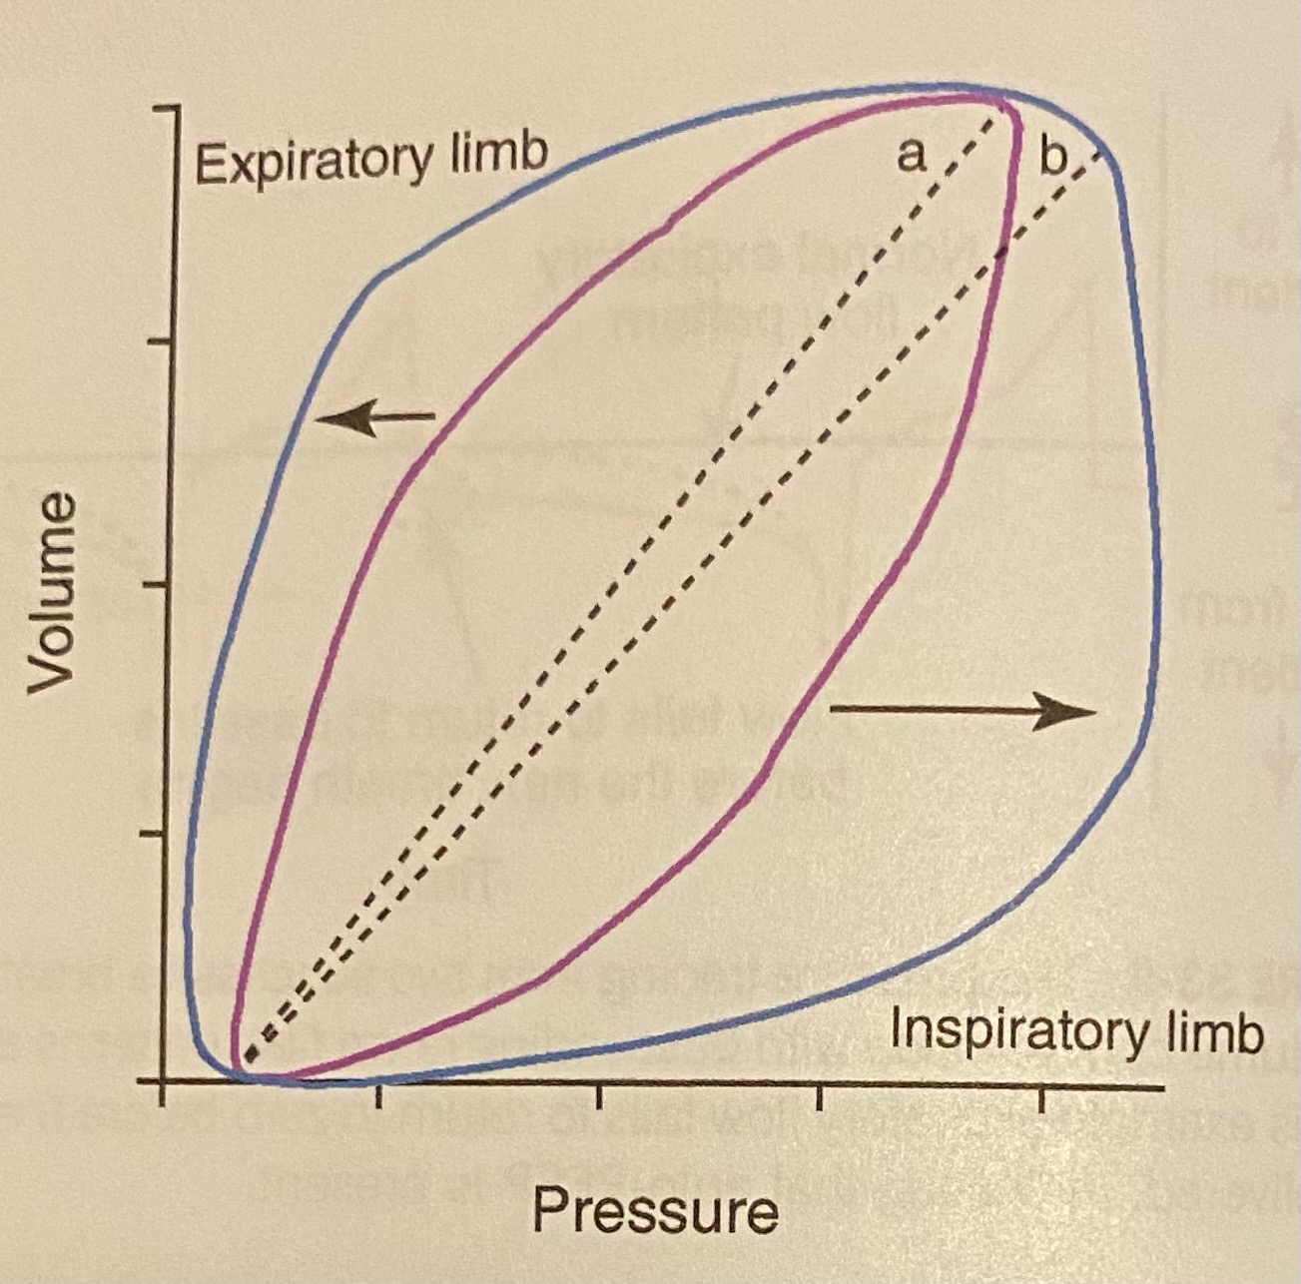
What has happened that resulted in the blue loop?
Increased Resistance
Notes:
The blue loops bows out farther from the dynamic compliance line, indicating that a greater applied pressure is required to overcome resistance and reach a certain volume
Cdyn line b has a decreased slope compared to Cdyn line a
Bowing can also be caused by providing the same tidal volume at a more rapid flow rate (because, remember, all airflow comes with resistance and this resistance increases at higher flow rates)

Slide 36
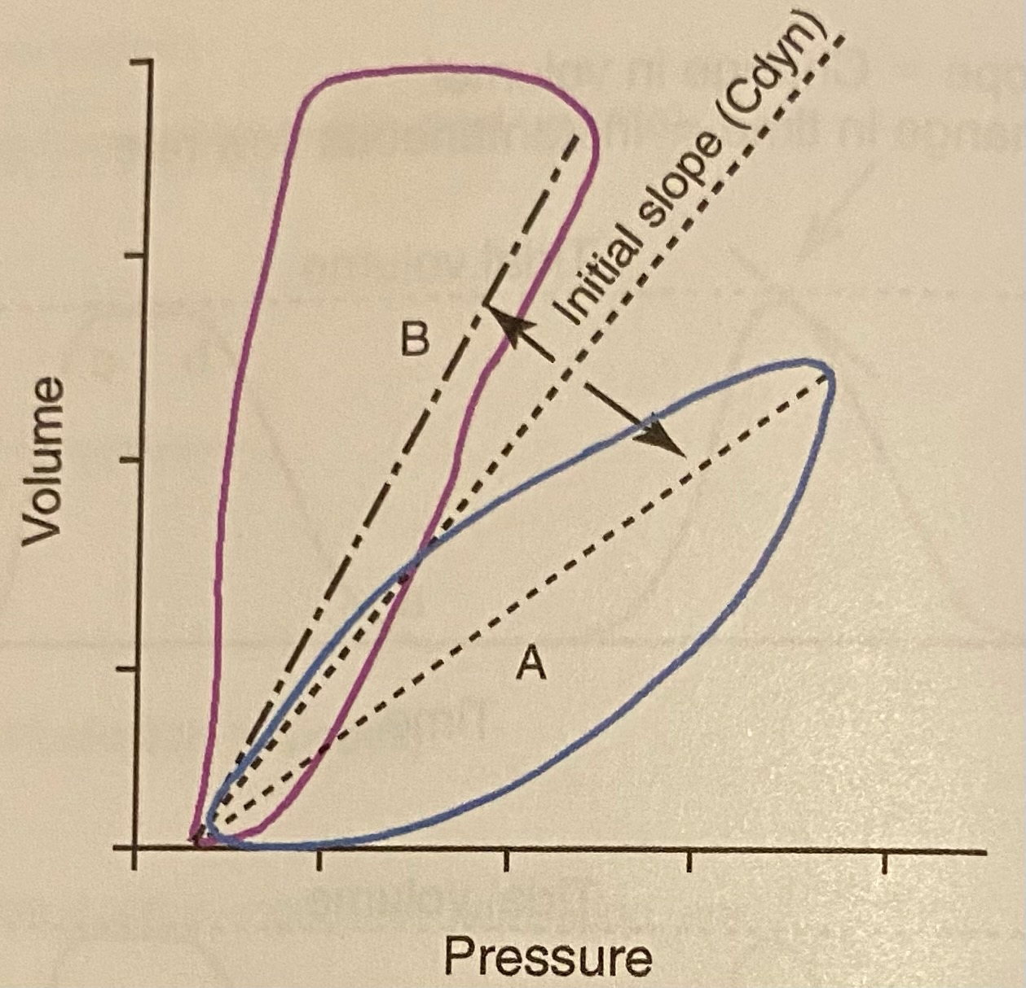
What has happened that resulted in the blue loop?
Reduced Compliance
Notes:
The purple loop (B) reflects decreased compliance

Slide 37
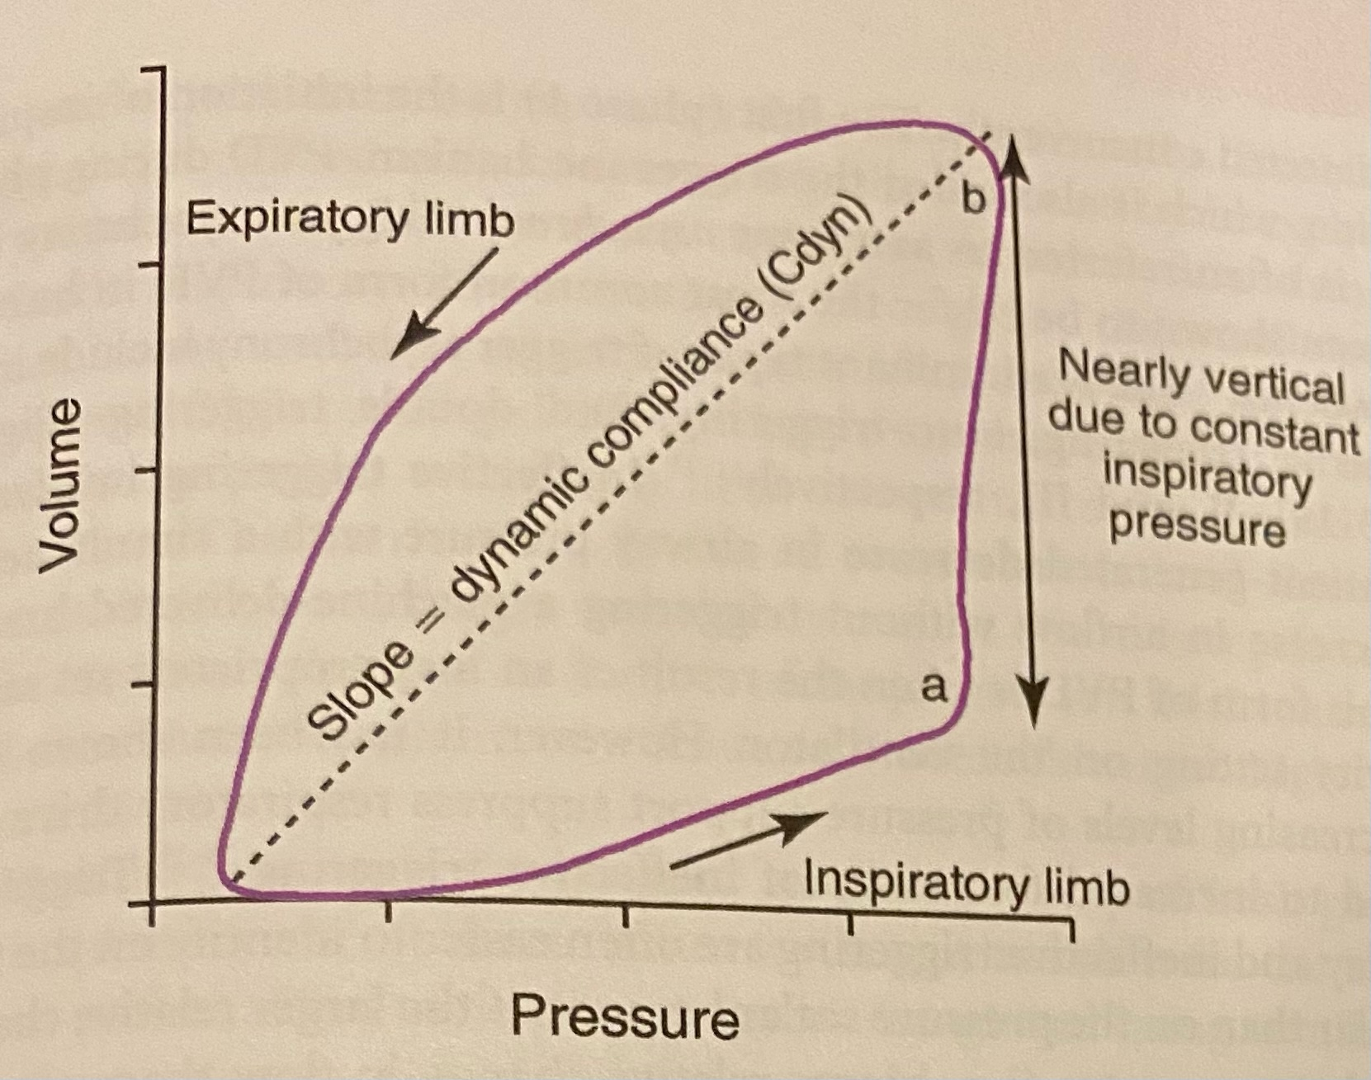
PV Loops in Pressure Control Mode

Slide 38
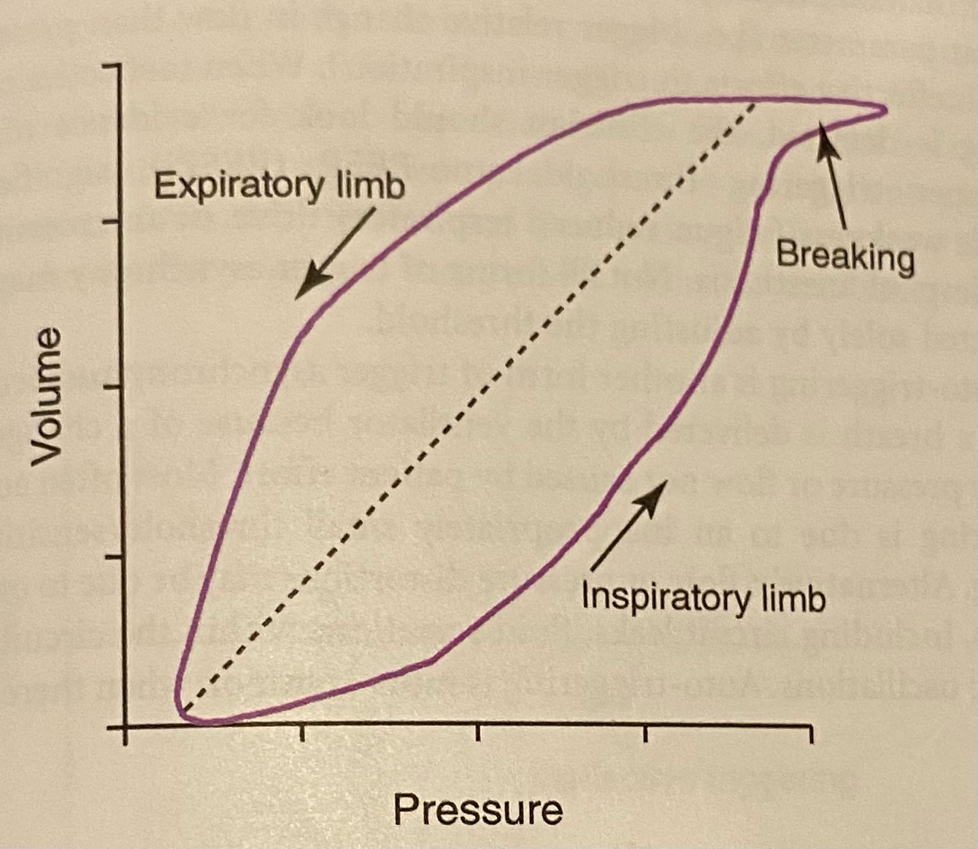
Alveolar Overdistention: Beaking
Notes:
Beaking:
- Excessively large tidal volumes cause beaking at the end of the inspiratory limb
- Once the alveoli have been expanded excessively, they can only accept additional volume with large pressure increases
Sometimes in very small patients (<2 kg), the PV loop will end looking like beaking, but it is not truly happening-it is a signal acquisition problem

Slide 39
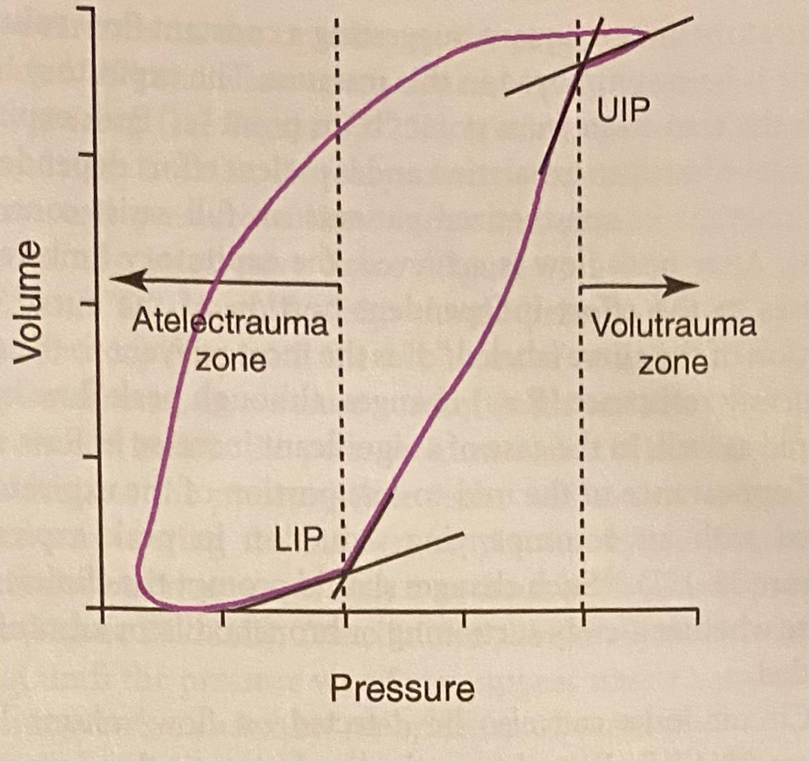
Preventing Ventilator-Induced Lung Injury with PV Loops
Notes:
LIP: Lower Inflection Point = point at which pulmonary compliance significantly increases; the point at which a number of collapsed conducting and/or gas exchange units open→ cyclic opening and closing of these areas can lead to atelectrauma

Slide 40
How do we minimize atelectrauma?
Decreasing PEEP to < LIP
Increasing TV > 15 mL/kg
Increasing PEEP to >/= LIP
Prolonging inspiratory time by > 2/3 of respiratory cycle
There is no way

Slide 41
Preventing Ventilator-Induced Lung Injury with PV Loops
Notes:
UIP: Upper Inflection Point = point at which pulmonary compliance significantly decreases due to alveolar overdistention and risk of alveolar injury (volutrauma) is increased

Slide 42
How do we minimize volutrauma?
Low PEEP
High PEEP
Keeping PIP < pressure at which UIP is noted
Prolonging inspiratory time by > 2/3 of respiratory cycle
There is no way

Slide 43
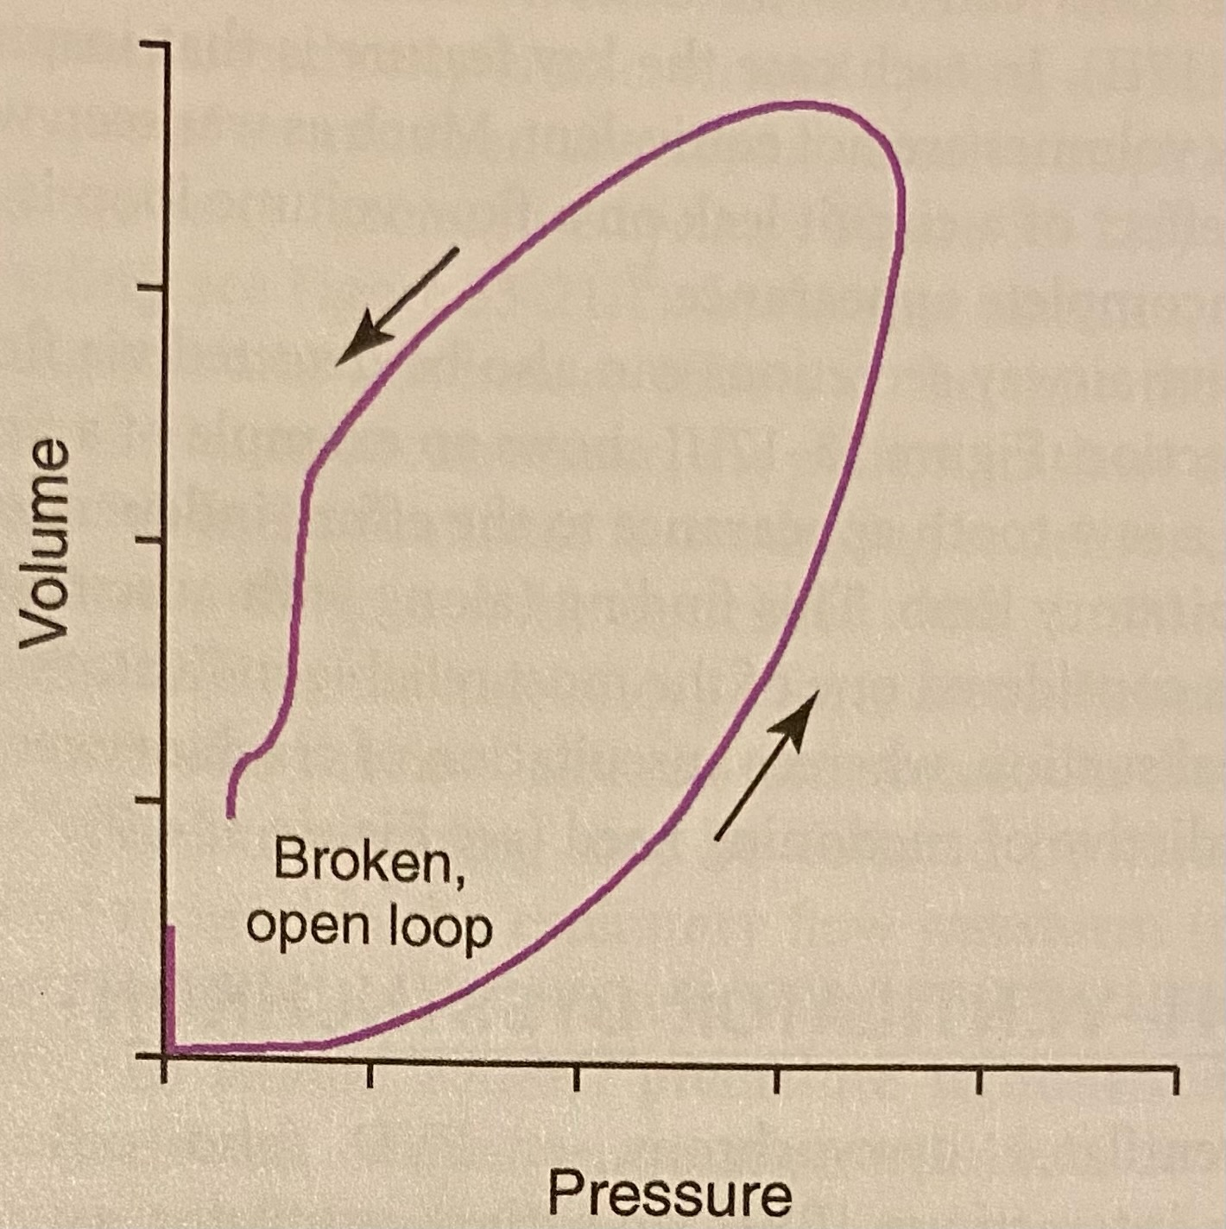
You see this PV loop. What do you troubleshoot?
Circuit Leak
Cuff inflation
Tubing
Pneumothorax

Slide 44
Flow-Volume Loops

Slide 45
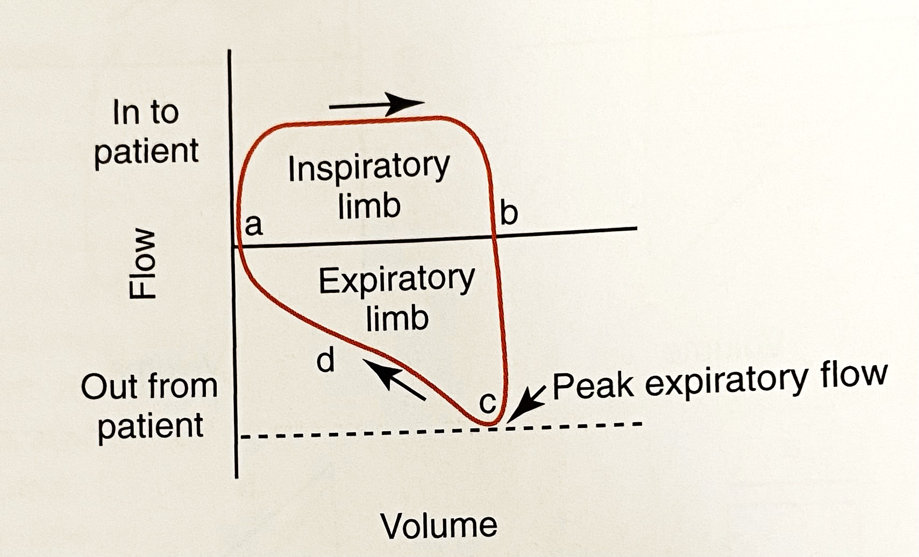
Flow-volume loops
Notes:
Inspiratory flow is above the x-axis in ventilator waveform (the opposite in pulmonary function testing)
A: Start of inspiration
B: End of inspiration/beginning of expiration
Square inspiratory limb shape suggests constant flow → volume control mode
Peak expiratory flow occurs in early exhalation and is dependent on elastic recoil and resistance of the airways
C-D: shape is determined by the resistance of the airways (exhalation)
D line is the most relevant portion to assess airway resistance (Raw), although peak flow will also change as well

Slide 46
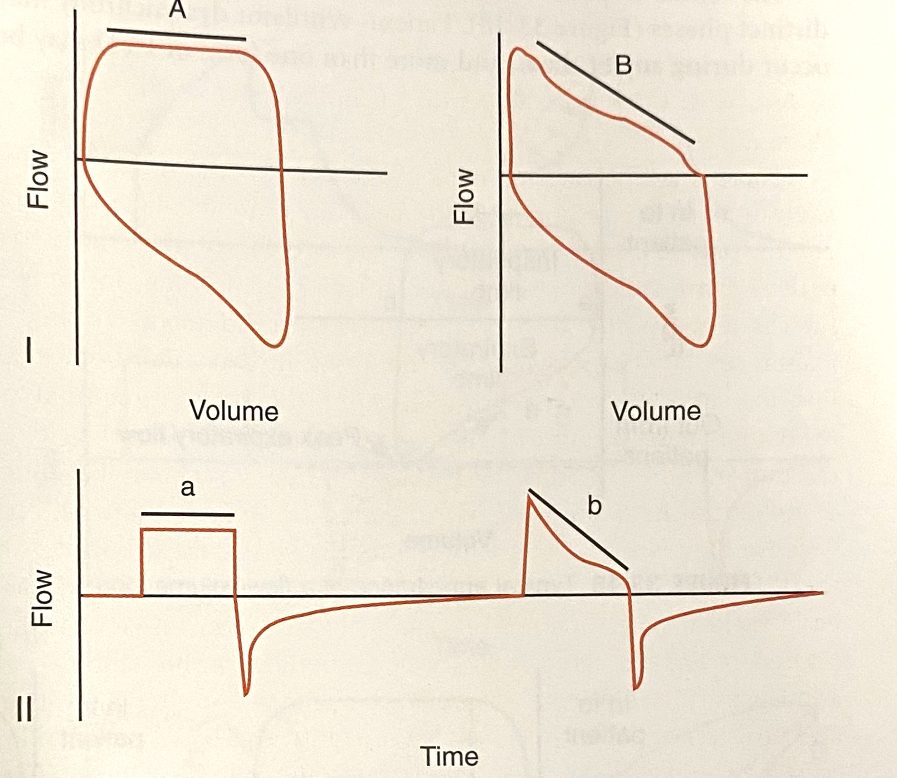
Flow-Volume Loops
Inspiratory and expiratory limbs should match the shape of the flow scalar portions
Useful for:
  Assessing excessive airway resistance
  Detecting copious airway secretions or circuit leaks
  Detecting flow asynchrony

Slide 47
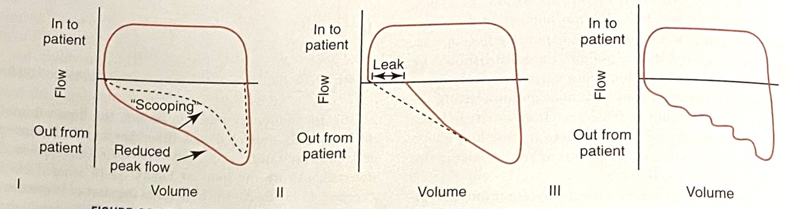
Increased Raw
Circuit Leak
Excessive
secretions

Slide 48
Sources
Silverstein and Hopper, “Mechanical Ventilation Waveforms”. Small Animal Critical Care Medicine, 2nd ed., Elsevier, St. Louis, MO, 2015.
Deranged Physiology Wedsite
  Static, dynamic and specific compliance
  Intrinsic PEEP and the expiratory hold manoevre
  Basics of Mechanical Ventilation, pdf

