Slide 1

Hydroxyethylstarch solutions: why they’re evil
(why potatoes don’t belong in vessels)
Cece Zhu
Resident Rounds Lit Review 10/20/22

Slide 2
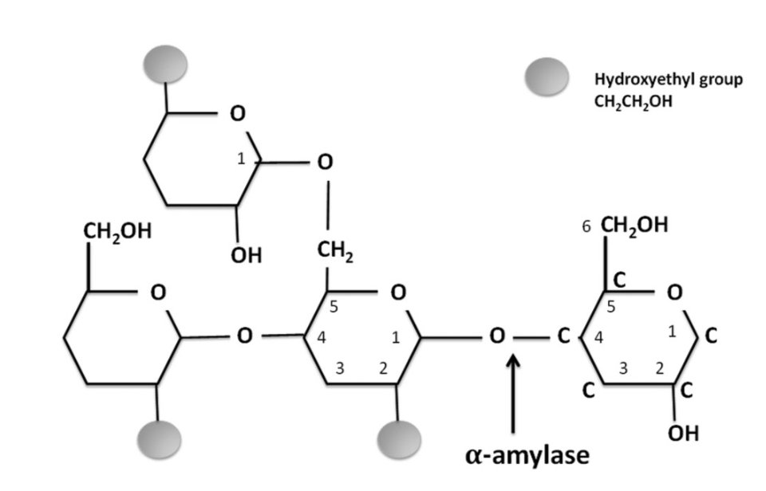
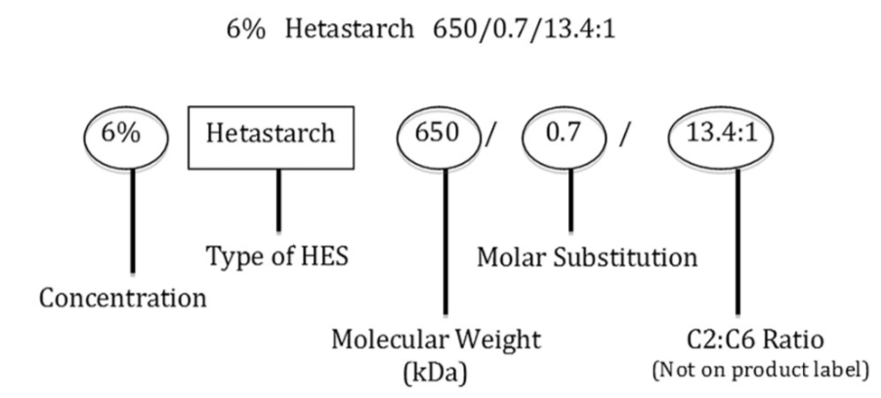
Physiology and classification
HES is a polymer of glucose units derived from amylopectin and modified by substituting hydroxyethyl for hydroxyl groups at C2, C3, and C6 positions on the glucose units
  Starch molecule is either corn or potato
The concentration (ie 6% HES) refers to the concentration of HES in solution (ie 6g HES/100 mL)
Hydroxyethyl starch solutions are categorized as first-, second-, or third-generation products relative to their average MW
  First-generation: high MW products (HES 450/0.7, HES 550/0.7, and HES 670/0.75)
  Second-generation: medium MW products (HES 200/0.5) *Vetstarch
  Third-generation: low MW products (HES 130/0.4 and HES 130/0.42)
Also classified according to their molar substitution or the average number of hydroxyethyl residues per glucose unit
  Ex: Hetastarch (0.7), hexastarch (0.6), pentastarch (0.5), tetrastarch (0.4)
Most are carried in 0.9% saline (Hextend is carried in LRS)

Slide 3
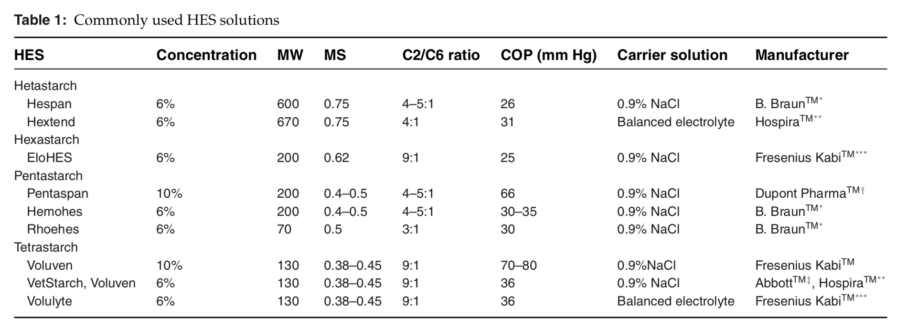
Physiology and classification
A colloid is a large hydrophilic molecule in solution that does not pass freely through a semipermeable membrane
  The natural particles in blood that create COP are proteins (globulins, fibrinogen, and albumin)

Slide 4
Physiology and classification
Most HES molecules are metabolized by alpha-amylase in plasma then cleared by renal excretion or tissue uptake
If not metabolized or excreted, HES molecules are recognized by the reticuloendothelial system as foreign and taken up by monocytes, macrophages, endothelial cells, proximal tubule (renal epithelial) cells, liver parenchymal cells, Schwann cells, and keratinocytes and incorporated into lysosomes where they are resistant to degradation
  Can lead to tissue accumulation
Can be administered for volume resuscitation or colloid support, especially those with concurrent hypoproteinemia or hypoalbuminemia that are unresponsive to conventional fluid resuscitation with crystalloids
  Approximately 3 to 4 times more crystalloids than colloids are required to achieve an equivalent plasma volume expansion
  Colloids remain for several hours within the intravascular space as opposed to only 30–60 minutes for most crystalloid solutions
The adverse effects of HES in the human patient population are well documented, and include volume overload, coagulopathy, acute kidney injury (AKI), proinflammatory effects, and allergic reactions
  Allergic reactions are rare in dogs and cats
Notes:
-Delayed onset-refractory pruritus has been reported to occur in 3–54% of people due to HES deposition in cutaneous Langerhans cells.

Slide 5
Acute kidney injury
Suggested mechanisms: osmotic nephrosis (i.e. proximal renal tubular vacuolization and swelling from pinocytosis of colloid particles), tubular plugging due to hyperviscous urine, attenuation or cessation of glomerular filtration rate (hyperoncotic AKI), and inflammation of the kidney interstitium
  HES has been shown to persist within macrophages and parenchymal cells in the canine kidney up to 18 days after administration
  Lysosomal accumulation and macrophage dysfunction occur as a result of the inability of cells to readily metabolize HES, with documented persistence in some organs for >8 years
  Significance and effect of osmotic lesions on renal function is unknown since the lesions have been found without accompanying AKI

Slide 6
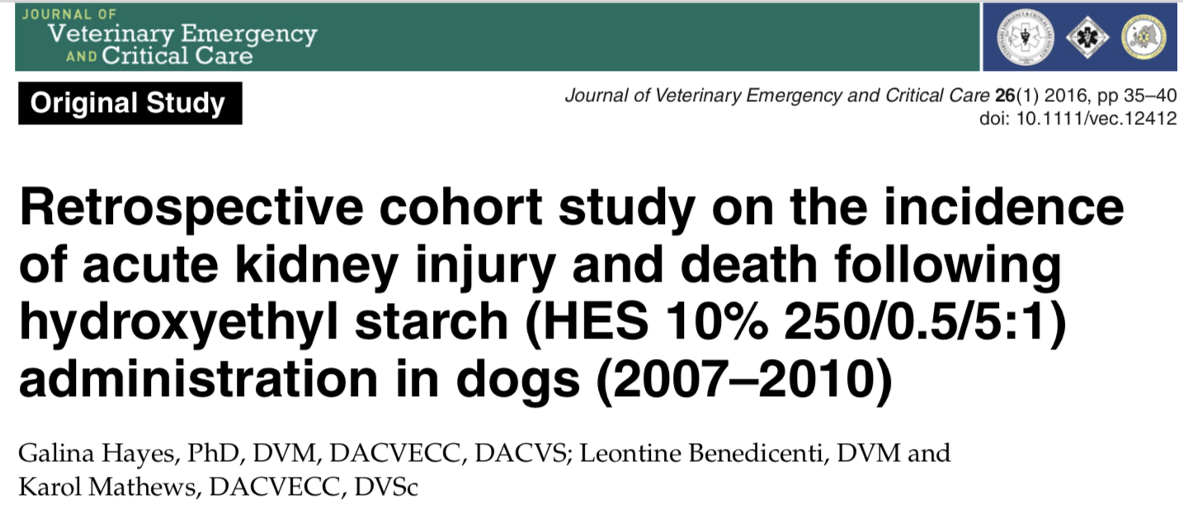
Acute kidney injury

Slide 7
Materials and methods:
  Retrospective cohort study conducted on canine patients admitted to the ICU between January 2007 and March 2010 in a veterinary teaching hospital setting
  2 groups: HES group and non-HES group (randomly selected sample of dogs admitted to the ICU over the same period)
  The HES used during the study period was 10% HES 250/0.5/5:1
  HES administration was at the discretion of the primary clinician
Data collection
  Data collected: APPLEfast score (calculated on information obtained within 24 hours of admission), HES dose, and method of administration (continuous rate infusion [CRI] or bolus), whether new onset AKI (defined as &2× increase in admission creatinine concentration or development of oliguria/anuria of <0.5 mL/kg/h for &12 h) occurred over the hospital stay, and survival status at discharge
  Additional info: signalment, primary diagnosis, and comorbidities including the identification of sepsis, nature of the admission (medical vs. surgical, surgical elective vs. emergent vs. trauma), total cost, the concurrent use of crystalloid fluid therapy and blood products, and new need for oxygen therapy

Slide 8
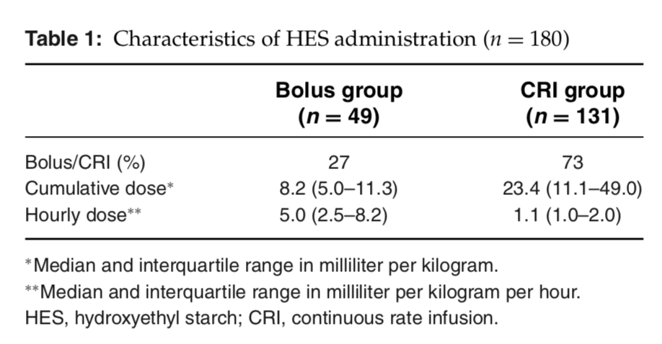
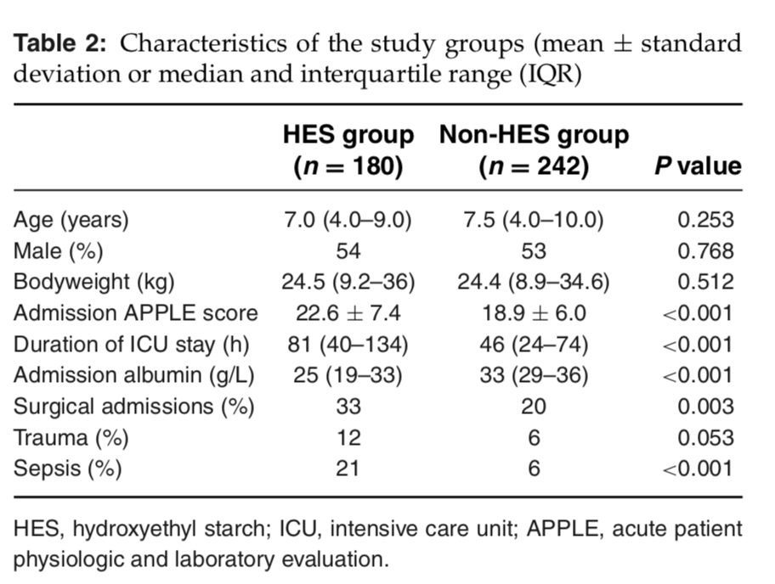
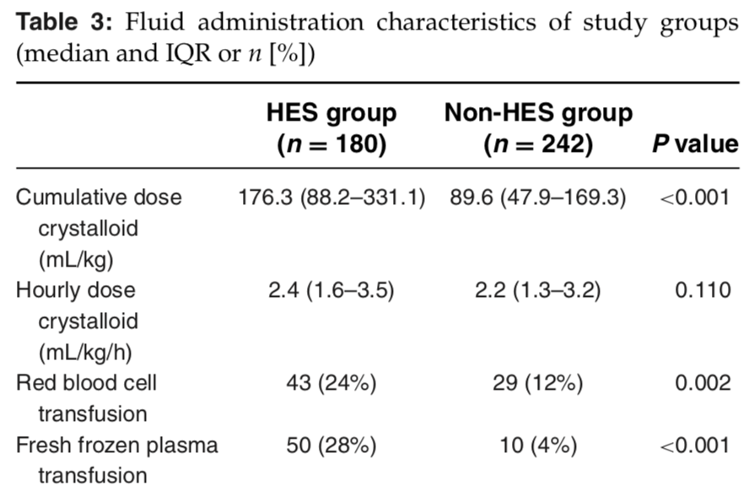
Statistical methods:
  Difference testing was performed between the groups using the 2-tailed t-test, Mann–Whitney U-test, chi-square test, and Fisher exact test as appropriate
  Multivariable logistic regression analysis with a composite outcome consisting of in-hospital nonsurvival or new onset AKI as the dependent factor and lots of independent variables
Results
  180 dogs in the HES group and 242 dogs in the non-HES group
  HES group had greater severity of illness (P < 0.001),
  longer duration of ICU stay (P < 0.001), and lower admission albumin
  (P < 0.001). A larger proportion of the HES group were surgical
  admissions (P = 0.003), had a history of trauma (P = 0.053), or were
  assessed to have a sepsis diagnosis (P < 0.001)
  HES group received a greater cumulative administration of
  crystalloid (P < 0.001) but no difference in median hourly rate
  HES group was more likely to
  receive blood product therapy
  (P = 0.002)

Slide 9
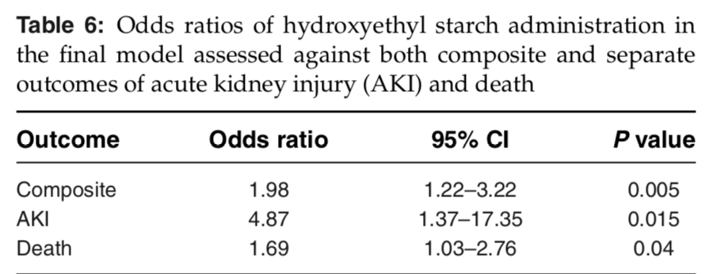
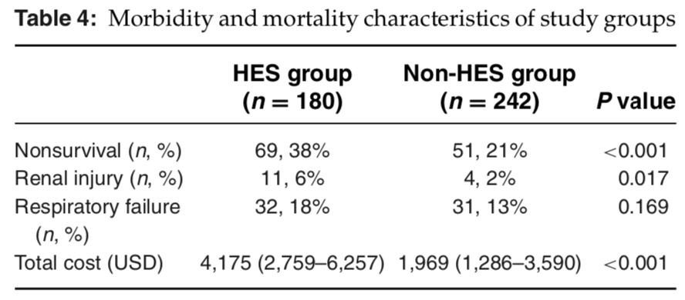
Results cont
  Overall mortality incidence was 28%, n = 120 (18 died as a result of naturally occurring cardiorespiratory arrest, and the remainder by euthanasia)
    Of euthanized: 80 due to the severity of illness, 20 due to a terminal dx identified, 2 due to finances
  Overall AKI incidence was 3.6%, n = 15
    Of AKI: 8 died or were euthanized, and 7 survived to discharge
    HES administration was associated with increased risk of mortality (OR = 2.33, 95% CI = 1.51–3.58, P < 0.001) and AKI (OR = 3.87, 95% CI = 1.21–12.37, P = 0.02)
      Odds of not surviving to discharge were 2.33 times higher in the HES group than in the non-HES group and odds of AKI were 3.87x higher in HES group
  This association between HES administration and adverse outcome was retained in multivariable analysis (OR = 1.98, 95% CI = 1.22–3.22, P = 0.005) after controlling for the confounding effects of illness severity, emergency surgical admission classification, and administration of blood products
  Model was rerun after excluding all patients that underwent euthanasia for financial reasons or due to diagnosis of a terminal disease process with poor long-term prognosis (n = 22)
    Starch administration remained an independent predictor of poor outcome (OR = 2.15, 95% CI = 1.29–3.60, P = 0.004)

Slide 10
  Results cont
    Higher doses per kg body weight per hour of HES independent of method of admin were associated with an increasing risk of in-hospital death or AKI with an OR = 12.15 (95% CI = 3.93–37.51, P < 0.001, n = 180) for each milliliter per kilogram per hour increase in dose
  Discussion
    Main findings: (1) HES admin showed an independent association with increased risk of in-hospital adverse outcomes including death and AKI, after attempting to control for the differences in illness severity, blood product administration, and emergency surgical admission classification between the HES and non-HES groups and (2) A dose-response relationship was present, with higher doses per kilogram per hour of HES associated with increasing risk compared with lower doses
    Limitations: observational study with retrospective data, multiple differences identified between the HES and non-HES groups at baseline, some confounders may not have been included in the multivariable analysis, presence of coagulopathies was not assessed
      Could have underreporting of long-term consequences of HES administration
      Study was underpowered to assess for specific HES effects within subgroups, for example septic dogs or dogs receiving only bolus HES therapy
    The number needed to harm was calculated as 6 (means that if 6 patients are treated with HES, one will experience an adverse outcome associated with HES use)
    Also uncertain how applicable findings are to dogs receiving forms of HES other than 10% 250/0.5

Slide 11
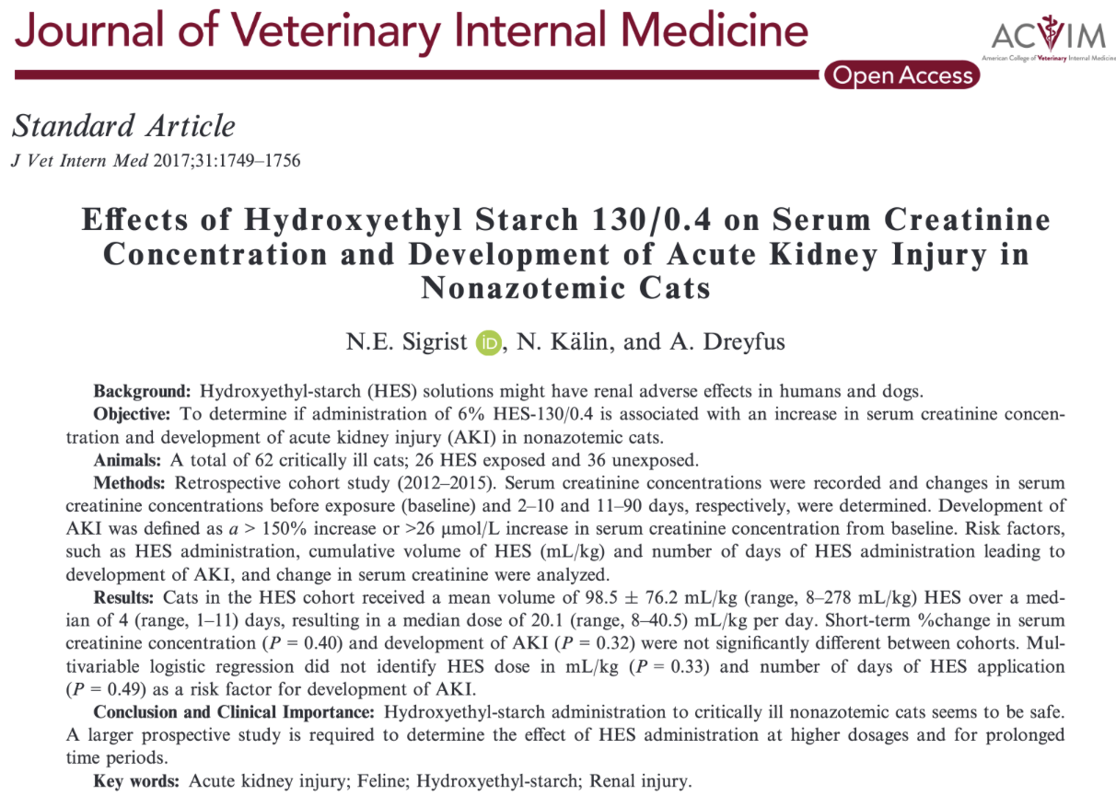

Slide 12
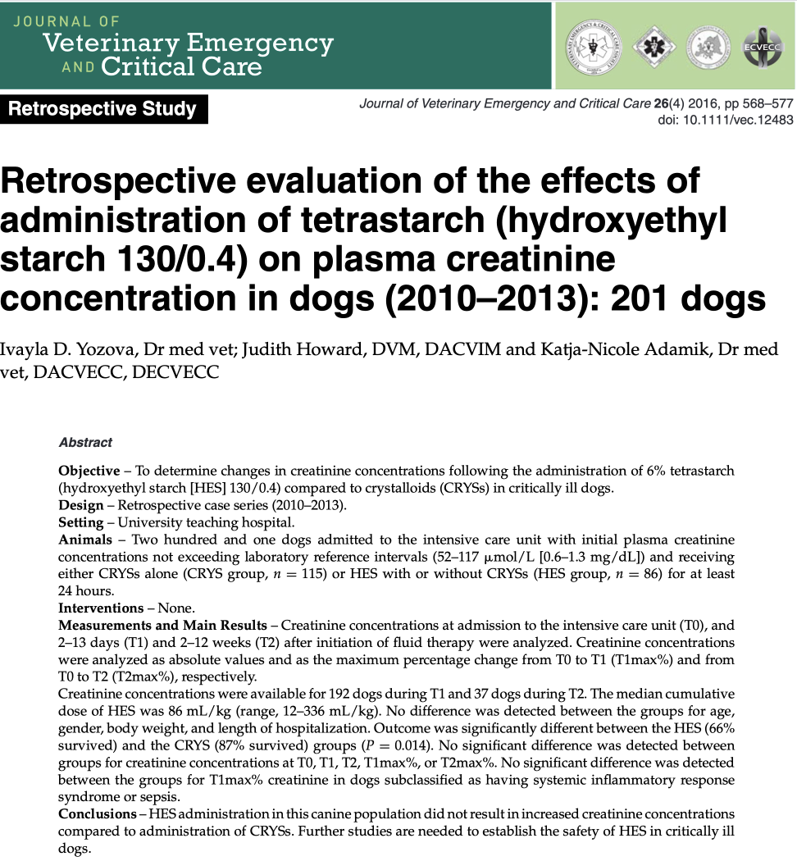

Slide 13
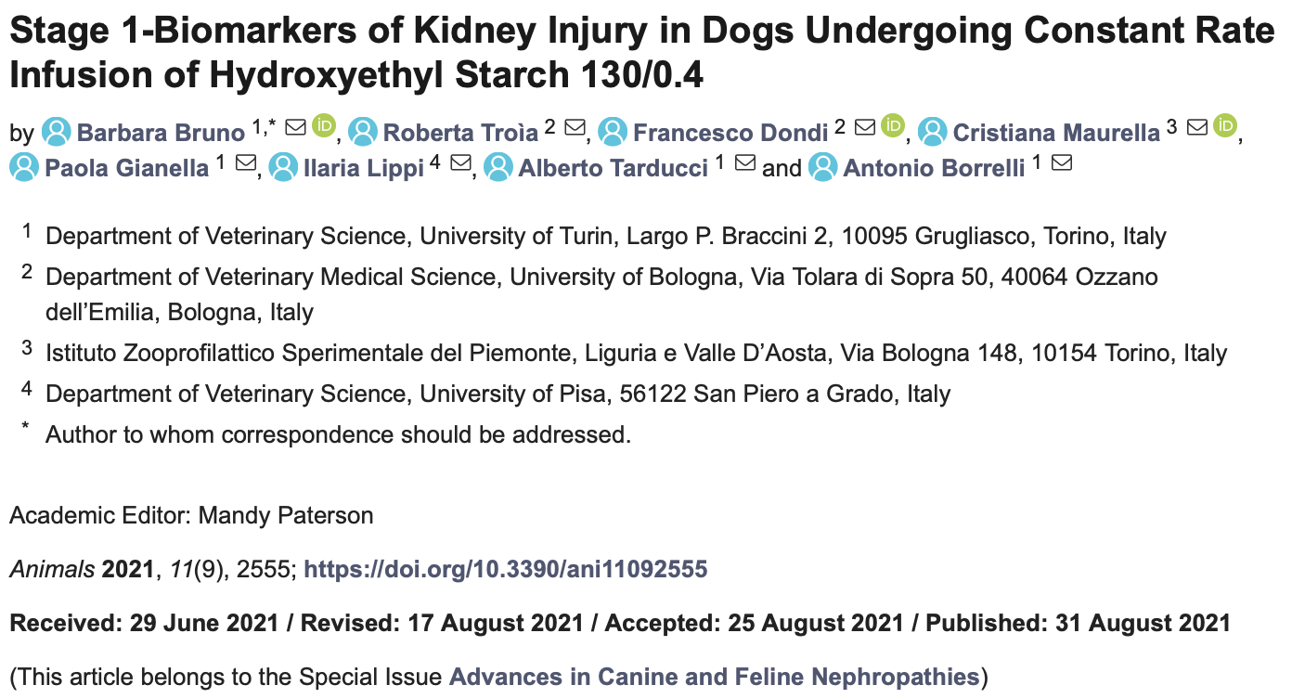
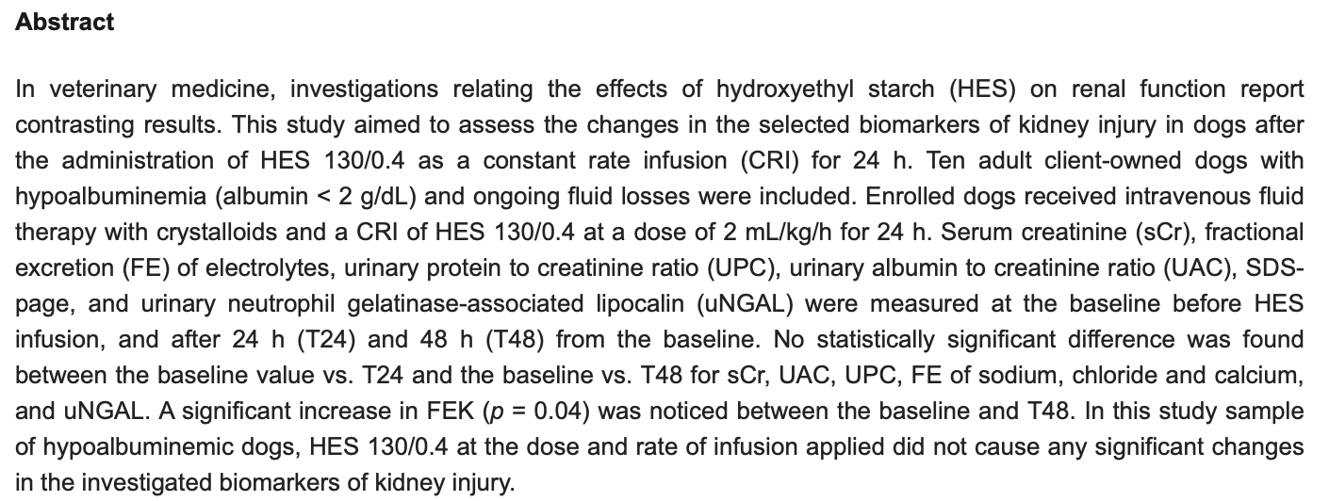

Slide 14
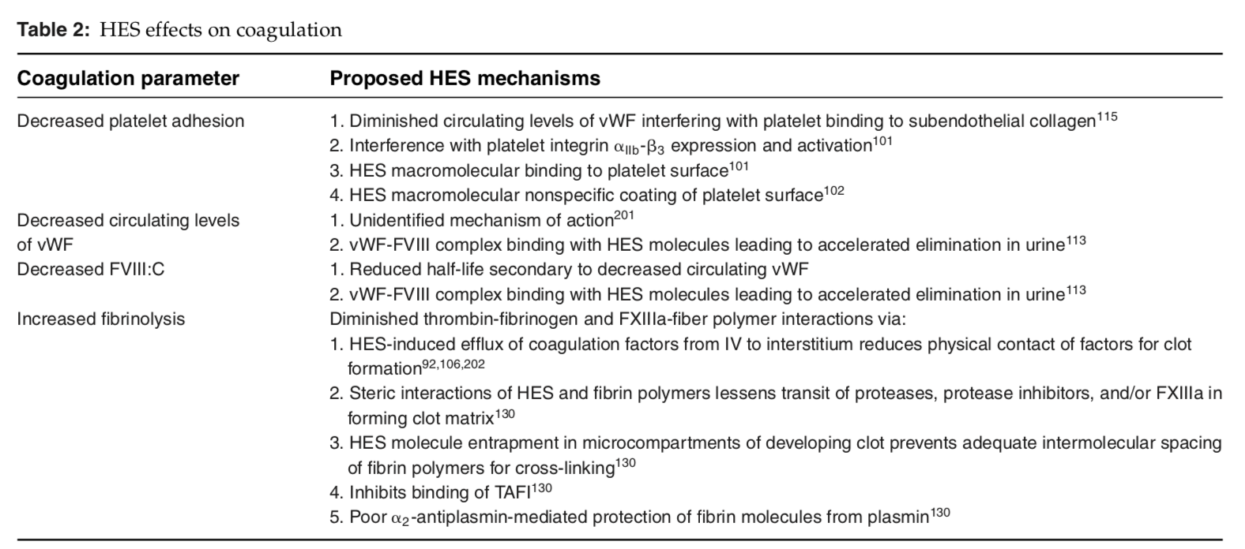
Coagulopathies
Suggested mechanisms: thought to occur secondary to a dilutional coagulopathy, platelet dysfunction, enhanced fibrinolysis, as well as decreased concentrations of vWF and factor 8
  Incorporation of HES molecules into polymerizing fibrin strands with subsequent alteration in clot strength and accelerated clot lysis is believed to underly HES-associated increased fibrinolysis
  Platelet dysfunction can be due to osmotic shrinkage + extracellular coating of platelets with colloidal macromolecules, inhibiting conformational changes, and interactions between glycoproteins IIb–IIIa and Ib and their ligands with subsequent decreased platelet aggregability and adhesion
  A high C2/C6 ratio or high MS may delay enzymatic degradation, and may enhance coagulopathies
Notes:
MS= molar substitution

Slide 15
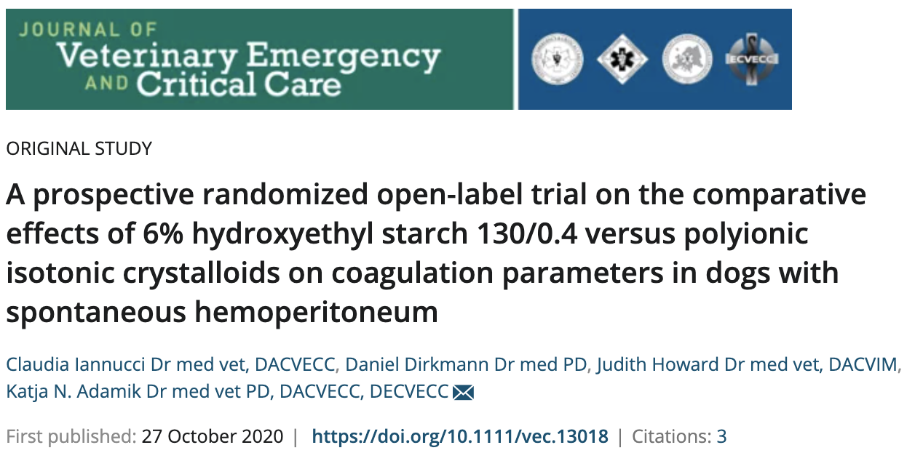
Coagulopathies

Slide 16
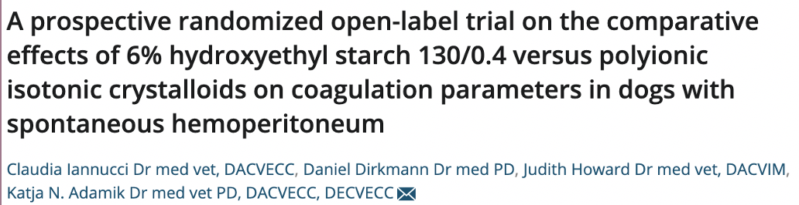
Materials and methods:
  Dogs with SHP and hypovolemic shock presented to the emergency service of a teaching hospital between January 2015 - June 2016
  Hemoperitoneum was confirmed by removal of nonclotting blood with a PCV ≥ 20% via paracentesis
  Dogs were considered to be in shock if at least 2 of the following were fulfilled: HR > 140, shock index > 0.9 (shock index = heart rate divided by the systolic blood pressure), and lactate > 2.5
  APPLEfast scores calculated
  Exclusion criteria: age < 10 months, BW < 8 kg, known trauma, previous history of coagulopathy or disorders associated with coagulopathies (hyperadrenocorticism, protein-losing enteropathy or nephropathy, and hepatic or renal insufficiency), and use of steroids or NSAIDs, artificial colloids, or blood products within 2 weeks prior to admission
  Dogs were randomly allocated to CRYS solution (CRYS group) or 6% HES 130/0.4 (HES group)
    CRYS group: bolus of 30 mL/kg
    HES group: bolus of 10 mL/kg within 20 min
    Heart rate, shock index, and blood sampling were assessed immediately prior to (T0) and 5 minutes after (T1) the end of the fluid bolus.
Notes:
SHP= spontaneous hemoperitoneum

Slide 17
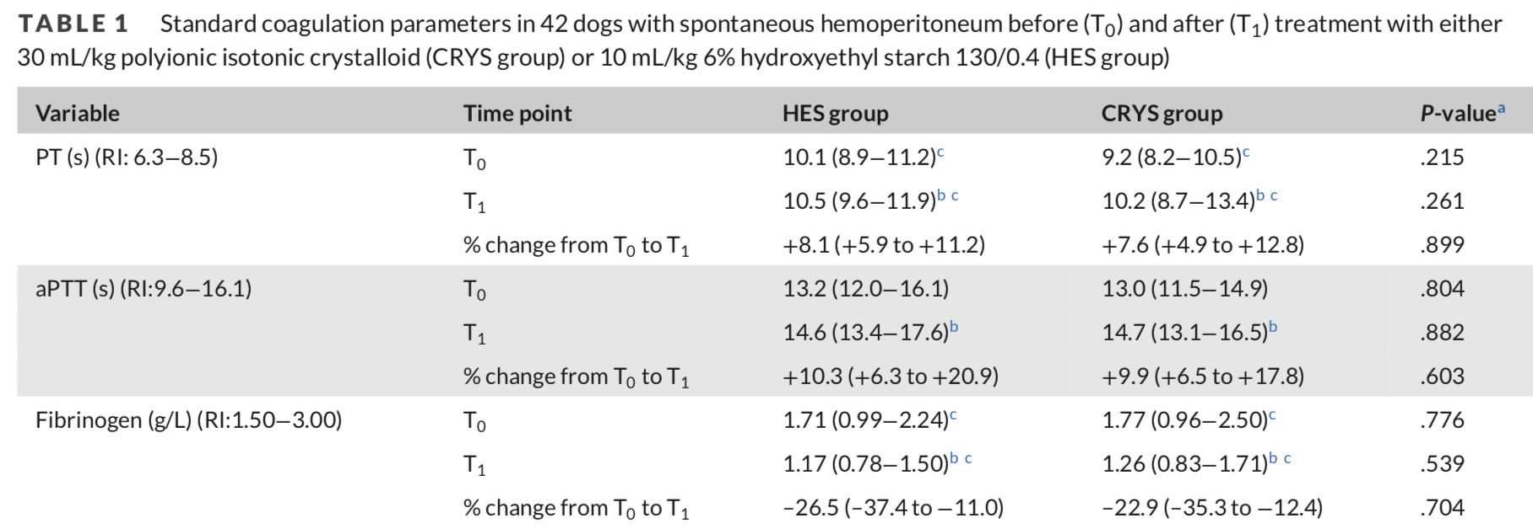
Materials and methods cont:
  Venipuncture was performed on the right jugular vein for the first sample (T0 ) and the left jugular vein for the second sample (T1)
  Samples were considered hypocoagulable if PT, aPTT, CT, or CFT was prolonged or fibrinogen or MCF was decreased
  Hyperfibrinolysis was defined as LI30 or LI45 below 100% or maximum lysis >10
Results:
  62 dogs with hemoperitoneum and shock were presented, 20 excluded, 42 dogs total
    20 in the HES group, 22 in the CRYS group
  No significant difference found between the 2 groups for sex (P = 0.83), age (P = 0.60), or BW (P = 0.71)
  All dogs got AUS performed by board-certified radiologist
  17 dogs (HES group, n = 7; CRYS group, n = 10) sent to surgery
    Of surgical group: 15 survived to discharge, 1 euthanized at surgery (CRYS group), and 1 died postop (HES group)
Notes:
Maximum clot firmness: MCF depends on both platelet and fibrinogen activation and the function of coagulation factor XIII
Clot formation time: CFT is an indicator of clot kinetics and is more strongly influenced by fibrinogen and platelets (usually not detectable in FIBTEM tracings)

Slide 18
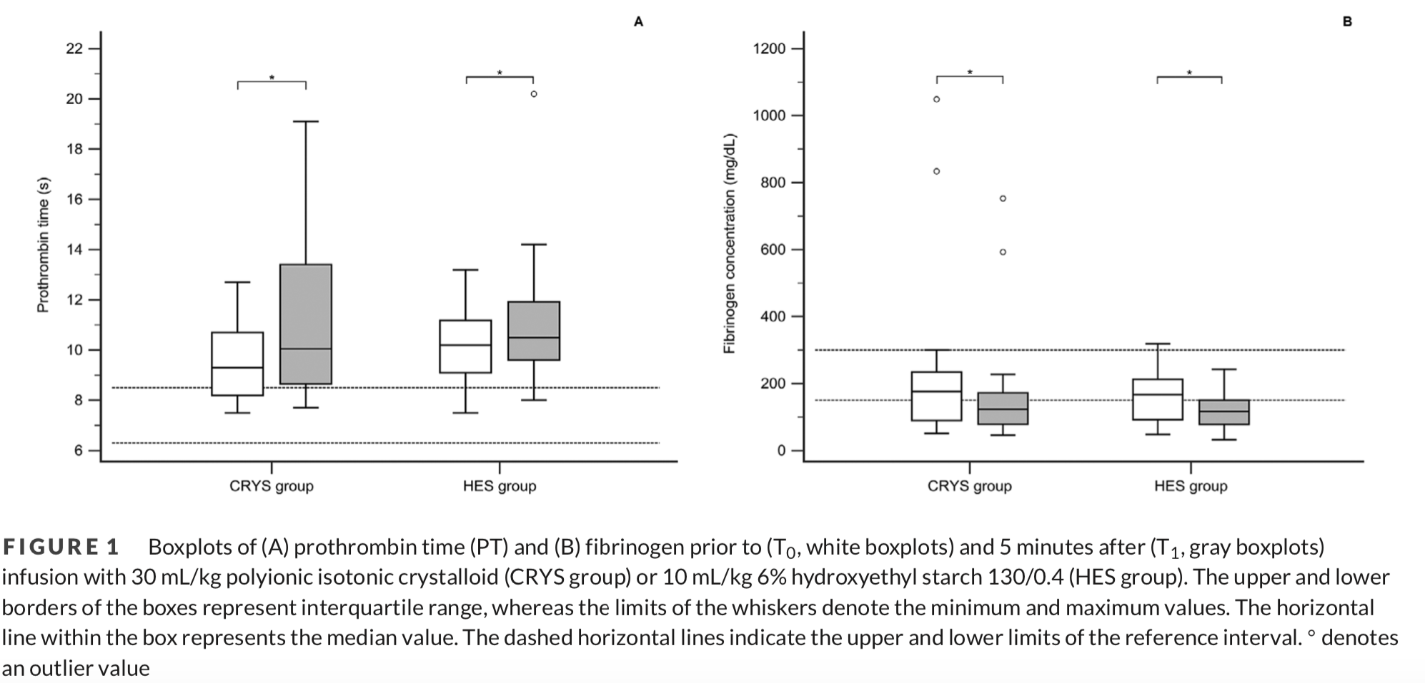
Results:
  Histopathology available in all 17 cases, with following diagnoses: HSA (13; 76%), benign hematoma (3; 18%), and splenic fibrohistiocytic nodules (1; 6%)
  Remaining 25 dogs were euthanized without surgery due to suspicion of diffuse metastatic neoplasia on abdominal (eg, presence of multiple cavitated splenic or hepatic lesions) or cardiac (right atrial lesion) ultrasound
    Seven of these dogs had full body necropsy and were diagnosed with hemangiosarcoma
  No significant differences were found between the groups for PT, aPTT, and fibrinogen concentrations at T0 or T1 or for the percentage change from T0 to T1
    Within the CRYS group, PT (P<0.001) and aPTT (P = 0.008) were significantly prolonged and fibrinogen concentrations (P < 0.001) decreased at T1 compared to T0
    Within the HES group, PT (P < 0.001) and aPTT (P < 0.001) were significantly prolonged and fibrinogen concentrations (P < 0.001) decreased at T1 compared to T0
Notes:
Maximum clot firmness: MCF depends on both platelet and fibrinogen activation and the function of coagulation factor XIII
Clot formation time: CFT is an indicator of clot kinetics and is more strongly influenced by fibrinogen and platelets (usually not detectable in FIBTEM tracings)

Slide 19
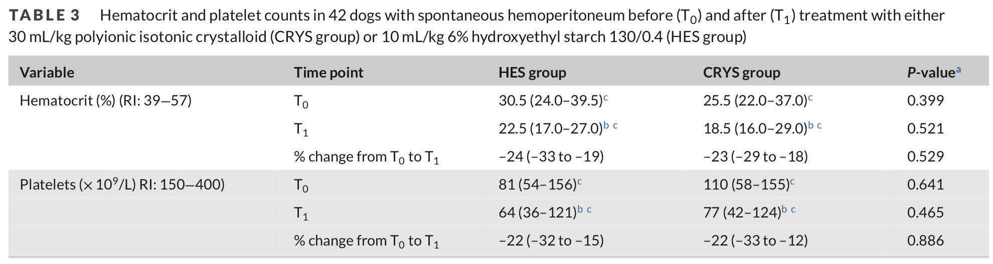
Results cont:
  At T0, 12 of 22 dogs in the CRYS group and 16 of 20 dogs in the HES group were classified as hypocoagulable (P = 0.108)
    At T1, 20 of 22 dogs in the CRYS group and 19 of 20 dogs in the HES group were classified as hypocoagulable (P = 1.000)
  No significant differences were found in any ROTEM variable between the groups at T0
  At T1, CFTEXTEM was significantly prolonged and MCFEXTEM significantly decreased in the HES group compared to the CRYS group
  Based on ROTEM variables, at T0, 12 of 22 dogs in the CRYS group and 12 of 20 dogs in the HES group were classified as hypocoagulable (P = 0.764)
    At T1, 13 of 22 dogs in the CRYS group and 14 of 20 dogs in the HES group were classified as hypocoagulable (P = 0.531)
  No significant differences in HCT and platelet counts were found between the groups at T0 or T1 or for the percentage change from T0 to T1

Slide 20
Results cont:
  Significant differences between T0 and T1 within both groups were found for HCT (P < 0.001) and platelet counts (P < 0.001)
  No significant differences in heart rate, shock index, lactate, or APPLEfast scores were found between the groups at T0 or T1 or for the percentage change from T0 to T1
  Lactate significantly decreased after fluid therapy in both the HES (P = 0.004) and CRYS groups (P = 0.001)
Discussion:
  Dogs in the present study were hypocoagulable at admission
  Fluid administration exacerbated coagulation impairment based on both standard and viscoelastic assays in both groups
  Significant differences compared to CRYS were observed in CTEXTEM , CFTEXTEM/INTEM , and MCFEXTEM , which suggests delayed clot formation, a weaker clot, and a less stable fibrin network
  PT and aPTT did not differ significantly between the groups
  Significantly lower MCF_{EXTEM} in the HES group at T1 compared with CRYS may be suggestive of possible platelet dysfunction
  No evidence of hyperfibrinolysis detected based on LI30 and LI45 and maximum lysis after HES admin
    Discrepancy may be due to the very large dose of tetrastarch used in the previous study assessing TEG clot lysis rates

Slide 21
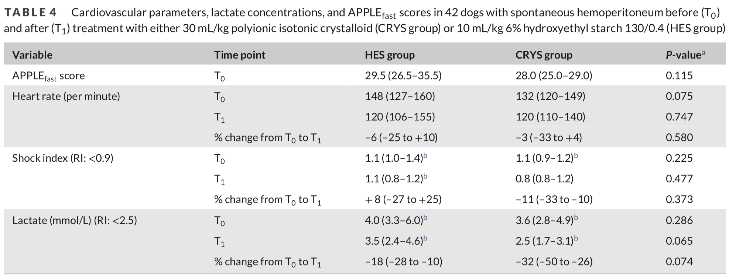
Discussion cont:
  Limitations:
    The extent to which the ROTEM changes in the HES group may be associated with a higher clinical risk of bleeding compared to the CRYS group remains unclear, as no bleeding risk scoring system was used
    Unclear if anemia-induced artificial hypercoagulability could have attenuated the coagulopathic effects of either HES or CRYS
    Coagulation assays were evaluated at only a single time point after fluid therapy
    Extent of intraoperative bleeding was not assessed
    Presence of hyperfibrinolysis was not further investigated using other markers of hyperfibrinolysis, such as D-dimers or FDPs
    Platelet function was not separately analyzed

