Slide 1


Respiratory monitoring
Cece Zhu
ECC Resident Rounds 11/17/22

Slide 2
Methods:
1. Respiratory rate and effort
2. Cyanosis
2. Pulse oximetry and co-oximetry
3. Blood gas analysis
4. Capnography

Slide 3
1. Respiratory rate and effort: MV = RR x TV
Factors controlling MV: central and peripheral neuronal control, central and peripheral chemoreceptors, neuromuscular junctions, respiratory mechanics/muscles
Control of breathing
  CNS
    Automatic impulses that control breathing are generated at the brainstem (medulla and pons): the medullary respiratory center, the apneustic center (lower pons), and the pneumotaxic center (upper pons)
      Medullary respiratory center: neurons concentrated in 2 sites (ventral and dorsal respiratory groups)
        DRG: responsible for inspiration
        VRG: controls voluntary forced exhalation and acts to inc force of inspiration
      Apneustic center: responsible for coordinating speed of inhalation and exhalation (can be overridden from pneumotaxic center)
      Pneumotaxic center: sends inhibitory impulses to inspiratory center; regulates insp volume and RR
    Cerebral cortex can override impulses from the brainstem (breathing is also under voluntary control)
    Axons descend down spinal cord to the phrenic, intercostal, and abdominal muscle motor neurons to generate a breath
      Phrenic: C3-C5
      External intercostal motor neurons: T2-T12
      Internal intercostal motor neurons: thoracic spinal cord

Slide 4
Question 1:
In health, is the primary determinant of breathing PCO2 or PO2? Under which circumstances does this relationship change?
Notes:
This is a simple recall question. You could stimulate some more discussion by also asking under what circumstances this changes and why. Remember that chronic hypercapnia can also cause this change.

Slide 5
Question 1:
In health, is the primary determinant of breathing PCO2 or PO2? Under which circumstances does this relationship change?
PCO2 is the primary determinant of breathing in health, mediated by the medulla. When a patient is severely hypoxemic (PaO2 <50), the primary driver of breathing becomes PO2. When a patient is chronically hypercapnic, the primary driver of breathing also becomes PO2.

Slide 6
1. Respiratory rate and effort
Control of breathing cont:
Lung receptors: stretch receptors and irritant receptors
Respiratory mechanics and muscular control
Central and peripheral chemoreceptors: input goes to medulla (mostly), pons, and cortex
  Central chemoreceptors in medulla: responsible for 85% of the respiratory response to CO2
    Inc in PaCO2-> inc in PvCO2 and CSF CO2-> CO2 in CSF forms carbonic acid-> dissociates into H+ and HCO3- (this dec in pH regulates ventilation)
    **Hypoxemia does not affect
  Peripheral chemoreceptors in carotid bodies at bifurcation of common carotid arteries and aortic bodies
    Senses dec in blood pH (whether resp or metabolic in origin) and partial pressure of oxygen, inc partial pressure of CO2, and hypoperfusion-> increase in ventilation
    Exclusively responsible to increasing ventilation in response to hypoxemia
    Response is more rapid (within 1-3 seconds) compared to central chemoreceptors, but response is less substantial
Notes:
Your first point also explains why NaHCO3 can cause a paradoxical cerebral acidosis
Control of breathing cont
Lung receptors
Stretch mechanoreceptors in the smooth muscle of airways respond to excessive stretching during large inspirations
Once activated-> vagus nerve APs-> inspiratory area in medulla and apneustic center of pons-> inhibits inspiratory discharge (slowing of RR by increasing expiratory time) *
Irritant receptors (juxtacapillary receptors) b/w airway epithelium are triggered by noxious gas, cold, inhaled dusts, interstitial fluid buildup, capillary wall distension
Once activated-> vagus nerve APs-> bronchoconstriction and inc RR (extreme stimulation may result in apnea)
Respiratory mechanics and muscular control
Insp: pharynx and larynx, diaphragm, rib cage, spine and neck muscles
Active exp: abdominal wall, rib cage, and spine
Disease processes affecting any of these will interfere with ability to generate a normal breath

Slide 7
Question 2:
Name look-alike causes of respiratory distress

Slide 8
  Question 2:
  Name look-alike causes of respiratory distress
  Respiratory compensation for metabolic acidosis
  Expect decrement of 0.7 mmHg in PCO2 per 1 meq/L decrease in bicarbonate
  Decrease in delivery of oxygen
  Decreased oxygen content (anemia, dysfunctional hemoglobin)
  Hypovolemia
  Hypotension
  Pain, anxiety, stress
  Hyperthermia
  Metabolic disease
  Abdominal distension
  Drug therapy: opioids, paralytic agents
  Neurologic disease (central and peripheral)

Slide 9
Respiratory distress
Causes for respiratory distress (inc RR and/or effort):
  Upper airway disease
  Lower airway disease
  Pulmonary parenchymal disease
  Pleural space disease
  Thoracic wall injury
  Pulmonary thromboembolism
  Look-alikes:
    Respiratory compensation for metabolic acidosis
      Expect decrement of 0.7 mmHg in PCO2 per 1 meq/L decrease in bicarbonate
    Decrease in delivery of oxygen
      Decreased oxygen content (anemia, dysfunctional hemoglobin)
      Hypovolemia
      Hypotension
    Pain, anxiety, stress
    Hyperthermia
    Metabolic disease
    Abdominal distension
    Drug therapy: opioids, paralytic agents
    Neurologic disease (central and peripheral)

Slide 10
Respiratory look-alikes
CaO2= (Hb x SaO2 x 1.34) + (0.003 x PaO2)
DO2= CaO2 x CO
Inadequate oxygen delivery is sensed by peripheral chemoreceptors
  Anemia, hypovolemia, pericardial tamponade, other types of blood flow obstruction (eg intra-abdominal hypertension)
  May inc RR to increase DO2 (by increasing CaO2)
Stress/pain/anxiety
  Cortical control of respiration via sympathetic stimulation
Hyperthermia
  When body temp > hypothalamic thermoregulatory setpoint, animal starts to pant
    Setpoint can change with fever, opioids
Metabolic disease
  Alterations in K, BG, calcium can cause muscle dysfunction
  Cushing’s, hyperthyroidism can alter respiratory mechanics or respiratory sensor input
    Cushingoid dogs may have tachypnea at rest d/t resp muscle weakness, muscle wasting, fat deposition within chest wall; hepatomegaly and abdominal fat may increase pressure on diaphragm
    Hyperthyroid cats may be tachypneic d/t increased CO2 production (d/t inc metabolic rate), respiratory muscle weakness (from muscle wasting), or occasionally hypokalemia
Peripheral neurologic disease: can affect phrenic nerve stimulation of diaphragm
  NM
  SC lesions C1-C5, C6-T2

Slide 11
2. Cyanosis
Reduced Hb is purple, so low O2 sat will cause cyanosis
The observation of cyanosis is dependent on the visual acuity of the observer, lighting (more readily detected in a well-lit room), and type of lighting (more readily detectable with incandescent as opposed to fluorescent lighting)
Requires an absolute concentration of deoxygenated hemoglobin to manifest sufficient cyanosis (3-5 g/dL)
  If hct 45%, cyanosis would manifest when arterial O2 sat decreased to 67% (equivalent to PaO2 37 mm Hg)
  Harder to detect in anemic patients
Lack of cyanosis should not be used as an indicator of proper oxygenation because cyanosis does not generally develop until arterial oxyhemoglobin is ≤85%

Slide 12
  Question 3:
  Describe how the pulse oximeter works and its limitations

Slide 13
3. Pulse oximetry
A pulse oximeter estimates oxyhemoglobin percentage by using 2 wavelengths of light: red at 660 nm and infrared at 940nm
  Machine emits wavelengths of light from probe’s light-emitting diode (LED) into patient’s tissue bed
  This emitted light reaches a receiver in the probe either by reflecting off the tissue or by through transmission to the receiving end of a probe (depends on type of probe)
  A photo detector measures the received signal and sends the information to a signal-processing unit
As this light is introduced into the tissue, each type of hemoglobin absorbs a different wavelength of light
  The oximeter uses the differential light absorption characteristics of deoxyhemoglobin and oxyhemoglobin to calculate the arterial blood’s functional hemoglobin saturation
  Surrounding tissues such as bone, fat, and venous blood also absorb light, so to target arterial hemoglobin in its measurements, the pulse oximeter considers only pulsatile (arterial) wavelength absorption in the calculations
Notes:
Oxyhemoglobin and deoxyhemoglobin together= functional hemoglobin

Slide 14
3. Pulse oximetry
Limitations:
  Reading site should be warm, well perfused, and clean
    Probe site should be moistened frequently with water or lubricant to help improve accuracy and to protect the underlying tissue because the clip can restrict local blood flow and the continuous light emission can burn if left in one place too long
    Best when placed over tissue with good arterial (pulsatile) blood flow
  Measurements should only be trusted if the monitor displays the patient’s correct pulse rate because light from other sources can reach and affect the probe’s receiver
  Dysfunctional hemoglobin species also absorb some light at these wavelengths, and thus they can falsely elevate or depress readings if they are present in large amounts.
    Methemoglobin absorbs light at 660 nm and 940 nm, which shifts the reported “oxyhemoglobin” value toward 80%–85%
    Carboxyhemoglobin can falsely elevate the SpO2 because it absorbs 940 nm light like oxyhemoglobin
  Jaundice can cause interference with red and infrared light
  May be more difficult to obtain a pulse wave on obese animals or animals with significant edema
  Peripheral vasoconstriction, vascular disease, or low cardiac output may not have enough blood flow to arteriolar beds to obtain an accurate SpO2
  Many studies have demonstrated that pulse oximetry is inaccurate at saturation values below 80%

Slide 15
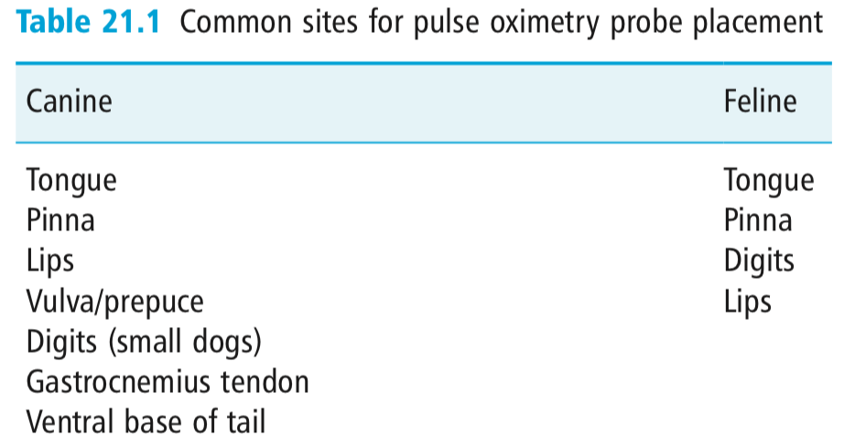
3. Pulse oximetry and co-oximetry
Oximetry is the use of light to quantify the percentage of blood hemoglobin that is present as oxyhemoglobin (is bound to oxygen)
A pulse oximeter uses 2 wavelengths (a ratio of near-infrared and red wavelengths) of light to measure functional hemoglobin in arterial blood using a device that can detect an arterial pulse
  Pulse oximetry can report functional hemoglobin saturation
A CO-oximeter uses multiple wavelengths of light to recognize and quantify multiple hemoglobin species, including oxyhemoglobin, deoxyhemoglobin, carboxyhemoglobin (bound to carbon monoxide), and methemoglobin (denatured)
  CO-oximetry can report the fractional hemoglobin saturation
Pulse CO-oximeters are not yet in routine use in veterinary medicine but are being used in humans as a non-invasive test for carbon monoxide toxicity and methemoglobin-inducing drug overdoses
Notes:
Oxyhemoglobin and deoxyhemoglobin constitute 97%–98% of a normal mammal’s total hemoglobin content, and they are together known as functional hemoglobin
Fractional hemoglobin saturation (fractional SO2) refers to the ratio of oxyhemoglobin to all hemoglobin species present, including methemoglobin and carboxyhemoglobin
I really like to ask people how pulse oximetry works and let them describe the process. You are talking about monitoring so this opens the discussion up to include common limitations of pulse-oximetry and then can lead directly to co-oximetry. Also, don’t forget that you will be responsible for knowing the wavelengths of light that are used in common pulse oximetry (I know it’s stupid but it is a thing anyway). If you want to talk this out during the week I’m happy to.

Slide 16
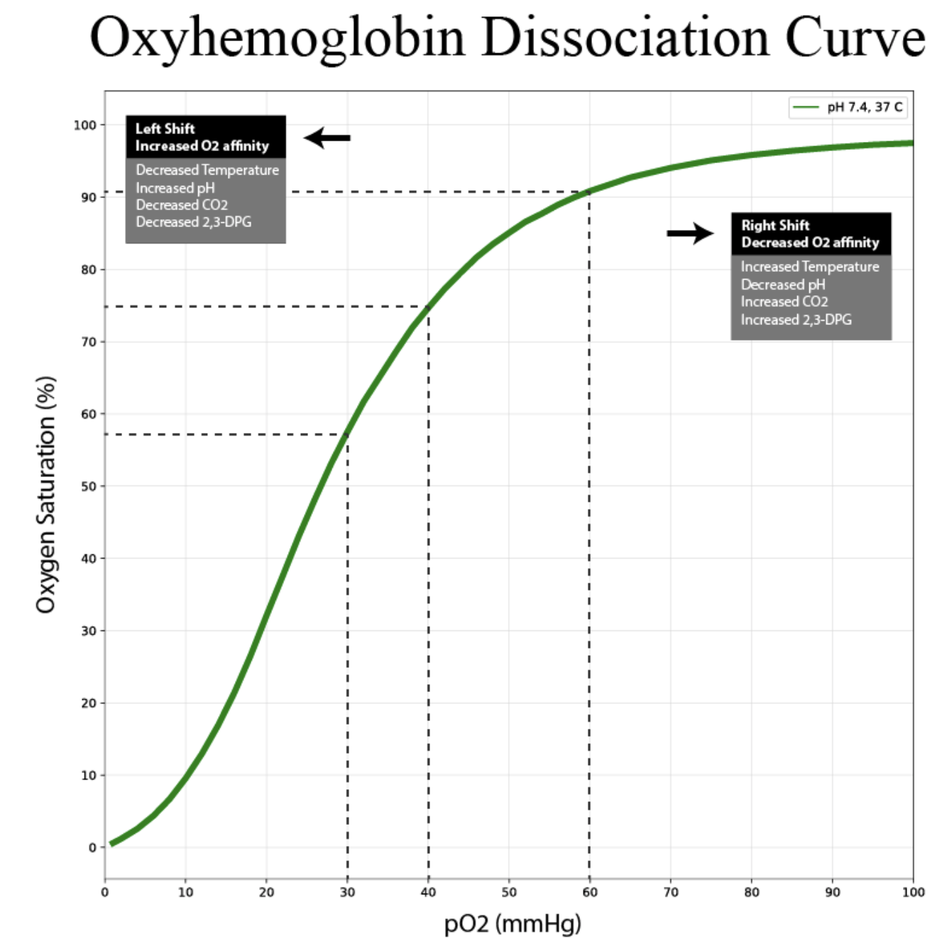
Pulse ox readings
Pulse oximetry reading of 96%–98% is considered normal for a dog or cat breathing room air at sea level
PaO2 describes the oxygen dissolved in arterial plasma
SpO2 describes the percentage of functional hemoglobin that is oxygenated in the arterial bloodstream
Relationship between PaO2 and SaO2 is not linear
  Above a PO2 of ∼100mmHg, huge changes in PO2 (to 550 mm Hg, for instance, as is expected at an FiO2 of 1.0) make almost no change in the SO2 because hemoglobin is nearly 100% saturated already

Slide 17
Question 4:
Fill out this chart
PaO2 | SaO2
500 (Severe hyperoxemia)
125 (Hyperoxemia)
100 (Normoxemia)
80 (Hypoxemia)
60 (Severe hypoxemia)
29 (P50)

Slide 18
Question 4:
Fill out this chart
PaO2 | SaO2
500 (Severe hyperoxemia) | 100
125 (Hyperoxemia) | 99
100 (Normoxemia) | 98
80 (Hypoxemia) | 95
60 (Severe hypoxemia) | 90
29 (P50) | 50
Notes:
p50 is the oxygen tension when hemoglobin is 50% saturated with oxygen
Note the p50 for dogs and cats is different from people. Choose one number, learn it and forget about the rest but know they exist.

Slide 19
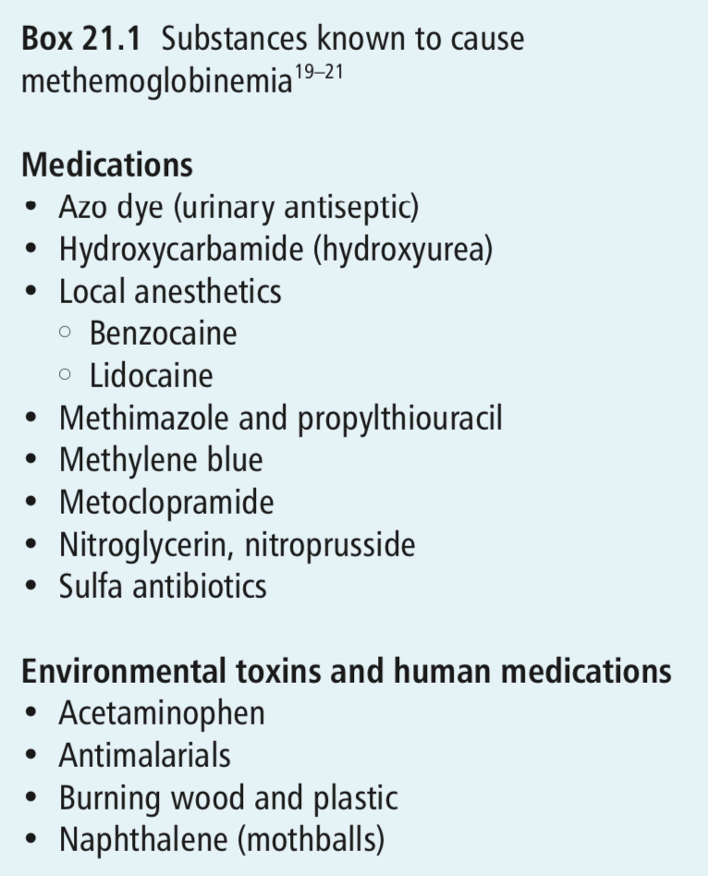
Science of the CO-oximeter
Measure hemoglobin oxygen saturation in a blood sample rather than through tissue
Uses 4-8 wavelengths of light to measure all relevant species of hemoglobin: total hemoglobin (tHb), oxyhemoglobin (O2Hb), deoxyhemoglobin (HHb), methemoglobin (MetHb), and carboxyhemoglobin (COHb)
Conductimetry to determine total hemoglobin concentration: whole blood conducts an electrical current due to the electrolytes in plasma (RBCs, WBCs, and platelets do not)
  Alterations in conductivity of the blood then correlate to approximate cell counts, such that diminished electrical conductivity indicates an increase in the ratio of nonconductive cells to conductive plasma (hct)
  Leukocytes and platelets do not have enough mass to affect conductimetry significantly
  Then uses a standard calculation to determine the tHb from the HCT
  Directly measures each of the dyshemoglobin species’ concentrations via spectrometric means as just described

Slide 20
CO-oximeter
Indications: patients with known or suspected exposure to drugs that cause methemoglobinemia or those that have been exposed to carbon monoxide
  Normal methemoglobin values in the canine and feline are less than 1%
  Normal carboxyhemoglobin values in canine and feline patients are less than 1%
Samples should be drawn from an artery or central vein whenever possible, peripheral venous samples may not be accurate in hypoperfused patients
Once a blood sample has been obtained, it is imperative that it’s well mixed and not exposed to room air, which can falsely increase pH and oxygenation
Inadequate sample mixing, incorrect anticoagulant use, clot formation, air exposure, air bubbles, or prolonged hold time prior to analysis can all lead to sample error

Slide 21
Question 5:
What would the pulse ox, ABG, and co-oximetry look like for a CO toxicity patient and a methemoglobin patient?
Type of diagnostic | CO toxicity | Methemoglobin
Pulse ox
ABG
Co-oximetry

Slide 22
Question 5:
What would the pulse ox, ABG, and co-oximetry look like for a CO toxicity patient and a methemoglobin patient?
Type of diagnostic | CO toxicity | Methemoglobin
Pulse ox | Normal-high (cannot distinguish difference b/w CO and oxyhemoglobin) | Lowers reading (metHb absorbs both light wavelengths; defaults to 85%)
ABG | Normal PaO2 PaCO2 may be low due to hypervent O2 sat likely normal (this is calculated) | Normal PaO2 PaCO2 may be low due to hypervent O2 sat likely normal (this is calculated
Co-oximetry | High CO-hb | High met-hb

Slide 23
4. Blood gas analysis
5 causes of hypoxemia: hypoventilation, decreased FIO2/high altitude, R-> L shunt, V/Q mismatch, diffusion impairment, + low venous O2 (high extraction)
  Can also separate into 3 causes: low FIO2, hypoventilation, venous admixture
  Causes of hypoventilation (high PaCO2): primary CNS suppression of ventilation, admin of meds that suppress ventilation (opioids, anesthetic agents), NM disease affecting ventilation (tick paralysis, botulism), upper airway obstruction, pleural space disease, chest wall injury (flail chest, pain), and respiratory muscle fatigue
  Causes of decreased inspired oxygen content: higher altitudes or anesthetic machine error
  Anatomic R-> L shunts: shunts blood from R to L circulation, bypassing alveoli
    AV malformation, cardiac shunts
Notes:
-Low venous oxygen from seizures, more oxygen and more time for capillary blood to be arterialized (lowering alveolar and art PO2) (in practice, this is offset by dec in shunt fraction)
The intersection between co-ox and blood gas offers a good opportunity to talk about limitations of both. For example, what would an ABG from a CO poisoned patient look like vs. the co-ox from the same patient. Or a patient with methemoglobinemia for that matter. How would the pulse ox look in both situations? Tying the strengths and weaknesses together will be helpful.

Slide 24
4. Blood gas analysis
  Venous admixture: all the ways in which venous blood can get from R to L side without being properly oxygenate (normally <5%)
    4 causes: low V/Q, small airway and alveolar collapse (atelectasis or 0 V/Q), diffuse defects, anatomic R-> L shunts
    Low V/Q: occurs secondary to small airway narrowing which impairs ventilation
      Responsive to oxygen
    Zero V/Q: small airway or alveolar collapse (“physiologic shunt” of blood flowing past non-functional alveoli)
      Non-responsive to oxygen (needs PEEP and PPV)
    Diffusion impairment: result of thickened respiratory membrane, decreased surface area (emphysema)
      Partially responsive to oxygen

Slide 25
Question 6:
Can you resolve hypoxemia in a hypoxic R->L PDA patient with supplemental oxygen?

Slide 26
Question 6:
Can you resolve hypoxemia in a hypoxic R->L PDA patient with supplemental oxygen?
No. The shunted blood that bypasses ventilated alveoli is never oxygenated. But some increase PaO2 will occur which may be helpful (most of the hemoglobin will be nearly fully saturated so only small increase in PaO2 is expected without much increase in SaO2). The response to oxygen therapy depends on the shunt fraction.

Slide 27
Question 7:
What happens to the PaCO2 and PaO2 when an arterial sample is not handled anaerobically?

Slide 28
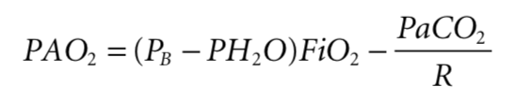
Question 7:
What happens to the CO2 and O2 when an arterial sample is not handled anaerobically?
Drop in PCO2 and increase in PaO2 if in room air (PO2 of room air is approximately 150 mmHg at sea level). PaO2 may decrease if the patient was on supplemental oxygen.

Slide 29
4. Blood gas analysis
Blood gas analyzer measures the pH, the PO2, and the PCO2
  Bicarbonate and base deficit are calculated
Most commonly sampled arterial sites: dorsal pedal (dorsal metatarsal) and femoral arteries
  Less common sites: brachial, radial, auricular, and lingual
Sample handling: exposure to room air and delayed analysis will alter the measurements
  Air bubbles in the sample syringe should be expelled immediately
  Due to gas diffusion, exposure to room air will cause a drop in the sample PaCO2 (PCO2 of room air is approximately zero) and change in the sample PaO2 (PO2 of room air is approximately 150 mm Hg at sea level)
    Increase in sample PaO2 when on room air
  If sample analysis must be delayed, the sample should be stored anaerobically in an ice water bath at 4°C (allows up to a 6-hour delay in analysis without significantly affecting results)
Notes:
You left out a word describing the change in PaO2 when exposed to room air. This is also a fantastic question: “what happens to the CO2 and O2 when an arterial sample is not handled anaerobically?” The tendency is for people to say they both go down. It can lead you to also have them consider what else could cause elevated O2 (i.e. supplemental oxygen). If people do in fact say both go down it’s an opportunity to revisit the alveolar gas equation to reinforce that concept.

Slide 30
Assessment of PCO2
PCO2 is primarily a measure of ventilation
Control of ventilation is primarily driven by medulla
  Increased PCO2 diffuses into CSF and lowers the pH, which stimulates central chemoreceptors and leads to increased ventilation
  Carotid bodies and aortic bodies (peripheral chemoreceptors) can stimulate ventilation secondary to decreased PaO2, increased PaCO2, or drop in pH
Causes of hypoventilation
  CNS dysfunction: anesthetics, TBI, neoplasia, infectious, cerebral edema
  Cervical SC disease: IVDD, neoplasia, infection, or inflammation
    C5-7: phrenic nerve (dog)
  Peripheral NM disease: tetanus, botulism, tick paralysis
  Pleural space disease: pleural effusion or pneumothorax, diaphragmatic hernia
  Obstructive diseases of the upper and lower airway: tracheal collapse, upper airway mass/foreign body, lower airway diseases such as asthma or bronchitis
  Chest wall: bandages
  Increased CO2 production in the tissues without appropriate compensation in ventilation: heat stroke and malignant hyperthermia (much less common)
  Increased abdominal pressure

Slide 31
Assessment of PCO2
Causes of hyperventilation
  Lung disease (stimulates pulmonary afferents to drive ventilation)
  Hypoxemia (triggers both central and peripheral chemoreceptors and increases ventilation)
    Can be caused by primary lung dz or from disease states that affect the ability to transport or use oxygen
      Ex: anemia, decreased cardiac output (shock, poor cardiac contractility), and mitochondrial dysfunction
  Those with metabolic acidosis may have a compensatory respiratory alkalosis

Slide 32
Assessment of PaO2
Oxygen is in blood in 2 forms
  PO2 (2-3% of total oxygen content)
  Oxygen bound to hemoglobin in RBCs
  O2 diffuses passively from alveoli to arteriole by concentration gradient
    The rate of diffusion is driven by Fick’s law: the diffusion of a gas across a membrane is directly proportional to the area of the tissue membrane and the pressure gradient, and inversely proportional to the thickness of the membrane
    Decreased SA occurs secondary to airway constriction (low V/Q) or lung unit collapse or consolidation (no V/Q: intrapulmonary shunting)
PaO2 is essentially a measure of how many perfused lung units are ventilated adequately to allow oxygen to diffuse into the pulmonary capillary as it heads to the left heart for systemic circulation

Slide 33
Assessment of arterial blood gas: A-a gradient
After gas exchange occurs, the oxygen content in the pulmonary capillary is normally the same as the oxygen content in the alveolus
  A small amount of blood (from bronchial and Thebesian circulations) normally returns to the L heart deoxygenated
  This deoxygenated blood mixes with blood coming from pulmonary capillaries, dropping Pao2 below PAO2
  Normal difference between PAO2 and PaO2 (“A-a gradient”) should be <15mmHg
  Venous admixture or intrapulmonary shunting: when an increased amount of blood enters the LA without being oxygenated (ex: perfused lung units that were not well ventilated due to a low V/Q or no V/Q scenario), the excessive deoxygenated blood further dilutes the properly arterialized blood coming from functional lung units
A-a gradient = PAO2 −PaO2 = [FiO₂(P_{b}− P_{H20})− PaCO2/RQ]− PaO2
  FiO2: 0.21 (21% on room air)
  P_{b}: barometric pressure (∼760 mm Hg at sea level)
  P_{H20}: vapor pressure of water (varies with temperature, but generally 47mmHg is used because this is the vapor pressure of water at 37°C which is body temp)
  RQ: respiratory quotient (approximately 0.8)
  Shortcut) PAO2= 150-PaCO2
This assessment also works when the patient is receiving 100% oxygen (expected gradient is <150mmHg)
For FIO2s between room air and pure oxygen, the expected gradient is established and must be extrapolated

Slide 34
Assessment of arterial blood gas: 120 rule
Because the PCO2 affects PAO2, when an animal is at sea level breathing room air, one can estimate what PaO2 to expect when one knows the PaCO2
PaCO2 + PaO2 ≥ 120: adequate lung function
PaCO2 + PaO2 < 120: abnormal lung function
Has to be in room air, sea level conditions

Slide 35
Assessment of arterial blood gas: P/F ratio
Can be used to evaluate pulmonary function at any FiO2
PaO2/FiO2 =“P:F ratio”
  Normal pulmonary function: P:F ratio should > 500mmHg
  Mild dysfunction: between 300 and 500mmHg
  Moderate dysfunction: between 300 and 200mmHg
  Severe dysfunction: less than 200mmHg
Main disadvantage is the disregard for the effect of ventilation (PCO2) (but only really an issue when making the calculation on room air)

Slide 36
Assessment of arterial blood gas: FIO2 x 5
Another way to approximate the expected PaO2 is to multiply the FiO2 by 5
  Ex: with normal pulmonary function in room air, PaO2 would be approximately 100 mmHg (5 x 21 = approx. 100)
Can be used to evaluate pulmonary function at any FiO2

Slide 37
Assessment of venous blood gas: PCO2
PACO2 ∝ (VCO2/Va) x K
  VCO2: amount of CO2 produced by metabolism and delivered to lung
  Assumes alveolar and arterial PCO2 are equal in patients with normal lungs
Even in states of severe V/Q imbalance, the relationship is valid because of the high solubility of this gas in circulation
Arterial PCO2 is a marker for ventilatory status
Venous PCO2 reflects arterial PCO2, tissue metabolism, and blood flow
  PVCO2 generally 5 mmHg higher than arterial blood
CO2 is carried in several forms by the blood to the lungs for removal
  Dissolved PCO2 (10% of the total CO2)
  Most of the CO2 is buffered within RBCs as bicarbonate (process is reversed in lungs back to CO2)
In certain disease states, the arterial-to-venous PCO2 gradient may increase
  Anemia: decrease in the ability to buffer the CO2
  Venous stasis
Notes:
For this and the next slide I usually ask what are two absolutes I know must be true on the arterial side if I know what the CO2 and O2 are on the venous side.
Art O2 must be higher and art CO2 must be lower

Slide 38
Question 8:
If you know venous CO2 and O2, what must be true of the arterial CO2 and O2?

Slide 39
Question 8:
If you know venous CO2 and O2, what must be true of the arterial CO2 and O2?
Arterial O2 must be higher and arterial CO2 must be lower

Slide 40
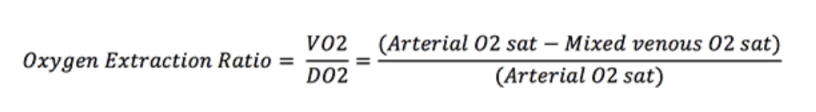
Assessment of venous blood gas: SO2 and PO2
Oxygen extraction ratio (OER)
  VO2: body’s oxygen consumption
  DO2: delivery of oxygen
  Normal ratio is approx. 25%
  Normal central venous O2 saturation is 70%
  Blood from a central venous line is adequate for most purposes (traditionally taken from pulmonary arterial catheter)
  As a general rule, when PvO2 is <30mmHg, may be an indication of decreased oxygen delivery
Notes:
Might throw the OER formula in here. Often can substitute subtracting saturations but the real formula uses oxygen contents.

Slide 41
Question 9:
Your post-op septic patient has been having progressively labored breathing in room air so you obtain an arterial blood gas. What is your interpretation?
pH | 7.28
PaO2 | 52.5
PaCO2 | 35
BE | -7
Hb | 6.3
Lactate | 4.9

Slide 42

Question 9:
Your post-op septic patient has been having progressively labored breathing in room air so you obtain an arterial blood gas. What is your interpretation?
Metabolic acidosis with respiratory alkalosis. Severely hypoxemic potentially consistent with acute lung injury (P/F ratio: 250, A-a gradient 62.5), severely anemic (hb x 3= hct 18.9%), hyperlactatemic
pH | 7.28
PaO2 | 52.5
PaCO2 | 35
BE | -7
Hb | 6.3
Lactate | 4.9

Slide 43
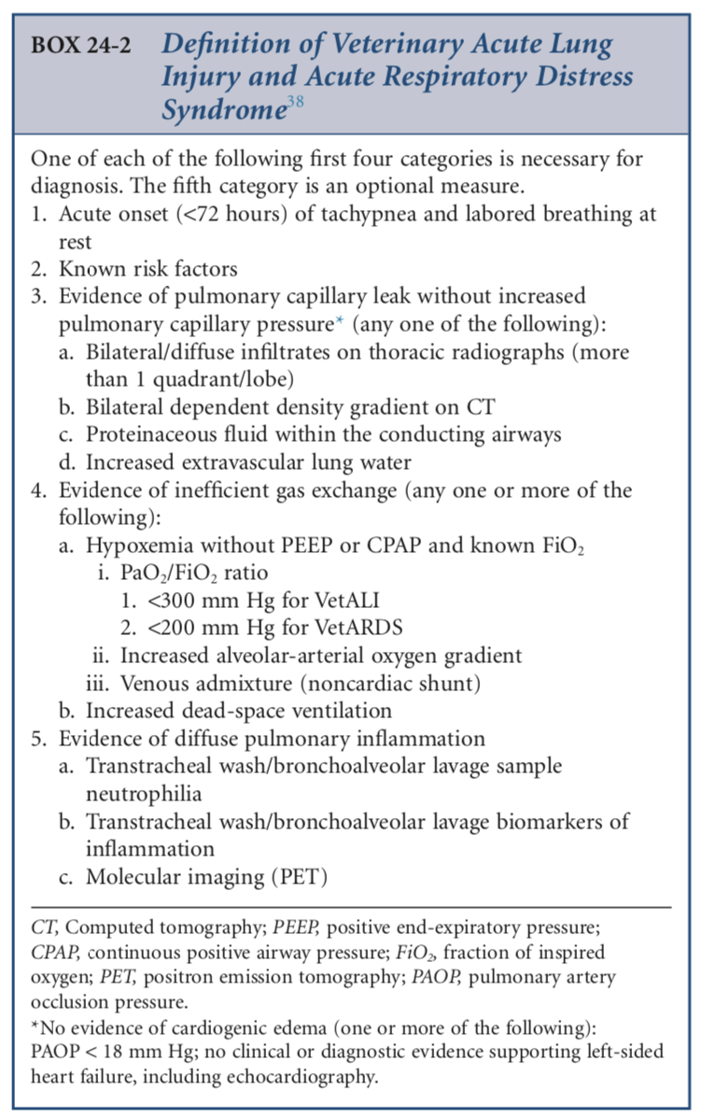


Slide 44
Question 10:
An anesthetized patient is having discordant readings. The ETCO2 is 40 mmHg while the PaCO2 is 60 mmHg. What disease process would you be worried about?

Slide 45
Question 10:
An anesthetized patient is having discordant readings. The ETCO2 is 40 mmHg while the PaCO2 is 60 mmHg. What disease process would you be worried about?
Diseases causing dead space ventilation such as ETT being too long, pulmonary thromboembolism (ventilating non-perfused lung) or low cardiac output states

Slide 46
4. Capnography
Capnogram: a continuous plot of carbon dioxide (CO2) in the respired gas versus time
Capnograph: the instrument that records the capnogram
Capnometer: detects the highest and lowest values for CO2 inspired gas and reports them as inspired and end-expired (AKA end-tidal) partial pressures or concentrations
Type of carbon dioxide analyzers:
  Mainstream: a sample cell is inserted directly in the airway between the tracheal tube and the breathing circuit and an infrared sensor fits over the sample cell and emits light through windows in the sample cell
    Light detected on the other side of the sensor measures CO2
    Waveforms generated are crisper than those from sidestream analyzers because they reflect real-time CO2 measurements and have no deformity due to dispersion of gases in a sample line
    Disadvantages: can be bulky and can have relatively large internal volume. Bulk puts traction on the endotracheal tube (inc risk of extubation) and internal volume adds to apparatus dead space
      Inc dead space can lead to rebreathing of CO2 and increased work of breathing
    Advantages: more reliable in smaller patients (small tidal volumes and elevated RRs)
Notes:
I’m putting this here cause it will get lost on the last slide but I notice you avoided the ETCO2 and PaCO2 problem we’ve encountered recently. Might be a good opportunity to put that in and leave out some of the other heavy hemoglobin physio stuff.

Slide 47
4. Capnography
Type of carbon dioxide analyzers cont:
  Sidestream: monitor is remote from the patient, small pump within the monitor aspirates gas from the patient’s airway through a long sampling tube
    Sample line can be attached to some endotracheal tube adaptors, breathing circuit Y-pieces, or most commonly, lightweight connectors that connect ETT to breathing circuit
    Waveforms tend to be more rounded
    Gas analysis is delayed because it takes time for the gas to reach the monitor (depends on the length and diameter of the tubing and how fast gas is aspirated by the machine)
      As gas aspirated from the airway travels through the tubing, gas molecules can move around and mix (i.e., the CO2-containing gas starts to mix with non-CO2- containing gas)
      Slow rates of aspiration, long sample lines, and large-bore sample lines result in capnogram waveforms with slurred up- and downstrokes
    Advantage is the ability to use them to monitor non-intubated patients (ex: nasal cannulas or feeding tube placement)

Slide 48
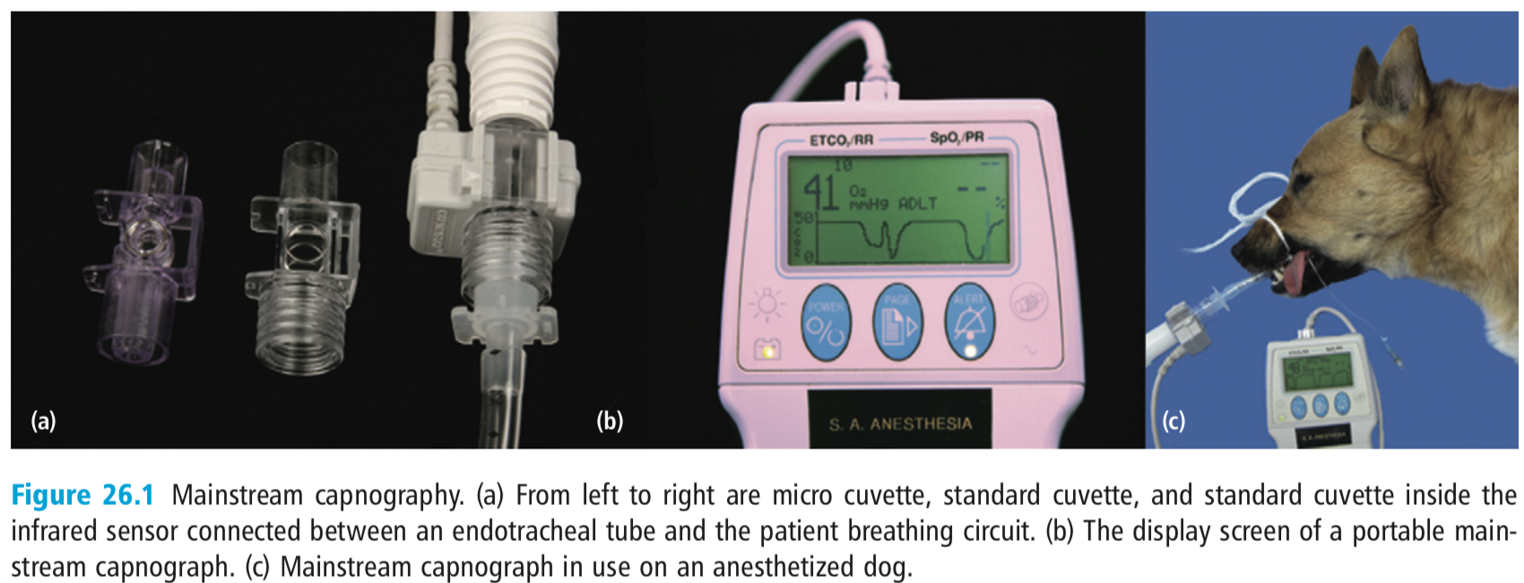
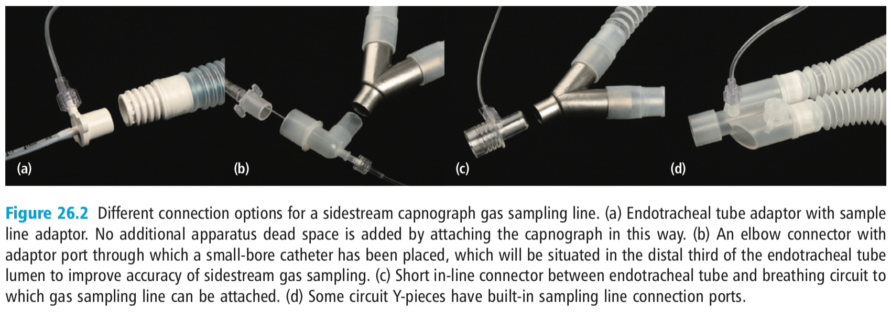

Slide 49
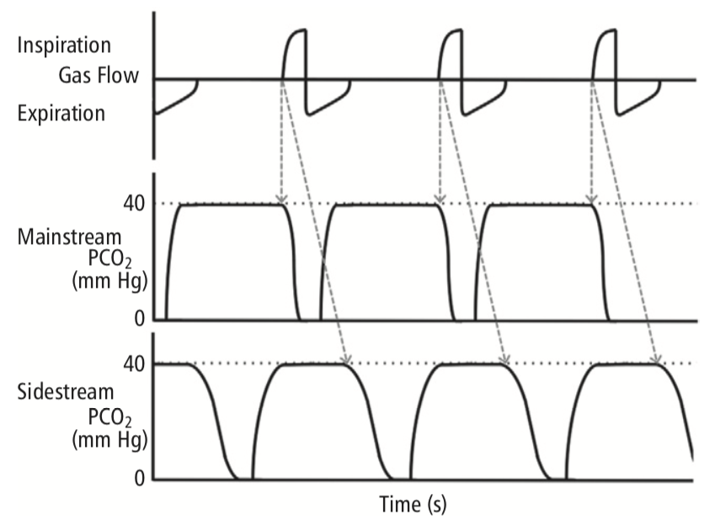
Notes:
dashed lines connecting the flow tracing with the capnograms illustrate the delay in registering changes in PCO2 by capnography. The magnitude of this delay with a sidestream analyzer varies with the monitor settings and equipment.
Mainstream capnograms tend to record sharper changes in PCO2, creating more vertical up-and-down strokes on the capnogram when compared with sidestream capnograms

Slide 50
5. Capnography
CO2 is highly diffusible such that perfused alveoli, alveolar and arterial partial pressures of CO2 are considered equivalent
  Gas sampled at the end of expiration is representative of alveolar gas and is thus used as an estimate of arterial PCO2
Indications:
  Ensuring correct placement of endotracheal tube
  Detection of apnea
    Sampling line of a sidestream analyzer can be attached to nasal prongs for the detection of apnea in non-intubated patients
  Monitoring adequacy of ventilation
    End-expired PCO2 is representative of alveolar PCO2
  Monitoring pulmonary perfusion during CPR
    Large drops in cardiac output (hypovolemic shock or cardiac arrest) result in exponential drops in expired PCO2
  Ensuring correct placement of nasogastric tube
    Detection of any significant level of CO2 should create suspicion of inaccurate placement
  Detection of equipment problems
    Problems such as malfunctioning unidirectional valves, exhausted CO2 absorbers, and inadequate fresh gas flows may be detected by alterations in the capnogram waveform

Slide 51
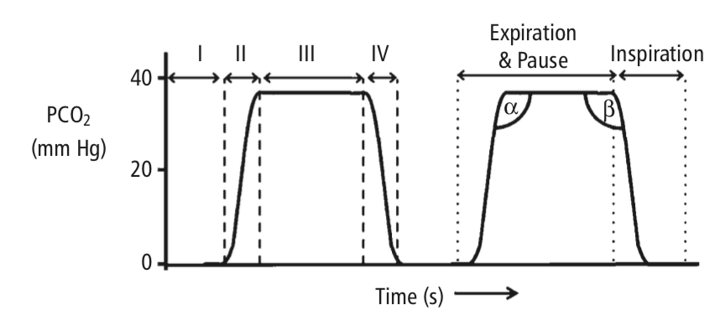
Capnogram
Phase 1
  The normally flat baseline segment
  Reflects inspiration
  At the very end of this phase, the direction of gas flow reverses as expiration begins. During early expiration, expired gas comes from anatomic dead space (normally CO2 free)
Phase 2
  Upstroke that corresponds to the period of expiration where CO2-containing alveolar gas begins to be exhaled in a mixture with gas from anatomic dead space
Phase 3
  Plateau phase with alveolar gas of nearly uniform composition is expired
  Expiration ends partway through this phase and is usually followed by a pause
  Alpha angle: normally close to 100–110°
Phase 4
  Rapid downstroke corresponding to inspiration
  Fresh normally CO2-free gas passes the sampling port as it is inspired into the lungs
  Beta angle: normally close to 90°

Slide 52
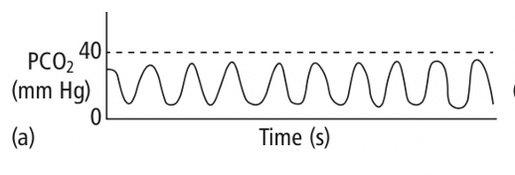
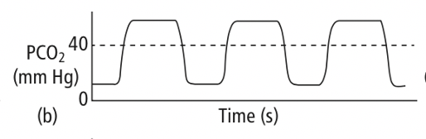
Abnormal capnograms: abnormal phase 1
If the response time of the analyzer is slow, especially with high RRs, then capnogram may look like a sine wave formation
If capnogram fails to return to baseline during inspiration and is not the result of a slow response time (i.e., the shape of the waveform is relatively normal), then there must be CO2 in the inspired gas
  Causes: saturated CO2 absorber or malfunctioning inspiratory valve in a circle system, or inadequate fresh gas flow in a non-rebreathing system
Periodic elevations in baseline can occur if external pressure is applied to the patient’s chest during the inspiratory period

Slide 53
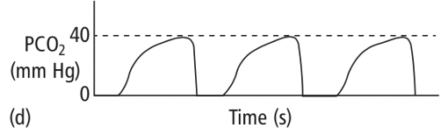
Abnormal capnograms: abnormal phase 2
Gas sampling rates in sidestream analyzers affect the shape of the capnogram
  Slow sampling rates decrease the slope of phase 2, shorten the plateau, and decrease the slope of phase 3
  Typically results in increases in both the alpha and beta angle
If the slope of phase 2 is decreased without delayed equipment response time, it suggests slow expiration (often also associated with a sloped alveolar plateau and increases in alpha angle but normal beta angle)
  Important causes of slow expiration are patient conditions causing airway narrowing or external conditions such as a partially obstructed or kinked ETT

Slide 54
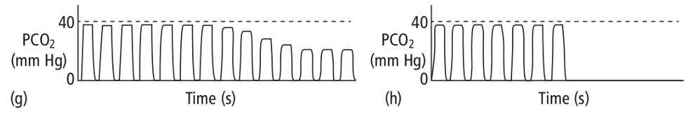
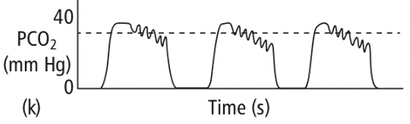
Abnormal capnograms: abnormal phase 3
A normally shaped capnogram with an elevated alveolar plateau reflects hypoventilation
  Very common in anesthetized or sedated patients
A normally shaped capnogram with lower than normal alveolar plateau may reflect hyperventilation
  Reduced CO2 production (hypothermia) or reduced delivery of CO2 to the lungs (low cardiac output)
  Alveolar dead space (ventilated but un-perfused areas) (ex: PTE) creates a situation in which peak expired PCO2 levels are substantially lower than PACO2
    Sudden reductions in pulmonary blood flow (ex: PTE) typically result in exponential decreases in the peak alveolar plateau as long as ventilation continues as opposed to an abrupt disappearance of the capnogram waveform as would occur with disconnect or accidental extubation
  Leak in the gas sampling line (constantly aspirating room air which dilutes CO2)
Conditions causing VQ mismatch result in a slanted plateau phase and an increased alpha angle
In a mechanically ventilated animal, spontaneous ventilatory efforts may be interspersed among mechanical breaths and cause dips or clefts in the alveolar plateau
Cardiogenic oscillations are undulations in the capnogram that are synchronous with cardiac contractions
  RV contraction and filling of the pulmonary vasculature expels a small volume of gas from the lungs with each beat

Slide 55
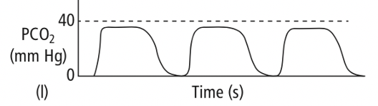
Abnormal capnograms: abnormal phase 4
If the slope of this phase is reduced (i.e., the beta angle is increased> 90 degrees), then either inspiration is occurring abnormally slowly (not common because it does not take much gas to replace the small volume of exhaled gas at the sampling site) or there is CO2 in the inspired gas
  Inadequate fresh gas flows on a non-rebreathing circuit or malfunctioning inspiratory valve on a circle system.

Slide 56
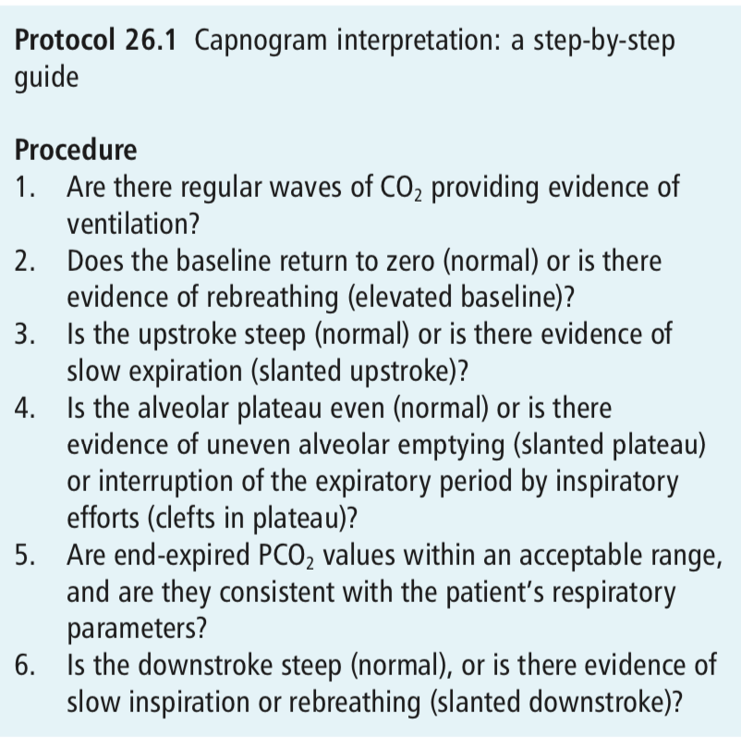
Abnormal capnograms

Slide 57
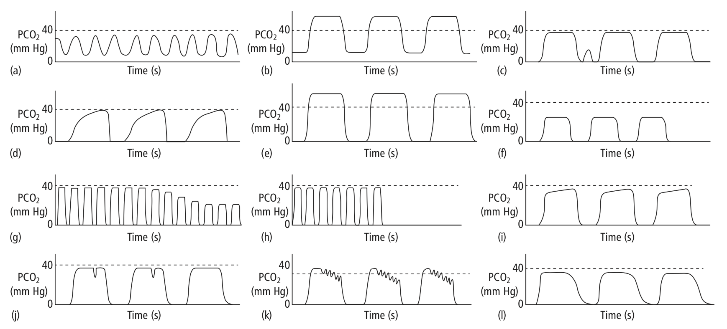
Question 11: Abnormal capnograms
Notes:
Sine wave form common with sidestream analysis on small patient with high respiratory rate
rebreathing of CO2-containing gas
expiratory effort between regular breaths
bronchoconstriction/ airway obstruction
hypoventilation
Hyperventilation
slow-speed capnogram suggesting reduced pulmonary blood flow
slow-speed capnogram indicating accidental extubation, patient disconnection, or sudden apnea
uneven alveolar emptying (areas of dec compliance emptying faster?)
spontaneous inspiratory efforts during mechanical ventilation
cardiogenic oscillations
faulty inspiratory valve

Slide 58
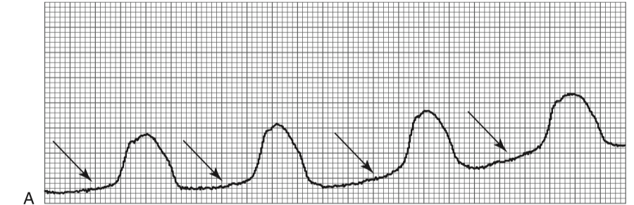
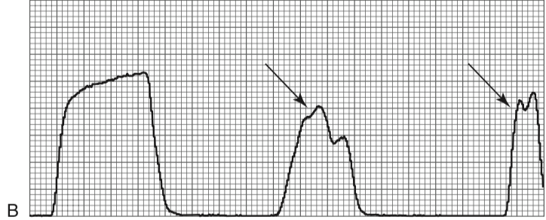
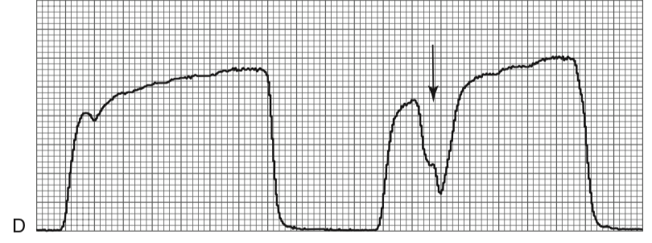
Question 12: Abnormal capnograms
Notes:
Rebreathing. Note how during expiration, carbon dioxide partial pressure does not return to zero (arrows).
Leak. The first waveform is normal; note how it is altered in subsequent breaths (arrows). Cannot localize where the leak (insp or exp limb)
Curare cleft. The first waveform is normal; note the depression during phase III (curare cleft) on the second waveform (arrow). A “curare cleft” is a decrease in carbon dioxide concentration during the alveolar plateau. This is due to a spontaneous inspiratory effort in mechanically ventilated patients

