Slide 1

Renal handling of magnesium, phosphorus and albumin

Slide 2
What are some general roles of phosphorus?
Phospholipids in cell membrane
Nucleic acids
Phosphoproteins involved in mitochondrial oxidative phosphorylation
Energy from phosphate bonds in ATP
Second messengers (cAMP)
Urinary buffer
Notes:
A constituent of structural phospholipids in cell membranes and hydroxyapatite in bone, phosphorus also is an integral component of nucleic acids and phosphoproteins involved in mitochondrial oxidative phosphorylation. Energy for essential metabolic processes (e.g., muscle contraction, neuronal impulse conduction, epithelial transport) is stored in high-energy phosphate bonds of adenosine triphosphate (ATP). The compound 2,3-diphosphoglycerate (2,3-DPG) decreases the affinity of hemoglobin for oxygen and facilitates the delivery of oxygen to tissues. Cyclic adenosine monophosphate (cAMP) is an intracellular second messenger for many polypeptide hormones. Phosphate is also an important urinary buffer, and urinary phosphate constitutes the majority of titratable acidity

Slide 3
Where is majority of phosphorus distribution in the body?
As hydroxyapatite or complexed with calcium in bone (80-85%)

Slide 4
Phosphorus distribution
Circulates in organic and inorganic forms
_____ % of inorganic is protein bound
  Remainder as free anion or complexed
15% of phosphorus in soft tissue
<1% in ECF
Notes:
Approximately 10% to 20% of the inorganic phosphate in serum is protein bound, and the remainder circulates as free anion or is complexed to sodium, magnesium, or calcium. The free and complexed fractions are available for ultrafiltration by the renal glomeruli.

Slide 5
True of false
Only free anion phosphorus is available for ultrafiltration by the glomeruli
Notes:
False, both free and complexed forms can be filtered

Slide 6
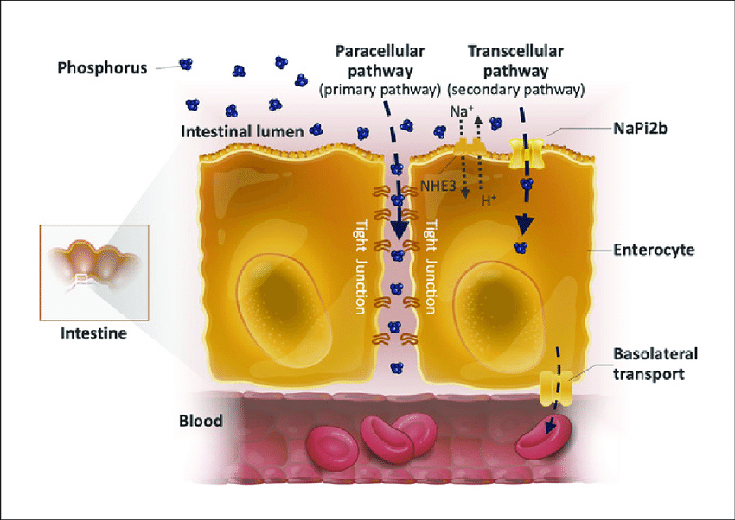
Intestinal absorption
Linear function of intake
Occurs via two mechanisms: passive diffusion and active transport
Passive diffusion via paracellular pathway
Active mucosal transport
  Sodium dependent
  Carrier mediated process
Notes:
Passive transfusion is principal route of phosphorus absortion in intestines and is the primary mechanism present in the jejumum and ileum. Active mucosal transport is increased by calcitriol, which Is probobably only important during dietary phosphorus defiency. Both mechanisms are present in the duodenum.

Slide 7
Renal handling
How much filtered phosphorus is absorbed by the renal tubules?
  80-90%
Where does the majority of phosphorus absorption occur?
  Proximal renal tubule
Filtration through glomerulus
  90-95% of serum phosphorus filtered
Notes:
More specifically 70% is absorbed in the proximal convoluted tubule and 15% in the proximal straight tubule. Apparently no absorption occurs in the thin of thick ascending loop of Henle and the reabsorption mechanism in distal convoluted tubule is uncertain. renal dysfunction is the most common cause of hyperphosphatemia beside that found in young dogs.
Freely filtered by the glomerulus

Slide 8
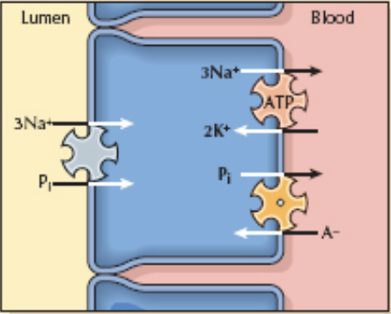
Describe the path of phosphorus absorption
Crosses luminal membranes by brush border cotransporter
  Na+-phosphate symtransporter
  Type IIa sodium phosphate cotransporter
Transport across basolateral membrane poorly understood
Notes:
Main transport protein in proximal tubules is type Iia sodium phosphate cotransporter which transports 3 sodium and one divalent phosphate across the luminal membrane, this promotes luminal electronegativity. Luminal entry is the rate-limiting step and the target for physio- logic and pathophysiologic mechanisms that alter phos- phate reabsorption.
When serum phosphorus level increases and the filtered load of phosphorus increases, the capacity to reabsorb phosphorus also increases. However, a maximum rate of transport (Tm) for phosphorus reabsorption is obtained usually at serum phosphorus concentrations. PTH is the most important regulator of renal phosphate transport, and it decreases the tubular transport maximum for phos- phate reabsorption (TmaxPi) in the proximal tubule

Slide 9
What hormones/substances increase reabsorption?
Growth hormone
Insulin
Thyroxine
Respiratory alkalosis
Notes:
Growth hormone: increases proximal renal tubular reabsorption, partially accounts for increased phosphorus in immature animals
respiratory alkalosis increases proximal tubular reabsorption of phosphate
Acute respiratory alkalosis induces hypophosphatemia via changes in cellular pH. Increased pH stimulates phosphofructokinase, thus stimulating glycolysis to produce ATP, thus consuming phosphate from the cellular space. Serum phosphate is shifted intracellularly to meet this demand. The kidney responds by increasing phosphate reabsorption, independent of serum phosphorus concentration and becomes refractory to the phosphaturic effect of PTH.

Slide 10
What hormones/situations decrease phosphorus reabsorption?
PTH
Calcitonin and atrial natriuretic peptide
ACTH
Acidosis
Volume expansion
Phosphatonins (FGF-23)
Notes:
PTH is most important regulator of renal phosphate transport
Calcitonin and ANP inhibit proximal tubular phosphate reabsorption
High doses of ACTH and glucocorticoids increase renal phosphate excretion
Metabolic acidosis: acutely has no effect, but chronically results in decreased proximal renal tubular transport, possibly mediated by glucocorticoids
Volume expansion: causes natriuresis , decreasing phosphate reabsorption because of sodium-phosphorus cotransporter
Phosphatonins are circulating substances that increase renal loss of phosphorus. These substances decrease sodium phosphate transporters in proximal convoluted tubules, whereas FGF-23 believed to also decrease formation of 1–25 dihydroxycholecalciferol. FGF-23 is increased in people with chronic renal failure,

Slide 11

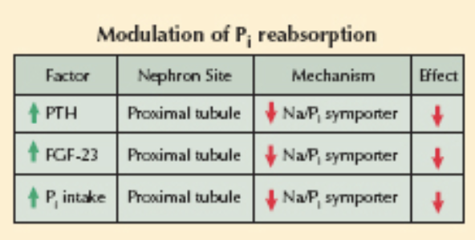
Notes:
Hyperphosphatemia promotes release of PTH, which down-regulates Na⁺/P_{i} symporters and basolateral Na⁺/K⁺ ATPases in the proximal tubule. As a result, phosphate reabsorption is suppressed. Additionally, hyperphosphatemia causes the release of FGF-23 from osteocytes and osteoblasts in bone, which causes decreased Na⁺/P_{i} expression. Finally, increased dietary phosphate intake appears to directly down-regulate Na⁺/P_{i} transport through a PTH-independent mechanism. Hypophosphatemia, meanwhile, causes the opposite effects.

Slide 12
Hypophosphatemia: clinical effects
Erythrocytes
  Decreased ATP concentration leads to fragility
  Hemolysis
  Decreased 2,3-DPG -> less oxygen delivery
Leukocytes
  Impaired chemotaxis, phagocytosis, bacterial killing
  May promote sepsis
Platelets
  Shortened survival time
  Impaired clot retraction
Notes:
Hypophosphatemia decreases erythrocyte concentrations of ATP, which increases erythrocyte fragility, leading to hemolysis. Hemolysis occurs when serum concentration < 1.0 mg/dL
Platelet dysfunction ostensibly because of depletion of cellular ATP stores.
Leukocytes in hypophosphatemic patients have impaired chemotaxis, phagocytosis, and bacterial killing.38 This altered function may promote sepsis in hypophos- phatemic patients receiving total parenteral nutrition.

Slide 13
Hypophosphatemia: clinical effects
Neuromuscular
  Weakness and pain from rhabdomyolysis
  Vomiting, anorexia, nausea second to ileus
Metabolic encephalopathy
  Impaired CNS handling of glucose and ATP production
Cardiac
  Impairment of contractility
Notes:
The central nervous system may manifest with metabolic encephalopathy as a result of ATP depletion and may include altered mental state, irritability, paresthesias, numbness, seizures, or coma. Cardiac function is impacted by ATP depletion. In addition to possible systolic heart failure, the myocytes become less stable, and arrhythmias are possible. The decreased diaphragmatic function impacts pulmonary function with subsequent hypoventilation.

Slide 14
Hypophosphatemia: causes
Translocation/maldistribution from extracellular to intra
  Administration of carbohydrate load (ie 5% dextrose)
  Insulin administration
  Refeeding syndrome
Notes:
Finally, cellular shifts can cause hypophosphatemia. This is most often seen with the administration of glucose or total parenteral nutrition (TPN) in malnourished patients. A rise in insulin causes phosphate to move to the intracellular compartment. Additionally, the increased anabolism leads to the formation of high-energy phosphate bonds, further depleting phosphate levels. Refeeding syndrome occurs when a patient who has been starved of nutrition suddenly is replenished with carbohydrates, proteins, and lipids. Insulin and glucose assist in driving phosphate intracellularly. The net body stores of phosphate necessary to perform basic metabolism, such as glycolysis, are depleted. The body begins to process the newfound foods to produce ATP for energy. Cells uptake all available free phosphate, leading to profound hypophosphatemia.

Slide 15
Hypophosphatemia: increased loss
Primary hyperparathyroidism
Vitamin D deficiency
  Hypocalcemia leading to increased PTH
Fanconi syndrome
  Decreased reabsorption, but serum concentration normal
Diuretics
  Proximally acting diuretics
  May increase excretion by effects on proximal tubule sodium reabsorption
Notes:
PTH: inconsistently causes hypophosphatemia, fractional excretion increased in some dogs
Fanconi: may be caused by metabolic or membrane defects affecting sodium transport, phosphaturia may be because of natriuresis
Diuretics: carbonic anhydrase inhibitors

Slide 16
treatment
Anticipate it
  Total parenteral nutrition, DKA, patients receiving phosphate binders
Treatment likely not necessary
  Asymptomatic with low concentration, but not depleted
  Serum P>1.8 mg/dL, unlikely to decrease more
Treatment likely indicated
  Asymptomatic patients at risk of depletion/symptomatic
  Patients with clinical signs
Notes:
DKA cat with a P of 1.6 mg/dL

Slide 17
Hyperphosphatemia: clinical effects
Decreased calcium
Soft tissue mineralization
  When [Ca] x [P] > 60-70
Notes:
Increased serum phosphorus concentration decreases serum calcium concentration so that the calcium phos- phate solubility product ([Ca] % [Pi]) remains constant.
Clinical signs related to hypocalcemia (more on why hypocalcemia occurs later)

Slide 18
Hyperphosphatemia: renal
Early chronic renal failure
  Does not usually occur
  Compensatory increase in phosphate excretion in remnant nephrons
  When is the compensatory mechanism overwhelmed?
    When GFR is 20% or less of normal
    Results in renal hyperparathyroidism
Notes:
However, sustained hyper- phosphatemia does not usually develop in early chronic renal failure because there is a compensatory increase in phosphate excretion by remnant nephrons. The effects of PTH on the kidneys mediate this increase in the FEPi. When the GFR decreases to 20% of normal or less (i.e., late chronic renal failure), this compensatory mechanism is exhausted and hyperphosphatemia develops

Slide 19
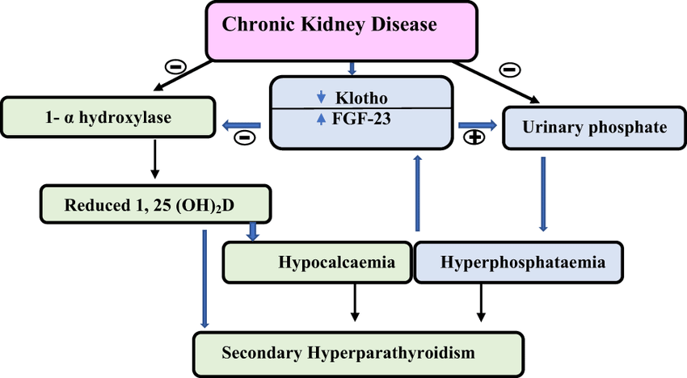
Notes:
Hyperphos- phatemia inhibits renal 1a-hydroxylase, which is present in the renal tubules (this inhibition impairs conversion of 25-hydroxycholecalciferol to calcitriol and thus
Hyperphosphatemia inhibits renal 1a – hydroxylase present in renal tubules which inhibits conversion of 25-hydroxycholecalciferol to calcitriol causing Less intestinal absorption of calcium leading to low serum iCa levels. Low calcium levels Stimulates PTH secretion, Increased renal excretion of phosphate and release of calcium and phosphorus from bone. reduces intestinal calcium absorption), and decreases serum ionized calcium concentration by the mass law effect ([Ca] % [Pi] constant). The resultant hypocalce- mia and the decreased serum calcitriol concentration stimulate PTH secretion. This increased PTH secretion increases renal excretion of phosphate and release of calcium and phosphate from bone. It also stimulates production of calcitriol. These actions normalize serum phosphorus and ionized calcium concentrations. Thus, calcium and phosphorus balance is maintained by a pro- gressive increase in serum PTH concentration (in early chronic renal failure. Eventually too much tubule loss and cannot compensate

Slide 20
Other causes of hyperphosphatemia
Tumor lysis syndrome
Tissue trauma or rhabdomyolysis
Hemolysis
Increased absorption in GI
  Iatrogenic
  Vitamin D
    Increases intestinal absorption of phosphorus and calcium

Slide 21
Hyperphosphatemia: treatment
Parenteral
  Volume expansion with saline
    Dilute ECF phosphorus
    Enhance excretion in dehydrated patients
    Increased GFR increases filtered load of phosphate
    Natriuresis impairing phosphate reabsorption
  Glucose and insulin
    Promotes phosphorus entry into cells
    Rarely necessary
Notes:
Administra- tion of glucose (and insulin if necessary) may temporarily decrease serum phosphorus concentration by promoting phosphorus entry into cells, although such therapy is rarely, if ever, necessary.

Slide 22
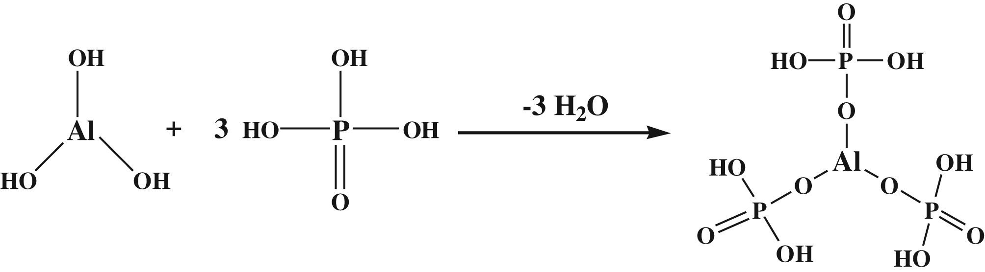
Hyperphosphatemia: treatment
Enteral
  Phosphorus restriction
  Oral phosphate binders
    MOA
      Cation binder combines with dietary phosphorus
      Produces insoluble and nonabsorbable compound
      Magnesium compounds?
Notes:
Magnesium compounds not ideal because cause diarrhea and limited ability to excrete magnesium in renal failure = risk of hypermagnesemia

Slide 23
Magnesium: roles
Mitochondria during oxidative phosphorylation and anaerobic glucose metabolism
Intracellular roles
  DNA synthesis and degradation
  Binding of ribosomes to RNA
  Second messenger production
Cofactor with ATP as driving force for intracellular ion pumps:
  Na-K
  HCO3
  Ca
Notes:
Perhaps most well known is magnesium’s function as a cofactor with ATP as the driving force behind intracellular ion pumping activity. Significant ion pumps, such as the membrane bound Na!-K! ATPase, HCO3- ATPase, and Ca2! ATPase, all require Mg2!-ATP to maintain effective ionic gradients within and outside the cell.6,100 As a result, magnesium has an important function in maintaining appropriate intracellular potassium concentrations and serves to regulate cytoplasmic calcium concentrations by stimulating the sequestration of calcium into the endoplasmic and sarcoplasmic reticula.

Slide 24
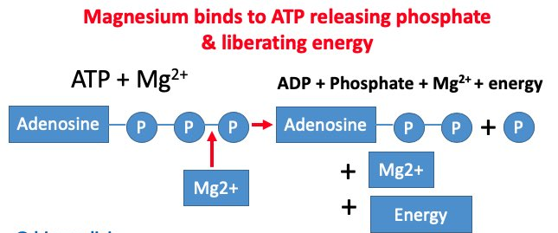
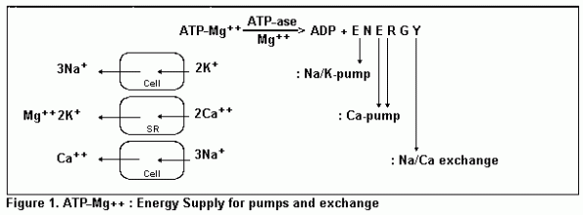
Notes:
Na-K ATP helps maintain intracellular potassium concentrations, Ca ATPase stimulates sequestration of calcium into endoplasmic and sarcoplasmic reticulum, regulation of cytoplasmic calcium concentrations

Slide 25
Magnesium: distribution
Not well documented in veterinary medicine
In humans:
  99% intracellular, 2/3 in bone and 20% muscle
  Extracellular three forms
    Ionized or free form (55%)
    Protein bound (20-30%)
    Complexed (15-25%)
Notes:
Protein bound lower percentage and less affected by changes in albumin concentration
magnesium is only 20% to 30% bound to protein and so is less affected by changes in albumin concentration.90,124 Inside the cell, magnesium is complexed to many organic compounds where it plays a pivotal role. Current estimates indicate that only about 1% to 2% of the intracellular magnesium is present in the ionized or free form.

Slide 26
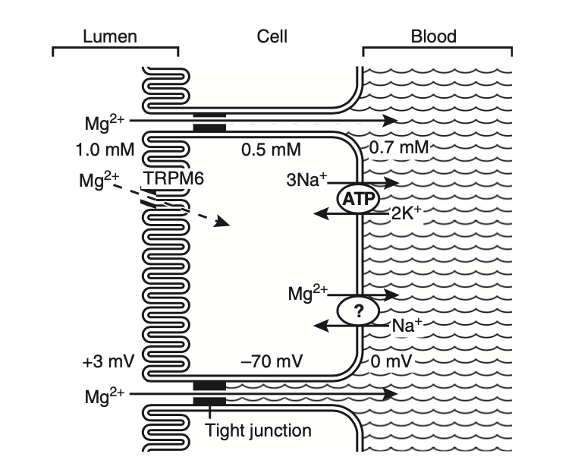
Magnesium: gastrointestinal
Primary site of absorption is ileum via two pathways
  Passive paracellular, unsaturable
    Between tight junctions
    Driving forces:
      Concentration gradient
      Transepithelial voltage gradient
        Formed by salt and water absorption
  Saturable active transport
Notes:
Two pathways for intestinal magnesium absorption exist: an unsaturable passive paracellular route and a saturable active transcellular route (Fig. 8-1).70,71,80 The paracellular movement of magnesium occurs through the tight junctions between epithelial cells. The driving forces for paracellular magne- sium movement are: transepithelial magnesium concen- tration gradient, the transepithelial voltage gradient formed by salt and water absorption, and the permeability of the tight junctions to magnesium.
The transepithelial voltage gradient is created by net move- ment of salt and water. A small positive intraluminal volt- age results in a small force favoring transepithelial cation movement. Solvent drag created by sodium and water reabsorption will also result in transepithelial movement of magnesium and other ions. Water and salt reabsorption from the gut therefore has a significant influence on mag- nesium absorption.
Identification of two very unique ion channels has only recently occurred. A unique family of genes called the transient receptor potential (TRP) family codes for both proteins.

Slide 27
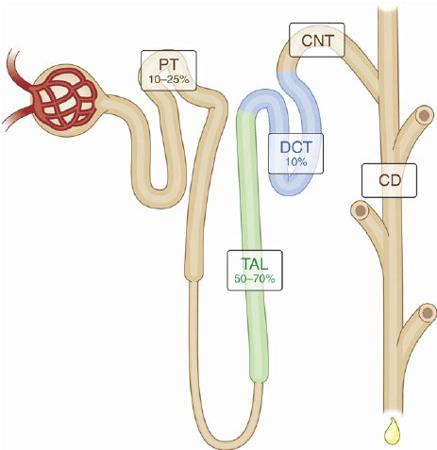
Magnesium: renal

Slide 28
Magnesium: proximal tubule
80% of total serum magnesium filtered by glomerulus
10-15% reabsorbed here
Mechanism:
  Passive and unsaturable mechanisms
  Appears to be paracellular
Notes:
Based on available data, absorption of magnesium in this tubular segment appears to occur through paracellular transport but the precise mechanism is not known.

Slide 29
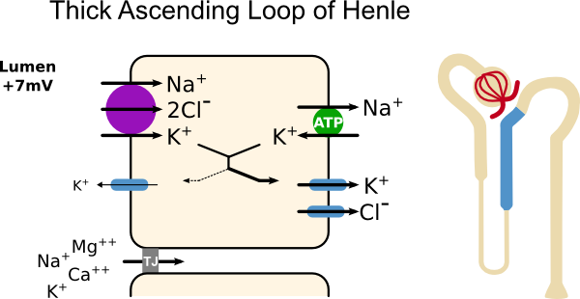
Magnesium: loop of henle
Majority of magnesium absorption: 60-70% in thick ascending
Via paracellular pathway through tight junctions
Driving force:
  Electropositive luminal environment
  Changes in transepithelial voltage influence absorption
    Movement of sodium and chloride
    Increase in salt movement increases electrical potential -> increased magnesium absorption
    Movement through tight junction occurs due to solvent drag
Notes:
Evidence gathered to date indicates that magnesium absorption in this segment occurs via the paracellular pathway through tight junctions between renal epithelial cells.
The principle force allowing magnesium transport in the loop, as in the gut, appears to be the electropositive luminal environment created by the movement of sodium and chloride from the lumen to the interstitial space.123 In addition, magnesium movement through the tight junctions occurs due to “solvent drag” created by the salt and water movement. The positive intraluminal charge facilitates movement of magnesium (and calcium) from the lumen to the interstitium through a paracellular “pore” or channel.
Changes in the transepithelial voltage and paracellular permeability to magnesium strongly influence magne- sium absorption from the thick ascending limb.35,66 Increases in salt movement from the lumen will concur- rently elevate the transepithelial electrical potential and facilitate magnesium absorption

Slide 30
What hormones/chemicals increase magnesium absorption?
  PTH, calcitonin, glucagon, ADH, aldosterone, insulin
What conditions/substances increase magnesium absorption?
  Prostaglandin E2, hypokalemia, hypophosphatemia, acidosis

Slide 31
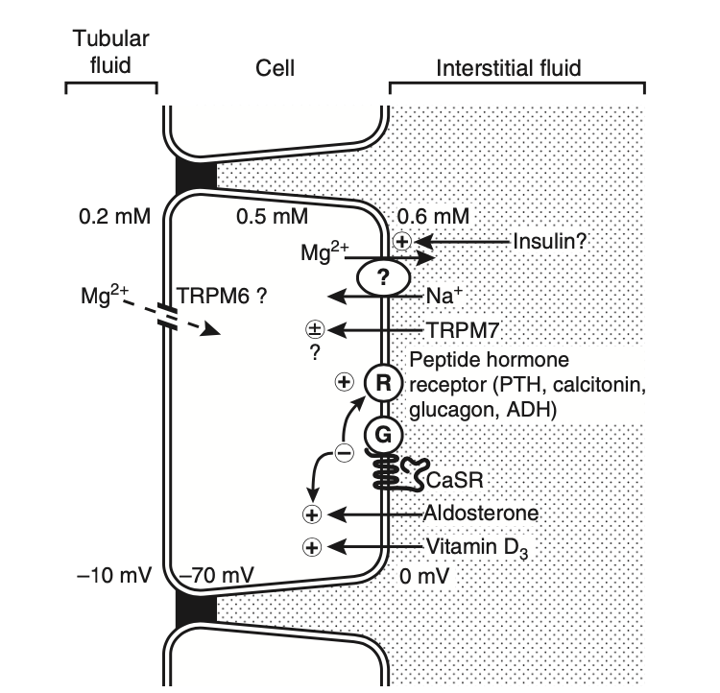
Magnesium: distal convoluted tubule
Site that determines final magnesium excretion
Reabsorb 10-15%
Through active transcellular routes
  Requires energy
  Saturable
  Dependent on concentration and voltage gradients
Principle entry through receptor protein TRPM6
Notes:
When neces- sary it can be very efficient at reabsorbing magnesium, reabsorbing as much as 70% to 80% of the magnesium that is delivered from the thick ascending limb
Reabsorption of magnesium in the DCT appears to occur only through active transcellular routes. Passive paracellular transport does not appear to occur to any sig- nificant degree. As a result, the absorption of magnesium via this route is an energy-requiring saturable process. The transcellular transport of magnesium is dependent on favorable transepithelial concentration and voltage gradients, similar to the gut.37 Evidence suggests that the principle entry for magnesium into the cell is through the unique transient receptor protein TRPM6
there is not yet a documented mechanism of magnesium efflux from the basolateral cell membrane.

Slide 32
Magnesium deficiency
Cardiovascular system
  Cardiac excitability, contraction and conduction
    How?
    cofactor for Ca ATPase
    Potentially acts as a calcium channel blocker for some calcium channels
Notes:
Magnesium (both intracellular ionized magnesium level and extracellular level) plays an important regulatory role in the
intracellular cycling of calcium in muscle cells. It is a cofactor for the Ca2! ATPase that rapidly shunts intracel- lular calcium back into the sarcoplasmic reticulum after the contraction cycle is complete. In addition, there is some evidence to suggest that extracellular magnesium may act as a calcium channel blocker for some cell mem- brane bound calcium channels, limiting the influx of extracellular calcium into the cytosol.77,100 Intracellular and extracellular magnesium levels thus play an important role in cardiac excitability, contraction, and conduction through their regulatory effects on calcium movement.

Slide 33
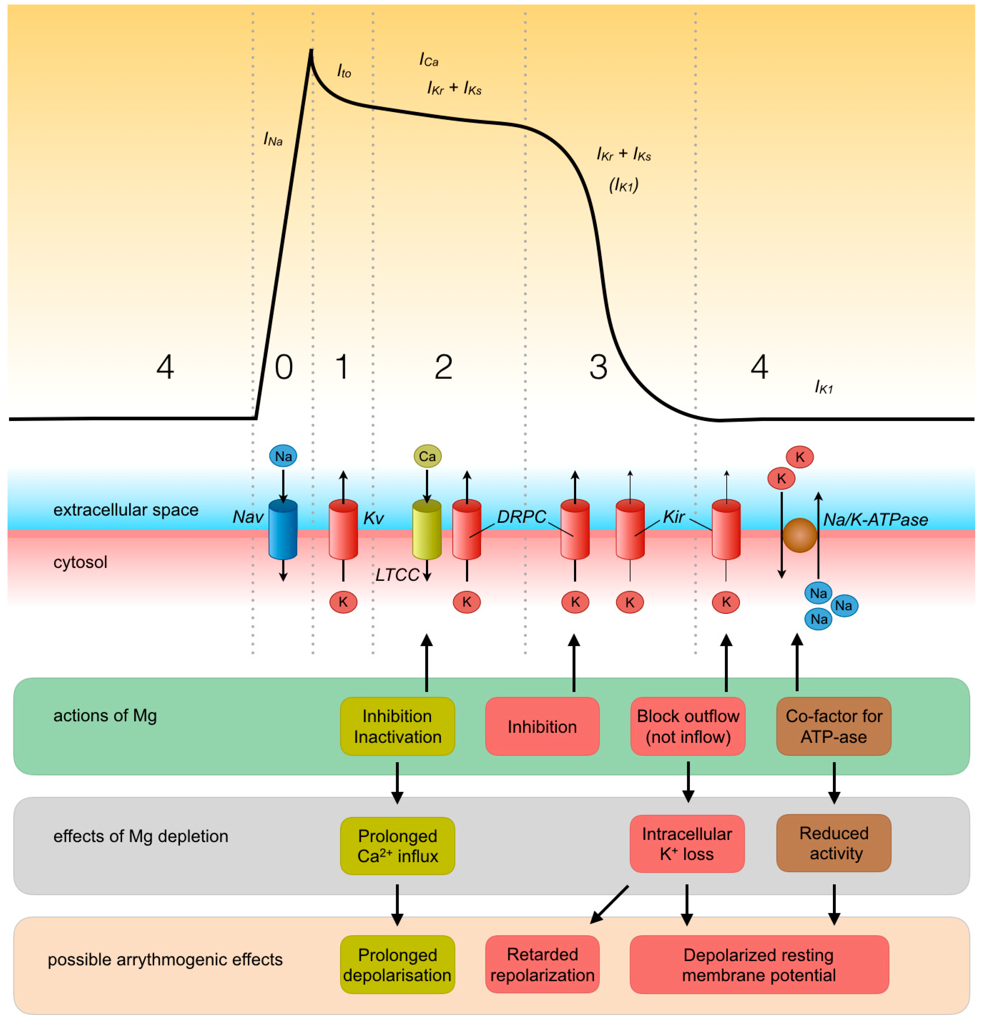

Magnesium deficiency and cardiac conduction
What are the actions of magnesium in cardiac conduction?
What effects does magnesium depletion have?
How could could this lead to arrythmias?
Notes:
Magnesium is a cofactor for the ion pumps that move sodium out of the cell, potassium INTO the cell and calcium OUT of the cell
Can also act to prevent intracellular leakage of potassium
Gating mechanism to control intracellular calcium (by its work as a cofactor for Ca ATPase which shunts calcium back into the SR following contraction)

Slide 34
Magnesium as antiarrhythmic
How could magnesium function as an antiarrhythmic?
  May limit intracellular calcium
  Also as cofactor for Na-K ATPase
What arrythmias could be treated with magnesium?
  Torsades de pointes (seems the main one)
  Atrial fibrillation?
  Ventricular arrythmias
  SVT
Notes:
Slow AV nodal conduction

Slide 35
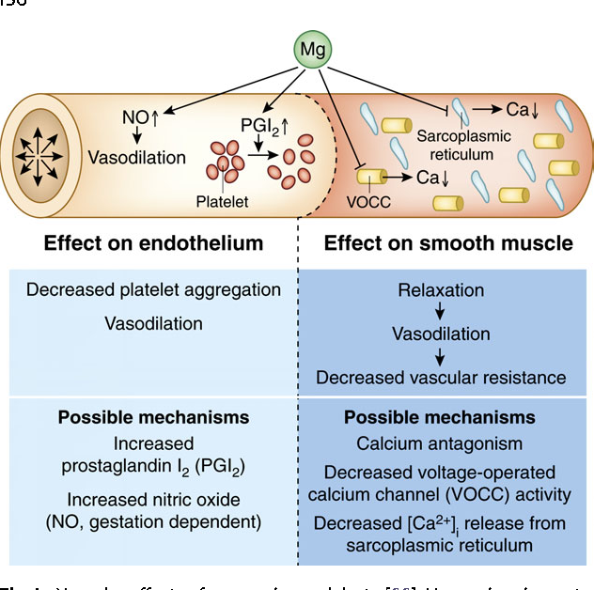
Magnesium and peripheral vasculature
What would increased magnesium levels have on vessel tone? Why?
  Hint: think of relationship with calcium
Notes:
In vascular smooth muscle, magnesium competes with calcium for binding sites, in this case for voltage-operated calcium channels (VOCC). Decreased calcium channel activity lowers intra- cellular calcium, resulting in relaxation and vasodilation. In the endothelium, magnesium increases production of prostaglandin I2 which in turn decreases platelet aggregation. Magnesium also increases NO production causing vasodilation.

Slide 36
Magnesium and neuromuscular system
In general: magnesium depletion leads to increased or decreased neuronal excitability?
How?
Enhanced transmission
  Increased chances of calcium binding to acetylcholine vesicles
  Increased acetylcholine in cleft
  Increased likelihood of muscle contraction
Notes:
1) increased

Slide 37
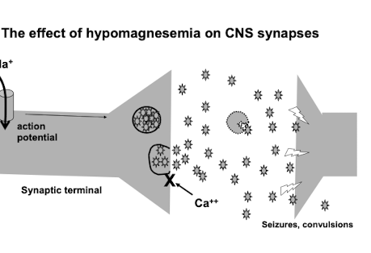
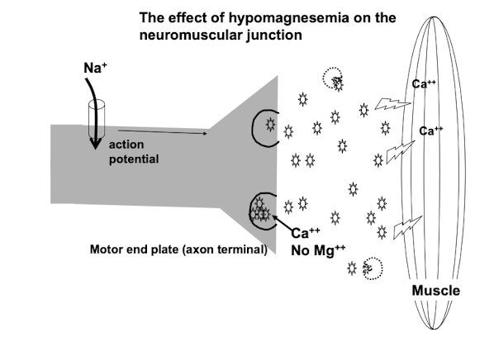
Notes:
Low [Mg2+] in the ECF means less competition for calcium at the axon terminus. Therefore, when an action potential arrives, more calcium goes in. More calcium in means more ACh release. This means a more vigorous, sustained muscle contraction occurs per given action potential signal. 2. Low [Mg2+] in the ECF means that once ACh is released, it is not as effectively broken down by acetylcholinesterase…this is the enzyme that needs Mg as a cofactor. Therefore, the stimulatory signal persists in the muscle ACh receptor… = sustained contraction of muscle. action 3. The same mechanism occurs in cholinergic CNS neurons…hence these animals can show both tetany and convulsions (seizures).
potential
Muscle

Slide 38
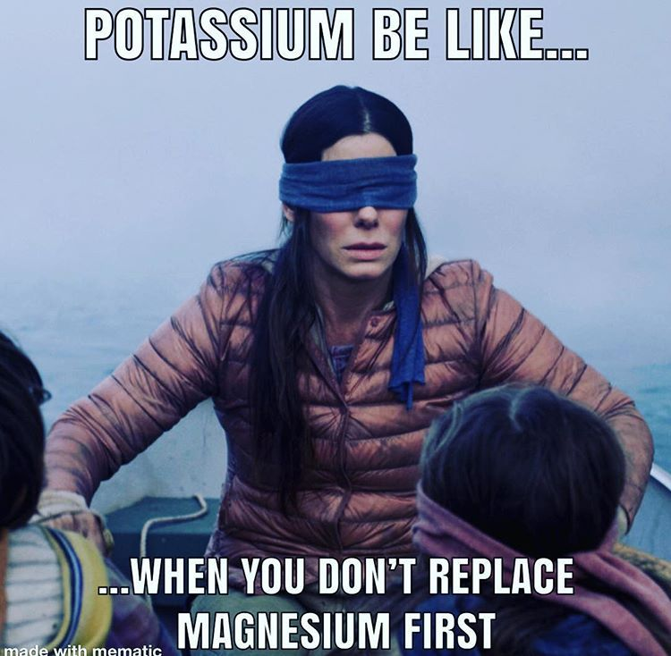
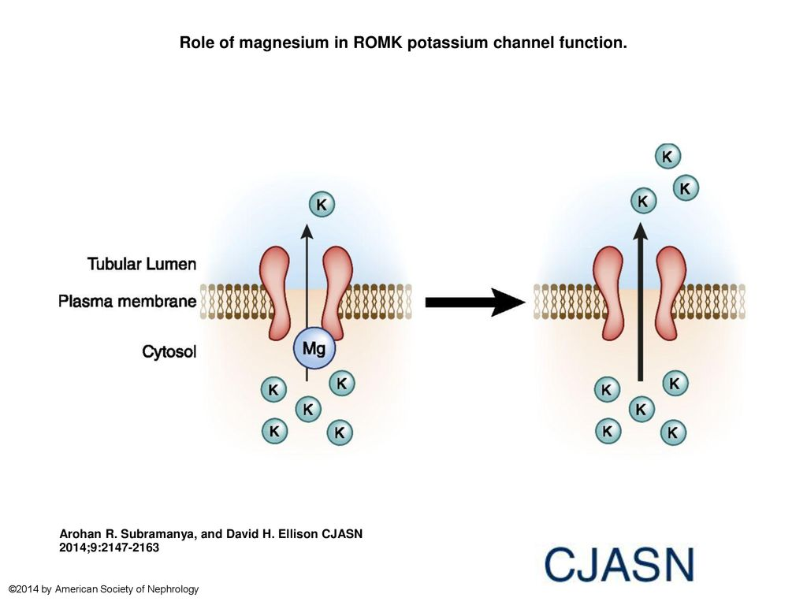
Magnesium and potassium
Hypokalemia
  Reports of refractory hypokalemia until magnesium is corrected
  Why?
  Cofactor for Na-K ATPase -> net loss of potassium
  Decreased Na-K-Cl cotransport -> decreased potassium re-entry
Effect of hypokalemia on magnesium?
  Results in decreased magnesium reabsorption in DCT
Notes:
Normally, magnesium binds to a cytosol-exposed site in ROMK (renal outer medullary potassium) to limit this outward flow. During hypomagnesemia, fewer Mg2+ ions can bind to this site, and K* is secreted more freely. Thus, magnesium deficiency causes K* wasting. This likely explains why magnesium repletion is required to efficiently restore potassium concentrations to normal during concomitant hypomagnesemia and hypokalemia. Other possible mechanisms are likely linked to the dependence of sodium-potassium⁺-ATPase, Sodium/Potassium co-transport, and other transport processes on magnesium

Slide 39
Magnesium and calcium
How can magnesium deficiency contribute to hypocalcemia?
  Increased renal loss
  Decreased liberation from bone
  Impairs production and response to PTH
Notes:
The most likely origin of the concurrent deficiency of calcium and magnesium is loss through the kidneys combined with decreased liberation from bone stores. As magnesium and calcium are the most important divalent cations in the body, reabsorption of these ions, not surprisingly occurs via similar pathways in the kidneys. The influence of multiple hormones, the CASR, and a shared PCLN-1 passive transport pore are likely to result in similar overall net patterns of loss or gain of divalent cations. In addition, there is some evidence in a canine model to suggest that chronic magnesium deficiency impairs the skeletal response to parathyroid hormone and may decrease the parathyroid gland function.

Slide 40
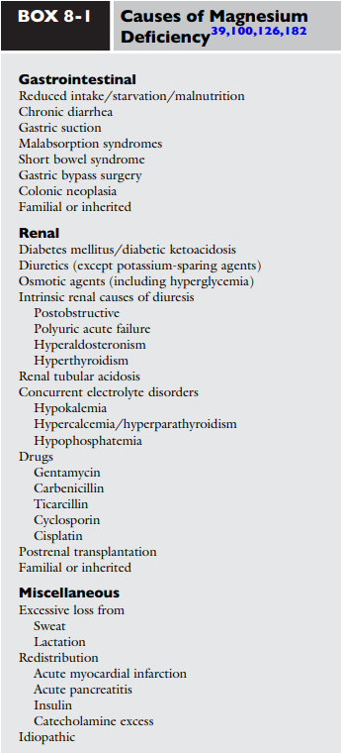
Differentials for magnesium deficiency

Slide 41
Administration of magnesium
What patients may be at risk?
  Anorexic for multiple days
  Suspected gastrointestinal or renal losses
  Patients in heart failure with ventricular arrythmias receiving loop diuretics or digitalis
  Diabetic patients, particularly DKA
How risky is supplementing magnesium?
  Required dose several times over therapeutic dose to produce negative effects
  Patient with impaired renal function most at risk
Notes:
Anesthetized normal dogs: Adverse cardiovascular effects not reached until plasma levels > 12.2 mEq/L Reached after cumulative infusion of 1 to 2 mEq/kg of magnesium
Dangerous arrhythmias and hypotension at cumulative doses of 3.9 mEq/L
Death occurred at doses of 5.9 to 10.9 mEq/kg

Slide 42
hypermagnesemia
Causes
  Renal insufficiency
  Iatrogenic (not reported in veterinary medicine)
Symptoms? (in humans)
  Weak respiratory musculature
  Hypotension
  Electrophysiologic derangement of cardiac conduction

Slide 43
Albumin: general
Synthesis
  In liver, accounts for 25% of proteins synthesized in liver
  What percentage of hepatocytes produce albumin?
  What variables are most important in albumin production?
Distribution
  What percentage of total body albumin is in the extravascular space?
Notes:
Nomally 20-30% of hepatocytes produce albumin and synthesis can be increased as needed by a factor of 200-300%
Nutrition and oncotic pressure as sensed by the hepatocyte, albumin synthesis decreases by 50% within 24 hours of a fast or protein deficient diet
50-70% of albumin in extravascular spac with largest concentrations in the skin and muscle

Slide 44
Albumin: roles
Maintenance of oncotic pressure
Acid/base buffering, SID
Transport of numerous substances
Notes:
Maintenance of oncotic pressure as the most abundant plasma protein
The albumin contains residues of histidine (which possesses a acid dissociation constant), which makes a great buffer donor of positive charges in case of alkalosis and negative charges in case of acidosis. The strong net negative charge of albumin (-17) explains its important contribution to the strong ion dif- ference (SID) and allows it to bind weakly and reversibly with a variety of ions. In this capacity, albumin functions as a circulating depot and transport molecule for many ions
Transport of: calcium, magnesium, copper, fatty acids, bilirubin, bile salts, amino acids, drugs

Slide 45
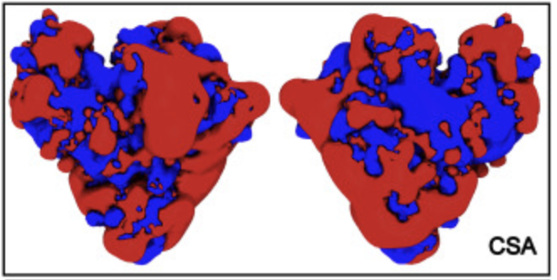
Albumin: physical properties
What is the molecular weight of albumin?
What is its charge?
What is its size? (nm)
Notes:
Molecular weight of roughly 66k Kda (ranges depending on what resource you read
Has a charge of -17 (species dependent)
Roughly 14 nm by 3.6 nm

Slide 46
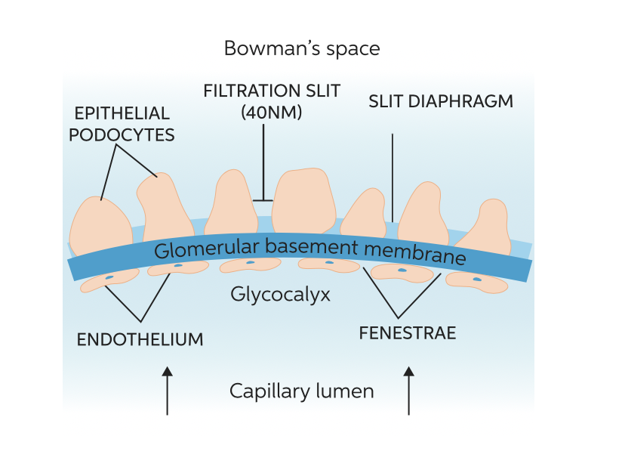
Albumin: glomerulus
Notes:
What are the three layers of the glomerular capillary?
Capillary endothelium with fenestrae opening of 50 to 100 nm
Glomerular basement membrane with a negative charge and filtration barrier that is impermeable to molecules with radii greater than 4 nm, size selection resides primarily in the lamina densa
Visceral epithelial cells or podocytes with filtration slits ranging from 10-30 nm
The charge selectivity of the glomerulus resides in the negatively charged sialoglycoproteins (e.g., laminin and fibronectin) and peptidoglycans (e.g., heparan sulfate) of the capillary endothelium, lamina rara interna, lamina rara externa, and visceral epithelium.

Slide 47
Albumin: glomerulus
What determines the glomerular filtration of albumin?
  Glomerular barrier
Does albumin have a high or low glomerular sieving coefficient and why?
What is the albumin concentrate in filtrate normally?
Notes:
Low sieving coefficient given large size and negative charge
The initial glomerular filtrate of healthy dogs and cats contains only 2-3 mg/dl of albumin compared with about 4 g/dl found in plasma. The urine of healthy dogs and cats contains only a small amount of albumin (< 1 mg/dl) and other proteins.

Slide 48
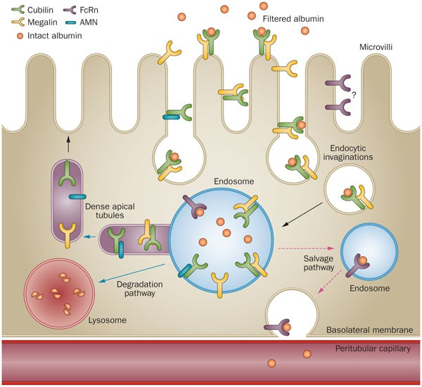
Albumin: reabsorption
In what segment does albumin reabsorption occur?
How is albumin reabsorbed? Describe the steps.
Notes:
Occurs in proximal tubule, most effective in early segment
Reabsorbed vis endocytosis, filtered protein binds specific receptors (megalin and cubulin?), the site then invaginates and forms an endosome. The endosome can then bind to lysosomes and the proteins are digested into amino acids. The endolysosome then fuses to basolateral membranes by facilitated diffusion.
Since it is receptor mediated it is a saturable process and can be overwhelmed with abnormally high albumin filtrate

Slide 49
Albuminuria
What are the three classifications of proteinuria? (origins of the protein)
Albuminuria can be due to disorder in the ________ or the _______
Notes:
Pre-renal (myoglobinuria, hemoglobinuria, bence jones proteins), renal from glomerular or tubulointerstitial disease or post renal from UTI vs urinary tract
Non-urinary disorders associated with proteinuria often involve the production of small-molecular-weight proteins (dysproteinemias) that are filtered by the glomeruli and subsequently overwhelm the reabsorptive capacity of proximal tubules
Can be due to glomerular disease or tubular dysfunction

Slide 50
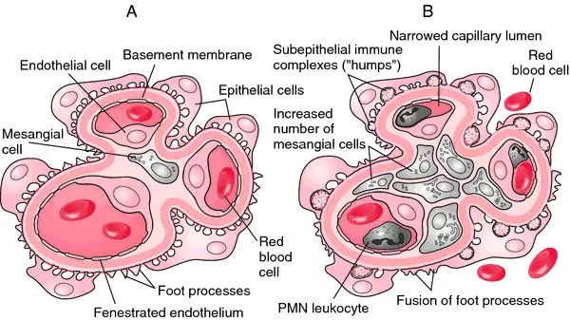
glomerulopathy
Pathophysiology? In general
Differentials?
  Infectious
    Canine adenovirus I
    Bacterial endocarditis
    Brucellosis
    Heartworm disease
    Ehrlichiosis
    Leishmaniasis
    Pyometra
    Borelliosis
    Chronic bacterial infections (gingivitis, pyoderma)
    Rocky Mountain spotted fever
    Trypanosomiasis
    Septicemia
    Helicobacter?
  Neoplastic
    All types
  Inflammatory
    Pancreatitis
    Systemic lupus erythematosus
    Other immune-mediated diseases
    Prostatitis
    Hepatitis
    Inflammatory bowel disease
  Other
    Hyperadrenocorticism and administration of long-term high-dose corticosteroids
    Idiopathic
    Familial
    Nonimmunologic-hyperfiltration
    Diabetes mellitus
Notes:
Glomerular hypertension results when glomerular capillary pressure rises due to afferent arteriolar tone reduction relative to efferent arteriolar tone. Glomerular hypertension causes proteinuria due to increased single nephron glomerular filtration rate (GFR) enlarging the radii of the pores within the filtration barrier and thus ultrafiltration of proteins occurs, can be from vasculitis damaging the endothelial layer
Glomerulonephritis is often defined as the presence of intraglomerular immune complexes. Leakage of plasma proteins into the glomerular filtrate occurs in this disorder because of alterations in the selective permeability of the glomerular capillary wall.

Slide 51
Proteinuria: in the tubule
How can the tubule contribute to proteinuria? (what conditions or what defects?
  Fanconi syndrome
  Damage from glomerular disease
    How?
Notes:
Fanconi syndrome inherited proximal tubular defect that results in abnormal amino acid reabsorption leading to proteinuria
Proteinuria can be toxic to the tubules: Some damage occurs secondary to obstruction of the tubules by protein casts.[47] However, the proteins themselves are also toxic to the tubular epithelial cells and lead to increased interstitial inflammation, fibrosis, and cell death. Proteinuria necessitates increased resorption of proteins through tubular cells by means of lysosomal processing. Ruptured lysosomes lead to cytoplasmic damage. Interstitial inflammatory cells, initially recruited in response to injury, contribute to the development of interstitial fibrosis.

Slide 52
Proteinuria: treatment
What medications and why?
  Angiotensin converting enzyme inhibitor
  Angiotensin receptor blocker
  Diet
Notes:
An ACEi may, in part, reduce proteinuria and pre- serve renal function by decreasing efferent glomerular arteriolar resistance leading to decreased (normalized) glomerular transcapillary hydraulic pressure.
The ARBs in clinical use block the angiotensin II type 1 receptor. Same effect just different mechanism
Diets low in sodium and protein restriction
The UPC, urinalysis, systemic arterial blood pres- sure (BP), and serum albumin, creatinine, and potassium concentrations (in fasting samples) should be monitored at least quarterly in all dogs being treated for glomerular disease.

Slide 53
