Slide 1
Pathophysiology of Sepsis
Part 1
Katie Sotos, DVM
3/28/2023

Slide 2
Brief Discussion of Sepsis-3

Slide 3
Definitions:
Sepsis
Life-threatening organ dysfunction caused by a dysregulated host response to infection
  Sepsis -3
  Modified from Sepsis-2 definition based on improved understanding of the pathobiology of sepsis
    Organ function
    Morphology
    Cell biology
    Biochemistry
    Immunology
    Circulation
Notes:
Sepsis is also a multifaceted host response to an infecting pathogen that may be significantly amplified by endogenous factors
Organ dysfunction, even when severe, is not associated with substantial cell death

Slide 4
Definitions:
Organ Dysfunction
An increase in the Sequential [Sepsis-related] Organ Failure Assessment (SOFA) score of 2 points or more
Associated with in-hospital mortality > 10%
  Sepsis-3
Notes:
- Baseline SOFA score should be assumed to be zero unless the patient is known to have pre-existing (acute or chronic) organ dysfunction before the onset of infection
- SOFA score of >/= 2 patients had 2-25 times increased risk of dying compared to patients with SOFA score < 2

Slide 5
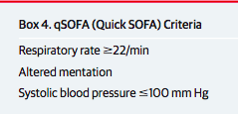
Which of the following is NOT associated with a poor outcome according to quickSOFA (q SOFA)?
RR </= 22 brpm
b) Altered mentation
c) Systolic BP </= 100 mmHg
Notes:
RR >/= 22 brpm is associated with poor outcomes w/ sepsis
Altered mentation represents any Glasgow Coma Scale score < 15
Systolic BP is used because it was the most widely recorded BP value in the electronic health record data sets for the Sepsis-3 analysis

Slide 6
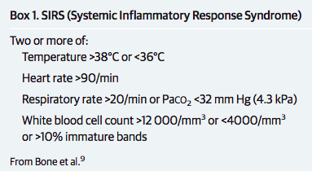
Why was the definition of sepsis changed?
Sepsis-2 definition focused on inflammatory excess ONLY
  Infection + 2/4 SIRS criteria
SIRS criteria do not indicate a dysregulated, life-threatening response, but rather an appropriate and adaptive host response
Notes:
SIRS criteria occur in many hospitalized patients, including those who never develop infection and never incur adverse outcomes: poor discriminant validity
1 in 8 patients admitted to critical care units in Australia and New Zealand with infection and new organ failure did not have the requisite minimum of 2 SIRS criteria to fulfill the definition of sepsis: poor concurrent validity

Slide 7
Why was the definition of sepsis changed?
Sepsis actually involves:
  Early activation of both pro- and anti-inflammatory responses
  Major modifications in non-immunologic pathways:
    Cardiovascular
    Neuronal
    Autonomic
    Hormonal
    Bioenergetic
    Metabolic
    Coagulation

Slide 8
Why was the definition of sepsis changed?
New definition highlights:
  Nonhomeostatic host response to infection
  Potential fatal nature that is excessive compared to a straightforward infection
  Need for urgent recognition and therefore intervention/treatment
Notes:
Even a modest degree of organ dysfunction when infection is first suspected is associated with an in-hospital mortality in excess of 10%

Slide 9
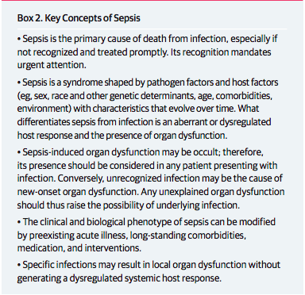
Key Concepts of Sepsis

Slide 10
Definitions:
Septic Shock
Subset of sepsis in which particularly profound circulatory, cellular, and metabolic abnormalities are associated with a greater risk of mortality than with sepsis alone
  Sepsis -3

Slide 11
Clinically Identifying Septic Shock
Blood Pressure
Lactate
Vasopressor requirement to keep MAP >/= 65 mmHg
> 2 mmol/L when euvolemic
In humans, this combination results in what percent of in-hospital mortality rates?
40%

Slide 12
Pathogenesis

Slide 13
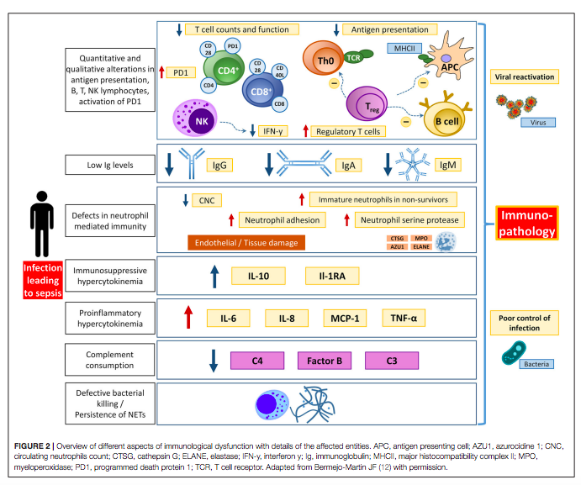
Notes:
Overview
Photo Source: Jarczak, Dominik et al. Sepsis-Pathophysiology and Therapeutic Concepts. Frontiers in Medicine vol. 8 628302. 14 May. 2021, doi:10.3389/fmed.2021.628302

Slide 14
Microbial Factors
Gram negative LPS
From GIT and genitourinary systems most commonly
LPS binds to lipopolysaccharide binding protein (LBP)
Host recognition and reaction
LPS-LBP complex binds to CD14 on macrophages
initiating…
Pathogen-associated molecular pattern (PAMP)
Notes:
- LPS is one of the most potent stimuli of host immune response

Slide 15
Microbial Factors
Inflammatory Cytokines from endothelial cells
Tumor necrosis factor-α (TNF-α)
Interleukins (IL-1, IL-6, IL-8)
Counter-inflammatory Cytokines
Interleukins (IL-4, IL-10, IL-13)
Interferon γ
Transforming growth factor β
Glucocorticoids
Signal transduction via TLRs on APCs and monocytes
Intranuclear translocation of NF-κβ of activated B cells
a.k.a. compensatory anti-inflammatory response syndrome (CARS)
Notes:
TLR: toll-like receptors
APCs: antigen-presenting cells
NF-κβ: nuclear factor-kappa-light-chain-enhancer
Early activation genes: IL-1, IL-12, IL-8, TNF-alpha, interferons
These then lead to the expression of Interferon-gamma, IL-6, and IL-6, complement, and coagulation pathways
These also cause negative feedback on the adaptive immune system
- The inflammatory cytokines are released by endothelial cells in response to DAMPs and PAMPs

Slide 16
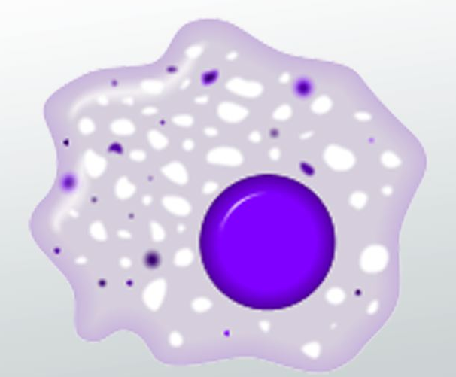
Activation of which immune cell initiates the sepsis-induced systemic inflammatory response?
Macrophage
Notes:
Photo Source: https://study.com/academy/lesson/macrophages-definition-function-types.html

Slide 17
Microbial Factors
What components of Gram positive bacteria does the immune system react to?
  Cell wall components: lipoteichoic acid, peptidoglycan, peptidoglycan stem peptides
  Bacterial DNA
  Soluble bacterial exotoxins

Slide 18
Microbial Factors
Gram positive exotoxins = “superantigens”
Widespread T cell activation
inducing…
Uncontrolled release of inflammatory cytokines
TNF-α
From skin, injured soft tissue, IVCs
Induce…
Interferon γ

Slide 19
In both Gram-negative and Gram-positive sepsis, what drives the host response and clinical manifestation of sepsis?
Interaction with PAMPs

Slide 20
PAMP Summary
Gram-negative
Gram-positive
Lipopolysaccharide (LPS)
  Cell wall components: lipoteichoic acid, peptidoglycan, peptidoglycan stem peptides
  Bacterial DNA
  Soluble exotoxins
    “superantigens”
Which is the most potent stimulus for the release of TNF-α?
Notes:
Pathogen-associated molecular pattern

Slide 21
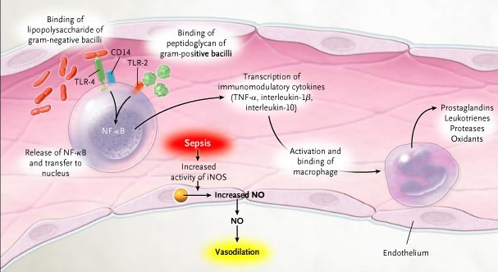
Notes:
Photo Source: https://www.nejm.org/doi/10.1056/NEJMra043632

Slide 22
Host Response to Bacterial Infection
TNF-α
  Early central regulatory of cytokine interactions
  Activates other inflammatory cells (i.e. neutrophils, monocytes)
  Attracts cells (i.e. neutrophils) to damaged area
Chemokines
  Attract cells (i.e. neutrophils) to the damaged area

Slide 23
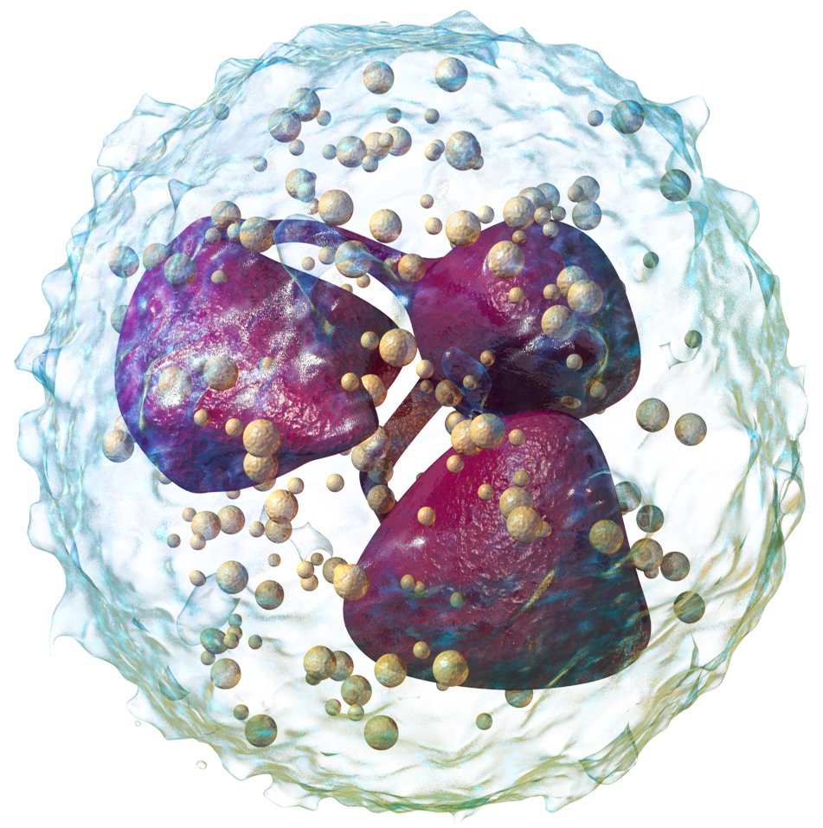
Which immune cell is the innate immune system’s first line of defense against pathogens?
Neutrophil
Notes:
Photo Source: https://en.wikipedia.org/wiki/Neutrophil

Slide 24
IN HEALTH

Slide 25
Neutrophils
Function/Mechanism
Recognize pathogens via pattern recognition receptors (PRRs) on membrane binding to PAMPs
Destroy invading pathogens via:
  Phagocytosis followed by degranulation
    Proteases + peptides fuse with phagosome
    ROS production via intraphagosomal oxidative burst destroys organism and triggers neutrophil apoptosis
      A.k.a. “respiratory burst”
  Formation of neutrophil extracellular traps (NETs)

Slide 26
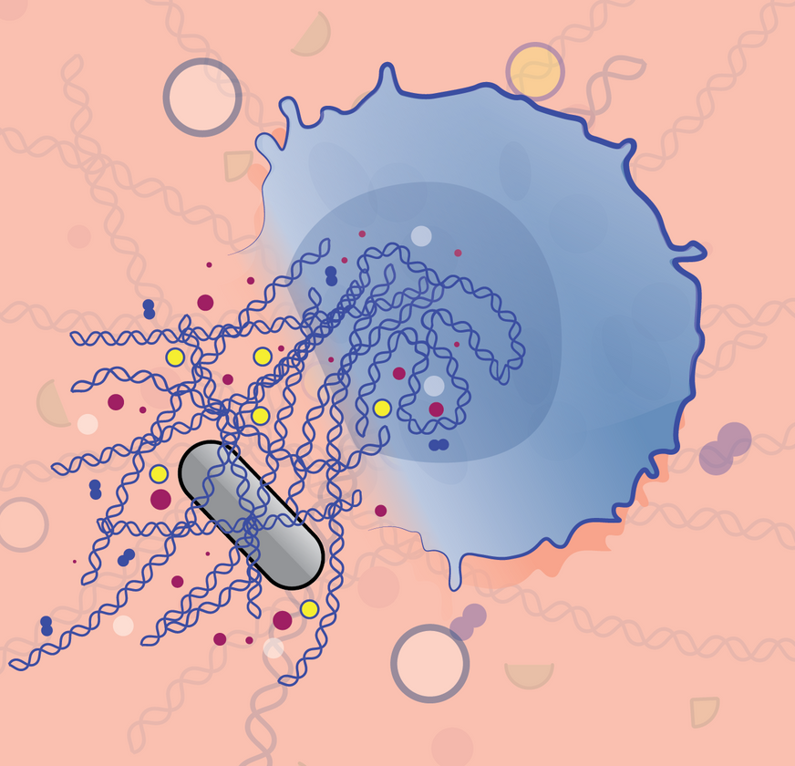
NETs
Nuclear material (DNA, histones) combine with cytotoxic molecules from cytoplasmic granules into extracellular space
Web ensnares and kills microorganisms
Limits spread of cytotoxic molecules to prevent regional tissue damage
Leads to neutrophil death via NETosis
Notes:
NETs have the potential to immobilize a wide range of pathogens (Gram positive and negative bacteria, virus, yeast, protozoa, parasites)
Release of NETs is triggered by: cytokines, chemokines, platelet agonists (i.e. thrombin, ADP, collagen, arachidonic acid), antibodies
NETosis is a programmed cell death that appears to have different characteristics from necrosis and apoptosis
Photo Source: https://www.the-scientist.com/infographics/how-cells-produce-neutrophil-extracellular-traps-66471

Slide 27
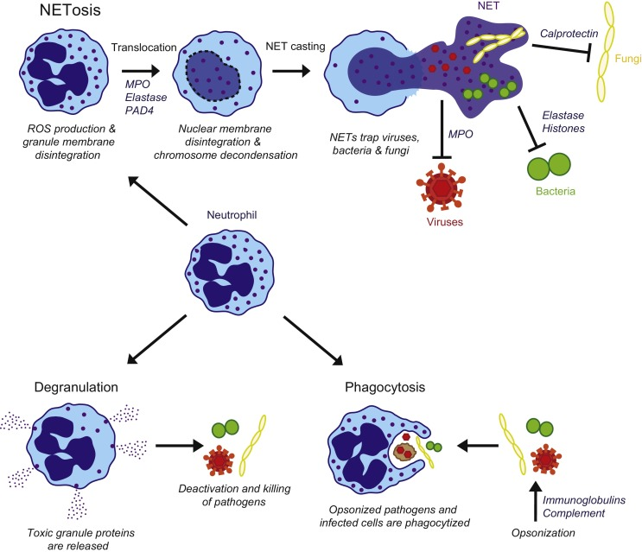
Notes:
Photo Source: https://id.elsevier.com/as/authorization.oauth2?platSite=SD%2Fscience&scope=openid%20email%20profile%20els_auth_info%20els_idp_info%20els_idp_analytics_attrs%20els_sa_discover%20urn%3Acom%3Aelsevier%3Aidp%3Apolicy%3Aproduct%3Ainst_assoc&response_type=code&redirect_uri=https%3A%2F%2Fwww.sciencedirect.com%2Fuser%2Fidentity%2Flanding&authType=SINGLE_SIGN_IN&prompt=login&client_id=SDFE-v3&state=retryCounter%3D0%26csrfToken%3Dffd665c4-c5e3-4381-a4e9-140b0c789ce3%26idpPolicy%3Durn%253Acom%253Aelsevier%253Aidp%253Apolicy%253Aproduct%253Ainst_assoc%26returnUrl%3D%252Fscience%252Farticle%252Fpii%252FS1526054216300604%26prompt%3Dlogin%26cid%3Darp-bc67eb69-cb36-4f72-9e74-63e1bfb6c372

Slide 28
What is the most important cytokine responsible for maintaining neutrophil homeostasis?
Granulocyte-colony stimulating factor
Notes:
- Driving factors behind myelopoiesis and neutrophil homeostasis are not completely understood

Slide 29
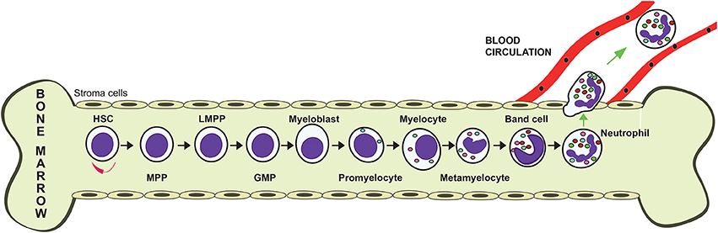
Granulocyte-colony stimulating factor (G-CSF)
Production
Bone marrow stromal cells
Also secreted from: macrophages, monocytes, endothelial cells, fibroblasts
Notes:
Photo Source: https://www.frontiersin.org/articles/10.3389/fphys.2018.00113/full

Slide 30
Elevated levels of which cytokine is a stimulus for G-CSF release by bone marrow stromal cells?
IL-17
Produced by specific lymphocytes under stimulation of IL-23, which is released by tissue macrophages

Slide 31
Pathway to G-CSF Release
Apoptosed neutrophils = phagocytosed by tissue macrophages
Tissue macrophage IL-23 secretion decreases
Lymphocyte IL-17 secretion decreases
G-CSF secretion from bone marrow stromal cells is decreased
Once neutrophil population has decreased and fewer are being phagocytosed, IL-23 secretion increases
IL-17 from lymphocytes increases
Plasma G-CSF concentrations increases
Neutrophil production is promoted
Notes:
The act of ingesting apoptotic neutrophils decreases the secretion of IL-23 by the macrophage

Slide 32
Granulocyte-colony stimulating factor (G-CSF)
Functions
Promotes progenitor differentiation into committed production of neutrophils
Increases cell division
Decreases time to maturation
Increases release of neutrophils from bone marrow

Slide 33
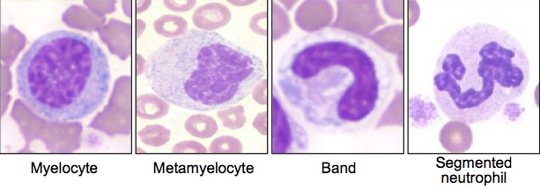
Neutrophils
Release from bone marrow
Stimulated by:
  Granulocyte-colony stimulating factor
  Inflammatory cytokines (macrophage inflammatory protein-2, IL-8)
  Chemotactic leukotrienes [i.e. complement C5a])
  GM-CSF (granulocyte-macrophage colony stimulating factor), TNF-α, TNF-β
Limited by: SDF-1a-CXCR4 axis
Notes:
The inflammatory cytokines are released by endothelial cells in response to DAMPs and PAMPs
SDF-1a-CXCR4 axis retains neutrophils in the marrow compartment and allow for selective neutrophil release and increased production
Photo Source: https://eclinpath.com/hematology/morphologic-features/white-blood-cells/left-shift/

Slide 34
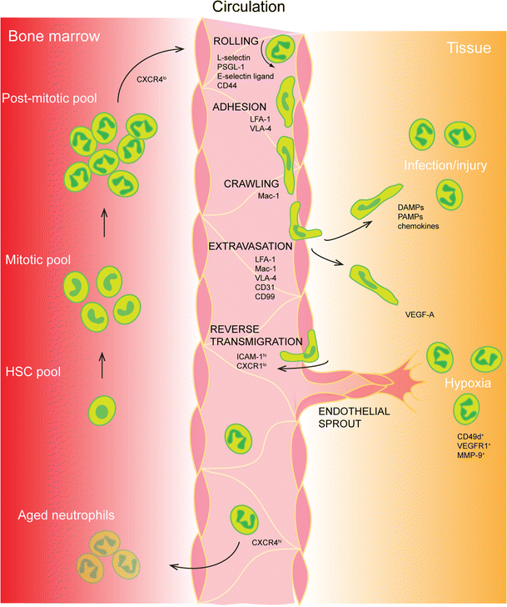
Neutrophils
Once released:
  Circulating pool
    Travel rapidly through large vessels’ centers w/ RBCs
    50% in dogs
    25% in cats
  Marginated pool
    Roll slowly along smaller vessel endothelium, stagnate in postcapillary venules
    50% in dogs
    75% in cats
Notes:
Photo Source: https://link.springer.com/article/10.1007/s00441-017-2780-z

Slide 35
IN SEPSIS…

Slide 36
Neutrophils
Release from bone marrow
Emergency myelopoiesis
Inflammatory cytokines and PAMP/DAMP binding PRRs on hematopoietic stem cells promote/stimulate:
  Progenitor cell proliferation
  Emergency granulocyte maturation
  Directed differentiation into granulocyte cell line

Slide 37
Neutrophils
Release from bone marrow
Inflammation
Release of immature and mature neutrophils from marrow
Emergency myelopoiesis
Decreased SDF-1a levels in marrow
Decreased CXCR4 expression on mature neutrophils
Notes:
- SDF-1a-CXCR4 axis retains neutrophils in the marrow compartment and allow for selective neutrophil release and increased production

Slide 38
Neutrophils
Movement/Migration
Decreased due to activated complement system
Details coming up soon…

Slide 39
Neutrophils
Function/Mechanism
Immature neutrophils have diminished:
  Phagocytosis capabilities
  Oxidative burst capacity
Increased immature neutrophils = associated w/ increased spontaneous production and release of NETs
  Assoc. w/ hypercoagulability and endothelial destruction
Notes:
Increased NETs can occur through either increased/excess production or decreased destruction
Overall less effective pathogen-fighting capabilities

Slide 40
Neutrophil Summary
Sepsis results in:
  Increased release of hypo-functional, immature neutrophils
  Diminished neutrophil migration
  Hypercoagulability and endothelial dysfunction through excessive NETs

Slide 41
The Complement System

Slide 42
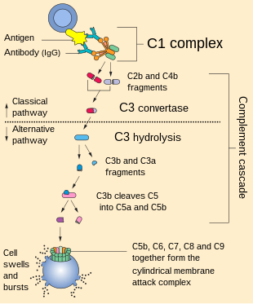
What is the complement system?
“One of the major mechanisms by which pathogen recognition is converted into an effective host defense against initial infection. Complement is a system of plasma proteins that can be activated directly by pathogens or indirectly by pathogen-bound antibody, leading to a cascade of reactions that occurs on the surface of pathogens and generates active components with various effector functions”
Notes:
There are three pathways of complement activation:
The classical pathway, which is triggered directly by pathogen or indirectly by antibody binding to the pathogen surface
The MB-lectin pathway
The alternative pathway, which also provides an amplification loop for the other two pathways
All three pathways can be initiated independently of antibody as part of innate immunity.
Photo Source: https://www.ncbi.nlm.nih.gov/books/NBK27100/#:~:text=Complement%20is%20a%20system%20of%20plasma%20proteins%20that%20can%20be,components%20with%20various%20effector%20functions.

Slide 43
Complement activation products (i.e. anaphylatoxins C3a, C4a, C5a) are ______ in the early stages of sepsis.
ELEVATED

Slide 44
Which anaphylatoxin is associated with the chemotaxis of neutrophils to the site of infection?
a) C3a
b) C4a
c) C5a

Slide 45
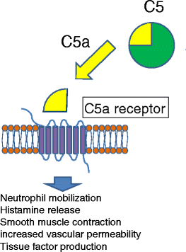
C5a Effect on Neutrophils
C5a binds to C5aR
Neutrophils develop into migratory cells
Enter inflamed tissue and remove pathogens and debris
PAMPs and DAMPs induce NET release and oxidative burst
Notes:
C5aR = receptor
Photo Source: https://inflammregen.biomedcentral.com/articles/10.1186/s41232-016-0013-6

Slide 46
C5a-C5aR in Sepsis
Overwhelming levels of C5a during sepsis lead to downregulation of C5aR
Low C5aR with concurrent high C5a levels is associated w/ a poor prognosis in sepsis
_____________________
Vilobelimab (anti-complement C5a) and Avdoralimab (anti-receptor C5aR monoclonal antibody; NCT04371367): clinical sepsis trial and COVID-19 testing
Notes:
Downregulation of C5R would therefore lead to fewer neutrophils developing into migratory cells, therefore being less able to enter inflamed tissue and remove pathogens and debris, and having less exposure to PAMPs and DAMPs to induce NET release and oxidative burst → LESS NEUTROPHIL ACTIVITY
In mice models: bloackade of C5a or C5aR inhibits the development of sepsis
Significantly increased survival occurs in models of mild/moderate sepsis of C5aR-deficient mice
Along w/ improved pathogen clearance and overall preserved liver function

Slide 47

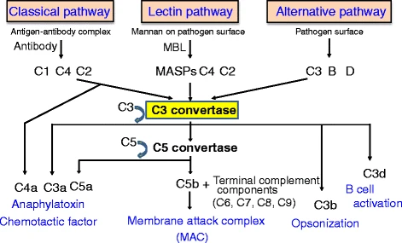
C5b
Notes:
C5b initiates the formation of MAC, which lyses cells as well as triggers inflammation
Photo Source (for both): https://inflammregen.biomedcentral.com/articles/10.1186/s41232-016-0013-6

Slide 48
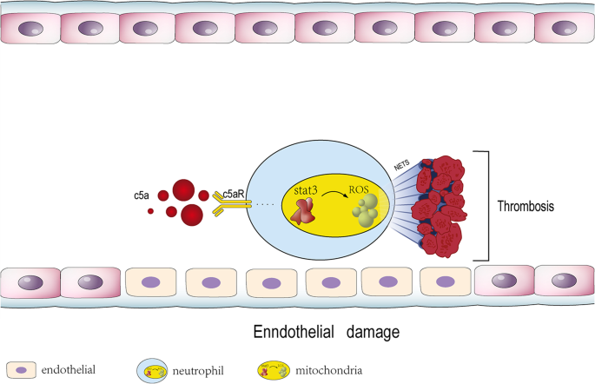
Complement & Coagulation
Prothrombotic
Hyperfibrinolytic
vs.
Antithrombotic
?
vs.
Hypofibrinolytic
?
PAMPs and DAMPs induce the release of NETs, granular enzymes, and ROS during the oxidative burst which shifts the coagulation balance toward prothrombotic activity whilst fibrinolysis is inhibited
Result = DIC
Notes:
The yellow thing is a neutrophil mitochondria
C5a-C5R also stimulations tissue factor production
Photo Source: https://thrombosisjournal.biomedcentral.com/articles/10.1186/s12959-022-00384-0

Slide 49
Sepsis-Induced Coagulopathy (DIC) and the Role of Endothelium in Sepsis

Slide 50
Sepsis-associated DIC
Systemic activation of coagulation with suppressed fibrinolysis that leads to organ dysfunction in combination with systemic inflammation
Instead of focusing only on consumptive coagulopathy, this focuses on:
  Organ dysfunction
  Thrombocytopenia
  Increased PT-INR
Notes:
PT-INR: prothrombin time international normalized ratio

Slide 51
Endothelium
Factors that affect it
How it contributes to inflammation
Pathogens and their products
Pro-inflammatory molecules from cell response to pathogens
DAMPs
Releases pro-inflammatory substances
Recruits inflammatory cells
Pro-coagulant activity (+ loss of anti-coagulant activity)
Hyperpermeability

Slide 52
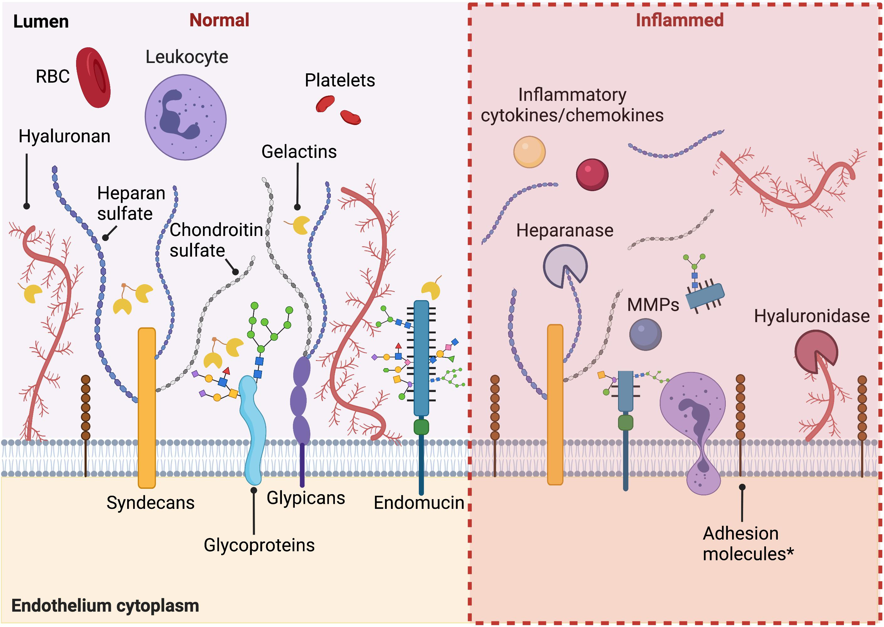
Notes:
- Endothelial cells lose their anticoagulant function after proinflammatory stimulation and promote coagulation by decreased expression of thrombomodulin and heparan sulfate on the cell surface and increased expression of tissue factor
Photo Source: https://www.frontiersin.org/articles/10.3389/fcell.2021.734276/full

Slide 53
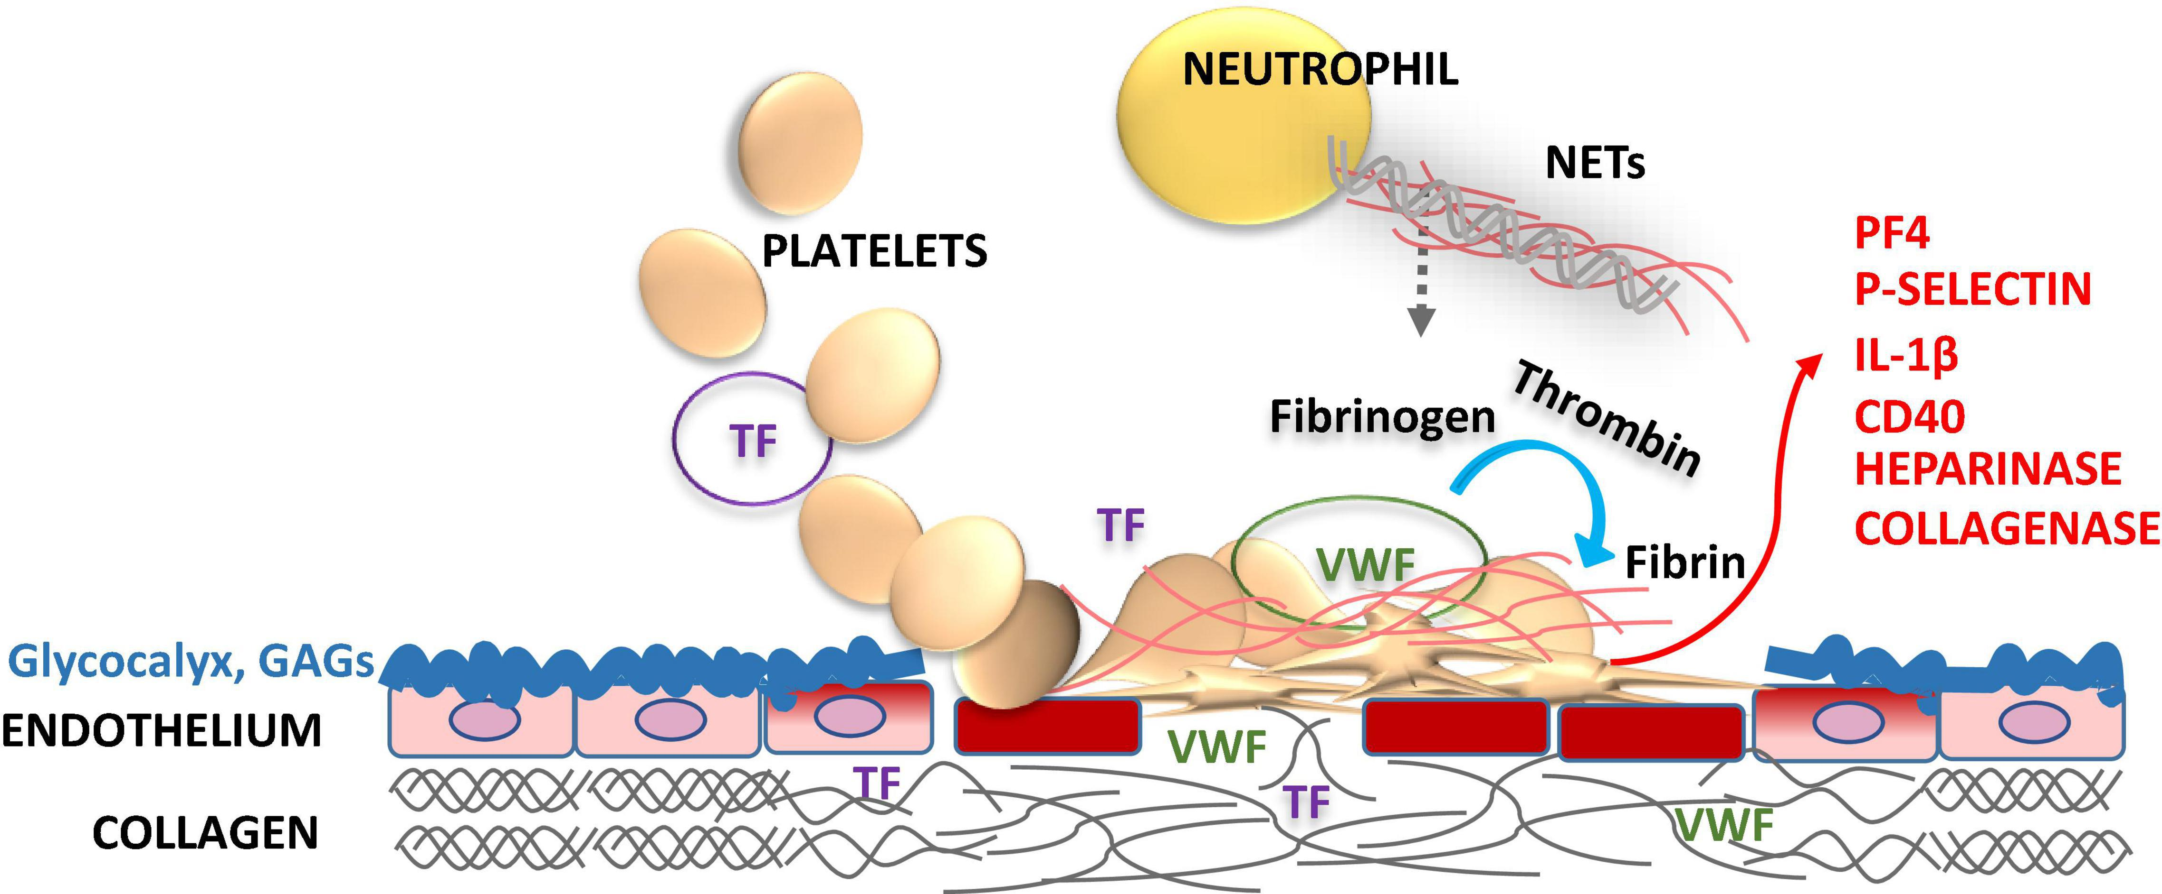
Notes:
- Endothelial cells lose their anticoagulant function after proinflammatory stimulation and promote coagulation by decreased expression of thrombomodulin and heparan sulfate on the cell surface and increased expression of tissue factor
Photo Source: https://www.frontiersin.org/articles/10.3389/fcvm.2022.866751/full

Slide 54
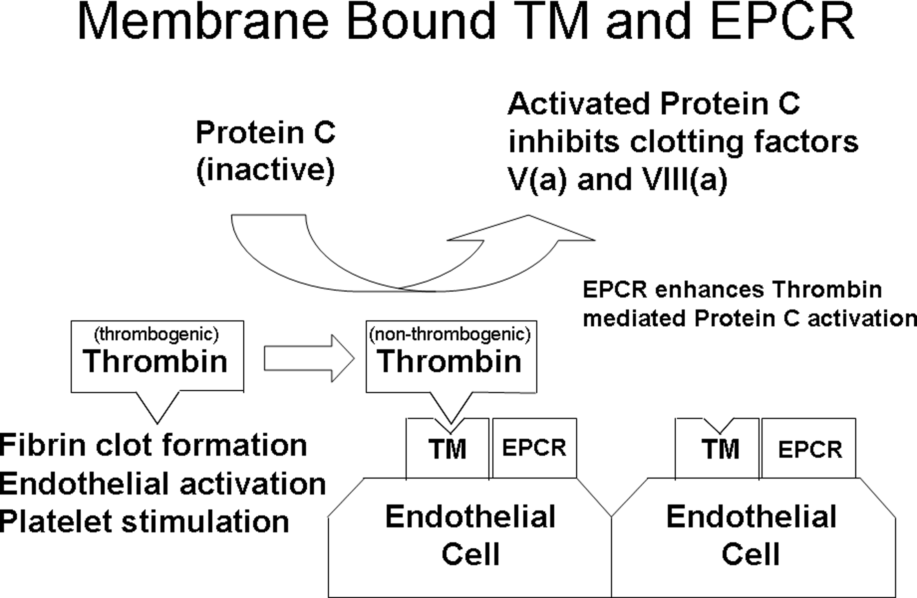
Notes:
Thrombomodulin: a high affinity thrombin receptor present on endothelial cell membrane, plays an important role as a natural anticoagulant. It acts as a cofactor of thrombin-catalyzed activation of protein C, and inhibits the procoagulant functions of thrombin.
Photo Source: https://journals.plos.org/plosone/article?id=10.1371/journal.pone.0206554

Slide 55
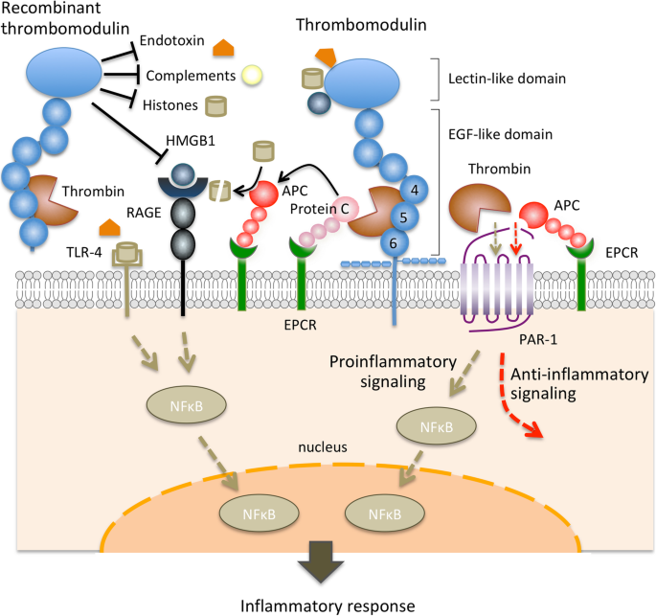
Notes:
Endothelial cells lose their anticoagulant function after proinflammatory stimulation and promote coagulation by decreased expression of thrombomodulin and heparan sulfate on the cell surface and increased expression of tissue factor
Thrombomodulin: a high affinity thrombin receptor present on endothelial cell membrane, plays an important role as a natural anticoagulant. It acts as a cofactor of thrombin-catalyzed activation of protein C, and inhibits the procoagulant functions of thrombin.
The other pathway demonstrated here is the pro-inflammatory serine protease thrombin activating the G-coupled protein receptor-1 (PAR-1) of endothelial cells, enhancing hyperpermeability, adhesion molecule expression, and cytokine production
Photo Source: https://pubmed.ncbi.nlm.nih.gov/9814688/#:~:text=Thrombomodulin%20(TM)%2C%20a%20high,the%20procoagulant%20functions%20of%20thrombin.

Slide 56
Coagulation
Anticoagulant Function Loss
Pro-coagulant Activity
Increased tissue factor (TF) expression
Adhered tissue factor-loaded monocytes
Leukocytic microparticles
Thrombin activation of PAR-1
Decreased cell surface expression of:
  Thrombomodulin
  Heparan sulfate

Slide 57
Humoral Immunity

Slide 58
Immunoglobulins
Glycoproteins produced and released by:
  Macrophages
  B cells
  T cells
  Lymphocytes
Notes:
B cells: Plasma cells

Slide 59
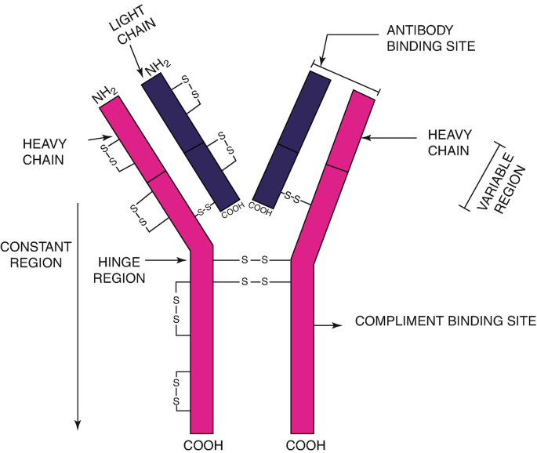
Immunoglobulins Structure
Variable region
  Non-covalent cross-linking with antigens
Constant region
  Signals antigen binding
Notes:
Photo Source: https://link.springer.com/chapter/10.1007/978-981-13-1035-5_23

Slide 60
Immunoglobulins Classes
IgA
IgG
Mucosal immunity
Opsonization
Complement activation
Secondary antibody reactions
IgM
Primary antibody response
Complement activation
Notes:
Opsonization: marking a pathogen for phagocytosis and coating it to allow intra-cellular movement without negative charges repelling each other
Antigen-binding affinity of IgM is less than IgG’s, but polyvalence of IgM allows for high avidity (combined affinity) and efficient engagement of complement to induce complement-dependent cell lysis
IgG, IgA, IgM behave synergistically in sepsis and septic shock
Low plasma levels of these antibodies is associated with reduced survival in patients at the onset or during sepsis/septic shock

Slide 61
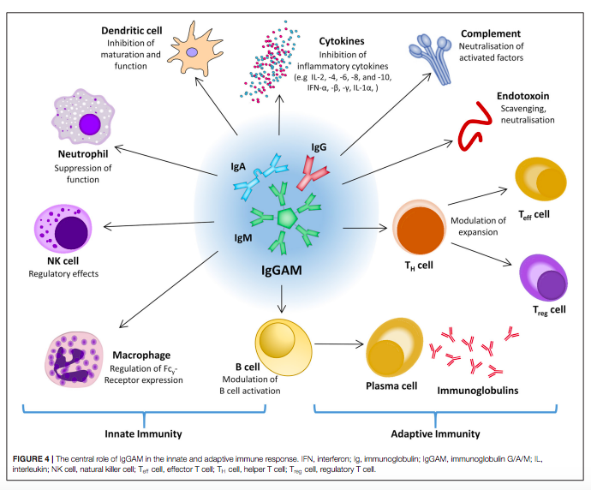
Notes:
Photo Source: Jarczak, Dominik et al. Sepsis-Pathophysiology and Therapeutic Concepts. Frontiers in Medicine vol. 8 628302. 14 May. 2021, doi:10.3389/fmed.2021.628302

Slide 62
Proposed Etiology of Low Levels of Immunoglobulins in Sepsis
Endothelial dysfunction w/ vascular leakage
Redistribution to inflamed tissue
Complement consumption
Excessive catabolism
Immunosuppression:
  Downregulated production
  Downregulated secretion
Notes:
Not fully understood

Slide 63
Notes:
Summary
Photo Source: Jarczak, Dominik et al. Sepsis-Pathophysiology and Therapeutic Concepts. Frontiers in Medicine vol. 8 628302. 14 May. 2021, doi:10.3389/fmed.2021.628302

Slide 64
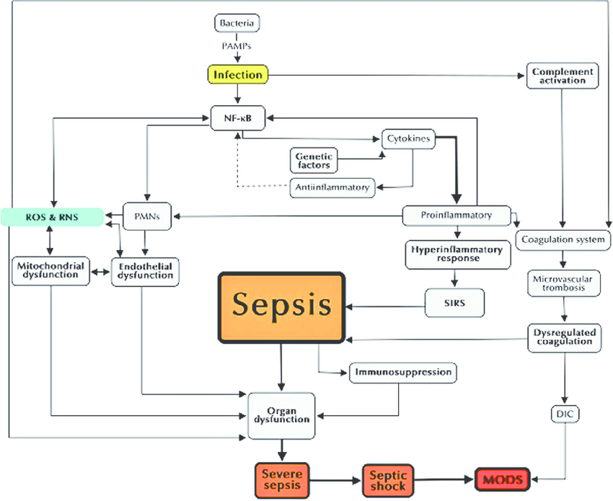
Notes:
More broad (less molecular) summary
Photo Source: Novel relationships between oxidative stress and angiogenesis-related factors in sepsis: New biomarkers and therapies – Scientific Figure on Research Gate. Available from: https://www.researchgate.net/figure/Pathophysiology-of-sepsis-Several-elements-are-crucial-in-the-progression-of-the_fig1_277024240 [accessed 15 Mar, 2023]

Slide 65
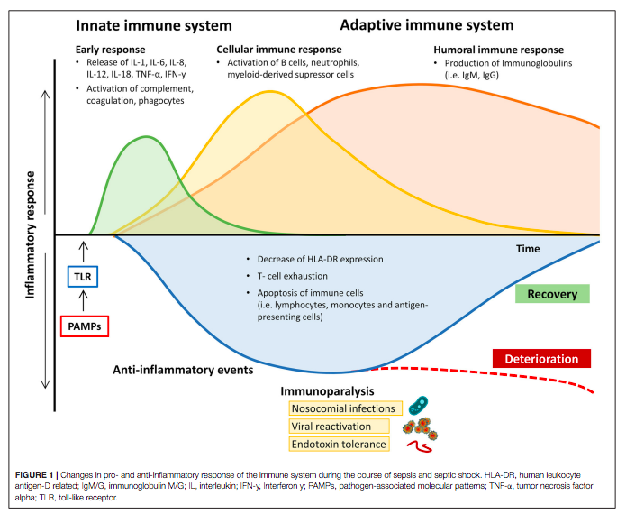
Notes:
Immune paralysis
HLA-DR expression: down-regulation of activating cell surface molecules
Often occurs in later stages of disease and makes the patient more susceptible to nosocomial infection, opportunistic injection, and viral reactivation
s
Photo Source: Jarczak et al.

Slide 66
Balancing the Immune Response
SIRS
Immune Paralysis
Disproportionate activation of proinflammatory mediators
Lack of CARS
Excessive anti-inflammatory activity
Concomitant immunosuppression
Notes:
Controlled inflammatory response is beneficial to the host → localized and represents a balance between activation of the inflammatory cascade and host CARS
CARS: compensatory anti-inflammatory response syndrome

Slide 67
Sources
Boffa, M C, and M Karmochkine. “Thrombomodulin: an overview and potential implications in vascular disorders.” Lupus vol. 7 Suppl 2 (1998): S120-5. doi:10.1177/096120339800700227
https://eclinpath.com/hematology/physiology/neutrophils/
Horiuchi, T., Tsukamoto, H. Complement-targeted therapy: development of C5- and C5a-targeted inhibition. Inflamm Regener 36, 11 (2016). https://doi.org/10.1186/s41232-016-0013-6
Janeway CA Jr, Travers P, Walport M, et al. Immunobiology: The Immune System in Health and Disease. 5th edition. New York: Garland Science; 2001. The complement system and innate immunity. Available from: https://www.ncbi.nlm.nih.gov/books/NBK27100/
Jarczak, Dominik et al. Sepsis-Pathophysiology and Therapeutic Concepts. Frontiers in Medicine vol. 8 628302. 14 May. 2021, doi:10.3389/fmed.2021.628302
Novel relationships between oxidative stress and angiogenesis-related factors in sepsis: New biomarkers and therapies – Scientific Figure on Research Gate. Available from: https://www.researchgate.net/figure/Pathophysiology-of-sepsis-Several-elements-are-crucial-in-the-progression-of-the_fig1_277024240 [accessed 15 Mar, 2023]
Ping Y et al. Chapter 8: The Oxidative Burst System in Amphioxus, Amphioxus Immunity. Academic Press 2016. https://doi.org/10.1016/B978-0-12-849903-0.00008-7. (https://www.sciencedirect.com/science/article/pii/B9780128499030000087)
Russell JA. Management of Sepsis. New England Journal of Medicine. 2006;355:1699-1713. dog:10.1056/NEJMra048682
Silverstein and Hopper. Small Animal Critical Care Medicine 2nd Edition. Chapter 90: Febrile Neutropenia and Chapter 91: Sepsis and Septic Shock. Elsevier Saunders 2015.
Singer M, Deutschman CS, Seymour CW, et al. The Third International Consensus Definitions for Sepsis and Septic Shock (Sepsis-3). JAMA. 2016;315(8):801-810. doi:10.1001/jama.2016.0287

Slide 68
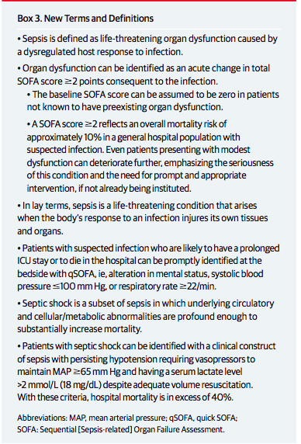
Sepsis-3 Definitions Summary

Slide 69
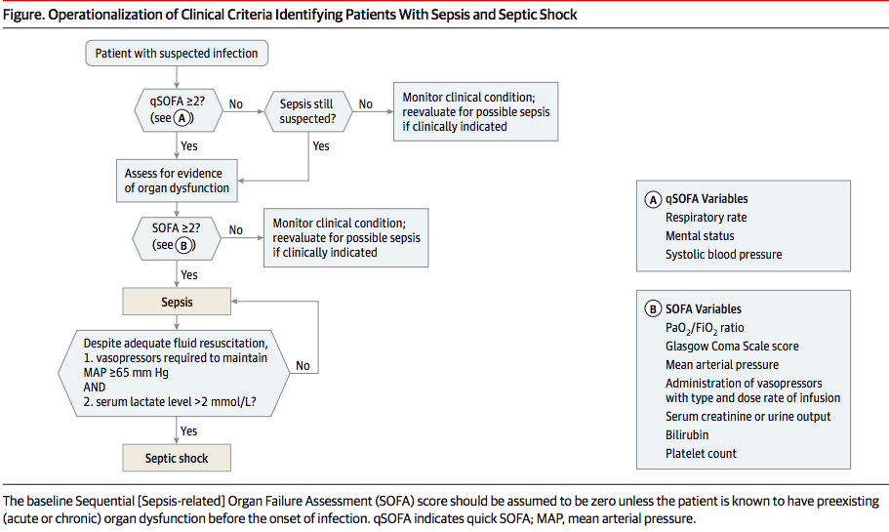
Sepsis-3 Flow Chart for Sepsis/Septic Shock Diagnosis

Slide 70
How can neutrophil responses to cytokine signaling result in extensive host tissue damage?
Release of…
  Reactive oxygen species
  Proteases
  Lysozmes
  Lactoferrin
  Cathepsins
  Defensins

