Slide 1
Massive Transfusion
Dr. Katie Sotos
1/5/2023 Board Review

Slide 2

Case: Gregoire
5 yo MN Labrador Retriever
Witnessed HBC this evening at 10 PM → brought immediately to the ER
ER Exam
  Pale mucous membranes
  CRT ~ 4s
  HR 200 bpm
  RR panting, clear lungs
  Very weak pulses
  T 98.0 F
  Many superficial abrasions, no large wounds
  Abdominal pain + fluid wave
Notes:
Photo Source: https://www.marthastewart.com/8243168/american-kennel-club-labrador-retriever-most-popular-dog-breed-2022

Slide 3
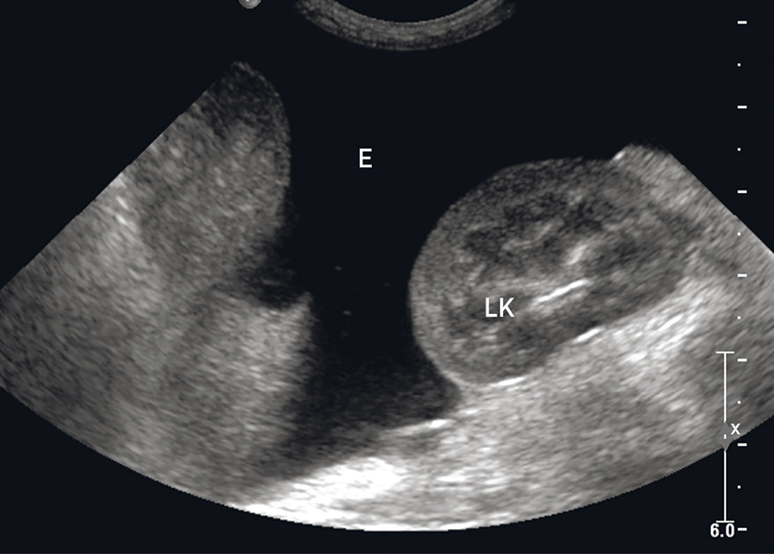
Case: Gregoire
ER Diagnostics:
  AFAST: fluid score of 3/4
  TFAST: few B-lines bilaterally, normal glide, no effusion, small LV
  NIBP: 80/40 (67) mmHg
  VBG: pH 7.245, pCO2 40, HCO3 22, BE -2.0, Na 140, K 5.1, HCT 24%, lact 6.5
  PCV/TS: 22%, 5.0
  SPO2 (FiO2 21%): 96%
  Effusion analysis: frank hemorrhagic, PCV 23%, TS 5.6
Notes:
Photo Source: https://todaysveterinarypractice.com/radiology-imaging/sonography-assessment-overview-of-afast-and-tfast/

Slide 4
Problem List?
Vehicular trauma resulting in:
  Hemoperitoneum → Anemia → Hemorrhagic shock
    Tachycardia
    Poor pulse quality
    Hypothermia
    Hyperlactatemia
    Pseudo-addisonian profile of Na and K
  Mild contusions (suspect based on B-lines)
  Superficial abrasions

Slide 5
Treatment and Response, Part 1
Treatments started ~ 12 AM
0.2 mg/kg Methadone IV
15 mL/kg PLA IV bolus over 15 min
1 mg/kg Cerenia IV
100 mg/kg Aminocaproic acid
Recheck vitals: HR 170, RR panting, T 98.5 F, NIBP 85/45 (73) mmHg
Recheck PCV/TS: 15%, 4.5
AFAST: fluid score 4/4
Blood Type: DEA 1.1 +
pRBC 15 mL/kg over 1 hour
Recheck vitals: HR 160, RR panting, T 98.7 F, NIBP 90/50 (80) mmHg
Recheck PCV/TS: 18%, 4.6
PT/PTT: 50s (H), PTT 300 (H)

Slide 6
Treatment and Response, Part 2
pRBC 15 mL/kg over 2 hours
FFP 15 mL/kg over 4 hours
Recheck vitals: HR 150, RR panting, T 99.2 F, NIBP 100/55 (88) mmHg
Recheck PCV/TS: 20%, 4.8
Recheck PT/PTT: 20s (H), 50s (H)
1h, 15 mL/kg pRBC
2h, 15 mL/kg pRBC
Over 4 h → 45 mL/kg blood products
4h, 15 mL/kg FFP

Slide 7
Treatment and Response, Part 3
1h, 15 mL/kg pRBC
2h, 15 mL/kg pRBC
Over 8h → 60 mL/kg blood products
4h, 15 mL/kg FFP
4h, 15 mL/kg pRBC
pRBC 15 mL/kg over 4 hours
Recheck vitals: HR 120, RR 40 brpm, T 99.0 F, NIBP 120/75 (110) mmHg
Recheck PCV/TS: 25%, 5.4

Slide 8
Treatment and Response, Part 4
1h, 15 mL/kg pRBC
2h, 15 mL/kg pRBC
Over 16h → 90 mL/kg blood products
4h, 15 mL/kg FFP
4h, 15 mL/kg pRBC
4h, 15 mL/kg pRBC + 15 mL/kg FFP
Recheck PCV/TS ~ 12 PM (12 hours after starting treatments): 20%, 4.9
Recheck vitals: HR 160, RR 60 brpm, T 98.6 F, NIBP 100/50 (83) mmHg
pRBC 15 mL/kg over 3 hours
Abdominal CT scan: hepatic laceration → surgery for liver lobectomy
  BP drops during induction, anesthesia starts 15 mL/kg FFP for oncotic support over 2h intra-op

Slide 9
Definition
Transfusion of 1 or more blood volumes within 24 hours
  90 mL/kg dog
  66 mL/kg cats
  Does this have to be whole blood?
    NO: whole blood or blood components
Replacing ½ of the estimated blood volume in 3 hours
Giving 1.5 mL/kg/min of blood products over 20 min
  Rapid rate carries greater risk of adverse effects
  More severe injury if blood needs to be given this fast
Notes:
Silverstein says 3-4 hours; TRACS says 3 hours for the ½ blood volume definition

Slide 10
Problems with the definition
Defines a treatment and not a cause/specific clinical condition
Arbitrary cutoff to the continuous variable of the volume of blood product transfused
Retrospective diagnosis

Slide 11
Problems with the process
Resource depletion
Expense

Slide 12
Which is NOT a complication associated with A massive transfusion?
Hypercalcemia
Hypomagnasemia
Hyperkalemia
Coagulation defects
Hypothermia
Acid-base alterations
Immunosuppression
Acute lung injury
Immunologic transfusion reactions
Transmission of infectious diseases
Notes:
HYPOcalcemia is the proper disturbance; we will discuss why shortly

Slide 13
Electrolyte derangements
Hypocalcemia and Hypomagnasemia
Why?
  Citrate in blood products (anticoagulant) binds Ca^{2+,} Mg²⁺
How quickly?
  Within hours
How often?
  40% of dogs per TRACS 1
  Massive transfusion is poorly reported in cats, so unknown
Notes:
One example of acute non-immunologic reaction
AKA Citrate Toxicity
Previous incidence rates reported 100% of dogs in one study and 20% were severe (iCa < 0.7 mmoL/L)

Slide 14
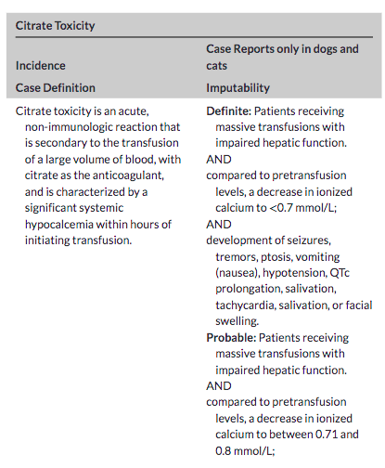
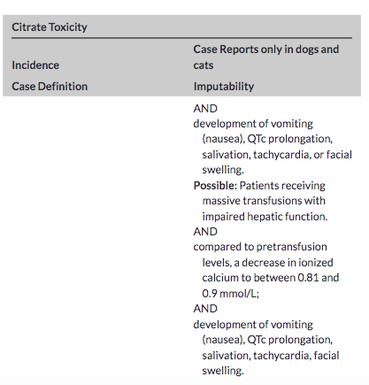
Lower pre-transfusion [iCa]
More severe clinical signs, including neurologic and hypotension
Notes:
TRACS 1

Slide 15
Electrolyte derangements
Hypocalcemia and Hypomagnasemia
Calcium supplementation?
  TRACS 3
    Recommended if iCa </= 0.9 mmol/L or based on clinical status, clinical signs, comorbidities even if iCa is > 0.9
    Empirical supplementation suggested in massive transfusions
      No human or veterinary studies have investigated this
      Note: must be through a separate IVC than the blood product IVC
    Resolves with supplementation, does not recur with transfusion discontinuation
    Restoring hepatic perfusion delivers citrate to liver where it is then metabolized
Notes:
Supplement calcium if: hypotensive, muscle tremors, arrhythmias, prolonged QT interval
Hypocalcemia is not seen in auto-transfusions as long as the blood does not contain citrate as an anticoagulant

Slide 16
Name two other specific therapies in which citrate toxicity contributes to Hypocalcemia
Therapeutic Plasma Exchange
Continuous Renal Replacement Therapy
Notes:
There are 10 case series and retrospective studies regarding specific treatments (massive transfusion, TPE, CRRT) that report Hypocalcemia due to citrate toxicity → in these the concentration of citrate was not measured

Slide 17
Electrolyte derangements
Hyperkalemia
Why does this occur in veterinary species?
  K⁺ leakage into the blood from damaged tissues
  Extracellular K⁺ shifting from acidosis
  Decreased K⁺+ excretion assoc. w/ oliguria
How often does this occur?
  20% of dogs in one study

Slide 18
What is the mechanism of Hyperkalemia in humans with massive transfusion?
In which canine breeds may this also occur and why?
Na-K ATPase pump is inactivated by the cold storage temperature
Akitas and Shiba Inus
Higher intracellular quantities of K⁺

Slide 19
Hemostatic defects
What are the 3 most common?
Thrombocytopenia
Hypofibrinogenemia
Dilutional coagulopathy

Slide 20
Hemostatic defects
Thrombocytopenia
Hypofibrinogenemia and Dilutional Coagulopathy
Occurs b/c of blood loss and dilution
Blood products lose platelets after …?
  2 days
  (cold storage, cell death)
Not proportional to blood volume received
Prolonged PT and aPTT
  Could be affected by consumption due to injuries/illness, as well
1 blood volume replaced should be safe
  Removes < 70% circulating coagulation factors
  Once @ 30% of normal or PT/PTT prolonged by 1.5 times → problems w/ hemostasis
Notes:
Administering large volumes of platelet-free blood can result in a dilutional thrombocytopenia
Dilutional thrombocytopenia is not proportional to the blood volume received since the lungs and spleen release platelet stores
Platelets can also be lose or consumed due to the underlying injuries
Platelets can dysfunction because of acidosis and hypothermia, as well → both of which occur w/ massive transfusion

Slide 21
Is this the same as acute traumatic coagulopathy (ATC)?
no

Slide 22
Acute traumatic coagulopathy
Clinically similar to massive transfusion-associated coagulation defects, but different mechanism
Altered coagulation enzyme activity
Hyperfibrinolysis
Release of activated Protein C
Secondary to:
  Tissue injury
  Hypoperfusion
  Acidosis
Can occur prior to fluid resuscitation

Slide 23
How to correct massive transfusion-associated coagulation defects?
Administer increased FFP and platelet/RBC ratios = 2:1 (up to 1:1)
  In humans, associated w/ decreased mortality
Notes:
Optimum ratio is still under investigation

Slide 24
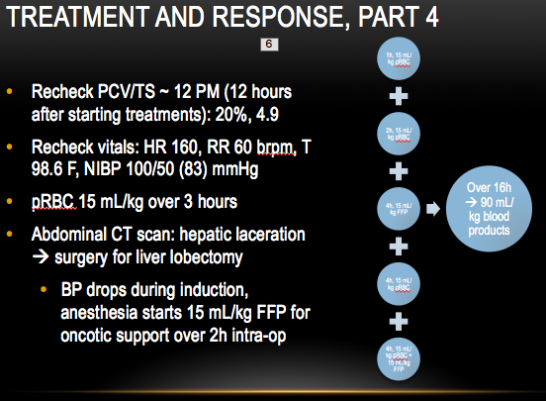
hypothermiA
Occurs in 69% of massively transfused dogs
Products are refrigerated
Organ systems affected by hypothermia
  Cardiovascular: hypotension, arrhythmias
  Respiratory: apnea, O2 dissociation, NCPE, pneumonia
  Neurologic: Ataxia, hyporeflexia, decreased consciousness, decreased cerebral blood flow
  Coagulation: microvascular bleeding, inactivated initiative enzymes, enhanced fibrinolysis, thrombocytopathia
  Renal: cold diuresis
  Hepatic: decreased metabolism
Notes:
- Coagulation effects are often overlooked because the coagulation testing occurs at 37 C (98.6 F) in the lab and not in vivo/at the patient’s body temperature

Slide 25
Metabolic acidosis
Glucose in stored blood metabolized to lactic and pyruvic acids
Hypothermia
Lactic acidosis from hypoperfusion of shock
pH of stored blood may be as low as:
6.4-6.6
Notes:
This “bloody vicious cycle” of progressive hypothermia, persistent acidosis, and inability to establish hemostasis has been recognized in human medicine as the leading cause of death after blunt trauma

Slide 26
Metabolic acidosis
How to reduce its impact
  Rapid infusers
  Warmed blood and fluids
  Warm air blankets
  Avoiding prolonged hypotension secondary to anesthesia

Slide 27
Immunosuppression and wound healing
Mechanism is unclear…
  Donor WBCs may have immunosuppressive effects through:
    Alloimmunization
    Inducing tolerance in recipient WBCs
    Releasing humoral factors that suppress immune cell function
Changes seen in experimental studies
  Decreased NK cell activity
  Decreased macrophage antigen presentation
  Suppression of erythroid, myeloid, and lymphoid hematopoiesis
Notes:
Well-documented in humans
One study showed wound complications in 29.5% of massively transfused patients, which is 6x higher than hospital average
Alloimmunization: foreign cells that contain specific antigens are administered to recipient
Humoral factors of immunity may include: naturally occurring antibodies (NAb), pentraxins, and complement/contact cascades
Most recent veterinary investigation into whether or not leukoreduced vs. non-leukoreduced pRBCs = assoc. w/ decreased incidence of transfusion reactions, increase in PCV, and survival to discharge (Radulescu et al.) did not identify a clinical advantage
Ultimately, the effect of leukoreduction on RBC storage lesion and transfusion reactions in dogs and cats is still unknown

Slide 28
Other complications
Acute Lung Injury (TRALI)
Immunologic Reactions
Nonimmunologic Reactions
Embolization of platelet aggregates, WBC, and fibrin if a 170-micron filter not used
Antileukocyte antibodies in donor blood → in vivo agglutination and neutrophil embolism
No time to crossmatch
Higher risk of:
  Hemolytic reactions
  Type I hypersens.
  FNHTR
  Postransfusion purpura (thrombocytopenia)
40% of cases
Transfusion transmitted infection
  Bacterial growth contamination
  Infectious disease
Hyperammonemia
  Risk if hepatic disease or massive transfusion
Notes:
Transfusion reactions are much higher than the hospital average
Possible blood borne pathogens: ehrlichia, babesia, leishmania
Patients with liver disease cannot metabolize or excrete ammonia
Hyperammonemia not reported in studies of dogs and cats (per TRACS 2)
Suggest using < 24h old fresh whole blood or < 7 day old pRBCs vs. older stored blood/components because ammonia levels rise with time in storage

Slide 29
Recommendations for management
Hypothermia, metabolic acidosis, coagulopathy :
Associated with increased mortality in people
Rapid resuscitation
Preventing cooling
Aggressive rewarming
  Fluid warmers, warm air blankets, warmed blood products, admixture of blood products and warm saline 1:1

Slide 30
Recommendations for management
Damage control surgical approach
Coagulation testing before and during massive transfusion
Point-of-care acid base and electrolyte monitoring
Notes:
Staged laparotomy
May be difficult to recognize hypocalcemia in an anesthetized patient, especially

Slide 31
outcome
High mortality rate
  Likely due to severity of injuries
  73% in one canine study
  16-75% in human literature
Good functionality in most survivors

Slide 32
References
Davidow et al. Association of Veterinary Hematology and Transfusion Medicine (AVHTM) Transfusion Reaction Small Animal Consensus Statement (TRACS) Part 1: Definitions and clinical signs. JVECC 2021; 31:141-166.
Davidow et al. AVHTM TRACS Part 2: Prevention and monitoring. JVECC 2021; 31:167-188.
Odunayo et al. AVHTM TRACS Part 3: Diagnosis and treatment. JVECC 2021; 31:189-203.
Radulescu SM, Skulberg R, McDonald C, Chan DL, Humm K. Randomized double-blinded clinical trial on acute transfusion reactions in dogs receiving leukoreduced versus nonleukoreduced packed red blood cells. J Vet Intern Med. 2021;35:1325-1332.
Silverstein and Hopper. Small Animal Critical Care Medicine 2nd Edition. Chapter 63: Massive Transfusion. Elsevier Saunders 2015.
Silverstein and Hopper. Small Animal Critical Care Medicine 2nd Edition. Chapter 148: Hypothermia. Elsevier Saunders 2015.

