Slide 1
Major Hypercoagulable Diseases
Trevor Chan, DVM

Slide 2
Hypercoagulability
Propensity for inappropriate thrombus formation
Coagulation is a balance of procoagulant and anticoagulant elements
Thrombophilia causes - Inherited or acquired
Virchow’s Triad
Notes:
Definition - Hypercoagulability AKA thrombophilia is a propensity for inappropriate thrombus formation
Coagulation is usually mitigated in vivo by endogenous factors that are in balance to either promote or inhibit clot formation
Many factors that reduce clot formation are activated by products of procoagulant factors
Balance can be thrown off by increased procoagulant elements, decreased anticoagulant elements, diminished fibrinolysis
Thrombophilia causes
Inherited or acquired factors can play a role
Inherited - in humans, factor V leiden mutation, protein C deficiency, etc.
None reported in vetmed
Virchow’s triad - endothelial dysfunction, hypercoagulability of blood, blood stasis/altered blood flow
While these three portions all contribute to hypercoagulability, clinically these are usually interrelated and not isolated factors
Endothelial dysfunction can lead to thrombomodulin loss of function, released von willebrand factor which both affect coagulability state of blood

Slide 3
Hypercoagulability
Propensity for inappropriate thrombus formation
Coagulation is a balance of procoagulant and anticoagulant elements
Thrombophilia causes - Inherited or acquired
Virchow’s Triad
Endothelial dysfunction
Hypercoagulability
Altered blood flow
Notes:
Definition - Hypercoagulability AKA thrombophilia is a propensity for inappropriate thrombus formation
Coagulation is usually mitigated in vivo by endogenous factors that are in balance to either promote or inhibit clot formation
Many factors that reduce clot formation are activated by products of procoagulant factors
Balance can be thrown off by increased procoagulant elements, decreased anticoagulant elements, diminished fibrinolysis
Thrombophilia causes
Inherited or acquired factors can play a role
Inherited - in humans, factor V leiden mutation, protein C deficiency, etc.
None reported in vetmed
Virchow’s triad - endothelial dysfunction, hypercoagulability of blood, blood stasis/altered blood flow
While these three portions all contribute to hypercoagulability, clinically these are usually interrelated and not isolated factors
Endothelial dysfunction can lead to thrombomodulin loss of function, released von willebrand factor which both affect coagulability state of blood

Slide 4
Mechanisms of Hypercoagulability

Slide 5
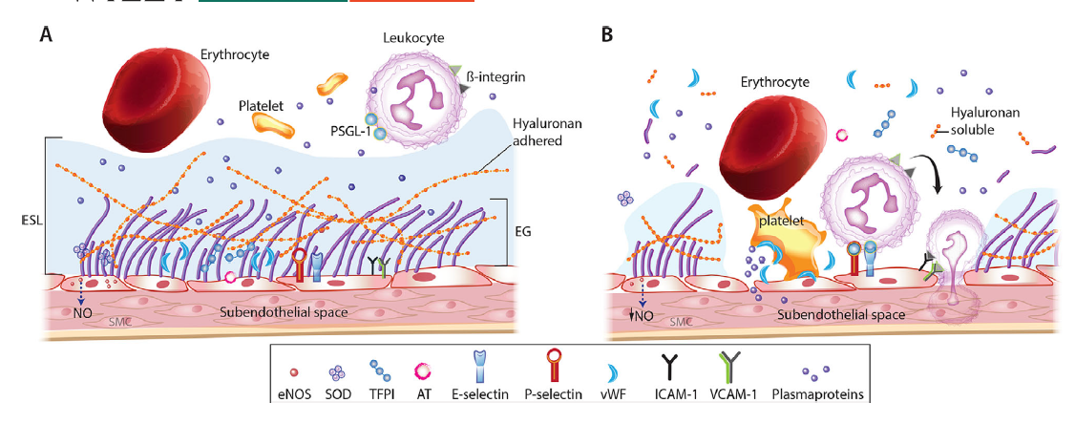
Gaudette S, Hughes D, Boller M. The endothelial glycocalyx: Structure and function in health and critical illness. J Vet Emerg Crit Care. 2020;30:117–134. https://doi.org/10.1111/vec.12925
Notes:
As I start to talk about different mechanisms of hypercoagulability, I wanted to bring this visual to mind from the state of the art review on the endothelial glycocalyx from Gaudette et. al. published in JVECC 2020.
Figure A shows the endothelial surface layer (ESL) in health, with its combination proteoglycans, glycosaminoglycans, and glycoproteins helping to maintain laminar blood flow and maintain an antithrombotic and anti-inflammatory state. At the bottom you can see the adhesion molecules well out of reach, an intact endothelial layer covering the subendothelial space where tissue factor, collagen, and Wiebel Palade bodies are stored. The ESL becomes an exclusion zone for platelets, erythrocytes, and leukocytes due to the electromagnetic charge and physical presence.
Figure B shows the ESL shedding and damage, allowing platelet adhesion and activation, diapedesis of leukocytes, and extravasation of fluid and proteins.

Slide 6
Endothelial disturbances
Endothelium naturally has an anticoagulant phenotype (glycocalyx)
Heparan sulfate, antithrombin, heparin cofactor II, thrombomodulin
Injury/activation - procoagulant phenotype
Tissue factor, decreased GAG synthesis, receptors for diapedesis
TNF alpha, bradykinin, thrombin, histamine, VEG-F
Wiebel-Palade bodies
Notes:
Endothelial disturbances
In health, endothelium has an anticoagulant phenotype to maintain laminar blood flow and proper organ perfusion
Endothelial glycocalyx and endothelial cells
EG - negatively charged glycosaminoglycans, proteoglycans, glycoproteins
Heparin sulfate 50-90% of proteoglycans and facilitates binding of antithrombin which improves efficiency of AT mediated inhibition of thrombin
Heparin cofactor II, thrombomodulin are also found within the EG
Tissue factor pathway inhibitor is also within the glycocalyx
EG is also a mechanoreceptor to sense altered blood flow and release NO during increased shearing stress to maintain appropriate organ perfusion
NO plays a role in vasodilation, the inflammatory response, leukocyte adhesion to endothelium, and inhibition of platelet aggregation
Injury/activation - endothelium changes to a prothrombotic phenotype
Decreased synthesis of GAGs which are the anchor points for the antithrombotic factors anchored to the EG
Starts to reveal receptors for inflammatory cytokines to cell surface receptors on endothelial cells
EC activation - tumor necrosis factor alpha, bradykinin, thrombin, histamine, vascular endothelial growth factor
Activated EC release ultralarge multimers of von willebrand factor from weibel-palade bodies, which also contain P-selectin, IL-8, tissue plasminogen activator (tPA), factor VIII
UL-vWF can bind to platelet GPIb alpha receptors, initiating platelet tethering and activation
More active than smaller vWF multimers in platelet adhesion and activation
During health, UL-vWF is usually quickly cleaved into smaller multimers via disintegrin-like and metalloproteinase with thrombospondin type 1 repeats (ADAMTS13)
vWF multimers circulate with factor VIII and are much less likely to activate platelets than UL-vWF
Usually, UL-vWF are tethered to sites of endothelial activation/injury via exposed collagen
Decrease/absence of ADAMTS13 results in higher concentrations of UL-vWF which can result in systemic platelet aggregation, thrombosis, and potentially consumptive thrombocytopenia
Humans have reported thrombotic thrombocytopenic purpura via ADAMTS13 antibodies, clopidogrel or cyclosporine use
Reportedly, some malignancies and systemic lupus erythematosus are also at risk
Potentially can play a role in DIC

Slide 7
Endothelial disturbances
Endothelium naturally has an anticoagulant phenotype (glycocalyx)
Heparan sulfate, antithrombin, heparin cofactor II, thrombomodulin
Injury/activation - procoagulant phenotype
Tissue factor, decreased GAG synthesis, receptors for diapedesis
TNF alpha, bradykinin, thrombin, histamine, VEG-F
Wiebel-Palade bodies (UL-vWF, P-selectin, IL-8, tPA, factor VIII)
Platelet tethering via GP1b alpha receptors, lack of ADAMTS13
Notes:
Endothelial disturbances
In health, endothelium has an anticoagulant phenotype to maintain laminar blood flow and proper organ perfusion
Endothelial glycocalyx and endothelial cells
EG - negatively charged glycosaminoglycans, proteoglycans, glycoproteins
Heparin sulfate 50-90% of proteoglycans and facilitates binding of antithrombin which improves efficiency of AT mediated inhibition of thrombin
Heparin cofactor II, thrombomodulin are also found within the EG
Tissue factor pathway inhibitor is also within the glycocalyx
EG is also a mechanoreceptor to sense altered blood flow and release NO during increased shearing stress to maintain appropriate organ perfusion
NO plays a role in vasodilation, the inflammatory response, leukocyte adhesion to endothelium, and inhibition of platelet aggregation
Injury/activation - endothelium changes to a prothrombotic phenotype
Decreased synthesis of GAGs which are the anchor points for the antithrombotic factors anchored to the EG
Starts to reveal receptors for inflammatory cytokines to cell surface receptors on endothelial cells
EC activation - tumor necrosis factor alpha, bradykinin, thrombin, histamine, vascular endothelial growth factor
Activated EC release ultralarge multimers of von willebrand factor from weibel-palade bodies, which also contain P-selectin, IL-8, tissue plasminogen activator (tPA), factor VIII
UL-vWF can bind to platelet GPIb alpha receptors, initiating platelet tethering and activation
More active than smaller vWF multimers in platelet adhesion and activation
During health, UL-vWF is usually quickly cleaved into smaller multimers via disintegrin-like and metalloproteinase with thrombospondin type 1 repeats (ADAMTS13)
vWF multimers circulate with factor VIII and are much less likely to activate platelets than UL-vWF
Usually, UL-vWF are tethered to sites of endothelial activation/injury via exposed collagen
Decrease/absence of ADAMTS13 results in higher concentrations of UL-vWF which can result in systemic platelet aggregation, thrombosis, and potentially consumptive thrombocytopenia
Humans have reported thrombotic thrombocytopenic purpura via ADAMTS13 antibodies, clopidogrel or cyclosporine use
Reportedly, some malignancies and systemic lupus erythematosus are also at risk
Potentially can play a role in DIC

Slide 8
Increased Procoagulant Elements
Tissue factor - endothelium disruption, monocytes/macrophages, neoplastic cells
Platelets - PS catalyst for tenase/prothrombinase complexes, GP IIbIIIa fibrinogen receptor
Dense granules
Alpha granules -
Microparticles - encourage thrombin generation similar to activated platelets
Notes:
Increased Procoagulant Elements
EC disruption exposes procoagulant substances such as tissue factor
TF can also be expressed on monocytes/macrophages that have been activated by inflammation and also neoplastic cells
TF exposure + interaction with activated factor VII starts the coagulation cascade
TF encourages inflammation via activation of nuclear factor kappa Beta leading to TNF alpha production
Platelets can also be a source of procoagulant membranes
Activated platelets flip their membranes and expose negatively charged phospholipids phosphatidylserine, phosphatidylethanolamine to the surface
These are catalysts for tenase and prothrombinase complexes for propagation phase of clot formation
Activated platelets also activate and increase active fibrinogen receptor (glycoprotein IIbIIIa [GP IIbIIIa])
Platelets also release alpha granules and dense granule contents
Alpha granules (P selectin, vWF, Thrombospondin, GP IIb/IIIa [integrin α_{IIb}β₃), Factor V, Factor VIII, Fibrinogen, VEGF, FGF)
platelet derived growth factor, fibronectin, transforming
growth factor b, b-thromboglobulin, platelet factor 4, fibrinogen, factors V and VIII, and adhesive
proteins such as von Willebrand factor (vWF)
Dense granules (ADP, ATP, Calcium, Serotonin, Histamine, Epinephrine)
Microparticles (MPs) are circulating small vesicles or blebs from activated/apoptotic cells
Can come from platelets, endothelial cells, leukocytes, erythrocytes, or neoplastic cells
Can have asymmetric phospholipid membrane contents which can encourage thrombin generation similar to activated platelets
Can express tissue factor, phosphatidylserine
Humans in sepsis have been documented to have granulocyte/platelet derived MPs that express TF circulating in their blood
TF-MPs have been shown in vitro to induce coagulation via VIIIa-TF pathway
Potential concurrent mechanism for prothrombotic state of IMHA
vWF-MPs can bind to vWF binding sites or UL-vWF multimers which tether and activate circulating platelets

Slide 9
Increased Procoagulant Elements
Tissue factor - endothelium disruption, monocytes/macrophages, neoplastic cells
Platelets - PS catalyst for tenase/prothrombinase complexes, GP IIbIIIa fibrinogen receptor
Dense granules - ADP, ATP, Epi, Calcium, Serotonin, Histamine
Alpha granules - P selectin, vWF, thrombospondin, Factor V, VIII, VEG-F, Fibroblast Growth Factor, GPIIbIIIa, Integrin α_{IIb}β₃
Microparticles - encourage thrombin generation similar to activated platelets
Notes:
Increased Procoagulant Elements
EC disruption exposes procoagulant substances such as tissue factor
TF can also be expressed on monocytes/macrophages that have been activated by inflammation and also neoplastic cells
TF exposure + interaction with activated factor VII starts the coagulation cascade
TF encourages inflammation via activation of nuclear factor kappa Beta leading to TNF alpha production
Platelets can also be a source of procoagulant membranes
Activated platelets flip their membranes and expose negatively charged phospholipids phosphatidylserine, phosphatidylethanolamine to the surface
These are catalysts for tenase and prothrombinase complexes for propagation phase of clot formation
Activated platelets also activate and increase active fibrinogen receptor (glycoprotein IIbIIIa [GP IIbIIIa])
Platelets also release alpha granules and dense granule contents
Alpha granules (P selectin, vWF, Thrombospondin, GP IIb/IIIa [integrin α_{IIb}β₃), Factor V, Factor VIII, Fibrinogen, VEGF, FGF)
platelet derived growth factor, fibronectin, transforming
growth factor b, b-thromboglobulin, platelet factor 4, fibrinogen, factors V and VIII, and adhesive
proteins such as von Willebrand factor (vWF)
Dense granules (ADP, ATP, Calcium, Serotonin, Histamine, Epinephrine)
Microparticles (MPs) are circulating small vesicles or blebs from activated/apoptotic cells
Can come from platelets, endothelial cells, leukocytes, erythrocytes, or neoplastic cells
Can have asymmetric phospholipid membrane contents which can encourage thrombin generation similar to activated platelets
Can express tissue factor, phosphatidylserine
Humans in sepsis have been documented to have granulocyte/platelet derived MPs that express TF circulating in their blood
TF-MPs have been shown in vitro to induce coagulation via VIIIa-TF pathway
Potential concurrent mechanism for prothrombotic state of IMHA
vWF-MPs can bind to vWF binding sites or UL-vWF multimers which tether and activate circulating platelets

Slide 10
Decreased Endogenous Anticoagulants
Endogenous anticoagulants restrict coagulation to the site of vascular injury
Anti-thrombin (inhibits thrombin, Factor Xa)
Heparan sulfate, endogenous heparins
Protein C (inhibits Factor Va, VIIIa)
Activate protein C via thrombin + thrombomodulin binding on endothelium
Cofactor protein S speeds up inhibition 20x
Tissue Factor Pathway Inhibitor (inhibits Factor VIIa-TF complexes, Factor Xa)
Endothelium, platelets, mononuclear cells, vascular smooth muscle, cardiac myosites, fibroblasts, megakaryocytes
Notes:
Decreased endogenous anticoagulants
Endogenous anticoagulants help restrict coagulation to the site of vascular injury in health
Simultaneous activation of anticoagulant arm while a clot is forming helps localize the reaction to where it is needed most and prevent DIC
Three primary anticoagulants are anti-thrombin, protein C, and tissue factor pathway inhibitor and all three of these systems are active at the level of the endothelial cells
Antithrombin
Inhibits thrombin and factor Xa, with secondary effects of factors IXa, fVIIa-TF complex
Most effective when bound to heparin-like GAGs found in the glycocalyx (heparan sulfate) or when exposed to exogenous heparins
Can increase thrombin inhibition to 1000 fold from non-bound antithrombin
Without heparins, AT inhibition can be increased nearly 8x by binding to thrombomodulin in the presence of thrombin
Decreased in systemic inflammation or critical illness by consumption due to thrombin generation, decreased production via negative APP, or degradation via neutrophil elastase. Urinary losses via glomerulonephritis can also play a role
Protein C
Inhibits factor Va, VIIIa
Activated to activated protein C via thrombin binding to thrombomodulin on the endothelial cell, mostly in the capillary beds
This activation is accelerated via endothelial protein C receptor
Cofactor - protein S leads to 20x faster inhibition of Va and VIIIa
Thrombomodulin binding to thrombin not only helps inhibit thrombin’s actions on fibrinogen and platelets, but also activates thrombin activatable fibrinolysis inhibitor (TAFI) which inhibits fibrinolysis
During inflammation, protein C system is less functional due to decreased synthesis from the liver. Inflammatory cytokines also interfere with activation of protein C via the cytokine’s effects on the endothelium and thrombomodulin
TNF alpha downregulates thrombomodulin expression
Elastase from endotoxin-activated neutrophils can cleave thrombomodulin from endothelium
Free floating/soluble thrombomodulin is less effective
Noted to be increased in humans with sepsis, independent predictor of DIC, MODS, mortality
TFPI
Released primarily from endothelial cells, also found in platelets, mononuclear cells, vascular smooth muscle, cardiac myocytes, fibroblasts, megakaryocytes
Inhibits fVIIa-TF complexes and factor Xa (all extrinsic pathway)
Protein S is a cofactor for inhibition of factor Xa
Decrease in TFPI activation contributes to thrombophilia associated with protein S deficiency in people

Slide 11
Disruption of Fibrinolysis
Fibrinolysis is the final protective step to prevent vascular occlusion
Plasminogen -> plasmin
Plasminogen activator inhibitor (PAI-1) is the major counterregulatory enzyme
TNF alpha, IL-1 beta result in delayed but more sustained increase of PAI-1 compared to tPA
Decreased fibrinolysis and persistent thrombus result
Notes:
Fibrinolysis is the final protective step to prevent vascular occlusion
Thrombi that remain in macro or microvasculature can impair organ function via oxygen delivery impairment and can be an important contributor to secondary injury that leads to MODS
Circulating plasminogen is incorporated into clots and is converted to plasmin via fibrinolytic activators including tPA and urokinase
Plasmin breaks down fibrin meshwork and allows for recannulation of blood vessels
tPA and urokinase sourced primarily from endothelial cells and released upon injury
Plasminogen effects decreased by endogenous plasminogen activator inhibitor (PAI-1)
In presence of TNF alpha, IL-1beta, delayed but more sustained increase in PAI-1 than tPA, decreasing fibrinolysis and resulting in persistent thrombi

Slide 12
Disruption of Fibrinolysis
Fibrinolysis is the final protective step to prevent vascular occlusion
Plasminogen -> plasmin via tPA, urokinase
tPA and urokinase from endothelial cells primarily and released upon injury
Plasminogen activator inhibitor (PAI-1) is the major counterregulatory enzyme
TNF alpha, IL-1 beta result in delayed but more sustained increase of PAI-1 compared to tPA
Decreased fibrinolysis and persistent thrombus result
Notes:
Fibrinolysis is the final protective step to prevent vascular occlusion
Thrombi that remain in macro or microvasculature can impair organ function via oxygen delivery impairment and can be an important contributor to secondary injury that leads to MODS
Circulating plasminogen is incorporated into clots and is converted to plasmin via fibrinolytic activators including tPA and urokinase
Plasmin breaks down fibrin meshwork and allows for recannulation of blood vessels
tPA and urokinase sourced primarily from endothelial cells and released upon injury
Plasminogen effects decreased by endogenous plasminogen activator inhibitor (PAI-1)
In presence of TNF alpha, IL-1beta, delayed but more sustained increase in PAI-1 than tPA, decreasing fibrinolysis and resulting in persistent thrombi

Slide 13
Diagnostics
Traditional tests - Platelet count, aPTT, PT
Drop in circulating platelet count + prolongation of > 20% in a patient with at risk disease process should be concerning for consumptive coagulopathy
Documentation of hypercoagulable state relies on
Identifying rise in prothrombotic elements
Decrease in endogenous anticoagulants
Decrease in fibrinolysis
How to document? Viscoelastic coagulation tests, search for ongoing thrombin generation markers, lysis of fibrin clot products, platelet activation testing
https://eclinpath.com/hemostasis/tests/viscoelastic-testing/
Notes:
Diagnostics
Before a consumptive coagulopathy or thrombotic complication arises, diagnosing a hypercoagulable state can be difficult
Detecting a thrombus or thromboembolus is often our only means of definitively detecting a pathologic coagulation is occurring
Traditional tests
Platelet count, activated partial thromboplastin time (aPTT) and prothrombin time (PT) are the most accurate for demonstration of hypocoagulability but struggle to illuminate a hypercoagulable state
Prolongations in PT/aPTT and decreased platelet counts may appear in hypercoagulable patients, usually due to consumption of platelets and coag factors after unregulated thrombin generation
This chapter’s authors recommend a drop in circulating platelet count + prolongation of 20% or above in baseline aPTT in patients with at-risk disease states should raise concern for consumptive coagulopathy and demand further investigation
Documentation of hypercoagulable states relies on
Identifying rise in procoagulant elements (MPs, factor V, factor VIII activity, fibrinogen levels)
Decrease in endogenous anticoagulants (AT, protein C, protein S, TFPI)
Decrease in fibrinolysis (decreased tPA, increased alpha 2 anti-plasmin, PAI-1, TAFI)
How do you document these? Testing to assess more than one aspect of coagulation like viscoelastic coagulation tests (VCM/TEG, ROTEM in Europe)
Time to initial fibrin crosslinking
Rate of clot formation
Viscoelastic characteristics of the clot formed
CAT - tests for thrombin generation potential (endogenous thrombin potential, ETP should be higher for hypercoagulability)
Hypercoagulable states clot more quickly, with faster rates of clot formation, and greater clot strength
Ongoing thrombin generation markers can help build suspicions as well
thrombin-AT complex (TAT), prothrombin activation fragment (F1+2), fibrinopeptides A and B
Lysis of fibrin clots (fibrin-ogen degradation product FDP or D-dimers)
Platelet contributions to hypercoagulable state may be inferred by assessing markers of platelet activation (P-selectin expression, platelet-neutrophil aggregates) or documentation of hyperactivity in response to standard stimuli (Chp 107)
Flow cytometry is needed to test specific proteins on platelets or other circulating cells
Looks for procoagulant MPs though this needs to be standardized to detect MPs usually less than 1.5 microns across
Advia 120 hemostasis analyzer reports a parameter called mean platelet component (MPC) which is related to granularity of circulating platelets.
After activation, granularity of platelets decreases, so decreased MPC may be indicative of circulating activated platelets
Needs more studying (insert paper)

Slide 14
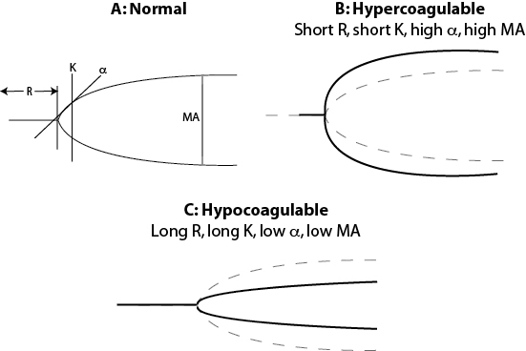
Diagnostics
Traditional tests - Platelet count, aPTT, PT
Drop in circulating platelet count + prolongation of > 20% in a patient with at risk disease process should be concerning for consumptive coagulopathy
Documentation of hypercoagulable state relies on
Identifying rise in prothrombotic elements
Decrease in endogenous anticoagulants
Decrease in fibrinolysis
How to document? Viscoelastic coagulation tests, search for ongoing thrombin generation markers, lysis of fibrin clot products, platelet activation testing
https://eclinpath.com/hemostasis/tests/viscoelastic-testing/
Notes:
Diagnostics
Before a consumptive coagulopathy or thrombotic complication arises, diagnosing a hypercoagulable state can be difficult
Detecting a thrombus or thromboembolus is often our only means of definitively detecting a pathologic coagulation is occurring
Traditional tests
Platelet count, activated partial thromboplastin time (aPTT) and prothrombin time (PT) are the most accurate for demonstration of hypocoagulability but struggle to illuminate a hypercoagulable state
Prolongations in PT/aPTT and decreased platelet counts may appear in hypercoagulable patients, usually due to consumption of platelets and coag factors after unregulated thrombin generation
This chapter’s authors recommend a drop in circulating platelet count + prolongation of 20% or above in baseline aPTT in patients with at-risk disease states should raise concern for consumptive coagulopathy and demand further investigation
Documentation of hypercoagulable states relies on
Identifying rise in procoagulant elements (MPs, factor V, factor VIII activity, fibrinogen levels)
Decrease in endogenous anticoagulants (AT, protein C, protein S, TFPI)
Decrease in fibrinolysis (decreased tPA, increased alpha 2 anti-plasmin, PAI-1, TAFI)
How do you document these? Testing to assess more than one aspect of coagulation like viscoelastic coagulation tests (VCM/TEG, ROTEM in Europe)
Time to initial fibrin crosslinking
Rate of clot formation
Viscoelastic characteristics of the clot formed
CAT - tests for thrombin generation potential (endogenous thrombin potential, ETP should be higher for hypercoagulability)
Hypercoagulable states clot more quickly, with faster rates of clot formation, and greater clot strength
Ongoing thrombin generation markers can help build suspicions as well
thrombin-AT complex (TAT), prothrombin activation fragment (F1+2), fibrinopeptides A and B
Lysis of fibrin clots (fibrin-ogen degradation product FDP or D-dimers)
Platelet contributions to hypercoagulable state may be inferred by assessing markers of platelet activation (P-selectin expression, platelet-neutrophil aggregates) or documentation of hyperactivity in response to standard stimuli (Chp 107)
Flow cytometry is needed to test specific proteins on platelets or other circulating cells
Looks for procoagulant MPs though this needs to be standardized to detect MPs usually less than 1.5 microns across
Advia 120 hemostasis analyzer reports a parameter called mean platelet component (MPC) which is related to granularity of circulating platelets.
After activation, granularity of platelets decreases, so decreased MPC may be indicative of circulating activated platelets
Needs more studying (insert paper)

Slide 15
Common Hypercoagulable Conditions

Slide 16
Systemic Inflammation
Glycocalyx shedding and endothelial cell activation
Increased tissue factor, UL-vWF, adhesion molecules (P-selectin)
Decreased production of nitric oxide
Disruption of glyocalyx anticoagulant defenses
Decreased thrombomodulin, protein C, antithrombin levels and efficacy
TFPI (tissue factor pathway inhibitor)
Increased PAI-1 release from inflammatory cytokines
Notes:
Systemic Inflammation
Complex process involving increased expression of tissue factor, activation of endothelial cells, and disruption of the glycocalyx, impairment of anticoagulant systems, and abatement of fibrinolysis
Glycocalyx shedding and endothelial cell activation leads to compromised production of local regulators such as nitric oxide, disruption of glycocalyx’s anti-coagulant defenses, and also leads to increased expression of pro-coagulant molecules such as UL-vWF or tissue factor and adhesion molecules such as P-selectin
Thrombomodulin can also be damaged through multiple mechanisms which leads to decreased activation of protein C and makes antithrombin less effective both due to decreased concentrations and impaired interaction with the GAGs in less abundant supply tethered to the endothelial cells
TFPI may have impaired endothelial cell localization (helps with inhibiting tissue factor-factor 7a and factor 10a)
Exuberant release of PAI-1 from inflammatory cytokine release slows fibrinolysis and impedes coagulation defenses

Slide 17
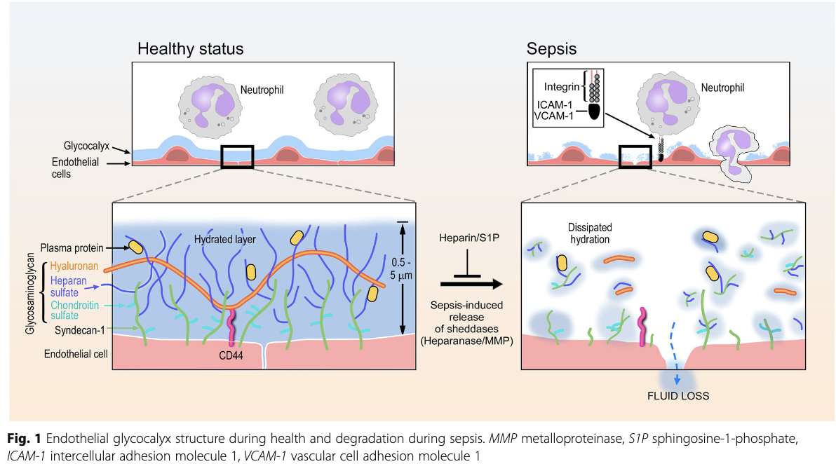
Sepsis
Uchimido, R., Schmidt, E.P. & Shapiro, N.I. The glycocalyx: a novel diagnostic and therapeutic target in sepsis. Crit Care 23, 16 (2019). https://doi.org/10.1186/s13054-018-2292-6
Notes:
Sepsis
Patients develop an initial hypercoagulable state, followed by a prolonged hypocoagulabe phenotype following consumption of coag factors
Prolongations in PT/aPTT, thrombocytopenia of 100k or less are associated independently with increased odds of death (follow link)
Cat etiologies of DIC - pancreatitis and sepsis (two of top 3 causes - find third cause in link)
Dogs with sepsis - noted prolongations of aPTT/PT with higher FDP/D-dimer concentrations
Lower protein C and antithrombin proteins noted as well - supportive of consumptive coagulopathy
Continually decreasing levels of protein C and antithrombin have noted worse outcomes (link for stats)
TAFI increased in dogs with bacterial sepsis and other inflammatory conditions, resulting in a downregulation of fibrinolysis
Experimentally induced canine endotoxemia have demonstrated a decrease in fibrinogen concentration and platelet count, prolongation in PT/aPTT, increased D-dimers
TEG testing also showed progressively hypocoagulable tracings
Decrease in protein C and S which demonstrates hypercoagulability but more likely a response
Other studies looking at platelet activity during endotoxemia utilizing a PFA-100 showed increased activity within 30 minutes of LPS administration but then decreased activity to below baseline
Strengthens support for consumptive coagulopathy

Slide 18
Protein Losing Nephropathy
In humans, PLN is multifactorial for thrombophilia
Platelets are hyperaggregable
Increased fibrinogen, Factor VIII activity, vWF
Variable Factor V levels
Loss of endogenous anticoagulants - antithrombin, protein C
Potential increased TFPI, TAFI, PAI-1 levels
In dogs:
Increased fibrinogen activity
Lower AT activity
Higher alpha-2 antiplasmin and low protein C activity
Elevated Factor VIII
Notes:
Protein-losing nephropathy
In people, thrombophilia is associated with PLN in a multifactorial mechanism
Platelets are hyperaggregable, increased markers of activation such as P-selectin
Soluble factors show increased factor VIII activity, increased fibrinogen concentrations
vWF, factor V levels variably elevated
Loss of endogenous anticoagulants - antithrombin activity decreased
AT levels fail to predict thrombotic risk in people
Protein C levels variable, some documented elevations in TFPI - potentially not significant in thrombophilia
Humans have increased TAFI and PAI-1 levels sometimes, suggested decreased fibrinolytic capabilities
People develop renal vein thrombosis, increased markers of endothelial cell activation documented - potential local mechanism?
Dogs with glomerular disease and significant proteinuria with or without nephrotic syndrome are at a higher risk of thrombotic complications
TEG tracings are more hypercoagulable in PLN and renal failure dogs compared to systemically ill and healthy dogs
Fibrinogen activity elevated in PLN dogs
AT activity was lower in PLN dogs than systemically ill dogs
Higher alpha2-antiplasmin and protein C activity
Hyperfibrinogenemia and low AT activity described in another study of 3 dogs, which also identified elevated factor VIII activity

Slide 19
Immune-mediated Hemolytic Anemia
Major complication of this disease is thromboembolic events
Low AT, elevated FDP/D-dimers, markedly elevated fibrinogen
TEG tracings are hypercoagulable
Circulating tissue factor
Cell free heme decreases nitric oxide, increases adhesion molecules
Platelet activation
Notes:
IMHA
Majority of deaths within first 2 weeks, with anemia and thrombotic complications as the highest reasons
Postmortem evaluations document consistent coagulopathies
Macro, microthrombi, widespread fibrin deposition, hemorrhage in 73.5%
Coagulation abnormalities for hypercoagulability
Low AT activity, elevated FDPs and D-dimers, markedly elevated fibrinogen concentration
TEG tracings also document hypercoagulability, mostly at the increased clot strength (maximal amplitude or MA)
Postulated to be due to fibrinogen, platelet count and function, and hematocrit
Circulating tissue factor also is a likely contributor to the hypercoagulability in these patients with upregulation of the TF gene expression in whole blood
Sources include platelets, MPs, mononuclear cells or from free heme stimulating the endothelial cells
Cell free heme can also decrease the bioavailability of nitric oxide and upregulate endothelial cell adhesion molecules such as E-selectin
In vitro, hemolyzed red cells have been demonstrated to increase thrombin generation - this is thought to take place in MPs or procoagulant erythrocyte membranes
Platelet activation in canine IMHA has been evaluated in two studies but they have reached inconsistent findings
One study identified increased P-selectin expression
The other found no significant increases in adhesion molecule expression, including P selectin or fibrinogen binding (GP IIb/IIIa expression) or platelet leukocyte aggregates
This study did report an increase in MPs without further identification of the source of these microparticles
Aspirin was found to increase survival in one retrospective study (talk about ACVIM treatment recommendations)

Slide 20
Hyperadrenocorticism
Humans with hyperadrenocorticism
Increased Factor VIII, IX, XI, XII, vWF, serum PAI-1
Comorbidities such as obesity, diabetes mellitus, hypertriglyceridemia
Dogs with hyperadrenocorticism
Elevated Factor II, V, VII, IX, X, XII, decreased AT, elevated TAT complexes
Notes:
Hypercortisolemia
Hyperadrenocorticism in people is associated with significant increased risk of thrombotic complications, with rates comparable to major orthopedic surgery (venous thromboembolic risk increased 5%)
Changes identified in people with HAC include elevated activity of factor VIII and vWF, elevations in serum PAI-1, elevated activity of factors IX, XI, and XII
Humans also suffer from comorbidities including obesity, DM, hypertriglyceridemia which are also prothrombotic conditions on their own
Dogs with HAC are known to be included in thromboembolic case series, but a consistent cause of definable procoagulant state has not been identified
One study identified elevated activity if factors II, V, VII, IX, X, and XII in addition to decreased AT, elevated TAT complexes were noted
No differences in plasminogen or PAI-1 when compared to healthy dogs
Another early study found elevations in activity of factors V, XI, AT and elevated plasminogen
A third study found no significant changes between platelet counts, MPV, AT, PT, aPTT, fibrinogen, or TEG tracings in healthy vs HAC dogs when age-matched
Experimental beagles given 1 mg/kg/day or 4mg/kg/day oral pred for 2 weeks demonstrated prothrombotic TEG, with elevated CAT thrombin levels only increased in 1 mg/kg/day treatment group

Slide 21
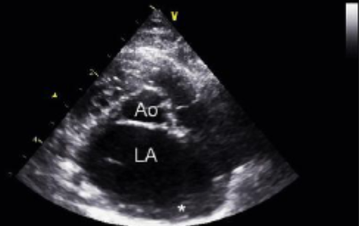
Cardiomyopathies
Feline HCM, Canine DCM, Atrial fibrillation - Arterial thromboembolism
LA + auricular enlargement - blood stasis, reduced nitric oxide
Jet lesions - increased TF, vWF
Hypercoagulable platelets
Smith, Francis W. K., Jr., et al. Manual of Canine and Feline Cardiology, Elsevier, 2015. ProQuest Ebook Central, https://ebookcentral-proquest-com.proxy.library.cornell.edu/lib/cornell/detail.action?docID=2072392.
Notes:
Cardiomyopathies
ATE in cats is most commonly associated with cardiac disease, and many cats are asymptomatic before experiencing an ATE
Dogs are less likely to experience thrombosis secondary to cardiac disease, but has been reported in DCM and Atrial fibrillation dogs
LA and auricular enlargement is associated with structural changes, culminating in a procoagulant phenotype
Increased TF, vWF on areas of damaged endothelial cells (jet lesions)
Growth hormones are increased in people with AF, and may upregulate TF expression
LA enlargement leads to blood stasis which reduces the nitric oxide release
Systemic hypercoagulable state develops in 50% of cats with cardiomyopathies with spontaneous echocardiographic contrast (smoke) with or without an LA thrombus and 56% of cats with ATE and LA enlargement
Platelets from cats with cardiomyopathy required significantly lower doses of ADP to result in irreversible aggregation in one study compared with platelets acquired from control cats
One small study looking at thyrotoxic cardiomyopathy, platelets were less responsive to ADP and more responsive to collagen for aggregation
Many cats in this study were treated for hyperthyroidism, unclear if methimazole could play a role
A newer study failed to replicate hyperactivity in platelets in HCM cats compared to healthy control cats, but the disease severity was decreased in this population

Slide 22
Neoplasia
DIC described in malignancies with hemangiosarcoma, mammary carcinoma, pulmonary adenocarcinoma most commonly
Coagulation components are also important for cancer cell behavior
Tissue factor increased for angiogenesis
TF increased, MPs generated - even found in tissue culture supernatants
TEG tracings are usually hypercoagulable
Mammary carcinoma - hyperfibrinogenemia, elevated Factor V, decreased Factor VIII activity
Multicentric lymphoma - platelet aggregation increased
Notes:
Neoplasia
DIC has been described in 9.6% of dogs with malignancies, most commonly with hemangiosarcoma, mammary carcinoma, and pulmonary adenocarcinoma, and this is also a top 3 reason for DIC development in cats
Components for coagulation are important for both thrombosis formation and cancer behavior - tumor growth, angiogenesis, and metastasis
TF found on malignant cells and in tumor vasculature, as well as on MPs generated
TF supports thrombophilia and also plays a key role in integrin function for tumor angiogenesis
A study in mice demonstrated TF blockade results in decreased angiogenesis and tumor growth through modulation of VEGF
TF expression on histopathology has demonstrated to be an independent predictor of poor overall or relapse free survival for many tumor types in people
In dog cancers, TF expression has been evaluated in mammary tumors, pancreatic carcinoma, pulmonary adenocarcinoma, prostatic carcinoma, and osteo/fibrosarcomas
TF was increased in all but osteosarcomas; carcinomas expressed the highest levels and also shed TF-expressing MPs into tissue culture supernatants
Recent investigation in dogs with various neoplasms showed hypercoagulable TEG tracings in 70.4%, and 4.2% had hypocoagulable tracings
Hypocoagulable dogs in this study (3) had disseminated cancer
Patients with distant metastatic disease have elevated fibrinogen and D-dimers compared with locally invasive or noninvasive disease
In canine patients with carcinomas, thrombocytosis and hyperfibrinogenemia were found more commonly compared to healthy controls
TEG tracings in dogs with carcinomas demonstrate hypercoagulability and decreased PAI-1 activity
Dogs with untreated mammary carcinoma have hemostatic abnormalities, with the most common documented to include hyperfibrinogenemia, elevated factor V, and decreased factor VIII activity
These abnormalities become more common with advancing tumor staging
Platelet and fibrinogen survival in dogs with metastatic disease are decreased, supportive of consumptive coagulopathy
AT has also been demonstrated to be lower in dogs with neoplasia and was associated with greater risk of mortality
Platelet aggregometry was assessed in dogs with untreated multicentric lymphoma and demonstrated a significant elevation in platelet aggregation with lymphoma dogs than healthy controls.
Another study demonstrated platelet activation time to be decreased, higher maximum aggregation, and greater ATP secretion in dogs with various malignancies

Slide 23
Brain Injuries
Humans with TBI - documented DIC like conditions, hemorrhage worsening prognosis
Brain is rich with tissue factor - Monocytes also express TF up to 24h post TBI
Enhanced thrombin generation in cerebral vasculature
Humans have documented increased TAT, IL-6, F1+2
Prolonged PT/aPTT, elevated D-dimers, lower platelets and fibrinogen
Elevated complement C5B-9
Procoagulant MPs increased in CSF and blood
Platelet hypofunction in TBI
Notes:
Isolated brain injuries
Intravascular coagulation resembling DIC has been recognized in people suffering TBIs with significant impacts on adult and children documented
Humans presenting with TBI + coagulopathies on presentation have an increased risk of hemorrhagic progression of neuronal lesions or development of ischemic lesions (85% compared to 31%)
Coagulopathies in these patients are associated with higher rates of craniotomies, single and multiple organ failures, fewer days intubation-free, and longer ICU and overall hospital days
Mortality also increases from 17.3% to 50.4% if TBI patients develop coagulopathies with an average development time of 4.5 days post-trauma with a faster onset with worsening injury severity
Brain is rich with tissue factor - implicated initiator of this DIC like coagulopathy development. Monocytes also express increased TF for the first 24 hours in TBI patients
Enhanced thrombin generation has been documented as blood flows through cerebral vasculature
Humans with TBI - prolonged PT/aPTT, elevated D-dimers, TAT, and F1+2, low AT, platelets, and fibrinogen on presentation
Complement C5B-9 and IL-6 were also elevated (IL-6 100x the control group)
Transcranial gradient (arterial vs. jugular venous blood) of TAT, F1+2, IL-6 was present
Further implications for for brain vasculature-initiated thrombin generation
Procoagiulant MPs after TBI are significantly increased in CSF and blood - primarily sourced from endothelial cells and platelets
Local procoagulant factors initiate coagulation, but inflammatory cytokines and procoagulant MPs provide a means for dissemination of the condition, leading to a potential systemic response
Studies have suggested a state of platelet hypofunction in brain injury patients
Non-brain injury patients generally have an increased platelet reactivity in trauma
A subset of platelets show increased function despite overall decreased aggregation responses, supportive of partial activation in vivo due to thrombin
P selectin expression, activated conformation of GPIIb/IIa
Cats with an experimentally induced TBI showed similar results, with decreased platelet counts, decreased clumping, and decreased fibrinogen

Slide 24
Management of Hypercoagulable Conditions

Slide 25
General Considerations
Always treat the underlying condition or trigger as best as possible
Recombinant anticoagulant therapy
Antithrombotic therapy - CURATIVE guidelines
Antiplatelets = aspirin, clopidogrel
Anticoagulants = unfractionated, low molecular weight heparin
Notes:
Main goal is always to treat this underlying condition or trigger as best as possible.
Antimicrobials, source control, surgery, aggressive supportive care
Maintaining oxygen delivery to tissues - avoid acidosis, ischemic injury, further inflammation
Recombinant anticoagulant therapy
AT supplementation has been effective at reversing apparent heparin resistance in cardiopulmonary patients with low AT activity
Study in humans with severe sepsis - AT supplementation did not improve survival but subgroup of patients without concomitant heparin administration showed improvement in survival at 90 days when receiving AT
Another study with human patients in severe sepsis with AT supplementation without heparin administration demonstrated an improved survival when DIC was present, but no difference compared to a placebo without DIC
Recombinant APC (activated protein C) has been shown to have multiple benefits in sepsis and inflammatory conditions
Prevents TNF-alpha mediated hypotension in people with sepsis
Improved survival in experimental E. coli septicemia in baboons
However, large clinical trials in humans with sepsis failed to demonstrate a survival benefit -> patented product Xigris was pulled from the market in Oct 2011
Recombinant TFPI has been shown to be an effective anti-thrombotic agent in experimental models of sepsis and DIC, coronary artery disease, and thrombosis in animal models
Also reduced mortality rate in sepsis induced DIC, but more extensive human trials have failed to prove a survival benefit
Recombinant soluble thrombomodulin is the newest potential therapeutic
Antithrombotic therapy
Antiplatelets - aspirin, clopidogrel
Anti-coagulants for thrombin inhibition - unfractionated or low molecular weight heparins
Patients should have identified risk for thrombotic disease and the risks of thrombosis outweigh possible adverse effects of therapy
Oral platelet inhibitors are more convenient for long term administration, but heparin maybe better for in hospital use because disease states such as sepsis may be accompanied by thrombocytopenia
Warfarin therapy is described in humans with thrombophilia, but is not commonplace in veterinary medicine, as well as also needs oral dosing which is an issue in our critically ill patients
CURATIVE guidelines were covered in a full lecture by Dr. Selman last year

Slide 26
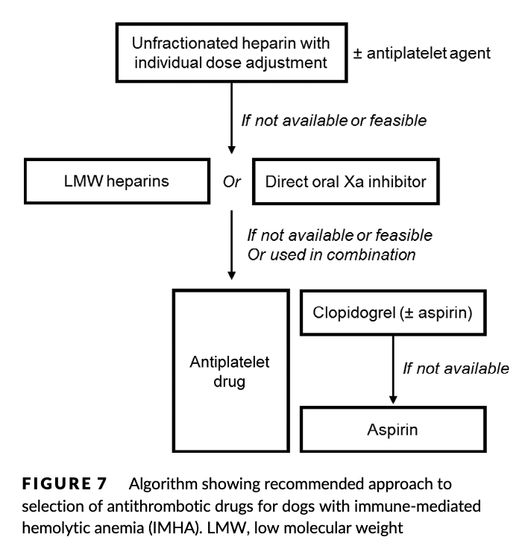
Specific Conditions
Diseases with antithrombotic recommendations
IMHA, PLN, Feline cardiomyopathies
Animals with multiple at-risk diseases
FATCAT study: clopidogrel > aspirin
Diseases to consider antithrombotics following testing/strong suspicion
Pancreatitis, Glucocorticoids/Hyperadrenocorticism
Neoplasia, Sepsis, TBI
Canine cardiomyopathies
Swann, J.W., Garden, O.A., Fellman, C.L., Glanemann, B., Goggs, R., Levine, D.N., Mackin, A.J., Whitley, N.T., 2019. ACVIM consensus statement on the treatment of immune‐mediated hemolytic anemia in dogs. Journal of Veterinary Internal Medicine 33, 1141–1172.. doi:10.1111/jvim.15463
Notes:
Protein-losing nephropathy
Any patient with PLN +/- nephrotic syndrome (hypoalbuminemia, edema, hypercholesterolemia, proteinuria) and significant proteinuria may benefit from thromboprophylaxis
AT has not been identified to be a reliable sole indicator for thrombophilia in these patients
Historically treated with aspirin, heparins may be less effective if marked decreased antithrombin activity
IMHA
ACVIM consensus statement for therapy
Flow chart to the right from the consensus statement
Hypercortisolemia
Recommendation is to test for evidence of prothrombotic state before anticoagulation
Consider other potential insults that could raise thrombotic risk such as systemic inflammation, infection, or surgery
Cardiomyopathies
Traditionally oral platelet inhibitors - fatcat clopidogrel study
LMWH (dalteparin/enoxaparin) has been administered in cats with cardiomyopathy but effective doses, intervals, and serum therapeutic ranges have not been determined definitively
Thrombolysis can be considered with any recent onset ATE and signs of ischemia but a study has similar survival compared to conservative management with a heightened risk of complications
tPA administration is reported to restore pulses in affected limbs 53% of the time within 24 hours
Neoplasia
Thrombotic complications more likely in carcinomas and round cell tumors
Not enough veterinary studies
Coagulation testing should be performed first, then consider antithrombotics pending these results (elevated D-dimers, TAT)
Isolated brain injury
HTS decreases leukocyte cell surface adhesion molecules, degranulation markers on neutrophils and monocytes, vascular and intercellular adhesion molecules, TNF alpha, tissue factor, and D-dimers in severe brain injury patients given HTS/dextran before hospital presentation
Immunomodulatory effects of HTS
Earlier restoration of normal cerebral perfusion pressure
Recombinant factor VIIa has been shown to attenuate the hemorrhagic phenotype of the TBI-induced coagulopathy in people
They used less plasma, required fewer days of mechanical ventilation, and had decreased cost of hospitalization
TBI induced coagulopathy described in humans has not been described in clinical veterinary cases, so each TBI case should be assessed for hemostatic status and keep in mind a potential for consumptive coagulopathy to develop

Slide 27
Dosages
Unfractionated Heparin
Dogs 100 U/kg IV bolus, then 480-900 U/kg/day (20-37.5U/kg/h) CRI
  SC 150-300 U/kg q6h
Cats - 250 U/kg q6h
Dalteparin
Dogs 100-175 U/kg SC q8h
Cats - 75 U/kg SC q6h
Enoxaparin
Dogs 0.8 mg/kg SC q6h
Cats - 0.75-1 mg/kg SC q6-12h
Rivaroxaban
Dogs 1-2 mg/kg/day PO
Cats 0.5-1 mg/kg/dy PO
Clopidogrel
Dogs (1.1-3.3 mg/kg PO q24h with potential single loading dose of 4-10 mg/kg)
Cats 18.75mg/cat PO q24h with potential single loading dose of 37.5mg/cat
Blais, M.-C., Bianco, D., Goggs, R., Lynch, A. M., Palmer, L., Ralph, A., & Sharp, C. R. (2019). Consensus on the Rational Use of Antithrombotics in Veterinary Critical Care (CURATIVE): Domain 3-Defining antithrombotic protocols. Journal of Veterinary Emergency and Critical Care, 29(1), 60–74. doi:10.1111/vec.12795
Notes:
Domain 3 from CURATIVE Guidelines

Slide 28
References
Blais, M.-C., Bianco, D., Goggs, R., Lynch, A. M., Palmer, L., Ralph, A., & Sharp, C. R. (2019). Consensus on the Rational Use of Antithrombotics in Veterinary Critical Care (CURATIVE): Domain 3-Defining antithrombotic protocols. Journal of Veterinary Emergency and Critical Care, 29(1), 60–74. doi:10.1111/vec.12795
Gaudette S, Hughes D, Boller M. The endothelial glycocalyx: Structure and function in health and critical illness. J Vet Emerg Crit Care. 2020;30:117–134. https://doi.org/10.1111/vec.12925
Goggs, R, Blais, M-C, Brainard, BM, et al. American College of Veterinary Emergency and Critical Care (ACVECC) Consensus on the Rational Use of Antithrombotics in Veterinary Critical Care (CURATIVE) guidelines: Small animal. J Vet Emerg Crit Care. 2019; 29: 12– 36. https://doi.org/10.1111/vec.12801
Hogan, D. F., Fox, P. R., Jacob, K., Keene, B., Laste, N. J., Rosenthal, S., … Weng, H.-Y. (2015). Secondary prevention of cardiogenic arterial thromboembolism in the cat: the double-blind, randomized, positive-controlled feline arterial thromboembolism; clopidogrel vs. aspirin trial (FAT CAT). Journal of Veterinary Cardiology, 17, S306–S317. doi:10.1016/j.jvc.2015.10.004
McMichael, M. (2005), Primary hemostasis. Journal of Veterinary Emergency and Critical Care, 15: 1-8. https://doi.org/10.1111/j.1476-4431.2005.04021.x
Silverstein, D., 2015. Small Animal Critical Care Medicine. St. Louis, Mo.: Elsevier, Saunders, Chp 104
Smith, Francis W. K., Jr., et al. Manual of Canine and Feline Cardiology, Elsevier, 2015. ProQuest Ebook Central, https://ebookcentral-proquest-com.proxy.library.cornell.edu/lib/cornell/detail.action?docID=2072392.
Swann, J.W., Garden, O.A., Fellman, C.L., Glanemann, B., Goggs, R., Levine, D.N., Mackin, A.J., Whitley, N.T., 2019. ACVIM consensus statement on the treatment of immune‐mediated hemolytic anemia in dogs. Journal of Veterinary Internal Medicine 33, 1141–1172.. doi:10.1111/jvim.15463
Uchimido, R., Schmidt, E.P. & Shapiro, N.I. The glycocalyx: a novel diagnostic and therapeutic target in sepsis. Crit Care 23, 16 (2019). https://doi.org/10.1186/s13054-018-2292-6

