Slide 1
Leptospirosis, Lyme Nephritis, Pyelonephritis
Trevor Chan, DVM
pollev.com/trevorchan951

Slide 2
Leptospirosis

Slide 3

Pop Quiz
What 4 serovars are in the Lepto vaccine?
Which serovars are linked to hepatic injury?
Which serovars are linked to abortions?
Grippotyphosa, pomona, icterohemorrhagiae, canicola
Grippotyphosa, Australis
Buenos Aires, Bratislava
pollev.com/trevorchan951

Slide 4
Leptospirosis - Introduction
Spirochetes - 0.1 micron flexible, motile, spiral shaped bacteria with a hook shaped end
Zoonotic; 250+ pathogenic serovars
Exposure - Infected water/soil, multiple location and wildlife reservoirs
Poster child? Any dog at this point
Peak seasons - high rainfall + 3 months after wet weather
Notes:
Overview
Spirochetes - 0.1 micron flexibile, motile, spiral shaped bacteria with a hook shaped end
Some forms are found in the dirt and are not pathogenic
Widespread, zoonotic disease caused by a systemic infection of Leptospira bacteria
Pathogenic species include over 250 different serovars
Differentiated by different LPS O antigens
Grouped into more than 20 antigenically related serogroups
10+ serovars known to be associated with disease in dogs worldwide
Do not replicate outside the house and are readily inactivated in the environment when exposed to excessive heat, UV radiation, a variety of disinfectants, and freezing conditions
Possible to survive in water/wet soil for weeks to months though
Exposure - drink from, swim, or wade in environmental water source can become infected
Exposure to wildlife or farm animals and their urine is a risk factor
Developing countries - sewage exposure
Classic predisposition - large breed, outdoor, intact male, hunting dog
Now, any dog - suburban/urban, geriatric small breed dogs with exposure to rodent urine
Peak seasons - high rainfall and up to 3 months after wet weather
Infection reservoirs - hawaii, northern CA and Pacific NW, upper midwest, parts of Texas, Colorado, NE/mid=Atlantic coastal
Also possible for SE US and Ontario
Europe, Caribbean, Central/South America, SE Asia, Oceania

Slide 5
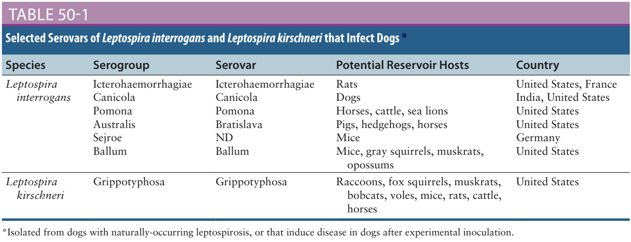
Leptospirosis - Pathophysiology
Leptospires penetrate intact mucous membranes or abraded skin
Toxins - phospholipases, sphingomyelinases, pore forming proteins
Notes:
Signs and their pathogenesis
Leptospires penetrate intact mucous membranes or abraded skin after direct contact with (which includes ingestion of) infected urine, soil, water, food, or fomites
Less likely but possible through bite wounds, ingestion of infected tissues, or venereal/placental transfer
Quick bacteremic multiplication as early as 1 day postinfection -> vasculitis, multiorgan failure possible
Toxins produced
Phospholipases
Sphingomyelinases
Pore forming proteins
Incubation period - 7 days, possibly shorter or longer depending on dose, strain virulence, host immune response
Diseases in dogs - interrogans, kirschneri, wolfii (Iran, needs further study), noguchii (Brazil)
Before vaccines, predominant serovars were icterohaemorrhagiae, canicola
Since bivalent vaccine against them, grippotyphosa, pomona, bratislava, autumnalis
Grippotyphosa, australis linked to hepatic injury
Abortions - Buenos aries, bratislava

Slide 6
Leptospirosis - Clinical manifestations
Varied progression of clinical signs - asymptomatic, acute, chronic all possible
Acute - febrile, shivering, lethargy, muscle tenderness, PU/PD, vomiting, diarrhea, abdominal pain, inappetance, icterus, blepharospasm, bleeding, dehydrated
Acute kidney injury, acute liver injury, uveitis, vasculitis
Pancreatitis, enteritis, abdominal pain
Myositis, pulmonary hemorrhage
Abortions, stillbirths, neonatal deaths
Chronic - months to years following exposure, CKD
Notes:
Lepto severity varies wildly
Some dogs can show no signs of illness
Mild, transient febrile illness
Renal failure, hepatic, pulmonary lesions with associated severe clinical signs and death
Acute leptospirosis
Fever - shivering, reluctance to move, generalized muscle tenderness from myositis, enlarged lymph nodes, dull mentation, dehydration
Lethargy, PU/PD, inappetance, vomiting, diarrhea to follow
GI signs - pancreatitis, enteritis in addition to AKI, acute liver injury
Conjunctivitis, scleral injection, icterus, or uveitis with aqueous flare
Suspect lepto in dogs that develop acute febrile illness, kidney/liver injury, uveitis, pulmonary hemorrhage (usually a european lepto feature)
Abortions, stillbirths, neonatal deaths
PU/PD - decreased responsiveness of inner medullary connecting ducts to ADH (acquired nephrogenic DI)
Liver involvement - icterus in some dogs
Leptospiral endotoxin - oleic and linoleic acid thought to interfere with hepatic transport pumps, leading to functional hepatic impairment
Hepatic apoptosis and injury also occurs
human/guinea pig models show loss of cellular adhesion molecule E-cadherin on hepatocytes
Chronic hepatitis documented in young dogs in France with leptospires documented in bile canaliculi via IHC, EM
Poor growth, weight loss, ascites
Uveitis, myocardial damage, reproductive complications can occur
Humans documented to have leptospiral DNA in aqueous humor and can have delayed uveitis up to 18 months after acute illness
ECG alterations suggest myocardial damage
Abortions during pregnancy, or stillbirths, neonatal death can occur
Bleeding tendencies
Petechial hemorrhages, hematuria, hematemesis, epistaxis, hematochezia, or melena have been described
Prescribe mechanism unknown, suspected vasculitis, endothelial dysfunction, disordered coagulation
Humans have documented thrombocytopenia (under 100k) and prolonged PT associated with bleeding
Tachypnea - severe pulmonary hemorrhage syndrome (SPHS)
High prevalence in continental Europe
Vasculitis - peripheral edema, mild pleural and peritoneal effusions
Dogs - CKD months to more than a year after AKI
Early renal damage can be marked by transient or undetected clinical signs
Followed by early clearance, persistent infection and progression of renal damage
Cats CS - usually the same if they get it

Slide 7
Leptospirosis - Diagnostics
CBC - Nonregenerative anemia, neutrophilia, bandemia, thrombocytopenia
Chemistry - Azotemia, elevated liver enzymes, hypoalbuminemia, elevated CK
VBG - Electrolyte derangements,
Additional bloodwork - elevated spec cPL, serum troponin
UA - isosthenuria/hyposthenuria, glucosuria, proteinuria, pyuria, cylinduria, bilirubinuria, elevated UPC
Coagulation - increased fibrinogen, D-dimers, FDP, decreased AT, PT/PTT prolonged
Notes:
CBC - neutrophilia, bandemia, nonregenerative anemia, lymphopenia, possible thrombocytopenia
Thrombocytopenia - 53% of dogs
Immune mediated, vasculitis, DIC mechanism possible
Chemistry - azotemia, elevated liver enzymes
Azotemia - 80-90% of dogs
Elevated creatinine 57% for one european study
Elevated LE - mild to moderate ALT/AST/ALP, Tbili
Uncommonly, elevated LE without azotemia
Hypoalbuminemia possible
Varied electrolyte abnormalities
Hyponatremia, hypochloremia, hyperphosphatemia
Decreased Na transporters by proximal convoluted tubules contributes to impaired sodium resorption, increased distal sodium delivery, potassium wasting
Paradoxical hypokalemia in dogs with acute oliguric renal failure
CK elevations - moderate to marked increases due to myositis
Increased serum troponin with myocardial damage
Increased spec CPL
Recommended serial daily renal values to trend renal function, liver enzyme activities, serum protein concentrations, electrolyte/ acidbase status
Urinalysis
Isosthenuria, hyposthenuria occasionally
Variable glucosuria - 77% of 44 dogs in one study
Proteinuria, pyuria, clyindruria, bilirbuinuria
UPC may be elevated - 0.4-11.6 with a median at 3
LMW - tubular over glomerular origins
Coagulation
Variable increases in fibrinogen, D-dimers, FDP
AT may be decreased
PT/PTT prolongations in 15% of tested dogs
PT prolongations noted with higher mortality in humans
DIC may result in a shortened PT

Slide 8
Leptospirosis - Diagnostic Imaging
Thoracic radiographs - possible severe pulmonary hemorrhage syndrome (SPHS)
Abdominal ultrasound
Renal - renomegaly, increased cortical echogenicity, pyelectasia, perirenal edema
Peritoneal effusion, lymphadenopathy
Pancreatitis, enteritis
Hepatomegaly
Splenomegaly
Notes:
Diagnostic Imaging
CXR - can be normal
Possible mild pleural effusion
Possible mild to severe diffuse interstitial pulmonary patterns
SPHS - severe, nodular to diffuse interstitial and alveolar patterns
AUS
Renal (nothing pathognomonic for leptospirosis)
Mild renomegaly
Increased renal cortical echogenicity
Mild pyelectasia
Perirenal fluid accumulation
Medullary band of increased echogenicity within the kidneys
Mild ascites
Pancreatitis - enlargement, hypoechogenicity
Gastric wall thickening
SI thickening
Hepatomegaly - mild to moderate
Splenomegaly with mottling of splenic echotexture
Possible abdominal lymphadenopathy

Slide 9
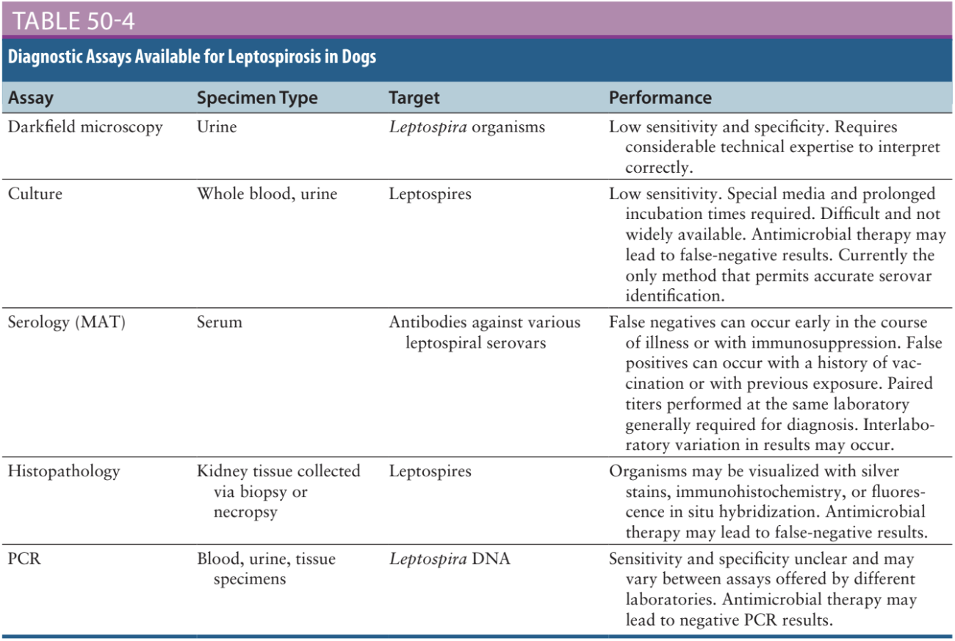
Leptospirosis - Microbiologic Testing
Notes:
Microbiologic Testing
Usually diagnosed on acute and convalescent phase serology
Darkfield Microscopy - insensitive, false positives possible, user experience dependent
Culture - slow to grow, insensitive test, not widely available
Special growth media required - Ellinghausen-McCollough-Johnson-Harris
3-6 month incubation period
Overgrowth with other bacteria/contaminants possible
Venous blood +/- urine via aseptic technique before ABX therapy directly onto culture medium ideal
Only certain labs have expertise to culture and identify leptospires to the serovar level via cross agglutinin absorption test
Genetic typing via pulsed field gel electrophoresis is another method
Serology
Microscopic agglutination test MAT
Lab mixes serial dilutions of patient sera with a panel of live leptospira serovars
Reported agglutinating antibody titer for each serovar tested which is the highest dilution of serum that causes the organisms to agglutinate as assessed via darkfield microscopy
Seropositive dogs have high titers to multiple serovars tested because of serologic cross-reactivity
Highest titer doesn’t always correlate with infection serovar and can change with serial testing
Documentation of fourfold or greater increase in titer to at least one serovar over time is usually required for diagnosis using MAT
Titers are usually low initially
Titers can be elevated with previous exposure or vaccination
A fourfold decrease later on in the disease progression can also be supportive of a diagnosis
Static titers (complete stasis vs 1-2 dilution changes over time) supportive of vaccine, chronic infection, previous exposure
Persist for 1 year after natural infection, often decline 4 months after vaccination, but possible for persistently high titers as well (1:1600 or higher)
Solo titers cannot be used for diagnosis of leptospirosis
Vaccines can confer cross-reactivity, so testing for serovars outside of vaccine scope is unreliable
Possible false negatives if infecting serovar or a related one is not in the panel tested
Convalescent titers should be performed 2-4 weeks after acute titer
Seroconversion is possible 3-5 days after initial titer is obtained
Space serial titers out at least 1 week and use the same lab
ABX can blunt rise in titers, but dogs usually seroconvert despite ABX
Danger to lab staff - live pathogenic serovars used, difficult to standardize test
ELISA - IgG and IgM antibodies against lepto surface antigens
Geographical variance against these assays
Europe - IgM lateral flow assay available with variable geographical sensitivity
PCR - detection of DNA of pathogenic leptospires in blood/urine
Sensitivity/specificity not thoroughly assessed, potential to vary geographically due to shedding patterns for different serovars
Advantageous for early diagnosis when serologic tests are negative or dogs have a previous history of vaccination
Specimens preferred pre-ABX therapy - both serum and urine recommended
Negative tests do not rule out leptospirosis diagnosis
Subclinically affected dogs can shed leptospires, so positive urine PCR may not correlate with clinical illness
Vaccines do not lead to positive PCR

Slide 10
Leptospirosis - Pathology
Diffuse - icterus, petechiation/ecchymoses, fibrin thrombi, effusion
Lungs - SPHS
GI - melena, hemorrhage
Kidneys - enlarged, pale, mottled, petechiated, infarcts
Interstitian nephritis, mixed inflammatory infiltrates, acute tubular necrosis
Liver - mild random hepatic necrosis, cholestasis, neutrophilic periportal hepatitis
Notes:
Pathologic Findings
Gross findings
Jaundice, petechiation, ecchymotic hemorrhages with potential fibrin thrombi throughout the body
Lungs - SPHS wet, mottled, heavy, dark-pink to red
Ascites, pleural, pericardial effusion
GI melena/hemorrhage
Kidneys - mildly enlarged, pale, mottled, petechiated, infarcts
CKD - shrunken, irregular potentially
Histopathology
Kidneys
Interstitial nephritis, mixed inflammatory infiltrates
Acute tubular necrosis - vasculitis, renal ischemia
Liver
Mild random hepatic necrosis
Mild neutrophilic periportal hepatitis
Cholestasis
Liver plate disarray
Heart
Multifocal, random, neutrophilic, necrotizing myocarditis
Myonecrosis occasionally in skeletal muscle
Lungs
SPHS - intra-alveolar hemorrhage, pneumocyte necrosis, hyaline membrane formation without significant inflammation
Silver Warthin-Starry stain, IHC can visualize bacteria within tissue
Fluorescence in situ hybridization identifies and localizes leptospires within kidneys

Slide 11
Leptospirosis - Treatment
Antimicrobials - doxycycline 5 mg/kg IV q12h for 14 days, penicillins
Supportive care - IV fluids, anti-emetics, anti-hypertensives, antacids, blood products
Nutritional support - NG tube, parenteral nutrition
Monitoring - serial electrolyte and acid/base status, ins-and-outs
Consider Ucath for accurate eliminations, otherwise serial weights
Renal Replacement Therapy
Oxygen therapy if needed
Notes:
Treatment
Antimicrobial drugs
Initial treatment - penicillins or doxycycline recommended for initial treatment of humans and dogs with suspected leptospirosis
Should be started before results of diagnostic assays are available
Hamsters - doxycycline clears spirochetes from all tissues, including the kidneys, within 3 days of infection
Ampicillin is less effective clearing from the kidneys
Leptospires resistant to chloramphenicol
ACVIM Consensus Statement on Leptospirosis in Dogs
Doxycycline 5mg/kg IV q12h for 14 days
Vomiting, adverse reactions -> IV ampicillin 30mgkg IVq6, penG but then followed up by doxycycline 2 weeks to clear tissues
Penicillins initially to clear bacteremia
Doxycycline x 2 weeks TGH when eating
Supportive Care
IV crystalloids +/- KCl supplementation
Antiemetics
Anti-hypertensives
Antacids
Blood products
Nutritional support - NG tube, parenteral nutrition
Enteritis, pancreatitis, AKI, acute liver injury
Monitoring
Serial assessment of electrolytes, acid/base status
Fluid therapy ins-and-outs
Body weight, respiratory rate, lung sounds, blood pressure
Renal outputs
Polyuria - high rate of fluids
Oligoanuria - overhydration, respiratory failure
Consider Ucath for accurate outs monitoring
Diuretics - furosemide, mannitol may help keep tubules open but does not improve GFR
Consider renal replacement therapy
SPHS
Oxygen therapy
Possible mechanical ventilation
Humans benefit from cyclophosphamide and plasma exchange
Renal Replacement Therapy
Early hemodialysis results in improved survival and shorter hospital stays in human patients with leptospirosis
Canine indications - inadequate urine output that develop volume overload, hyperkalemia, BUN >80 mg/dL, signs of uremia refractory to medical management
UC Davis - average for 45/89 of dogs with lepto resulted in 3 treatments

Slide 12
Leptospirosis - Prognosis, Prevention
Excellent when treatment is initiated early and aggressively - 80%+
Successful treatment - normal platelet count, nonazotemic, serum liver enzyme values normal within 10-14 days
Icterus, residual kidney injury may take up to 4 weeks
Vaccine - Icterohaemorrhagiae, Canicola, Grippotyphosa, Pomona
Avoid reservoir host species, environmental water sources
In hospital precautions
Notes:
Prognosis
Excellent when treatment is initiated early and aggressively
Survival rates over 50%, and in centers with hemodialysis - 80%+
SPHS survival rates are unknown but theorized to be lower
Successful treatment - normal platelet count, serum BUN/Creatinine, serum liver elevations normal within 10-14 days
Icterus may take a while to resolve, urine concentrating ability may delay for up to 4 weeks to return to normal
Possible to have residual kidney injury
Immunity and Vaccination
USA - 4 way vaccines - Icterohaemorrhagiae, Canicola, Grippotyphosa, Pomona
12 month immunity
Ideally performed a few months before onset of peak season for leptospirosis in any given region
No need to restart series in dogs due for annual booster
Unsure about natural immunity’s duration and crossreactivity
Prevention
Avoid potential reservoir host species or environmental water sources
Wildlife, farm animals, rodent control
In hospital precautions for dogs with known/suspected leptospirosis
Warning sign on cage/run
Minimize movement around hospital
Avoid transport along common hallways
gloves/gowns
Protective eyewear/face shields if aerosolization of urine likely
Handwashing before and after
No pregnant/immunocompromised staff working with patient
Prompt disinfection of urine/urine spills
Iodine based disinfectants
Quaternary ammonium solutions
Accelerated hydrogen peroxide
1:1 dilution with 10% bleach
10% bleach directly into urine storage collection systems before disposal
Treatment with appropriate ABX
Indwelling rather than intermittent urinary catheterization for monitoring output
Dogs walked/gurneyed outside to urinate frequently if Ucath not in place
Urination outside in designated area that can be easily disinfected
warning s to others who handle the dog or specimens from dog

Slide 13
Pop Quiz
Name an in-hospital precaution that should be taken with a Leptospirosis patient
Warning signs on cages, treatment sheets
Minimize movement around hospital
Wear gloves/gowns when handling
Wear protective eyewear if aerosolization of urine is likely
Disinfection of urine/spills
Indwelling catheter + bleach to discard
Urination outside in designated areas
pollev.com/trevorchan951
Notes:
In hospital precautions for dogs with known/suspected leptospirosis
Warning sign on cage/run
Minimize movement around hospital
Avoid transport along common hallways
gloves/gowns
Protective eyewear/face shields if aerosolization of urine likely
Handwashing before and after
No pregnant/immunocompromised staff working with patient
Prompt disinfection of urine/urine spills
Iodine based disinfectants
Quaternary ammonium solutions
Accelerated hydrogen peroxide
1:1 dilution with 10% bleach
10% bleach directly into urine storage collection systems before disposal
Treatment with appropriate ABX
Indwelling rather than intermittent urinary catheterization for monitoring output
Dogs walked/gurneyed outside to urinate frequently if Ucath not in place
Urination outside in designated area that can be easily disinfected
Verbal warnings to others who handle the dog or specimens from dog

Slide 14
Lyme Nephritis

Slide 15
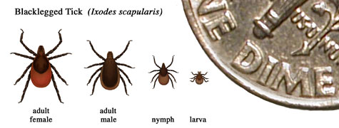
Pop Quiz
Name the organism that causes Lyme Disease.
Name the scientific and colloquial name for the vector of #1.
Borrelia burgdorferi
Ixodes scapularis east coast, Ixodes pacificus on the west coast; Black-legged tick AKA deer tick
pollev.com/trevorchan951
https://www.cdc.gov/lyme/transmission/index.html

Slide 16
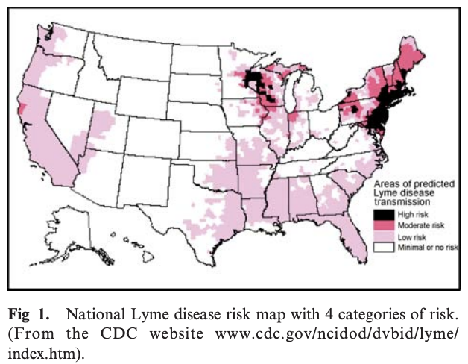
Lyme Disease - Overview
Borrelia burgdorferi - tickborne organism associated with Lyme Disease
Vector - Ixodes Ticks (2 year, 3 stage life-cycle)
Larva, Nymph, Adult - one blood meal per life cycle
Reservoir hosts - rodents, birds, lizards, deer
Peak time - Summer to Fall
Mostly asymptomatic, lyme arthropathy, lyme nephritis
Goldens and Labs predisposed to LN
Notes:
Lyme disease - Borrelia burgdorferi - tickborne organism associated with Lyme disease
Transmission via Ixodes ticks
Ixodes ticks - larva, nymph, adults - 2 year, 3 stages
One blood meal per life stage
Uninfected tick larvae hatch and feed on Borrelia infected reservoir hosts
Mice, squirrels, shrews, birds, and lizards
Endemic areas can have Bb in nymphal or adult ticks up to 50% prevalence
Warmer months - questing behavior of ticks and recreational habits of humans and dogs
Later in the same summer, nymphs molt to adults and feed on large mammals, preferentially deer, but also dogs and humans
Adult Ixodes ticks can be active in the fall, winter, and early spring as long as the ambient air temperatures exceed 40*F
Deer help maintain, amplify, and spread tick population because adult ticks mate on them
Migratory birds also help spread nymphal ticks and Bb
Clinical syndromes associated with experimental infection of dogs with Bb
Humans describe acute flu-like illness (fever, erythema migrans rash, arthritis, cardiac/neuro/chronic skin changes with only 10% of people asymptomatic)
Dogs 95% asymptomatic
Koch’s Postulates - transient fever, anorexia, arthritis in puppies
Guidelines for associating pathogen with disease
Arthropathy - oligoarthropathy with neutrophilic inflammation on arthrocentesis
Lyme Nephritis - poorly understood - severe, acute progressive and often fatal protein-losing nephropathy and under 30% have lameness
Lab + Goldens predisposed

Slide 17
Lyme Nephritis - Pathophysiology
Type 1 membranoproliferative glomerulonephritis with subendothelial glomerular immune complex deposition
Complexes induce proinflammatory response and induces host damage
Potential genetic deficiencies of factor H
OspA - molecular mimicry, proinflammatory properties
Jarisch-Herxheimer reaction when spirochetes die in large numbers
Notes:
Immune-mediated Mechanisms
Type 1 membranoproliferative glomerulonephritis with subendothelial glomerular immune-complex deposition may occur because of passive entrapment of cationic antigens or circulating complexes in normal or previously altered glomeruli
Complexes then attract inflammatory cells or activate resident glomerular cells to release vasoactive substances, proinflammatory cytokines, activators of platelets, and of the injurious classic complement cascade which attacks cell membranes and dissociates the major slit diaphragm protein, nephrin, from the podocyte cytoskeleton
Lyme proteins OspE and OspF bind to the soluble complement regulatory protein, factor H, which normally inhibits too much damage from occurring
Genetic deficiencies of factor H have been associated with MPGN and atypical hemolytic uremic syndrome
Secondary tubular changes may be due to hypertension, efferent arteriole vasoconstriction, tubular hypoxia, or toxic proteins in the glomerular filtrate
OspA is known to have some molecular mimicry (15 self proteins, streptococcal M protein) as well as proinflamatory properties - induces cytokines IL-6, IL-8, LI-1beta, IFN-gamma (more likely proinflammatory than molecular mimicry)
Antibodies to other proteins of Bb cross react with nerve axonal protein, myelin basic protein, heat shock protein, muscle/myosin, cardiolipin, gangliosides
Sonicated fractions of Bb are proinflammtory and induce TNF alpha, IL 1 alpha, IL 1 beta, and IL-8
Lipoproteins, flagellin, DNA of Bb interact with Toll-like receptors to signal activation of neutrophils, mononuclear cells, and endothelial cells
Spirochetal infections including syphilis, Lepto, Bb notorious for causing Jarisch-Herxheimer reaction due to proinflammatory products released from dying organisms
Fever, rash, muscle tenderness, hypotension

Slide 18
Lyme Nephritis - Clinical Presentation
Kidney failure signs - vomiting, anorexia, pigmenturia, oliguria/anuria, PU/PD
PLN signs - thromboembolic events, hypertension, effusions/edema
Hypercoagulability - dyspnea, hind end weakness, GI signs, seizures
Acute blindness, epistaxis, cerebrovascular event
Notes:
Presentation and Clinical Signs
PLN signs - Thromboembolic events possible, hypertension, effusions/edema
KIdney failure signs - vomiting, anorexia, pigmenturia, oliguria/anuria, PU/PD
Hypercoagulability occurs due to hypoalbuminemia, decreased antithrombin activity, vasculitis, hypertensive damage to endothelium
Can affect the pulmonary, arterial, and venous beds
Clinical signs - collapse, sudden death, TE, dyspnea, hindend weakness, pancreatitis, gastrointestinal signs, seizures
Sudden blindness from hypertension (retinal hemorrhage/detachment), cerebrovascular events, epistaxis
Hypoalbuminemia - pleural, pericardial, peritoneal effusions, dependent edema
Exercise intolerance, lethargy, dyspnea, bloating, swollen legs or scrotum
Varied presentations - acute vs chronic, stable, progressive, mild-moderate-severe PLN

Slide 19
Lyme Nephritis - Proteinuria DDX
Pre-renal
Stress, fever, glucocorticoids, exercise (swimming), Bence-Jones proteins
Renal
Glomerular (ICGN - infectious, noninfectious), Amyloidosis, Neoplasia)
Tubular (Fanconi’s Syndrome, CKD, Infectious diseases, Neoplasia)
Post-renal
UTI, Neoplasia (cystitis), Reproductive tract disease
Notes:
So we may get these cases partially worked up from a pcDVM and they may have already identified proteinuria. What would be some of your other differentials for a proteinuric dog?
Pre-renal
Stress, fever, glucocorticoids, exercise (swimming), Bence-Jones proteins
Renal
Glomerular (ICGN - infectious, noninfectious), Amyloidosis, Neoplasia)
Tubular (Fanconi’s Syndrome, CKD, Infectious diseases, Neoplasia)
Post-renal
UTI, Neoplasia (cystitis), Reproductive tract disease

Slide 20
Lyme Nephritis - Diagnostics
CBC -mild to moderate nonregenerative anemia, thrombocytopenia
Chemistry - Azotemia, hypoalbuminemia, hypercholesterolemia, hyperphosphatemia
UA, UPC, UC, SDS-PAGE - USG <1.022, proteinuria, hematuria
NIBP, CXR, AUS
NCSU Tick panel, Leptospirosis
Lyme disease detection - 4DX SNAP, Cornell Multiplex, Antech Accuplex4
Renal biopsy, joint cytology/culture
Notes:
What do we expect from a LN dog?
CBC - mild to moderate nonregenerative anemia, thrombocytopenia
Chemistry - azotemia, hypoalbuminemia, hypercholesterolemia, hyperphosphatemia
UA - USG <1.022, proteinuria, hemoglobinuria/hematuria, glucosuria, cylindruria
Persistent moderate or high microalbuminuria 2+ dipstick proteinuria, or a 1+ dipstick with a USG <1.012 warrants follow up UPC determination
Consider pooled samples to eliminate daily variation
Proteinuria
Over 0.4, localization to the kidney vs. lower urogenital tract is important
Kidney - urine protein electrophoresis (SDS-PAGE) identifies source as glomerular (high molecular weight) vs. tubular (low molecular weight)
LN may have both components though
Screen for coinfections - potentially incidental Lyme positive patient. Lyme positive should be at the very least a proof of tick/wildlife exposure but many patients can be coinfected (babesia, anaplasma, ehrlichia, bartonella), Leptospirosis (proteinuria, glycosuria, active sediment with negative culture)
Potentially consider RMSF, mycoplasmosis, brucellosis, leishmaniasis, fungal
Also possible for hemolytic uremic syndrome, genetic glomerulopathies - Berners, Samoyeds, English Cockers, Soft coated wheaten terriers
Renal cortical biopsy
Control hypertension, platelet count should be adequate, antithrombotic therapy stopped for at least several days

Slide 21
Lyme Nephritis - Searching for Lyme Disease
Searching for organism itself is not helpful
Searching for antibodies against OspA, OspC, OspF, C6
4DX SNAP plus - heartworm, antibodies against Lyme C6, Anaplasma x2, Ehrlichia x3
Cornell Multiplex - Western blot and quant of Ab against Osp A/C/F
Antech Accuplex4 - Similar profile to 4DX SNAP
NCSU Tick Panel - search for coinfections
Notes:
Searching for Bb antigens is not helpful - few organisms are in tissues or fluids
Bb exposure documentation - finding natural exposure antibodies, but high titers do not coincide with disease
OspA expression - allows Bb to attach to the tick’s midgut
Decreases expression 2-4 days of tick feeding
OpsC and another possible 116 new antigens upregulated during early infection int he house, during first 10 days, and waning between days 17-30
Antibodies against OspC rise 2-3 weeks after infection, wane 3-5 months
OspF antibodies rise 6-8 weeks after infection, remain increased
Testing - antibodies directed against either whole cell antigens
IFA, ELISA, KELA, IgM, IgG
Or individual lyme antigens (western blot, C6 peptide, OspA, OspC, OspF)
Testing for antibodies directed against whole cell antigens are less specific for natural exposure antibodies, since they crossreact with vaccinal antibodies as well as antibodies to other spirochetes
Lyme bacterin vaccines
Made from killed whole Bb bacteria grown in culture in vitro with Bb expressing many antigens
Sununit recombinant OspA vaccines only induce opsA antibodies with unknown protective titers
4DX SNAP Plus - heartworm, antibodies against Lyme C6 peptide, A. phagocytophilum, A. platys, E. canis, E chaffeensis, E ewingii
Multiplex (AHDC) - Western blot and quantitation of antibodies against Osp A/C/F
AccuPlex4 (Antech) - heartworm, Lyme, Anaplasmosis, Ehrlichiosis potentially 1-2 weeks earlier than other tests
Algorithm against relationship and magnitude of 5 markers that differentiate vaccinal and natural exposure antibodies, potentially differentiating even between early vs late infections
Results given qualitatively
Quantitation of natural exposure antibodies that wane after treatment may be useful clinically
Decisions about further treatment may be made based on how the quantitative titers change, especially in retrievers (timeline of 6 months after starting treatment)

Slide 22
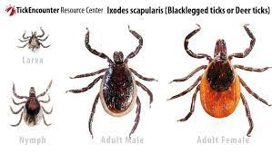
Lyme Nephritis - Coinfections
Fever, lameness, anorexia, proteinuria, azotemia
Infectious, Immune-mediated, neoplastic
Tickborne diseases (environmental exposure +/- sharing same vector)
Anaplasma, Ehrlichia, Rickettsia, Neorickettsia, Bartonella, Babesia, Mycoplasma
Leptospirosis
Pop Quiz - Name up to 4 diseases Ixodes ticks can concurrently carry besides Bb.
Ixodes ticks can be coinfected with A. phagocytophilum, Babesia microti, Bartonella spp, or Tickborne encephalitis virus
https://www.fs.usda.gov/Internet/FSE_DOCUMENTS/fseprd700756.pdf
Notes:
DDX or coinfections for Dogs with suspected lyme disease?
Fever, lameness, anorexia, proteinuria +/- azotemia
Infectious, immune mediated, neoplastic causes
Possible for seropositive result for Lyme to be coincidental
Tick-borne diseases (environmental exposure to multiple species of ticks/fleas or even share the same vector specifically
Anaplasma phagocytophilum
Ehrlichia spp
Rickettsia riskettsii
Neorickettsia risticii
Bartonella spp
Babesia spp
Mycoplasma spp
Leptospira spp
Ixodes spp can carry
Borrelia burgdoferi
A. phagocytophilum
Babesa microti
Bartonella spp
Tickborne encephalitis virus
Notes
Coinfections documented in Westchester County dogs, humans
Coinfections experimentaly induced increased lameness 29 to 53%
Potentially need to immunosuppress these animals if they’re truly lyme nephritis patients

Slide 23
Lyme Nephritis - Treatment
Antimicrobials - Doxycycline 10-20 mg/kg/day
Fluid therapy - Subcutaneous vs. IV fluids
ACE inhibitor, Anti-hypertensives, Anti-thrombotics
Kidney diet - modified medium-low protein + phosphorus diet, +/- phosbind
Omega-3 fatty acid supplementation
Gastrointestinal supportive medications
Immunosuppression - prednisolone, mycophenolate, cyclophosphamide, azathioprine, chlorambucil
Notes:
Treatment
Patient has renal proteinuria, Lyme + status
Doxycycline 10-20mg/kg/day due to possible coinfections
IV fluids vs SQ fluids
Mild dehydration, conservative SQF boluses may be preferred
IVC provoke thrombogenesis and crystalloids may induce/aggravate effusive disease
Concerns for hypertension, coagulopathy, volume overload
Monitor urine output - progression of oliguric/anuric output may require diuretics/RRT
ACE inhibitor (enalapril/benazepril 0.5-2mg/kg/day) to reduce proteinuria by decreased GFR due to dilatation of both efferent and afferent arterioles
Antithrombotic (aspirin 1-2mg/kg/day, clopidogrel 1-3mg/kg/day, dipyridamole 1mg/kg q12h)
Modified medium-low protein/phosphorus diet
Omega 3 fatty acid supplement
Antihypertensive if ACEi not enough - amlodipine 0.1-0.75mg/kg/day calcium channel blocker
Dogs with renal failure may need other medications
Phosphate binders, gastrointestinal supportive medications - anti-emetics, antinausea, antacids, appetite stimulants
Immunosuppressives
If your patient is renal biopsy confirmed to have active immune complex disease and progressive disease
Potentially still viable if renal biopsy not performed due to hypertension, thrombocytopenia, owner constraints
Humans - 1mg/kg q24-48 with a cap at 60-80mg for months
Mycophenolate 10-20mg/kg q12 IV, PO long term
Pulse steroids (methylprednisolone sodium succinate 5mg/kg q24 for 2 days
Prednisolone 1-2mg/kg/day PO pulse or with taper
Cyclophosphamide 200-250 mg/m^2 q2-3 weeks IV or 50 mg/m^2 4d/week PO q2-3 weeks
Azathioprine 2 mg/kg q24 po for 2 weeks, then 2 mg/kg q48h PO
Chlorambucil 0.2mg/kg q24-48h PO

Slide 24
Lyme Nephritis - Discharge Recommendations
Recheck schedule - 1-2 weeks if moderate to severe, 4 weeks if mild
NIBP, PCV/TS, serum albumin, creatinine, BUN, P, Na/K, HCO3
Proteinuria - 1ml from 3+ daily samples
Prognosis - Guarded
Prevention - tick control
Vaccine is controversial
Notes:
Longer term treatment after discharge
Moderately severe cases monitored q1-2 weeks for blood pressure, PCV, serum albumin, creatinine, BUN, phosphorus, Na/K, HCO3 concentration
Mild cases can be monitored monthly
Proteinuria - monitored with serial UPCs - daily variation can alter UPC by 35% near a UPC of 12 and 80% at a UPC of 0.5, pool 3 daily samples leading up to recheck
Within 20% of average of 3 separate samples using 1ml from each
Additional ACEi help - angiotensin-receptor blocker losartan 0.125-0.25mg/kg/day in azotemic dogs, 0.5-1 mg/kg/day in nonazotemic dogs
Spironolactone (aldosterone receptor antagonist) can be a helpful diuretic to decrease effusive disease 1-2mg/kg q12
Monitor for RAAS inhibition severity so serum K concentrations are not above 6.5
Prognosis
Guarded
Dehydration with moderate to severe azotemia, requiring IV fluids have a poorer prognosis
Rapid progression within 1-2 weeks
Prevention
Tick control (consider tick prevention via amitraz, permethrin over products that kill ticks after attachment)
Vaccination may be problematic, controversial in endemic areas due to immune mediated pathogenesis to LN and the lyme bacterin is associated with more postvaccinal adverse events than other vaccines we routinely use, increases immune complexes circulating in the blood for weeks to months

Slide 25
Pyelonephritis

Slide 26
Pyelonephritis - Etiology
Usually ascending bacteria rather than hematogenous spread
Concurrent diseases
Alteration to uroepithelium
Neoplasia
Obstructive uropathy
Immunosuppressive treatment
Alterations to urine composition
Incontinence
Notes:
Etiology - usually ascending bacteria from lower urinary tract rather than hematogenous spread
Renal trauma or urinary tract obstruction can increase incidence of hematogenous spread due to interference with renal microcirculation
Humans - hematogenous pyelo happens in patients with chronic illness or immunosuppressed
Can be acute or chronic
Bouillon 2018 retrospective - 75% had evidence of concurrent diseases, 47% had more than one predisposing factor
Alteration to uroepithelium (urolithiasis), neoplasia both within and outside urogenital tract, obstructive uropathy (lithiasis, neoplasia), immunosuppressive treatment, alteration of urine composition (steroids, chemo, CKD, diuretic), incontinence (neurogenic vs USMI)
Interestingly, no dog in that retrospective had diabetes mellitus, hyperadrenocorticism

Slide 27
Pyelonephritis - Clinical Signs
Hx - anorexia, vomiting, diarrhea, lethargy, back pain, PU/PD
Range of clinical presentations and stability
Subacute pyelonephritis - Fever, dehydration, abdominal +/- lumbar pain (enlarged, painful kidney)
Chronic - insidious, ADR, kidney disease
Boullion 2018 - histopath + anorexia, fever + subacute pyelonephritis
Notes:
Clinical signs
One or both kidneys enlarged +/- painful
PU/PD, vomiting
Acute - fever, lumbar pain CS consistent with uremia (anorexia, lethargy, vomiting, diarrhea)
Chronic - potentially aclinical - insidious nature can lead to long term kidney injury and failure
Significant associations
degree of histopath severity and anorexia
Fever associated with histopath subacute pyelonephritis
Can be very sick - potential for urosepsis

Slide 28
Pyelonephritis - Diagnostics
CBC - Neutrophilic leukocytosis with a left shift
Chemistry - Azotemia
VBG - Metabolic acidosis
UA - decreased urine concentrating ability, bacteriuria, pyuria, proteinuria, hematuria, granular casts
UC - What two bacteria are most commonly cultured?
Imaging - pyelectasia, hydroureter, renomegaly, obstructive uropathy, neoplasia
Notes:
Labwork
Chemistry - azotemia
CBC - neutrophilic leukocytosis with left shift
VBG - Metabolic acidosis
UA - decreased urine concentrating ability, bacteriuria, pyuria, proteinuria, hematuria, and/or granular casts
Ideally positive aerobic urine culture via pyelocentesis or renal biopsy
15/47 (32%) had no bacteria found Bouillon 2018
Culture isolates
E. coli, Staphylococcus
Imaging
Pyelectasia, hydroureter, increased renal size, renal hyperechogenicity
Renal cysts/abscesses, ascites
Urolithiasis, obstructive uropathy, cystitis, ectopic ureters
Chronic - poor corticomedullary definition, distortion of renal collecting system, irregular renal shape, reduced kidney size
DDX for pyelectasia, hydroureter, hydronephrosis
Neoplasia, ectopic ureter, obstructive urolithiasis, CKD, IV fluids, diuretics
Gold Standard - histopathology, positive urine culture for pyelocentesis
Usually from clinical signs, positive urine culture +/- imaging with presumed diagnosis and improved azotemia with treatment

Slide 29
Pyelonephritis - Treatment
Removal of predisposing factors
IV fluid therapy
Broad spectrum antimicrobials
Enterobacteriaeceae - fluoroquinolones, third generation cephalosporin
4-6 weeks duration
Possible need for ureteral stent, surgical drainage of cysts/abscesses, nephrectomy
Notes:
Treatment
Removal of predisposing factors
IV fluid therapy
Broad spectrum antimicrobials
Enterobacteriaceae - fluoroquinolone, third generation cephalosporin
4-6 weeks duration
Humans - 2-3 weeks is standard therapy
UA/UC after 1 week of treatment, prior to ABX discontinuation, and 2-4 weeks after ABX treatment
Unilateral advanced pyelonephritis, pyonephrosis, renal abscess
Ureteral stent, surgical drainage, partial to total nephrectomy

Slide 30
References
Aronson, LR.: Chapter 96: Urosepsis. Editors - Silverstein, D., & Hopper, K. (2022). Small Animal Critical Care Medicine (3rd ed.). Elsevier - OHCE. https://bookshelf.health.elsevier.com/books/9780323764704
Bouillon J, Snead E, Caswell J, Feng C, Hélie P, Lemetayer J. Pyelonephritis in Dogs: Retrospective Study of 47 Histologically Diagnosed Cases (2005-2015). J Vet Intern Med. 2018 Jan;32(1):249-259. doi: 10.1111/jvim.14836. Epub 2017 Dec 2. PMID: 29197113; PMCID: PMC5787179.
Littman, M.P. (2013), Lyme nephritis. Journal of Veterinary Emergency and Critical Care, 23: 163-173. https://doi.org/10.1111/vec.12026
Littman MP, Goldstein RE, Labato MA, Lappin MR, Moore GE. ACVIM small animal consensus statement on Lyme disease in dogs: diagnosis, treatment, and prevention. J Vet Intern Med. 2006 Mar-Apr;20(2):422-34. doi: 10.1892/0891-6640(2006)20[422:asacso]2.0.co;2. PMID: 16594606.
Littman MP, Gerber B, Goldstein RE, Labato MA, Lappin MR, Moore GE. ACVIM consensus update on Lyme borreliosis in dogs and cats. J Vet Intern Med. 2018 May;32(3):887-903. doi: 10.1111/jvim.15085. Epub 2018 Mar 22. PMID: 29566442; PMCID: PMC5980284.
Sykes, J.E. (2014). Chapter 50 – Leptospirosis. Canine and Feline Infectious Diseases
Sykes JE, Hartmann K, Lunn KF, Moore GE, Stoddard RA, Goldstein RE. 2010 ACVIM small animal consensus statement on leptospirosis: diagnosis, epidemiology, treatment, and prevention. J Vet Intern Med. 2011 Jan-Feb;25(1):1-13. doi: 10.1111/j.1939-1676.2010.0654.x. Epub 2010 Dec 13. PMID: 21155890; PMCID: PMC3040842.

