Slide 1
Ischemia reperfusion injury

Slide 2
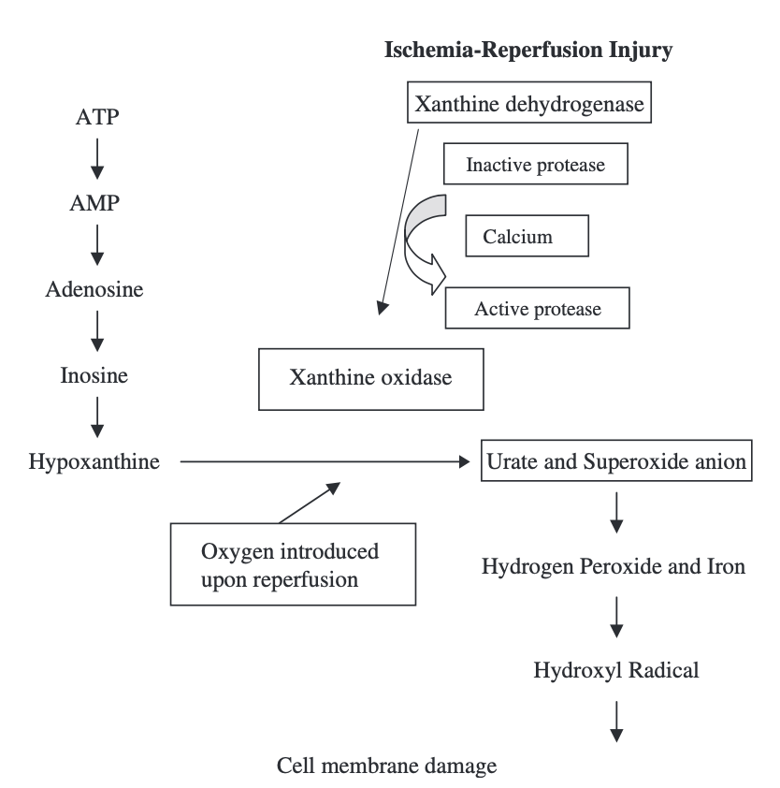
What happens when we are unable to maintain ATP?
Notes:
Setting the stage for ROS formation and reperfusion energy begins with a period of ischemia before oxygenated blood is reintroduced.
Unable to maintain ATP generation and ATP is broken down adenosine, inosine, hypoxanthine. Concentrations of hypoxanthine begin to accumulate.
The lack of ATP leads to dysfunction of the ATP dependent pumps

Slide 3
12 YO MC Mixed breed canine, post CPA, VBG from peripheral vein
 | Value
pH | 7.012
CO2 | 63 mmHg
iCa | 1.03
K | 6.8
Na | 138
Cl | 107
Lactate | 6.2

Slide 4
CBC
WBC | 2.8 (L)
Segmented neutrophils | 0.9 (L)
Band Neutrophils | 1.8 (H)
PLT | 339

Slide 5
Acidosis
Anaerobic metabolism
  Resultant drop in intracellular pH with accumulation of hydrogen ions
  Subsequent enzyme dysfunction
  Damage to regulatory membrane channels
Return
Notes:
Intracellular pH drops secondary to anaerobic metabolism which activates the Na/H exchange which pumps hydrogen out of cells in exchange for sodium¸

Slide 6
Calcium
Intracellular calcium rises
  Decreased extrusion
  Calcium release from organelles
  Calcium influx
Consequences
  Cell swelling
  Apoptosis
  Role in ROS generation?
Return
Notes:
Rise in calcium is one of the earliest events in IRI, extent of damage is dependent on extent of ischemia
Decreased extrusion is due to loss of ATP dependent pumps, net efflux of potassium,
increased intracellular calcium also activates calpain which convert XD to XO (XO requires oxygen for activation and begins to accumulate during ischemia)

Slide 7
Potassium
Why do you see a hyperkalemia (and possibly other electrolyte derangements)?
  Decreased ATP inactivates the membrane pumps
  Efflux of potassium out of cells
  Influx of Na, Ca, Cl
    Contributes to cell swelling
Return

Slide 8
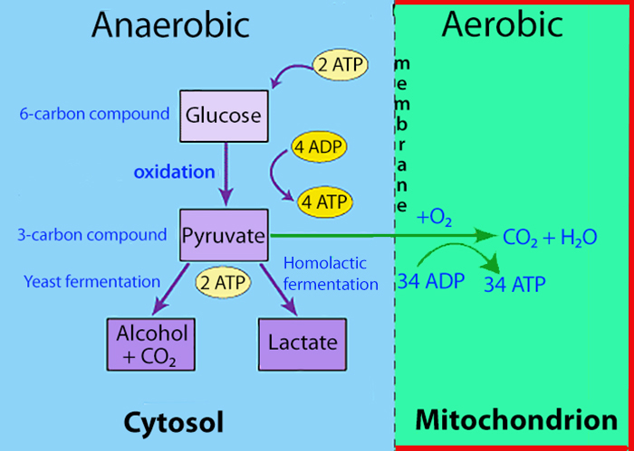
Lactate
Return
Notes:
Anaerobic metabolism leads to less production of ATP and generation of lactate and hydrogen ions

Slide 9
Neutrophils
What attracts/mediates neutrophil role in IRI?
How do neutrophils contribute to IRI?
Notes:
Neutrophil chemotaxis and infiltration is initiated by ROS, PAF, XO. Mediated by expression of adhesion molecule (ICAM1, E-selectin) expression expressed on endothelial surface that culminates in extravasation of neutrophils. Expression of nuclear factor kappa B (NFkB) increases inflammatory mediators and increases expression of adhesion molecules.
Neutrophils mediate a majority of the microvascular injury through generation of oxidants, ROS, and proteolytic enzymes released from neutrophils during oxygen burst. Can also cause physical obstruction of capillaries contributing to the no reflow phenomenon (neutrophils adhere to endothelium resulting in endothelial swelling, platelet activation, thrombus formation, further neutrophil recruitment)

Slide 10
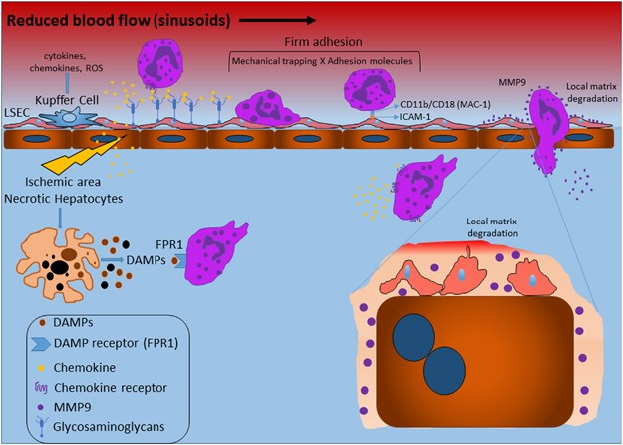
Notes:
Once neutrophils become adherent to the endothelium, they move over the endothelial cell surface and then diapedese through intercellular endothelial cell junctions and migrate to the site of inflammation. This migration may be facilitated by disruption of the intercellular junction integrity by elastase or other mediators.
Nuclear transcription factor (NFκB) seems to play an important role in the upregulation of endothelial cell adhesion molecules during phase 2 neutrophil adhesion. Unlike many transcription activators, NFκB is normally present in the cytoplasm and must be translocated into the nucleus to elicit a response
A vicious cycle occurs during reperfusion, with continued neutrophil chemotaxis and activation leading to additional ROS formation, endothelial damage, and capillary plugging
t is likely that neutrophils play a key role in no-reflow. Neutrophils adhering to the endothelium can cause damage resulting in endothelial swelling and additional neutrophil accumulation, which can lead to further ischemia and a downward spiral in which even more neutrophils are attracted to the area.

Slide 11
Reperfusion
Notes:
Reperfusion paradoxically causes more damage than ischemia, creates severe endothelial damage

Slide 12
ROS Generation
Notes:
ROS formation burst seen within 10-30 seconds of reperfusion and 70% of oxygen delivered to tissues is oxidized to superoxide
Xanthine dehydrogenase is converted to xanthine oxidase due to the presence of calcium, which converts a protease, calpain, to its active form. Hypoxanthine is metabolized by xanthine oxidase to urate and superoxide anion upon re-introduction of oxygen. ATP – adenosine triphosphate, AMP – adenosine monophosphate.
In health, the XD form predominates and converts hypoxanthine to xanthine and xanthine to uric acid. XD does not require oxygen for its activation, and uses nicotinamide adenine dinucleotide, a carrier that can accept two electrons and transfer them. During ischemia, due to increased calcium, the XO form predominates and requires oxygen for its activation. There is, in essence, a roadblock during ischemia, with continued accumulation of hypoxanthine and XO, neither of which can be utilized because the enzyme XO requires oxygen.

Slide 13
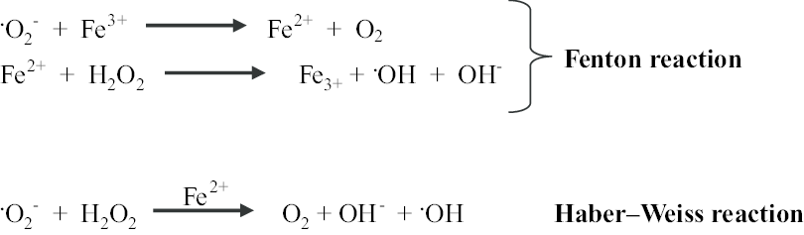
ROS
Notes:
H2O2 combines with transition metal, usually free iron, to generate hydroxyl radical. During ischemia, intracellular iron that is bound to ferritin is released, most likely as a result of a combination of acidosis and increased concentrations of reducing equivalents.⁴⁶ In addition, superoxide mobilizes iron from ferritin⁴⁷ and hydrogen peroxide mobilizes iron from heme.⁴⁸ Proteolytic degradation of ferritin occurs during times of oxidative stress and may contribute to the release of free iron. Red blood cells contain large amounts of iron and hemolysis may contribute to free iron release during oxidative stress.
The hydroxyl radical is the one of the most destructive and potent oxidizing agents known reacting with almost every molecule in the living cell.²⁴ It causes a chain reaction of lipid peroxidation that leads to loss of membrane selective permeability, damage to DNA, and degradation of structural proteins and membrane-bound enzyme activity.⁵¹ The chain reaction will continue until the hydroxyl radical is scavenged, two radicals combine to form a non-reactive species, or the substrate is consumed.

Slide 14
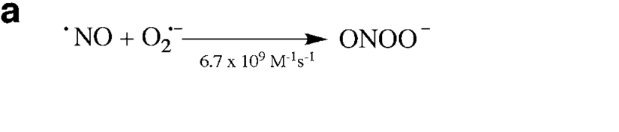
Nitric Oxide
Notes:
As oxygen is required for NO• production, ischemia results in NO• depletion and subsequent vasoconstriction, decreased perfusion, and cellular injury. During reperfusion, there is an increase in NO• production, which is cytotoxic and causes severe nonresponsive vasodilation. Concurrently, there is release of ROS, which can inactivate NO•. In addition, NO• and •O−2 combine to produce ONO−2 and cause further cellular injury.
Hypoxia induces transcription of iNOS (inducible nitric oxide synthase) but because oxygen is required for NO production, NO levels don’t increase. Upon reperfusion, may be sustained increases in NO. NO and superoxide will rapidly combine to form peroxynitrite (ONOO-) which is highly reactive.
Inactivation of endothelial NO causes vasoconstriction, and inhibition of the prostacyclin arm of the arachidonic acid cascade favors vasoconstriction and platelet aggregation, cyclo-oxygenase-2 (COX-2) is activated, leading to the formation of proinflammatory prostaglandins and ROS from arachidonic acid and the subsequent activation of phospholipase A2.. Oxygen is also required for NO synthesis and during hypoxia, oxygen can become a limiting substrate. In addition, complement activation and synthesis of platelet activating factor (PAF) occur

Slide 15
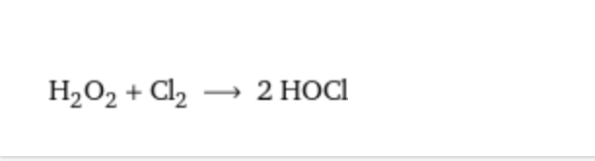
ROS
Notes:
Hydrogen peroxide can react with chloride to form hypochlorous acid (HOCl), which occurs in the phagocytic vesicles of neutrophils via myeloperoxidase and is important in killing bacteria

Slide 16
Cellular effects of oxidative injury
Lipid peroxidation
Nucleic acids
Proteins
Notes:
Lipid peroxidation is a major source of cellular injury, resulting in increased cell membrane permeability; inhibition of normal cellular enzyme processes; damage to proteins, intracellular membranes, capillaries, and alveoli; and inactivation of lung surfactant. The two main free radicals that can initiate lipid peroxidation are •OH and ONO−2, although many other free radicals and RONS can also initiate lipid peroxidation. Polyunsaturated fatty acid is the major target of lipid peroxidation, and injury to polyunsaturated fatty acids results in a chain reaction of the generation of other ROS
Oxidative stress can cause DNA and RNA damage, including mutations, and is therefore one of the contributing factors in mutagenesis, carcinogenesis, and aging
Proteins are affected during oxidative stress due to decreased production secondary to inhibition of ribosomal translation, and direct reversible and irreversible oxidative injury. As a result, impairment of cellular signaling and metabolism can occur.

Slide 17
Assessing for IRI
Measurement of ROS
Malondialdehyde
Isoprotanes
Biomarkers and antioxidant levels
Notes:
ROS are highly reactive and have a fleeting existence and are therefor difficult to measure. MDA is a byproduct of lipid peroxidation and can be tested via ELISA or thiobarbituric acid reactive substances, compounded by generation of the product ex vivo. Isoprotanes are prostaglandin like compounds which are formed when ROS oxidizes the cell membrane and arachidonic acid, more reliable than MDA in vivo, but uses mass spectrometry which is a limitation

Slide 18
Management of IRI
Lidocaine
  Multimodal effects
  GDV
N-acetylcysteine
Deferoxamine
Allopurinol
Avoiding hyperoxemia
Notes:
Lidocaine: fast sodium channel antagonist, local anesthetic, 1B antiarrhythmic, antagonist of ATP sensitive potassium channels, scavenges superoxide and hydroxyl radicals, inflammatory modulators, inhibits granulocytes. In GDV showed benefit when given prior to fluids and decompression, reduced incidence of kidney injury and cardiac arrythymias, coagulopathies and decreased hospital time Buber T, Saragusty JAVMA 2007.
NAC is a glutathione precursor that penetrates into cells and replenishes intracellular glutathione levels, may improve cellular anti-oxidant capabilities, evidence for efficacy is equivocable but is relatively safe. Glutathione can act as a chain breaking anti-oxidant and as a metal chelator.
Deferoxamine is an iron chelator, some studies in humane was unrewarding, study in GDV showed decreased mortality. Risky to chelate iron as it is required in hemoglobin.
Allopurinol is a structural analog of hypoxanthine and competes with and inhibits XO, seems only beneficial as a pretreatment, but is used in organ transplant mediums
In a canine experimental study, titration of oxygen supplementation to an SpO2 of 94% to 96% compared with a consistent FiO2 of 1 led to superior functional neurologic outcomes and a reduction in neuronal degeneration in vulnerable brain regions.27 The inspired oxygen concentration, especially early after ROSC, should therefore be titrated to normoxemia (PaO2 80 to 100 mm Hg; SpO2 94% to 98%), avoiding both hypoxemia and hyperoxemia

