Slide 1
Fresh Frozen Plasma - Pros and Cons
Trevor Chan, DVM

Slide 2
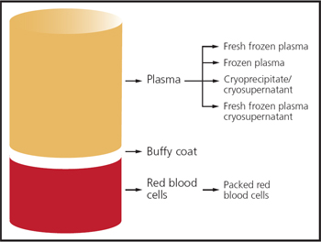
Fresh Frozen Plasma
Whole blood - pRBC = fresh frozen plasma
Separated and frozen within 6-8 hours of whole blood collection
Store at -20C for 1 year -> then frozen plasma for 4 more years
Contains all coagulation factors except platelets
Can also be separated into cryoprecipitate and cryo-poor plasma
Albumin and Immunoglobulins stable throughout shelf-life
https://www.vin.com/apputil/content/defaultadv1.aspx?id=5328370&pid=11349&print=1
Notes:
After collecting whole blood from a donor dog into a sterile plastic collection bag containing Citrate-Phosphate-Dextrose-Adenine anticoagulant, the sample is centrifuged slowly to separate the blood into these components.
The entire collection system uses plastic - glass containers have negative charge that will activate platelets, Factors VIII and XII
After the first year of cold storage, FFP loses its labile coagulation factors - What are the labile factors? (Factors V and VIII)
T/F - You can refreeze a FFP unit and still consider it FFP?
True, within 1 hour of thawing
Cryoprecipitate - Factor VIII, vWF, fibrinogen, fibronectin
Cryopoor plasma - the rest of the clotting factors ( 2, 7, 9, 10)

Slide 3
Potential Indications for FFP
Coagulopathies
  Congenital - vWF Disease, Hemophilia A & B
  Acquired - rodenticide toxicity, heat stroke, synthetic liver failure, DIC, SIRS/sepsis
  10ml/kg, repeated as needed
  Cryoprecipitate 1 unit ~50ml/10kg, or 1-2ml/kg
  Cryopoor plasma - 6-10ml/kg
Albumin supplementation, oncotic support
  40-50ml/kg for 1.0 g/dL increase
Immunoglobulins
alpha-Macroglobulin (anti-proteases)
Logan, J. C., Callan, M. B., Drew, K., Marryott, K., Oakley, D. A., Jefferies, L., & Giger, U. (2001). Clinical indications for use of fresh frozen plasma in dogs: 74 dogs (October through December 1999), Journal of the American Veterinary Medical Association, 218(9), 1449-1455. Retrieved Dec 12, 2022, from https://avmajournals.avma.org/view/journals/javma/218/9/javma.2001.218.1449.xml
Notes:
Coagulopathies - can use FFP or components of it if available to help minimize intravascular volume expansion and exercise appropriate management of blood bank supplies
vWF, Hemophilia A - cryoprecipitate
Hemophilia B - cryopoor
Vit K - frozen plasma
Synthetic liver failure, DIC - FFP
Cryoprecipitate dosing (1 unit ~50ml)/10kg or 1-2ml/kg
Cryo-poor plasma 6-10ml/kg for rodenticide poisoning
Some thoughts for coagulopathies - traditional testing such as PT/aPTT are not predictive of bleeding risk; these tests are not designed to predict bleeding. Additionally the coagulation factor relationship with these tests are nonlinear. Biologically normal patients can have abnormal test results, and the tests themselves can overestimate the upper limb of the coagulation cascade and underestimate the lower limb. For example, PT is highly dependent on Factor VII, so a patient with a Factor VII deficiency may have a more prolonged PT time than a patient with a deficiency in the common cascade (10, 5, 2). Using VCM/TEGs instead to strengthen clinically relevant coagulopathies needs more studies
Albumin supplementation and oncotic support has been described in canine parvovirus and SIRS/sepsis patients
Some use of FFP, cryopoor plasma, or hyperimmune plasma in parvovirus dogs as well
Alpha macroglobulins contain anti-proteases - original thought for acute pancreatitis treatment

Slide 4
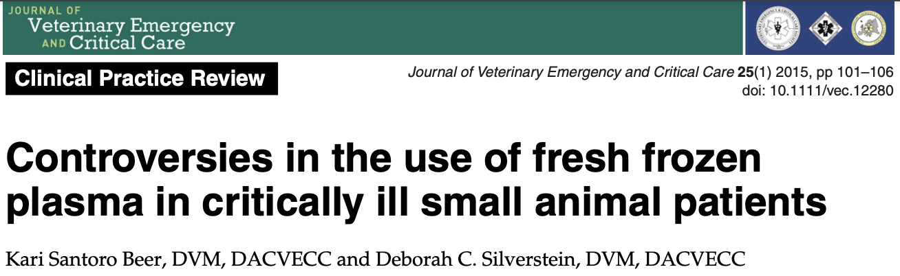
UPenn 2001 - coagulation factors, albumin, immunoglobulins, alpha macroglobulins
Michigan 2010 - mostly coagulation factor supplementation
DIC - theorized, no studies as of yet
SIRS - preliminary results, coagulopathies can occur without SIRS
Notes:
Synopsis of the literature, these are some of the highlights
A retrospective published in 2001 from UPenn by Logan et. al describes FFP use for coagulation factors, albumin support, immunoglobulins, and alpha macroglobulins
A more recent retrospective published in 2010 from Michigan by Snow et. al documents a move away from FFP for albumin, immunoglobulins, and alpha macroglobulins at that hospital when comparing records from records between 96-98 and 06-08. They documented improvements in PT/aPTT but not in albumin concentrations. Median volume administered in this retrospective was 15-18 ml/kg.
FFP in DIC patients - theorized to help via administering clotting factors, antithrombotic proteins, anti-proteases, and albumin, as well as mitigating concerns for dilutional coagulopathies with excessive crystalloid administration but there hasn’t been a vet study to document this theorized benefit
In a study with published preliminary results by Bauer in 2013- dogs with and without SIRS both demonstrated severe coagulopathies - critically ill dogs can have coagulopathies without concurrent SIRS

Slide 5
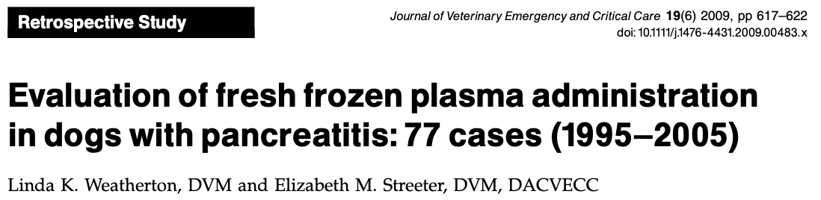
Retrospective 1995-2005 dogs with pancreatitis
77 dogs, 20 received FFP, 57 did not
7/20 FFP dogs died/euthanized vs. 6/57 of non-FFP dogs
No illness severity score reported
SIRS criteria dogs were not more likely to receive FFP
Coagulopathy prevalence not different between groups
Notes:
Acute pancreatitis pathophysiology is thought to be at least partially mitigated by consumption of circulating anti-proteases and anti-typsinases and so FFP was thought to be helpful in replenishing those enzymes. Alpha macroglobulins decrease via injections of active trypsin and complications increased in those experimental dogs.
Further studies have not supported alpha macroglobulin levels with severity of disease
Human studies do not show a difference in morbidity or survival in acute pancreatitis patients who receive FFP or do not. With a lack of clinical improvement documented and potential risk of transfusion reactions, human medicine has stopped this treatment
Retrospective from 1995-2005 for dogs with pancreatitis in Iowa. 77 cases, 7/20 with FFP transfusions died/euthanized vs. 6/57 that did not receive FFP. While transfusion were associated with higher mortality, there was no illness severity score. The authors do say that dogs meeting the SIRS criteria were not more likely to receive FFP however, and there was not a difference in presence of coagulopathies within the groups. They did not document any FFP benefits in this study.

Slide 6
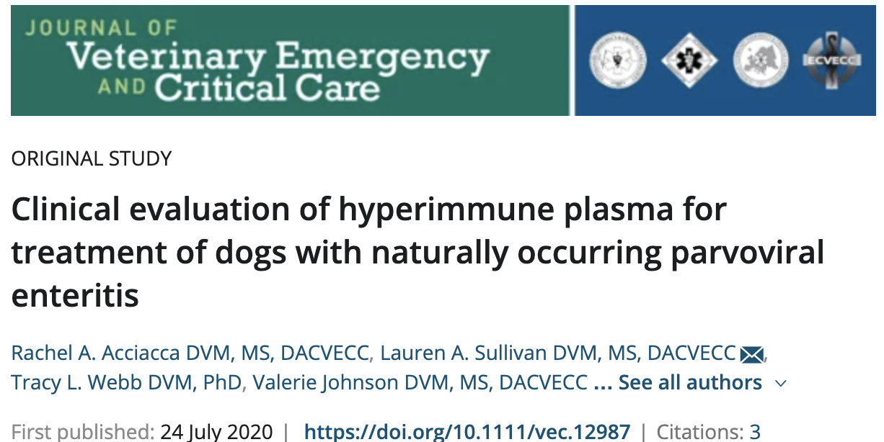

Notes:
Other studies have shown hyperimmune plasma to improve survival and decrease vomiting in experimental CPV dogs
Commercial Hyperimmune plasma - plasma from dogs that were hyperimmunized against canine parvovirus and Ecoli bacterin was collected via plasmapheresis
Contains CPV antibodies with titers 1:20 to >1:80 and anti-endotoxin antibodies 1:10k to 1:60k
Prospective, randomized-placebo-controlled clinical trial
31 dogs admitted for CPV either received HIP or saline during their first 6 hours of hospitalization at 10ml/kg
Everything else was standardized - IVF therapy, cefoxitin, maropitant, buprenorphine
Results - HIP - lower shock index at 24h, lower plasma lactate at 24h
No difference in hospitalization duration - survival HIP 16/16, control 14/15
Underpowered, but seems to be well tolerated in critically ill patients
Roughly 20 mL/kg of plasma must be administered to increase serum albumin concentration by 0.5 g/dL.
Anecdotal reports suggest that administration of fresh-frozen plasma (6.6–11 mL/kg IV or intraperitoneal, 3 doses administered 12 hours apart) may be prophylactic at preventing severe infection in exposed dogs

Slide 7
Cons to FFP
Not the panacea that we used to think it was
Cost, availability of product
Transfusion reactions
Hypersensitivity (facial pruritus, urticaria, fever)
Febrile nonhemolytic transfusion reaction
Hemolytic transfusion reactions
TACO - transfusion associated circulatory overload
TRALI - transfusion associated acute lung injury
Not first line treatment for hypoalbuminemia
Notes:
More recently, we’ve been seeing clinical evidence undercut assumed efficacy of FFP transfusions in a bunch of diseases - now recommendations are really only for patients actively bleeding and/or patients with coagulopathies who need a procedure
Hypersensitivity - mast cell activation
Febrile nonhemoytic - IM reactions against leukocytes or platelets
Hemolytic - Ab against RBC antigens, severity depends on complement activation, IgG vs. IgM, and temperature binding
TRALI - Ab mediated (leukocytes antibodies transfused into patient) or Cytokine mediated (proinflammatory mediators accumulate during storage)

Slide 8
References
Acciacca, RA, Sullivan, LA, Webb, TL, Johnson, V, Dow, SW. Clinical evaluation of hyperimmune plasma for treatment of dogs with naturally occurring parvoviral enteritis. J Vet Emerg Crit Care. 2020; 30: 525– 533. https://doi.org/10.1111/vec.12987
Ann E. Hohenhaus, Chapter 24 - Blood Transfusion and Blood Substitutes, Editor(s): Stephen P. DiBartola, Fluid, Electrolyte, and Acid-Base Disorders in Small Animal Practice (Fourth Edition), W.B. Saunders, 2012, Pages 585-604
Beer, K.S. and Silverstein, D.C. (2015), Controversies in the use of fresh frozen plasma in critically ill small animal patients. Journal of Veterinary Emergency and Critical Care, 25: 101-106. https://doi-org.proxy.library.cornell.edu/10.1111/vec.12280
Logan, J. C., Callan, M. B., Drew, K., Marryott, K., Oakley, D. A., Jefferies, L., & Giger, U. (2001). Clinical indications for use of fresh frozen plasma in dogs: 74 dogs (October through December 1999), Journal of the American Veterinary Medical Association, 218(9), 1449-1455.
Mazzaferro EM. Update on Canine Parvoviral Enteritis. Vet Clin North Am Small Anim Pract. 2020 Nov;50(6):1307-1325. doi: 10.1016/j.cvsm.2020.07.008. Epub 2020 Sep 2. PMID: 32891439; PMCID: PMC7467068.
Snow SJ, Jutkowitz LA, Brown AJ. Trends in plasma transfusion at a veterinary teaching hospital: 308 patients (1996–1998 and 2006– 2008). J Vet Emerg Crit Care 2010; 20(4):441–445.
Urs Giger, Chapter 61 - Transfusion Therapy, Small Animal Critical Care Medicine (Second Edition), 2015, Pages 327-332

