Slide 1

Consensus review: Systemic hypertension
*SACCM chapter 159 Antihypertensives
Cece Zhu
ECC Board Review 7/26/22

Slide 2
Question 1:
When using doppler and oscillometric BP, width of cuff should be __ to ___% of circumference of extremity?
A) 20-30%
B) 30-40%
C) 40-50%
D) 50-60%

Slide 3
Question 1:
When using doppler and oscillometric BP, width of cuff should be __ to ___% of circumference of extremity?
A) 20-30%
B) 30-40%
C) 40-50%
D) 50-60%

Slide 4
2. BP measurement
3. Normal values for canine and feline BP
First measurement should be discarded and average of 5-7 consecutive indirect measurements obtained
Age may increase BP mildly
  In people, age and increases in BP is well documented
  1-3 mmHg/year (dogs) (not consistent in all studies)
  1.5 mmHg/year (cats) (not consistent in all studies)
Sex may affect BP?
  Intact females < Neutered pets < Intact males
Breed differences: hounds have higher BP by 10-20 mmHg
Obesity may affect BP? (May be related to underlying disease)

Slide 5
4. Hypertension definitions
3 types of hypertension:
  Situational: caused by autonomic nervous system alterations in response to excitement or anxiety
        No justification to treat
  Secondary: persistent pathological hypertension concurrent with disease or condition known to cause hypertension or associated with admin of a therapeutic agent or toxin known to cause hypertension
      May persist despite effective treatment of primary condition
      *Most common in dogs and cats
  Idiopathic: persistent pathological hypertension in absence of any identifiable underlying cause and represents a multifactorial disorder involving genetic, lifestyle, and environmental factors
      Suggests one or more of neurohumoral and renal systems regulating BP is abnormal
      Accounts for 13-20% of cases in cats

Slide 6
4. Hypertension definitions -> Secondary hypertension
Causes in dogs + prevalence of hypertension
  CKD (9-93%)
  AKI (15-87%)
  Hyperadrenocorticism (naturally or iatrogenic) (20-80%)
  DM (24-67%)
  Obesity: small effect
  Primary hyperaldosteronism: rare
  Pheochromocytoma (43-86%)
  Hypothyroid: uncommon
  Brachycephalic: no prevalence data

Slide 7
4. Hypertension definitions -> Secondary hypertension
Causes in cats + prevalence of hypertension
  CKD (17-65%)
  DM (0-15%)
  Hyperthyroidism (5 pre-tx/25 post-tx – 87%)
  Obesity: hypertension uncommon
  Primary hyperaldosteronism: uncommon dz, 50-100%
  Pheochromocytoma: unusual disease
  Hyperadrenocorticism: 19%

Slide 8
Question 2:
Case example: Your patient comes in with a 3d history of restlessness and panting at home, and his owner took home BPs that were consistently around 170mmHg systolic. He is also a newly diagnosed typical Addisonian who received his second dose of DOCP 5 days ago. Do you think his hypertension is secondary to the DOCP injection?
A) Yes
B) No

Slide 9
Question 2:
Case example: Your patient comes in with a 3d history of restlessness and panting at home, and his owner took home BPs that were consistently around 170mmHg systolic. He is also a newly diagnosed typical Addisonian who received his second dose of DOCP 5 days ago. Do you think his hypertension is secondary to the DOCP injection?
A) Yes
B) No

Slide 10
4. Hypertension definitions -> Secondary hypertension
Medications and intoxicants associated with secondary hypertension:
  GC (dog): significant mild-mod dose dependent increases in BP at doses enough to induce signs of Cushing’s
  Mineralocorticoids (dog): at high doses, DOC can increase BP/ DOCP is not associated with inc BP
  Erythropoiesis-stimulating agents (dog + cat): difficult to assess in conjunction with progressive CKD
  Phenylpropanolamine (dog): transient inc in BP for 3-5 hrs/ uncommon when long term for incontinence
  Ephedrine (dog)
  Pseudoephedrine (dog): uncommon when long term for incontinence
  Toceranib phosphate (Palladia) (dog): documented in 28% of previously normotensive dogs
  Chronic high dose sodium chloride: BP in dogs and cats seem relatively salt-insensitive
  Cocaine (dog)
  Methamphetamine/amphetamine (dog)
  5-hydroxytryptophan (dog)

Slide 11
Question 3:
Case example: You suspect your patient has idiopathic hypertension due to reliably sustained hypertension, a normal CBC, chemistry, and UA. However, her USG on a morning sample is 1.012. Is this patient still likely to have idiopathic hypertension?
A) Yes
B) No

Slide 12
Question 3:
Case example: You suspect your patient has idiopathic hypertension due to reliably sustained hypertension, a normal CBC, chemistry, and UA. However, her USG on a morning sample is 1.012. Is this patient still likely to have idiopathic hypertension?
A) Yes
B) No
Hypertension can cause pressure diuresis, so a low USG in a patient with hypertension does not establish that kidney disease is present

Slide 13
*Proposed mechanisms of blood pressure elevation
Hyperadrenocorticism: GC induce hepatic production of angiotensinogen
Hyperthyroidism: increased CO caused by effect of TH on cardiac muscle
Chromocytomas: release epi and norepi-> vasoconstriction and inc CO
Diabetes mellitus: multifactorial
    Diabetic nephropathy on renal function
    Hyperinsulinemia secondary to insulin resistance causes sodium and water retention and increased sympathetic activity-> changes in blood volume and vasoconstriction
    Hypertrophy of vascular smooth muscle secondary to mitogenic effects of insulin
    Elevations in insulin levels lead to increased levels of intracellular calcium-> hyperresponsive vascular smooth muscle contraction and increased peripheral vascular resistance
Notes:
*= SACCM chapter 159

Slide 14
Question 4:
What are the four target organs affected in systemic hypertension?

Slide 15
Question 4:
What are the four target organs affected in systemic hypertension?
Kidneys, eyes, brain, and heart/blood vessels

Slide 16
5. Target organ damage (TOD)
Chronic hypertension is problematic b/c it can cause injury to tissues
Hypertension has been assoc with proteinuria and histological renal injury
  Proteinuria assoc with faster progression of renal disease and mortality
  Anti-hypertensive agents generally decreases severity of proteinuria
  Hypertension may occur in any stage of CKD/creatinine concentration is not directly related to BP
Ocular lesions may be as high as 100% in hypertensive cats
  Exudative retinal detachment most common, also retinal hemorrhage, multifocal retinal edema, retinal vessel tortuosity, retinal perivascular edema, papilledema, vitreal hemorrhage, hyphema, secondary glaucoma, retinal degeneration
  Can occur in BP as low as 168 mmHg/ increased risk at SBP <180 mmHg
  Effective anti-hypertensive tx can lead to retinal reattachment, but restoration of vision only occurs in a minority of patients

Slide 17
5. Target organ damage (TOD)
Hypertensive encephalopathy causes white matter edema and vascular lesions (hemorrhage/ischemia/infarction)
  Neurologic signs reported in 29-46% of hypertensive cats
  More likely to occur in cats with sudden increase in BP, SBP >180 mmHg, or both
  CS: lethargy, seizures, acute altered mentation, altered behavior, disorientation, balance disturbances, focal neurologic defects
Cardiac abnormalities common in hypertensive cats and dogs
  Increased CO rarely cause of hypertension/ heart is a target organ
  Most common change assoc with hypertensive cardiomyopathy is LV concentric hypertrophy
      May be indistinguishable from feline idiopathic HCM

Slide 18
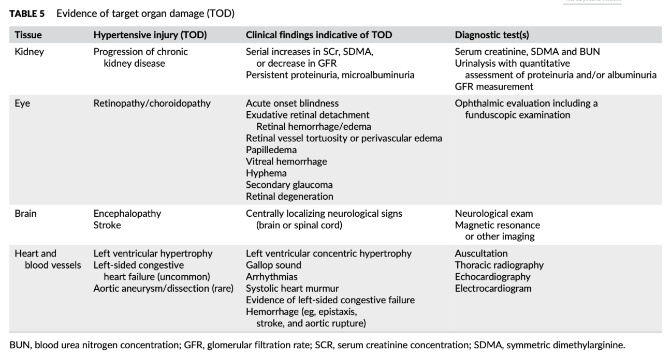
5. Target organ damage (TOD)

Slide 19
6. Prevalence and selection of patients for hypertension screening
Prevalence is unknown (0.5—13% of dog populations)
2 indications to measure BP
  Patient with abnormalities consistent with hypertensive TOD
      Ex: hypertensive choroidopathy/retinopathy, hyphema, intracranial neuro signs, renal abnormalities (proteinuria, azotemia), CV abnormalities (LVH, gallop, arrhythmia, systolic murmur, epistaxis)
      Some CS may be nonspecific: lethargy, inactivity, photophobia, altered appetite
  Presence of conditions causally associated with secondary hypertension, treatment of a medication or toxin that may increase BP

Slide 20
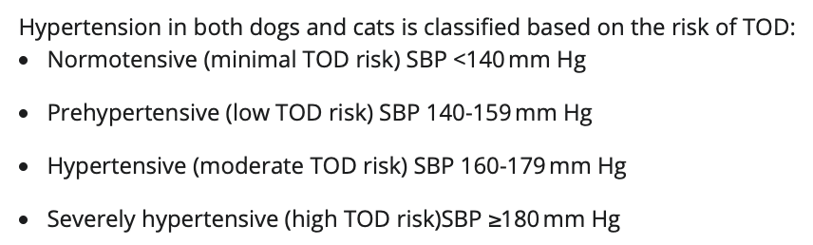
7. Diagnosis of hypertension
Presence of TOD justifies treatment with single measurement session
Most cases, BP should be confirmed on multiple (>2) occasions
If pre-hypertension (low-mod risk of TOD), measurements can occur over 4-8 weeks
If more severe (>180 mmHg), measurements over 1-2 weeks
Goal is to decrease BP to normotensive to pre-hypertensive stage
Classification is based on target organ risk

Slide 21
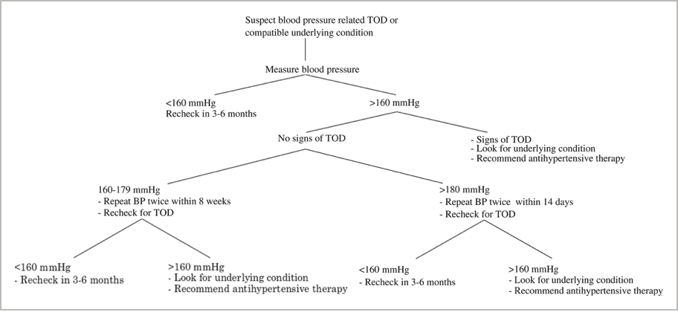
7. Diagnosis of hypertension

Slide 22
Question 5:
Case example: Your patient is undergoing first line anti-hypertensive therapy and primary treatment for secondary hypertension. You recheck BP 7 days after starting your first line anti-hypertensive and the BP is 150 mmHg. Do you want to add a secondary anti-hypertensive agent or increase your first line dose?
A) Yes
B) No

Slide 23
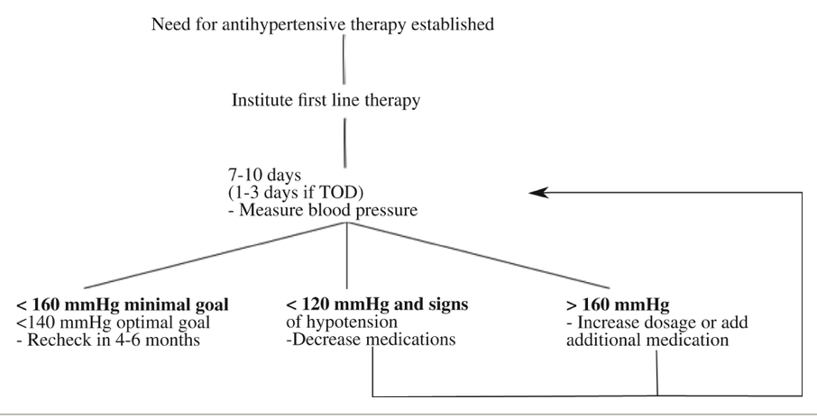
Question 5:
Case example: Your patient is undergoing first line anti-hypertensive therapy and primary treatment for secondary hypertension. You recheck BP 7 days after starting your first line anti-hypertensive and the BP is 150 mmHg. Do you want to add a secondary anti-hypertensive agent or increase your first line dose?
A) Yes
B) No
According to guidelines, no need to increase dose or add secondary agent. Recheck in 4-6 months.

Slide 24
8. The hypertensive patient: evaluation and decision to treat
Prehypertensive: usually not treated, inc freq of monitoring
Patients with known risk categories (CKD, hyperthyroid, Cushing’s) may benefit from increased monitoring as well
Treatment of hypertension should not be postponed until underlying condition is controlled

Slide 25
8. The hypertensive patient: evaluation and decision to treat
Effective management of condition causing secondary hypertension may lead to complete or partial resolution of hypertension in some but not all cases
Overall goal is to decrease risk of TOD (SBP< 140 mmHg) and that the antihypertensive treatment should be adjusted if SBP =/> 160 mmHg
  Minimal goal of treatment: decrease in SBP to =/<160 mmHg
Dietary salt restriction is controversial (has variable effects on BP, many enhance efficacy of antihypertensive agents)
  Recommendation: avoid high dietary salt intake

Slide 26
8.2. The hypertensive patient: evaluation and decision to treat (dogs)
Usually not an emergency and should be treated over several weeks
Certain diseases will require specific classes of agents
  Pheochromocytoma: alpha and beta adrenergic blockers
  Hyperaldosteronism: aldosterone receptor blockers
Otherwise, RAAS inhibitors and CCB most widely recommended
Due to prevalence of CKD in hypertensive dogs and antiproteinuric effect, RAAS inhibitors often first line in dogs
  ACEi (enalapril/benazepril), ARB (telmisartan), aldosterone antagonists (spironolactone)

Slide 27
8.2. The hypertensive patient: evaluation and decision to treat (dogs)
In dogs with concurrent CKD, decrease in UPC by =/>50% is a secondary goal of anti-hypertensive treatment
Exception to RAAS inhibitor as single agent: severely hypertensive dogs (SBP >200mmHg), use RAAS inhibitor and CCB (amlodipine)
Use of CCB as sole agent in dogs should be avoided b/c CCB preferentially dilates renal afferent arteriole (can expose glomerulus to increases in glomerular capillary hydrostatic pressure)
  ACEi and ARBs preferentially dilate the renal efferent arteriole, so coadmin with a CCB may have limited effect on glom hydrostatic pressures

Slide 28
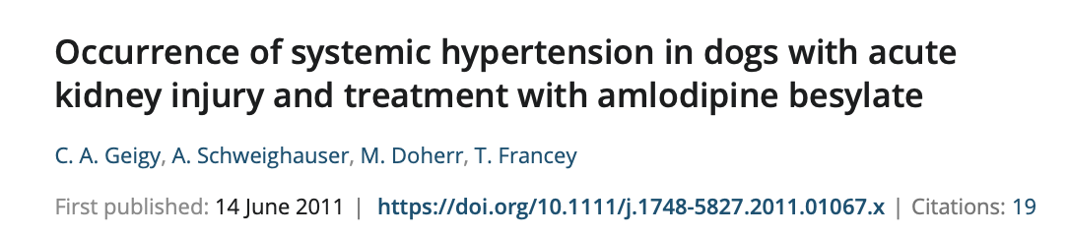
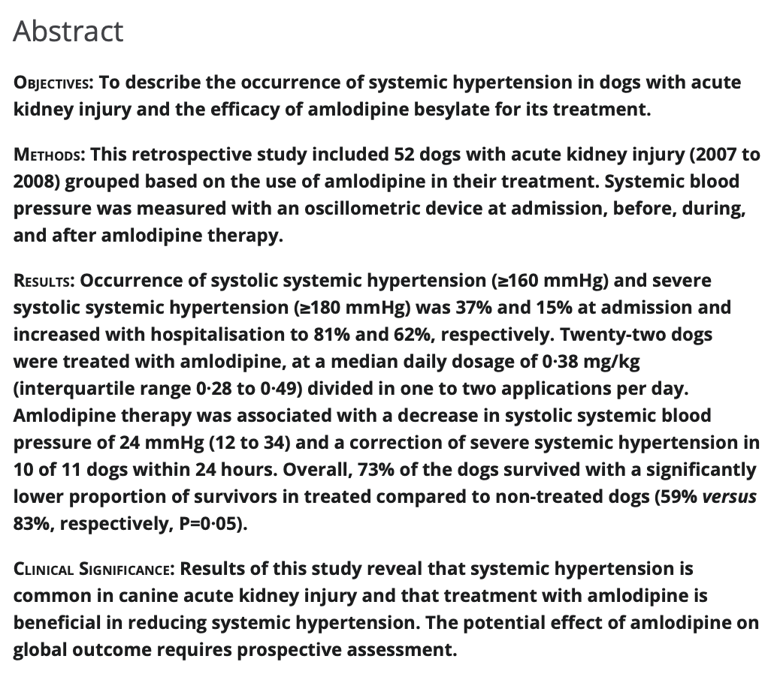
Notes:
2011 JSAP

Slide 29
8.2. The hypertensive patient: evaluation and decision to treat (dogs)
Diuretics frequently given to hypertensive people, but not first choice in vet patients due to prevalence of CKD and adverse effects of further dehydration and volume depletion
  Can be considered in small subset of hypertensive pets in which volume expansion is clinically apparent (ie edema)
Anti-hypertensives in general (esp RAAS inhibitors) should be used with caution in dehydrated dogs in which GFR may decrease with their use
  Unless rapidly progressive TOD, should be carefully rehydrated and re-evaluated prior to antihypertensive treatment

Slide 30
*question 6: Oral anti-hypertensives
Drug | Class | Effect
Benazepril/enalapril | Angiotensin converting enzyme inhibitor | Arterial and venous vasodilation
Telmisartan/losartan | Angiotensin 2 receptor blocker | Arterial and venous vasodilation
Amlodipine | Calcium channel blocker | Arterial vasodilation
Prazosin | A1 blocker | Balanced vasodilation
Phenoxybenzamine | A1 and A2 blocker | Balanced vasodilation
Acepromazine | A1 blocker | Vasodilation
Spironolactone | Aldosterone antagonist | Vasodilation
Propranolol | Beta 1 and B2 blocker (non-selective) | Dec CO, dec sympathetic outflow, dec BP, cardiodepression
Atenolol | Beta 1 blocker (higher doses, B2) | Dec CO, dec sympathetic outflow, dec BP, cardiodepression
Hydrochlorothiazide | Thiazide diuretic | Vasodilation (mostly arterial)

Slide 31
*question 6: Oral anti-hypertensives
Drug | Class | Effect
Benazepril/enalapril | Angiotensin converting enzyme inhibitor | Arterial and venous vasodilation
Telmisartan/losartan | Angiotensin 2 receptor blocker | Arterial and venous vasodilation
Amlodipine | Calcium channel blocker | Arterial vasodilation
Prazosin | A1 blocker | Balanced vasodilation
Phenoxybenzamine | A1 and A2 blocker | Balanced vasodilation
Acepromazine | A1 blocker | Vasodilation
Spironolactone | Aldosterone antagonist | Vasodilation
Propranolol | Beta 1 and B2 blocker (non-selective) | Dec CO, dec sympathetic outflow, dec BP, cardiodepression
Atenolol | Beta 1 blocker (higher doses, B2) | Dec CO, dec sympathetic outflow, dec BP, cardiodepression
Hydrochlorothiazide | Thiazide diuretic | Vasodilation (mostly arterial)

Slide 32
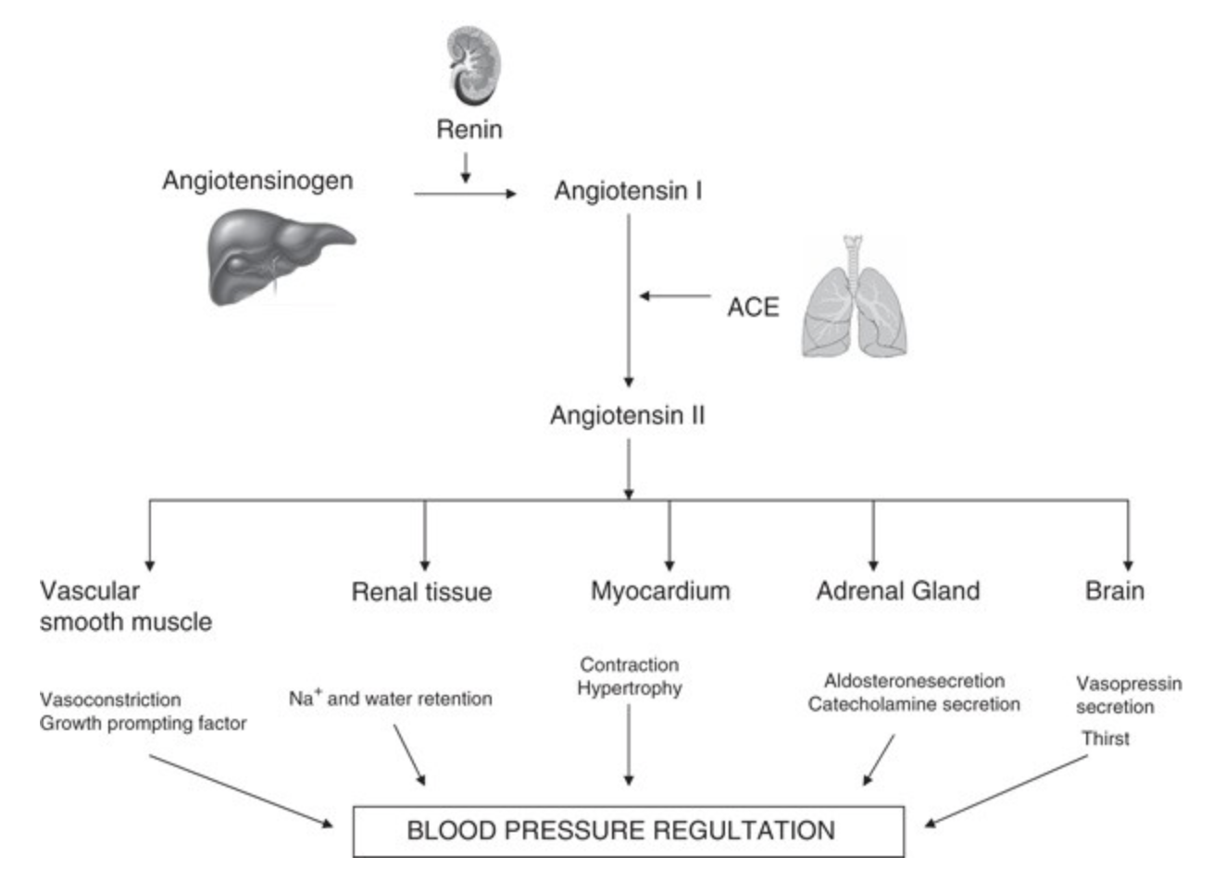
Question 7: Renin angiotensin aldosterone system (RAAS)

Slide 33
Renin angiotensin aldosterone system (RAAS)
Responsible for long term adjustments to blood pressure
Juxtaglomerular cells (kidney) produces prorenin
  Cleaved to renin with drop in BP
Renin converts angiotensinogen (produced by liver) into angiotensin I
Angiotensin I is converted to Angiotensin II by ACE (mostly in lungs and kidneys)
Ang II is a hormone, binds to receptors in tissues

Slide 34
*Ace inhibitors
ACE inhibitors competitively inhibit the conversion of angiotensin I to angiotensin II
    Angiotensin is a potent vasoconstrictor → inhibition = arterial and venous dilation
    Prevents aldosterone release→ decrease in sodium and water retention, decreased volume
ACE inhibition also leads to decrease in aldosterone production and blocks breakdown of bradykinins (a vasodilatory and natriuretic peptide)
    Aldosterone decrease leads to decrease in sodium and water retention and → decreased volume

Slide 35
*Ace inhibitors
Reduces proteinuria by maintaining heparan sulfate layer of glomerular basement membrane, lowering glomerular capillary hypertension, decreased release of extracellular matrix and collagen from mesangial and tubular cells, and reducing degree of glomerular and interstitial fibrosis
Adverse effects: weakness and lethargy d/t drop in BP
All ACE inhibitors have rapid oral absorption and are well distributed

Slide 36
Ace inhibitors
Benazepril
    Peak plasma levels occur about 75 min after oral dosing
    T1/2 in healthy dogs is 3.5 hours, T1/2 in healthy cats is 16-23 hours
    Mostly liver metabolism
Enalapril
    Converted in liver to enalaprilat (active metabolite)
    Onset of action in dogs is 4-6 hours, lasts 12-14 hours
    40% excreted in kidneys, 35% excreted in feces
    T1/2 of enalaprilat in dogs is 11 hours
    Mostly kidney metabolism
Lisinopril
    Peak plasma levels in dogs occurs 4 hours after ingestion
    T1/2 in dogs is 3 hours, effects last 24 hours

Slide 37
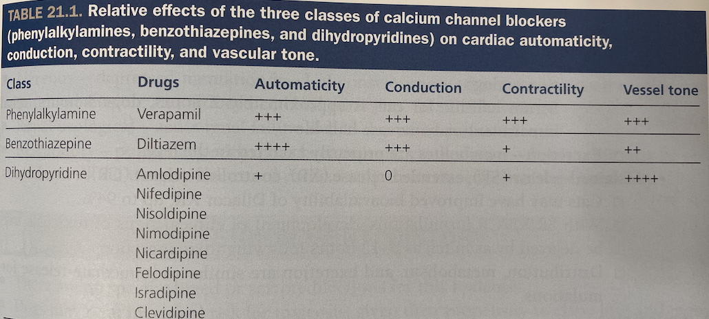
Calcium channel blockers
MOA: inhibit intracellular movement of calcium through L type voltage gated slow calcium channels (primarily in atrial muscle, vascular smooth muscle, and beta cells of pancreas)
Automaticity and conduction: SA node depolarization and AV node conduction are dependent on L type calcium channel activation
Contractility: L type calcium channel blockade impairs phase 2 of action potential in cardiac muscle-> reduced excitation-contraction coupling of cardiac muscle and reduced forced of contractility
Vascular tone: impairs vascular smooth muscle contraction-> vasodilation
  May cause reflex tachycardia

Slide 38
Calcium channel blockers
Pancreas: hypoinsulinemia and hyperglycemia may occur d/t impaired beta cell function
Amlodipine (dihydropyridines):
  Absorption: slow following oral dosing, peak plasma concentrations and clinical effects reported 5-9 hours after PO dosing
  Distribution: highly protein bound (>90%)
  Metabolism: slowly metabolized to inactive compounds by liver, terminal half life in dogs is up to 30 hours
  Excretion: renal excretion of inactive mtabolites

Slide 39
8.3. The hypertensive patient: evaluation and decision to treat (cats)
CCB (specifically amlodipine) has been first choice for anti-hypertensive tx b/c of established efficacy in cats with idiopathic hypertension or CKD
  SBP <200mmHg: starting dose of 0.625mg/cat/day
  SBP >200mmHg: may consider starting dose of 1.25mg/cat/day
  Rarely, 2.5mg/cat/day required
  May activate systemic or intrarenal RAAS
Amlodipine and ACEi or amlodipine and ARB is reportedly well tolerated
Use of ACEi as first line therapy is not recommended
  Likely will not be sufficient dec in BP

Slide 40
8.3. The hypertensive patient: evaluation and decision to treat (cats)
ACEi and ARB
Pros
  Preferentially dilate renal efferent arteriole, decreasing intraglomerular pressure and magnitude of proteinuria
Cons
  Theoretical tendency for GFR to decrease (can have acute increases of azotemia)
      Should not be started in dehydrated cats!

Slide 41
8.3. The hypertensive patient: evaluation and decision to treat (cats)
In cats with primary hyperaldosteronism, rec tx with aldosterone antagonists (spironolactone), potassium supplementation, and adrenalectomy if possible
  Will often also need amlodipine for adequate BP control
In cats with phenochromocytoma (rare), combo of phenoxybenzamine and amlodipine may be required

Slide 42
*IV anti-Hypertensives
Drug | Class | Effect
Fenoldopam | Dopamine 1 receptor agonist | Vasodilation, natriuresis
Labetolol | Beta blocker | Vasodilation
Hydralazine | Systemic arteriolar vasodilator (may induce dilation by preventing oxidation of nitric oxide) | Arterial vasodilator, reduced peripheral vascular resistance
Nitroprusside | Arterial and venous vasodilator (nitric oxide donor-> inc cGMP, inhibiting vascular smooth muscle contraction) | Vasodilation
Phentolamine | A1 and A2 adrenergic antagonist | Vasodilation

Slide 43
*fenoldopam
Peripheral dopamine 1 agonist
Maintains or increases renal perfusion, vasodilates
Paucity of data likely due to $$ of drug
Adverse effects
  Reflex tachycardia, increased intraocular pressure

Slide 44
*Sodium nitroprusside
Arterial and venous dilator (non-specific)
Reacts with physiologic sulfhydryl groups present in RBCs and cell membranes to release nitric oxide-> stimulates production of cGMP in vascular smooth muscle-> cGMP activates a kinase that subsequently leads to inhibition of calcium influx into smooth muscle and decreased calcium-calmodulin stimulation of myosin light-chain kinase-> decreases phosphorylation of myosin light chains-> decrease smooth muscle contraction-> rapid vasodilation-> acutely lowering blood pressure
Also reacts with hemoglobin to form methemoglobin
These reaction produces nitric oxide and 5 cyanide groups
  Free cyanide is converted to thiocyanate -> filtered at glomerulus

Slide 45
*Sodium nitroprusside
Minimal change in renal blood flow and only slight increase in heart rate
Used in hypertensive crisis, for rapid reduction of preload and afterload in CHF, and controlled BP reduction during surgery
Very potent, BP needs to be closely monitored
  Acts in seconds and has half life of 2-3 minutes
Adverse effects
  Shock and severe hypotension
  Cyanide intoxication can be seen in those with reduced liver function, reduced kidney function, or receive nitroprusside for prolonged periods of time or at high doses
  Signs of CN tox: development of nitroprusside resistance, depression and stupor, seizures, metabolic acidosis (increased lactate level and increase venous oxygen tension) d/t inhibition of mitochondrial cytochrome c oxidase

Slide 46
*Sodium nitroprusside
Treatment of CN tox
  Discontinue drug
  Hydroxocobalamin therapy (binds cyanide in vascular space and form cyanocobalamin)
  Exogenous thiosulfate and nitrite admin may be necessary in severe cases

Slide 47
*Hydralazine
Arteriolar dilator acting directly on smooth muscle of arterioles by mechanisms not completely understood
  May lower blood pressure by preventing oxidation of nitric oxide
Adverse effects (people)
  Reflex sympathetic activation
  Lupus-like reaction
  Non-specific: anorexia, nausea, V/D, muscle cramps, tremors
Adverse effects (vet)
  Primarily reflex tachycardia, weakness, GI upset, can see sodium retention

Slide 48
8.4. Hypertensive emergencies
Acute tx recommended for patients with TOD and hypertension
Goal: decrease SBP by approx. 10% over first hour and another approx. 15% over next few hours, followed by gradual decrease to normal BP
IV medication options:
  Fenoldopam (dopamine 1 receptor agonist): causes renal arterial vasodilation, natriuresis, and increased GFR in normal dogs
      Delivered as CRI
  Labetolol
  Hydralazine
  Nitroprusside
  Phentolamine (short acting competitive alpha-adrenergic blocker)

Slide 49
8.4. Hypertensive emergencies
Oral meds can be started when BP has been controlled for 12-24 hours
Patients with markedly increased SBP (=/>180 mmHg) without TOD can be treated with PO medication
  Hydralazine PO, amlodipine PO

Slide 50
