Slide 1

Catecholamines and cardiogenic shock
**SACCM Chpts 39, 46, 157
Cece Zhu
Resident Board Review 10/27/22

Slide 2
Catecholamines
Catecholamines are used to augment arterial BP, myocardial contractility, and CO
In general, tx of hypotension should be considered when MAP < 80 mmHg or SBP <100 mmHg
  Especially when MAP < 60 mmHg or SBP < 80 mmHg
General approach to hypotension:
1) If sinus bradycardia, first, second, or third degree AVB, give an anticholinergic agent (atropine or glyco). If HR doesn’t improve or HR improves but not BP, move on to catecholamine therapy
  Can start with low dose but low dose of either drug can cause a centrally mediated increase in vagal tone and worsening of bradycardia (if this happens, give more anticholinergic)
2) If vagotonic agent (A2 agonist, opioid) has been given, reverse if possible. Decrease anesthetic depth if possible
3) If ventricular arrhythmias, consider an antiarrhythmic
4) If hypovolemic, restore blood volume
5) If preload adequate, poor forward flow could be due to poor contractility, then a cardiotonic agent should be given: dopamine 5-20 mcg/kg/min
6) If higher dose of dopamine does not work, or causes sinus tach or vent arrhythmias, administer a vasoconstrictor such as norepinephrine (0.1-2 mcg/kg/min), phenylephrine (0.5-5 mcg/kg/min), or vasopressin (0.5-5 mUkg/min)

Slide 3
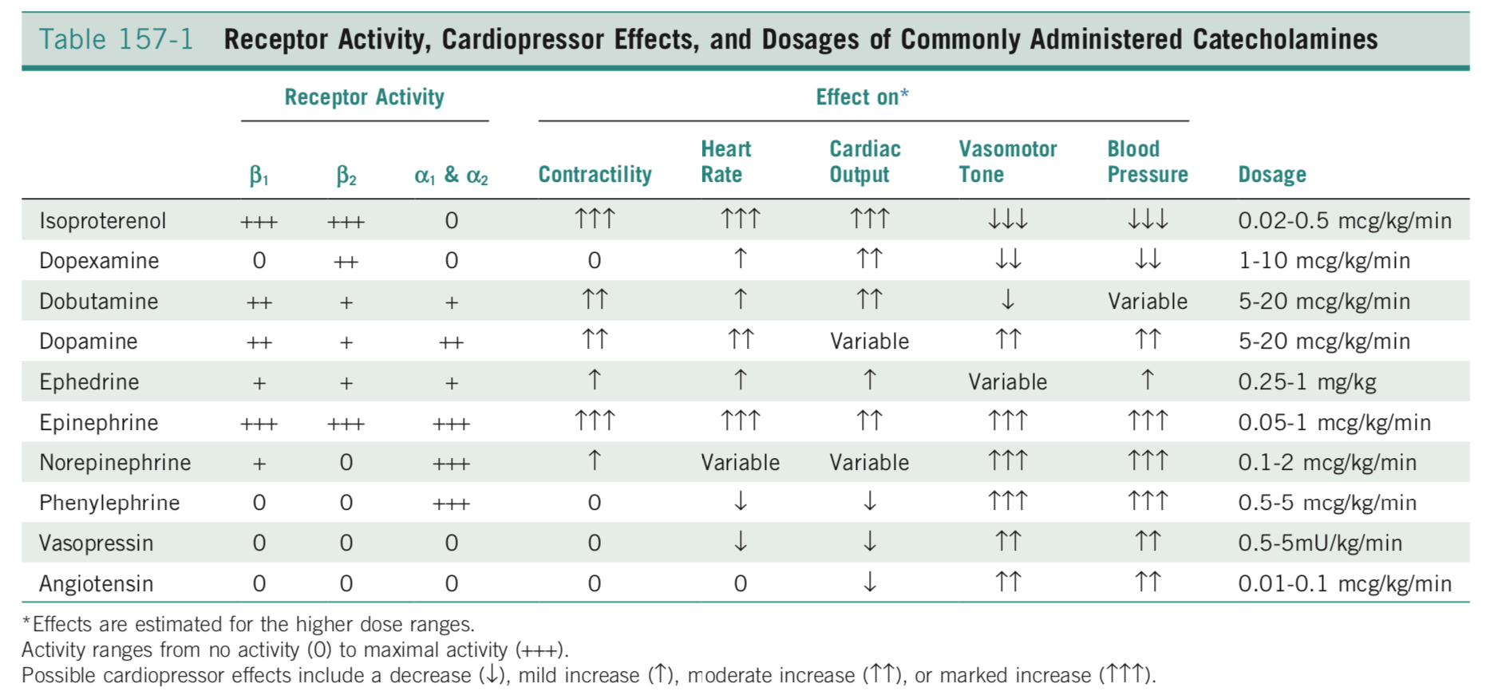
Catecholamine choices
B1 agonists primarily augment HR and contractility and ectopic pacemaker activity
B2 agonists primarily causes vasodilation
A1 and A2 agonists cause vasoconstriction and can also cause ectopic pacemaker activity

Slide 4
Dopamine
The endogenous precursor to norepi and an important neurotransmitter in the CNS
Has direct B and A agonist activity and also releases norepi from sympathetic nerve endings
Also is a dopamine receptor agonist -> arterial vasodilation
  D1 postsynaptic receptors-> vasodilation
  D2 presynaptic receptors-> inhibit norepi release -> promotes less vasoconstriction
Effects are dose related
  Dopaminergic vasodilatory effects at low doses: 1-3 mcg/kg/min
  Beta effects at medium doses: 5-10 mcg/kg/min
  Alpha effects at high doses: >15 mcg/kg/min
  Reported renal effects (inc renal blood flow) at <5 mcg/kg/min
Given to critically ill patients, dopamine causes modest vasoconstriction and increase in BP with little change or modest increases in cardiac output
Primarily used to raise BP in hypotensive patients

Slide 5
Dobutamine
A synthetic analog of dopamine with strong B1 agonist activity and some B2 and A1 effects, without dopaminergic effects
Given to critically ill patients, will cause modest vasodilation and marked increase in cardiac output with little change in blood pressure
Primarily used to increase forward flow when baseline BP is acceptable

Slide 6
Ephedrine
A sympathomimetic amine that primarily acts by increasing the release of norepi from sympathetic nerve endings
May also have some direct B agonist effects
A general cardiovascular stimulant and bronchodilator
Can be used as first line therapy in CV support instead of dopamine, but not as effective or reliable
Causes modest decrease in HR and increase in CO, vascular resistance, and arterial blood pressure
Can be given as a single dose (lasts 5-15 min) or CRI
  Prolonged use can deplete norepi stores, which results in tachyphylaxis
  Crosses the BBB and causes a mild analeptic effect (CNS stimulant)
  Also given orally for urinary incontinence (inc urethral sphincter tone)
Notes:
tachyphylaxis: progressive decrease in response to a given dose after repetitive admin of a substance

Slide 7
Norepinephrine
Primarily an alpha agonist-> arteriolar and venous constriction
Minimal B1 agonist activity (compared to phenylephrine and vasopressin, norepi may increase HR and contractility)
Generally causes vasoconstriction and inc BP with variable effects on HR
  CO may be increased, decreased, or be unchanged (depends on differences in baseline effective circulating volume and myocardial contractility, and the relative effect of venoconstriction on venous capacitance and venous resistance to blood flow) (ie dec capacitance would increase venous return)
    Ex: Pets with effective circulating volume but vasodilation would be expected to have inc in CO
    Ex: Pets with hypovolemia and associated vasoconstriction will lead to further decrease in venous return and CO when further venoconstriction occurs
High doses can cause ventricular arrhythmias and decrease venous return due to venoconstriction, as well as excess arteriolar vasoconstriction and impaired tissue perfusion
Used to raise BP
Notes:
attr

Slide 8
Phenylephrine
An alpha agonist without beta activity
Causes vasoconstriction and increase in arterial BP and dec in HR
  CO may increase or decrease
Very similar effects as norepi and vasopressin
Norepi may provide marginally better HR and inotropic support
Used to raise BP

Slide 9
Vasopressin
A non-catecholamine vasoconstrictor acting via vasopressin V1 receptor that increases intracellular calcium and vasomotor tone
A pure vasoconstrictor with no direct effect on heart
Will increase SVR, a baroreceptor reflex decrease in HR, no change in contractility, and no change or decrease in CO
Arterial blood pressure usually increased
Very similar effects as norepi and phenylephrine
Norepi may provide marginally better HR and inotropic support
May be effective in patients hyporesponsive to catecholamines since it operates on different receptors

Slide 10
Angiotensin 2
Hormone derived from ang 1 by ACE
Ang 2 causes vasoconstriction and aldosterone release (inc sodium reabsorption in collecting tubules of kidneys)
Results in inc in SVR, little change in HR, no change in contractility, and little change or dec in CO
May be a less potent venoconstrictor than vasopressin
Not commonly used

Slide 11
Epinephrine
A potent B1, B2, A1, A2 agonist
A potent inotrope and chronotrope, arteriolar and venular vasoconstrictor, and bronchodilator
Potently increases arterial BP and can cause ventricular ectopic pacemaker activity
Inc HR, SVR, CO, art blood pressure
Not first line drug to support CV dysfunction but used for rescue therapy

Slide 12
Isoproterenol
Potent B agonist with no A activity
A potent vasodilator and hypotensive agent
Inc HR and CO, dec BP
Can have marked augmentation of forward blood flow and tissue perfusion but BP needs to be very carefully monitored

Slide 13
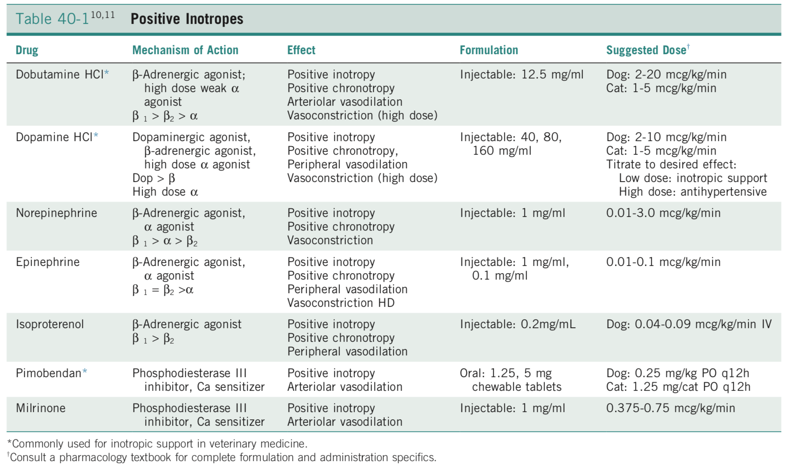

Slide 14
Cardiogenic shock
Defined as inadequate cellular metabolism secondary to cardiac dysfunction, despite adequate IV volume
Dx made on clinical signs of shock along with evidence of cardiac dysfunction
Tx aimed at restoring cardiac output to normalize tissue perfusion and cellular metabolism

Slide 15
Pathophysiology
Many types of shock (inadequate cellular energy production), such as distributive, metabolic, hypoxic, cardiogenic
When there’s adequate IV volume but reduced CO from cardiac dysfunction, a patient has forward flow failure (and when this forward failure causes inadequate tissue perfusion, the patient has cardiogenic shock)
CO= SV x HR
  Either decrease in SV or HR can cause reduction in cardiac output
  SV determined by preload, afterload, and contractility
Decrease in SV will cause a reflex increase in HR (baroreceptor mediated sympathetic stimulation) as well as increase RAAS to increase the effective circulating volume

Slide 16
Pathophysiology
Sustained decrease in cardiac output will lead to organ dysfunction
  Reduced coronary blood flow may lead to arrhythmias or decreased contractility
  Reduced renal blood flow will lead to AKI
  Reduced GI blood flow can lead to mucosal sloughing and hemorrhagic diarrhea
Cardiogenic shock is a manifestation of forward failure (reduced flow into aorta and systemic circulation)

Slide 17
Clinical signs
Signs of shock: change in mentation, cold extremities, pale MM, prolonged CRT, poor pulses
Can see pulmonary changes if in L CHF (backward failure)
HR should be elevated in animals with cardiogenic shock unless a primary bradyarrhythmia is the cause of shock or if patient is moribund
  Tachycardia will be either an appropriate response to hypotension or CHF or may be a malignant tachyarrhythmia that is the primary cause of cardiogenic shock
  ECG and CXR should be performed + assessment of patient’s volume status

Slide 18
Clinical signs
Renal blood flow is reduced with cardiogenic shock and may result in azotemia
GI perfusion also reduced and may lead to vomiting and hemorrhagic diarrhea
VBG may reveal acidosis (lactic acidosis and uremic acids) with possibl respiratory alkalosis
Echo dx: systolic dysfunction in the presence of adequate end-diastolic volume
  Will vary depending on underlying cause of cardiogenic shock
Pulmonary arterial catheter dx: dec CO with increase in preload parameters (central venous pressure, pulmonary arterial pressure, and pulmonary wedge pressure)

Slide 19
3 main categories of cardiogenic shock
1. Systolic dysfunction
2. Diastolic failure
3. Bradyarrhythmias

Slide 20
1. Systolic dysfunction
Systolic dysfunction can result from dec in contractility or dec flow through LVOT (mechanical failure)
Failure of contractility
  DCM
  Sepsis
  Endomyocarditis
  Myocardial infarction
Mechanical failure
  Functional obstruction (eg aortic stenosis or HCM)
  Severe retrograde blood flow (eg chordae tendinae rupture or acute severe mitral regurg)

Slide 21
Failure of contractility: DCM
This is the most common cause of cardiogenic shock resulting from systolic dysfunction
Common in dogs (Dobermans, Boxers, Great Danes, Labs, American cocker spaniels), rare in cats (unless taurine deficiency)
Progressive decrease in myocardial contractility results in gradual decrease in SV and forward failure
  Activation of RAAS and sympathetic system will stimulate renal retention of Na and water-> inc IV volume-> inc end-diastolic volume
  Eccentric hypertrophy occurs secondary to myocardial stretch
  Compensatory until chambers are so enlarged they cannot sustain further increase in IV volume
    Any increased end-diastolic pressure leads to inc pulmonary capillary hydrostatic pressure and cardiogenic pulmonary edema or ascites
Aim of treatment is to maximize cardiac output by increasing stroke volume
  Diuretics if CHF
  Positive inotropic agents such as B1 adrenergic receptor agonists (dobutamine), phosphodiesterase inhibitors (amrinone, pimobendan), or cardiac glycosides (digoxin)

Slide 22
Failure of contractility: Sepsis
Dysfunctional myocardium in sepsis (even during hyperdynamic phase of sepsis with inc CO, a decrease in ejection fraction is noted)
  Reduction in ventricular compliance, biventricular dilation, and decrease in contractile function all contribute to decrease in EF
Myocardial dysfunction peaks within days of onset of sepsis and has been shown to resolve within 7-10 days in survivors

Slide 23
Failure of contractility: Endomyocarditis
A rare condition of cats that occurs several days after routine procedures such as neutering
Cats have normal myocardial function before anesthesia, but cardiac dysfunction, hypotension, pulmonary edema, and interstitial pneumonia rapidly develop
Not well described
Endocardium is hyperechoic on echo, and histopath reveals neutrophilic inflammation and fibroplasia
Supportive care recommended, px often poor
May have an infectious component?

Slide 24
Failure of contractility: Myocardial infarction
Rarely seen (or recognized) in dogs and cats
More commonly due to systemic disease that cause a hypercoagulable or hypofibrinolytic state

Slide 25
Mechanical failure
Cardiogenic shock resulting from mechanical failure is rare in dogs and cats
Forward flow can be reduced by an obstruction to LVOT (aortic stenosis or HOCM) or by severe acute retrograde blood flow (such as chordae tendineae rupture)
Dogs with MMVD and associated regurgitant flows typically have normal to inc myocardial contractility, but chordae rupture leads to acute and extensive mitral regurgitation that reduces forward flow sufficiently to result in cardiogenic shock and pulmonary edema

Slide 26
2. Diastolic failure
Diastolic failure is due to inadequate ventricular filling
  Can result from hypovolemia, physical restriction (cardiac tamponade), inability of myocardium to relax (HCM), or inadequate filling time (tachycardia)
Diastolic failure will result in dec preload and therefore reduced SV
If patient is unable to maintain CO with an inc in HR, cardiogenic shock ensues
The most common cause of dec preload resulting in inadequate CO is hypovolemia (but this is not technically cardiogenic shock)
Cardiac tamponade
HCM
Tachyarrhythmias

Slide 27
Cardiac tamponade
Decreased diastolic ventricular filling (due to physical restriction) will lead to a dec in SV and CO
  Reflex tachycardia will occur to maintain normotension
  But eventually, HR will not be sufficient to maintain adequate CO and hypotension will occur
If effusion is chronic, patient may have decreased sodium and increased potassium from reduced effective circulating volume-induced pseudohypoadrenocorticism
Tx: increasing IV volume to increase preload, pericardiocentesis to allow for normal ventricular filling

Slide 28
HCM
Characterized by concentric hypertrophy of ventricular myocardium (and inability of myocardium to relax)
Decreased end-diastolic ventricular volume leads to decreased SV and CO
Systolic function will usually be preserved by neurohormonal mechanisms to increase IV volume, so typically we see backward flow failure
However, cats with CHF that receive overzealous diuretic therapy can progress to hypovolemic shock
Cats with end-stage HCM may also have severely impaired systolic function, leading to decreased SV and cardiogenic shock
Treatment of cats with with HCM includes use of B blockers or calcium channel blockers to enhance lusitropy and diastolic filling

Slide 29
Tachyarrhythmias
Inadequate ventricular filling at high heart rates (inadequate time for diastolic filling before systole)
  Dogs >200 BPM
EDV, SV, and CO are reduced
The most common cause is supraventricular tachycardia (can be cardiac or extra-cardiac disease in origin)
Therapies include vagal maneuvers, calcium channel blockers, and beta blockers to slow the HR (and therapies to treat underlying disease)

Slide 30
Bradyarrhythmias
Severe bradycardia can lead to a decrease in CO that causes cardiogenic shock
  HR < 60 bpm in dogs, < 100 bpm in cats
Bradyarrhythmias can result from alterations in autonomic tone, drugs, electrolyte abnormalities, trauma, hypoxia, inflammation, or infiltration of myocardium, and degenerative disease of conduction system
  More commonly, bradyarrhythmias result from alterations in the conduction system, resulting in inadequate impulse formation or propagation.
An increase in SV will occur secondary to an increased preload (because of the increased time for diastolic filling), but at low HRs or during exertion, CO may be inadequate and cardiogenic shock will ensue
The most common cause of cardiogenic shock is severe high grade second degree AVB or third degree AVB
  Those with severe SSS/sinus arrest will also have decreased perfusion and shock
  Third degree AVB escape rates are from the bundle of His, bundle branches, or Purkinje fibers
    Bundle of His: 40-60 bpm
    Bundle branches or distal purkinje fibers: 20-40 bpm
    Cats with third degree AVB will have higher ventricular escape rates: 100-140 bpm (less commonly present for cardiogenic shock and syncope)
  Second degree AVB can be vagally mediated or secondary to SA or AV node pathology
BBB and first degree AVB are not associated with clinical signs

Slide 31
Bradyarrhythmias
Inc SV will occur secondary to inc preload (from increased time for diastolic filling), but at low heart rates or during patient exertion, CO will be inadequate and cardiogenic shock will ensue
Dx: ECG and signs of shock
  BP may be normal (BP does not equal flow or perfusion)
Atropine response test is warranted (0.02-0.04 mg/kg IV)
  Vagally induced bradyarrhythmias and SSS may respond
A beta agonist such as isoproterenol or dobutamine can be given and will sometimes increase the HR sufficiently to treat cardiogenic shock
If there is no response to medical therapy, patient should have artificial cardiac pacing
IV fluids are contraindicated in these cases until a normal HR can be achieved because preload is already increased and further increase in LV filling pressure may result in backward heart failure

Slide 32
Bradyarrhythmias: sinus bradycardia
Rarely a primary disorder or a cause of clinical signs
More likely secondary to systemic disease causing increased vagal tone
  GI, respiratory, neurologic, ocular
ECG: P waves and QRS complexes are associated, QRS complexes narrow
  Wandering pacemaker possible (variation in amplitude of P wave in relation to respiratory cycle)
Presence of sinus bradycardia in animal with impaired consciousness should raise suspicion of increased intracranial pressure
Resolution of primary disease will lead to inc HR with no need for medical or pacemaker therapy

Slide 33
Bradyarrhythmias: Sinus node dysfxn
Sinus arrest: prolonged pause with no atrial activation or P wave on the ECG
Sinus block: failure of impulse to exit the sinus node
  Cannot be differentiated from sinus arrest on ECG
Lack of CO from pause of approx. 6-8 seconds results in syncope
SSS: periods of normal sinus rhythm or sinus bradycardia, interspersed with long sinus arrest that can last up to 10-12 seconds because junctional and ventricular pacemakers fail to initiate escape beats
  Older mini schnauzers and terrier breeds are more commonly affect
Use of opioids can result in prolongation of periods of asystole (sedated dogs can become hemodynamically unstable)
A variant of SSS is called bradycardia-tachycardia syndrome, characterized by periods of paroxysmal atrial tachycardia followed by temporary failure of sinus rhythm to resume when tachycardia abruptly stops (an exaggeration of the normal “overdrive suppression”)

Slide 34
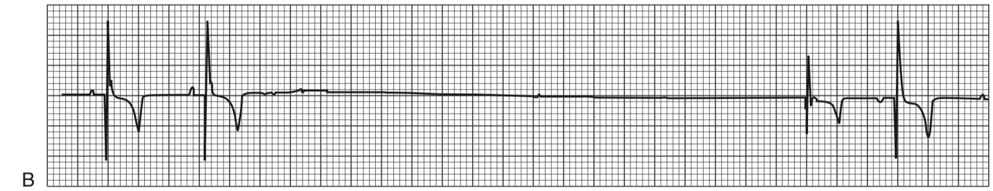
SSS: Two sinus beats are followed by a period of sinus arrest (3.9 seconds), which is terminated by an escape beat originating from the atrioventricular junction or the ventricles. The last beat is originating in the atrium. Its negative P wave is consistent with a wandering pacemaker or an impulse initiated at the bottom of the atrium.

Slide 35
Bradyarrhythmias: AVB
First degree AVB: all atrial impulses conducted to ventricles, but PR interval is prolonged
  PR >130 msec in dogs, PR >90 msec in cats
  Results from AV node fibrosis, inc vagal tone, drugs that delay AV node conduction (digoxin, calcium channel blockers, B blockers)
Second degree AVB: some P waves are not followed by QRS complex
  Hemodynamic effect depends on frequency of ventricular contraction
  High grade when more atrial impulses fail to be conducted to ventricles than are conducted
  Mobitz type 1 (Wenckebach): progressive increase in PR interval duration ending by a blocked P wave
    Usually from combo of AV node fibrosis and progress increase in vagal tone
    Usually benign and does not require specific treatment
  Mobitz type 2: unexpected blocked P waves (PR intervals before and after the blocked P waves are identical)
    QRS of conducted beats are usually wide b/c area of block is below the bundle of His, causing BBB and intraventricular conduction delays
    More likely to result in clinical signs
  Type 1 usually improves after atropine and type 2 is unchanged or worsens

Slide 36
Bradyarrhythmias: AVB
Third degree AVB: absence of conducted P waves to ventricles (ECG has independent atrial and vent activities)
  CO is dramatically reduced
  QRS complexes wide and bizarre, rates around 20 to 60 beats/min in dogs and 60 to 120 beats/min in cats
  Atrial rate is elevated (under control of adrenergic tone)
  Activation of ventricles is dependent on escape rhythm (QRS complexes usually wide and bizarre)
  Ventricular rate is regular unless ventricular premature beats originating from an ischemic myocardium are present
Causes of AVB: myocardial fibrosis, inflammation or infiltration, potentially drug tox (calcium channel blockers, B blockers, digoxin)
  Age related fibrodegenerative disease is the most common cause of AVB in dogs
  Marked elevation of cardiac troponin I suggests myocarditis as cause
  Third degree AVB in cats is often due to structural heart disease
Cats (occasionally dogs) may show no apparent signs, and bradycardia is detected on PE. More commonly, animals present with signs of low cardiac output such as syncope, congestive heart failure, or weakness

Slide 37
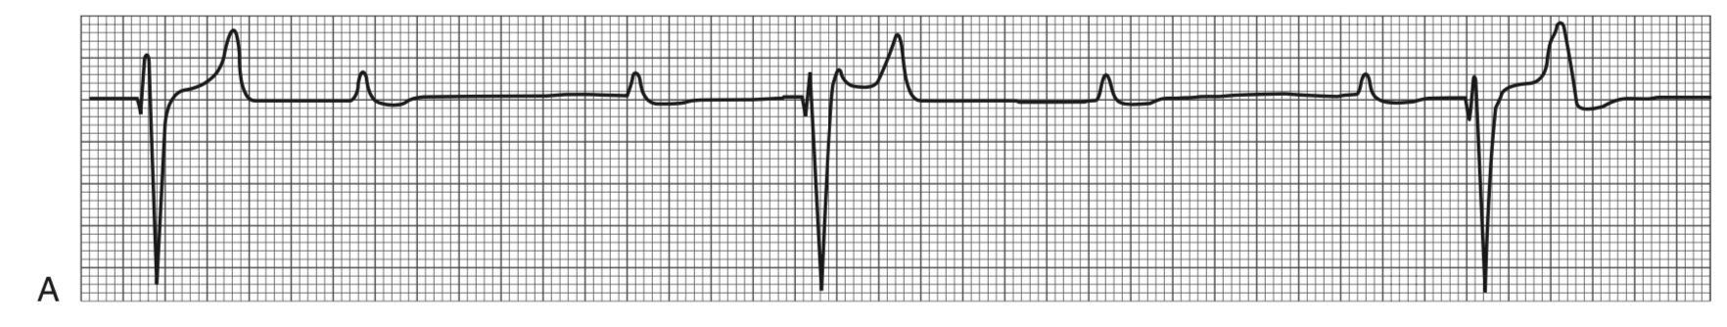
Third-degree atrioventricular block: PP and RR intervals are regular but the P waves bear no constant relation to the R waves. Ventricular escape rhythm at a rate of 37 beats/min (recording speed: 50 mm/sec; amplitude: 10 mm/mV)

Slide 38
Bradyarrhythmias: Atrial standstill
Defined by lack of visible atrial electrical activity
Can be temporary or persistent
  Persistent standstill is rare, more prevalent in English Springer Spaniels (young dogs)
Generally a significant myocardial pathologic condition is present and long term px is guarded
ECG: lack of P waves, regular ventricular or AV nodal escape rhythm (20-60 bpm in dogs)
Hyperkalemia is a common cause of temporary atrial standstill
  Usually at K > 5.5-6 mmol/L

Slide 39
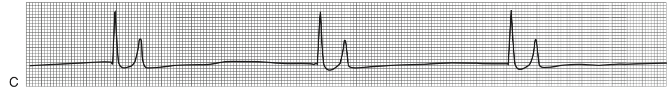
Acquired atrial standstill secondary to hyperkalemia: bradycardia (38 beats/min), tall and tented T waves, absent P waves (recording speed: 50 mm/sec; amplitude: 10 mm/mV)

Slide 40
Bradyarrhythmias: medical treatment
Vagally induced bradyarrhythmias and sick sinus syndrome may respond to the admin of parasympatholytics
  Increase in HR after IV admin of atropine or glycopyrrolate confirms contribution of vagal tone to the bradyarrhythmia
  Side effects of parasympatholytics limit long term use (mydriasis, dry mouth, constipation, urine retention)
Sympathomimetic inotropes increase HR by beta stimulation
  *Dopamine: 5-10 mcg/kg/min
  *Dobutamine: dog 2-20 mcg/kg/min, cat 1-5 mcg/kg/min
  Isoproterenol (pure beta agonist) improves conduction in AV node and His-Purkinje system, and may increase rate of ventricular escape rhythm in complete AVB
    But causes significant decrease in diastolic blood pressure via B2 stimulation
    Respiratory and metabolic acidosis decrease its effectiveness
  Terbutaline: 0.2 mg/kg PO q8-12, 0.01 mg/kg IV): selective B2 agonist
  Aminophylline (10 mg/kg PO q12, 10 mg/kg IV): phosphodiesterase inhibitor and bronchodilator with mild chronotropic effect
  These drugs may temporarily increase HR in dogs with SSS
Notes:
Dopamine and dobutamine may contribute to an increase in heart rate and systolic function

Slide 41
Indications for temporary pacing
Temporary pacemaker placement prior to anesthesia for permanent pacemaker can improve patient stability
Dysrhythmias causing hemodynamic instability
  Third degree AVB
  Second degree AVB
  Persistent atrial standstill
  SSS
  Sinus arrest
  Sinus bradycardia that doesn’t respond to drug therapy
  Asystole
  Patients with right or left bundle branch block can develop complete bundle branch block (and subsequent life-threatening bradyarrhythmia) during a procedure that has the potential to damage the functional bundle branch (ex: patient with L BBB that requires R heart catheterization for balloon valvuloplasty for PS)
Notes:
The right bundle branch is smaller and more prone to injury than the left, and patients requiring right heart catheter- ization frequently develop right bundle branch block.

Slide 42
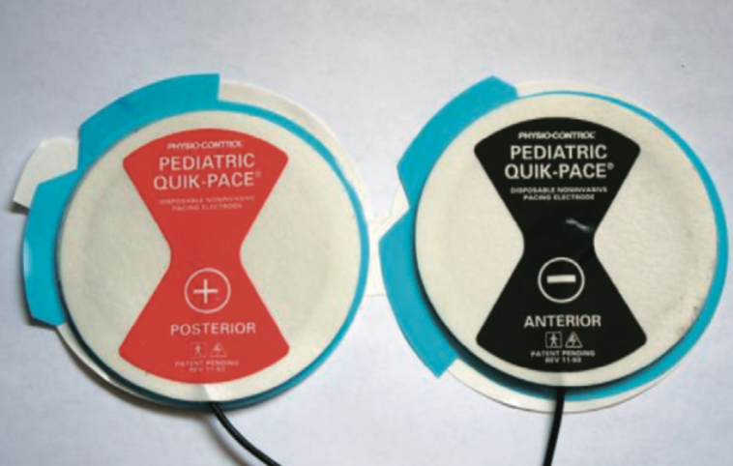
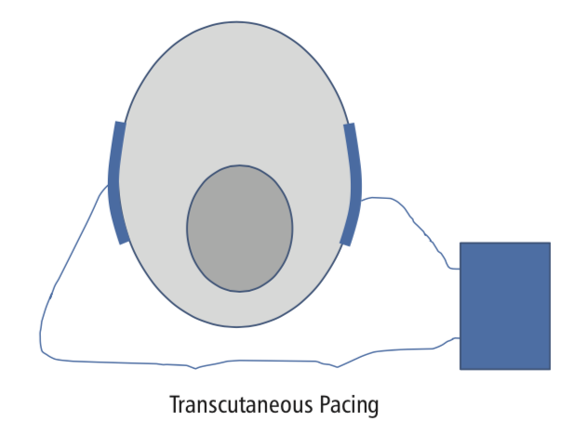
Bradyarrhythmias: pacemaker therapy
Transcutaneous pacing (aka endocardial pacing)
  Many external defibrillators are often multifunction devices and have this capability
  Pacing electrodes within adhesive pads are applied to clipped skin on either side of thorax
    (Negative) L electrode more important: over palpable apex beat
    Electrode polarity is critical and that reversing the polarity can result in extremely high capture thresholds or result in failure to capture
    Manufacturer diagrams indicate how the electrodes should be placed on a human patient: electrode that would be placed in the left parasternal or left anteriolateral (apex) position on a human should be placed on the dog’s left side over the apex. The electrode placed in the right parasternal or the posterior position in a human should be placed on the dog’s right side.
  Optimal electrode size appears to be weakly correlated to body size (generally, use pediatric electrodes for patients less than 15kg)
Notes:
Options:
1. positive electrode placed in the lower right scapular border
2. positive electrode placed in the lower left scapular border
3. positive electrode placed in the right parasternal region

Slide 43
Bradyarrhythmias: pacemaker therapy
Transcutaneous pacing (aka endocardial pacing) cont
  Thorax can be bandaged to ensure good contact
  Electrocardiographic electrodes must be attached to the pacing electrodes so that the patient’s intrinsic QRS complexes can be sensed by the pacemaker
  Pacing rate is programmed, and pads sense the intrinsic cardiac rhythm and deliver an impulse if necessary (sensitivity can be adjusted to sense intrinsic QRS complexes)
  Current (mA) should be gradually increased until ventricular capture is achieved (recognized by appearance of wide QRS complexes on ECG in addition to palpation of associated femoral pulses)
  Drawback: stimulates skeletal muscles, painful
    Generally only in anesthetized patients

Slide 44
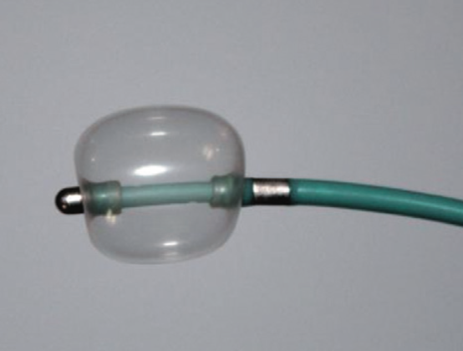
Bradyarrhythmias: pacemaker therapy
Temporary transvenous pacing
  Lead placed in the R side of heart (typically RV) and connected to external generator
  Leads are usually bipolar, 100-110 cm in length and 4-6 Fr in diameter, tip is curved and not attached to endocardium (some have small balloon at tip)
  Jugular, saphenous, or femoral vein can be used depending on size of patient
    In very large dogs a 110-cm pacing lead may be unable to reach the right ventricle from a saphenous vein
    In dogs <10-15 kg, a saphenous vein may be too small to accommodate an introducer for a 4Fr temporary pacing lead
  Vascular introducer sheath placed via Seldinger’s technique or via cutdown
  Fluoroscopic guidance is recommended, but if unavailable, distance from introducer to apex can be estimated
    Wide QRS complexes appear when catheter reaches RV
  Lead then advanced to RV apex and attached to generator and HR set to 80-100 bpm
  US can be used to identify position of lead

Slide 45
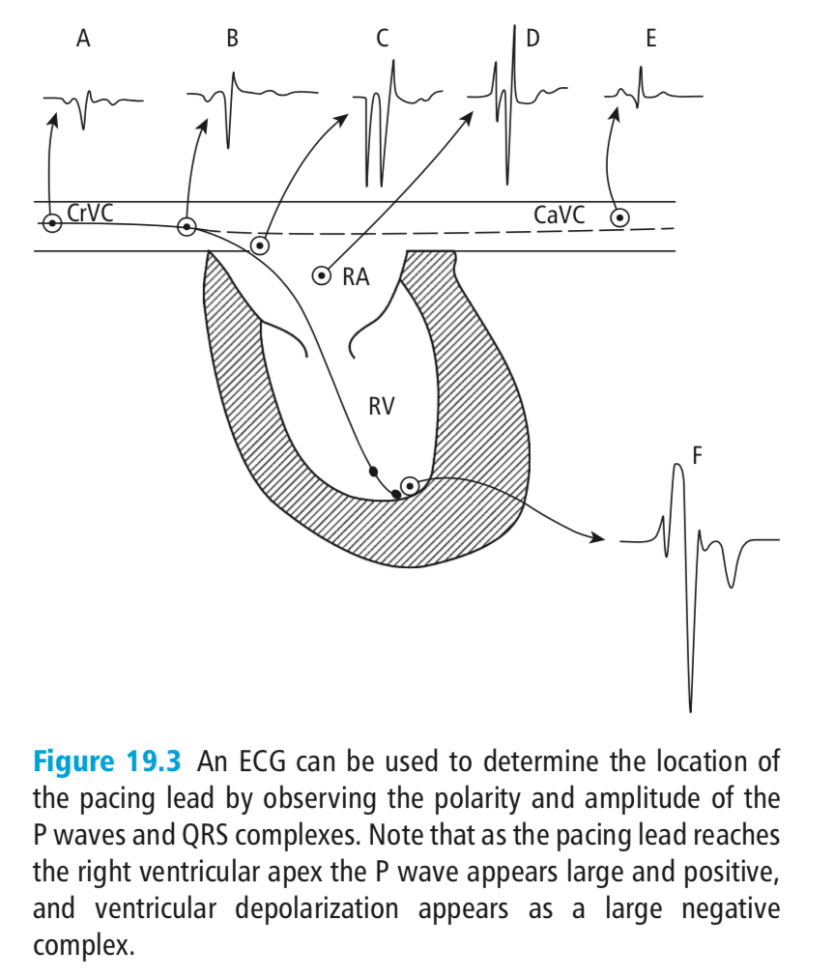
Bradyarrhythmias: pacemaker therapy
Temporary transvenous pacing cont
  Team should be prepared for movement of lead tip within the heart, causing loss of capture
  If pacing is lost, lead should be adjusted until capture is regained (lead can be held in place with tape or sutured but should remain accessible)

Slide 46
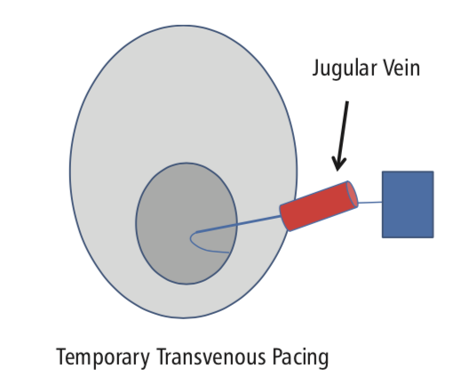
Bradyarrhythmias: pacemaker therapy
Temporary transvenous pacing cont
  External pacing generator is usually in VVI mode (ventricle paced, ventricle sensed, inhibition of pacing when spontaneous ventricular activation sensed)
    Mode requires selection of appropriate current delivered to endocardium to consistently activate ventricular contraction
    Sensitivity needs to be low enough to recognize spontaneous QRS but high enough to prevent detection of other potentials such as T waves (usually 1.5 mV adequate)
Can be placed with patient awake or mildly sedated
Vascular anomalies are uncommon but a persistent L
cranial vena cava can be present, so if possible save the R
jugular vein for placement

Slide 47
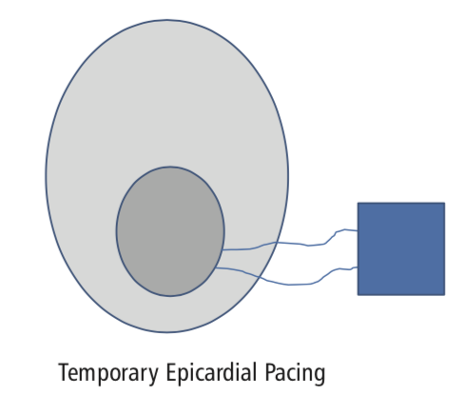
Bradyarrhythmias: pacemaker therapy
Transthoracic pacing
  Pacing electrode inserted percutaneously into L or R ventricle
  Risk of injury associated with transthoracic pacing is significant, it could be started much more quickly in an emergency than transvenous pacing
Thump pacing
  Striking precordium with fist
  The force required to stimulate a heartbeat with fist pacing is much less than that required to produce an adequate pulse using chest compression
  Hemodynamically fist pacing is just as effective as transcutaneous or transvenous pacing
Transesophageal pacing
  Electrode in esophagus
  Paces the atria, does not reliably pace the ventricles
  If the bradyarrhythmia is due to AVB or complete BBB, another type of pacing should be used
  Indicated when drug therapy is not effective in treating sinus bradycardia, sinus block, or sinus arrest, particularly during anesthesia
  Only operate in asynchronous mode (do not sense intrinsic electrical activity)
Epicardial pacing
  Detachable electrode attached to epicardium
  Generally used in patients recovering from cardiac surgery

Slide 48
Bradyarrhythmias: pacemaker therapy
Output pulse
  The strength of the stimulus (output pulse) delivered to the heart
  Usually measured in milliamperes (mA) (some manufacturers measure in volts)
  Ability to capture the ventricle is a function of duration of the stimulus as well as its amplitude
    Longer duration stimuli can achieve capture at a lower output than shorter stimuli
    Ex: transvenous pacing uses the shortest duration pulse, lowest amplitude
  Capture means that the stimulus provided by the pacemaker has resulted in depolarization of the heart
  Evidence of a pacing spike that does not result in myocardial depolarization is known as failure to capture
Sensitivity
  Sensitivity control sets the minimum amplitude needed to identify an intrinsic QRS complex
  Undersensing: failure to detect intrinsic beats
  Oversensing: prevention of pacing when other signals exceed the pacemaker’s sensitivity setting
    Muscular contractions produced by shivering/trembling are common sources of myopotentials in the body
    Electrocautery units, clippers, etc

