Slide 1
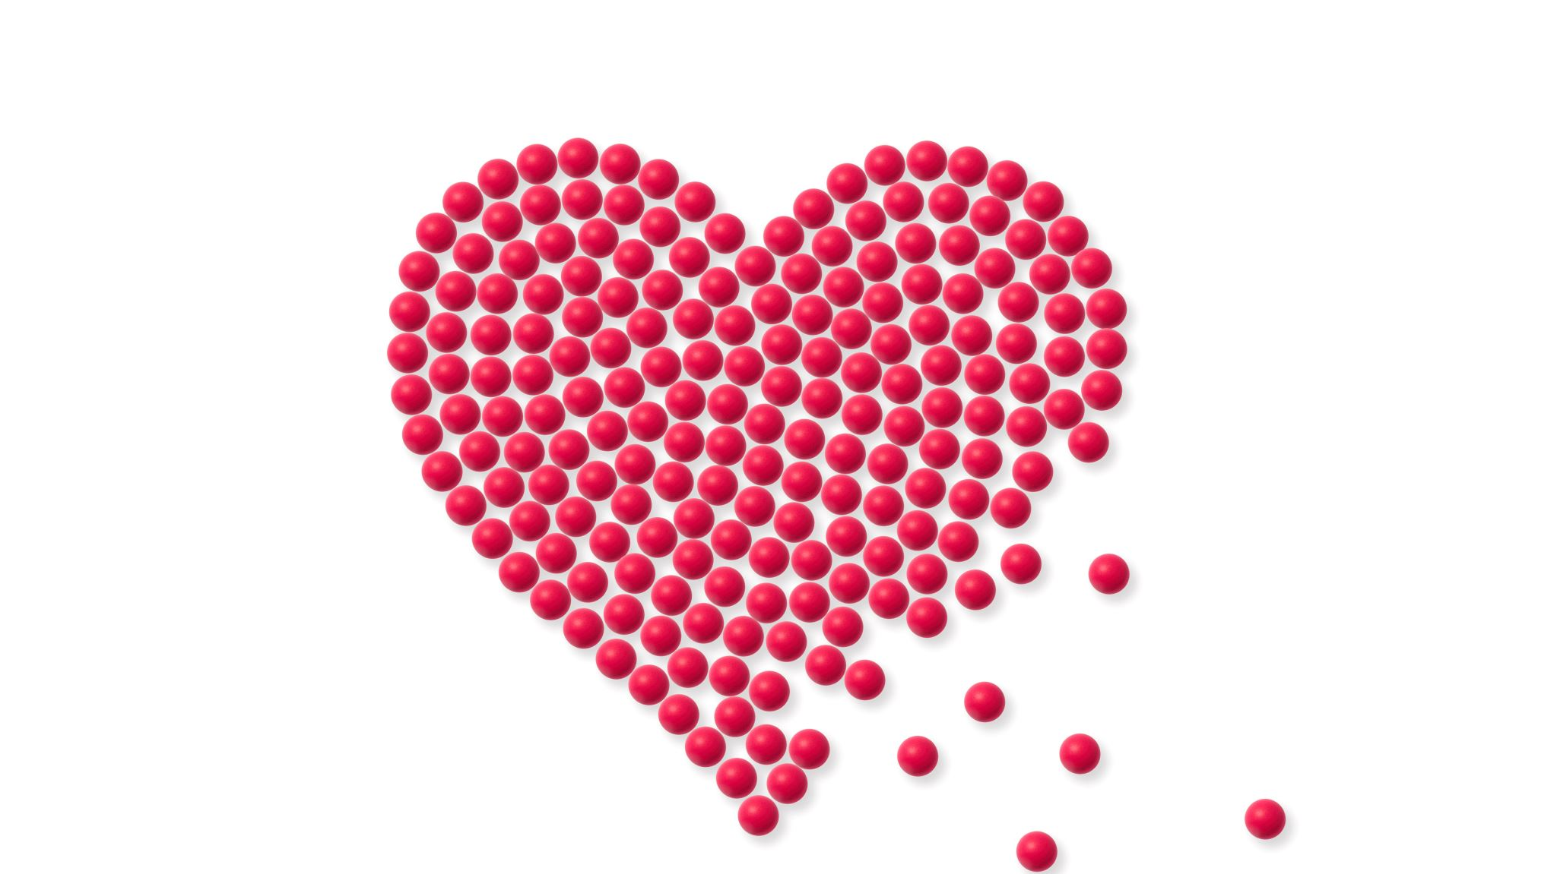
Cardiac Physiology
Jamie Selman, DVM

Slide 2
Circuitry

Slide 3
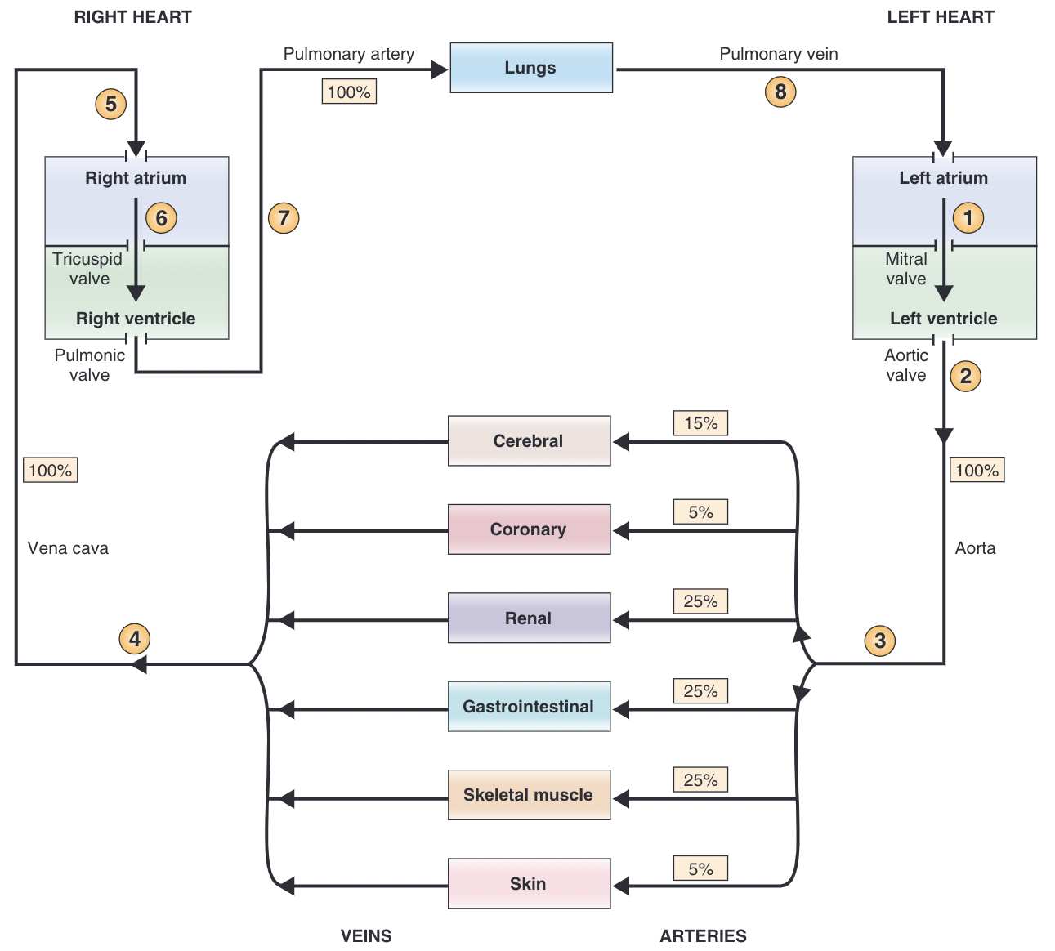
Left and Right Side of the Heart
Left heart
  Systemic circulation
Right heart
  Pulmonary circulation
Cardiac Output = rate at which blood is pumped from either ventricle
  LV = RV
Blood Vessels
  Conduits for blood delivery
  Regulation of blood flow
Notes:
The left heart and right heart have different functions. The left heart and the systemic arteries, capillaries, and veins are collectively called the systemic circulation. The left ventricle pumps blood to all organs of the body except the lungs. The right heart and the pulmonary arteries, capillaries, and veins are collectively called the pulmonary circulation. The right ventricle pumps blood to the lungs. The left heart and right heart function in series so that blood is pumped sequentially from the left heart to the systemic circulation, to the right heart, to the pulmonary circulation, and then back to the left heart.
Because the two sides of the heart operate in series, the cardiac output of the left ventricle equals the cardiac output of the right ventricle in the steady state
The blood vessels have several functions. They serve as a closed system of passive conduits, delivering blood to and from the tissues where nutrients and wastes are exchanged. The blood vessels also participate actively in the regulation of blood flow to the organs. When resistance of the blood vessels, particularly of the arterioles, is altered, blood flow to that organ is altered.

Slide 4
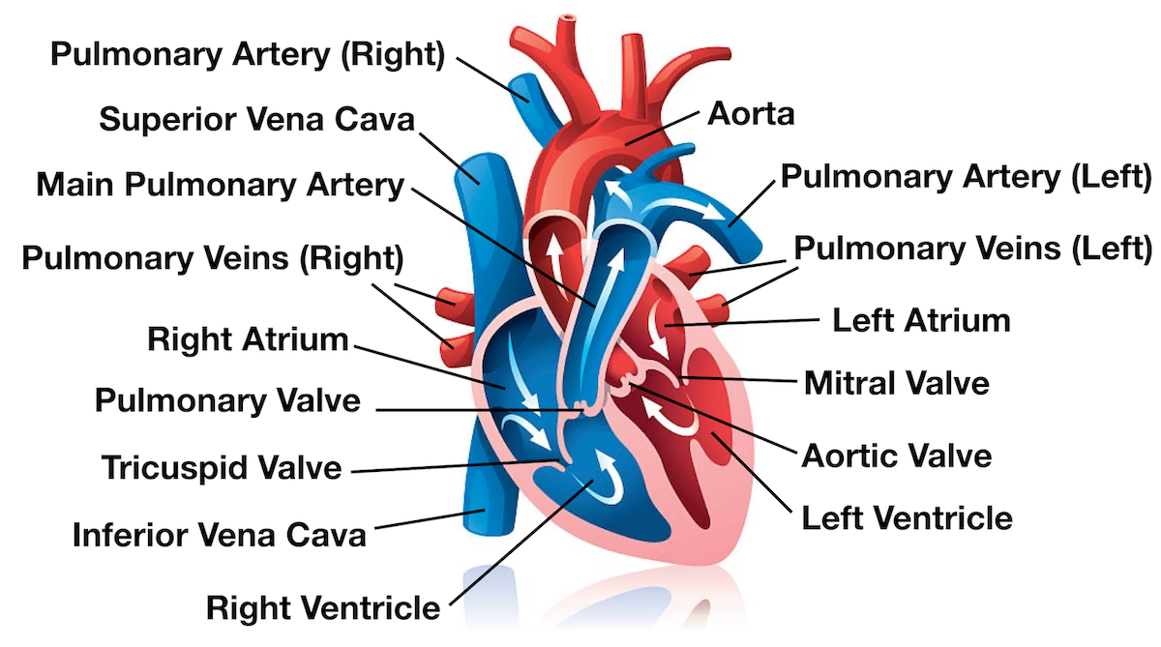
Circuitry
Oxygenated blood fills the left ventricle
Blood is ejected from the left ventricle into the aorta
Cardiac output is distributed among various
organs
Blood flow from the organs is collected in the veins
Venous return to the right atrium
Mixed venous blood fills the right ventricle
Blood is ejected from the right ventricle into
the pulmonary artery
Blood flow from the lungs is returned to the heart via the pulmonary vein
Notes:
Oxygenated blood fills the left ventricle. Blood that has been oxygenated in the lungs returns to the left atrium via the pulmonary vein. This blood then flows from the left atrium to the left ventricle through the mitral valve (the AV valve of the left heart).
Blood is ejected from the left ventricle into the aorta. Blood leaves the left ventricle through the aortic valve (the semilunar valve of the left side of the heart), which is located between the left ventri-cle and the aorta. When the left ventricle contracts, the pressure in the ventricle increases, causing the aortic valve to open and blood to be ejected forcefully into the aorta and through the arterial system
Cardiac output is distributed among various organs via sets of parallel arteries. Given this parallel arrangement of the organ systems, it follows that the total systemic blood flow must equal the cardiac output.
Blood flow from the organs is collected in the veins. The blood leaving the organs is venous blood and contains waste products from metabolism, such as carbon dioxide (CO2). This mixed venous blood is collected in veins of increasing size and finally in the largest vein, the vena cava. The vena cava carries blood to the right heart
Venous return to the right atrium. Because the pressure in the vena cava is higher than in the right atrium, the right atrium fills with blood, the venous return. In the steady state, venous return to the right atrium equals cardiac output from the left ventricle.
Mixed venous blood fills the right ventricle. Mixed venous blood flows from the right atrium to the right ventricle through the AV valve in the right heart, the tricuspid valve.
Blood is ejected from the right ventricle into the pulmonary artery. When the right ventricle contracts, blood is ejected through the pulmonic valve (the semilunar valve of the right side of the heart) into the pulmonary artery, which carries blood to the lungs. In the capillary beds of the lungs, oxygen (O2) is added to the blood from alveolar gas, and CO2 is removed from the blood and added to the alveolar gas. Thus, the blood leaving the lungs has more O2 and less CO2 than the blood that entered the lungs.
Blood flow from the lungs is returned to the heart via the pulmonary vein. Oxygenated blood is returned to the left atrium via the pulmonary vein to begin a new cycle.

Slide 5
Hemodynamics
Notes:
The term hemodynamics refers to the principles that govern blood flow in the cardiovascular system.

Slide 6
Types and Characteristics of Blood Vessels
Arteries
  Function to deliver oxygenated blood to tissues
  Thick walled
  Elastic tissue, smooth muscle, connective tissue
  Artery Volume = stressed volume
Arterioles
  Smooth muscle, highest resistance to blood flow
  Innervated by many alpha and beta adrenergic receptors
Capillaries
  Thin walled, lined with single layer of endothelial cells
  Site of exchange
  Selective perfusion
Veins and Venioles
  Thin walled
  Large compliance, under low pressure
  Vein volume = unstressed volume
Notes:
he arteries receive blood
directly from the heart and are under the highest
pressure in the vasculature. The volume of blood
contained in the arteries is called the stressed
volume (meaning the blood volume under high
pressure).
arterioles
Alpha = constriction
Beta = dilation
arterioles are not only the site of highest
resistance in the vasculature, but they also are the
site where resistance can be changed by alterations
in sympathetic nerve activity, by circulating cate-
cholamines, and by other vasoactive substances.
Capillaries
are the site where nutrients, gases, water, and solutes
are exchanged between the blood and the tissues
and, in the lungs, between the blood and the alveo-
lar gas
Not all capillaries are perfused with blood at all
times. Rather, there is selective perfusion of capillary
beds, depending on the metabolic needs of the tis-
sues. This selective perfusion is determined by the
degree of dilation or constriction of the arterioles and
precapillary sphincters (smooth muscle bands that
lie “before” the capillaries). The degree of dilation
or constriction is, in turn, controlled by the sympa-
thetic innervation of vascular smooth muscle and
by vasoactive metabolites produced in the tissues
Because the walls of the veins
contain much less elastic tissue than the arteries,
the veins have a large capacitance (capacity to
hold blood). In fact, the veins contain the largest
percentage of blood in the cardiovascular system. The
volume of blood contained in the veins is called the
unstressed volume

Slide 7
As a blood vessel becomes smaller in diameter, would velocity of blood increase, decrease, or stay the same?

Slide 8
As a blood vessel becomes smaller in diameter, would velocity of blood increase, decrease, or stay the same?
Increase

Slide 9
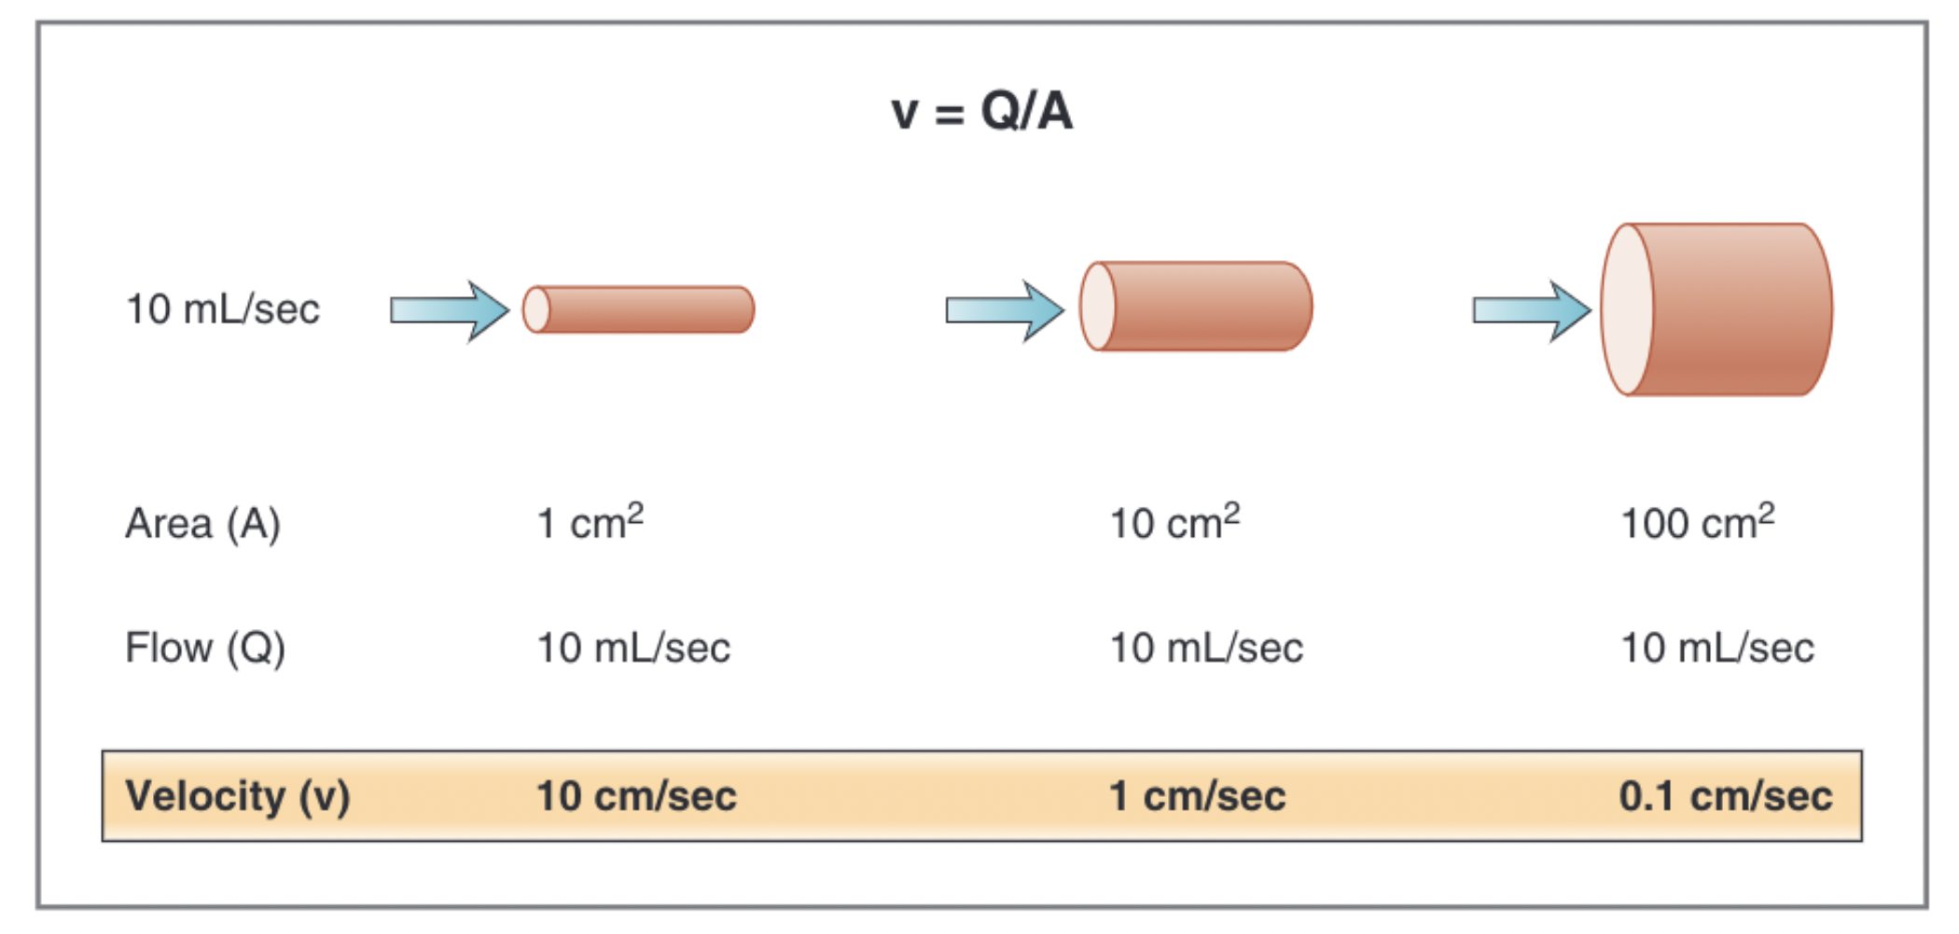
Velocity of Blood Flow
V = Q/A
V = velocity of blood flow (cm/sec)
Q = flow (mL/sec)
A = cross sectional area (cm²)
Notes:
Velocity of blood flow (v) is linear velocity and
refers to the rate of displacement of blood per unit time.
Thus, velocity is expressed in units of distance per unit
time (e.g., cm/sec).
Flow (Q) is volume flow per unit time and is expressed
in units of volume per unit time (e.g., mL/sec).
Area (A) is the cross-sectional area of a blood vessel
(e.g., aorta) or a group of blood vessels (e.g., all of the
capillaries). Area is calculated as A = πr2,
Figure 4-4 illustrates how changes in diameter alter
the velocity of flow through a vessel. In this figure,
three blood vessels are shown in order of increasing
diameter and cross-sectional area. The flow through
each blood vessel is identical, at 10 mL/sec. However,
because of the inverse relationship between velocity
and cross-sectional area, as vessel diameter increases,
the velocity of flow through the vessel decreases.
The total blood flow at each level of
blood vessels is the same and is equal to the cardiac
output. Because of the inverse relationship between
velocity and total cross-sectional area, the velocity of
blood flow will be highest in the aorta and lowest in
the capillaries. From the standpoint of capillary func-
tion (i.e., exchange of nutrients, solutes, and water),
the low velocity of blood flow is advantageous: It maxi-
mizes the time for exchange across the capillary wall.

Slide 10
Relationships between Blood Flow,
Pressure, and Resistance
Blood flow determined by
  Pressure difference - driving force
  Resistance – impediment to flow
Ohm’s law: Q =ΔP/R
  Q = Flow (mL/min)
    Direction of flow always high to low
  ΔP = pressure difference (mmHg)
    Magnitude directly proportional to ΔP
  R = resistance (mmHg/mL/min)
    Flow always inversely proportional to resistance
    Flow changed mostly by change in resistance of arterioles and other vessels
Notes:
Blood flow through a blood vessel or a series of blood
vessels is determined by two factors: the pressure dif-
ference between the two ends of the vessel (the inlet
and the outlet) and the resistance of the vessel to blood
flow. The pressure difference is the driving force for
blood flow, and the resistance is an impediment to flow.
The relationship of flow, pressure, and resistance
is analogous to the relationship of current (I), voltage
(ΔV), and resistance (R) in electrical circuits, as ex -
pressed by Ohm’s law
The magnitude of blood flow (Q) is directly propor-
tional to the size of the pressure difference (ΔP) or
pressure gradient. The direction of blood flow is deter-
mined by the direction of the pressure gradient and
always is from high to low pressure. For example, during
ventricular ejection, blood flows from the left ventricle
into the aorta and not in the other direction, because
pressure in the ventricle is higher than pressure in the
aorta.
blood flow is inversely proportional to
resistance (R). Increasing resistance (e.g., by arteriolar
vasoconstriction) decreases flow, and decreasing resis-
tance (e.g., by arteriolar vasodilation) increases flow.
The major mechanism for changing blood flow in the
cardiovascular system is by changing the resistance of
blood vessels, particularly the arterioles.

Slide 11
Resistance to Blood Flow
Poiseuille Equation
  R = 8ηl/ πr⁴
  R = resistance
  η = viscosity of blood
  l = length of blood vessel
  R = radius of blood vessel
Series and Parallel Resistances
  Series resistance – arrangement of blood vessels within a given organ
    Major artery → smaller arteries → arterioles → capillaries → venules → veins
  Total Resistance – the total resistance of the system arranged in series is equivalent to the sum of the individual resistances
    R_{total} = R_{artery} + R_{arterioles} + R_{capillaries} + R_{venules} + R_{vein}
  Parallel Resistance - the distribution of blood flow among the various major arteries branching off the aorta
    the total resistance in a parallel arrangement is less than any of the individual resistances
    1/R_{total} = 1/R_{coronary} + 1/R_{renal} + 1/R_{GI} + 1/R_{skeletal muscle} + 1/R_{skin +} 1/R_{cerebral}
Notes:
The relationship between resis-
tance, blood vessel diameter (or radius), and blood
viscosity is described by the Poiseuille equation.
First, resistance to flow
is directly proportional to viscosity (η) of the blood;
for example, as viscosity increases (e.g., if the hemato-
crit increases), the resistance to flow also increases.
Second, resistance to flow is directly proportional to
the length (l) of the blood vessel. Third, and most
important, resistance to flow is inversely proportional
to the fourth power of the radius (r4) of the blood
vesse. When the radius of a blood vessel decreases, its resistance
increases, not in a linear fashion but magnified by the fourth power relationship. if the radius
of a blood vessel decreases by one half, resistance
does not simply increase twofold—it increases by
16-fold (24)!
Although total
flow is constant at each level in the series, the pres-
sure decreases progressively as blood flows through
each sequential component (remember Q = ΔP/R or
ΔP = Q × R). The greatest decrease in pressure
occurs in the arterioles because they contribute the
When blood flow is distributed through a set of
parallel resistances, the flow through each organ is
a fraction of the total blood flow. The effects of this
arrangement are that there is no loss of pressure in
the major arteries and that mean pressure in each
major artery will be approximately the same as
mean pressure in the aorta.
Adding a resistance to the circuit
causes total resistance to decrease, not to increase.

Slide 12
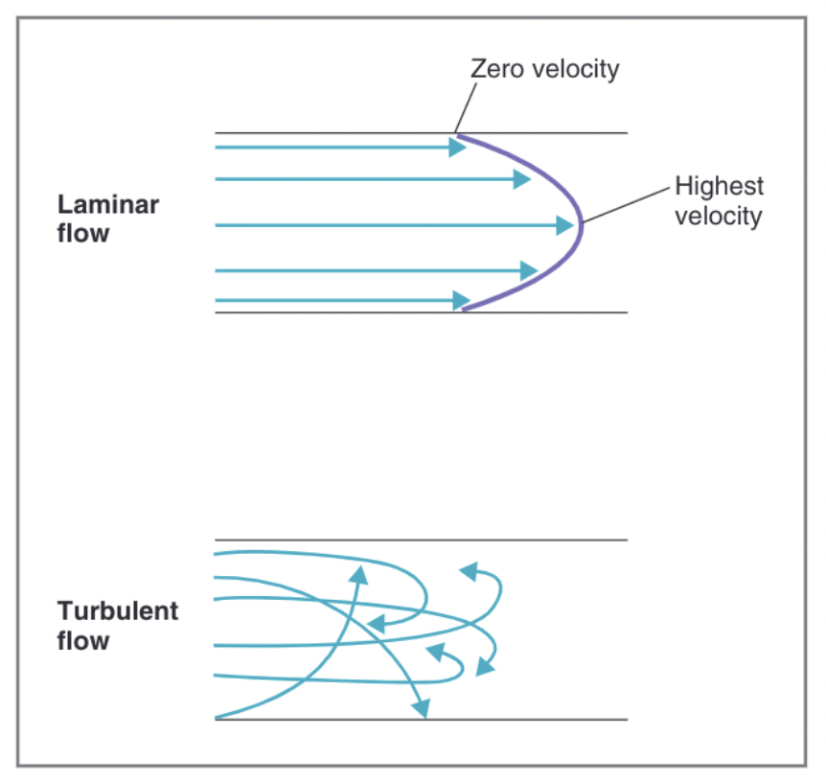
Laminar Flow and Reynolds Number
Laminar Blood flow
  Ideal
  Parabolic profile of velocity where velocity highest in the center and lowest towards vessel walls
  Blood next to vessel walls does not move and blood in the middle moves past blood that’s ”stuck”
Turbulent Blood flow
  Irregularity (such as valve or clot) disrupts laminar flow
  More energy/pressure required to drive turbulent flow
  Murmurs
Notes:
Ideally, blood flow in the cardiovascular system is
laminar, or streamlined. In laminar flow, there is a
parabolic profile of velocity within a blood vessel, with
the velocity of blood flow highest in the center of the
vessel and lowest toward the vessel walls
In turbulent flow (see Fig. 4-6), the fluid
streams do not remain in the parabolic profile; instead,
the streams mix radially and axially. Because energy is
wasted in propelling blood radially and axially,
more energy (pressure) is required to drive turbulent
blood flow than laminar blood flow. Turbulent flow
is often accompanied by audible vibrations called
murmurs.

Slide 13
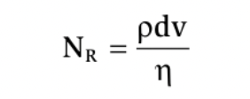
Reynolds Number
Reynolds number = dimensionless number
that is used to predict whether blood flow will be laminar or turbulent
N_{R} = Reynolds number
⍴ = density of blood
d = diameter of blood vessel
v = velocity of blood flow
η = viscosity of blood
<2000 laminar
>3000 turbulent
Major influences
  Changes in blood viscosity
  Changes in blood flow
Notes:
The major influences on Reynolds number in the
cardiovascular system are changes in blood viscosity
and changes in the velocity of blood flow. Inspection
of the equation shows that decreases in viscosity (e.g.,
decreased hematocrit) cause an increase in Reynolds
number. Likewise, narrowing of a blood vessel, which
produces an increase in velocity of blood flow, causes
an increase in Reynolds number.
The major influences on Reynolds number in the
cardiovascular system are changes in blood viscosity
and changes in the velocity of blood flow. Inspection
of the equation shows that decreases in viscosity (e.g.,
decreased hematocrit) cause an increase in Reynolds
number. Likewise, narrowing of a blood vessel, which
produces an increase in velocity of blood flow, causes
an increase in Reynolds number.
The effect of narrowing a blood vessel (i.e., decreased
diameter and radius) on Reynolds number is initially
puzzling because, according to the equation, decreases
in vessel diameter should decrease Reynolds number
(diameter is in the numerator). Recall, however, that
the velocity of blood flow also depends on diameter
(radius), according to the earlier equation, v = Q/A or
v = Q/πr2. Thus, velocity (also in the numerator of the
equation for Reynolds number) increases as radius
decreases, raised to the second power. Hence, the depen-
dence of Reynolds number on velocity is more powerful
than the dependence on diameter.

Slide 14
Shear
Shear - adjacent layers of blood traveling at different velocities
  Highest at vessel wall
  Lowest at center of vessel where velocity is highest
  Breaks up RBC clumps and decreases blood viscosity

Slide 15
What type of blood vessel has the largest compliance?

Slide 16
What type of blood vessel has the largest compliance?
Vein

Slide 17
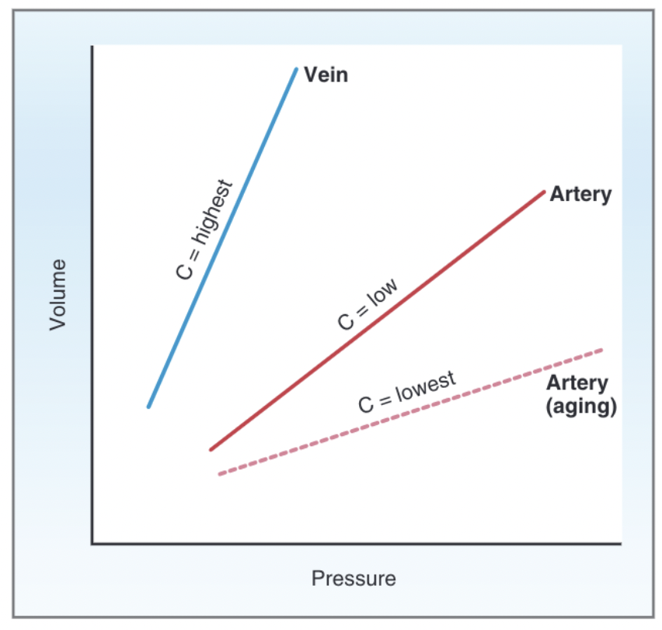
Compliance of Blood Vessels
Compliance = volume of blood a vessel can hold at a given pressure
C = V/P
C = Compliance or capacitance (mL/mm Hg)
V = Volume (mL)
P = Pressure (mm Hg)
Notes:
The equation for compliance states that the higher
the compliance of a vessel, the more volume it can hold
at a given pressure. Or, stated differently, compliance
describes how the volume of blood contained in a
vessel changes for a given change in pressure (ΔV/ΔP).
illustrates the principle of compliance and
shows the relative compliance of veins and arteries. For
each type of blood vessel, volume is plotted as a func-
tion of pressure. The slope of each curve is the compli-
ance. Compliance of the veins is high; in other words,
the veins hold large volumes of blood at low pressure.
Compliance of the arteries is much lower than that of
the veins; the arteries hold much less blood than the
veins, and they do so at high pressure.
The difference in the compliance of the veins and
the arteries underlies the concepts of unstressed volume
and stressed volume. The veins are most compliant and
contain the unstressed volume (large volume under low
pressure). The arteries are much less compliant and
contain the stressed volume (low volume under high
pressure). The total volume of blood in the cardiovas-
cular system is the sum of the unstressed volume plus
the stressed volume (plus whatever volume is con-
tained in the heart).

Slide 18
Pressures in the Cardiovascular System

Slide 19
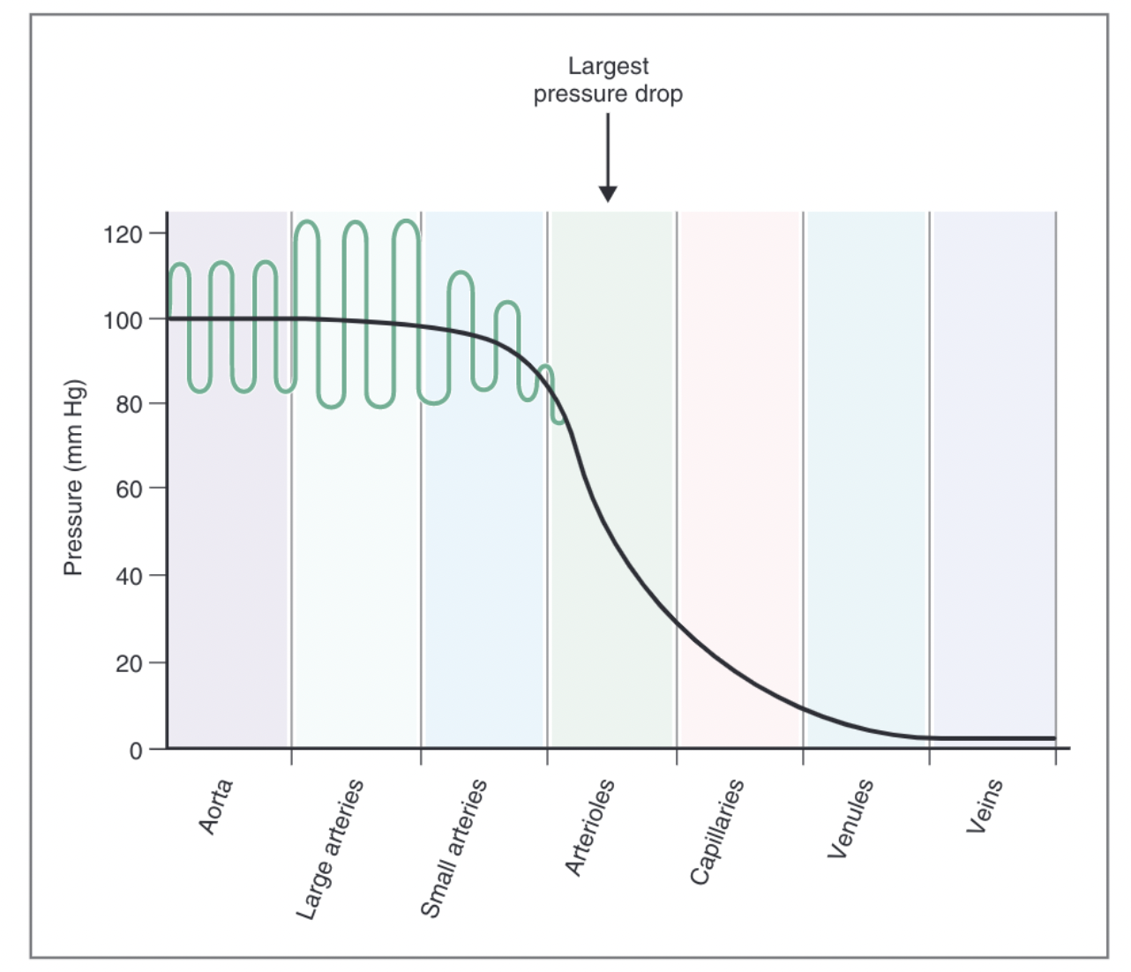
Pressure Profile in the Vasculature
Mean pressure in aorta highest (100 mmHg)
  Large volume of blood from LV
  Low compliance
Large arteries
  Not big drop due to high elastic recoil
Small arteries
  Starts to decrease
Arterioles (30 mmHg)
  High resistance to flow = big drop in pressure
Capillaries
  Frictional resistance to flow and filtration of
  fluid out of the capillaries
Venules and veins
  Very high compliance (large volume of blood at low pressure
Notes:
Blood pressures are not equal throughout the cardio-
vascular system. If they were equal, blood would not
flow, since flow requires a driving force (i.e., a pressure
difference). The pressure differences that exist between
the heart and blood vessels are the driving force for
blood flow.
Figure 4-8 is a profile of pressures within the systemic
vasculature. First, examine the smooth profile, ignoring
the pulsations. The smooth curve gives mean pressure,
which is highest in the aorta and large arteries and
decreases progressively as blood flows from the arter-
ies, to the arterioles, to the capillaries, to the veins, and
back to the heart. This decrease in pressure occurs as
blood flows through the vasculature because energy is
consumed in overcoming the frictional resistances.

Slide 20
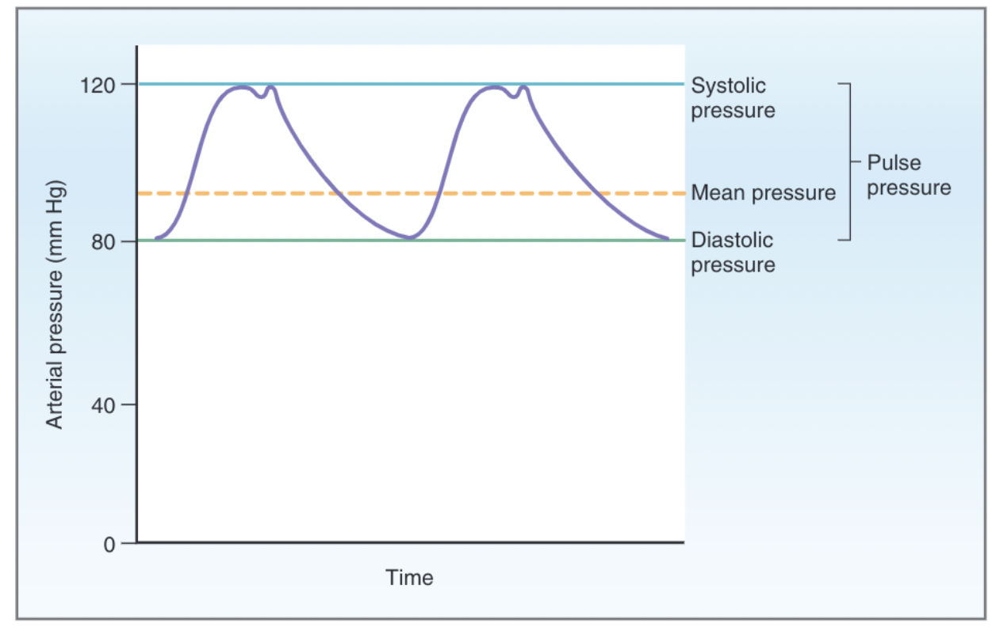
Arterial Pressure in Systemic Circulation
Diastolic pressure - pressure in the arteries during ventricular relaxation when no blood is being ejected from the LV
Systolic pressure – pressure after blood has been ejected from LV ventricle during systole
  Dicrotic notch - aortic valve closure
Pulse pressure - difference between systolic
pressure and diastolic pressure
  If other values equal, pulse pressure = SV
Mean arterial pressure - average pressure in a
complete cardiac cycle
  Mean arterial pressure = Diastolic pressure/ (1/3)Pulse pressure
Notes:
although
mean pressure in the arteries is high and constant,
there are oscillations or pulsations of arterial pressure.
These pulsations reflect the pulsatile activity of the
heart: ejecting blood during systole, resting during dias-
tole, ejecting blood, resting, and so forth. Each cycle
of pulsation in the arteries coincides with one cardiac
cycle.
Notice that mean arterial pressure is not the simple
mathematical average of diastolic and systolic pres-
sures. This is because a greater fraction of each
cardiac cycle is spent in diastole than in systole.
Thus, the calculation of mean arterial pressure gives
more weight to diastolic pressure than systolic
pressure.

Slide 21
Why is the MAP not just the average of diastolic and systolic pressures?

Slide 22
Why is the MAP not just the average of diastolic and systolic pressures?
Because a greater fraction of each cardiac cycle is spent in diastole than in systole so there is more weight given to diastolic pressure

Slide 23
Venous Pressure in Systemic Circulation
Pressure is less than 10 mm Hg at venules and veins
Pressure decreases further in the vena cava and the right atrium
Vessel resistance at each level of the systemic vasculature causes a fall in pressure

Slide 24
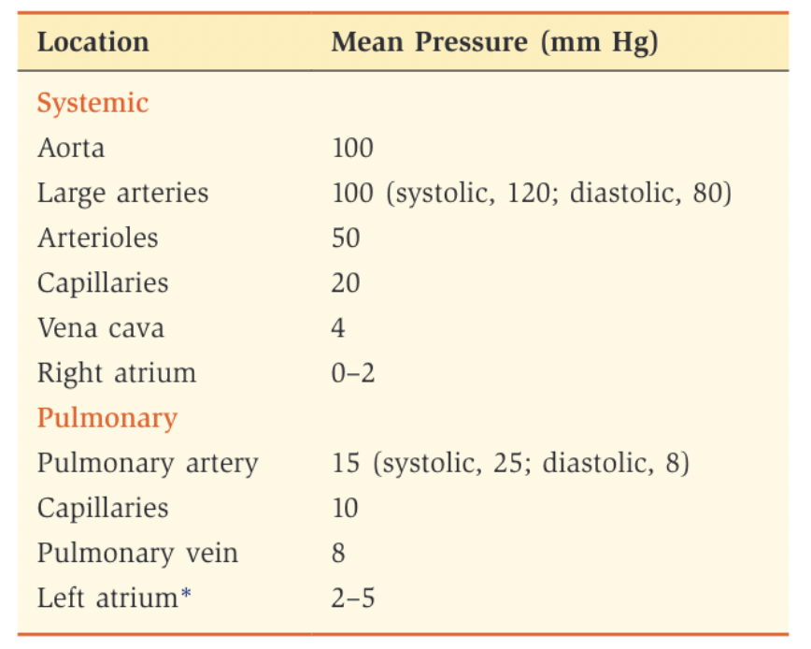
Pressures in the Pulmonary Circulation
Pulmonary vasculature pressure much lower than systemic circulation
Pattern of pressures same as systemic circulation
Pulmonary vascular resistance must be lower than systemic vascular resistance
  (Q = ΔP/R)

Slide 25
Cardiac Electrophysiology

Slide 26
Cardiac Action Potentials
Notes:
Cardiac electrophysiology includes all of the processes
involved in the electrical activation of the heart: the
cardiac action potentials; the conduction of action
potentials along specialized conducting tissues; excit-
ability and the refractory periods; the modulating
effects of the autonomic nervous system on heart rate,
conduction velocity, and excitability; and the electro-
cardiogram (ECG).

Slide 27
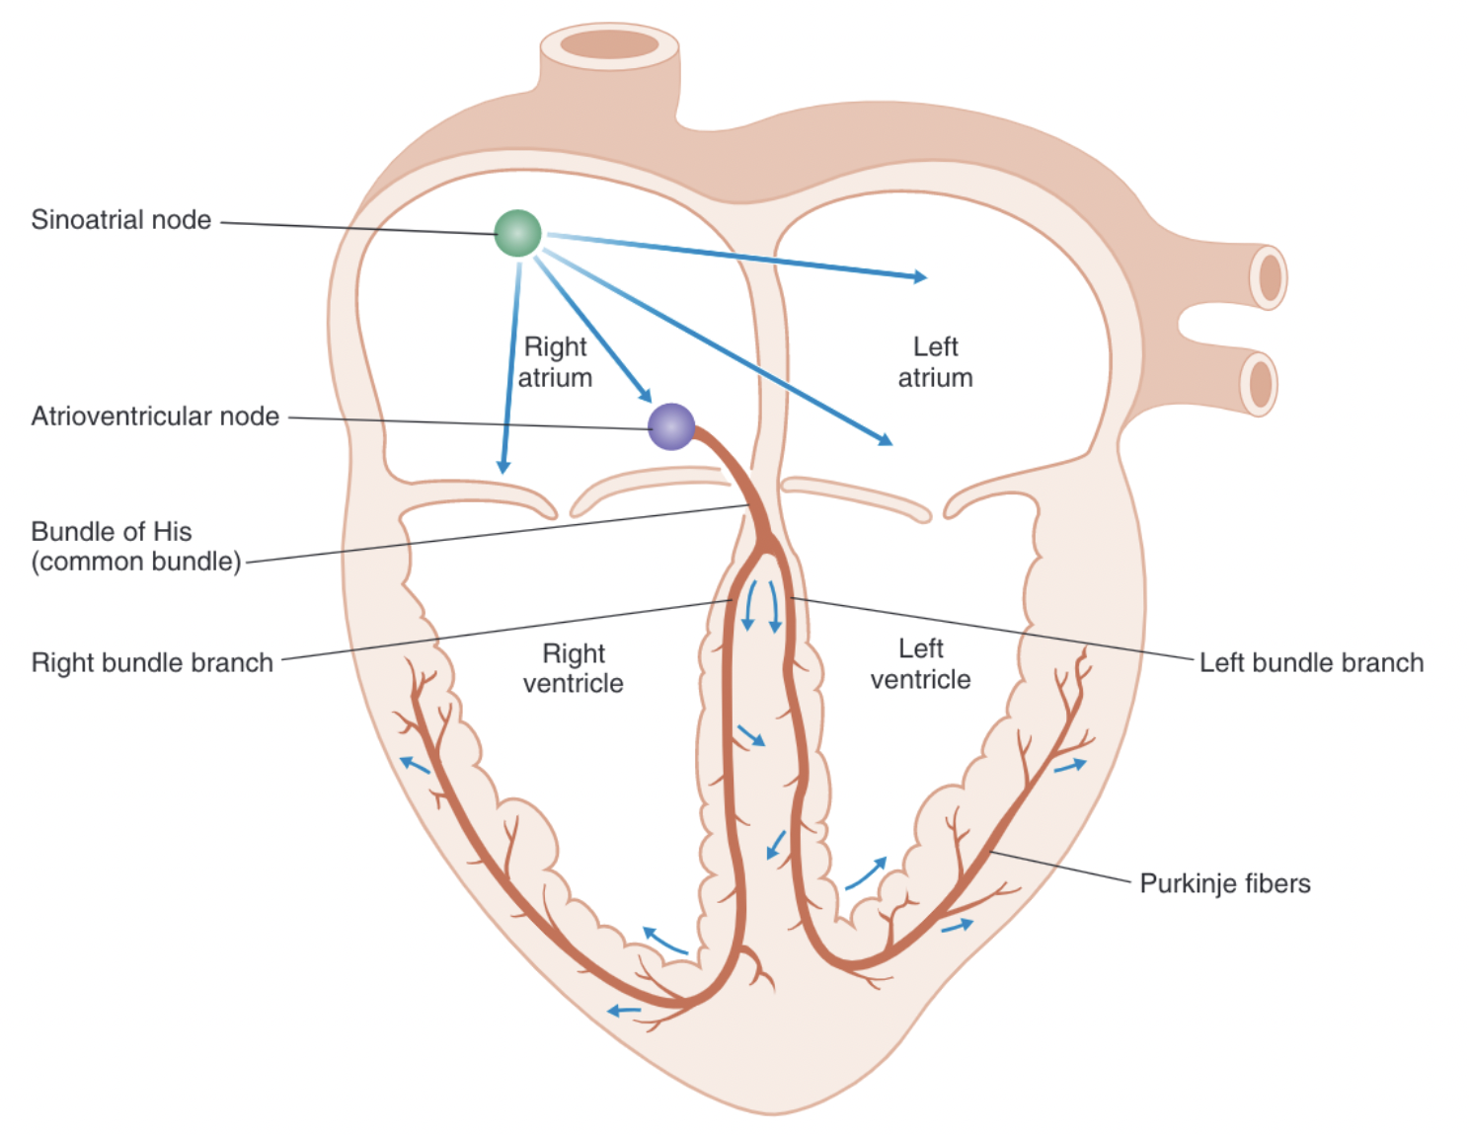
Origin and Spread of Excitation Within the Heart
Two kinds of muscles cells
  Contractile cells
  Conducting cells
Action potential spread through the heart
  SA node
  Atrial intranodal tracts and atria
  AV node (slower conduction)
  Bundle of His, Purkinje system, and ventricles
Normal Sinus Rhythm
  Action potential must originate in the SA node
  SA nodal impulses must occur regularly at normal HR
  Activation of the myocardium must occur in
  the correct sequence and with the correct timing and delays
Notes:
Contractile cells
constitute the majority of atrial and ventricular tissues
and are the working cells of the heart. Action potentials
in contractile cells lead to contraction and generation
of force or pressure. Conducting cells constitute the
tissues of the SA node, the atrial internodal tracts, the
AV node, the bundle of His, and the Purkinje system.
Conducting cells are specialized muscle cells that do
not contribute significantly to generation of force; in-
stead, they function to rapidly spread action potentials
over the entire myocardium
SA node. Normally, the action potential of the heart
is initiated in the specialized tissue of the SA node,
which serves as the pacemaker. After the action
potential is initiated in the SA node, there is a spe-
cific sequence and timing for the conduction of
action potentials to the rest of the heart.
Atrial internodal tracts and atria. The action
potential spreads from the SA node to the right and
left atria via the atrial internodal tracts. Simultane-
ously, the action potential is conducted to the
AV node.
AV node. Conduction velocity through the AV node
is considerably slower than in the other cardiac
tissues. Slow conduction through the AV node
ensures that the ventricles have sufficient time to
fill with blood before they are activated and con-
tract. Increases in conduction velocity of the AV
node can lead to decreased ventricular filling and
decreased stroke volume and cardiac output.
Bundle of His, Purkinje system, and ventricles.
From the AV node, the action potential enters the
specialized conducting system of the ventricles. The
action potential is first conducted to the bundle of
His through the common bundle. It then invades
the left and right bundle branches and then the
smaller bundles of the Purkinje system. Conduction
through the His-Purkinje system is extremely fast,
and it rapidly distributes the action potential to the
ventricles. The action potential also spreads from
one ventricular muscle cell to the next, via low-
resistance pathways between the cells. Rapid con-
duction of the action potential throughout the
ventricles is essential and allows for efficient con-
traction and ejection of blood

Slide 28
Cardiac Action Potentials
Membrane potential is determined by relative conductance and permeability to ions and concentration gradient
  Ions flow down electrochemical gradient to drive membrane potential toward equilibrium potential
Na+ K+ ATPase maintains Na and K concentration gradients across cell membrane
Changes in membrane potential are caused by the flow of ions(mostly K+) into or out of the cell.
  Depolarization - membrane potential has become less negative (inward current)
  Hyperpolarization - membrane potential has become more negative (outward current)
Two basic mechanisms can produce a change in membrane potential
  Change in electrochemical gradient
  Change in conductance to an ion
Threshold potential - potential difference at which there is a net inward current and AP activated
Notes:
Depolarization occurs
when there is net movement of positive charge into
the cell, which is called an inward current. Hyper-
polarization means the membrane potential has
become more negative, and it occurs when there is
net movement of positive charge out of the cell,
which is called an outward current.

Slide 29
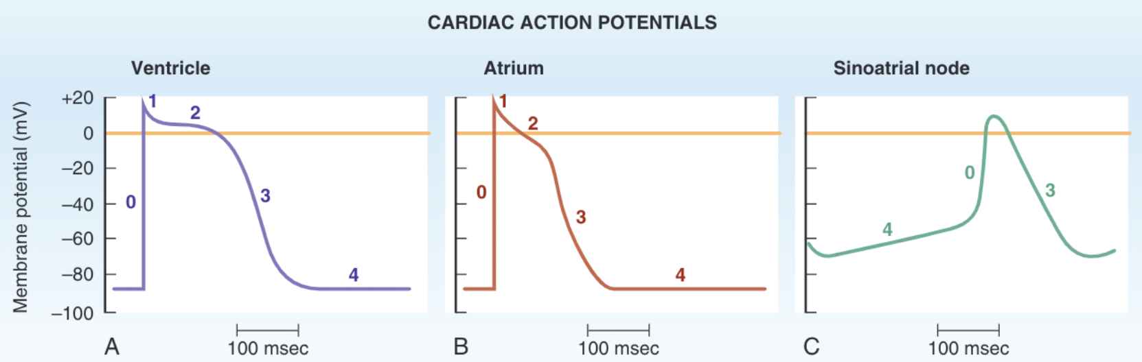
Action Potentials of Ventricles, Atria, and the Purkinje System
Long duration
Stable resting membrane potential
Plateau
Notes:
Long duration. In each of these tissues, the action
potential is of long duration. The longer the action potential, the
longer the cell is refractory to firing another action
potential. Thus, atrial, ventricular, and Purkinje cells
have long refractory periods compared with other
excitable tissues.
Stable resting membrane potential. The cells of
the atria, ventricles, and Purkinje system exhibit a
stable, or constant, resting membrane potential.
Plateau. The action potential in cells of the atria,
ventricles, and Purkinje system is characterized by
a plateau. The plateau is a sustained period of depo-
larization, which accounts for the long duration of
the action potential and, consequently, the long
refractory periods

Slide 30
Initial depolarization of the cell membrane is caused by what ion moving intracellularly?

Slide 31
Initial depolarization of the cell membrane is caused by what ion moving intracellularly?
Sodium!

Slide 32
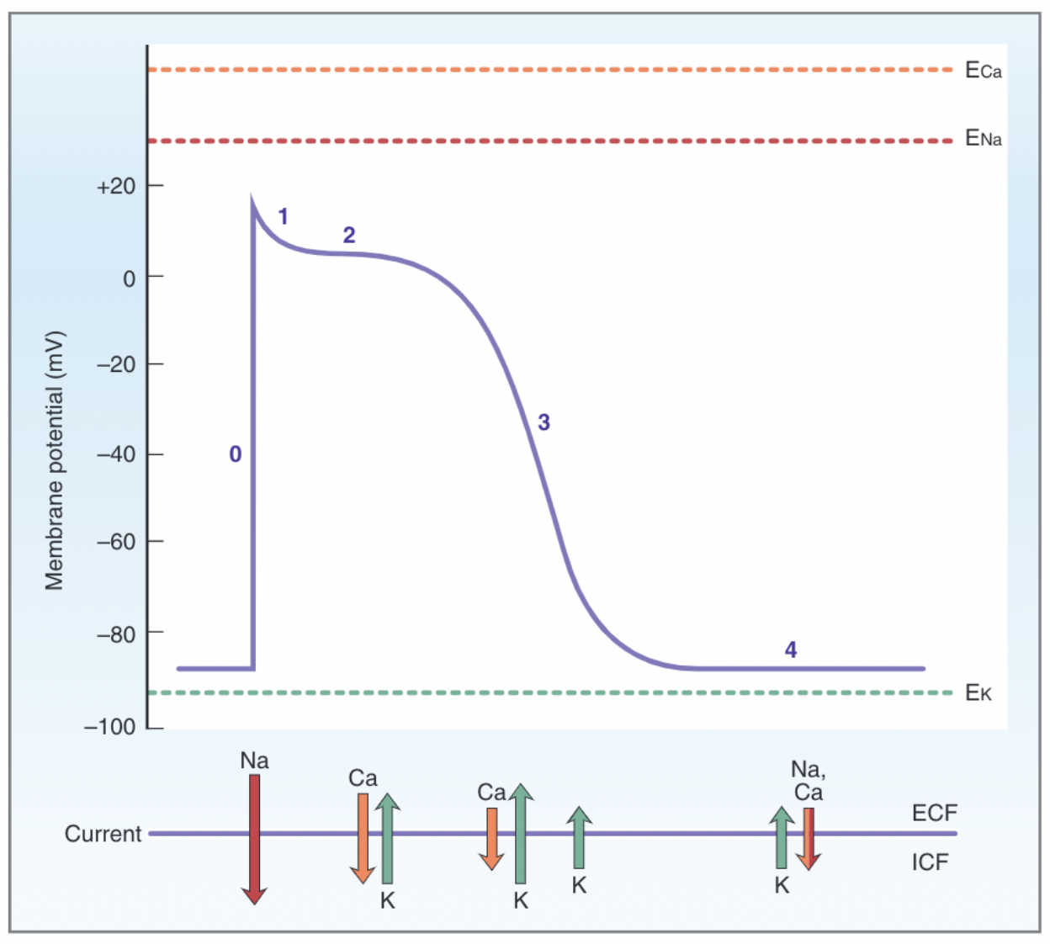
Action Potential
Phase 0, upstroke
  Intracellular flow of Na+
  Reaches +20 mV before Na+ channels close
  Na+ equilibrium potential (+65 mV) not reached
Phase 1, initial repolarization
  Net outward current caused by
    Cessation of Na+ intracellular flow
    Flow of K+ extracellularly
Phase 2, plateau
  Period of depolarized membrane potential caused by
    Ca+ moving intracellularly
    K+ moving extracellularly
Phase 3, repolarization
  Decreased Ca+ moving intracellularly
  Increased K+ moving extracellularly
Phase 4, resting membrane potential, or electrical diastole
  Stable membrane
  K+ moving extracellularly
  Ca+ and Na+ moving intracellularly

Slide 33
Action Potentials in the SA Node
Phase 0, upstroke
  increase in in Ca2+ intracellularly via L-type Ca2+ channels
Phases 1 and 2 are absent
Phase 3, repolarization
  The same, K+ leaving cell
Phase 4, spontaneous depolarization or pace-
maker potential
  Longest portion of the SA node action potential
  Funny chanel – Slow depolarization, produced by the opening of Na+ channels and an inward Na+ current called “I_{f}”.
  The rate of phase 4 depolarization sets the heart rate

Slide 34
Latent Pacemakers
Latent pacemakers
  AV node, bundle of His, and Purkinje fibers
  These cells have potential for automaticity, but it normally is not expressed
The pacemaker with the fastest rate of phase 4 depolarization controls the heart rate
Overdrive suppression
  The SA node has the fastest firing rate of all the potential pacemakers, and impulses spread from the SA node to the other myocardial tissues
  If “latent pacemaker” firing rate is driven by the SA node, their own capacity to spontaneously depolarize is suppressed
A latent pacemaker becomes the pacemaker of the heart if:
  SA node firing rate decreases (e.g., due to vagal stimulation) or stops completely
  Intrinsic rate of firing of one of the latent pacemakers should become faster than that of the SA node
  Conduction of action potentials from the SA node to the rest of the heart is blocked because of disease in the conducting pathways
Notes:
The cells in the SA node are not the only myocardial
cells with intrinsic automaticity; other cells, called
latent pacemakers, also have the capacity for sponta-
neous phase 4 depolarization.

Slide 35
Conduction Velocity
Conduction velocity (m/sec) = the speed at which action potentials are propagated within the tissue.
  Slowest in the AV node
  Fastest in the Purkinje fibers
Depends on the size of the inward current during the upstroke
  Larger the inward current, the more rapidly local currents will spread to adjacent sites and depolarize them to threshold
  Also depends on cable properties of myocardial fibers
    Cell membrane resistance
    Internal resistance
Notes:
in myocardial tissue, Ri is particularly low because of low-resistance connections between the cells called gap junctions. Thus, myocardial tissue is especially well suited to fast conduction. Conduction velocity does not depend on action potential duration

Slide 36
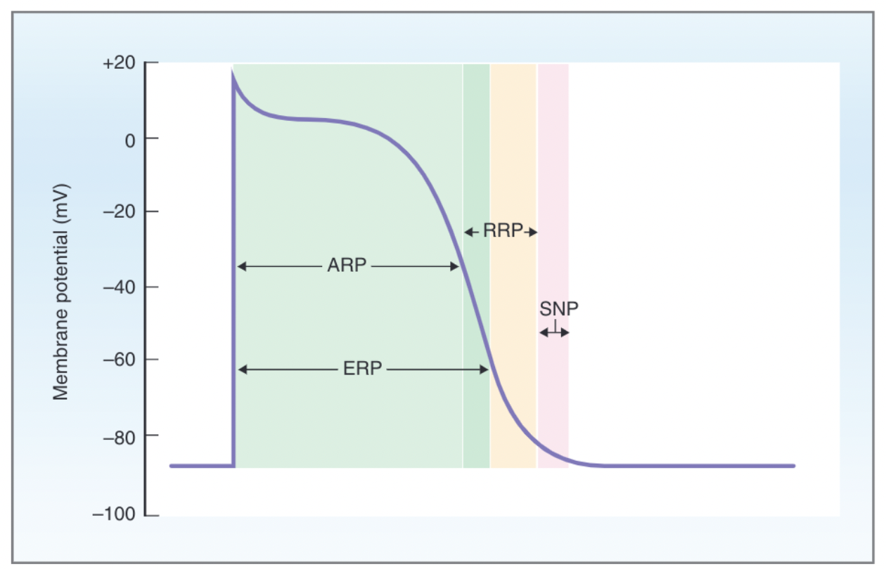
Excitability and Refractory Periods
Excitability - amount of inward current required to bring a myocardial cell to the threshold potential
Absolute refractory period - no matter how large a stimulus there can be no action potential because most of the Na+ channels are closed.
Effective refractory period - Na+ channels start to recover
Relative refractory period - Even more Na+ channels have recovered and it is possible to generate a second action potential, although a greater-than-normal stimulus is required
Supranormal period - Cell is more excitable than normal during this period. Na+ channels are recovered
2
1
3
4
Notes:
The physiologic basis for the refractory periods in
myocardial cells is similar to that in nerve cells. Recall
from Chapter 1 that activation gates on Na+ channels
open when the membrane potential is depolarized to
threshold, permitting a rapid influx of Na+ into the cell,
which causes further depolarization toward the Na+
equilibrium potential. This rapid depolarization is the
upstroke of the action potential. However, inactivation
gates on the Na+ channels also close with depolariza-
tion (although they close more slowly than the activa-
tion gates open). Therefore, during those phases of the
action potential when the membrane potential is depo-
larized, a portion of the Na+ channels will be closed
because the inactivation gates are closed. When the
Na+ channels are closed, inward depolarizing current
cannot flow through them, and there can be no upstroke.
Without an upstroke, a normal action potential cannot
occur and the cell is refractory. Once repolarization
occurs, the inactivation gates on the Na+ channels
open, and the cell is once again excitable
The distinction between the absolute and
effective refractory periods is that absolute means
absolutely no stimulus is large enough to generate
another action potential; effective means that a con-
ducted action potential cannot be generated

Slide 37
Excitability and Refractory Periods
Excitability - amount of inward current required to bring a myocardial cell to the threshold potential
Absolute refractory period - no matter how large a stimulus there can be no action potential because most of the Na+ channels are closed.
Effective refractory period - Na+ channels start to recover
Relative refractory period - Even more Na+ channels have recovered and it is possible to generate a second action potential, although a greater-than-normal stimulus is required
Supranormal period - Cell is more excitable than normal during this period. Na+ channels are recovered
Notes:
The physiologic basis for the refractory periods in
myocardial cells is similar to that in nerve cells. Recall
from Chapter 1 that activation gates on Na+ channels
open when the membrane potential is depolarized to
threshold, permitting a rapid influx of Na+ into the cell,
which causes further depolarization toward the Na+
equilibrium potential. This rapid depolarization is the
upstroke of the action potential. However, inactivation
gates on the Na+ channels also close with depolariza-
tion (although they close more slowly than the activa-
tion gates open). Therefore, during those phases of the
action potential when the membrane potential is depo-
larized, a portion of the Na+ channels will be closed
because the inactivation gates are closed. When the
Na+ channels are closed, inward depolarizing current
cannot flow through them, and there can be no upstroke.
Without an upstroke, a normal action potential cannot
occur and the cell is refractory. Once repolarization
occurs, the inactivation gates on the Na+ channels
open, and the cell is once again excitable
The distinction between the absolute and
effective refractory periods is that absolute means
absolutely no stimulus is large enough to generate
another action potential; effective means that a con-
ducted action potential cannot be generated

Slide 38
what kind of dromotropic and chronotropic effect does parasympathetic stimulation have on the heart?

Slide 39
what kind of dromotropic and chronotropic effect does parasympathetic stimulation have on the heart?
Sympathetic – positive chronotropic and dromotropic
Parasympathetic – negative chronotropic and dromotropic

Slide 40
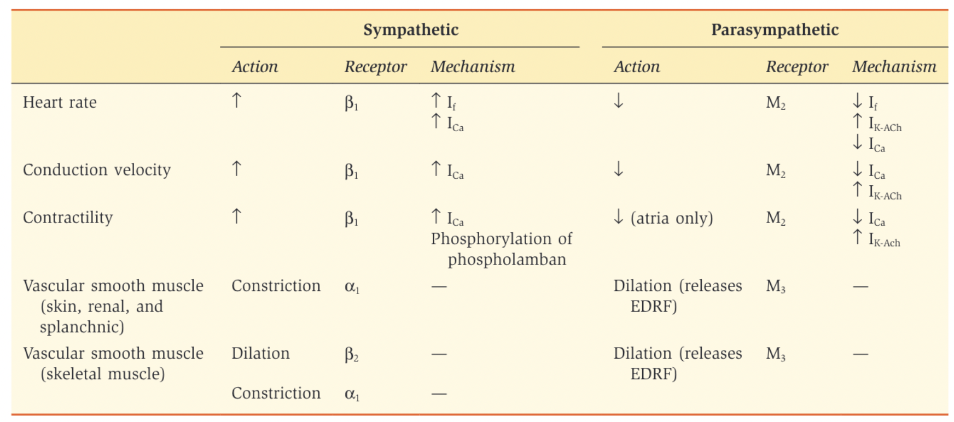
Autonomic Effects on Heart and Blood Vessels
Notes:
Briefly, sympathetic stimulation
increases heart rate and parasympathetic stimulation
decreases heart rate
Positive chronotropic effects are increases in heart
rate. The most important example is that of stimula-
tion of the sympathetic nervous system
Negative chronotropic effects are decreases in heart
rate. The most important example is that of stim-
ulation of the parasympathetic nervous system
The effects of the autonomic nervous system on con-
duction velocity are called dromotropic effects
Stimulation of the sympathetic nervous system pro-
duces an increase in conduction velocity through the
AV node (positive dromotropic effect), which increases
the rate at which action potentials are conducted from
the atria to the ventricles
Stimulation of the parasympathetic nervous system
produces a decrease in conduction velocity through
the AV node (negative dromotropic effect), which
decreases the rate at which action potentials are con-
ducted from the atria to the ventricles
f conduction velocity
through the AV node is slowed sufficiently (e.g., by
increased parasympathetic activity or by damage to the
AV node), some action potentials may not be conducted
at all from the atria to the ventricles, producing heart
block

Slide 41
ECG
To be discussed later

Slide 42
Cardiac Muscle Contraction

Slide 43
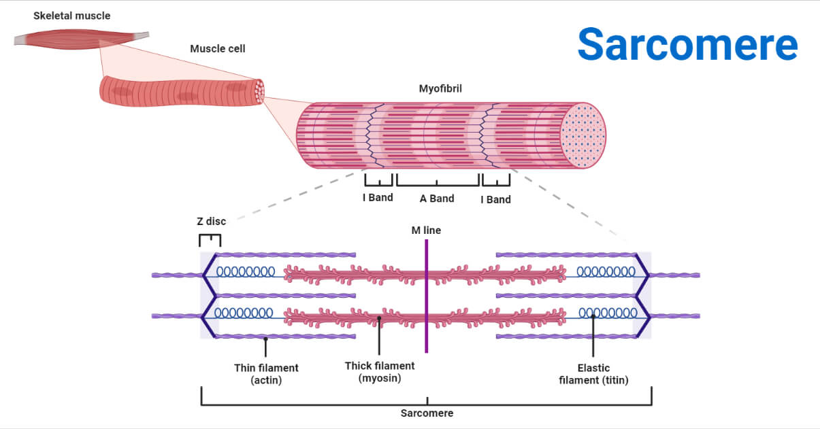
Myocardial Cell Structure
Sarcomeres
  Thin filaments - myosin
  Thick filaments – actin, tropomyosin, and troponin
Sliding filament model
  Cross-bridges form between myosin and actin which break
  Thick and thin filaments move past each
  other.
  As a result of this cross-bridge cycling, the muscle fiber produces tension.
Notes:
As in skeletal muscle, the cardiac muscle cell is composed of sarcomeres which are composed of thick and thin filaments. The thick filaments are composed of myosin, whose globular heads have actin-binding sites and ATPase activity. The thin filaments are composed of three proteins: actin, tropomyosin, and troponin. Actin is a globular protein with a myosin-binding site. Tropomyosin runs along the groove of the twisted actin strands and functions to block the myosin-binding site. Troponin is a globular protein composed of a complex of three subunits; the troponin C subunit binds Ca2+ which induces, a conformational change and removes the tropomyosin inhibition of actin-myosin interaction.

Slide 44
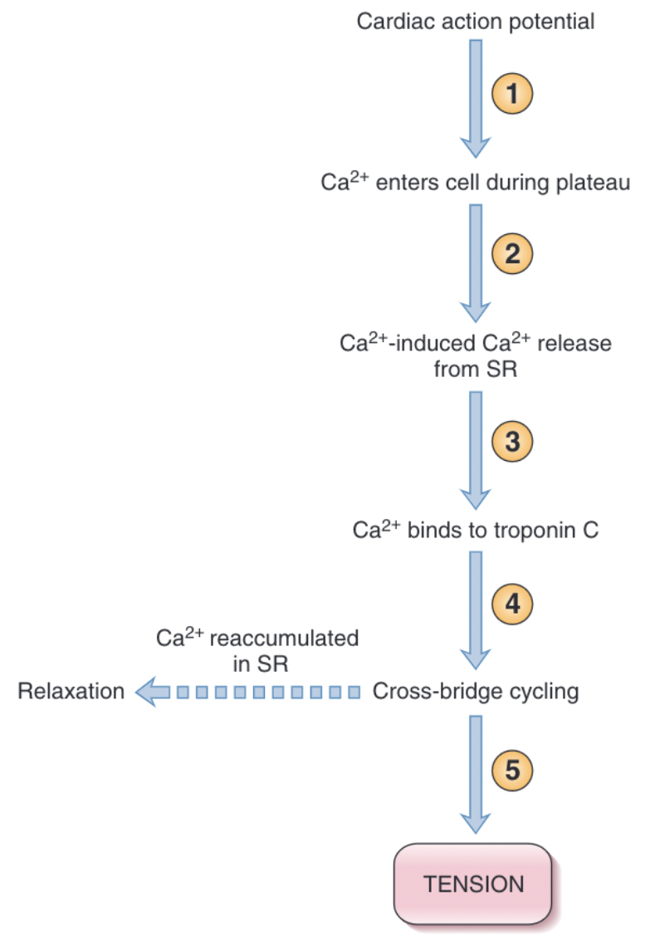
Excitation-Contraction Coupling
The cardiac action potential
Ca2+ induced Ca2+
Cross bridge cycling
Ca2+ release from the sarcoplasmic reticulum
Ca2+ is reaccumulated in the sarcoplasmic reticulum by the action of the Ca2+ ATPase and Ca2+-Na+ exchange in the sarcolemma membrane. Sarcolemma transporters pump Ca2+ out of the cell with the Ca2+ ATPase using ATP directly and the Ca2+- Na+ exchanger using energy from the inward Na+ gradient.
Magnitude of the tension developed by myocardial cells proportional to the intracellular Ca2+ concentration

Slide 45
Contractility
Contractility (inotropism) - ability of myocardial cells to develop force at a given muscle cell length
Mechanisms for Changing Contractility
  Contractility correlates directly with the intracellular Ca2+ concentration. Amount of Ca2+ released from the sarcoplasmic reticulum depends on two factors
    size of the inward Ca2+ current during the plateau of the myocardial action potential
    amount of Ca2+ previously stored in the sarcoplasmic reticulum for release

Slide 46
Effects of the Autonomic Nervous System on Contractility
Sympathetic nervous system – positive inotropic effect mediated via activation of β1 receptors
  Increased contractility
  Increased peak tension
  Increased rate of tension development
  Fast rate of relaxation
Parasympathetic nervous system – negative inotropic effect via ACh

Slide 47
Is contractility better when the heart rate is faster or when the heart rate is slower? Why?

Slide 48
Effect of Heart Rate on Contractility
Heart rate increases → contractility increases
Heart rate decreases → contractility decrease
Contractility correlates with intracellular Ca2+ concentration during excitation-contraction coupling
  With HR increase, there are more action potentials per unit time and an increase in the total amount of trigger Ca2+ that enters the cell during the plateau phases of the action potentials.
  Greater influx of Ca2+ into the cell during the action potentials, the sarcoplasmic reticulum accumulates more Ca2+ for subsequent release

Slide 49
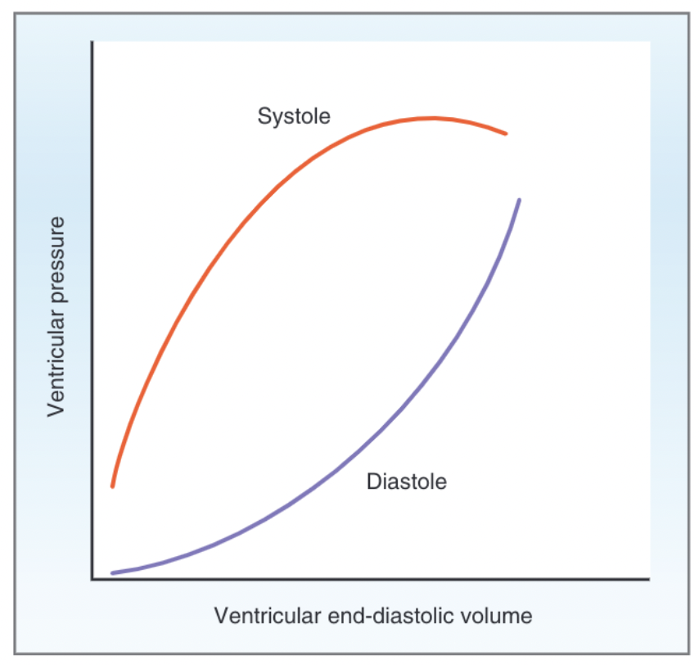
Length-Tension Relationship in Cardiac Muscle
Maximal tension that can be developed by a myocardial cell depends on its resting length
Length-tension relationship - degree of overlap of thick and thin filaments and the number of possible sites for cross-bridge formation determines length and therefore maximal tension
The length-tension relationship for single myocardial cell can be extended to a length tension relationship for the ventricles
Notes:
Systolic and diastolic left ventricular pressure-
volume curves. The systolic curve shows active pressure as a
function of end-diastolic volume (fiber length). The diastolic curve
shows passive pressure as a function of end-diastolic volume
The upper curve is the relationship between ven-
tricular pressure developed during systole and end-
diastolic volume (or end-diastolic fiber length)
The lower curve is the relationship between ven-
tricular pressure and ventricular volume during dias-
tole, when the heart is not contracting

Slide 50
Stroke Volume
Stroke volume = The volume of blood ejected on one ventricular contraction
Stroke volume = End-diastolic volume - end-systolic volume
Stroke volume = Volume ejected on one
beat (mL)
End-diastolic volume = Volume in the ventricle
before ejection (mL)
End-systolic volume = Volume in the ventricle
after ejection (mL)
Notes:
The volume of blood ejected on one ventricular contrac-
tion is the stroke volume.

Slide 51
Ejection Fraction
Ejection fraction, which is the fraction of the end-diastolic volume that is ejected in one stroke
volume
  Normally 55%
Indicator of contractility
Ejection fraction = Stroke volume/End-diastolic volume

Slide 52
Cardiac Output
Cardiac output = Stroke volume x Heart rate
Cardiac output = Volume ejected per minute (mL/min)
Stroke volume = Volume ejected in one beat (mL)
Heart rate = Beats per minute (beats/min)
Notes:
The ejection fraction is an indicator of
contractility, with increases in ejection fraction reflect-
ing an increase in contractility and decreases in ejection
fraction reflecting a decrease in contractility. Thus,
Ejection fraction Stroke volume
End-diastolic volume

Slide 53
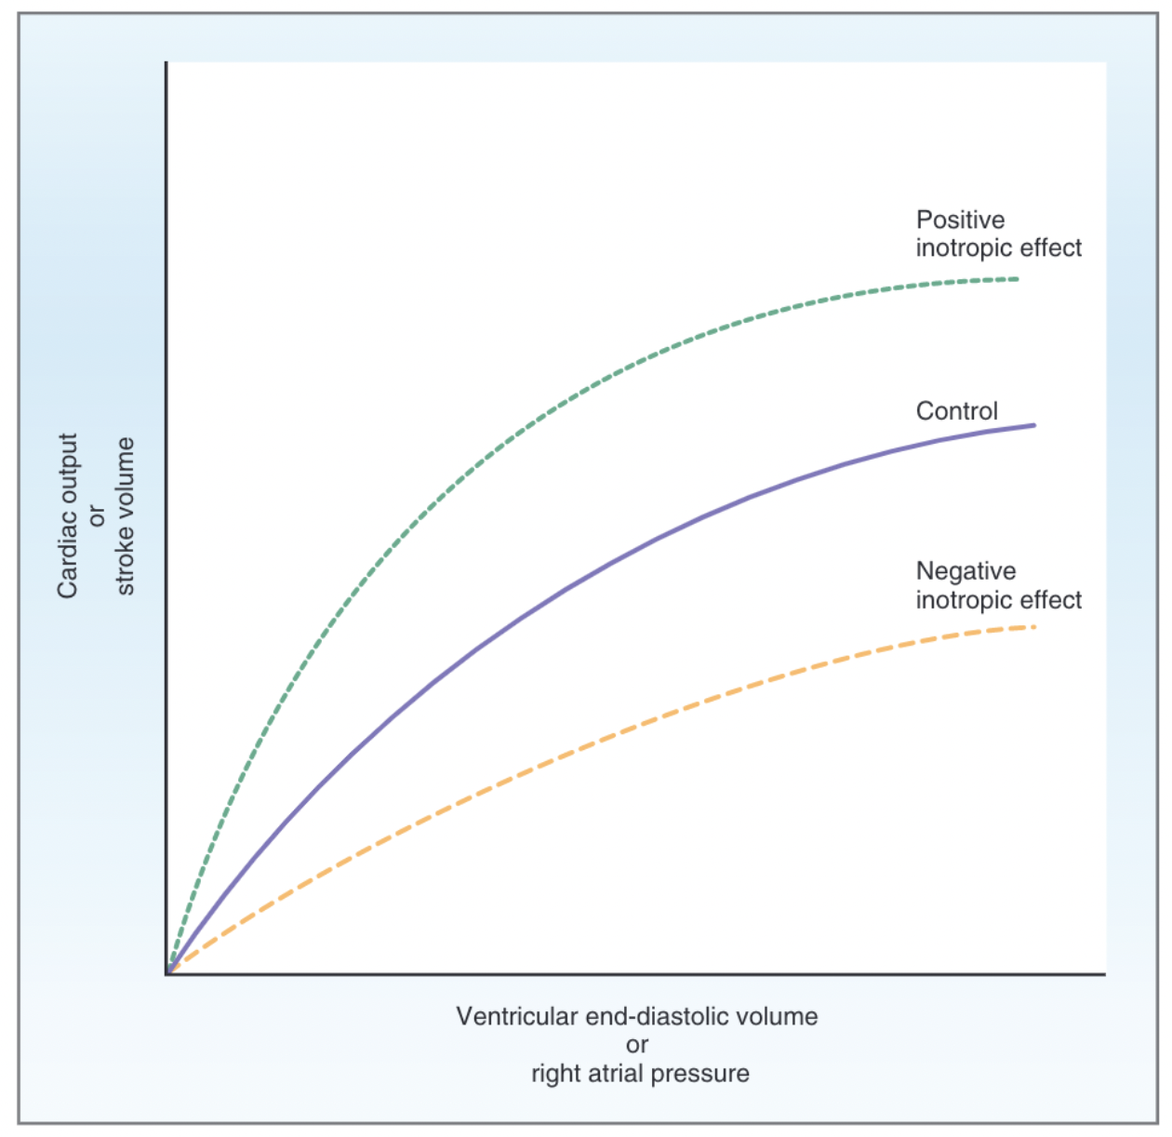
Frank-Starling Relationship
The volume of blood ejected by the ventricle depends on the volume present in the ventricle at the end of diastole
When end-diastolic volume becomes high the curve start to bend
  Ventricle reaches a limit and is not able to “keep up” with venous return
Drugs with positive inotropic effects increase ejection fraction
Drugs with negative inotropic effects decrease ejection fraction
Notes:
he Frank-Starling relationship governs
normal ventricular function and ensures that the
volume the heart ejects in systole equals the volume it
receives in venous return. Recall from a previous discus-
sion that, in the steady state, cardiac output equals
venous return. It is the Frank-Starling law of the heart
that underlies and ensures this equality
Cardiac output and stroke volume are
plotted as a function of ventricular end-diastolic volume
or right atrial pressure. (Right atrial pressure may be
substituted for end-diastolic volume because both
parameters are related to venous return.
There is a
curvilinear relationship between stroke volume or
cardiac output and ventricular end-diastolic volume. As
venous return increases, end-diastolic volume increases,
and because of the length-tension relationship in the
ventricles, stroke volume increases accordingly.
when end-diastolic volume becomes high does the
curve start to bend: At these high levels, the ventricle
reaches a limit and simply is not able to “keep up” with
venous return.
Agents that increase contractility have a positive
inotropic effect (uppermost curve). Positive inotropic
agents (e.g., digoxin) produce increases in stroke
volume and cardiac output for a given end-diastolic
volume. The result is that a larger fraction of the end-
diastolic volume is ejected per beat and there is an
increase in ejection fraction.
Agents that decrease contractility have a negative
inotropic effect (lowermost curve). Negative inotropic
agents produce decreases in stroke volume and cardiac
output for a given end-diastolic volume. The result is
that a smaller fraction of the end-diastolic volume is
ejected per beat and there is a decrease in ejection

Slide 54
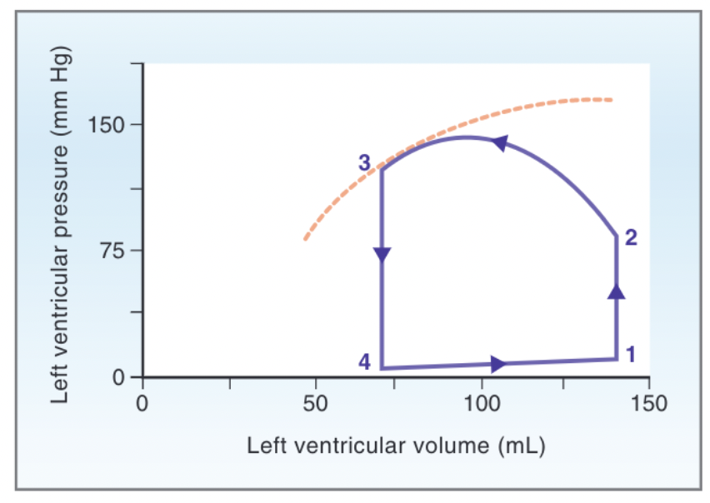
Ventricular Volume-Pressure Loops
Isovolumetric contraction (1 → 2)
Ventricular ejection (2 → 3)
Isovolumetric relaxation (3 → 4)
Ventricular filling (4 → 1)
Notes:
The next group of charts we will look at are the ventricular volume pressure loops. As you can see a portion of that systolic pressure-volume curve Is superimposed as a gold dashed line on the ventricular pressure-volume loop. The dashed line shows the maximum possible pressure that can be developed for a given ventricular volume during systole. The ventricular pressure-volume loop describes one complete cycle of ventricular contraction, ejection, relaxation, and refilling. In isovolumetric contraction, the left ventricle has already filled with blood from the left atrium, and pressure is quite low because the ventricular muscle is relaxed. The ventricle then contracts, this is represented by 1-2, and ventricular pressure increases dramatically. Because all valves are closed, no blood can be ejected from the left ventricle, and ventricular volume is constant, although ventricular pressure becomes quite high. In ventricular ejection (2- 3) the left ventricular pressure becomes higher than aortic pressure, causing the aortic valve to open. Once the valve is open, blood is rapidly ejected, driven by the pressure gradient between the left ventricle and the aorta. During this phase, left ventricular pressure remains high because the ventricle is still contracting. Ventricular volume decreases as blood is ejected into the aorta. The volume remaining in the ventricle at
point 3 is the end-systolic volume. The width of the pressure-volume loop is the volume of blood ejected, or the stroke volume. During the next phase of isovolumetric relaxation or (3 to 4) systole ends and the ventricle relaxes. Ventricular pressure decreases below aortic pressure and the aortic valve closes. Although ventricular pressure decreases rapidly during this phase, ventricular volume remains constant because all valves are closed again. At the last stage ventricular filling, represented by 4 to 1, the ventricular pressure has fallen to a level that now is less than left atrial pressure, causing the mitral (AV) valve to open. The left ventricle fills with blood from the left atrium passively and also actively, as a result of atrial contraction in the next cycle. Left ventricular volume increases back to the end-diastolic volume. The ventricular muscle is relaxed, and pressure increases only slightly as the compliant ventricle fills with blood.

Slide 55
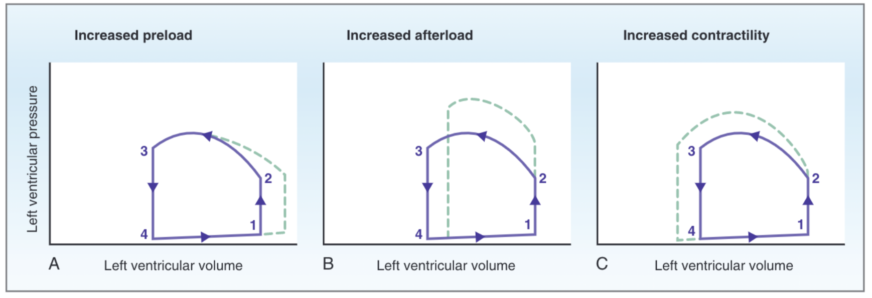
Changes in V/P Loops
Notes:
A - increased
preload. preload
is end-diastolic volume. Stroke volume, as mea-
sured by the width of the pressure-volume loop,
increases. This increase in stroke volume is based on the Frank-Starling relationship, which states that
the greater the end-diastolic volume (end-diastolic
fiber length), the greater the stroke volume ejected
in systole.
B - increased after-
load (increased aortic pressure) on ventricular cycle. A consequence of the increased after-
load is that less blood is ejected from the ventricle
during systole; thus, stroke volume decreases,
more blood remains in the ventricle at the end of
systole, and end-systolic volume increases.
C. increased con-
tractility on the ventricular cycle. When contractil-
ity increases, the ventricle can develop greater
tension and pressure during systole and eject a
larger volume of blood than normal. Stroke volume
increases, as does ejection fraction; less blood
remains in the ventricle at the end of systole, and,
consequently, end-systolic volume decreases

Slide 56
Cardiac Work
Stroke Work - work the heart performs on each beat.
Cardiac minute (power) - work per unit time
  Volume work (cardiac output)
  Pressure work
Myocardial O2 consumption
  Correlates directly with minute work
  Pressure work more costly than volume work
    Aortic stenosis
    Left heart works harder than right heart
    Systemic hypertension
Notes:
increases in cardiac
output or increases in aortic pressure
will increase the work of the heart
For example, in aortic stenosis,
myocardial O2 consumption is greatly increased because
the left ventricle must develop extremely high pressures
to pump blood through the stenosed aortic valve (even
though cardiac output actually is reduced).
Another consequence of the greater O2 consumption
of pressure work is that the left ventricle must work
harder than the right ventricle. Although cardiac output
is the same on both sides of the heart, mean aortic
pressure (100 mm Hg) is much higher than mean pul-
monary artery pressure (15 mm Hg). Thus, the pres-
sure work of the left ventricle is much greater than the
pressure work of the right ventricle, although the
volume work is the same.

Slide 57
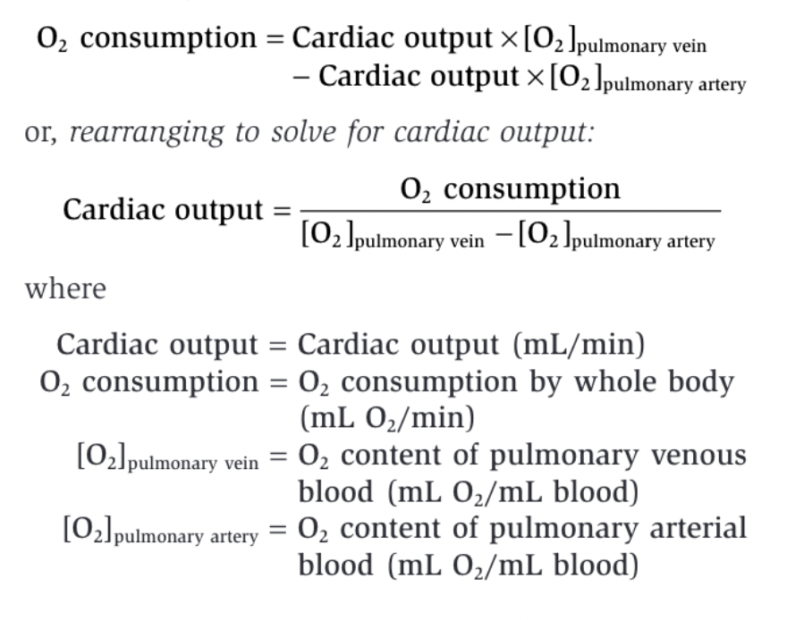
Measurement of Cardiac Output—Fick Principle
Fick principle – in the steady state, the cardiac output of the left and right ventricles is equal
  Conservation of mass, a concept that can be applied to the utilization of O2 by the body
Notes:
The amount
of O2 in the pulmonary veins is pulmonary blood flow
multiplied by the O2 content of pulmonary venous blood.
Likewise, the amount of O2 returned to the lungs via the
pulmonary artery is pulmonary blood flow multiplied by
the O2 content of pulmonary arterial blood. Recall that
pulmonary blood flow is the cardiac output of the right
heart and is equal to the cardiac output of the left heart.
Thus, stating these equalities mathematically,

Slide 58
Cardiac Cycle

Slide 59
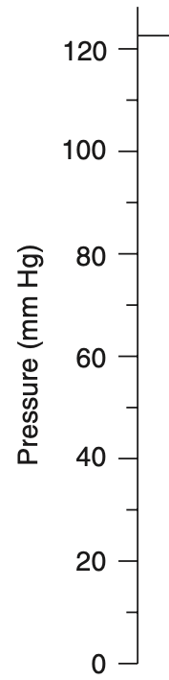
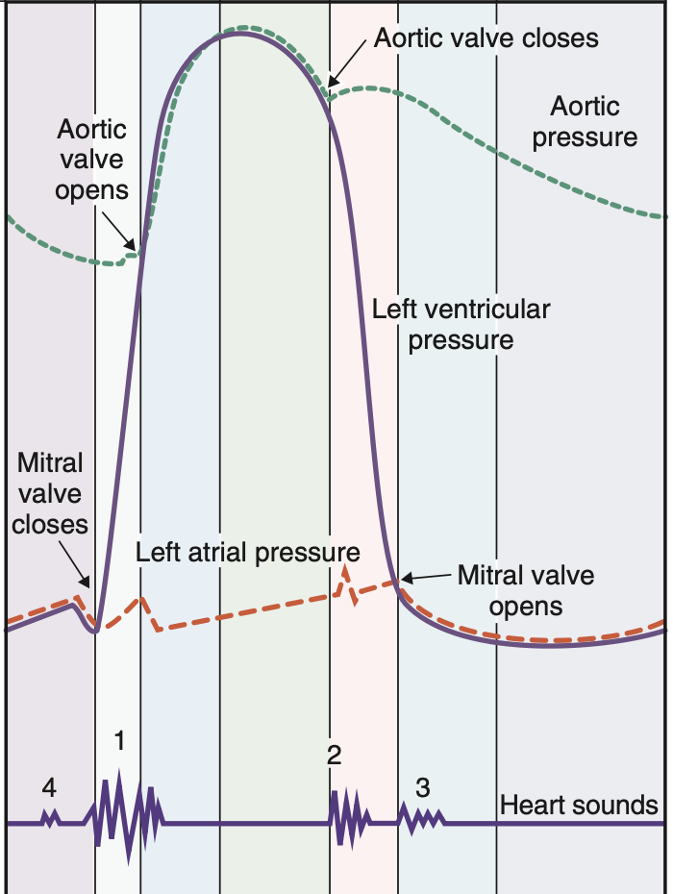
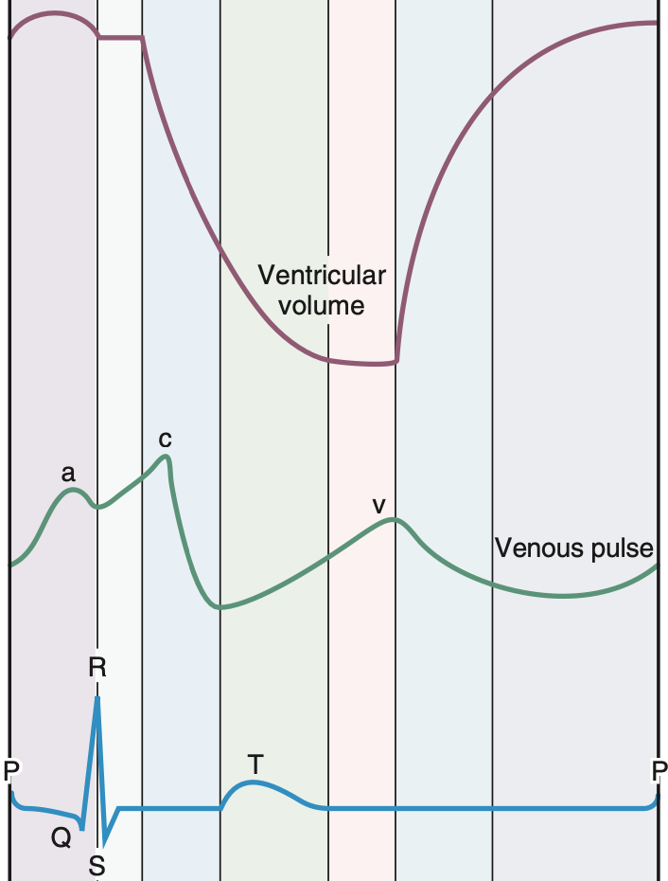
A B C D E F G
A B C D E F G
Notes:
This illustration is the cardiac cycle. It is divided into seven phases, which are represented by each letter and divided by each of the vertical lines. The ECG is at the very bottom which represents the electrical events that happen during one cycle. This illustration is meant to be read vertically, one phase at a time, with the ECG as as time marker. The other lines that are plotted include the left ventricular pressure and volume, aortic and and left atrial pressures, venous pulse, and heart sounds. The cardiac cycle begins with the depolarization and contraction of the atria.

Slide 60
Atrial Systole (A)
Atrial contraction
P wave marks depolarization and precedes atrial contraction
Increase in left atrial pressure → reflected back into veins → appears as a wave on on venous pulse line
Mitral valve open → ventricle filling even before systole
Atrial systole → increase in ventricular volume → increase in ventricular pressure
S4 = atrial contraction
Notes:
Atrial systole is atrial contraction. It is preceded by the P wave on the ECG which marks depolarization of the atria. Contraction of the left atrium increases pressure in the atrium and reflects back into the vens which appears as a wave on the venous pulse line as the “a wave”. As the atrium is filling, the ventricle is relaxed so the mitral valve is open and the ventricle is filling with blood which increases ventricular volume, then as the atria contracts the ventricular volume increases even more, which is evident on the ventricular pressure and ventricular volume lines. The fourth heart sound, which corresponds with atrial systole, is not usually heard. In animals with ventricular hypertrophy it can be heard because it’s the sound of blood hitting a non compliant or “stiff” ventricle.

Slide 61
Isovolumetric Ventricular Contraction (B)
Starts during the QRS complex
Left ventricle contracts → increase in left ventricular pressure
Ventricular pressure increases dramatically, ventricular volume remains the same
Left ventricular pressure > left atrial pressure → mitral valve closes
S1 = closure of AV valves (mitral and tricuspid)
Notes:
Phase B begins during the QRS complex and is characterized by left ventricular contraction which corresponds to a dramatic increase in the ventricular pressure. The ventricular volume remains the same because all valves are closed and there is no additional filling through mitral valve or ejection through aortic valve. As soon as the left ventricular pressure is greater that the left atrial pressure the mitral valve will close. The first heart sounds is made by the closing of the AV valves. This can occasionally be a split heart sound because the mitral valve closes before the tricuspid valve. This can be exacerbated to the point where the split is heard during bundle branch blocks or pulmonary hypertension.

Slide 62
Rapid Ventricular Ejection (C)
Ventricle continues to contract and reaches highest pressure
Ventricular pressure > aortic pressure → aortic valve opens
Pressure gradient drives blood from ventricles into aorta
Ventricular volume decreases, aortic pressure increases
During this phase atrial filling begins → left atrial pressure increases as blood returns from pulmonary circulation
End of this phase = end of ST segment or beginning of T wave
Notes:
Ventricles continue to contract and the ventricular pressure reaches its highest value. As the ventricular pressure becomes higher than the aortic pressure, the aortic valve opens and blood is rapidly ejected into the aorta. This is driven by the pressure gradient between the left ventricle and the aorta. The majority of stroke volume is ejected from the ventricle so ventricular volme decreases and aortic ppressure increases. During this phase, atrial filling begins and left atrial pressure slowly increases as blood returns to the left heart from the pulmonary circulation. This new blood will be ejected from the heart in the next cycle. The end of this phase coincides with the end of the ST segment or the beginning of the T wave.

Slide 63
Reduced Ventricular Ejection (D)
Ventricles repolarize
T wave on ECG
Ventricular pressure falls
Ventricular volume and pressure falls as aortic valve is still open
Aortic pressure decreases because blood leaving aorta faster than ventricular blood is entering
Left atrial pressure continues to increase as blood fills atria
Notes:
During reduced ventricular ejection, the ventricles begin to repolarize, which corresponds to the T wave on the ECG. The ventricular pressure is falling because ventricles are no longer contracting. The aortic valve is open so the blood continues to leave the ventricle and go into the aorta, however it is at a reduced rate. The aortic pressure is decreasing even though blood from the ventricles is entering the aorta because blood is going into arterial circulation faster than it is moving from the ventricle to the aorta. The left atrial pressure continues to increase as blood returns to the left heart from the lungs.

Slide 64
Isovolumetric Ventricular Relaxation (E)
After the ventricles are fully repolarized
Left ventricular pressure decreases dramatically
Left ventricular pressure < aortic pressure → aortic valve closes
S2 = aortic and pulmonic valves closing
Dicrotic notch on aortic pressure curve = aortic valve closes
Ventricular volume is constant because all valves closed
Notes:
Isovolumetric ventricular relaxation begins after ventricles are fully repolarized, marked by the end of the T wave. Because the left ventricle is relaxed, the left ventricular pressure decreases dramatically. When the left ventricular pressure falls below the aortic pressure, the aortic valve closes. The aortic valve closes slightly before the pulmonic valve but these valves closing is the second heart sound. When the aortic valve closes, the aortic pressure curve causes a “blip” called the dicrotic notch. All valves are closed, so no blood is being ejected from the ventricle and volume is constant.

Slide 65
Rapid Ventricular Filling (F)
Ventricular pressure drops to lowest level → mitral valve opens
Ventricle fills with blood → ventricle volume increases rapidly
Ventricular pressure remains low as ventricle is relaxed
S3 = flow of blood from atria to ventricle
  Not heard except with non compliant ventricles
Aortic pressure decreases
Notes:
When ventricular pressure falls to the lowest level, the mitral valve opens and the ventricle fills with blood from the left atrium, increasing the ventricular volume rapidly. Ventricular pressure will remain the same because the ventricles are relaxed and compliant. Rpid flow of blood from atria to ventricles produces the third heart sound which is again only heart in heart disease where the ventricles are non compliant. During this phases and next the aortic pressure decreases as blood is continuing to distribute throughout arterial circulation.

Slide 66
Reduced Ventricular Filling (G)
Longest phase of cardiac cycle
Ventricular filling at slower rate
Increases in heart rate decrease or eliminate time available for this phase
Notes:
Reduced ventricular filling is the longest phase of the cardiac cycle and is characterized by ventricular filling at a much slower rate. Atrial systole marks the end of this phase, and this is where ventricular volume equals end diastolic volume. Changes in heart rate alter the time available for ventricular filling. Increases in heart rate reduce time before next P wave and reduce or even eliminate time available for ventricular filling. If heart rate is fast enough ventricular filling is compromised, end diastolic volume is compromised, and stroke volume is ultimately reduced

Slide 67
Relationships Between Cardiac Output and Venous Return
Notes:
one of the most important factors determining cardiac
output is left ventricular end-diastolic volume. In turn,
left ventricular end-diastolic volume depends on venous
return, which also determines right atrial pressure.
Thus, it follows that there is not only a relationship
between cardiac output and end-diastolic volume but
also a relationship between cardiac output and right
atrial pressure.
one of the most important factors determining cardiac
output is left ventricular end-diastolic volume. In turn,
left ventricular end-diastolic volume depends on venous
return, which also determines right atrial pressure.
Thus, it follows that there is not only a relationship
between cardiac output and end-diastolic volume but
also a relationship between cardiac output and right
atrial pressure.

Slide 68
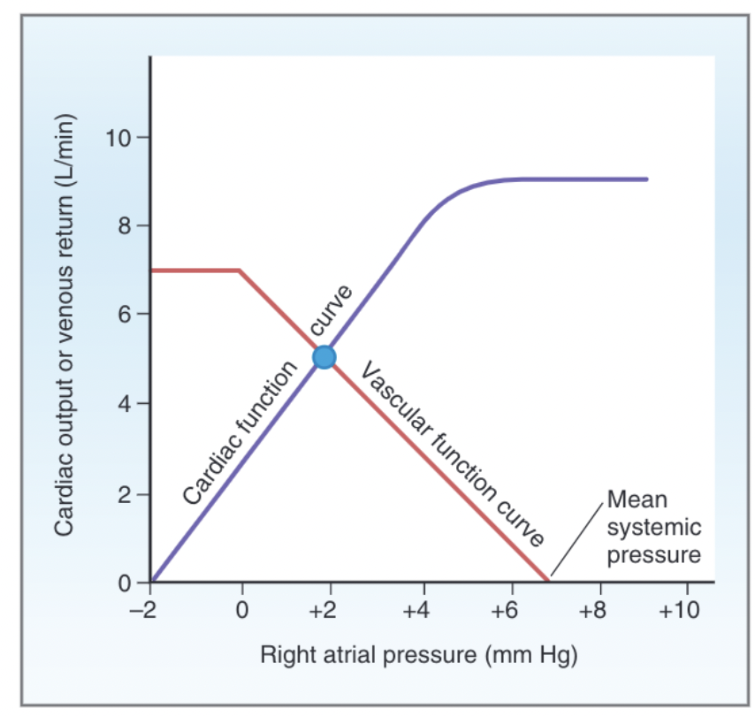
Cardiac Function Curve
Plot of the relationship between cardiac output of the left ventricle and right atrial pressure
As venous return increases, right atrial pressure increases, and end-diastolic volume and end- diastolic fiber length increase
Increases in end diastolic fiber length produce increases in cardiac output
Volume of blood the left ventricle ejects as cardiac output equals or matches the volume it receives in venous return
When right atrial pressure reaches 4 mm Hg, cardiac output can no longer keep up with venous return and the cardiac function curve levels off
Notes:
The cardiac function
curve is a plot of the relationship between cardiac
output of the left ventricle and right atrial pressure.

Slide 69
Vascular Function Curve
Depicts the relationship between
venous return and right atrial pressure
Inverse relationship between venous return and right atrial pressure
Flat portion of the vascular function
curve occurs at negative values of right atrial
  Veins collapse, impeding
  blood flow back to the heart

Slide 70
Mean Systemic Pressure
The value for right atrial pressure at which venous return is zero is called the mean systemic pressure.
Mean systemic pressure or mean circulatory pressure is the pressure that would be measured throughout the cardiovascular system if the heart were stopped.
Two factors influence the value for mean systemic pressure:
  Blood volume
  Distribution of blood between the unstressed volume and the stressed volume
Notes:
increased blood volume and decreased
compliance of the veins produce an increase in mean
systemic pressure and shift the vascular function curve
to the right. Decreased blood volume and increased
compliance of the veins produce a decrease in mean
systemic pressure and shift the vascular function curve
to the left.

Slide 71
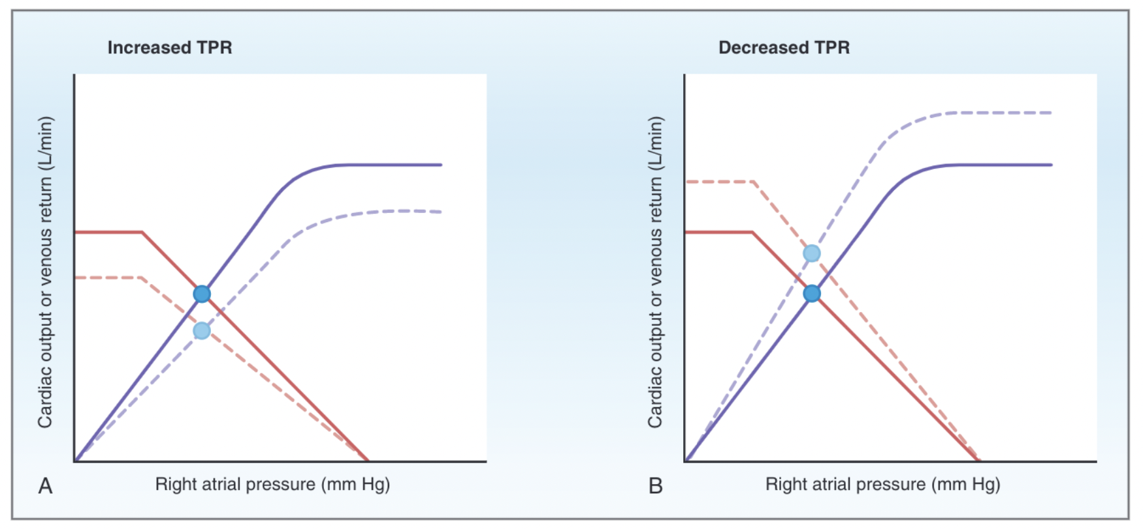
Effects of increased total peripheral resistance and decreased TPR on the cardiac and vascular function curves
Notes:
Changes in TPR reflect changes in the degree of con-
striction of the arterioles
In-
creases in TPR cause an increase in arterial pressure
by “holding” blood in the arteries. This increase in
arterial pressure produces an increase in afterload
on the heart, which decreases cardiac output. The
cardiac function curve shifts downward as a result
of the increased afterload. (2) The increase in TPR
produces a counterclockwise rotation of the vascular
function curve. This rotation means that less blood
returns to the heart for a given right atrial pressure—
venous return is decreased. The curves intersect at a new steady state point at which
both cardiac output and venous return are decreased.
Decreases in TPR cause a decrease in arterial pres-
sure and a decrease in afterload, causing the cardiac
function curve to shift upward. (2) The decrease
in TPR produces a clockwise rotation of the
vascular function curve, which means that more
blood returns to the heart for a given right
atrial pressure—venous return is increased. The
curves intersect at a new steady state point at
which both cardiac output and venous return are
increased.

Slide 72
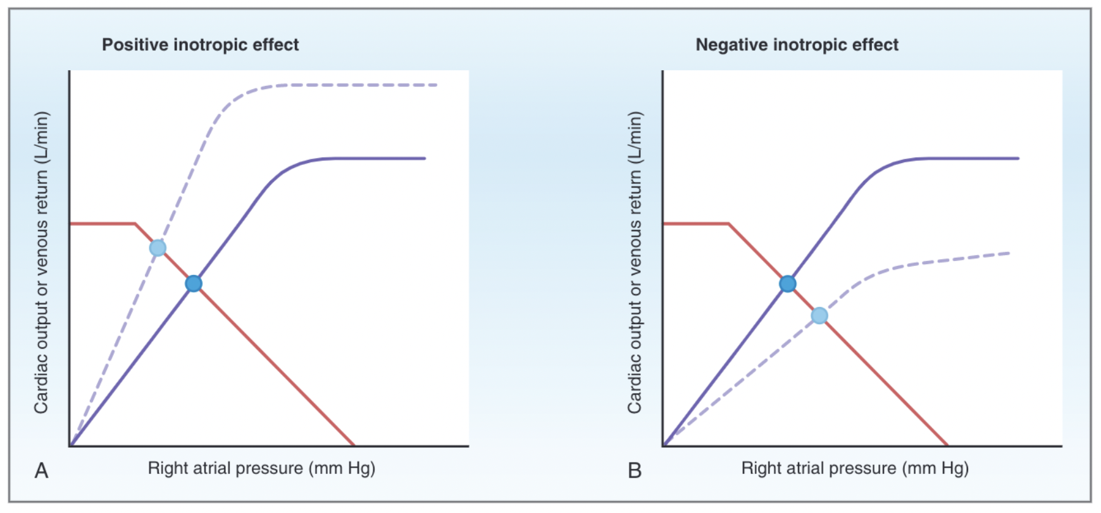
Effects of positive inotropic agents and negative inotropic agents on the cardiac and vascular function curves
Notes:
The point at
which the two curves intersect is the unique operating
or equilibrium point of the system in the steady state.
In the steady state, cardiac output and venous return
are, by definition, equal at the point of intersection.
Combining these curves provides a useful tool for
predicting the changes in cardiac output that will
occur when various cardiovascular parameters are
altered. Cardiac output can be altered by changes in
the cardiac function curve, by changes in the vascular
function curve, or by simultaneous changes in both
curves. The basic premise of this approach is that, after
such a change, the system will move to a new steady
state. In the new steady state, the operating point at
which the cardiac and the vascular function curves
intersect will have changed. This new operating point
tells what the new cardiac output and the new venous
return are in the new steady state.
Positive inotropic agents
produce an increase in contractility, an increase in
stroke volume, and an increase in cardiac output for
any level of right atrial pressure. Thus, the cardiac
function curve shifts upward, but the vascular func-
tion curve is unaffected. The point of intersection (the
steady state point) of the two curves now has shifted
upward and to the left. In the new steady state,
cardiac output is increased and right atrial pres-
sure is decreased. The decrease in right atrial pres-
sure reflects the fact that more blood is ejected from
the heart on each beat as a result of the increased
contractility and increased stroke volume.
decrease in contractility
and a decrease in cardiac output for any level of
right atrial pressure. The cardiac function curve
shifts downward, and the vascular function curve is
unchanged. In the new steady state, cardiac output
is decreased and right atrial pressure is increased.

Slide 73
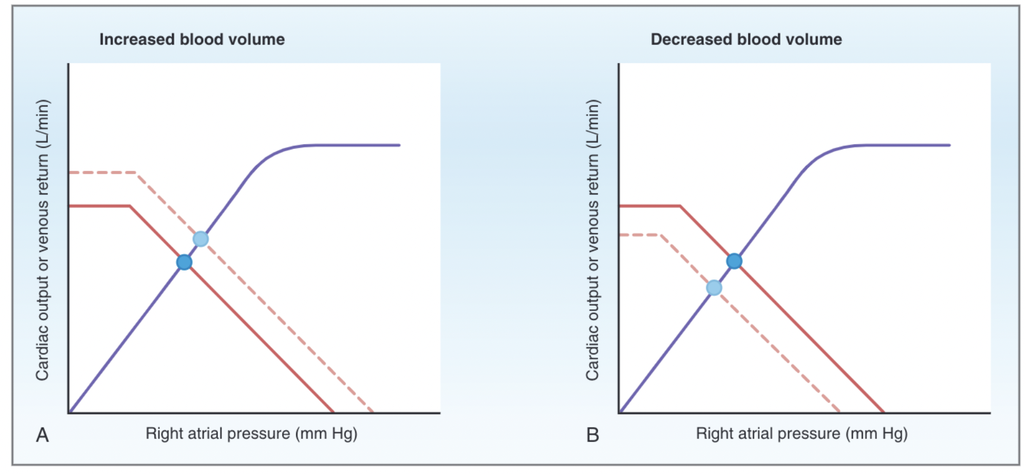
Effects of increased blood volume and decreased blood volume on the cardiac and vascular function curves
Notes:
Increases in
blood volume increase the amount of blood in the
stressed volume and, therefore, increase the mean
systemic pressure. Mean systemic pressure is the
point on the vascular function curve where venous
return is zero. Increases in blood volume shift this
intersection point to the right and, therefore, shift
the curve to the right in a parallel manner. In the new steady state, the cardiac
and vascular function curves intersect at a new point
at which cardiac output is increased and right
atrial pressure is increased.
The
decrease in blood volume decreases the amount of
blood in the stressed volume and mean systemic
pressure, which shifts the vascular function curve to
the left in a parallel manner. In the new steady state,
cardiac output is decreased and right atrial pres-
sure is decreased.

Slide 74
Regulation of Arterial Pressure
Mean arterial pressure (P_{a}) - driving force for blood flow, and it must be maintained
at a high, constant level
P_{a} = Cardiac output x TPR
P_{a} = Mean arterial pressure (mm Hg)
Cardiac output = Cardiac output (mL/min)
TPR = Total peripheral resistance (mm Hg/mL/min)
Notes:
Pa is regulated by two major systems. The first system
is neurally mediated and known as the baroreceptor
reflex. The baroreceptor reflex attempts to restore Pa to
its set-point value in a matter of seconds. The second
system is hormonally mediated and includes the renin-
angiotensin-aldosterone system, which regulates Pa
more slowly, primarily by its effect on blood volume.

Slide 75
What are the two systems in which MAP is regulated in the body and which system works to change blood pressure faster? Why

Slide 76
What are the two systems in which MAP is regulated in the body and which system works to change blood pressure faster? Why
MAP will be regulated by the baroreceptor reflex and the renin angiotensin aldosterone system. The baroreceptor reflexes restore MAP in a matter of seconds while the renin angiotensin system regulates MAP more slowly.

Slide 77
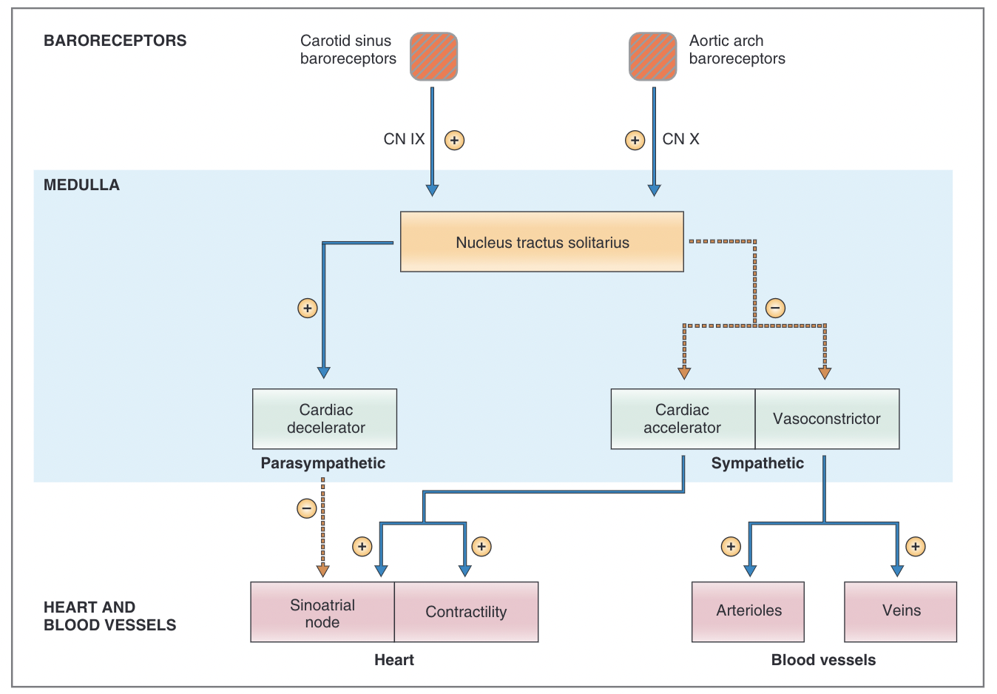
Baroreceptor Reflex
Notes:
The baroreceptors are located in the walls of the carotid
sinus, where the common carotid artery bifurcates into
the internal and external carotid arteries, and in the
aortic arch. The carotid sinus baroreceptors are respon-
sive to increases or decreases in arterial pressure,
whereas the aortic arch baroreceptors are primarily
responsive to increases in arterial pressure. The baroreceptors are mechanoreceptors, which are
sensitive to pressure or stretch. Thus, changes in arte-
rial pressure cause more or less stretch on the mecha-
noreceptors, resulting in a change in their membrane
potential.
Increases in arterial pressure cause increased stretch
on the baroreceptors and increased firing rate in the
afferent nerves. Decreases in arterial pressure cause
decreased stretch on the baroreceptors and decreased
firing rate in the afferent nerves.
Such a change in membrane potential is a
receptor potential, which increases or decreases the
likelihood that action potentials will be fired in the
afferent nerves that travel from the baroreceptors to
the brain stem. The strongest stimulus for the baroreceptors is a rapid
change in arterial pressure!
Information from the carotid sinus baroreceptors is
carried to the brain stem on the carotid sinus nerve,
which joins the glossopharyngeal nerve (cranial nerve
[CN] IX). Information from the aortic arch barorecep-
tors is carried to the brain stem on the vagus nerve
(CN X).
Brain stem cardiovascular centers are located in the
reticular formations of the medulla and in the lower
one third of the pons. afferent infor-
mation about blood pressure is then sent to the medulla. This information is integrated in the nucleus
tractus solitarius, which then directs changes in the
activity of several cardiovascular centers.
The parasympathetic outflow is the effect of the
vagus nerve on the SA node to decrease the heart rate.
The sympathetic outflow has four components: an
effect on the SA node to increase heart rate, an effect
on cardiac muscle to increase contractility and stroke
volume, an effect on the arterioles to produce vasocon-
striction and increase TPR, and an effect on veins
to produce venoconstriction and decrease unstressed
volume.

Slide 78
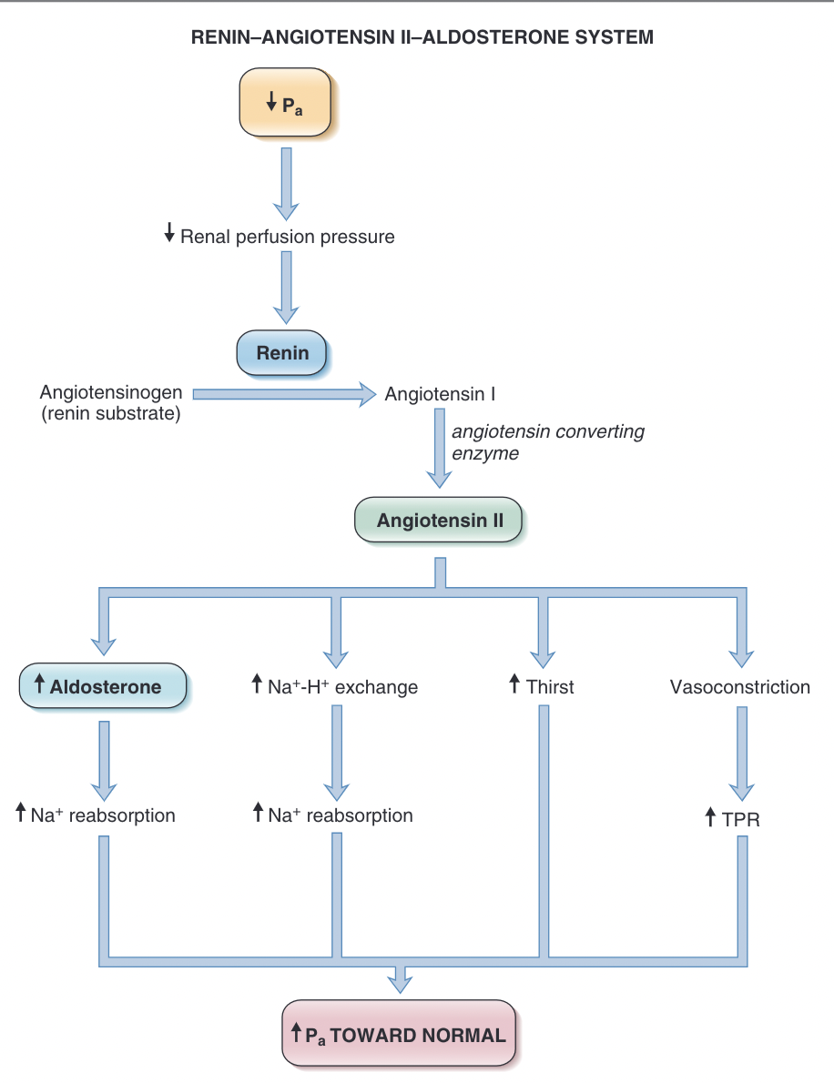
Renin-Angiotensin Aldosterone System
Notes:
The renin–angiotensin II–aldosterone system regulates
Pa primarily by regulating blood volume. This system
is much slower than the baroreceptor reflex because it
is hormonally, rather than neurally, mediated.
A decrease in Pa causes a decrease in renal perfusion
pressure, which is sensed by mechanoreceptors in
afferent arterioles of the kidney. The decrease in Pa
causes prorenin to be converted to renin in the
juxtaglomerular cells.
In plasma, renin catalyzes the
conversion of angiotensinogen (renin substrate) to
angiotensin I
In the lungs and kidneys, angiotensin I is converted
to angiotensin II, catalyzed by angiotensin-
converting enzyme (ACE)
Angiotensin II acts on the zona glomerulosa cells
of the adrenal cortex to stimulate the synthesis
and secretion of aldosterone
Aldosterone then
acts on the principal cells of the renal distal
tubule and collecting duct to increase Na+ reab-
sorption and, thereby, to increase ECF volume and blood volume. Angiotensin II stimulates Na+-H+
exchange in the renal proximal tubule and
increases the reabsorption of Na+ and HCO3−. Angiotensin II acts on the hypothalamus
to increase thirst and water intake. stimulates secretion of antidiuretic hormone,
which increases water reabsorption in collecting
ducts. Angiotensin II also acts directly on the arte-
rioles . to cause vasoconstriction. The result-
ing increase in TPR leads to an increase
in Pa.

Slide 79
Other Regulatory Mechanisms
Peripheral Chemoreceptors in Carotid and
Aortic Bodies
Central Chemoreceptors
Antidiuretic Hormone
Cardiopulmonary (Low-Pressure) Baroreceptors
  Increased secretion of atrial natriuretic peptide
  (ANP).
  Decreased secretion of ADH
  Renal vasodilation
  Increased heart rate
Notes:
eripheral chemoreceptors for O2 are located in the
carotid bodies near the bifurcation of the common
carotid arteries and in the aortic bodies along the
aortic arch. The carotid and aortic bodies have high
blood flow, and their chemoreceptors are primarily
sensitive to decreases in the partial pressure of O2. When arterial PO2 decreases, there is an increased
firing rate of afferent nerves from the carotid and
aortic bodies that activates sympathetic vasoconstrictor
centers. As a result, there is arteriolar vasoconstric-
tion . increase in parasympa-
thetic outflow to the heart that produces a transient
decrease in heart rate.
If the brain becomes ischemic
(i.e., there is decreased cerebral blood flow), cerebral
PCO2 immediately increases and pH decreases. The
medullary chemoreceptors detect these changes and
direct an increase in sympathetic outflow that causes
intense arteriolar vasoconstriction in many vascular
beds and an increase in TPR. Blood flow is thereby
redirected to the brain to maintain its perfusion
ADH secretion from the posterior pituitary is
increased by two types of stimuli: by increases in serum
osmolarity and by decreases in blood volume and
blood pressure. cause vasoconstriction of arterioles and increased TPR.
there are also low-pressure baroreceptors located in
the veins, atria, and pulmonary arteries. These so-
called cardiopulmonary baroreceptors sense changes
in blood volume
when there is an increase in blood
volume, the resulting increase in venous and atrial
pressure is detected by the cardiopulmonary barorecep-
tors. The function of the cardiopulmonary barorecep-
tors is then coordinated to return blood volume to
normal, primarily by increasing the excretion of Na+
and water.

Slide 80
Microcirculation
Notes:
The term “microcirculation” refers to the functions of
the smallest blood vessels, the capillaries and the
neighboring lymphatic vessels. Delivery of blood to and
from the capillaries is critically important because the
capillaries are the site of exchange of nutrients and
waste products in the tissues, as well as the site of
fluid exchange between the vascular and interstitial
compartments.

Slide 81
Exchange of Substances Across the Capillary Wall
The exchange of solutes and gases across the capillary wall occurs by simple diffusion
  Gases such as O2 and CO2 are highly lipid soluble and readily cross the capillary wall by diffusing through the endothelial cells; diffusion is driven by the partial pressure gradient for the individual gas.
  Water-soluble substances are not lipid soluble; thus,
  they cannot cross the endothelial cell membranes. The
  diffusion of water-soluble substances is limited to
  the aqueous clefts between endothelial cells
The most important mechanism for fluid transfer across the capillary wall is osmosis, driven by hydrostatic and osmotic pressures
Proteins are generally too large to cross the capillary walls via the clefts between endothelial cells and are retained in the vascular compartment

Slide 82
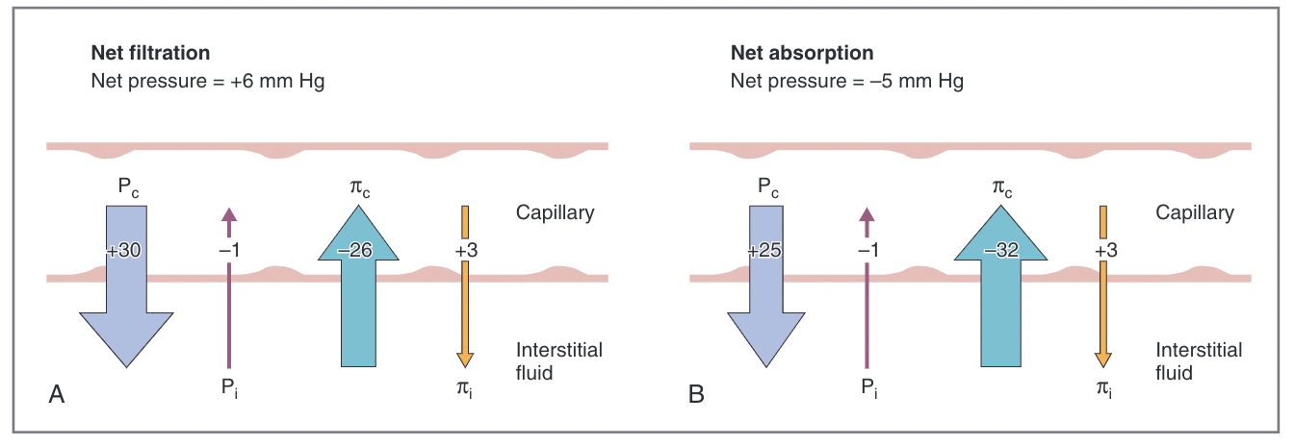
Starling Equation
Fluid movement across a capillary wall is driven by the
Starling pressures across the wall and is described by
the Starling equation as follows:
J_{v} = K_{f} [(P_{c} – P_{i}) – (π_{c} – π_{i})]
J_{v} = Fluid movement (mL/min)
K_{f} = Hydraulic conductance (mL/min • mm Hg) (water permeability)
P_{c} = Capillary hydrostatic pressure (mm Hg)
P_{i} = Interstitial hydrostatic pressure (mm Hg)
π_{c} = Capillary oncotic pressure (mm Hg)
π_{i} = Interstitial oncotic pressure (mm Hg)
Notes:
The Starling equation states that fluid movement (Jv)
across a capillary wall is determined by the net pressure
across the wall, which is the sum of hydrostatic pres-
sure and oncotic pressures. The direction of fluid
movement can be either into or out of the capillary.
When net fluid movement is out of the capillary into
the interstitial fluid, it is called filtration; when net
fluid movement is from the interstitium into the capil-
lary, it is called absorption. The magnitude of fluid
movement is determined by the hydraulic conduc-
tance, Kf (water permeability), of the capillary wall.
The hydraulic conductance determines how much
fluid movement will be produced for a given pressure
difference.
The net pressure, which is the net driving force, is
the algebraic sum of the four pressures.
In the example
in Figure 4-34A, the sum of the four Starling pressures s a net pressure of +6 mm Hg, indicating that there
will be net filtration out of the capillary. In the example
in Figure 4-34B, the sum of the four pressures is a net
pressure of −5 mm Hg, indicating that there will be net
absorption into the capillary.

Slide 83
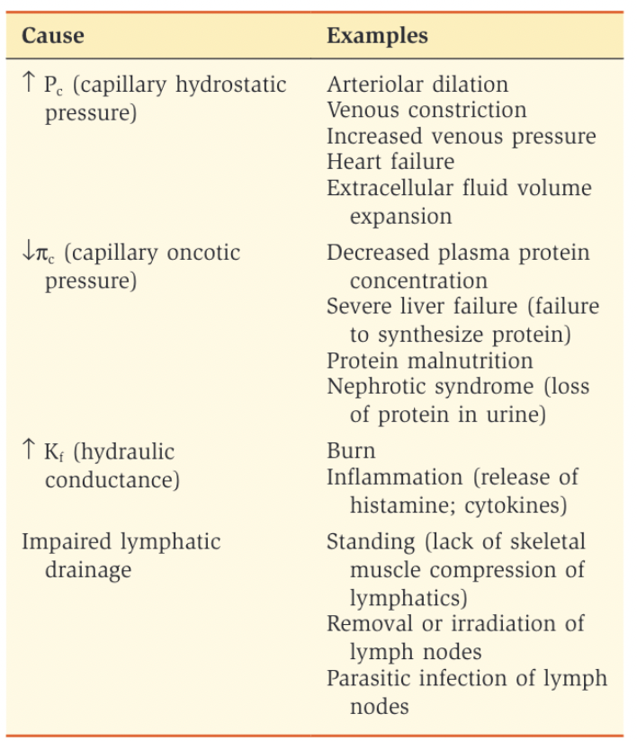
Lymph
The lymphatic system is responsible for returning interstitial fluid and proteins to the vascular compartment
  one-way flap valves, which permit interstitial fluid and protein to enter, but not leave, the capillaries
  Capillaries merge into larger lymphatic vessels and eventually thoracic duct, which empties lymph into the large veins
  lymphatic vessels have a smooth muscle wall, which has intrinsic contractile ability
Edema forms when the volume of interstitial fluid exceeds the ability of the lymphatics to
return it to the circulation.
  Increased filtration
  lymphatic drainage
  is impaired

Slide 84
Special Circulations
Notes:
Blood flow is variable between one organ and another,
depending on the overall demands of each organ
system. blood flow to a specific organ or organ
system can increase or decrease depending on its metabolic demands
Changes in blood flow to an individual organ are
achieved by altering arteriolar resistance. The mecha-
nisms that regulate blood flow to the various organs
are broadly categorized as local (intrinsic) control and
neural or hormonal (extrinsic) control. Local control
of blood flow is the primary mechanism utilized for
matching blood flow to the metabolic needs of a tissue.

Slide 85
Local Control of Blood Flow
Autoregulation
Active hyperemia
Reactive hyperemia
Notes:
Autoregulation is the maintenance of a constant
blood flow to an organ in the face of changing arte-
rial pressure
Active hyperemia illustrates the concept that blood
flow to an organ is proportional to its metabolic
activity
Reactive hyperemia is an increase in blood flow in
response to or reacting to a prior period of decreased
blood flow

Slide 86
Neural and Hormonal Control of Blood Flow
Sympathetic innervation produces vasoconstriction via α1 receptors or vasodilation via β2 receptors
Other vasoactive mediators
  Histamine - dilation of arterioles and constriction of venules, with the net effect being a large increase in Pc, which increases filtration out of capillaries, and local edema
  Bradykinin - dilation of arterioles and constriction of venules, resulting in increased filtration out of capillaries and local edema
  Serotonin - local vasoconstriction
  Prostacyclin and the prostaglandin-E series – vasodilators
  Thromboxane A2 and the prostaglandin-F series - vasoconstrictors.
  Angiotensin II and vasopressin – vasoconstrictors that increase TPR
  Atrial natriuretic peptide is a vasodilator hormone that is secreted by the atria in response to increases in atrial pressure

Slide 87
Questions?

